Slide 1
Immutability that doesn’t make you sick
Aleksandr Kugushev
Notes:
Источники мудрости в IT

Slide 2

I want you to
Don’t hesitate following the rules this book
Play around with the wording, make your own interpretation
Don’t forget sharing this book with your neighbor

Slide 3
Plan
Advantages of using immutable entities and collections
Techniques to make entities immutable
How to make changes to immutable entity
Myths about immutable collections

Slide 4
Why?
Avoiding unexpected changes in huge code base
In memory cache
Multithreading
Snapshot semantic

Slide 5
Avoiding unexpected changes in huge code base
Result GetResult(Entity entity)
{
/* a lot of code */
var name = GetEntityName(entity);
/* a lot of code */
return LoadResult(name,
name == entity.Name);
}
public string GetEntityName(Entity entity)
{
string name = entity.Name;
/* a lot of code */
// Bugfix 666
entity.Name = $"Name: {entity.Name}";
/* a lot of code */
return name;
}

Slide 6
In memory cache
private readonly Dictionary<int, Entity> cache = new Dictionary<int, Entity>();
void DoSomething(int id)
{
/* a lot of code */
if (!cache.TryGetValue(id, out var entity))
entity = cache[id] = GetEntity(id);
/* a lot of code */
//Bugfix 1313
entity.Name = "Hello World!";
}
Entity GetEntity(int id) { /*---*/ }

Slide 7
Multithreading and snapshot semantic
Thread1
Thread2
public Entity Entity { get; private set; }
void DoSomething()
{
var entity = Entity;
Console.WriteLine(Entity.Name);
Console.WriteLine(entity.Name);
/* a lot of code */
Console.WriteLine(Entity.Name);
Console.WriteLine(entity.Name);
}
/*---*/
void UpdateEntityName(string name)
{
Entity.Name = name;
}

Slide 8
Immutable entities
Records
Constructor
Builder
Wrapper
Immutable interface

Slide 9
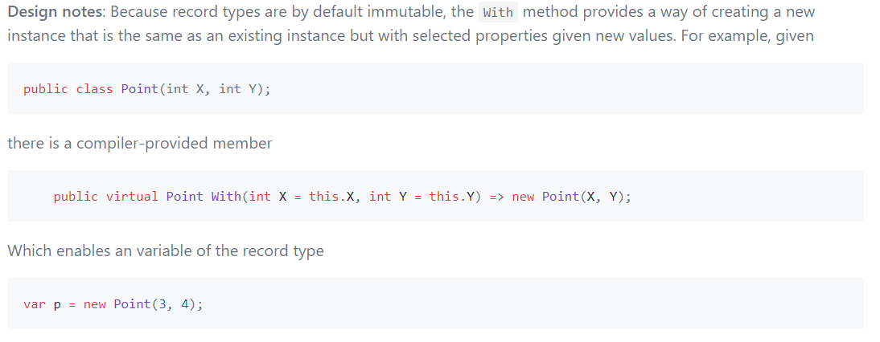
Records

Slide 10
Constructor
class Bicycle
{
public Bicycle(int id, string name)
{
Id = id;
Name = name;
}
public int Id { get; }
public string Name { get; }
}

Slide 11
Constructor ☹
class Car
{
public Car(int id, string model, string modelFull, string mark, int certificate, int issuerId,
string issuePlace, DateTime issueDate, IReadOnlyList<IOwner> owners)
{
Id = id;
Model = model;
ModelFull = modelFull;
Mark = mark;
Certificate = certificate;
IssuerId = issuerId;
IssuePlace = issuePlace;
IssueDate = issueDate;
Owners = owners;
}
/*…*/
}
Notes:
- Проверка в compile time
- Много аргументов в конструкторе
- Сериализация
- Entity Framework
+ Simple
+ Automapper can

Slide 12
Constructor +/-
Advantages
Disadvantages
Simple
Well known
No compile time validation
Ugly if big
No serialization
No Entity Framework

Slide 13

Builder
class Bicycle
{
public Bicycle(Builder builder)
{
Id = builder.Id;
Name = builder.Name;
}
public int Id { get; }
public string Name { get; }
public class Builder
{
public int Id { get; set; }
public string Name { get; set; }
}
}
Notes:
+ Popsticle immutability
+ POCO class

Slide 14
Builder ☹
class Car
{
public Car(Builder builder)
{
Id = builder.Id;
Model = builder.Model;
ModelFull = builder.ModelFull;
Mark = builder.Mark;
Certificate = builder.Certificate;
IssuerId = builder.IssuerId;
IssuePlace = builder.IssuePlace;
IssueDate = builder.IssueDate;
Owners = builder.Owners;
}
/*---*/
public int Id { get; }
public string Model { get; }
public string ModelFull { get; }
public string Mark { get; }
public int Certificate { get; }
public int IssuerId { get; }
public string IssuePlace { get; }
public DateTime IssueDate { get; }
public IReadOnlyList<IOwner> Owners { get; }
public class Builder
{
public int Id { get; set; }
public string Model { get; set; }
public string ModelFull { get; set; }
public string Mark { get; set; }
public int Certificate { get; set; }
public int IssuerId { get; set; }
public string IssuePlace { get; set; }
public DateTime IssueDate { get; set; }
public IReadOnlyList<IOwner> Owners { get; set; }
}
}
Notes:
- No compile time

Slide 15
Builder +/-
Advantages
Disadvantages
Still Simple
Well known
Constructor doesn’t change
Support serialization
Support Entity Framework, but…
No compile time validation
Ugly if big

Slide 16
Wrapper
class Wrapper<T>
{
public Wrapper(T entity)
public V Get<V>(Func<T, V> getter);
}

Slide 17
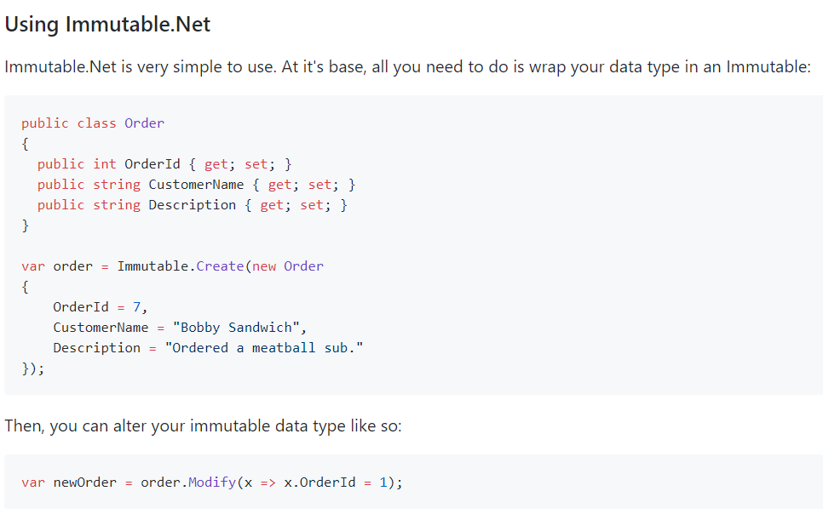
github.com/mattnischan/Immutable.Net

Slide 18
Wrapper: Example
class Credentials<T>
{
/*MUTABLE LEGACY*/
}
class Address
{
/*MUTABLE LEGACY*/
}
class BirthInformation
{
/*MUTABLE LEGACY*/
}
class Owner
{
public Owner(int id, Credentials<RealEntity> credentials, Address address, BirthInformation birthInformation)
{
Id = id;
Credentials = Immutable.Create(credentials);
BirthInformation = Immutable.Create(birthInformation);
Address = Immutable.Create(address);
}
public int Id { get; }
public Immutable<Credentials<RealEntity>> Credentials { get; }
public Immutable<Address> Address { get; }
public Immutable<BirthInformation> BirthInformation { get; }
}

Slide 19
Wrapper +/-
Advantages
Disadvantages
We can use mutable POCO classes!!!
Support serialization
Support Entity Framework
Require external dependency
It makes code a little bit more complicated

Slide 20
Immutable interface
Available only inside a creator
Available everywhere
class Bicycle : IBicycle
{
public int Id { get; set; }
public string Name { get; set; }
}
interface IBicycle
{
int Id { get; }
string Name { get; }
}

Slide 21
Immutable interface ☺
interface ICar
{
int Id { get; }
string Model { get; }
string ModelFull { get; }
string Mark { get; }
int Certificate { get; }
int IssuerId { get; }
string IssuePlace { get; }
DateTime IssueDate { get; }
IReadOnlyList<IOwner> Owners { get; }
}
class Car: ICar
{
public int Id { get; set; }
public string Model { get; set; }
public string ModelFull { get; set; }
public string Mark { get; set; }
public int Certificate { get; set; }
public int IssuerId { get; set; }
public string IssuePlace { get; set; }
public DateTime IssueDate { get; set; }
public IReadOnlyList<IOwner> Owners { get; set; }
}

Slide 22
Immutable interface +/-
Advantages
Disadvantages
Compile time validation
Performance
Mutable and immutable states of an entity
Support deserialization
Support Entity Framework
Specification via Expression<Predicate<Entity>>
Verbose
Vulnerable against cast
No methods*

Slide 23
With pattern
class Bicycle
{
// …
public Bicycle WithName(string value)
{
return value == Name
? this
: new Bicycle(Id, value);
}
}

Slide 24
Anti-pattern “With builder”
public ICar With(Action<Car> builder)
{
var clone = (Car)MemberwiseClone();
builder(clone);
return clone;
}

Slide 25
Dangerous “With builder”
class Car : ICar
{
public Owner CurrentOwner { get; set; }
public IEntity With(Action<Car> builder)
{
var clone = (Car)MemberwiseClone();
builder(clone);
return clone;
}
}
class Owner : IOwner
{
public string Name { get; set; }
}
void Test_SellCar()
{
ICar car = new Car
{
CurrentOwner = new Owner
{
Name = "Aleksandr Kugushev"
}
};
ICar soldCar = car.With(e
=> e.CurrentOwner.Name = "Jon Skeet");
Assert.Equal(
"Aleksandr Kugushev",
car.CurrentOwner.Name);
}

Slide 26
Myth 1: Immutable collections are useless
class Car
{
// ...
public IReadOnlyList<IOwner> Owners { get; private set; }
public Car AddItems(IOwner owner)
{
return new Car
{
Owners = Owners.Append(owner).ToList()
};
}
}

Slide 27
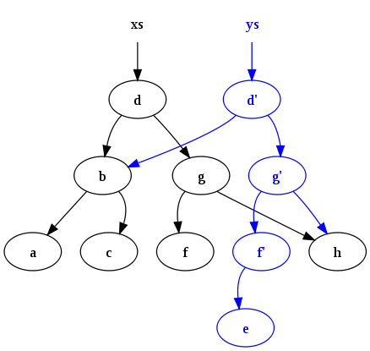
Immutable collections
Instead of comparing immutable collections with a mutable collection we should consider it as an alternative to use mutable collections in an immutable way.

Slide 28
Myth 2: We should use Immutable collections everywhere
 | Mutable (amortized) | Mutable (worst case) | Immutable
Stack.Push | O(1) | O(n) | O(1)
Queue.Enqueue | O(1) | O(n) | O(1)
List.Add | O(1) | O(n) | O(log n)
HashSet.Add | O(1) | O(n) | O(log n)
SortedSet.Add | O(log n) | O(n) | O(log n)
Dictionary.Add | O(1) | O(n) | O(log n)
SortedDictionary.Add | O(log n) | O(n log n) | O(log n)

Slide 29
Benchmarks: List
[Params(1000)]
public int Count { get; set; }
[GlobalSetup]
public void GlobalSetup()
{
var r = new Random();
BigList = Enumerable.Range(0, Count)
.Select(i => r.Next()).ToList();
BigImmutableList =
ImmutableList.Create<int>(BigList.ToArray());
}

Slide 30
Benchmark: Append
Mean: 1,193.7 ns
Mean: 365.9 ns
[Benchmark]
object List_Add()
{
return BigList
.Append(42)
.ToList()
.AsReadOnly();
}
[Benchmark]
object ImmutableList_Add()
{
return BigImmutableList
.Add(42);
}

Slide 31
Benchmark: Select
Mean: 133,267.5 ns
Mean: 276,739.8 ns
[Benchmark]
object List_Select()
{
return BigList
.Select(i => i.ToString())
.ToList();
}
[Benchmark]
object ImmutableList_Select()
{
return BigImmutableList
.Select(i => i.ToString())
.ToImmutableList();
}

Slide 32
Benchmark: Where
Mean: 3,990.8 ns
Mean: 74,251.9 ns
[Benchmark]
object List_Where()
{
return BigList
.Where(i => i < 100)
.ToList();
}
[Benchmark]
object ImmutableList_Where()
{
return BigImmutableList
.Where(i => i < 100)
.ToImmutableList();
}

Slide 33
Benchmarks: Dictionary
[Params(1000)]
public int Count { get; set; }
[GlobalSetup]
public void GlobalSetup()
{
var r = new Random();
Big = Enumerable.Range(0, Count)
.ToDictionary(i => i, i => r.Next().ToString());
BigImmutable = Big.ToImmutableDictionary();
}

Slide 34
Benchmark: Dictionary Get
Mean: 20.47 ns
Mean: 109.25 ns
[Benchmark]
object Dictianary_Get()
{
return Big[42];
}
[Benchmark]
object ImmutablDictionary_Get()
{
return BigImmutable[42];
}

Slide 35
Benchmark: New Dictionary Set
Mean: 35,392.16 ns
Mean: 4,628.17 ns
[Benchmark]
object Dictianary_Set()
{
var newDict =
new Dictionary<int, string>(Big);
newDict[42] = "123";
newDict.Add(Count + 1, "new");
return newDict;
}
[Benchmark]
object ImmutableDictionary_Set()
{
var newDict = BigImmutable
.SetItem(42, "123");
return newDict
.Add(Count + 1, "new");
}

Slide 36
Useful presentations and articles
Jon Skeet — The changing state of immutability C#
Eric Lippert:
Immutability in C# Part One
Immutability in C# Part Two
Dixin's Blog: Functional Programming In-Depth (12) Immutability, Anonymous Type, and Tuple

Slide 37
Conclusion
Know your tools
Immutability is not an extreme
No Fear
Notes:
Используйте все возможности с умом
Неизменяемость это не экстрим, а вполне реальный подход
Не бойтесь иммутабельности. Если ее приготовить правильно, от нее Вас точно не стошнит.

