Slide 1
Advanced Data Science Capstone Project Vaccination against COVID vs. New Cases of COVID Author: Aleksandr Migunov

Slide 2
Part 1 Presentation for stakeholders

Slide 3
The Data Set
The data set used in this project is Data on COVID-19 (coronavirus) by Our World in Data (https://github.com/owid/covid-19-data/tree/master/public/data) which contains data for every country and for the whole world taken from official sources.
All the data is taken from the official resources and updated daily.

Slide 4
The Data Set
This dataset contains: data on new cases of COVID; total cases; new vaccinations; total vaccinations; numbers of people vaccinated with, at least, one dose of vaccine; numbers of people fully vaccinated; total boosters, and a number of other information.

Slide 5
The Use Case
The use case for this project is analysis of the progress of vaccination against COVID in the world (vaccination with, at least, one dose of vaccine and full vaccination) and analysis of the dynamics of new cases of COVID.
This project has two main goals.

Slide 6
The Use Case
The first goal is to analyze how the progress of vaccination affects the number of new cases of COVID, whether it is possible to stop the pandemic of COVID through vaccination or not, and if so, then, when it may happen.
The second goal is to make a prognosis when the whole population of the world will be vaccinated (with one dose of vaccine and fully vaccinated) if the speed of the vaccination remains the same as now.

Slide 7
The Solution of the Use Case
First, I analyzed the dynamics of the new cases of COVID in the world, the progress of vaccination (vaccination with one dose of vaccine, full vaccination, and with booster vaccine), and calculated Pearson correlation coefficient between them.
Pearson correlation coefficient is a measure of linear correlation between two sets of data.

Slide 8
The Solution to the Use Case
Pearson correlation coefficient always has a value between −1 and 1.
If it is around 0, then, there is no correlation between the random variables.
If it has a high positive value (close to 1), then, both random variables are correlated and increase of decrease together.

Slide 9
The Solution to the Use Case
If Pearson correlation coefficient is has a negative value and close to -1, it means that when one variable increases, then, the other one decreases, and vice versa.
In this part of the project, I am checking the hypothesis that the progress of vaccination decreases the number of new cases of COVID.

Slide 10
The Solution to the Use Case
If this hypothesis is true, then, Pearson correlation coefficient must be negative. If it is close to 0 or positive, then, this hypothesis is false, which means that the progress of vaccination does not decrease the number of new cases of COVID.

Slide 11
The Solution to the Use Case
Besides the calculation of Pearson correlation coefficient, I also drew diagrams which show dynamics of new cases of COVID, progress of vaccination, and correlation between them.
I got the following results.

Slide 12
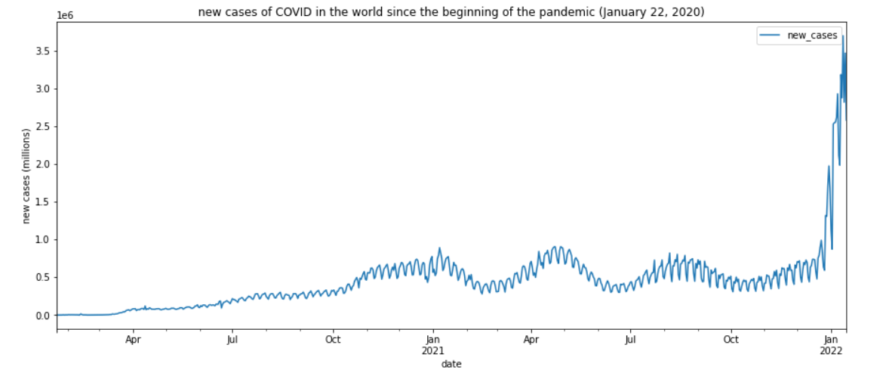
New Cases of COVID in the World

Slide 13
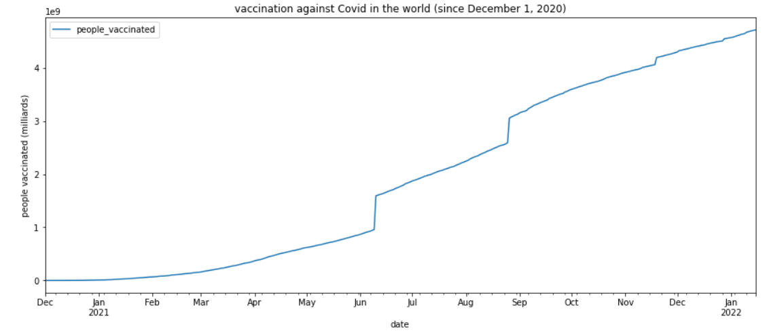
Vaccination in the World

Slide 14
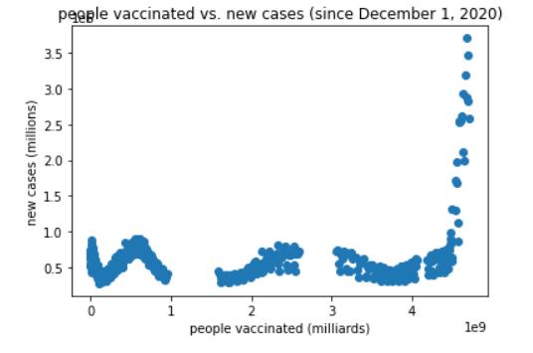
People vaccinated vs. new cases

Slide 15
Pearson correlation coefficient
Pearson correlation coefficient between the new cases of COVID and the number of people vaccinated with, at least one dose of vaccine is equal 0.2895.
This means that the hypothesis that the progress of vaccination with, at least, one dose of vaccine in the world reduces the number of new cases, is false.

Slide 16
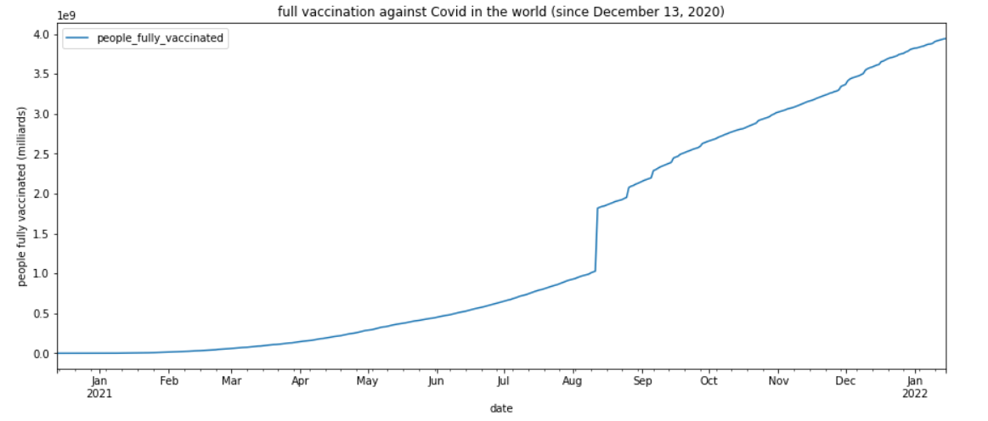
Full vaccination in the World

Slide 17
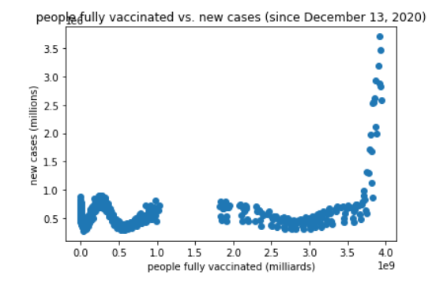
People fully vaccinated vs. new cases

Slide 18
Pearson correlation coefficient
Pearson correlation coefficient between the new cases of COVID and the number of fully vaccinated people is equal 0.3557.
This means that the hypothesis that the progress of full vaccination in the world reduces the number of new cases, is also false.

Slide 19
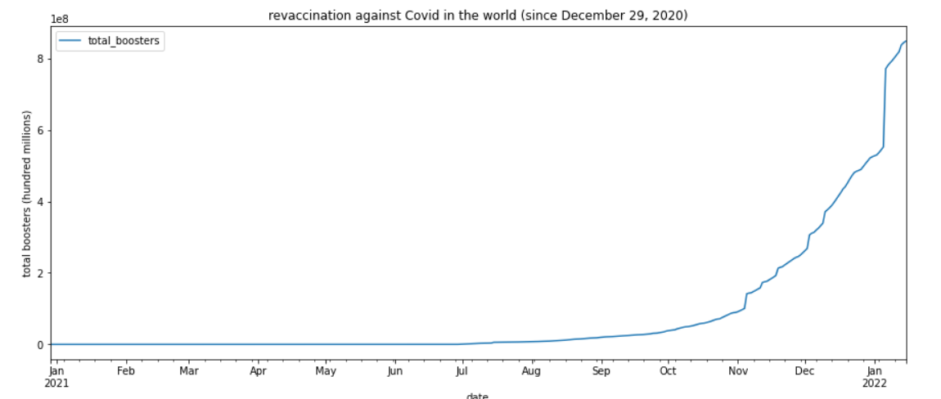
Vaccination with booster vaccines

Slide 20
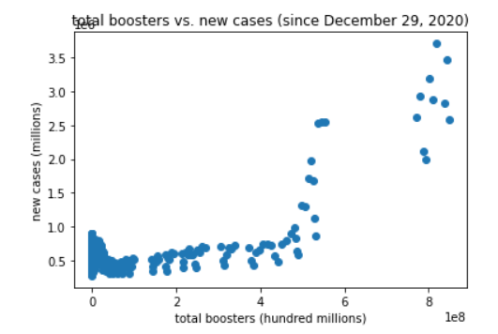
Booster vaccines vs. new cases

Slide 21
Pearson correlation coefficient
Pearson correlation coefficient between the new cases of COVID and the total boosters is equal 0.7544.
This means that the hypothesis that the progress of vaccination with booster vaccines in the world reduces the number of new cases, is also false.

Slide 22
Dynamics in individual countries
I also analyzed dynamics of new cases, vaccination, full vaccination, and booster vaccination in several countries.
It is similar to the dynamics in the world. Everywhere the number of new cases of COVID is either growing or very high, and the number of vaccinated people is also growing.

Slide 23
Individual countries
Pearson coefficient coefficients between new cases of COVID and vaccination, full vaccination, and booster vaccination are either positive or close to 0.

Slide 24
Example of UAE
As an example, let’s look at the United Arab Emirates.
I chose this country because it has the highest number of vaccinated people in the world.
In UAE, 99% of the total population are vaccinated with, at least, one dose of vaccine, and 92% of the total population are fully vaccinated.

Slide 25
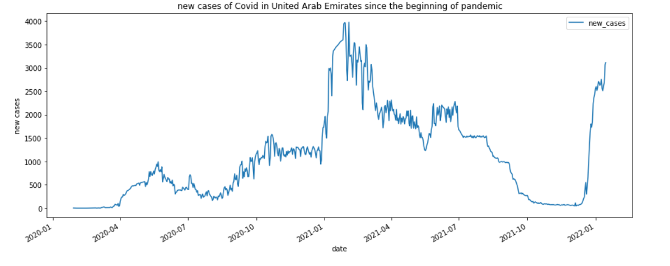
New cases of COVID in UAE

Slide 26
Example of UAE
From the diagram, we see that even in the country when practically everyone is vaccinated, the number of new cases of COVID is still growing.
This means that the progress of vaccination does not decrease the number of new cases of COVID and the pandemic of COVID cannot be stopped with vaccination.

Slide 27
Prognosis of vaccination
In the next part of the project, I developed machine learning models of the progress of vaccination (with, at least, one dose of vaccine) and full vaccination.
Then, I used these models in order to make prognosis when all the people in the world will be vaccinated if the current speed of vaccination remains the same as now.

Slide 28
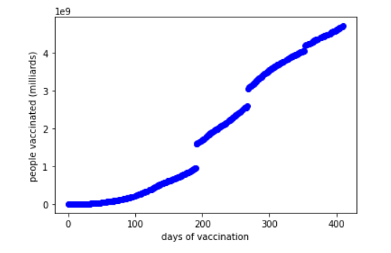
Dynamics of vaccination

Slide 29
ML models of vaccination
For modeling this function, I used linear regression model and then polynomial regression model with different number of degrees.
I divided the dataset into train and test datasets.
I used the train dataset for training the models.
Then, I used the test datasets for evaluating performance of the models.

Slide 30
Evaluation
For evaluation of the model performance, I used R squared.
R squared ranges between 0 and 1.
The higher is R squared, the better is model performance.
The highest possible value of R squared is 1, and therefore the best models have R squared very close to 1.

Slide 31
ML models of vaccination
I began with linear regression model. I defined it, trained it, and evaluated its performance. Then, I did the same with polynomial regression models, beginning with squared polynomial regression model.

Slide 32
Evaluation
The linear regression model had R squared = 0.9637.
The squared polynomial regression model had R squared = 0.9778.
The cubic polynomial regression model had R squared = 0.9947.
The 4-degree polynomial regression model had R squared = 0.9950.

Slide 33
Evaluation
The 5-degree polynomial regression model had R squared = 0.9955.
Although model performance increases with the increase of the degree of polynomials, polynomials with high degrees give a very bad approximation of the function for times that are higher than used in the training and test datasets, and therefore cannot be used for prognosis.

Slide 34
Evaluation
They perform well within the datasets, but for higher values they either very rapidly grow or very rapidly drop.
In the first case, they give too optimistic prognoses – that the vaccination of the whole population of the earth will be completed in a few days, which is obviously not realistic.

Slide 35
Evaluation
In the second case, they give too pessimistic prognoses – that the progress of vaccination will be stopped very quickly and therefore only very new few people will be vaccinated.
Both scenarios are incorrect, and therefore I did not use polynomial regression models with polynomials of degrees = 6 and higher.

Slide 36
Prognosis
According to the linear model vaccination will be completed in 100 days.
According to the quadratic model vaccination will be completed in 107 days.
According to the 5-degree model vaccination will be completed in 95 days.
Other two models (the cubic and the 4-degree) do not give usable results.

Slide 37
Prognosis
Therefore, three models of vaccination (with, at least, one dose of vaccine) give similar results.
If the speed of the vaccination remains the same, then, the whole population of the world will be vaccinated (with, at least, one dose of vaccine) in 95-107 days.

Slide 38
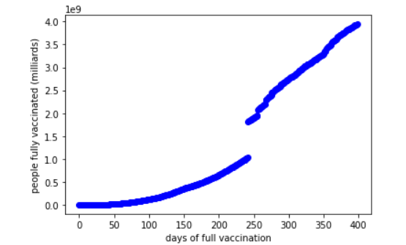
Dynamics of full vaccination

Slide 39
ML models of full vaccination
I did the same steps for the models of full vaccination.
I first developed linear regression model and then polynomial regression models with polynomials of different degrees.
I trained them, evaluated them, and used them to make prognoses.

Slide 40
Evaluation
The linear regression model had R squared = 0.8961.
The quadratic polynomial regression model had R squared = 0.9680.
The cubic polynomial regression model had R squared = 0.9798.
The 4-degree polynomial regression model had R squared = 0.9880.

Slide 41
Evaluation
The 5-degree polynomial regression model had R squared = 0.9885.
So, in general, performance of models of full vaccination was worse than performance of models of vaccination (with, at least, one dose of vaccine).

Slide 42
Prognosis
According to the linear model full vaccination will be completed in 234 days.
According to the quadratic model full vaccination will be completed in 123 days.
According to the 5-degree model full vaccination will be completed in 457 days.
Other two models (the cubic and the 4-degree) do not give usable results.

Slide 43
Prognosis
So, the three models of full vaccination give very different results.
Although 5-degree polynomial model has the best performance, its result (457 days) seems to be quite pessimistic, considering that all the models of vaccination (with, at least, one dose of vaccine) do not give the result of more than 107 days.

Slide 44
Prognosis
I tried other kinds of models for full vaccination, but I could not find a satisfactory model for it.
However, since we already have a satisfactory prognosis for vaccination (with, at least, one dose of vaccine), we can use it.

Slide 45
Prognosis
Since most vaccines require two doses (and some require only one dose) and the interval between the two doses usually should be 14, 21, or 28 days, it can be concluded that the full vaccination should be completed about 28 days after the vaccination with one dose of vaccine.

Slide 46
Prognosis
The result for prognosis of vaccination with, at least one dose of vaccine was that if the speed of the vaccination remains the same, then, the whole population of the world will be vaccinated (with, at least, one dose of vaccine) in 95-107 days.
Therefore, we can conclude that if the speed of the vaccination remains the same, then, the whole population of the world will be fully vaccinated in 135 days or sooner.

Slide 47
Part 2 Presentation for peers

Slide 48
Architectural decision
I used the Lightweight IBM Cloud Garage Method for Data Science.
It has following seven steps:

Slide 49
Architectural decision
Initial Data Exploration
Extract, Transform, Load
Feature Creation
Model Definition
Model Training
Model Evaluation
Deploy Model

Slide 50
Architectural decisions
I wrote the details of the architectural decisions in Architectural Decisions Document

Slide 51
Data quality assessment
Accessibility: data can be easily and quickly retrieved from OWID website.
Appropriate amount of data: the volume of data is appropriate for the tasks of this project. The dataset available at OWID website contains all the necessary data.
Believability: all the data is from official sources and therefore is reliable.

Slide 52
Data quality assessment
Completeness: data which is necessary for the tasks of this project is complete.
Objectivity: since all the data is from official sources, it can be assumed that it is unbiased, unprejudiced, and impartial.
Relevancy: the data is applicable for the tasks of this project.
Timeliness: the data is up-to-date, it is updated daily.

Slide 53
Data pre-processing
Data cleaning: there were some missing data (NaNs) in the dataset. I dealt with them in different ways: I removed the columns that contained only NaNs; if the necessary data was missing until a certain date, I removed the rows that contained NaNs; in other cases, I replaced NaNs with zeros.

Slide 54
Data pre-processing
Data integration: since I used only one dataset, there was no need in this procedure.
Data reduction: since the dataset is not very large (around 40 MB), there was no need in data reduction.

Slide 55
Feature engineering
Since the dates in the dataset were in object type which cannot be used directly for machine learning, I transformed them into date_delta in float64 type.
I tried data normalization, but it did not improve performance of the models and made calculation of prognoses more complicated. So, I decided to use data without normalization.

Slide 56
Model algorithm
Since the machine models need to predict the number of people and since the data that I am using are labeled, I need to use regression. To begin with, I chose linear regression models and also polynomial regression models with different degrees polynomials (quadratic, cubic, etc.). Other kinds of non-linear regression (exponential, logarithmic, sigmoid, etc.) would not work for these models because the diagrams of growing the number of people vaccinated and people fully vaccinated with time, show that other functions (except linear and polynomial) will not be fitting.

Slide 57
Model algorithm
Since my models are very simple – the number of people vaccinated and fully vaccinated depends only on time, and since the datasets are quite small (containing data only for about 400 days), there is no need to use deep learning models. So, I used only machine learning models in this project.
I also tried Lasso and Ridge, but they did not give any improvement of performance of the models.

Slide 58
Model performance indicators
I used R square since it is quite convenient indicator for regression models which gives scores in range between 0 and 1, where 1 is the best possible performance.

