Slide 1
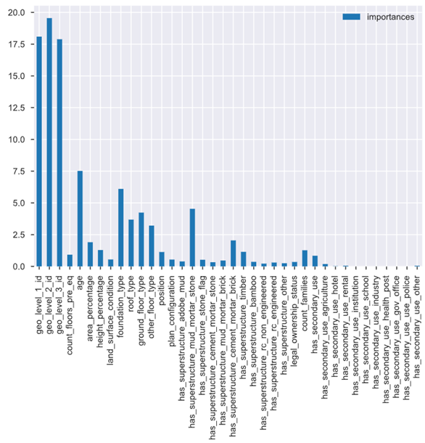
Automated Feature Engineering
The features geo_level_1_id, geo_level_2_id, and geo_level_3_id are poorly interpretable in the dataset. These features represent different areas (geographical regions) of Kathmandu with varying levels of granularity, ranging from broader to more specific.
However, despite their lack of interpretability, these features contribute the most to the model's outcome.

Slide 2
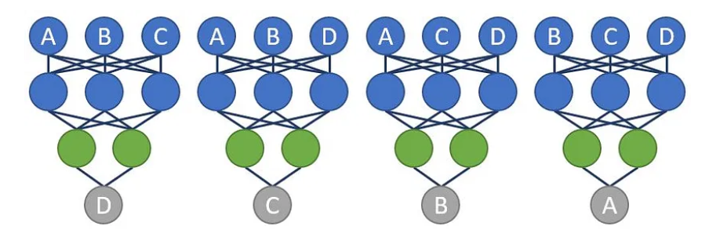
Automated Feature Engineering
Idea:
Augment the dataset with features that somehow reflect the dependencies between these "encoded" geographical regions.
Neural networks excel at creating various feature representations of an object, providing more accurate descriptions of dependencies in the data

Slide 3
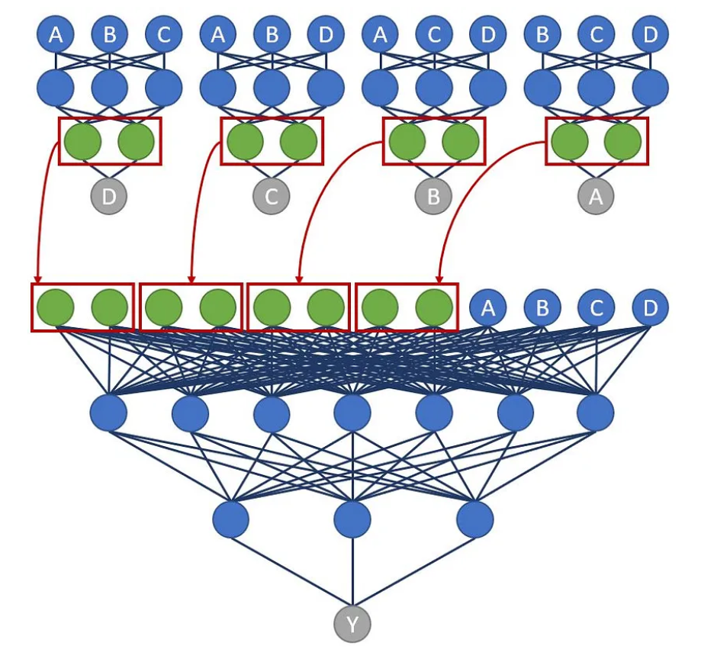
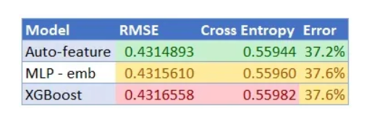
Automated Feature Engineering
The last layer contains our new features that describe the dependencies between the input features passed to the neural network, including a selective feature from the dataset

Slide 4
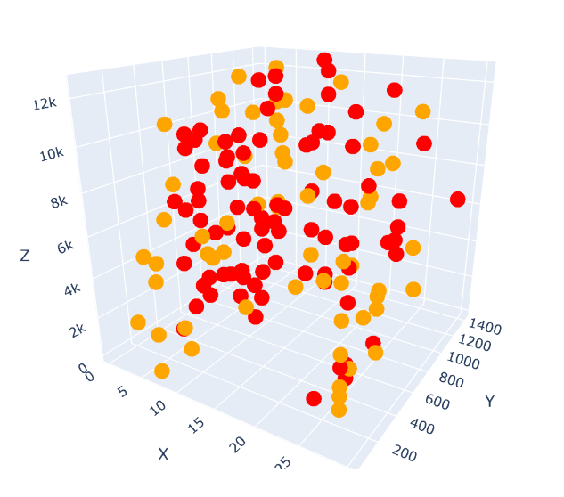
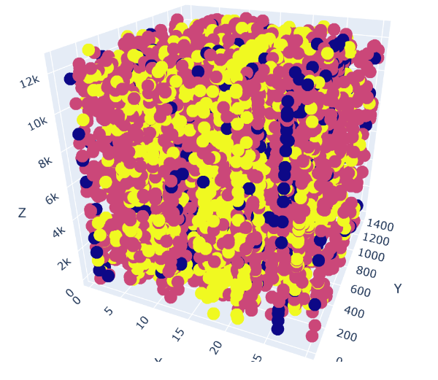

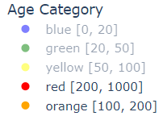
More about geo_level_id
Age Distribution of Buildings by geo_level_id
Distribution of Buildings by Destruction Severity across geo_level_id

Slide 5
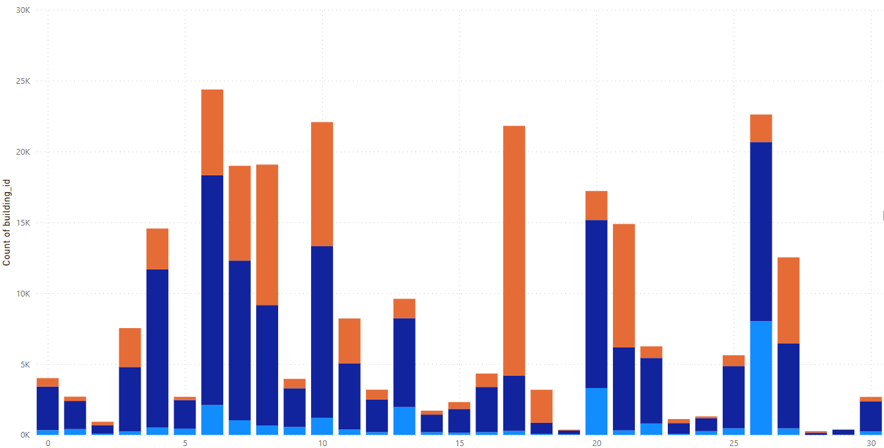
More about geo_level_id
The geographical regions represented in the dataset do not overlap, allowing us to identify the most affected geo_level_ids. (geo_level_1_id - most affected - 8, 17, 18, 21)
Notes:
[8, 17, 18, 21]

Slide 6
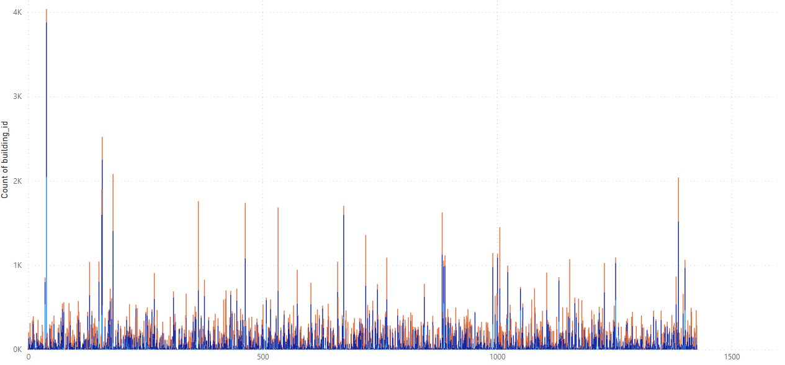
More about geo_level_id
Similarly, for geo_level_2_id, the most affected include 0, 4, 9, 88, 105, 123, 764, etc. (There is a programmatic implementation for finding such ids)

Slide 7
More about geo_level_id
Contrary to the fact that specific building locations cannot be extracted from these features, we are still able to make presumptive identifications of certain existing areas within the city in the dataset. Additionally, we can make assumptions about destructibility.
The goal was to find some significant, well-known building, such as the Kasthamandap Temple
Basing our findings on the material - wood, and considering the age of the buildings, along with the fact that the temple was previously used as a hotel, we have tentatively identified this temple (and the Durbar Square itself) in our dataset.
Notes:
1*Что несомненно бы помогло нам в прогнозировании разрушений. Как минимум, мы смогли бы точно сопоставить координаты здания и его удаленность от эпицентра землетрясения

Slide 8
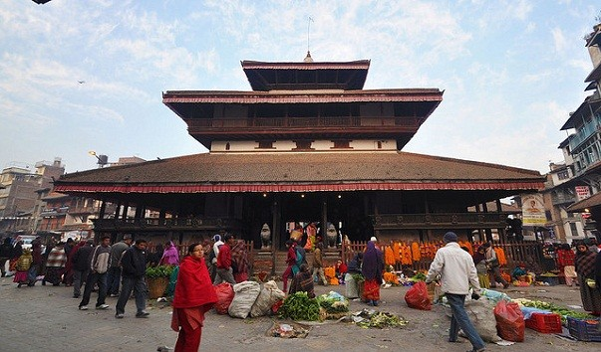
About the Temple
It is believed that the Kasthamandap Temple was constructed from a single Sal tree trunk, known for its enhanced strength and resistance to environmental factors.
This three-tiered pagoda was formerly used as a shelter for merchants and travelers journeying from Tibet to India. Such small inns in the Kathmandu Valley were not uncommon.

Slide 9
About the materials (has_superstructure_…)
№1
Reinforced concrete buildings tend to collapse primarily due to the soft lower floor, which lacks rigid walls (usually the commercial floor, with 90% reinforcement).
Roller shutters are also common (some shops use a curtain instead of a door).
Upper floors are typically made of brick masonry, which is somewhat less stable.
In multi-story buildings, there is usually a ground-level parking floor with few internal walls, leading to less stability and increased vulnerability.
Important features in the dataset - ground_floor_type, height_percentage, other_floor_type

Slide 10
About the materials (has_superstructure_…)
№2
The proximity of buildings really strongly affects the destructibility
Important features in dataset - count_floors_pre_eq, position
№3
Heavy roof contributes to additional load (tile coverings).It is especially important for weak houses made, for example, of some kind of clay and mud
Important features in dataset - roof_type

Slide 11
About the matetials (has_superstructure_…)
№4
Buildings with a random roof are quite vulnerable. Buildings that had not only stone, but also wood are more stable
Important features in dataset - has_superstructure_is_…
№5
It is necessary to pay attention to the height of the building and the material. For example, three-storey clay (adobe) are more vulnerable
Important features in dataset - has_superstructure_is_…, count_floor

Slide 12
About the materials (has_superstructure_…)
№6
For unreinforced buildings, the main causes of complete collapse include the accumulation of significant loads (roof, the building, and furnishings), age, and a lack of reinforcements that could help the building withstand horizontal seismic waves. The earthquake shakes not only vertically but also horizontally.
Important features in dataset - age, has_superstructure_is_…

Slide 13
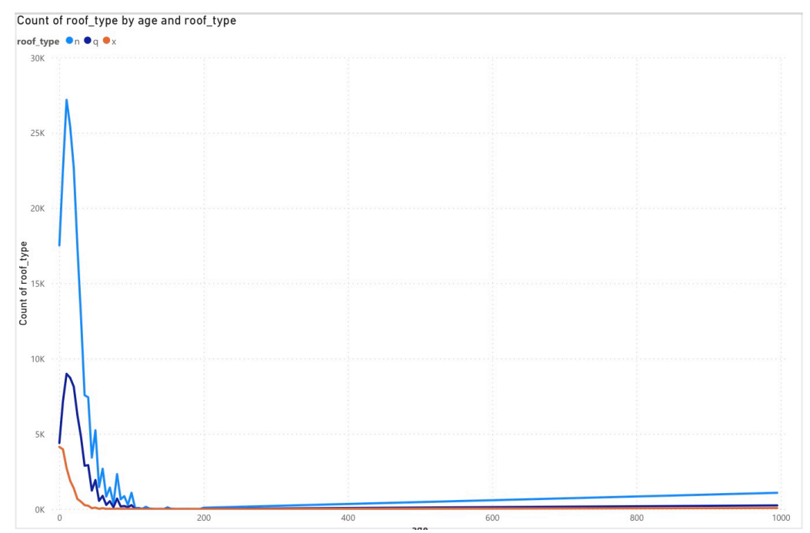
About the materials (has_superstructure_…)

Slide 14
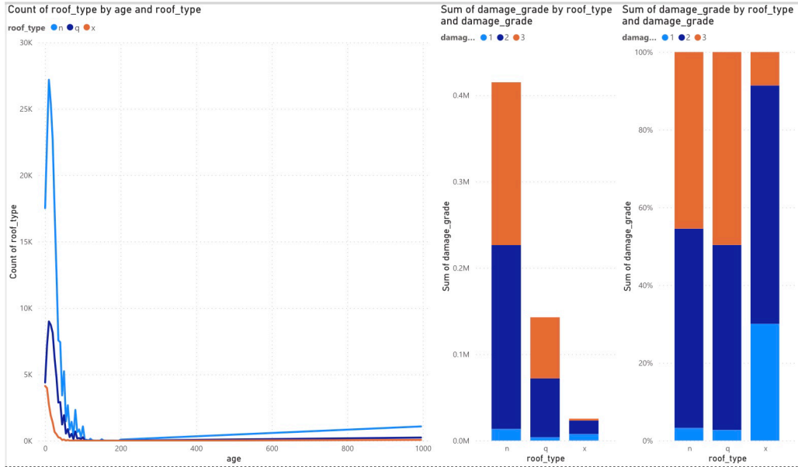
About the materials (has_superstructure_…)

Slide 15
