Slide 1
Exploring the Filter Design Pattern
Enhancing Flexibility in Software Engineering
Made by Alex Pitkin & Ilya Vorotyntsev
as a part of Design Patterns course

Slide 2
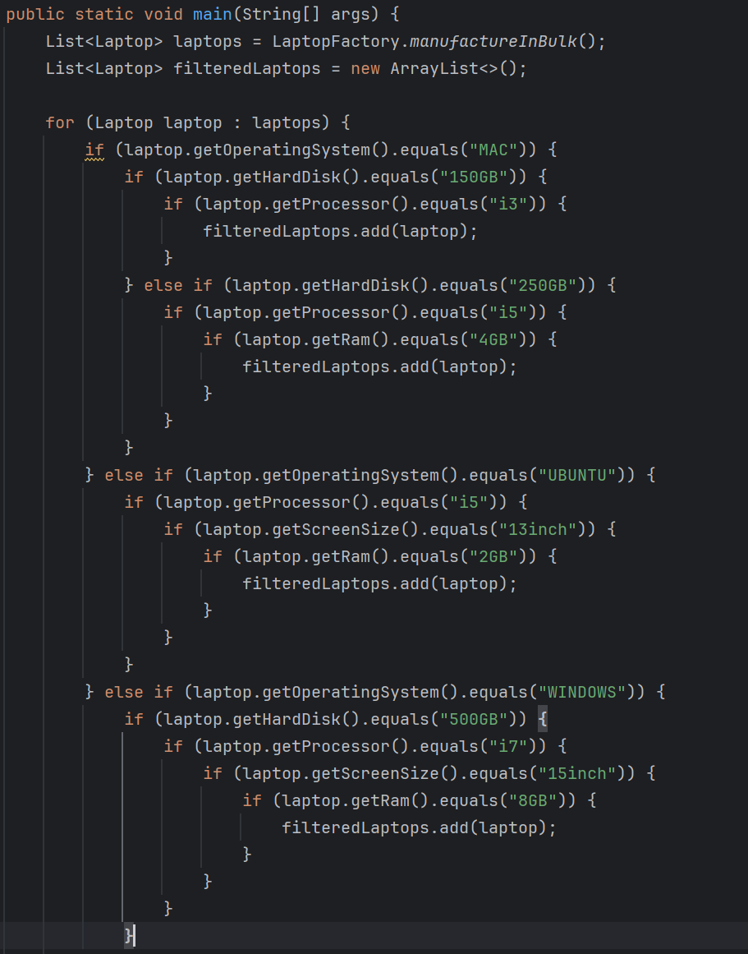
Why we need Filter?
Sometimes we have code like this…
… and its not good code ☹

Slide 3

A Tool for Dynamic Data Filtering
The Filter Design Pattern is structural a design pattern that allows developers to filter a set of objects using different criteria/filter condition and chaining them in a decoupled way through logical operations.

Slide 4
Advantages and Disadvantages
\^o^/ | ＞﹏＜
Modularity and reusability: Promotes breaking down the application into small, focused filters that can be easily reused in different contexts without modification. | Performance Issues: For applications dealing with large datasets, the process of applying multiple filters can become a performance bottleneck, especially if filters are complex or data is voluminous.
Easier testing and maintenance: Isolating functionality into separate filters makes it simpler to test, debug, and maintain specific components without affecting the entire system. | Complexity: Managing multiple filters and their interactions can increase the complexity of the system, particularly when filters are numerous or involve intricate logic.
Flexibility in configuration: Filters can be arranged in various configurations to achieve different goals, allowing for adaptable data processing pipelines.

Slide 5
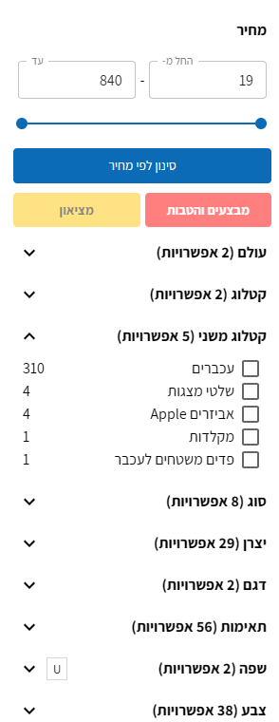
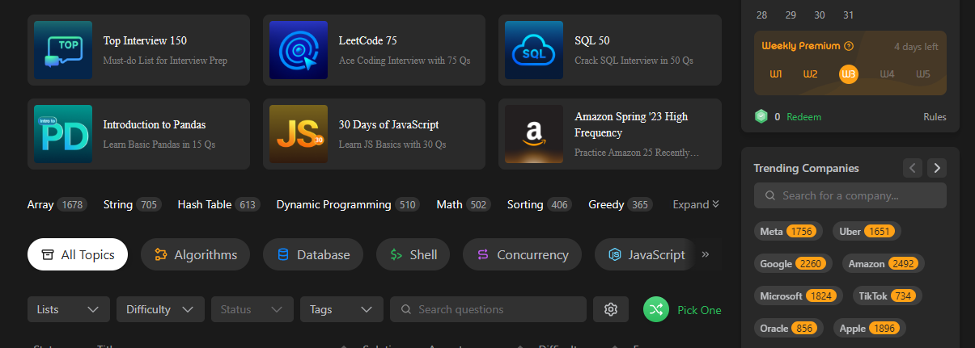
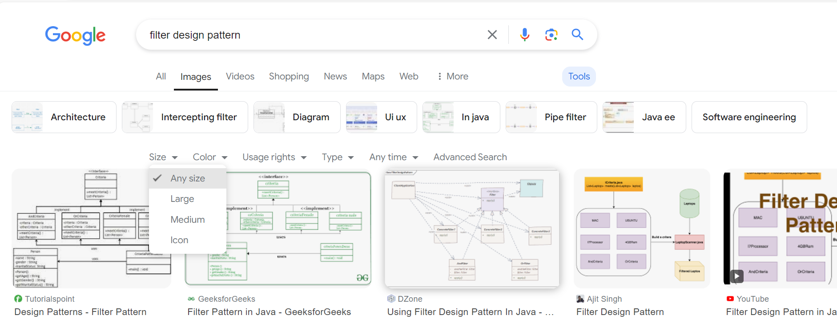
Examples from a Real World
Coding Interview
Online Shop
Search Engine

Slide 6
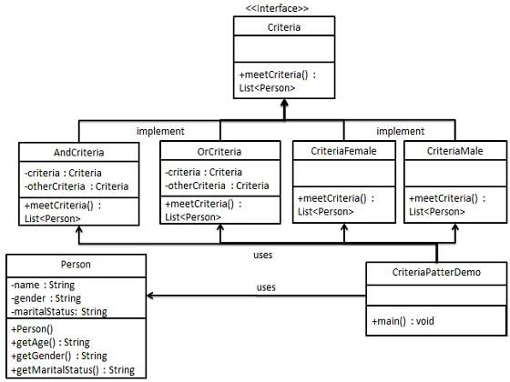
Code Examples – Step 0
We're going to create a Person object, Criteria interface and concrete classes implementing this interface to filter list of Person objects.
CriteriaPatternDemo, our demo class uses Criteria objects to filter List of Person objects based on various criteria and their combinations.

Slide 7
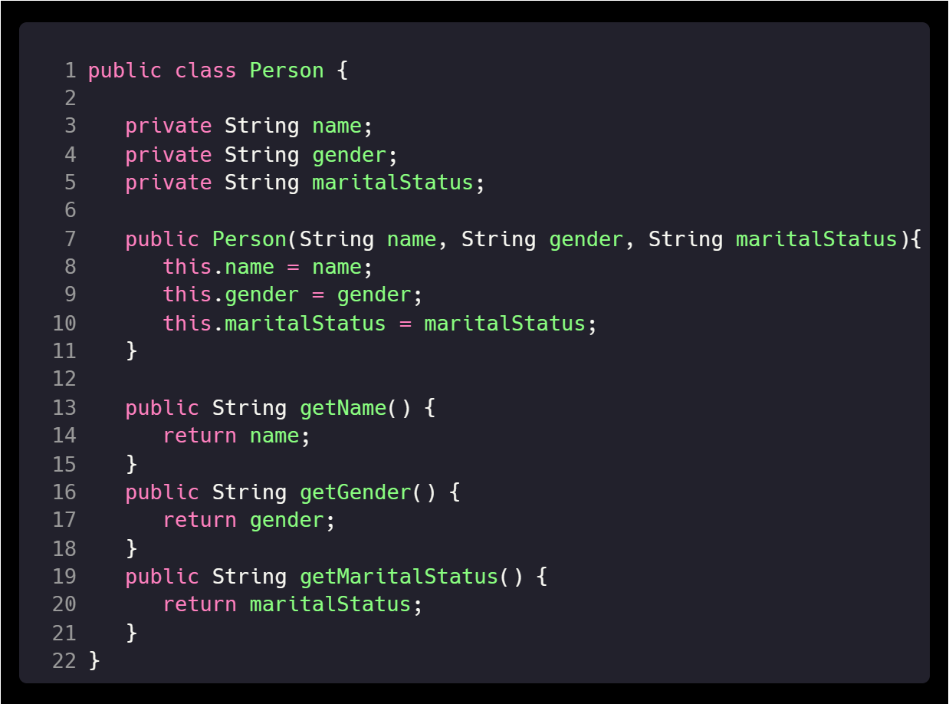
Code Examples – Step 1
Create a class on which criteria is to be applied.
Person.java

Slide 8
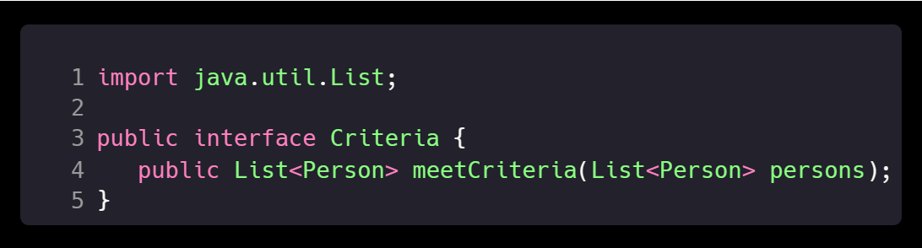
Code Examples – Step 2
Create an interface for Criteria.
Criteria.java

Slide 9
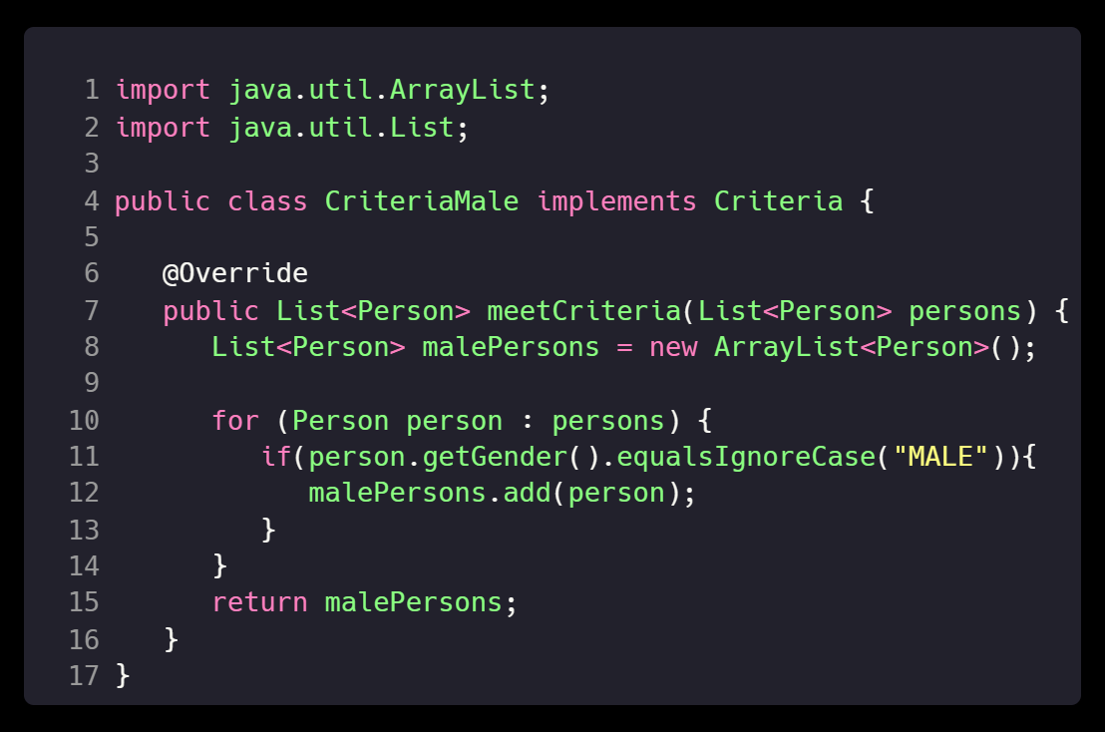
Code Examples – Step 3
Create concrete classes implementing the Criteria interface.
CriteriaMale.java

Slide 10
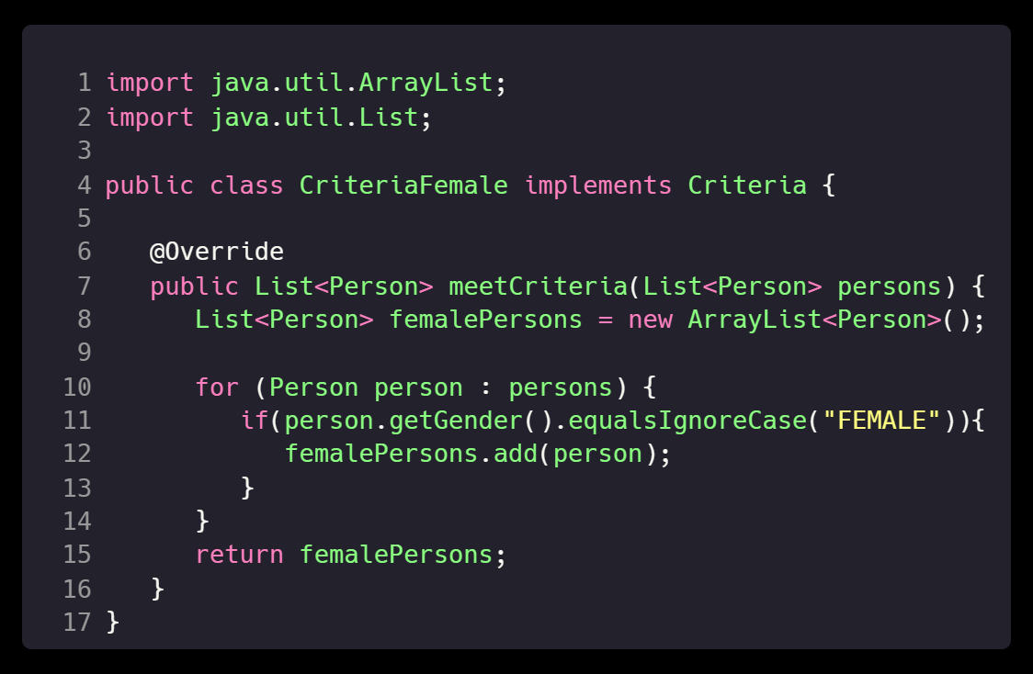
Code Examples – Step 3
Create concrete classes implementing the Criteria interface.
CriteriaFemale.java

Slide 11
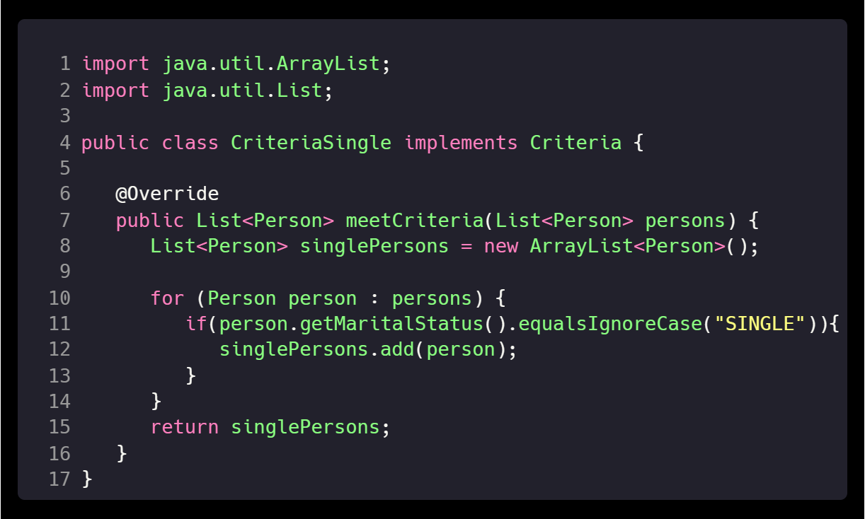
Code Examples – Step 3
Create concrete classes implementing the Criteria interface.
CriteriaSingle.java

Slide 12
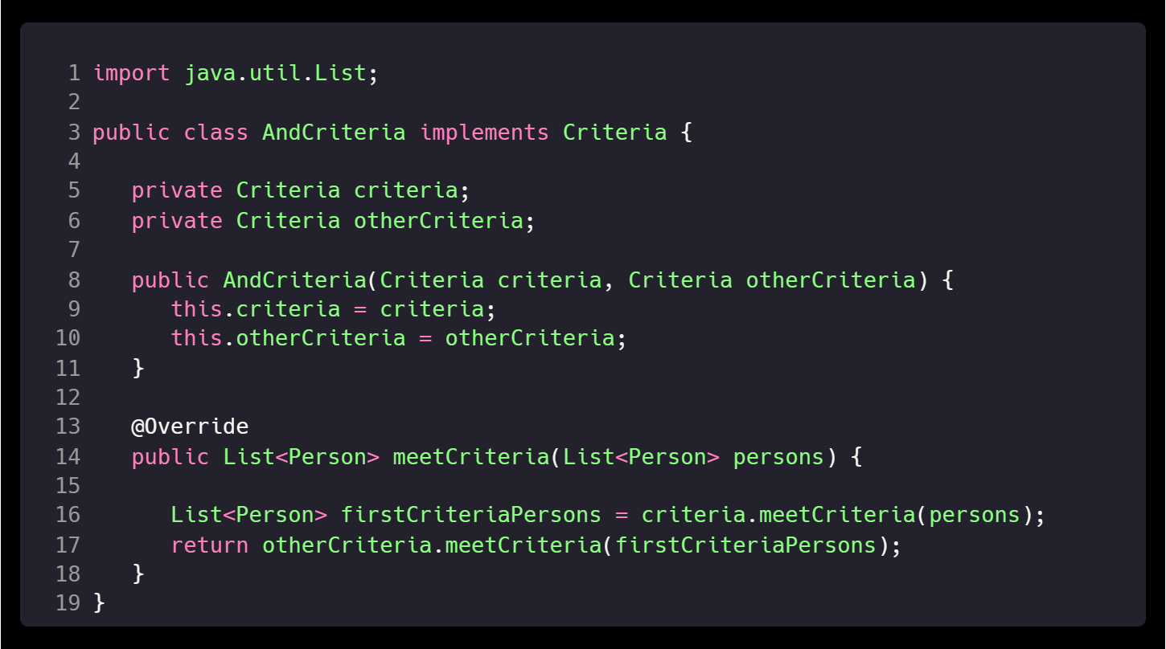
Code Examples – Step 3
Create concrete classes implementing the Criteria interface.
AndCriteria.java

Slide 13
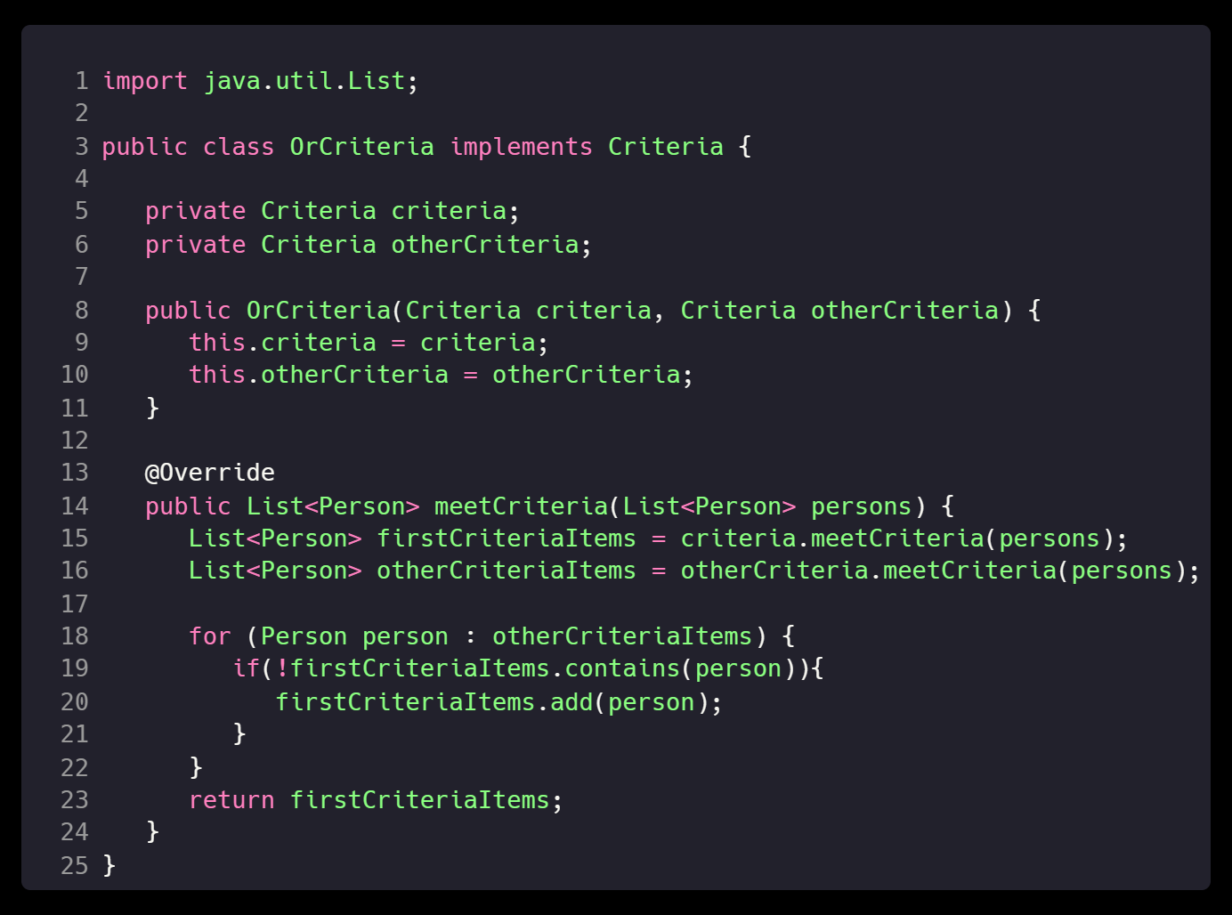
Code Examples – Step 3
Create concrete classes implementing the Criteria interface.
OrCriteria.java

Slide 14
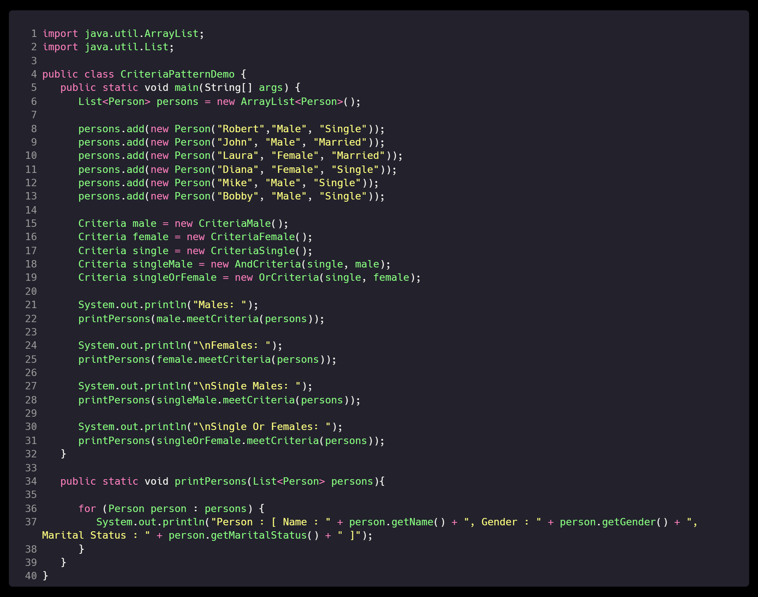
Code Examples – Step 4
Use different Criteria and their combination to filter out persons.
CriteriaPatternDemo.java

Slide 15
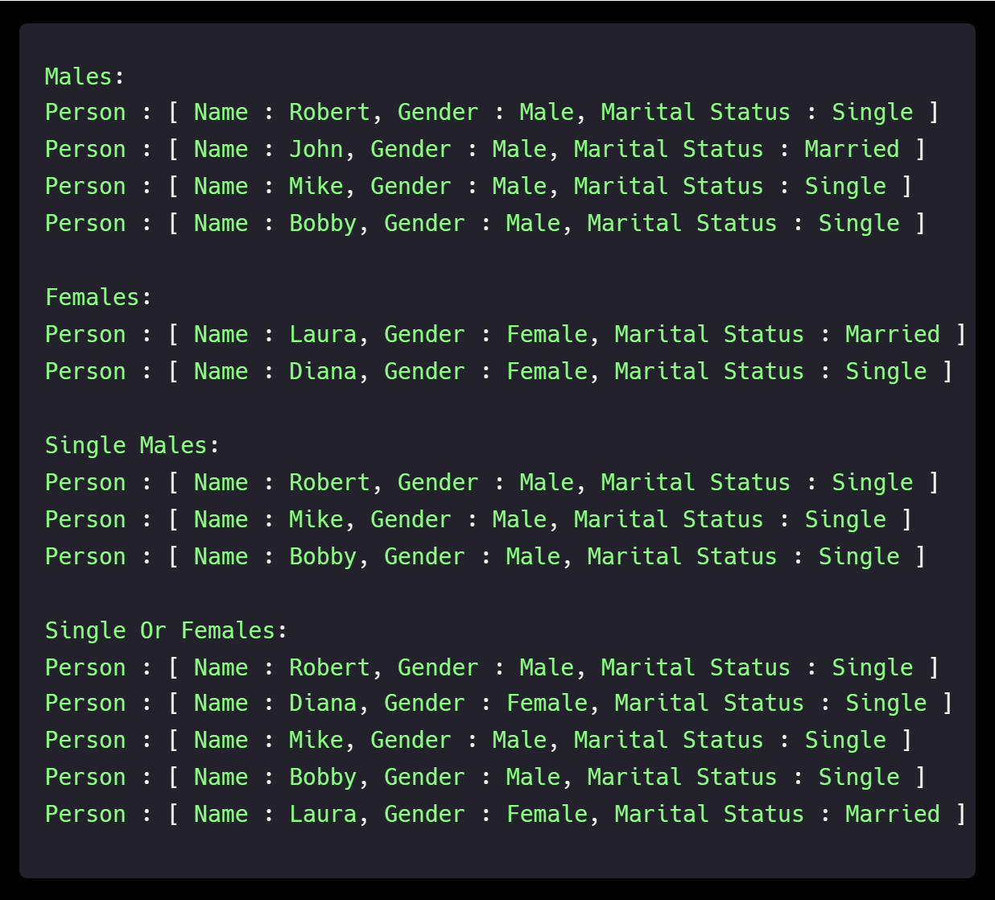
Code Examples – Step 5
Verify the output.

Slide 16
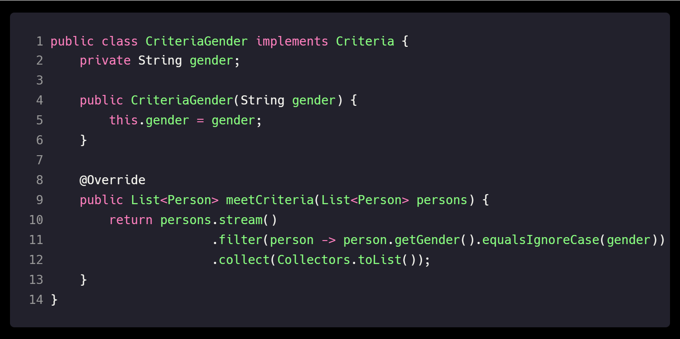
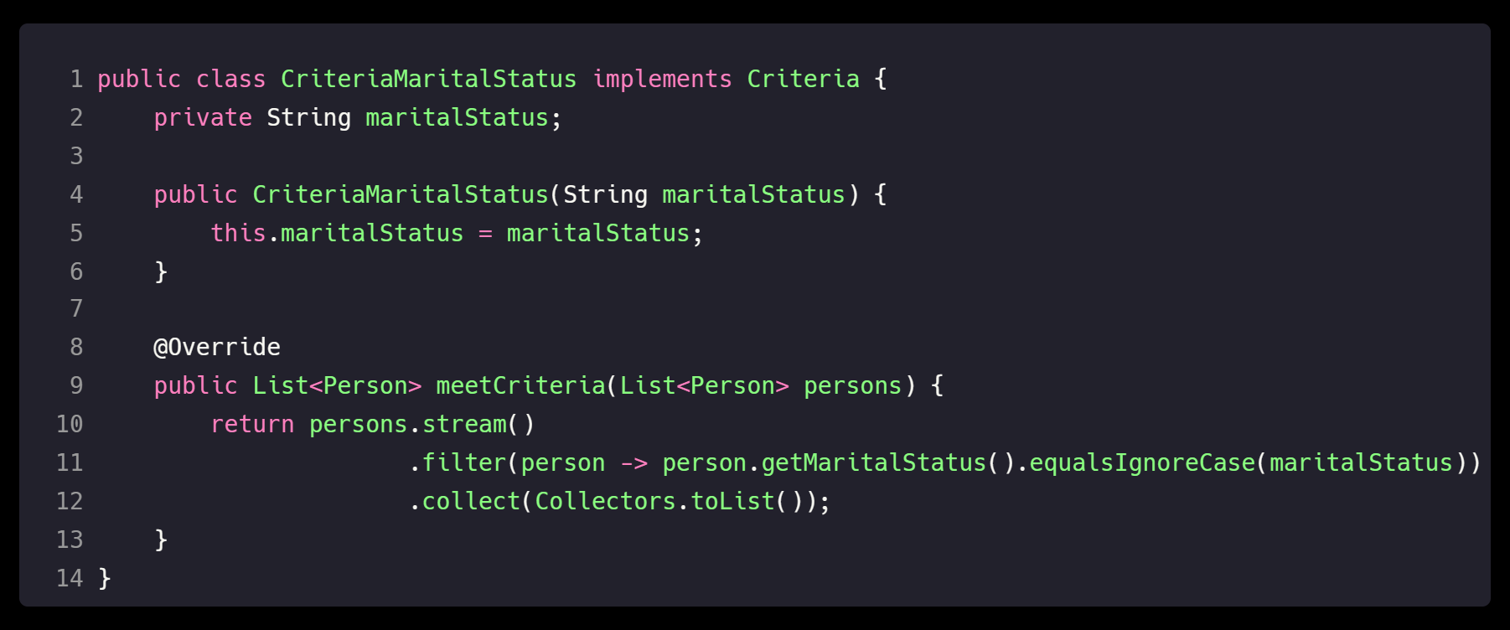
Improvements for Code Examples
Let's change some Criteria classes to remove duplicated code.

Slide 17
Class Work
https://github.com/AleksandrPitkin/DP_Filter
Understand and debug the code (!very important)
We live in 2024, a very modern world, and a lot of people think there are more than two genders…
So, let's help them.
Think about a new gender and add it as a Criteria.
Next add a few new persons with this gender.
After that, check it on query:
(newGender && married) || (male && single)

Slide 18
GOOD WORK 💖 WE ARE VERY PROUD OF YOU

