Slide 1
IMAGE CLEANUP TOOL
Group A2
Aleksandr Rozenman
Jovan Ruano
Steven Wirsz

Slide 2
BILATERAL FILTER "OIL PAINTING“
GAUSSIAN BLUR "OUT OF FOCUS“
SMOOTHING FUNCTION "SMEARED COLORS“
HISTOGRAM STRETCH “CONTRAST ENHANCING”
COLOR HISTOGRAM STRETCH “COLOR CORRECTION”
ADD GAUSSIAN NOISE
THRESHOLD BLACK TO ZERO
THRESHOLD WHITE TO ZERO
FILTERS

Slide 3
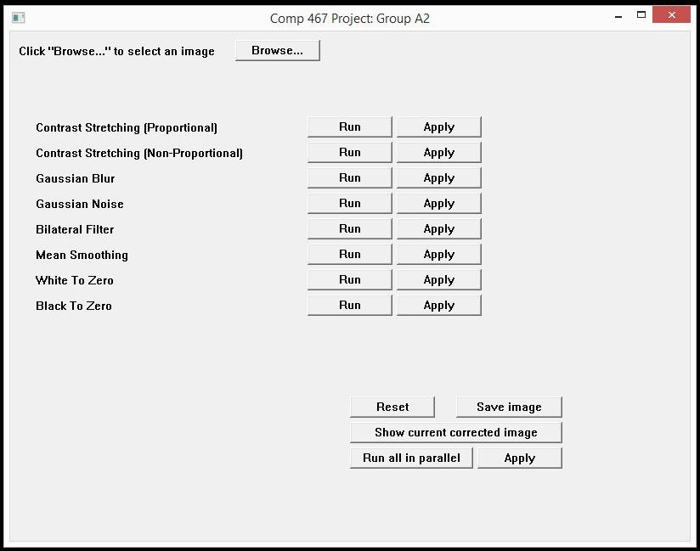
INTERFACE

Slide 4
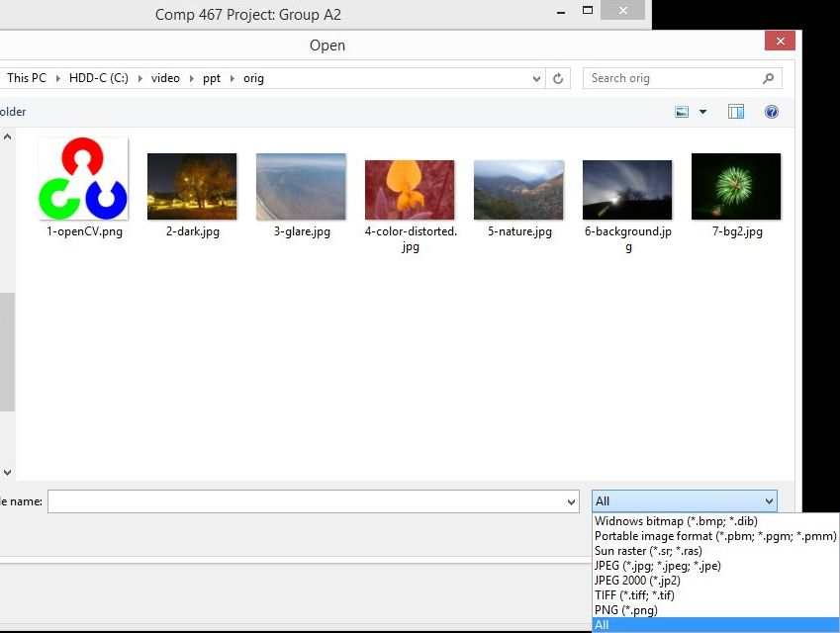

Slide 5
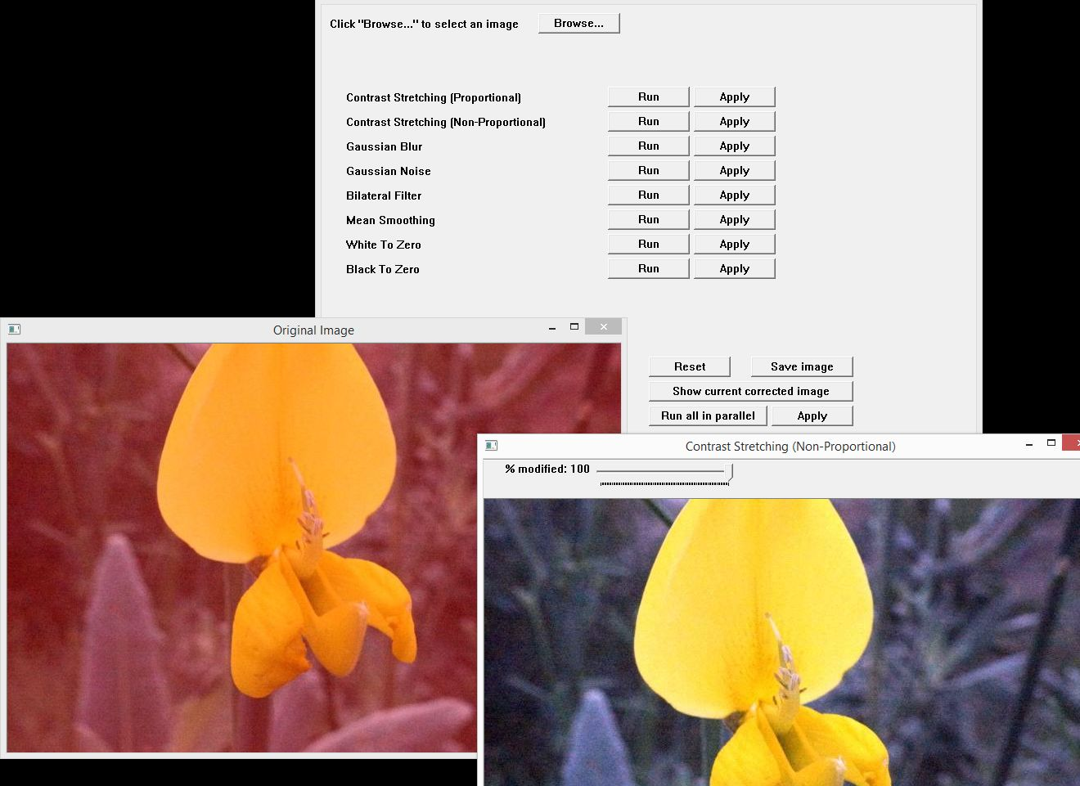

Slide 6
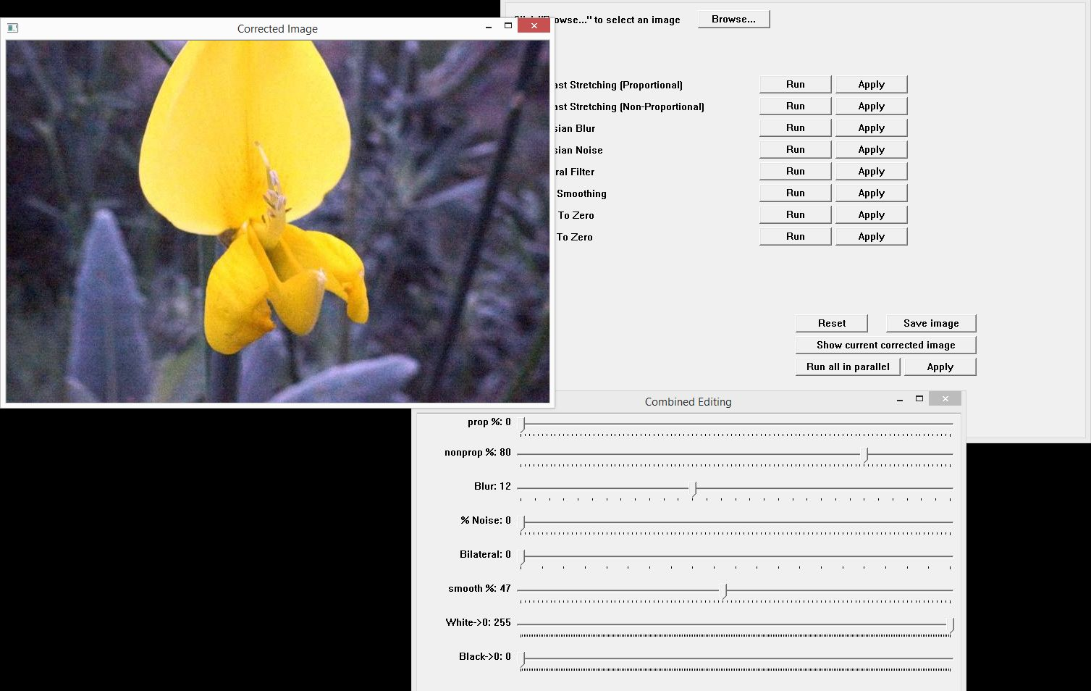

Slide 7
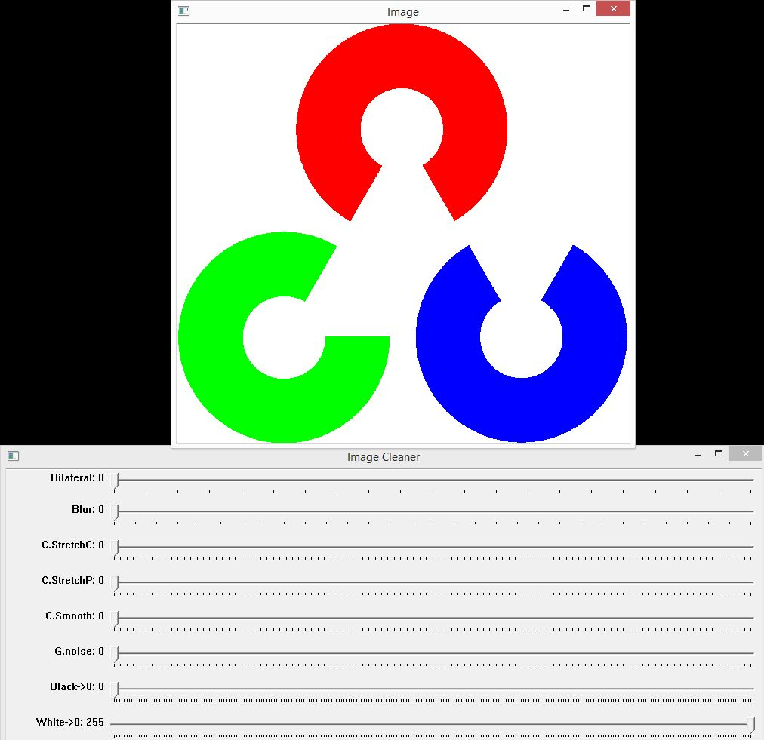
NOISE REMOVAL

Slide 8
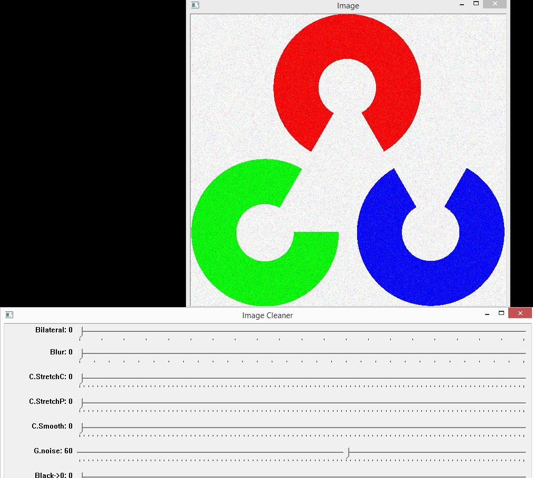

Slide 9
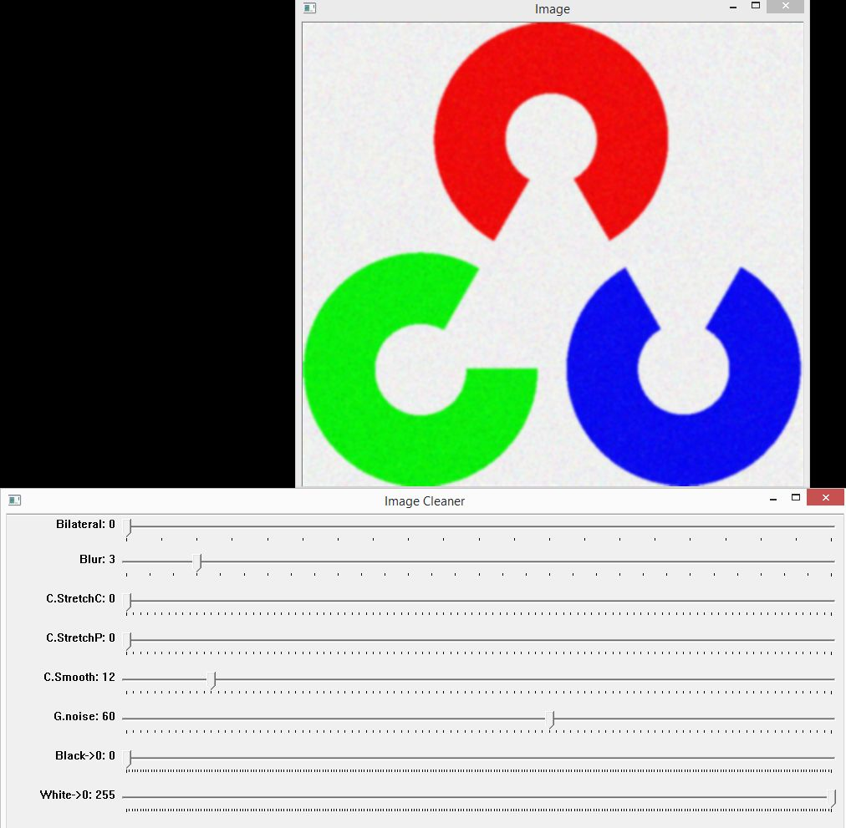

Slide 10
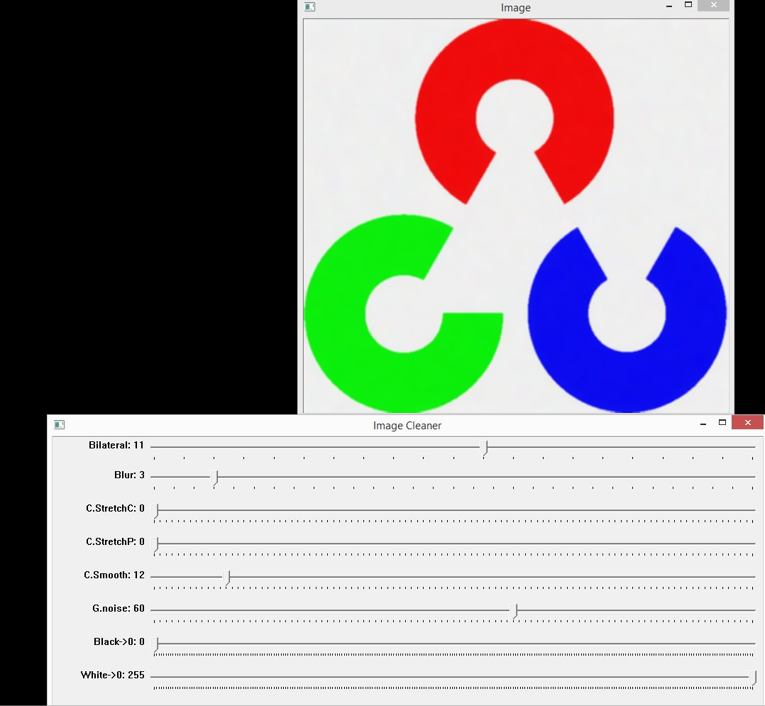

Slide 11
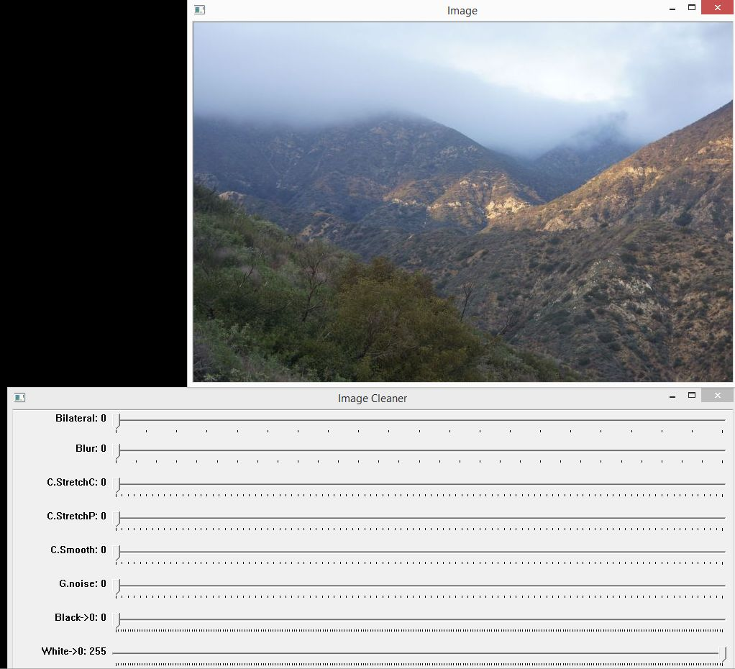

Slide 12
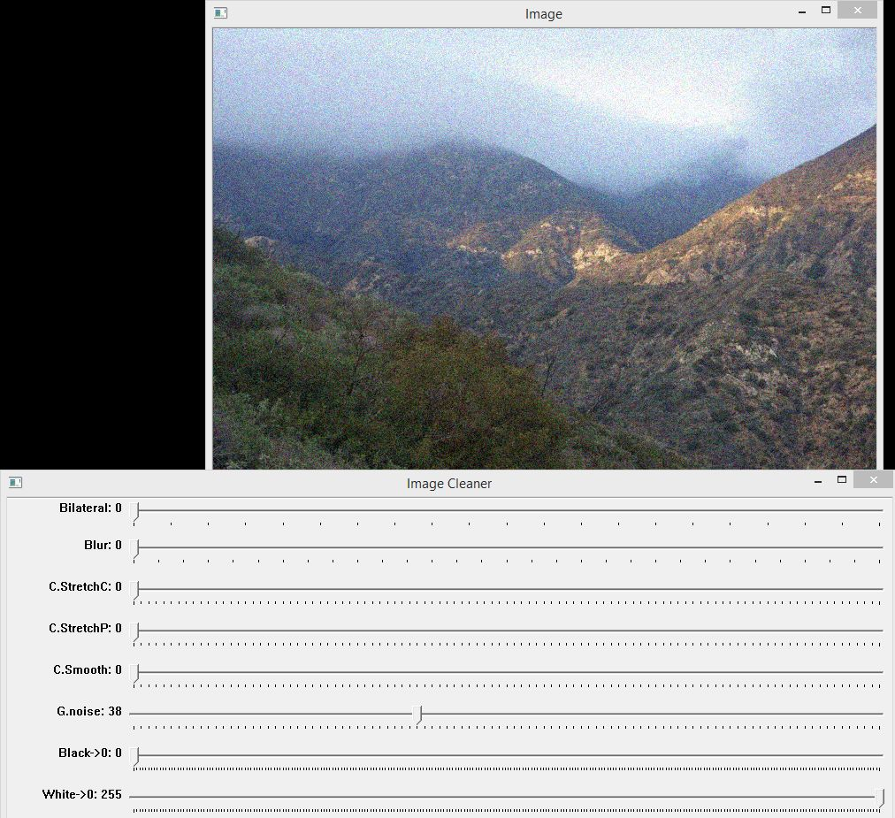

Slide 13
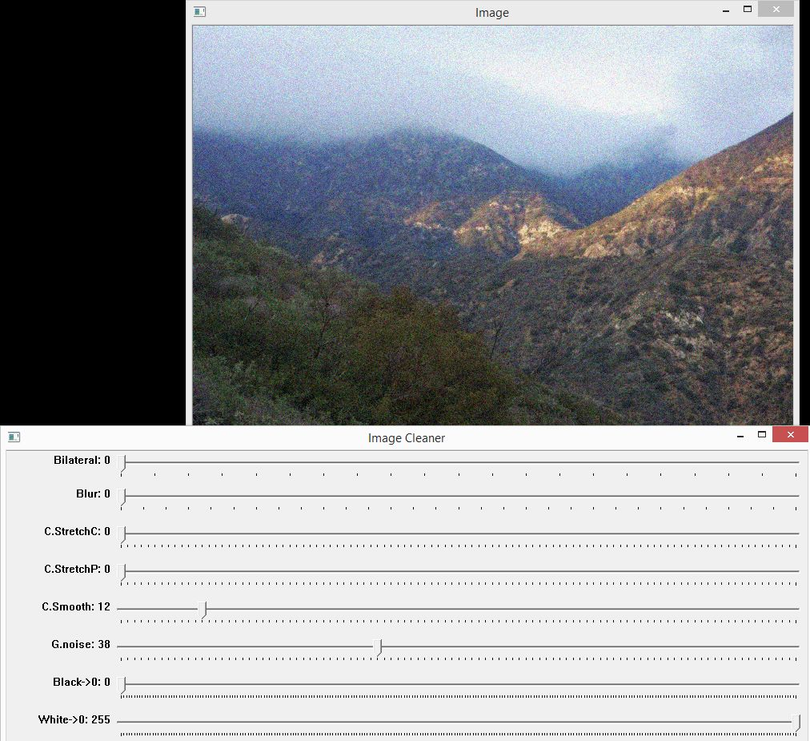

Slide 14
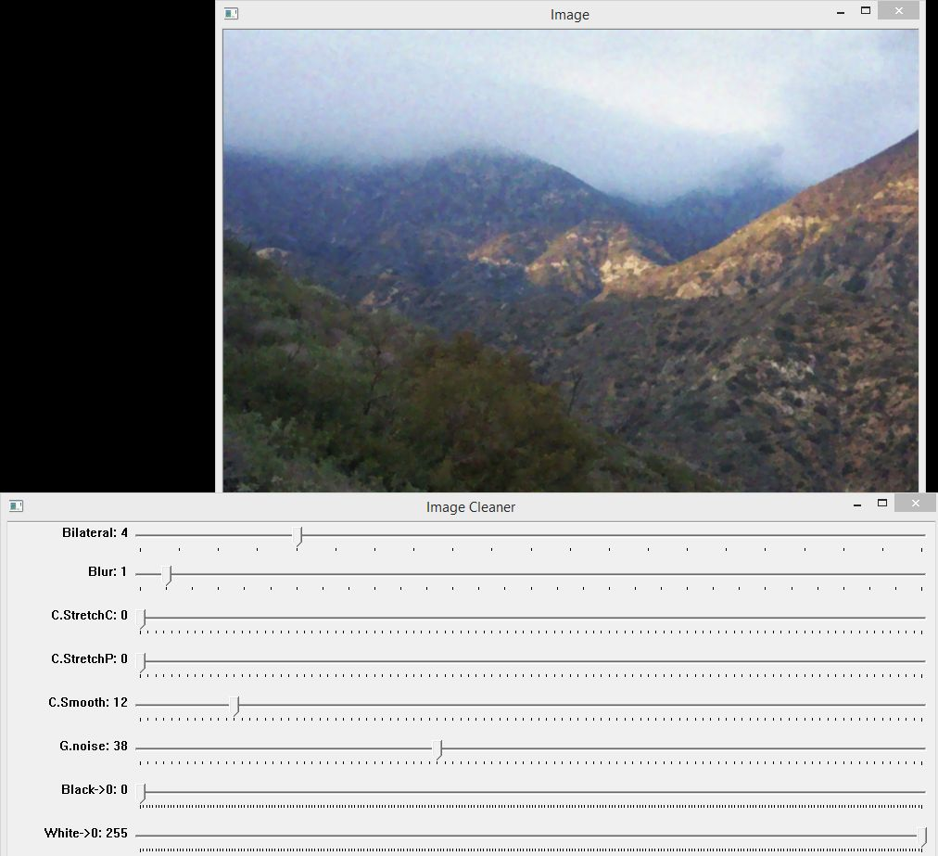

Slide 15
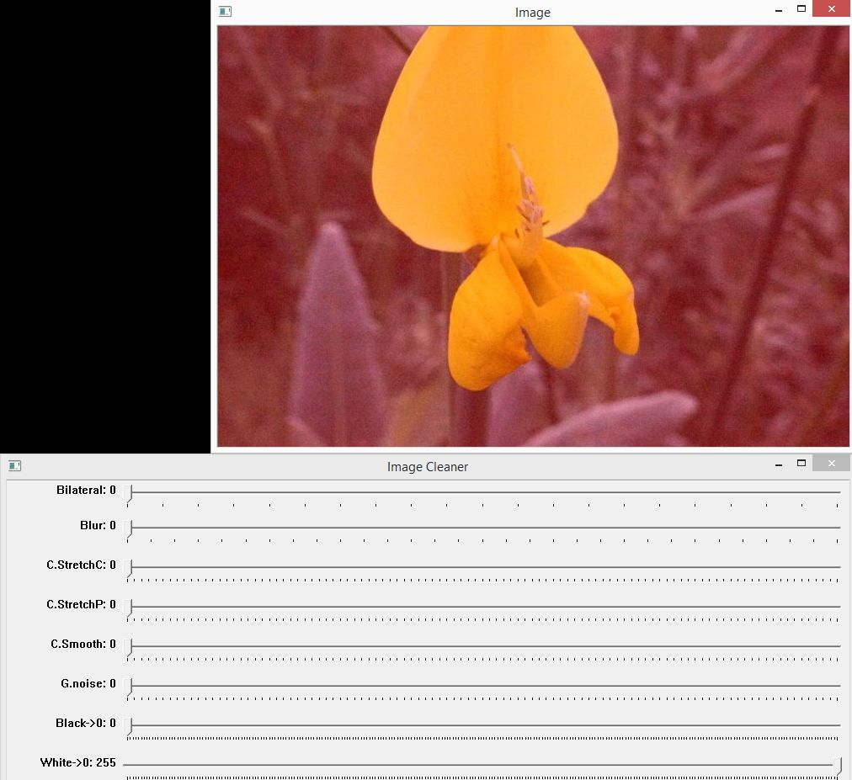
COLOR CORRECTION

Slide 16
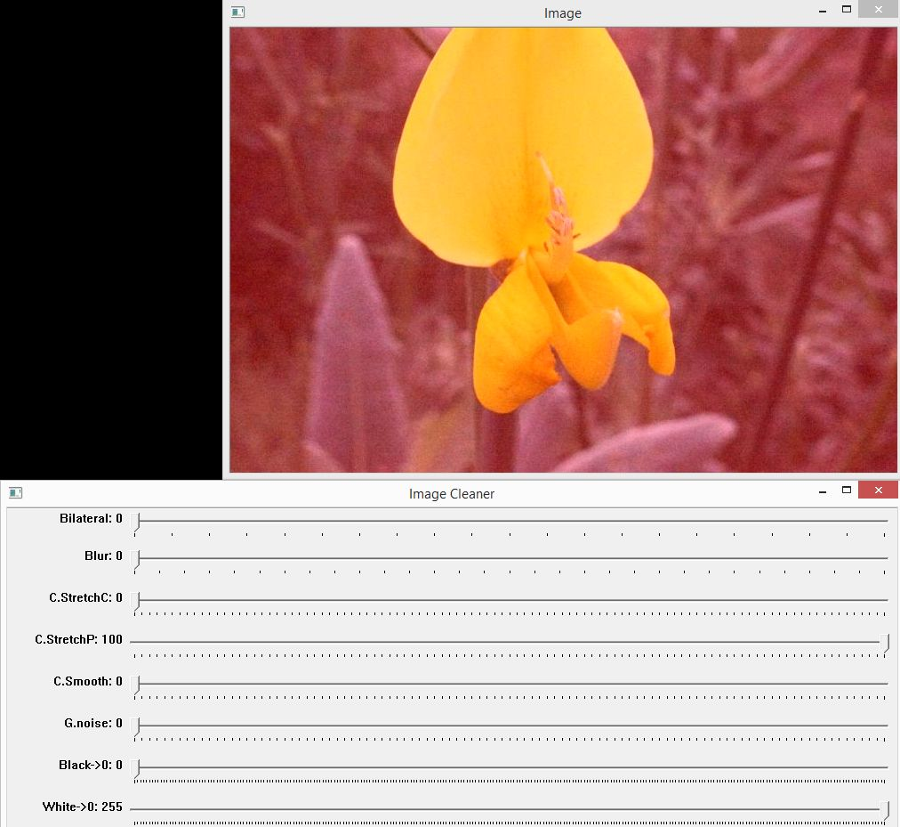

Slide 17
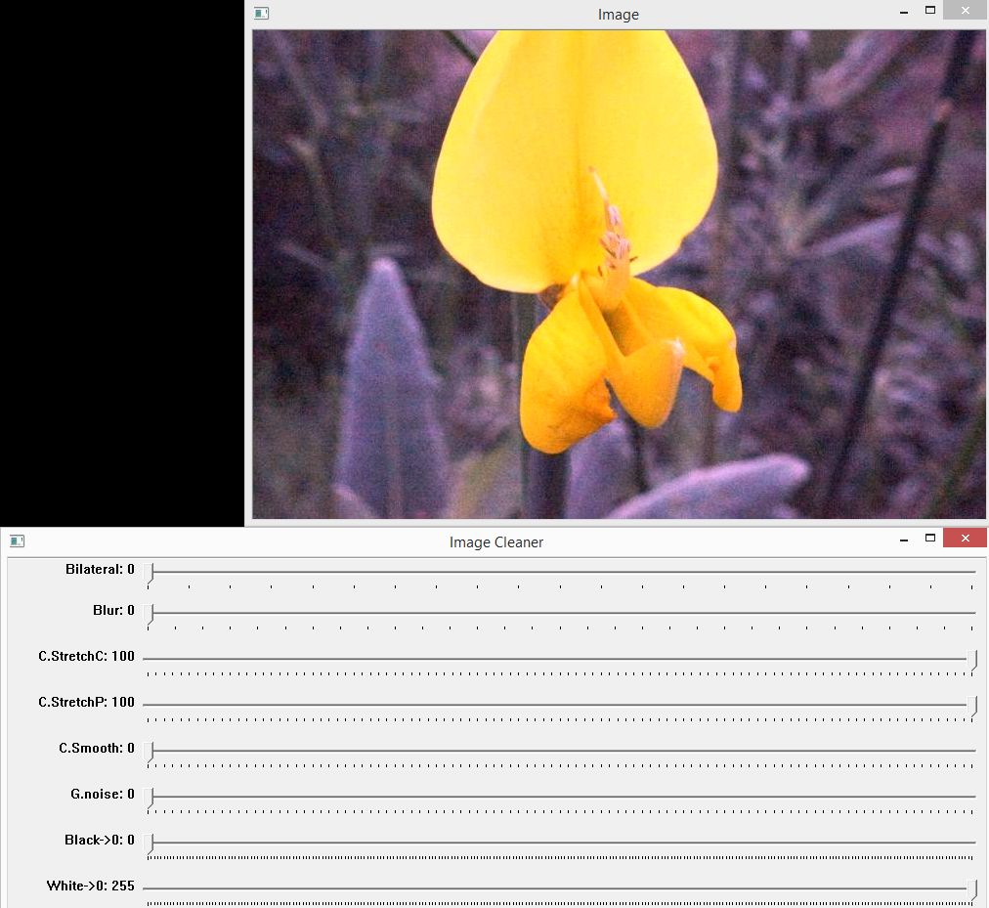

Slide 18
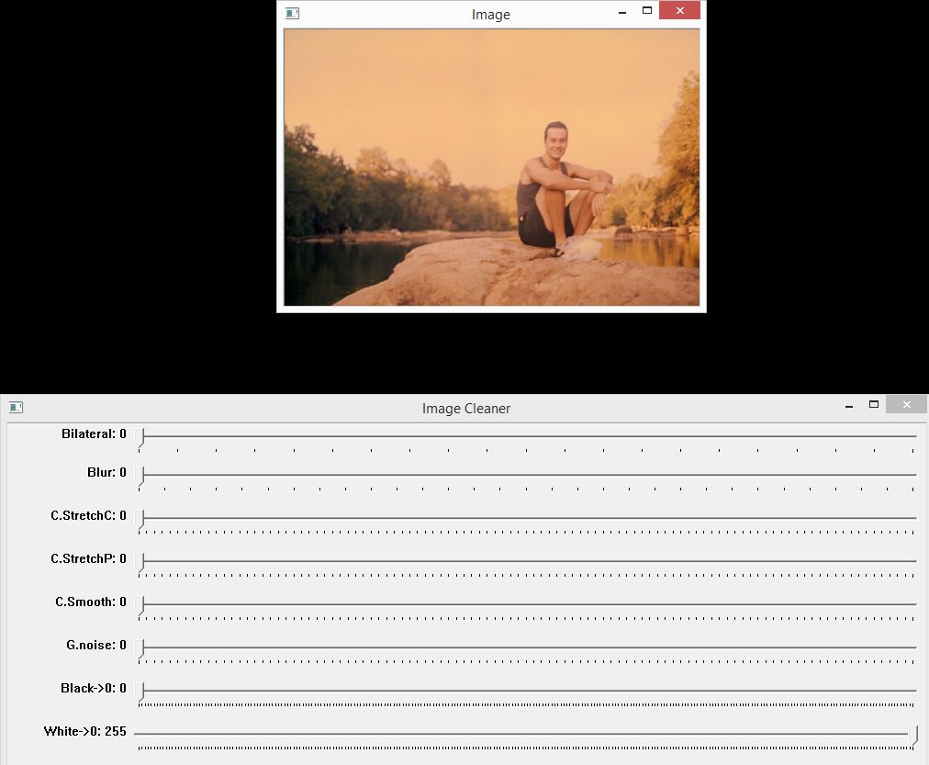

Slide 19
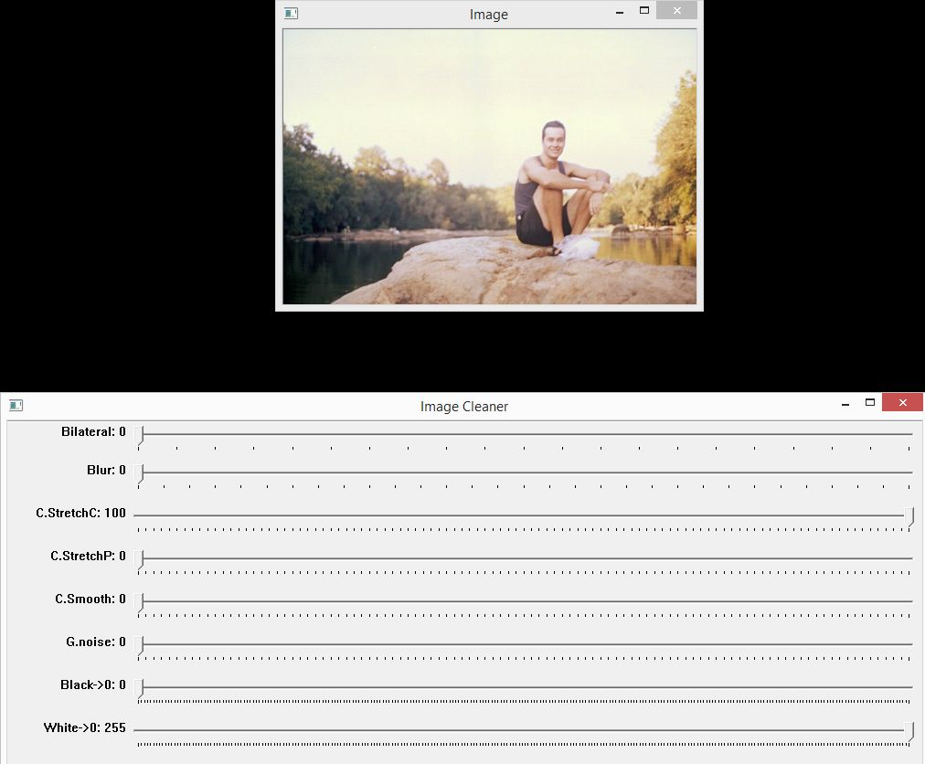

Slide 20
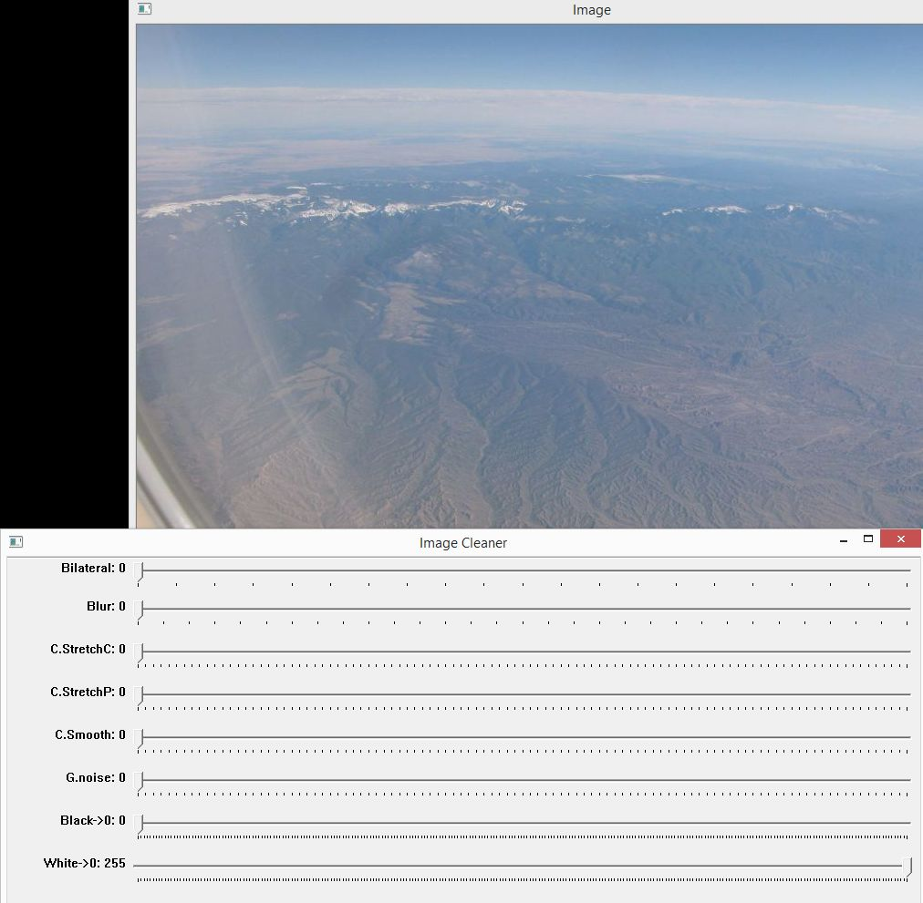
THRESHOLDING

Slide 21
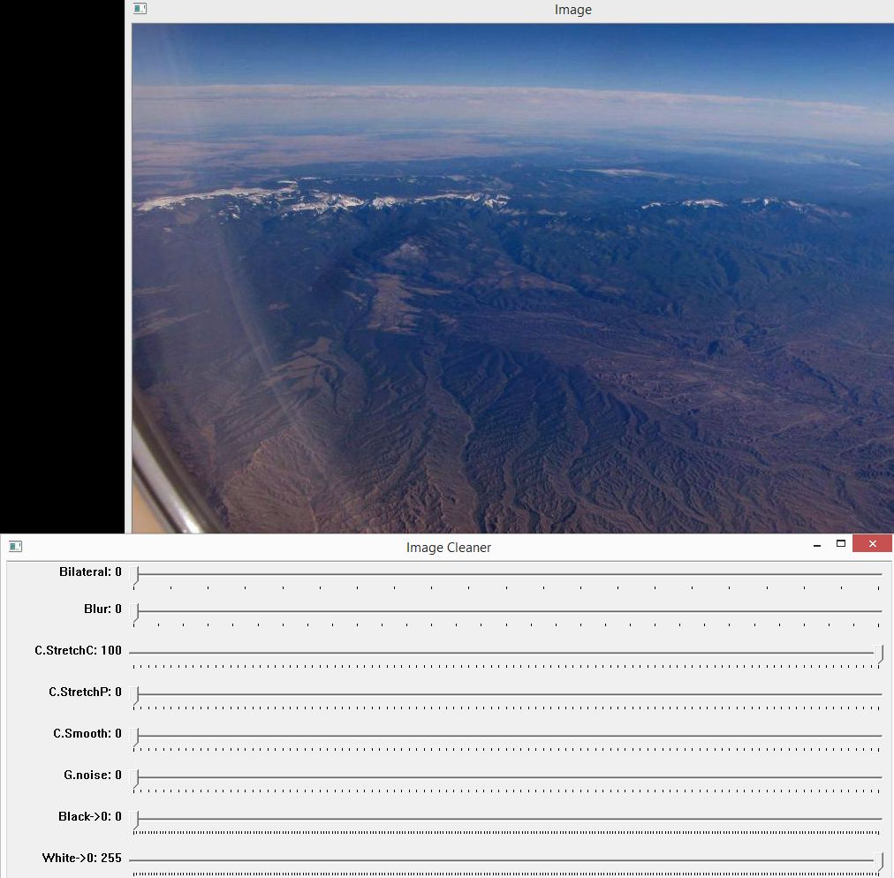

Slide 22
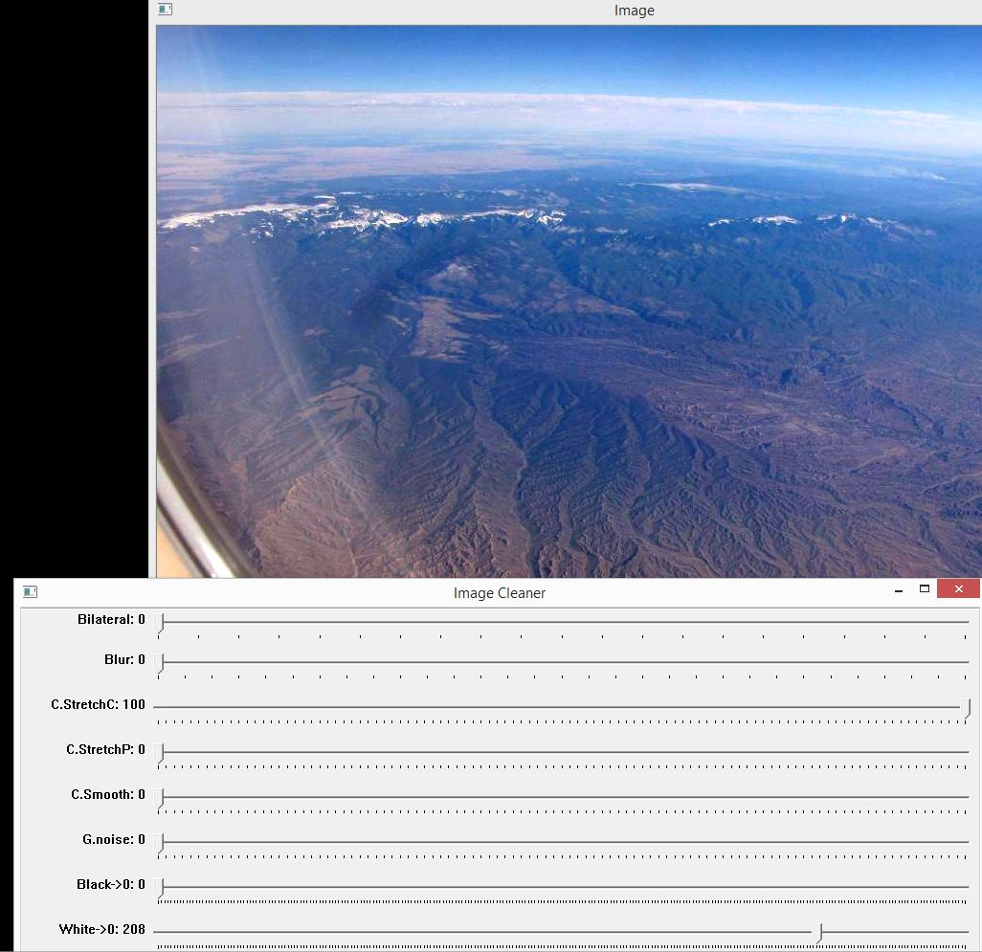

Slide 23
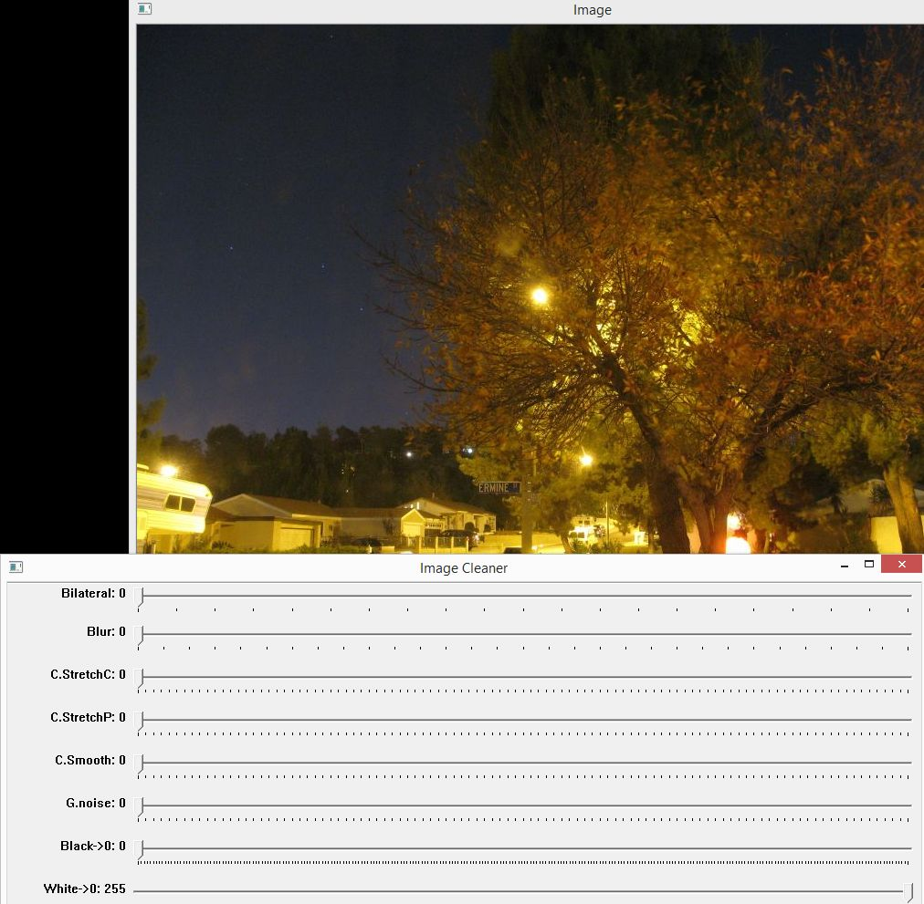

Slide 24
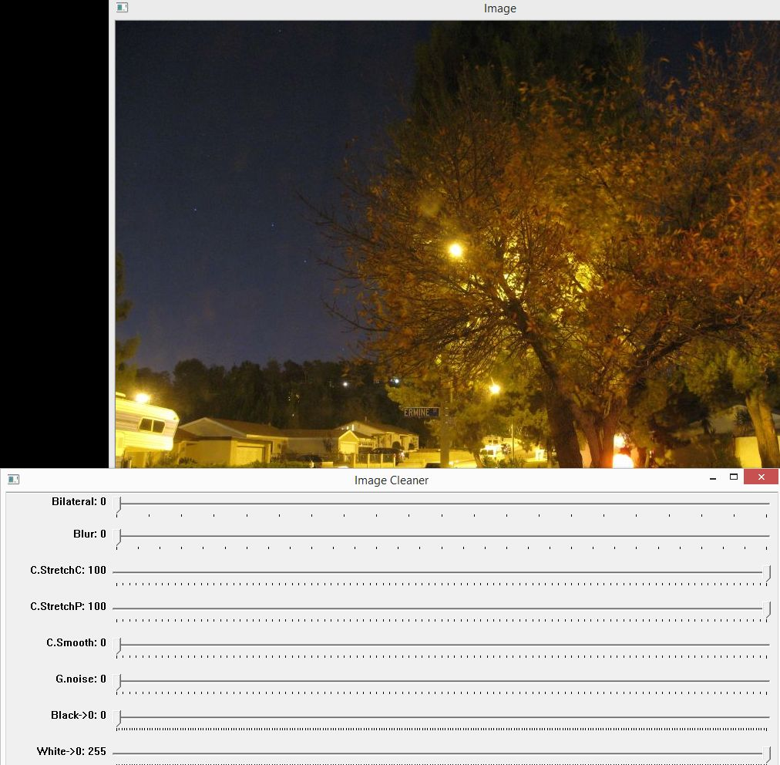

Slide 25
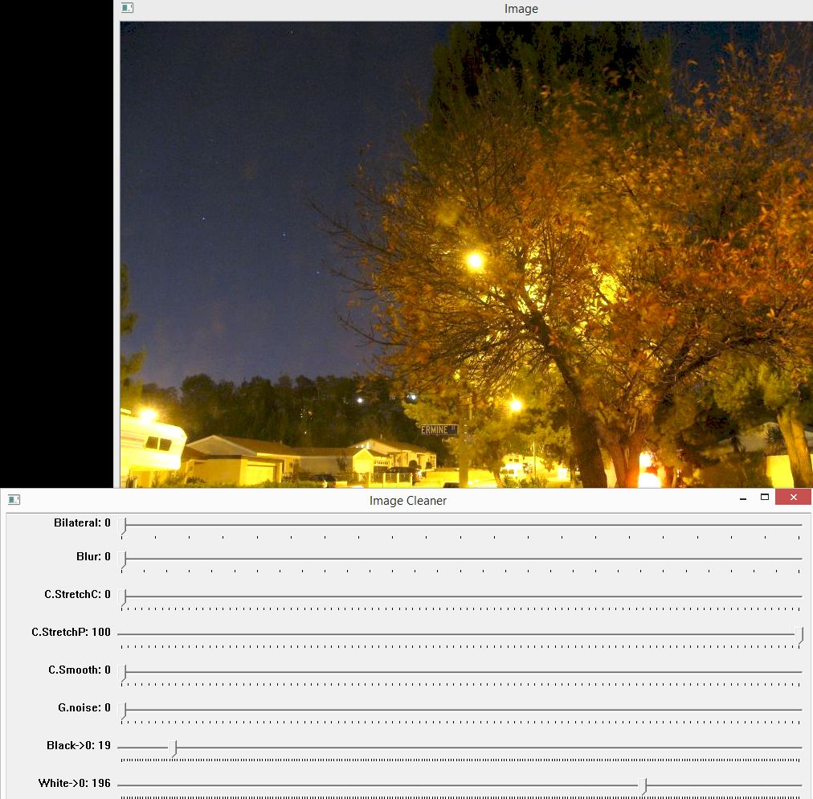

Slide 26
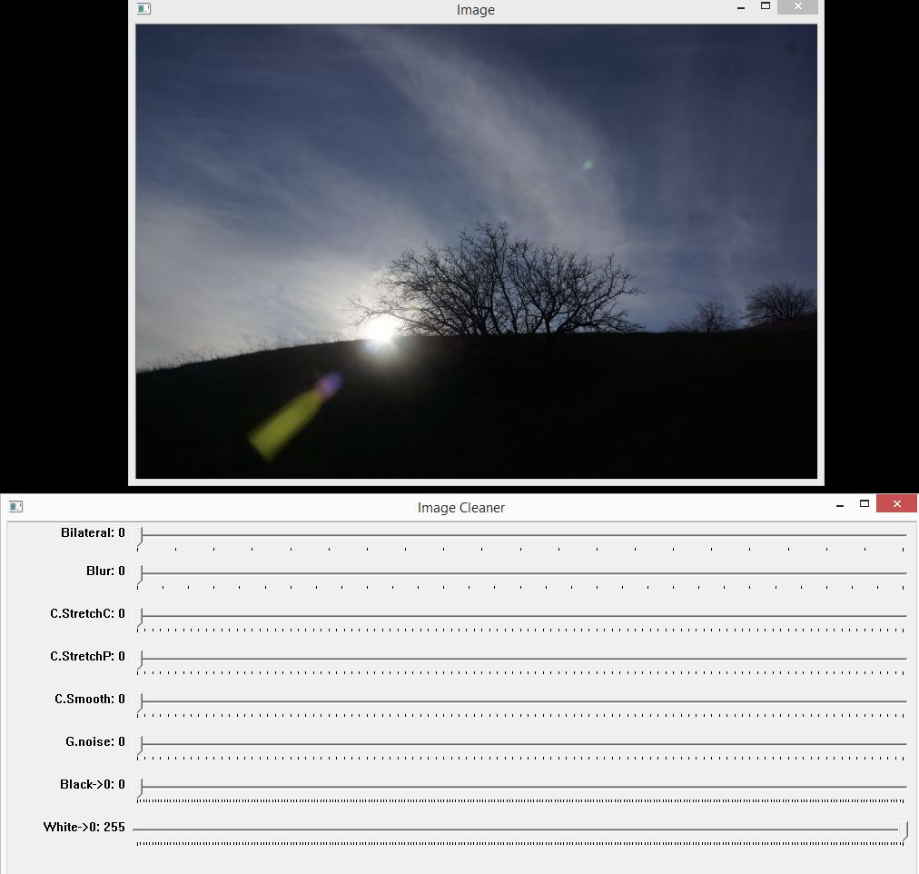
BACKGROUND REMOVAL

Slide 27
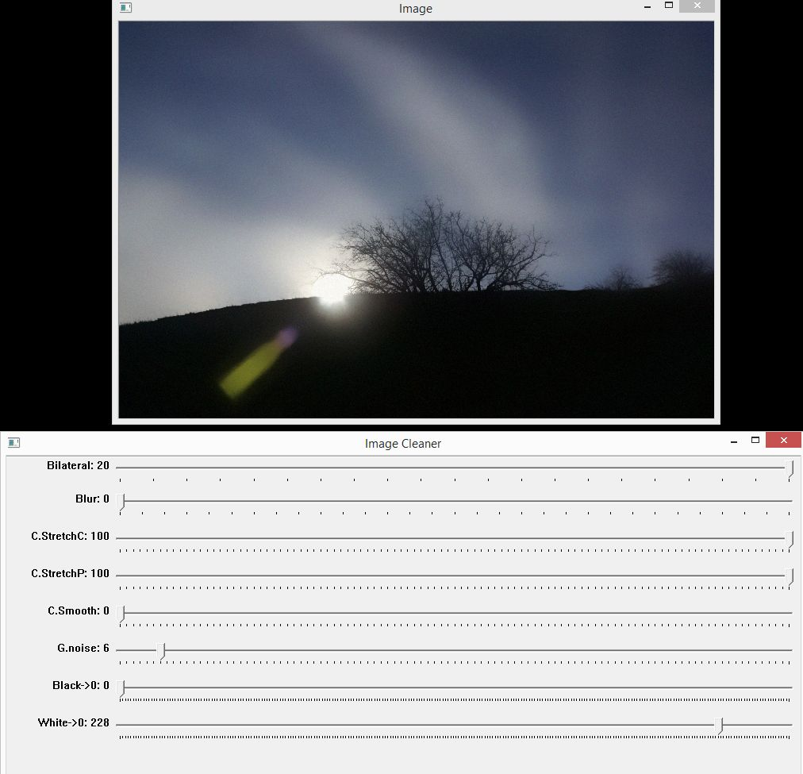

Slide 28
QUESTIONS?

