Slide 1
Presentation Project 1 Phase 3
Piotr Obarski, Agnieszka Sitko & Annanina Koster

Slide 2
Table of Contents
Approach
Justification
Results
Strong points
Drawbacks
List of genes
Plots
Conclusion

Slide 3
Approach
3600 patients and 16 thousand genes
ANOVA and Scheffe test: to find the few (14) genes that have a lot of CancerTypes that have (significantly) different gene expressions

Slide 4
Justification
Chosing those genes that help identify many different Cancertypes, instead of genes that can only identify one Cancertype

Slide 5
Results
The found interval of the gene expressions of these 14 genes indicates the Cancertype
Given a set of gene expressions, Cancertype can now be predicted!

Slide 6
Strong points
Gives most information with fewest genes
All 14 genes tell something about 1 Cancertype (instead of just 1 or increasing the number of genes drastically)
This approach is very unlikely to detect a Cancertype if it is not present

Slide 7
Drawbacks
If a Cancertype is detected by only one gene, using all 14 genes won’t detect his Cancertype!
Two genes can be similar (this is not the case!!)
Genes can be uninformative (not the case!!)

Slide 8
List of genes
"APOOL" "ARHGAP29" "COL3A1" "CXXC5" "FAM58A" "FBXL7" "FJX1" "IL32" "LYPD3" "NBEAL2" "PEX13" "SAMD10" "TSPAN9" "TTC22"

Slide 9
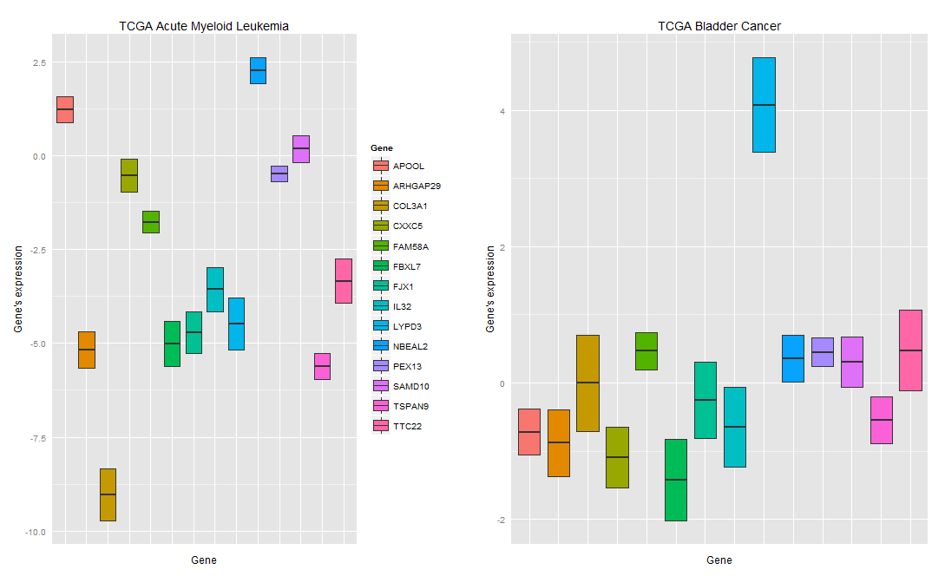
Plots

Slide 10
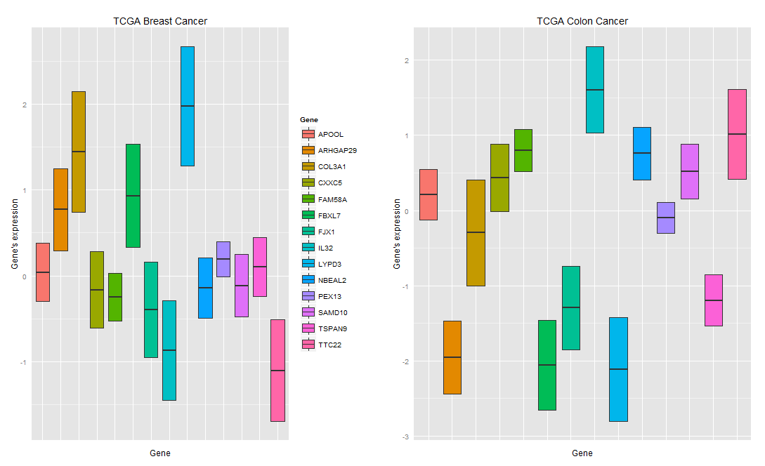
Plots

Slide 11
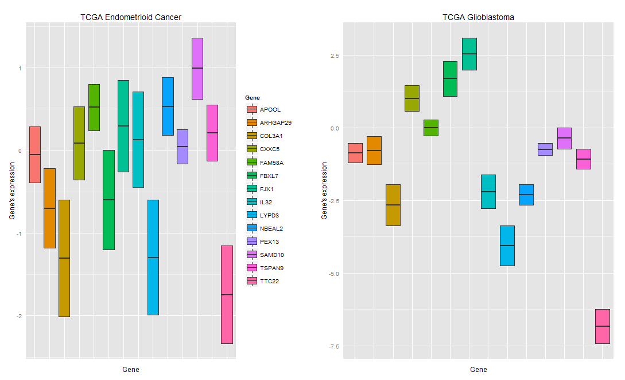
Plots

Slide 12
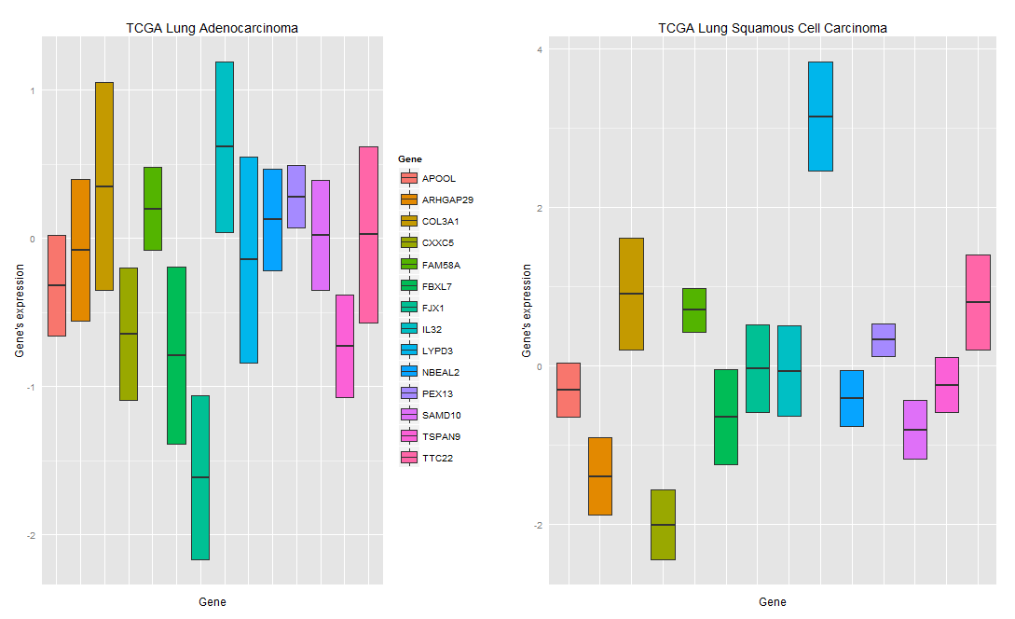
Plots

Slide 13
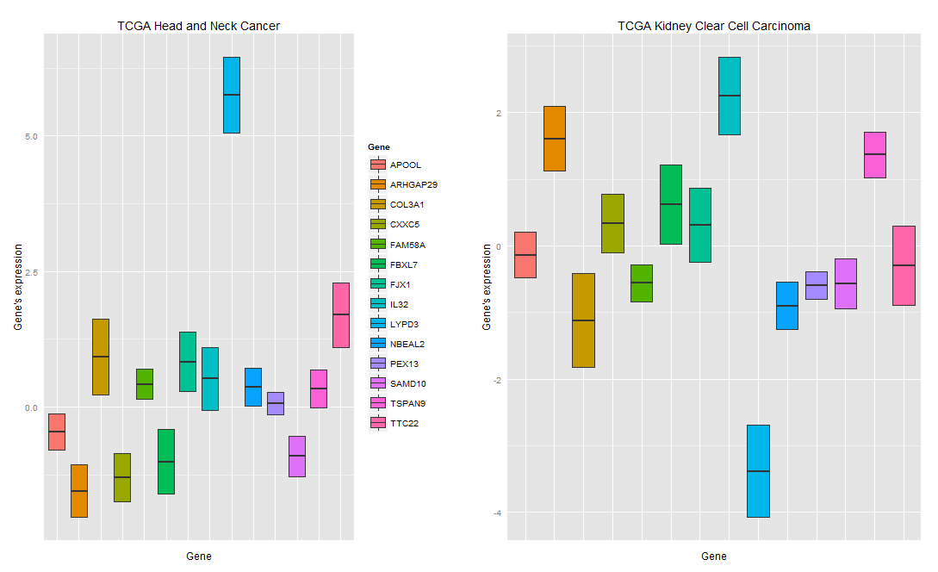
Plots

Slide 14
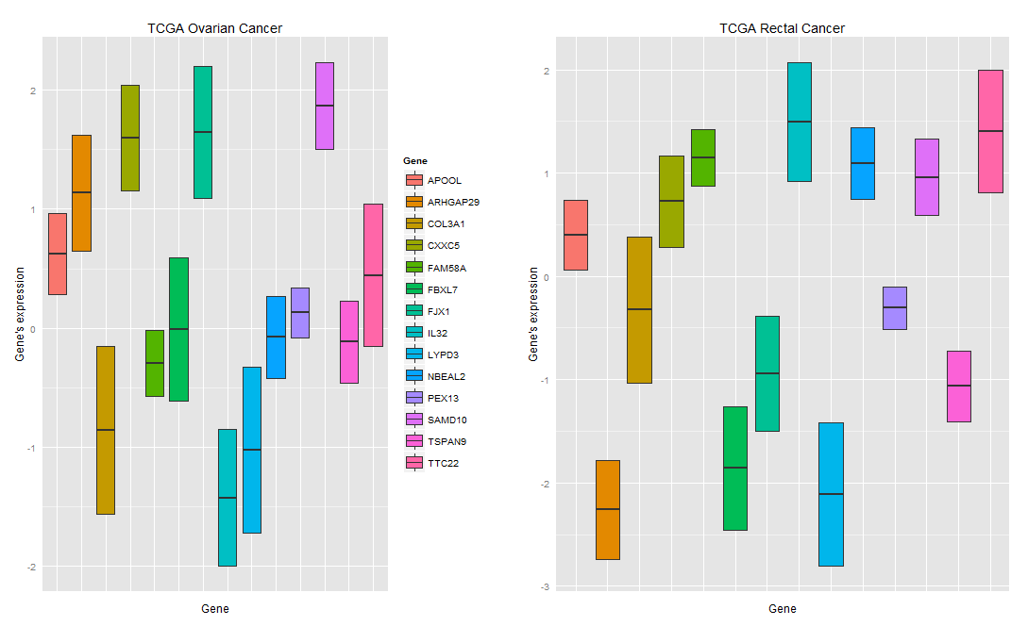
Plots

Slide 15
Conclusion
14 genes have been found that have (significantly) different gene expressions for each Cancertype
Therefore, given a list of gene expressions of these genes, a Cancertype can be predicted!

