Slide 1
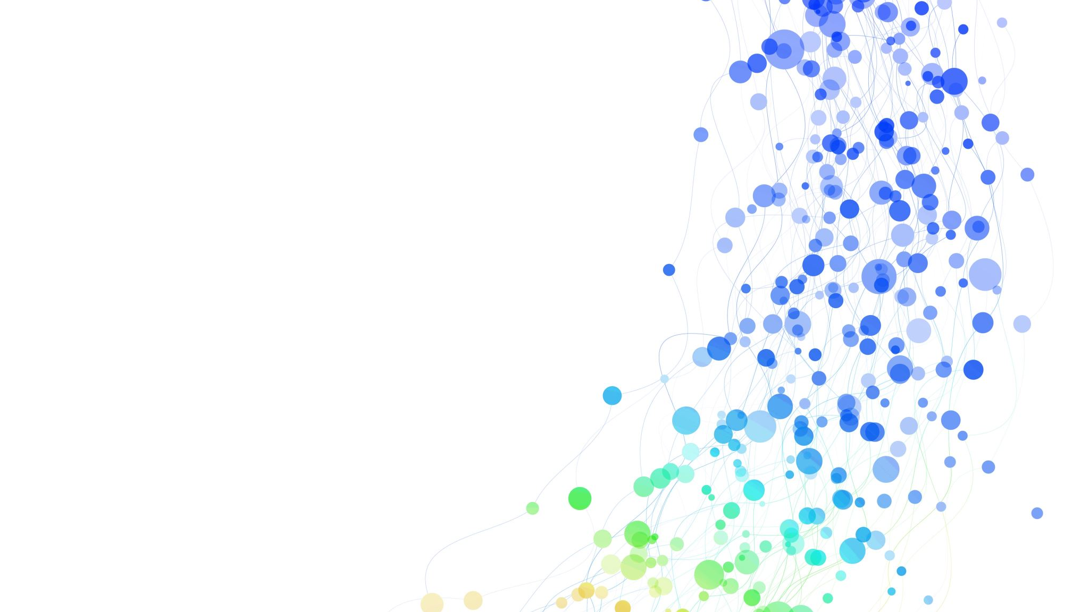
Accelerating Generative Adversarial Networks with HPC
EUROCC2 training

Slide 2
Generative Models
Generative models aim to learn the underlying probability distribution of data;
The aim is to generate new, previously unseen samples that resemble the training data.
Discriminative models predict labels; Generative models attempt to model the structure and variability of the data itself.
What is a Generative Model?
Learns the probability distribution of data P(x) or joint distribution P(x, y)
Can generate new synthetic samples
Captures structure, correlations, and variability in data
Works in high-dimensional spaces (images, audio, text, simulation)

Slide 3
Discriminative vs Generative
Discriminative Models:
Learn P(y/midx)
Focus on decision boundaries
Example: image classifier
Generative Models:
Learn how data is produced
Model the full data distribution
Enable sampling and synthesis

Slide 4
Major Families of Generative Models
Autoregressive Models
Generate data sequentially
Example: PixelCNN, GPT-style models
Explicit likelihood modeling
Variational Autoencoders (VAE)
Latent variable models
Probabilistic encoder-decoder structure
Explicit likelihood approximation
Flow-based Models
Invertible transformations
Exact likelihood computation
structured latent mapping
Generative Adversarial Networks (GANs)
Implicit generative modeling
No explicit likelihood
Adversarial training mechanism
Diffusion Models
Iterative denoising process
Strong theoretical foundation
Currently dominant in high-fidelity generation

Slide 5
Key Differences Between Families
Density Modeling
Exact likelihood → Autoregressive, Flow
Approximate likelihood → VAE
No likelihood → GAN
Score-based density estimation → Diffusion
Sampling Process
Sequential → Autoregressive
Single-pass → GAN
Iterative refinement → Diffusion
Deterministic invertible mapping → Flow
Latent Space Structure
Strong Latent Structure → VAE, GAN
Week/implicit latent structure → Autoregressive
Noise trajectory space → Diffusion
Training Objective Type
Maximum likelihood → Autoregressive, Flow
Variational inference → VAE
Minmax game → GAN
Score matching / denoising → Diffusion

Slide 6
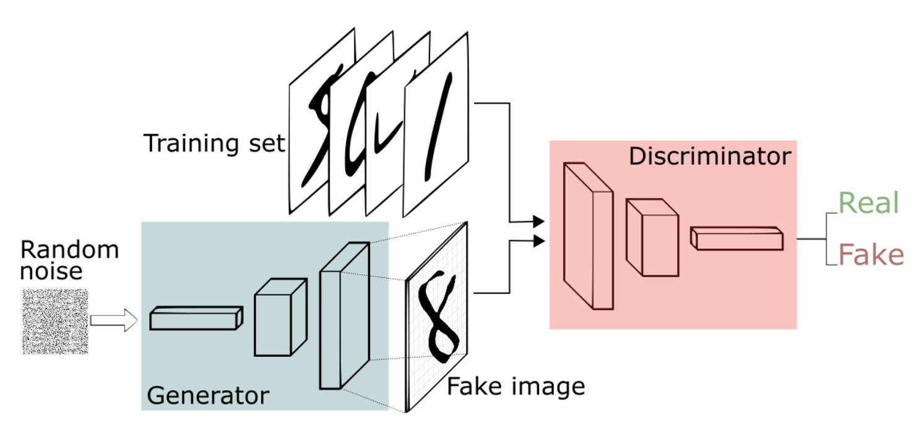
What is a GAN?
A Generative Adversarial Network is a framework for training a generative model through adversarial competition between two neural networks: a Generator and a Discriminator.
The Generator learns to produce synthetic samples
The Discriminator learns to distinguish real data from generated data.

Slide 7


What is a GAN?
GAN training is formulated as a two-player minimax optimization problem. The generator and discriminator have opposing objectives, forming a zero-sum game.
Original GAN Objective (Goodfellow et al., 2014):
Discriminator maximizes correct classification
Generator minimizes discriminator’s ability to detect fakes
Optimization Structure
Alternate updates:
Update D using real and fake samples
Update G using discriminator gradients
Nash equilibrium when:
Latent Space
Uniform distribution or
Typically 64-512 dimensions
Encodes generative factors implicitly

Slide 8





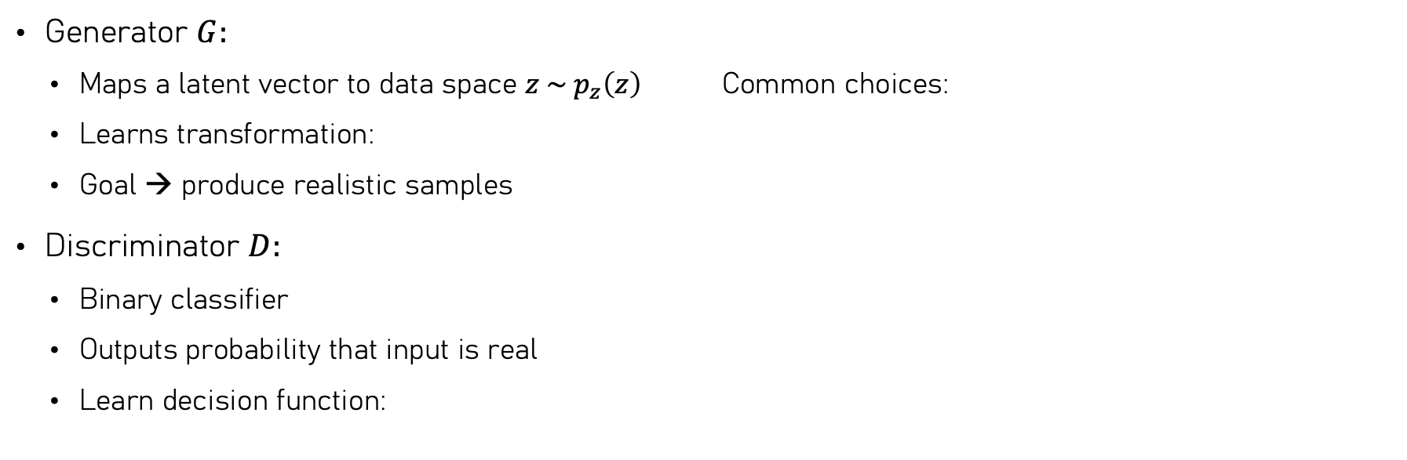
What is a GAN?
Generator $G:$
Maps a latent vector to data space $z \sim p_{z}\left(z\right)$ Common choices:
Learns transformation:
Goal → produce realistic samples
Discriminator $D:$
Binary classifier
Outputs probability that input is real
Learn decision function:

Slide 9
GAN Mechanism
GAN training is a dynamic, adversarial optimization process in which two neural networks — the Generator and the Discriminator — are updated alternately. Their interaction defines the learning signal and determines training stability.
Alternating Optimization
Train Discriminator on:
Real samples → label = 1
Generated samples → label = 0
Freeze D, train Generator using gradients flowing through D
Repeat iteratively
This creates a continuously shifting objective landscape.

Slide 10

GAN Mechanism
2. Gradient Flow Structure
Generator does not compare output directly to real images
Generator learns through:
Discriminator defines the gradient quality
Weak D → meaningless gradients
Overpowering D → vanishing gradients
The discriminator is effectively a learned loss function.

Slide 11

3. Balance between G and D
If D trains too fast:
Generator gradients vanish
If G trains too fast:
Discriminator becomes unreliable
Training stability depends on maintaining equilibrium.
4. Implicit Distribution Matching
Generator progressively reshapes its output distribution
Discriminator pushes generator toward high-density regions of real data
At theoretical equilibrium:
In practice, equilibrium is rarely perfect
5. Useful:
Two optimizers interacting → unstable dynamics
Small hyperparamters changes can dramatically affect convergence
Scalling batch size or learning rate changes interaction dynamics

Slide 12
Network Architectures
Generator
Fully connected (early GANs)
Convolutional (DCGAN)
Residual locks
Attention mechanisms
Style-based mapping networks
Discriminator
Convolutional classifier
Patch-based (PatchGAN)
Spectral normalization layers
Residual architectures

Slide 13
Key Insights
Generator never sees real labels
It learns through discriminator gradients
The discriminator defines the learning signal
The two networks co-evolve during training
No explicit likelihood estimation
Sample-based training
Implicit distribution modeling
Sensitive to balance between G and D

Slide 14
Why GANs Are Computationally Expensive
GAN training is computationally demanding because it simultaneously optimizes two deep neural networks in a tightly coupled adversarial loop.
Each iteration involves multiple forward and backward passes, large intermediate activations, and sensitivity to batch size and update frequency.

Slide 15
Two networks, two optimization steps per iteration:
Discriminator forward + backward pass, generator forward + backward pass
Often multiple D updates per G update (e.g., WGAN variants)
Effectively doubles compute compared to standard supervised training
Convolution-dominated architectures
G performs progressive upsampling; D process high-dimensional inputs
Large convolutional stacks increase FLOPs significantly
Memory-intensive backpropagation
Activations stored for backward pass
Optimizer states double parameter memory
Gradient buffers required for both networks
Mixed precision reduces but does not eliminate memory pressure
Sensitivity to batch size
Larger batches often needed for stability
Batch size affect gradient quality
Memory limits constrain batch scaling
Evaluation and monitoring overhead
Frequent sample generation for inspection
Metric computation (e.g., FID, IS)
Checkpointing both G and D
Logging and visualization during training
Iterative experimentation cost
Hyperparameter sensitivity requires repeated runs
Architecture tweaks multiply compute demands
Stability tuning increases total training time

Slide 16
GAN Training as a Systems Problem (infrastructure perspective)
GAN training is not solely an optimization problem, but an end-to-end systems engineering problem. Sustained throughput depends on coordinated performance across compute, memory, and data subsystems.
Compute Is Only One Component of Throughput
GPUs execute forward and backward propagation
CPUs manage preprocessing, augmentation, orchestration
CPU-side inefficiencies lead to GPU underutilization
Peak FLOPs ≠ sustained training performance
2. Memory as a First-Class Constraint
Activations for both networks retained for backpropagation
Optimizer states increase parameter memory footprint
Batch size constrained by device memory capacity
Memory allocation patterns affect runtime stability
3. Data Pipeline as a Throughput Determinant
Image decoding and augmentation are CPU-bound
Insufficient DataLoader parallelism causes GPU starvation
Storage latency impacts batch delivery time
Prefetching, caching, and pinned memory improve transfer efficiency

Slide 17
GAN Training as a System Problem (Distributed & Stability Perspective)
When scaling beyond a single device, communication, synchronization, and optimization dynamics become tightly coupled. Systems decisions directly influence convergence behavior.
4. Communication Overhead in Multi-GPU Training
Gradient synchronization requires collective communication (all-reduce)
Communication cost increases with model size and device count
Scaling efficiency depends on interconnect bandwidth
Small per-device batch sizes reduce compute-to-communication ratio
5. System Design Influences Optimization Dynamics
Batch scaling modifies gradient variance
Throughput changes alter relative G/D update frequency
Synchronization timing impacts gradient consistency
Systems constraints can perturb adversarial balance
6. Reliability, Reproducibility, and Fault Tolerance
Long-running jobs require robust checkpointing
Cluster schedulers influence resource allocation
Distributed environments require failure handling strategies
Deterministic execution becomes more complex at scale

Slide 18
Exercise 1: Baseline Profiling and Measurement

Slide 19
Evolution of GAN Architecture
Since their introduction in 2014, Generative Adversarial Networks have evolved through successive architectural and objective refinements aimed to improve training stability, sample fidelity, scalability to higher resolutions, and controls of latent representations.
Original GAN (2014)
Fully connected multilayer perceptrons for both G and D
Minimax objective based on Jensen–Shannon divergence
Severe training instability and mode collapse
Limited scalability to high-dimensional image data
DCGAN (Deep Convolutional GAN)
Replaced fully connected layers with convolutional architectures
Strided convolutions for downsampling, transposed convolutions for upsampling
Batch normalization to stabilize gradient flow
Enabled stable training on 64×64 image datasets
Impact: Established convolutional design principles for GANs.
Wasserstein GAN (WGAN)
Progressing growing GAN
Style-based architectures (StyleGAN series)

Slide 20
Evolution of GAN Architecture
Wasserstein GAN (WGAN)
Replaced JS divergence with Wasserstein-1 distance
Introduced critic instead of probabilistic discriminator
Enforced Lipschitz continuity constraint
Improved gradient behavior and convergence stability
WGAN-GP introduced gradient penalty for practical stability.
Progressing growing GAN
Gradual increase of image resolution during training
Stabilized high-resolution generation
Reduced optimization difficulty in early phases
Enabled 1024×1024 image synthesis
Style-based architectures (StyleGAN series)
Mapping network separates latent space from synthesis network
Adaptive Instance Normalization (AdaIN) for style modulation
Stochastic noise injection for fine-grained detail
Improved disentanglement and controllability
Impact: State-of-the-art image quality and latent manipulation.

Slide 21
DCGAN Design Principles
Deep Convolutional Generative Adversarial Networks (DCGAN) introduced architectural constraints that significantly improved the stability of adversarial training and enabled scalable image generation using convolutional neural networks. These design principles also established the computational patterns that dominate modern GAN workloads.
Architectural Design Principles
Replace fully connected layers with deep convolutional architectures in both generator and discriminator
Use strided convolutions for spatial downsampling in the discriminator instead of pooling operations
Use transposed convolutions (fractionally-strided convolutions) in the generator for learned upsampling
Apply batch normalization in both networks to stabilize gradient propagation
Use ReLU activations in the generator and LeakyReLU in the discriminator to improve training dynamics

Slide 22
DCGAN
Impact on Training Stability
Convolutional structure preserves spatial correlations in image data
Batch normalization reduces internal covariate shift and improves convergence
Removal of pooling layers allows learned hierarchical feature extraction
Improved gradient flow between generator and discriminator
Compute and Systems Implications
Convolutional layers dominate floating-point operations (FLOPs) during training
Upsampling operations in the generator create large intermediate activation tensors
Backpropagation through convolution layers significantly increases memory usage
High arithmetic intensity makes DCGAN architectures well suited for GPU acceleration
The DCGAN architecture established a convolution-dominated compute profile, where training performance becomes constrained primarily by GPU compute throughput and memory bandwidth, rather than model control flow or CPU-side computation.

Slide 23
Wasserstein GAN and Stability Improvements
Wasserstein Generative Adversarial Networks (WGAN) reformulate the GAN training objective by replacing the Jensen–Shannon divergence with the Wasserstein-1 (Earth Mover) distance. This modification provides smoother gradients and significantly improves training stability, particularly when the generated and real data distributions have limited overlap.
Original GAN objective minimizes Jensen–Shannon divergence
When distributions do not overlap, gradients can vanish
Training becomes unstable and prone to mode collapse
Discriminator often saturates, providing weak learning signals

Slide 24


Wasserstein Distance Formulation
WGAN minimizes the Earth Mover (EM) distance between distributions:
WGAN Objective:
The adversarial objective becomes:
Practical Impact
• More stable gradient signals during training
• Reduced sensitivity to discriminator saturation
• Improved convergence behavior and training diagnostics
• Enables deeper architectures and larger batch sizes

Slide 25
Style-Based GANs and Memory Scaling
Style-based GAN architectures introduce a modified generator design that separates latent representation from image synthesis. This architecture improves control over generated features while enabling high-resolution image generation, but it also substantially increases computational and memory requirements.

Slide 26
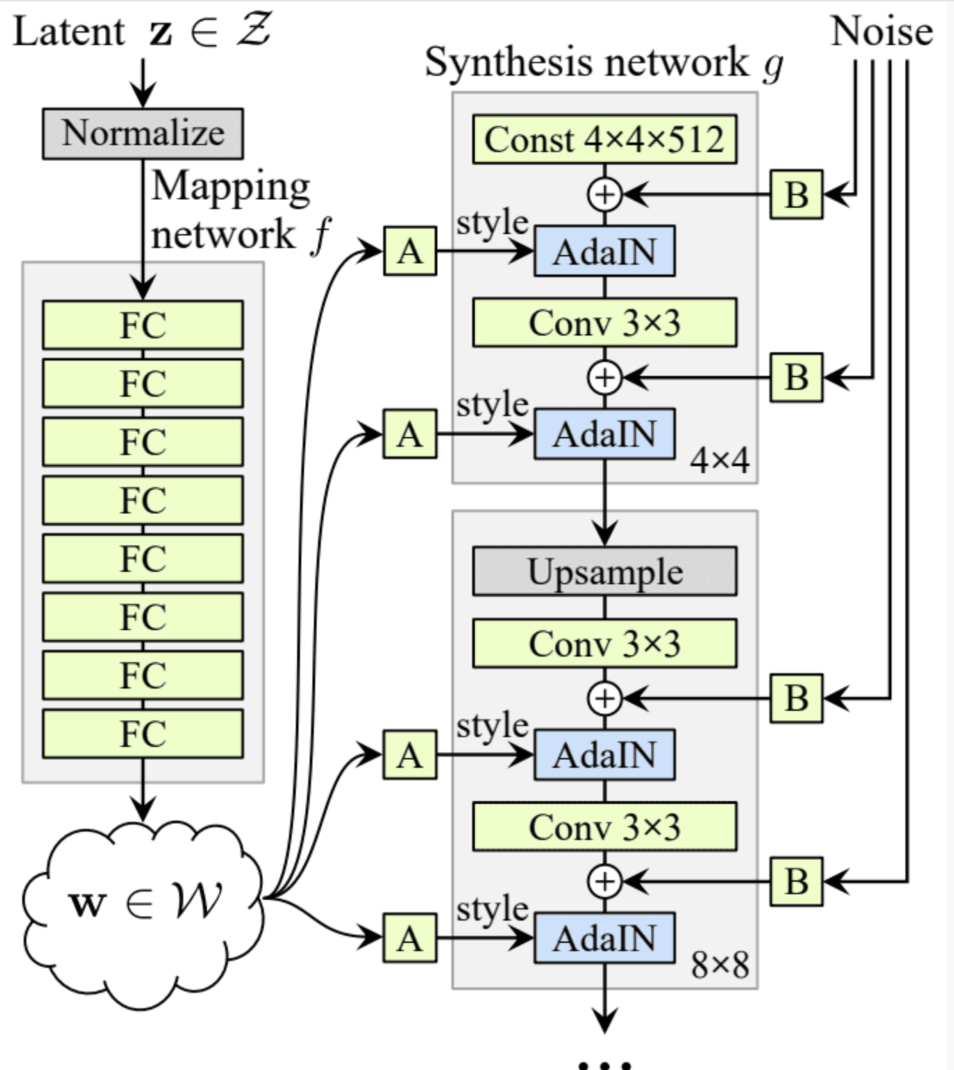
Style-Based GANs
Style-Based Generator Architecture
Introduces a mapping network that transforms latent vector z into an intermediate latent space w
Uses style modulation to control feature statistics at each convolutional layer
Applies Adaptive Instance Normalization (AdaIN) to inject style information into the synthesis network
Allows disentangled control over coarse, mid-level, and fine image features

Slide 27
Style-Based GANs
High-Resolution Synthesis
Generator progressively refines spatial resolution across multiple convolutional blocks
Enables synthesis of images at 1024×1024 resolution and beyond
Stochastic noise injection improves local texture realism
Memory and Compute Implications
Increasing resolution causes quadratic growth in activation memory
Deep synthesis networks require large intermediate feature maps
Training high-resolution StyleGAN models often requires multi-GPU memory scaling strategies

Slide 28
Where Computation Happens in GANs
In GAN training, the computational cost arises from convolutional operations and their associated backpropagation steps. Understanding where computation is concentrated is essential for optimizing performance and effectively utilizing GPU acceleration.
Compute Distribution in GAN Training
Convolutional layers dominate FLOPs in both generator and discriminator networks
Generator compute is concentrated in upsampling blocks that progressively increase spatial resolution
Discriminator compute is concentrated in deep convolutional feature extraction layers that process high-dimensional inputs
Forward vs Backward Pass Cost
Forward propagation performs feature extraction and image synthesis
Backpropagation computes gradients for both networks and typically requires 2–3× the compute of the forward pass
Training therefore involves multiple expensive passes per iteration (generator + discriminator updates)

Slide 29
Where Computation Happens in GANs
Memory–Compute Interaction
Intermediate activations must be stored during the forward pass for gradient computation
Large feature maps in high-resolution generators increase memory bandwidth pressure
Efficient GPU utilization depends on balancing compute intensity with memory access patterns
Key Insight
GAN training performance is primarily determined by GPU throughput for convolution operations and memory bandwidth for activation storage, making GPU architecture and memory efficiency central factors in training scalability.

Slide 30
Memory Consumption Breakdown (Parameters, Activations, Optimizer)
During GAN training, GPU memory consumption arises from three primary components: model parameters, intermediate activations required for backpropagation, and optimizer states. Efficient memory management is essential for enabling larger batch sizes, deeper architectures, and higher-resolution image generation.
Model Parameters
Includes weights and biases of both generator and discriminator networks
Memory requirement scales with network depth and number of convolutional filters
Stored in GPU memory for both forward and backward computation
Activation Tensors
Intermediate feature maps produced during forward propagation
Must be retained for gradient computation during backpropagation
Memory usage increases rapidly with image resolution and batch size
Typically represents the largest portion of GPU memory consumption
Optimizer States
Adaptive optimizers (e.g., Adam) store additional moment estimates for each parameter
Requires storing first and second moment statistics
Effectively multiplies parameter memory footprint by a constant factor

Slide 31

Architectural Scaling: Resolution vs Compute Cost
In GAN architectures, computational cost increases rapidly with image resolution due to the expansion of spatial feature maps and the repeated application of convolutional operations. As resolution grows, both the number of floating-point operations (FLOPs) and memory requirements scale significantly, making high-resolution generation computationally demanding.
Resolution and Computational Complexity
Image resolution determines the spatial size of intermediate feature maps
Convolutional operations scale approximately with:
Impact on Generator and Discriminator
Generator: upsampling stages progressively increase spatial dimensions, amplifying compute cost
Discriminator: high-resolution inputs require deeper convolutional stacks for feature extraction
Training therefore scales roughly quadratically with image resolution
Memory Implications
Larger feature maps increase activation storage requirements
Higher resolution often requires smaller batch sizes to fit GPU memory
Memory bandwidth becomes a limiting factor for training throughput

Slide 32
Exercise 2: Architectural Modifications and Performance Analysis

Slide 33
HPC System Architecture for Deep Learning
High-Performance Computing (HPC) systems provide the computational infrastructure required for training large-scale deep learning models. These systems integrate heterogeneous compute resources, high-bandwidth memory, and high-speed interconnects to support massively parallel workloads typical in modern neural network training.
Core Components of an HPC Deep Learning System
Compute Nodes
Each node typically contains multiple GPUs and multi-core CPUs
CPUs manage data preprocessing, orchestration, and communication tasks
GPUs execute computationally intensive operations such as matrix multiplications and convolutional kernels
Accelerator Hardware
GPUs provide massively parallel execution units optimized for tensor operations
Tensor cores accelerate mixed-precision matrix multiplications
High memory bandwidth enables efficient handling of large activation tensors
High-Speed Interconnects
GPUs within a node communicate via PCIe or NVLink
Multi-node communication occurs through Infiniband or high-speed Ethernet
Low-latency interconnects are critical for distributed gradient synchronization
Storage and Data Infrastructure
Parallel file systems (e.g., Lustre, GPFS) support high-throughput data access
Local SSD storage often used for dataset caching
Efficient data pipelines are required to prevent compute resource starvation

Slide 34
CPU vs GPU
Efficient deep learning training relies on a clear functional separation between CPU and GPU resources. While GPUs execute highly parallel numerical computations, CPUs coordinate data preparation, system orchestration, and host-side processing required to maintain continuous GPU utilization.
GPU Responsibilities
Execute compute-intensive tensor operations such as matrix multiplications and convolutions
Perform forward and backward propagation during neural network training
Maintain model parameters, gradients, and intermediate activations in device memory
Accelerate training through specialized hardware units (e.g., tensor cores for mixed-precision computation)
CPU Responsibilities
Manage data loading, decoding, and preprocessing pipelines
Perform dataset transformations and augmentation operations
Coordinate training orchestration, including batching, scheduling, and process control
Handle logging, monitoring, checkpointing, and evaluation tasks
CPU–GPU Interaction
CPU prepares and transfers training batches to GPU memory
Asynchronous data transfers allow overlap of computation and data preparation
Efficient host–device communication is necessary to avoid GPU idle time

Slide 35
CPU Roles
In modern deep learning pipelines, CPUs perform a range of critical tasks beyond simple dataset retrieval. They are responsible for managing data preparation, orchestration, and system-level operations that ensure continuous GPU utilization and stable training execution.
Data Preparation and Transformation
Perform image decoding, normalization, and preprocessing operations
Execute data augmentation pipelines (cropping, flipping, color transformations)
Construct mini-batches and maintain dataset iterators
Data Pipeline Parallelization
Spawn multiple data loading workers to parallelize preprocessing tasks
Use memory pinning to accelerate host–device data transfers
Prefetch batches to ensure GPUs receive data without delay
Training Orchestration
Coordinate training loops, scheduling, and process management
Manage distributed training processes and inter-process communication
Handle gradient synchronization triggers in distributed environments
Auxiliary Computation
Compute evaluation metrics (e.g., FID, Inception Score)
Perform logging, monitoring, and experiment tracking
Manage checkpoint serialization and model persistence
The CPU functions as the control and data management layer of the training system, ensuring that GPUs remain continuously supplied with prepared data and that system-level operations do not interrupt computational throughput.

Slide 36
GPU Execution Model and Throughput Optimization
GPUs are designed for massively parallel numerical computation. Their execution model organizes thousands of lightweight threads into structured groups that execute identical instructions concurrently, enabling high-throughput processsing of tensor operations common in deep learning workloads.
GPU Parallel Execution Model
Computation is executed by Streaming Multiprocessors (SMs)
Each SM schedules groups of threads called warps (typically 32 threads)
Warps execute instructions in a Single Instruction, Multiple Data (SIMD) fashion
Large numbers of concurrent threads hide memory latency and maximize hardware utilization
Tensor Computation in Deep Learning
Deep learning workloads consist primarily of matrix multiplications and convolutions
GPUs exploit data parallelism across tensor dimensions
Specialized hardware units (e.g., tensor cores) accelerate mixed-precision arithmetic
Throughput Optimization Strategies
Maximize GPU occupancy by launching sufficient parallel threads
Use large batch sizes to increase arithmetic intensity
Reduce kernel launch overhead through efficient batching of operations
Ensure continuous data supply to avoid GPU idle cycles
Achieving high training throughput requires aligning neural network workloads with the GPU execution model, ensuring that parallel computational resources remain fully utilized throughout forward and backward propagation.

Slide 37
Memory Hierarchy and Bandwidth Constraints
GPU performance in deep learning workloads is strongly influenced by the memory hierarchy and available bandwidth between different memory levels. Efficient utilization of these memory layers is essential for sustaining high computational throughput during training.
GPU Memory Hierarchy
Registers – fastest storage located within each processing core, used for temporary variables during computation
Shared Memory / L1 Cache – low-latency memory shared among threads within a block
Global GPU Memory (HBM/GDDR) – large-capacity device memory storing model parameters, activations, and gradients
Host Memory (CPU RAM) – stores datasets and intermediate data before transfer to the GPU
Bandwidth and Latency Characteristics
Register and shared memory access have very low latency and extremely high bandwidth
Global memory accesses are slower and often become a performance bottleneck
Data transfers between CPU and GPU occur over PCIe or NVLink, introducing additional latency
Implications for Deep Learning Training
Large activation tensors require frequent global memory access during forward and backward passes
Inefficient memory access patterns reduce effective GPU utilization
Training performance depends not only on compute capacity but also on memory bandwidth availability

Slide 38
Data Pipeline Engineering and GPU Starvation
The efficiency of deep learning training pipelines depends on the continuous delivery of data to the GPU. When data preparation or transfer becomes slower than GPU computation, the accelerator remains idle between batches—a phenomenon known as GPU starvation. Effective data pipeline engineering is therefore critical for maintaining high training throughput.
Sources of Pipeline Bottlenecks
Data decoding and preprocessing (e.g., image decompression, normalization) are typically CPU-bound
Insufficient parallel data loading limits the rate at which batches are prepared
Slow storage systems introduce latency during dataset retrieval
Inefficient host–device data transfers delay batch delivery to GPU memory
Pipeline Optimization Strategies
Use multiple parallel data loading workers to overlap preprocessing tasks
Enable prefetching to prepare future batches while the GPU processes the current batch
Use pinned (page-locked) memory to accelerate CPU–GPU data transfers
Cache frequently accessed datasets on local high-speed storage (SSD/NVMe)
System-Level Interaction
CPU performs preprocessing while GPU executes forward and backward passes
Proper pipeline design enables overlap between computation and data preparation
Balanced pipelines ensure GPUs remain continuously utilized

Slide 39
Storage and Filesystem Impact on Training Speed
The performance of the storage subsystem directly influences the efficiency of deep learning training pipelines. Slow storage access can delay data loading and preprocessing, creating bottlenecks that reduce GPU utilization and overall training throughput.
Storage Access Patterns in Deep Learning
Training datasets often consist of large numbers of small files (e.g., images, audio samples)
Each training iteration requires frequent read operations to construct mini-batches
Random access patterns increase the importance of low-latency storage systems
Types of Storage in HPC Environments
Local SSD / NVMe storage – high throughput and low latency for dataset caching
Network-attached storage (NAS) – shared access across nodes but higher latency
Parallel file systems (e.g., Lustre, GPFS) – designed for high-throughput distributed workloads
Impact on Training Performance
Storage latency can slow data loading and cause GPU starvation
Shared storage contention may reduce data throughput in multi-node training
Dataset caching on local storage can significantly improve pipeline efficiency

Slide 40
Parallelism Strategies: Data, Model, Pipeline
Scaling deep learning training across multiple accelerators requires structured parallelization strategies. These approaches distribute computation and memory across devices to increase training throughput and enable models that exceed the capacity of a single GPU.
Data Parallelism•
Replicates the full model across multiple GPUs
Each device processes a different subset of the training batch
Gradients are synchronized across devices after backpropagation (e.g., all-reduce)
Most widely used strategy due to simplicity and strong scaling behavior
Model Parallelism
Splits the neural network across multiple GPUs
Different devices compute different portions of the model
Enables training of models that exceed the memory capacity of a single GPU
Requires communication between devices during forward and backward passes
Pipeline Parallelism
Divides the model into sequential stages across GPUs
Different mini-batches are processed simultaneously at different pipeline stages
Improves hardware utilization by overlapping computation across stages
Requires careful scheduling to minimize pipeline idle time

Slide 41
Exercise 3: Bottleneck Identification in the Training Pipeline

Slide 42
Single-GPU Optimization Strategy Before Scaling
Before attempting multi-GPU or distributed training, it is essential to optimize performance on a single GPU. Single-device optimization establishes a performance baseline and ensures that computational resources are fully utilized before introducing additional system complexity.
Establishing a Performance Baseline
Measure training throughput (e.g., samples/sec or images/sec)
Monitor GPU utilization and memory consumption
Identify bottlenecks using profiling tools (e.g., PyTorch profiler, NVIDIA Nsight)
Maximizing GPU Utilization
Increase batch size within available GPU memory limits
Ensure efficient data pipeline throughput to avoid GPU idle time
Use optimized libraries and GPU kernels for tensor operations
Memory and Precision Optimization
Enable mixed-precision training to reduce memory usage and increase compute throughput
Monitor activation memory footprint to avoid unnecessary allocations
Use gradient checkpointing if memory becomes a limiting factor
System-Level Efficiency
Overlap CPU data preprocessing with GPU computation
Ensure efficient host–device data transfers
Minimize unnecessary synchronization or blocking operations

Slide 43
Mixed Precision (AMP): Theory and Practical Gains
Mixed precision training accelerates deep learning workloads by performing most tensor operations in lower numerical precision while maintaining critical computations in higher precision. This approach improves computational throughput and reduces memory usage without significantly affecting model convergence.
Numerical Precision in Deep Learning
Standard training typically uses 32-bit floating point (FP32) precision
Mixed precision combines FP16 (half precision) with FP32
Lower precision reduces memory footprint and increases arithmetic throughput
Automatic Mixed Precision (AMP)
Framework-level utilities automatically manage precision casting
Tensor operations are executed in FP16 where numerically stable
Critical operations (e.g., loss computation, gradient accumulation) remain in FP32
Gradient Scaling
Small FP16 gradients may underflow during backpropagation
Dynamic loss scaling
Multiplies the loss before gradient computation
Gradients are rescaled afterward to maintain numerical stability
Performance Benefits
Reduced GPU memory consumption allows larger batch sizes
Increased arithmetic throughput through tensor core acceleration
Typical speed improvements range from 1.3× to 2× depending on workload

Slide 44
Batch Size Scaling and Stability Trade-offs
Batch size is a critical hyperparameter that influences both computational efficiency and optimization dynamics in deep learning training. While larger batch sizes improve hardware utilization and throughput, they can also alter gradient statistics and affect convergence behavior, particularly in adversarial training settings such as GANs.
Impact on Computational Throughput
Larger batch sizes increase arithmetic intensity and improve GPU utilization
Reduces overhead associated with kernel launches and data transfers
Enables more efficient parallel processing on GPU architectures
Impact on Optimization Dynamics
Gradient estimate becomes less noisy as batch size increases
Reduced stochasticity may slow exploration of the loss landscape
In GANs, large batches can influence the balance between generator and discriminator updates
Learning Rate Interaction
Batch size scaling often requires learning rate adjustment
Common heuristic: scale learning rate proportionally with batch size
Improper scaling can lead to unstable training or slow convergence
Memory Constraints
Batch size is limited by GPU memory capacity, especially for high-resolution GAN models
Larger batches increase activation memory requirements during backpropagation

Slide 45
CUDA Memory Optimization Techniques
Efficient utilization of GPU memory is essential for training deep learning models at scale. CUDA memory optimization techniques aim to reduce memory overhead, minimize allocation latency, and maximize effective device memory usage during forward and backward propagation.
Efficient Memory Allocation
Reuse GPU memory buffers to reduce frequent allocation and deallocation overhead
Avoid unnecessary tensor copies during computation
Utilize framework-level memory caching mechanisms to improve allocation efficiency
Activation Memory Management
Intermediate activations consume a large portion of GPU memory during training
Gradient checkpointing recomputes selected activations during backpropagation to reduce memory usage
Enables training of deeper networks under limited memory constraints
Memory Access Optimization
Align tensor operations to ensure coalesced memory access patterns
Reduce global memory transactions by maximizing data reuse within kernels
Exploit shared memory when implementing custom CUDA kernels
Mixed Precision and Memory Footprint
FP16 tensors reduce storage requirements compared to FP32
Mixed precision training lowers activation and gradient memory usage
Enables larger batch sizes and higher-resolution models within fixed GPU memory capacity

Slide 46
Overlapping CPU–GPU Workloads Efficiently
Efficient deep learning training requires concurrent utilization of CPU and GPU resources. Overlapping host-side data preparation with device-side computation reduces idle time and maximizes overall system throughput.
Asynchronous Execution Model
GPU kernels execute asynchronously with respect to the host CPU
CPU can continue preparing future batches while the GPU processes the current batch
Proper scheduling allows computation and data preparation to proceed in parallel
Host–Device Data Transfer Optimization
Use non-blocking data transfers to avoid CPU-side synchronization delays
Employ pinned (page-locked) host memory to accelerate DMA transfers to GPU memory
Transfer data while previous kernels are still executing
Pipeline Parallelism in the Training Loop
CPU performs data loading, preprocessing, and batching concurrently with GPU computation
DataLoader prefetching prepares upcoming batches ahead of time
Ensures continuous data availability for the GPU
Synchronization Considerations
Avoid unnecessary CPU–GPU synchronization points during training
Excessive synchronization reduces overlap and lowers effective throughput
Efficient pipelines maintain high GPU utilization throughout training
Maximizing training efficiency requires designing pipelines where CPU-side data preparation and GPU-side model computation occur simultaneously, ensuring that neither processor becomes a performance bottleneck.

Slide 47
Exercise 4: AMP integration and throughput benchmarking

Slide 48
Wrap-up
Efficient GAN training requires a combined understanding of generative modeling, computational architecture, and systems-level optimization. High performance is achieved not only through algorithmic improvements but also through careful engineering of the full training pipeline.
Key Technical Takeaways
GAN Fundamentals
GANs train two neural networks through adversarial optimization
Stability depends on maintaining balance between generator and discriminator
Architectural design strongly influences compute cost and memory usage
Computational Characteristics
Convolutional operations dominate training compute
Activation storage and optimizer states drive memory consumption
Resolution scaling increases compute and memory requirements significantly
Systems Perspective
Efficient training requires coordination between CPU, GPU, storage, and network resources
Data pipelines must continuously feed GPUs to avoid idle compute cycles
Memory bandwidth and communication overhead often limit scalability

