Slide 1

git init git-interactive-game_
A Gamified, Localized Engine for Mastering Git & CLI Workflows
CEP146 — ESSENTIAL TOOLING FOR PROGRAMMERS
ALEKSANDRA TRUNOVA & GABRIEL BRITO PINTO · SENECA POLYTECHNIC

Slide 2


The Command Line Barrier
The "Black Box" Problem
High Friction Curve
Disconnected Resources
Beginners type abstract syntax into a plain terminal with no visibility into real-time folder structure changes.
Misplaced spaces or forgotten flags like -m or --global trigger cryptic error traces that stall momentum.
Students constantly context-switch to external docs for simple reference guides.

Slide 3

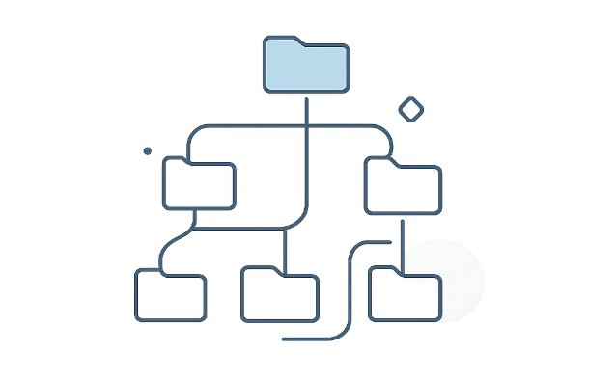
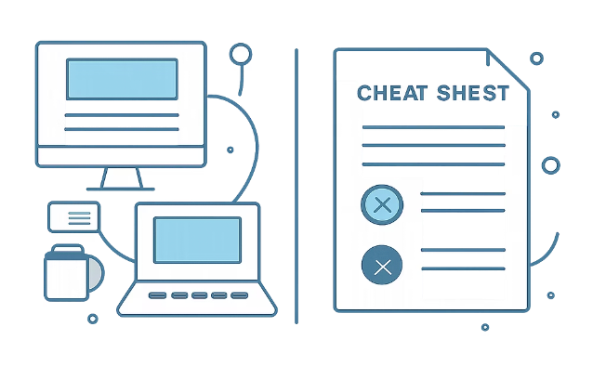
Introducing the Git Interactive Trainer
Interactive Loop
Mental Mapping
Scannability
Simulated Web Terminal
A localized sandboxed browser terminal that intercepts inputs and validates strings instantly.
Real-Time Visual Feedback
Executing commands instantly renders interactive tree structures, directories, and branch lines.
All-In-One Workspace
Integrates step-by-step level menus and dynamic cheat-sheet modules side-by-side on a single page.

Slide 4

Under the Hood: Data-Driven Design
JSON Dataset
Validation Engine
Interactive User Interface
The architecture flows from structured data through validation logic to immediate UI response with no external APIs, no server round-trips.
The JSON Dataset
Input Sanitization & State Binding
Levels, objectives, expected strings, and terminal tips are parsed dynamically from a structured JSON tree.
The engine trims, sanitizes, and matches user text against level requirements. Valid matches advance levelId and update visuals automatically.

Slide 5
Structured Progression Path
Four levels scaffold complexity from environment setup to distributed collaboration.
Level 1 · Base Environment
Level 3 · Branching Workflows
pwd · mkdir · cd · git config · git init
branch · checkout · switch · merge · --abort
1
2
3
4
Level 2 · The Core Pipeline
Level 4 · The Cloud Ecosystem
touch · status · diff · add · commit · log
clone · remote add · push · fetch · pull

Slide 6
Roles and Responsibilities
Aleksandra Trunova
Gabriel Brito Pinto
Project Documentation & Web Page Infrastructure
Level Logic Systems & Video Production
Designed the integrated UI layout using Tailwind CSS
Authored core reference technical schemas and scannable markdown documentation
Maintained repository environment configurations and deployment
Engineered the core validation loops and logic for working with dataset
Mapped structural system rules to dynamic visual representation flags
Produced and polished the comprehensive project demonstration video guide

Slide 7


Application Demonstration
Watch the live walkthrough covering terminal feedback loops, command filtering, and responsive layout scaling.
Terminal Feedback Loop
Dynamic Filtering
Responsive Framework
Visual response on correct vs. incorrect command entries
Real-time command parsing and interface operations
Layout scaling seamlessly across all active views

Slide 8


git checkout -b questions
Thank you for watching, we are open for questions.
GitHub Repository
Live App Deployment
github.com/cep-git-game
Hosted on GitHub Pages accessible from any browser, no install required
CEP146 — Essential Tooling for Programmers · Aleksandra Trunova & Gabriel Brito Pinto · Seneca Polytechnic

