Slide 1

GitHub
Version Control and Collaboration
with
Jojo Karlin
ITP Workshop
The Graduate Center
@jojokarlin jkarlin@gradcenter.cuny.edu

Slide 2
Workshop
Objectives
Get a sense of the layout of GitHub
Get the basic purpose of git
Get a GitHub account
Start your own repository
Follow a repository (and see where it goes!)
What you will learn

Slide 3
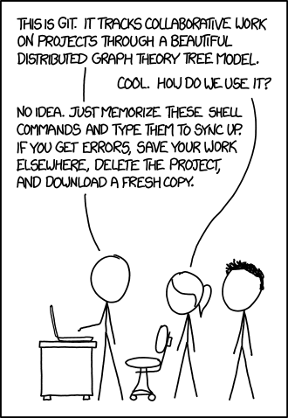
http://xkcd.com/1597/

Slide 4

What is ?
Git is the open source distributed version control system that facilitates GitHub activities on your laptop.
Basically, it is doing the work behind GitHub. It follows and records every change you make on your computer.
Linux creator Linus Torvald released git in 2005 for Linux kernel development (which has thousands of collaborators). He named it for himself.

Slide 5

What is GitHub?
GitHub is the online face of Git.
GitHub is a way to access a vast scope of projects.
GitHub helps you collaborate with line by line documentation of revisions.
GitHub is a place to store your projects, explore new ones, and collaborate.

Slide 6
GitHub and you
git is a very powerful software, but one of its best assets is that it works for EVERYONE from the click-through beginner to the expert who dreams in code.
That said, there are many features on GitHub that you can leave alone until you are ready to participate in more advanced projects.
Don’t worry! GitHub can work for you, too.

Slide 7
Let’s begin.

Slide 8
Make your very own GitHub account by going to github.com.

Slide 9
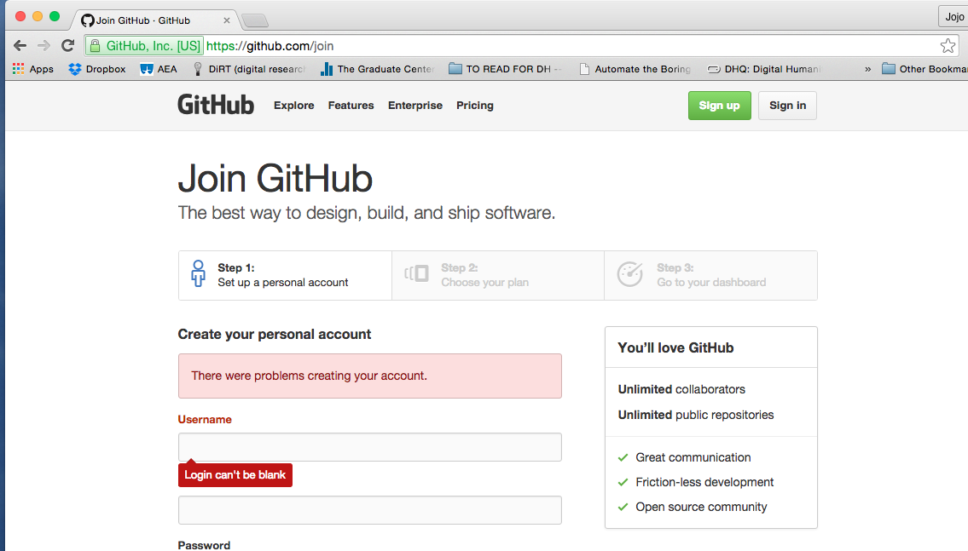
Click “Sign Up”

Slide 10
Make yourself at home.

Slide 11
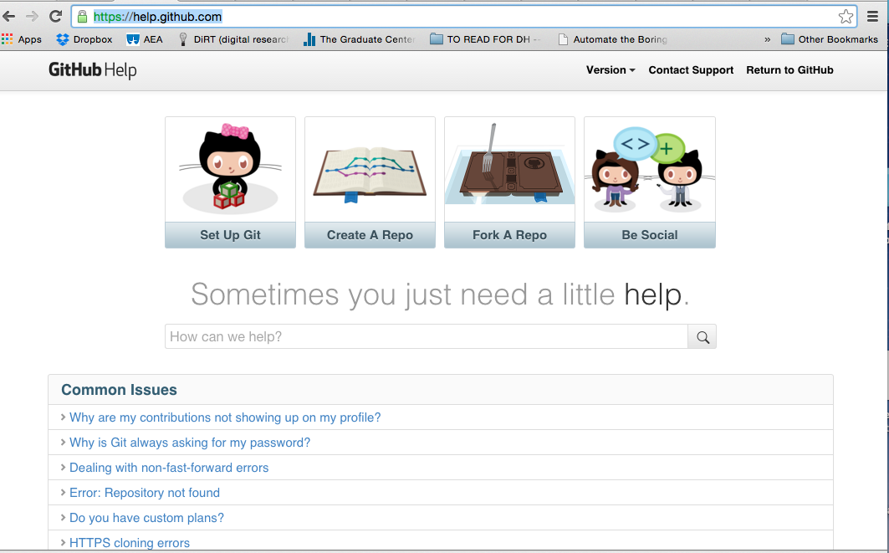
There is so much help available it can be overwhelming. Remember, it’s fine to stick to the simplest parts.

Slide 12
A repository is a project.

Slide 13
Create a repository!
To create a new repository on GitHub:
Click the icon next to your username, top-right.
Name your repository hello-world.
Write a short description.
Select Initialize this repository with a README.
In just a moment, we will create a repository using git
on the Command Line!

Slide 14
README.
This file should serve as a title page and abstract for your project.
Your repository or project may wind up consisting of a number of files of different types and sizes. The README. should explain what everything is meant to do-- a mission statement and index all in one.

Slide 15
Good practice
Good project
Believe me. Using GitHub will help your digital projects.
DOCUMENTATION!
Even when you’re not sure what you are documenting, the exercise of articulating your edits will help you proceed.
initiate a repository with a README.
create a requirements file outlining exactly which version of which software you are using.
BE SUPER CLEAR ABOUT YOUR ENVIRONMENT.

Slide 16

GitHub KEY TERMS
GitHub can be confusing because there are a lot of metaphors happening at once.
Family Tree type metaphors:
BRANCH
ROOT
ORIGIN
MASTER
Relationships language:
PUSH
PULL
COMMIT
Archive words:
REPOSITORY
Octocat?
Dinner table?
FORK

Slide 17
Git-ionary
CLONE is your version of an existing project copied to your very own computer.
FORK is a CLONE on the GitHub server side.
BRANCHes are for separate modules of BIG projects. (Don’t worry about this)
AVOID CONFLICT! Don’t merge multiple branches simultaneously.
Don’t worry about PULL REQUESTS on small projects.

Slide 18
Using git at the Command Line
open Terminal

Slide 19
local git commands
(at your computer at home)

Slide 20
$ git init [myproject]
$ cd myproject
here’s where you name your project
[you don’t need the brackets]
this creates the directory with git already enabled,
which starts the project, but also creates the control file which will store the information related to when you make any changes on the document.

Slide 21
$ git add .
$ git commit -m “[descriptive message]”
This command connects with the software and puts your file in a holding zone readying it to be permanently committed to the project
(the ‘.’ means all, you can also choose to add one file you select)
This command commits your changes to the official project. Be clear about what you’ve done. This is the “record this snapshot” command.

Slide 22
$ git clone [github url]
download an existing project (with all its controls ready to go!)

Slide 23

commit
some changes

Slide 24
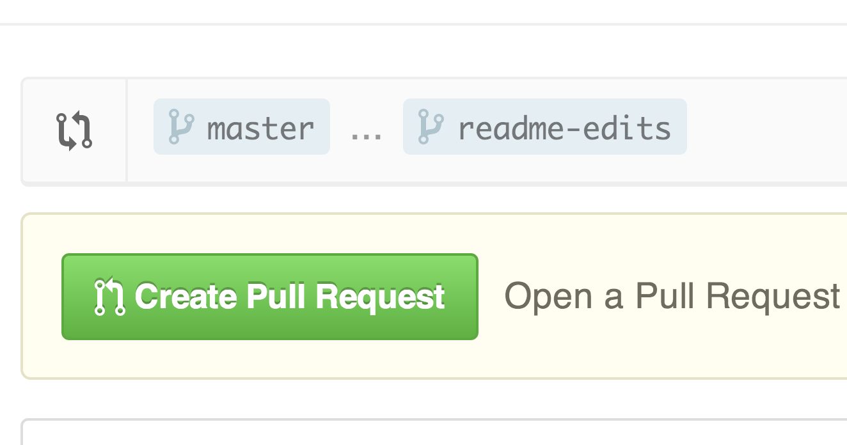



Here’s where later on you might create or fork
a branch to work on a portion of the project…
A pull request would then ask your master branch to check your changes
receive feedback
(git requires the administrator of the master branch to review)
don’t worry about this!
...but for now, stick to using GitHub to compile the history for your own personal project. You can think of it as a nifty, nit-picky backlog of all the changes you make. It’s a super powerful undo button.

Slide 25
typetypetypetypetypestoppingpoint
ADD
COMMIT (with -m “clear message”)
PUSH

Slide 26
make sure you committed your changes locally first!

Slide 27
your master branch gives the go and commits your changes to the master

Slide 28

ready to merge!

Slide 29
$ git add [file]
$ git commit -m “[your message!]”
$ git push [your local alias] [master]

Slide 30
$ git pull
$ git status
$ git diff
Makes sure you’re up to date when you sit down at your desk
Shows you all the files you’ve changed that need to be committed to the master branch
Shows file differences that haven’t yet been staged (added)

Slide 31
Read more about GitHub
and how much it can do for you
http://infospace.ischool.syr.edu/2012/10/10/the-librarians-arsenal-git-github/
http://readwrite.com/2013/09/30/understanding-github-a-journey-for-beginners-part-1
https://github.com/learn-co-students/git-github-and-learn-oc-000
https://github.com/learn-co-students/git-version-control-101-v-000

Slide 32
Got git?
http://git-scm.com/video/what-is-git
https://vimeo.com/github

Slide 33
PICK a project and see where it goes!
Social Paper
Git-Lit
Open Lab
https://github.com/cuny-academic-commons/social-paper
https://github.com/Git-Lit
https://github.com/livinglab/openlab/

Slide 34
Did we succeed?
What’s your sense of the layout of GitHub?
Do you get how git and GitHub differ? *hint: GitHub is an online hub for git
Did you get a GitHub account?
Did you start your own repository?
Follow a repository?
How well did you get git?

Slide 35
Thank you for adding your commitment, push and pull to master version control.
Your projects will thank you.

Slide 36
Please contact me if you have any questions!
jkarlin@gradcenter.cuny.edu
@jojokarlin
The Graduate Center
ITP Core 1

