Slide 1


Advanced .Net Debugging
Using Visual Studio, R# and OzCode
IT Week, Summer 2015

Slide 2
Why debug?
1
It is ‘legacy’ code
2
There is no logging or tests
3
The problem was not localized properly by testers
4
You get a repro only once a few hours (seldom)
5
You are exploring new APIs

Slide 3
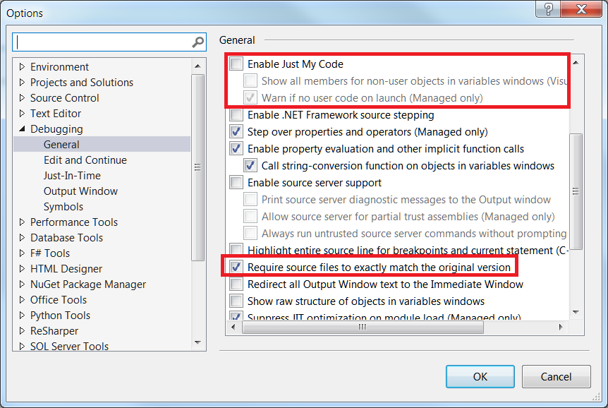
Settings
Notes:
How to setup native code: http://referencesource.microsoft.com/setup.htm

Slide 4
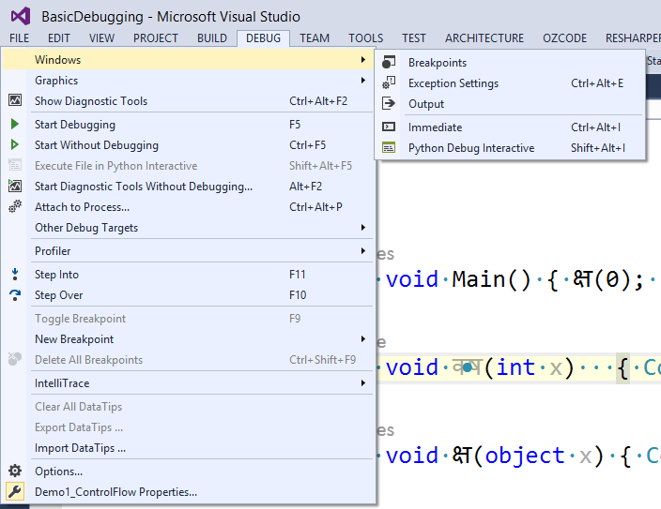
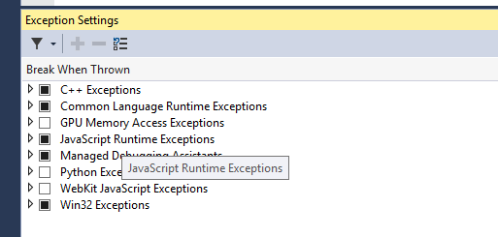
Break on first chance exceptions
Notes:
OzCode: break on all CLR exceptions

Slide 5
Demo 1: basic setup
Description
Project: Demo1_ControlFlow
Problem: the code goes to unexpected place
Breakpoints
Step Into
Debugging Tools
Notes:
Features:
1. Starting debugging:
1.1 Using F11 (step into) to find first entry point
1.2 Using Breakpoint and using F5 (Start Debugging)
1.3 Using Ctrl+F10 (Run to Cursor) to avoid setting/resetting breakpoint

Slide 6
Demo 2: pdb files
Description
Project: Demo2_pdb_makes_a_difference!
Problem: where did the exception happened?
pdb files,
‘ReSharper → Tools → Browse Stack Trace’
Debugging Tools
Notes:
Notes: Pdb files are our friends! (link)
1. Run the program (type Steve) in appropriate configuration
2. Show stack trace in R#
3. Point out that we do not know where exception happened - is it line 22 or line 23?
4. Swap into Pdb configuration
5. Run with Steve
6. Show that now we have a line number
7. Show that .csproj was modified by hand

Slide 7
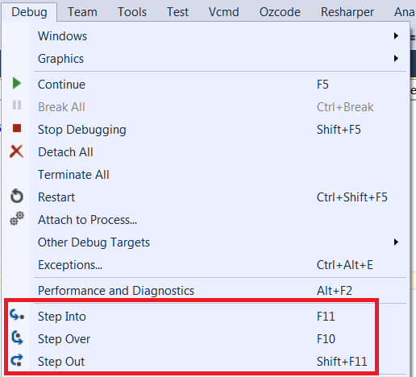
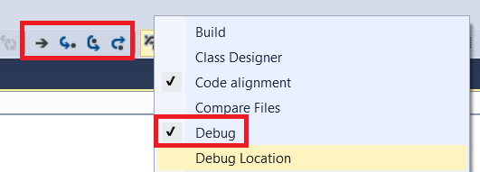
Control flow: Step Out/Into/Over
Use to investigate code without setting a lot of breakpoints
Notes:
1. We already used F11 to find an entry point, lets do it again
2. Using F10 I move in current function, without stepping into implementation of other code (unless there is a breakpoint there)
3. Type “Steve1” as name and run to like 24
4. But what if we want to see inside? (for example if we do not unerstand what is going on)
5. Move yellow marker up to line 23
6. Did you know that you can use StepIntoSpecific(Alt+F11) to get down the call stack?
7. Now to get back we can either F10 out way to victory, press Shift+F11 to get out or use Ctrl+F10
8. Add a $ReturnValue pseudovariable in CalculateIncome method (http://msdn.microsoft.com/en-us/library/ms164891.aspx)
9. Show format specifiers (http://msdn.microsoft.com/en-us/library/e514eeby.aspx) adding h specified for Tax variable
10. Anyway we found a bug - we need to multiply by (100 - Tax), so we can Edit and continue (even on x64) for the win!

Slide 8
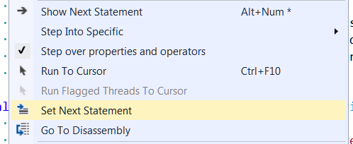
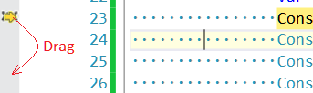
Control flow: Set Next Statement
Use when:
You want to skip some code and do not want to recompile/rerun it.
You missed some important code and it is safe to run it again.
Notes:
Was demoed in Control flow: Step Out/Into/Over

Slide 9
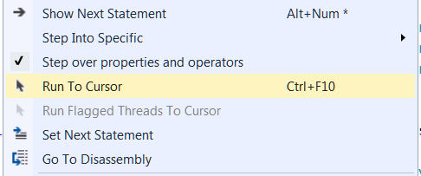
Control Flow: Run To Cursor
Use instead of a bunch of ‘Step Over’ or instead of setting a breakpoint, running to it and then removing it
Notes:
Was demoed in Control flow: Step Out/Into/Over and Demo1: basic setup

Slide 10
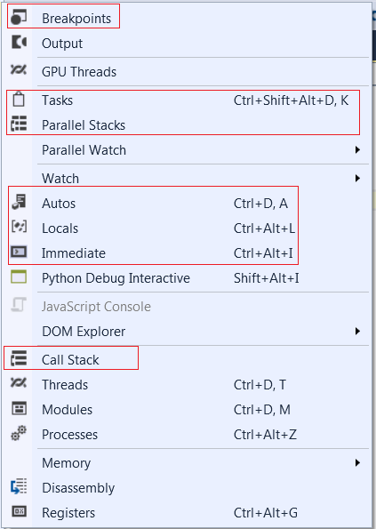
Debug windows
Debug → Windows
You need to be in Debug mode to see them
Notes:
I have already showed watch window, lets take a look what else do we have.
Show the Debug -> Windows menu.

Slide 11
Debug Windows: Immediate Window
Run [almost] any code you want when in a Debugger:
1. Inspect variables
2. Set values
Limitations: implicitly-typed arrays, lambda expressions, etc.
Notes:
One of the essential windows I used very often.
You can always pop up LinqPad and type some code there, but often there is just too much code from working solution to copy paste. You can easilty start debugging right in Immidiate Window.
Demo: new IncomeCalculator(70).CalculateIncome(1000);
But the most power comes when you are in Debug session, you can execute almost anything!
Unlike other windows you have full IntellySense:
Go to CalculatePrice
And modify payroll with 800*DateTime.Now.Second
No mote limitations in VS2015

Slide 12
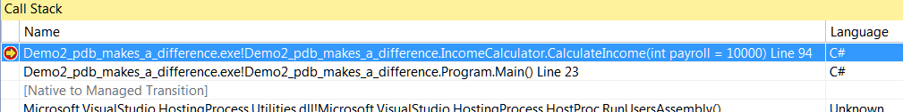
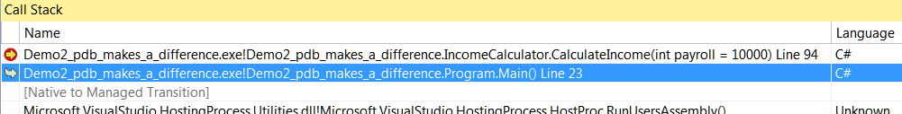
Debug Windows: Call Stack
See where are you now
Go up the stack to see arguments and other values
Notes:
Stay in debug of CalculatePrice from previous example
1. Click around to see that you can inspect values all other the place
2. Right click - a LOF of options
3. Point out “Show parameter values) - REALLY helpful in recursion scenarios
4.

Slide 13
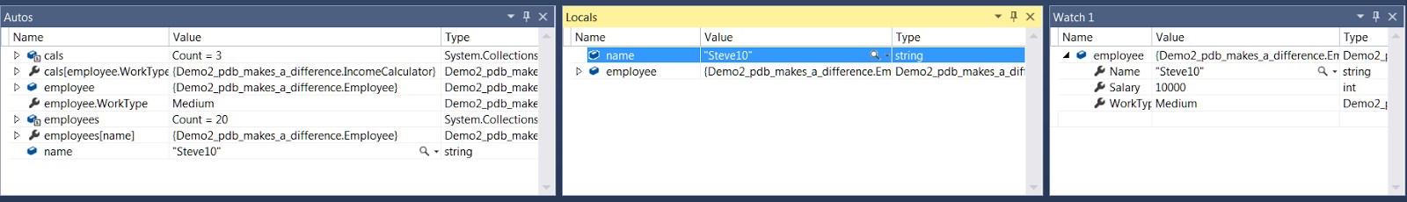
Debug Windows: Autos, Locals, Watch
Watch: you have full control over what is in here
Locals: values that are local to current scope (function, class, etc.)
Autos: whatever is available in current scope (static variables, parameters, locals, etc.)

Slide 14
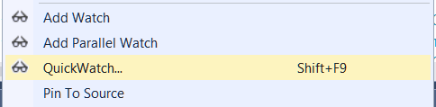
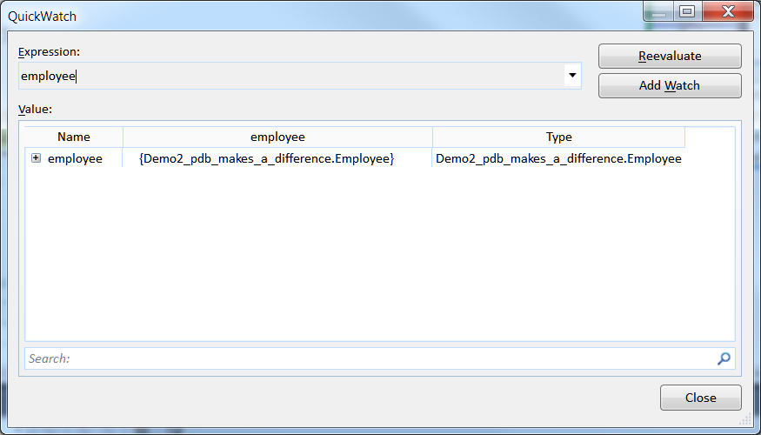
Debug Windows: quick watch
Use:
1. When you need to dive really deep into the object
2. To add a lot of fields or properties in Watch window
Notes:
On line 23 show that if you just dig into object while in preview - clicking anywhere resets you selection.
Show how to get into quick watch and how to add watch.

Slide 15


Pinning quick watch
Easy to inspect variable on the fly, without pointing to them with mouse. It is possible nested values.
Notes:
Go into Employee constructor and show Autos window.
Show that changed values are marked with red color and when mouseovering it shows previous value.
Does not worke with OzCode installed.

Slide 16
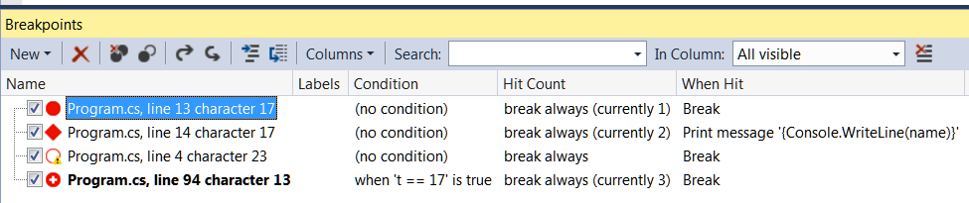
Debug Windows: breakpoints
1. Delete breakpoints (after all of them are not needed)
2. Export/Import breakpoint to switch between Debug Sessions
Notes:
1. Delete all breakpoints (we no longer need them)
2. Show export/import breakpoints
3. More on breakpoints later!

Slide 17
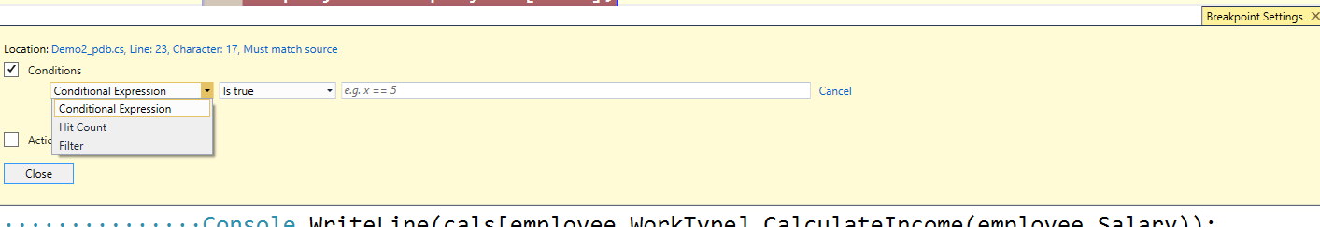
Breakpoint
May have:
1. A condition
2. A ‘When hit’ statement
3. ‘Hit counter’
4. ‘Filter’
Notes:
Right click on any breakpoint

Slide 18
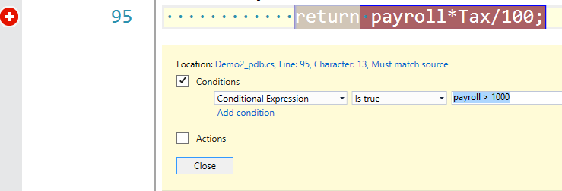
Breakpoint: condition
Allows to avoid breakpoint being hit when based on some local variables, parameters, etc.

Slide 19
Breakpoint: hit count
Useful when you need to skip the first hit, or the first few hits (warmup period) and you have no control to do it with condition.
Notes:
Reset condition
Set hit count to 2, reset counter
Do “Steve1” a few times

Slide 20
Breakpoint: when hit
You can use it as a trace point - to run some basic code, most likely a print message with current state. If you uncheck ‘Continue Execution’ you can run the program for a while and then inspect ‘log’ without any modification to real code.
Notes:
Reset breakpoint,
Add when hit with code {Console.WriteLine(new System.Diagnostics.StackTrace().GetFrame(1).GetMethod().FullName)}
do “Steve1” a few times

Slide 21
Demo 3: Solving a real problem
Description
Project: Demo3_Multiple_Controllers
Problem: expected method is not called
trace points
conditional breakpoints
Debugging Tools
Notes:
Demo description: there are several controllers running work and ResultContainer that aims to sync the results with an internal counter. When counter reaches 0 the work is Done.
Show Controller1 - we run StartExecution in the begining, StopExecution in the end and AddObjectToResult in the middle - the correct implementation.
1. Need to show how to bruteforce it setting simple breakpoints
1.1 Put breakpoint onto StartExecution and FinishExecution
1.2 Run and see that the first is called 4 times and the second only 2 times.
1.3 Now we can analize callpath, but also we can...
2. add trace points to see controllers who called Start and Stop Methods {Console.WriteLine(new System.Diagnostics.StackTrace().GetFrame(1).GetMethod().FullName)}
3. Now we see that the Controller1 works ok, but the problem is in Controllers 0 and 2
4. Explain what is wrong
5. SHow that you can add just $CALLER keyword and the output will be placed in Output window

Slide 22
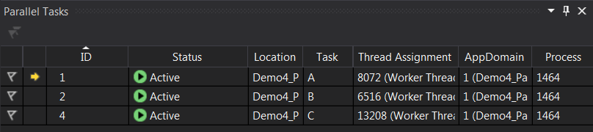
Parallel Stacks and Parallel Tasks
Allows to watch all Task-based threads (all threads are available in Threads window) and switch between them.
Notes:
Switch to Demo4
When you debugging several threads - a lot of windows are needed! Full screen (alt+shift+enter) have an entire new layout for you!
We should have opened:
1. Debug -> Tasks
2. Debug -> Windows -> Parallel Stacks -> Threads
3. Debug -> Windows -> Threads
4. Debug -> Windows -> Parallel Watch
5. Debug -> Windows -> Warch

Slide 23
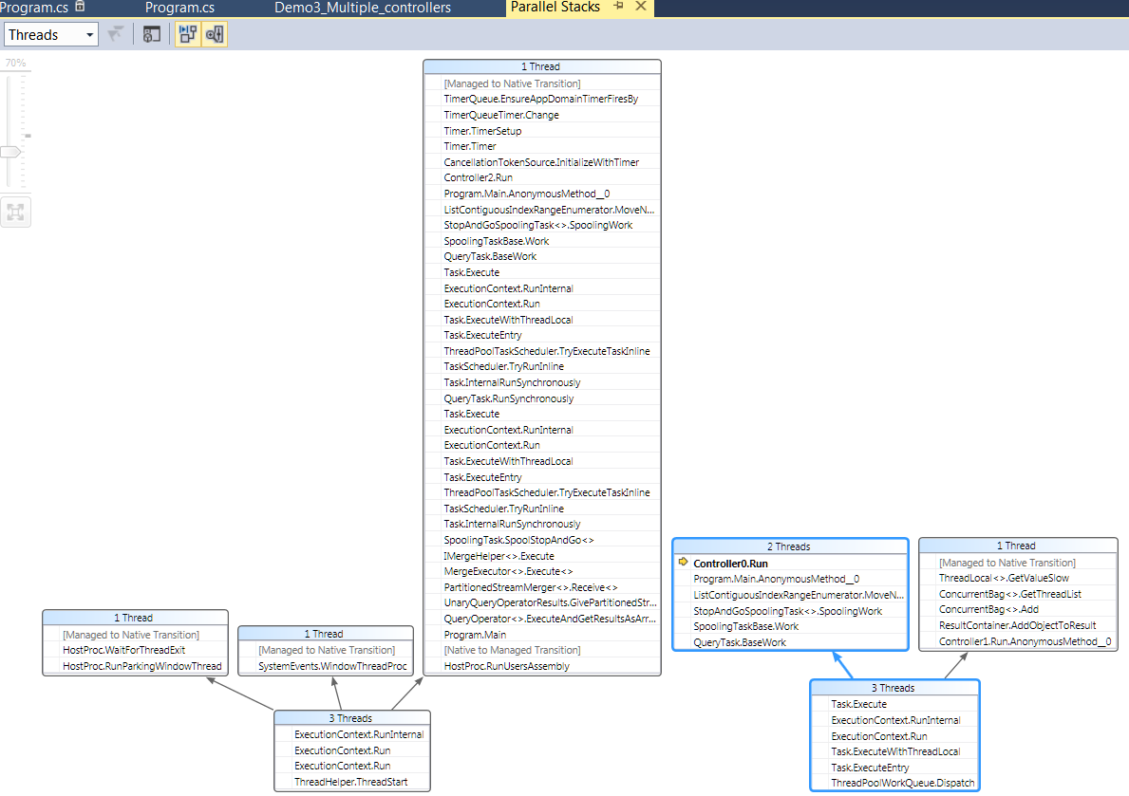
Parallel Stacks and Parallel Tasks
Notes:
By the way - there are several Parallel Watch and Watch windows… why? because you can configure them differently (or just add different variables to avoid scroll bars)

Slide 24
Parallel Stacks: Demo
Description
Project: Demo4_ParallelStacks
Problem: deadlock
Parallel Stacks
Debugging Tools
Notes:
Step through every breakpoint to show what is going on in Tasks Window (Active, Scheduled, Blocked, etc.)
Show the difference between parallel watch and watch windows.
Select one of blocker threads.
Flag it in Tasks window.
Freeze it in Threads window. Hm… lets freeze everything but one thread in Tasks window.
But the way - there is not only “Run to cursor”, but “Run flagged threads to cursor”

Slide 25
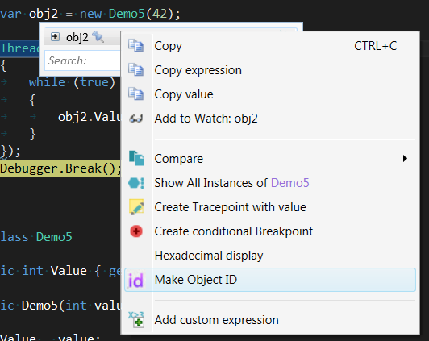
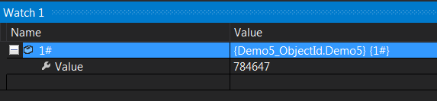
Object Id
Add Id to the object in scope
Access it anywhere else by given id while object still in memory
Notes:
Run to get into line 27
Add obj2 to watch window
Make object id
Run again
Break at line 13
Add 1# into watch window

Slide 26
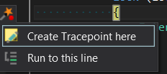
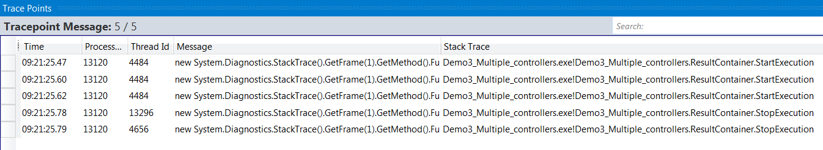
OzCode: Trace Points
Separate window to view results with timestamp, threadId and stack trace included by default.
Notes:
Show using Demo3: {new System.Diagnostics.StackTrace().GetFrame(1).GetMethod().FullName}

Slide 27
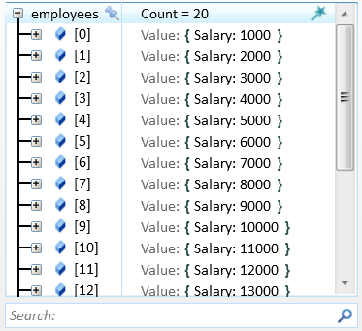
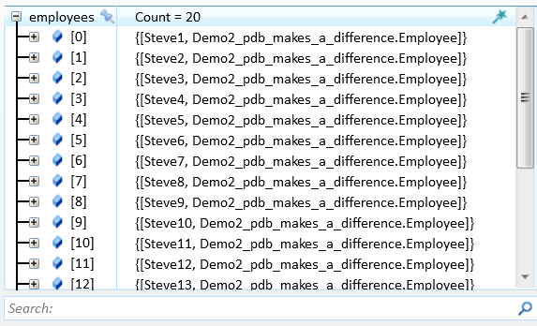
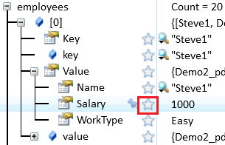
OzCode: Reveal
Quick view for nested properties. Most useful in collections.
Notes:
Show on Demo2 project

Slide 28
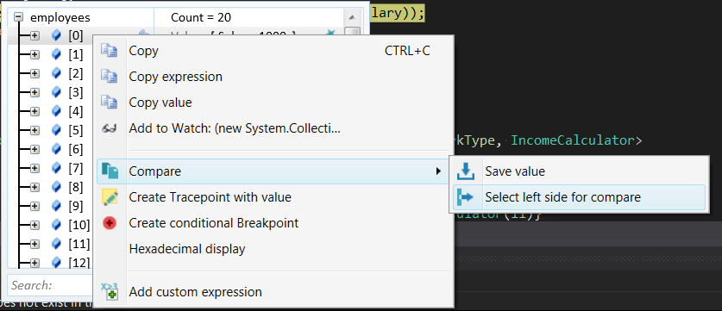
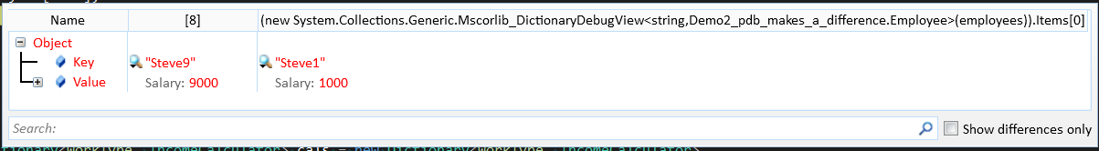
OzCode: Compare
Compare two objects
Compare the same object before and after some function
Notes:
Show on project2

Slide 29
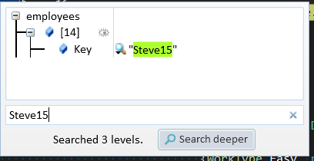
OzCode: Search
Find deep nested values of properties
Search item in collection
Notes:
Show on project2

Slide 30
External references
Parallel Stacks: [1] [2]
Visual Studio book (lots of goodies)
Debugging multi-threaded applications
OzCode
Latest demo at TechEd2014, Build 2015
Release optimizations
Notes:
Other links:
http://referencesource.microsoft.com/

