Slide 1
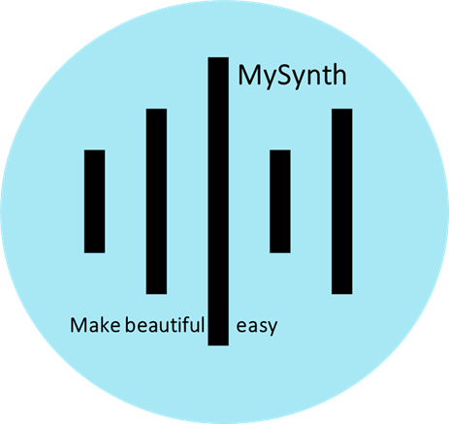
MySynth Effects Module
MAKE Beautiful easy

Slide 2
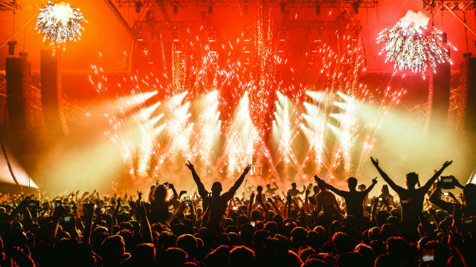
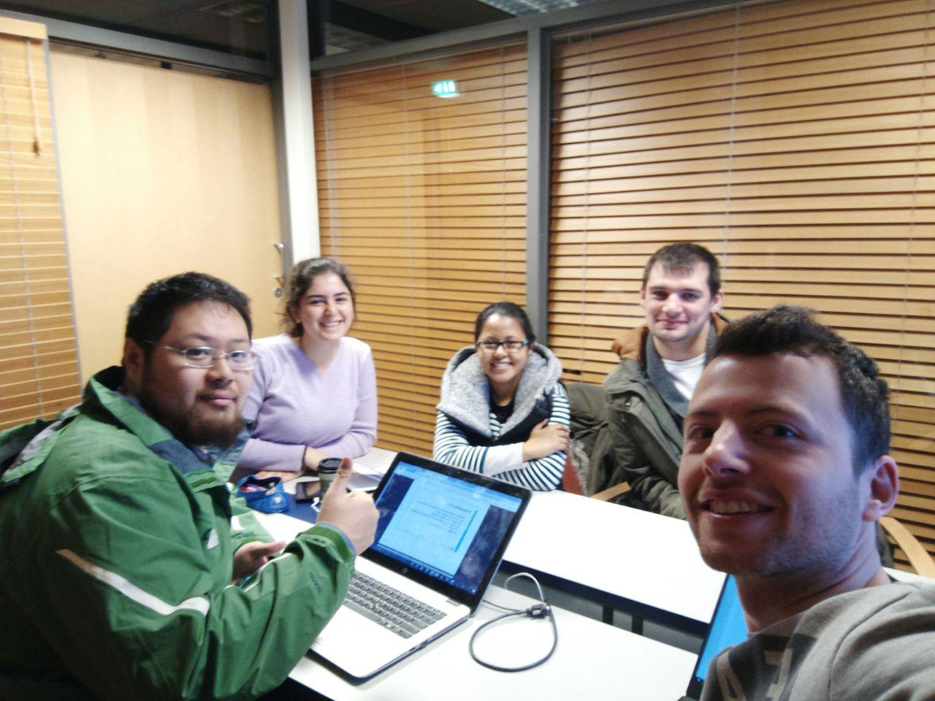

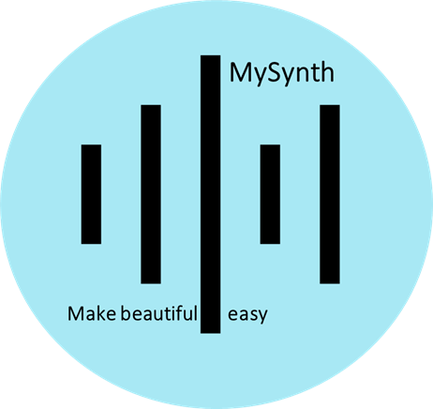
Rich Featured
Low Price
$
Passionate
Team
Competition
Modularity
Powerful Hardware
Effects
RaspberryPi
RaspberryPi

Slide 3
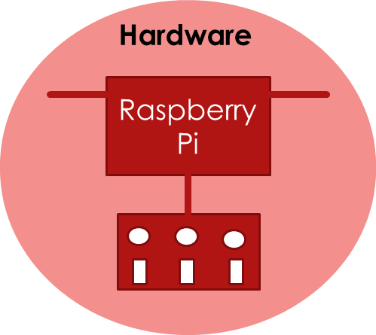

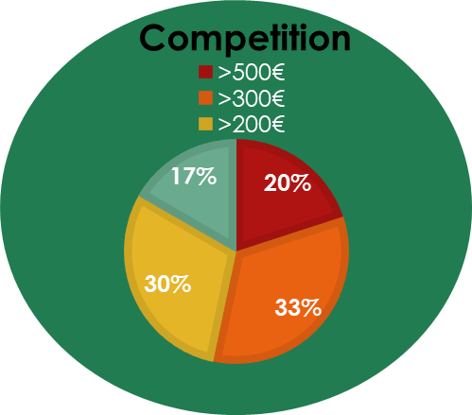
Powerful Computing power
Promising extendibility
Re-programmable
Eurorack compatible module
Rich-featured sound
Various sound effects
Affordable price with rich-featured functions and promising extendibility

Slide 4
MAKE Beautiful easy

