Slide 1
BCG Gamma Technical Challenge PowerCo_v5
Samarth Goenka

Slide 2
Agenda
Scenario
Approach
Findings
Future implications
Appendix

Slide 3
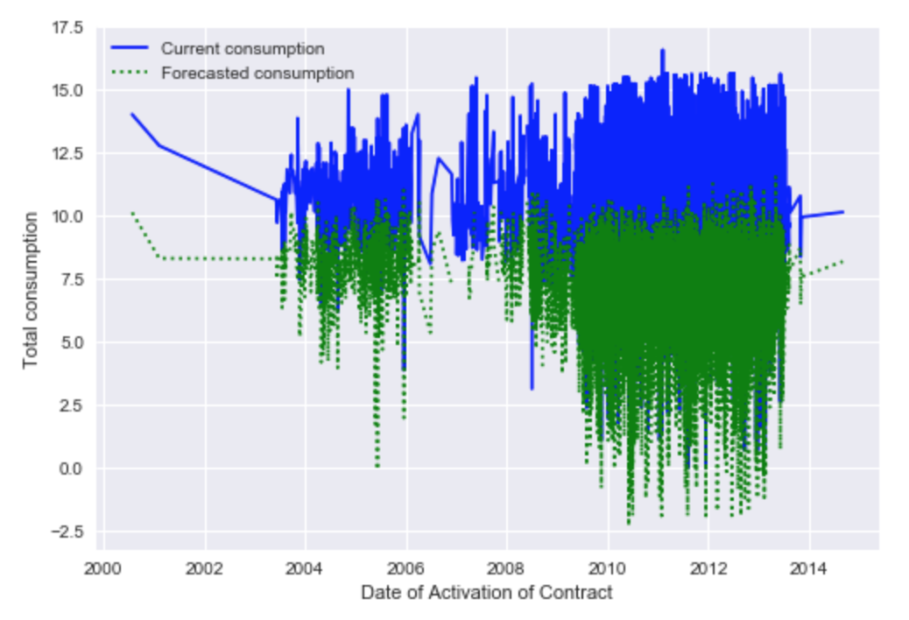
Scenario – Decreasing forecasted consumption
With actual consumption following a similar trend to forecasted consumption, a recognized churn issue in the future means lower actual future consumption
So how do we find customers most likely to churn and prevent them from defecting to competitors?

Slide 4
Approach – Develop an algorithmic model that can predict customers most likely to churn
Model | Decision Tree | Logistic Regression | Bagging Classifier | Random Forest | Adaptive Boosting
Reason | Easy to implement; sets a good benchmark | Gives a smooth fit when working with continuous data | Averages out variances and biases of estimators, which is important due to high variance in data | Many randomized decision trees implemented together | Accounts for anomalies and outliers in the dataset by weighing classifiers based on performance
Time efficiency | 1.34 s | 4.60 s | 1.38 s | 5.91 s | 9.93 s
Accuracy on training data (RoC) | 0.63 | 0.59 | 0.93 | 0.96 | 1.00
Voting Classifier
Combines all 3 to give the majority classification

Slide 5
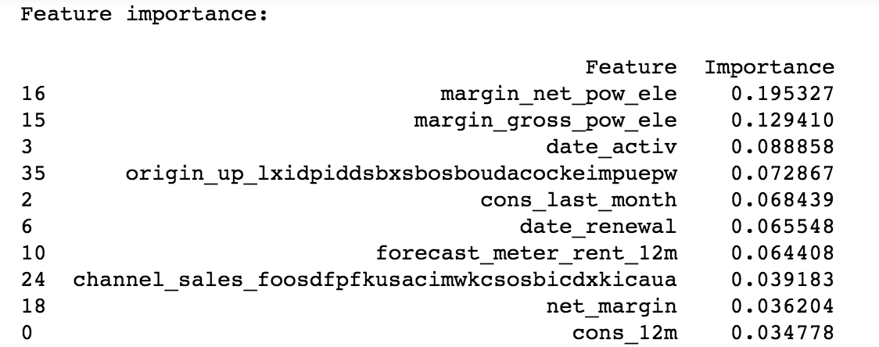
Margins and date of activation are the top 3 important factors in our model
Seems to have a high price elasticity, due to high importance to net margin and gross margin. This clearly follows the SME head’s view of customer defects to competitors
Contracts activated towards the end of the dataset timeline are more likely to result in customers churning. This may be due to changes in market landscape, such as increase in competition due to liberalization of European energy market
The electricity campaign represented by lxidpiddsbxsbosboudacockeimpuepw has not performed well. We could look into issues related to transparency of campaign details, and levels of customer engagement
Last month’s consumption is also highly weighted with low consumption more likely to result in customers defecting. This implies that customers are gradually decreasing consumption before defecting

Slide 6
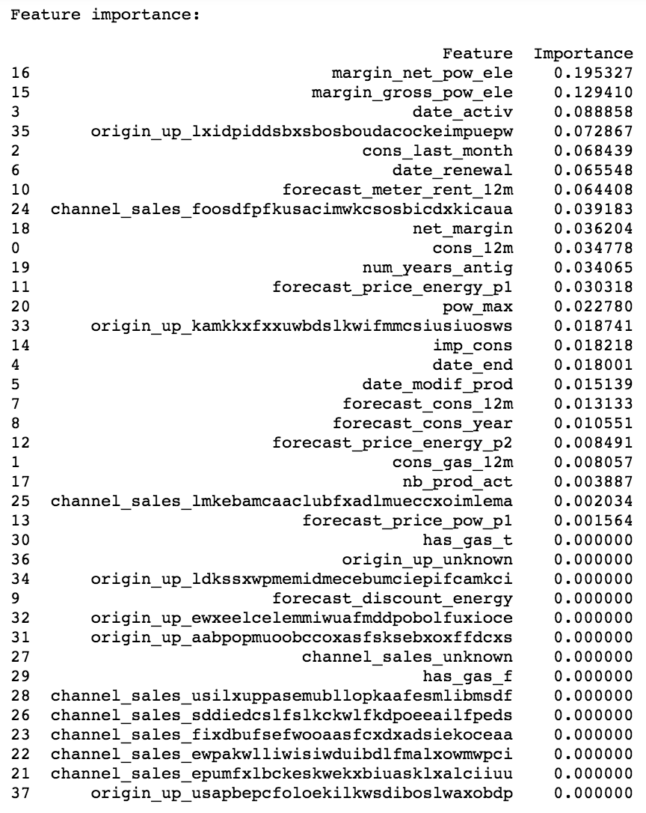
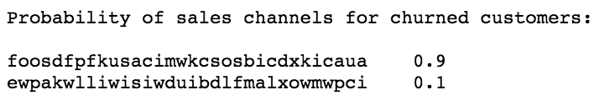
A closer look at sales channels tells us something important!
9 out of 10 customers are consuming through this channel!
Most of the sales channels seem to not play a role in determining the churning of a customer.
However, the channel represented by foosdfpfkusacimwkcsosbicdxkicaua is significantly important in resulting in the customer defecting

Slide 7
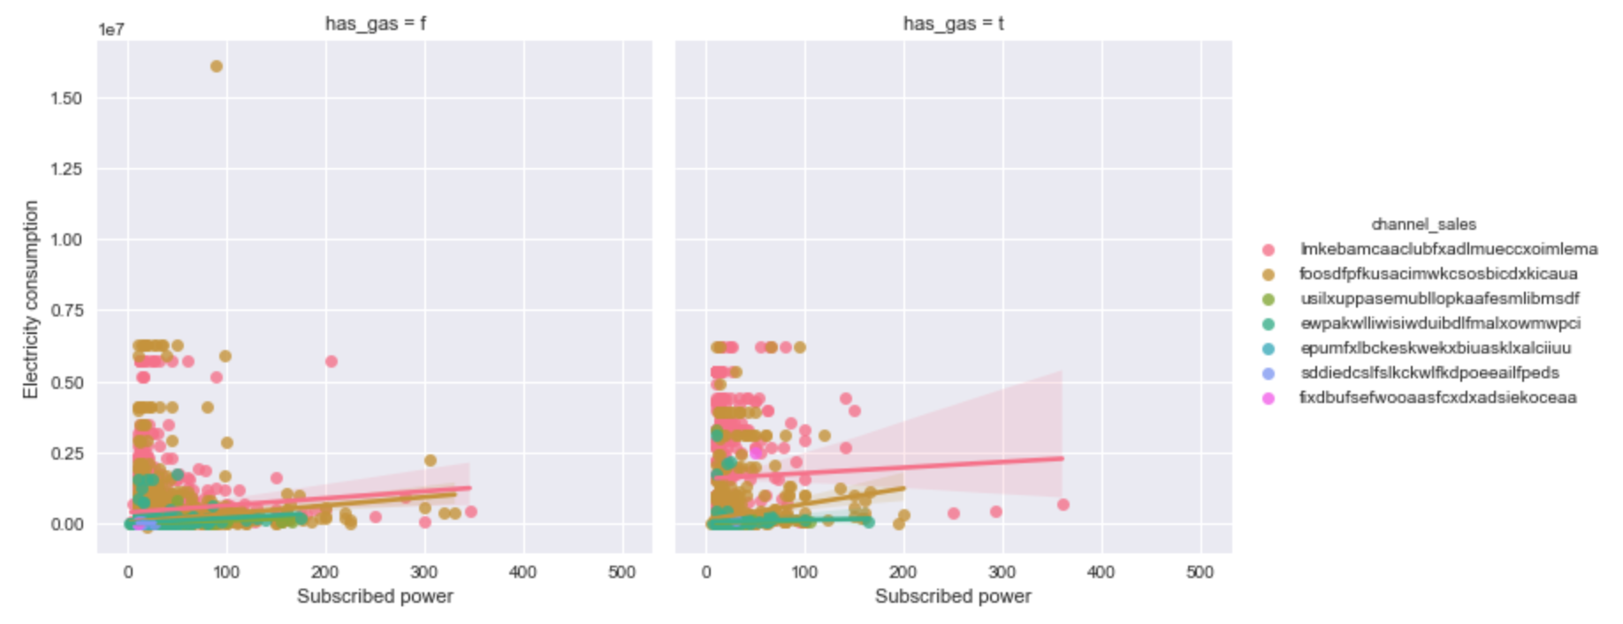
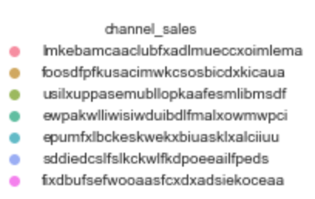
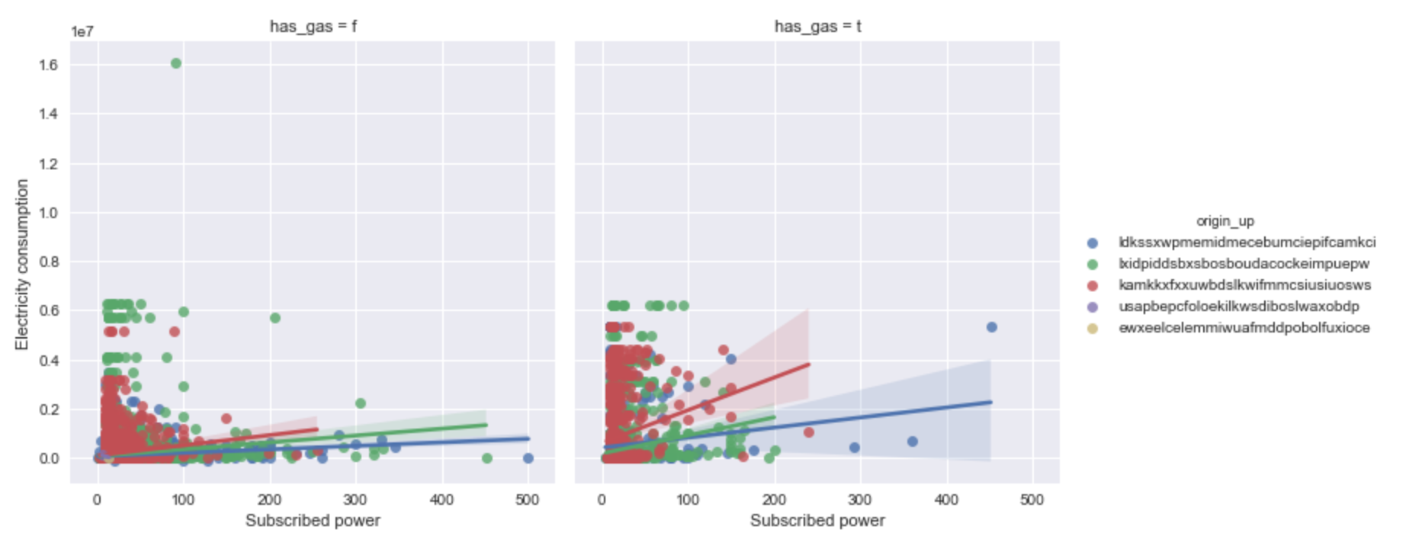
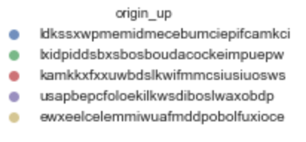
Why higher power subscription incentives will not necessarily translate into higher consumption?
The correlation between overall subscribed power and electricity consumption:
Pearson correlation = 0.102
Kendall correlation = 0.282
This shows a weak positive correlation, and one that is not strong enough to consider resources spent to increase subscribed power in order to drive consumption
These graphs show the correlations broken down by sales channels and electricity campaigns

Slide 8
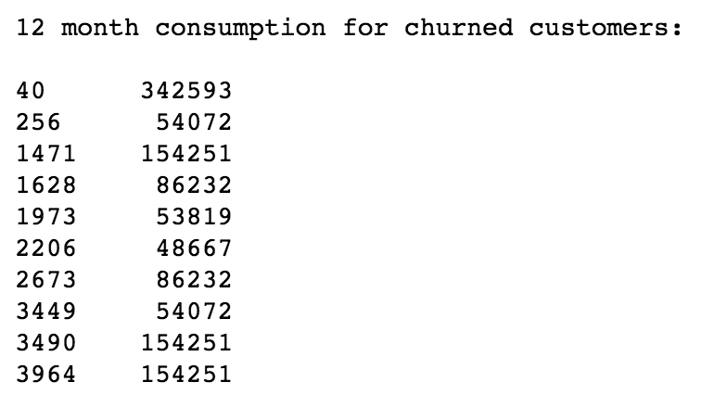
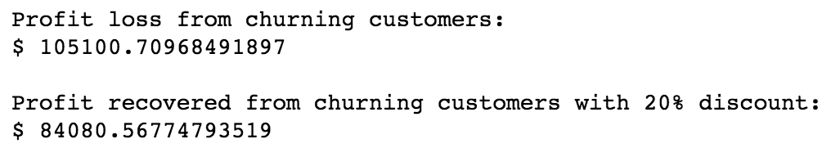
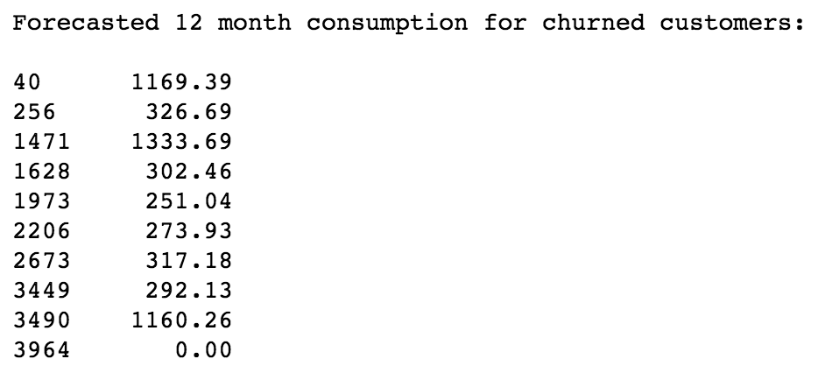
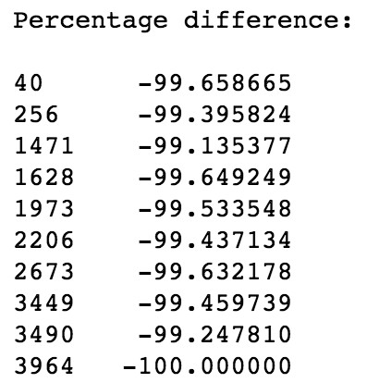
Does the 20% discount that keeps customers from defecting help PowerCo overall?
The model suggests that the 20% discount definitely makes sense for the forecasted time period!
However, what are its implications for the future?

Slide 9
What other analysis can be done to give PowerCo a concrete justified suggestion?
Realistically, PowerCo will not be able to go back to the original price after offering the 20% discount to the churned customers. Moreover, through word-of-mouth the customers that are not churning would threaten to defect if their prices were not discounted. Hence, we would have to recalculate the profits if the 20% discount was offered to all customers.
I would also look at the average time between date of activation and renewal of contracts for both churned and non-churned customers. Through this, we can infer a timeline of customer engagement, which can be used alongside proven campaigns.
We can assess which time periods the churning customers seem to be consuming their electricity in and apply a price discount for those periods only. Unlike a 20% discount on all prices, this method allows PowerCo to retain the churners and offer a 20% discount on that time period to other customers as well.
Although my classifiers worked well, I would use more classifiers, such as Naïve Bayes to look at the correlation between training features in an attempt to get a better accuracy on the training data. I can potentially develop a neural network to provide more efficient and accurate results.

Slide 10
Appendix
Assumptions
We cannot make inferences from columns that have a lot of empty cells/ missing values but we can generalize results from columns that do have a low proportion of empty cells
For columns, we do not know whether an empty cell implies missing value or nothing worth mentioning. Hence, we will fill them with “unknown” in the case of categorical data such as sales channel, and the mean value in the case of numerical data such as net margin.
We have no prior knowledge of which feature (factor) is more likely to affect the probability of a customer churning
We will assume that the training data is a good representation of the testing data, and therefore split our training data into random groups of training and testing data to test the accuracy of our model on at least the training data.
For the pricing data, we will assume that empty cells are the same as 0, and that a 0 means that there was no consumption in that time period. Further, we will assume that time time periods are three, 8 hour periods with period 1 representing the period of maximum consumption for each customer and not any one particular period. We will also assume that the prices are in cents and are monthly prices, with the prices for power being variable prices, and prices for energy being fixed prices.
We will then average the average monthly variable price to get the average annual variable price and sum the sum of monthly fixed prices to get the total fixed price.
Revenue = Annual var price * Consumption for 12 months + Total fixed price

