Slide 1
Shukersal
Version 0

Slide 2



System Design
Technologies Used:

Slide 3
System Design
N-Tier architecture
SPA React App + REST Api
.NET MVC.

Slide 4
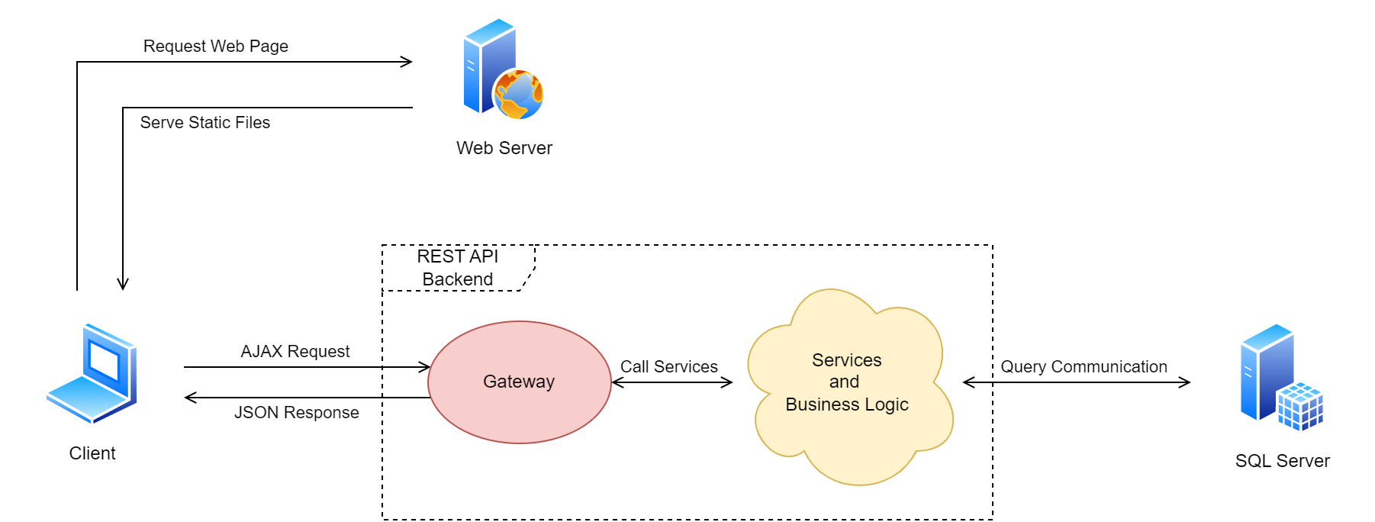
System Design
Architecture Diagram

Slide 5
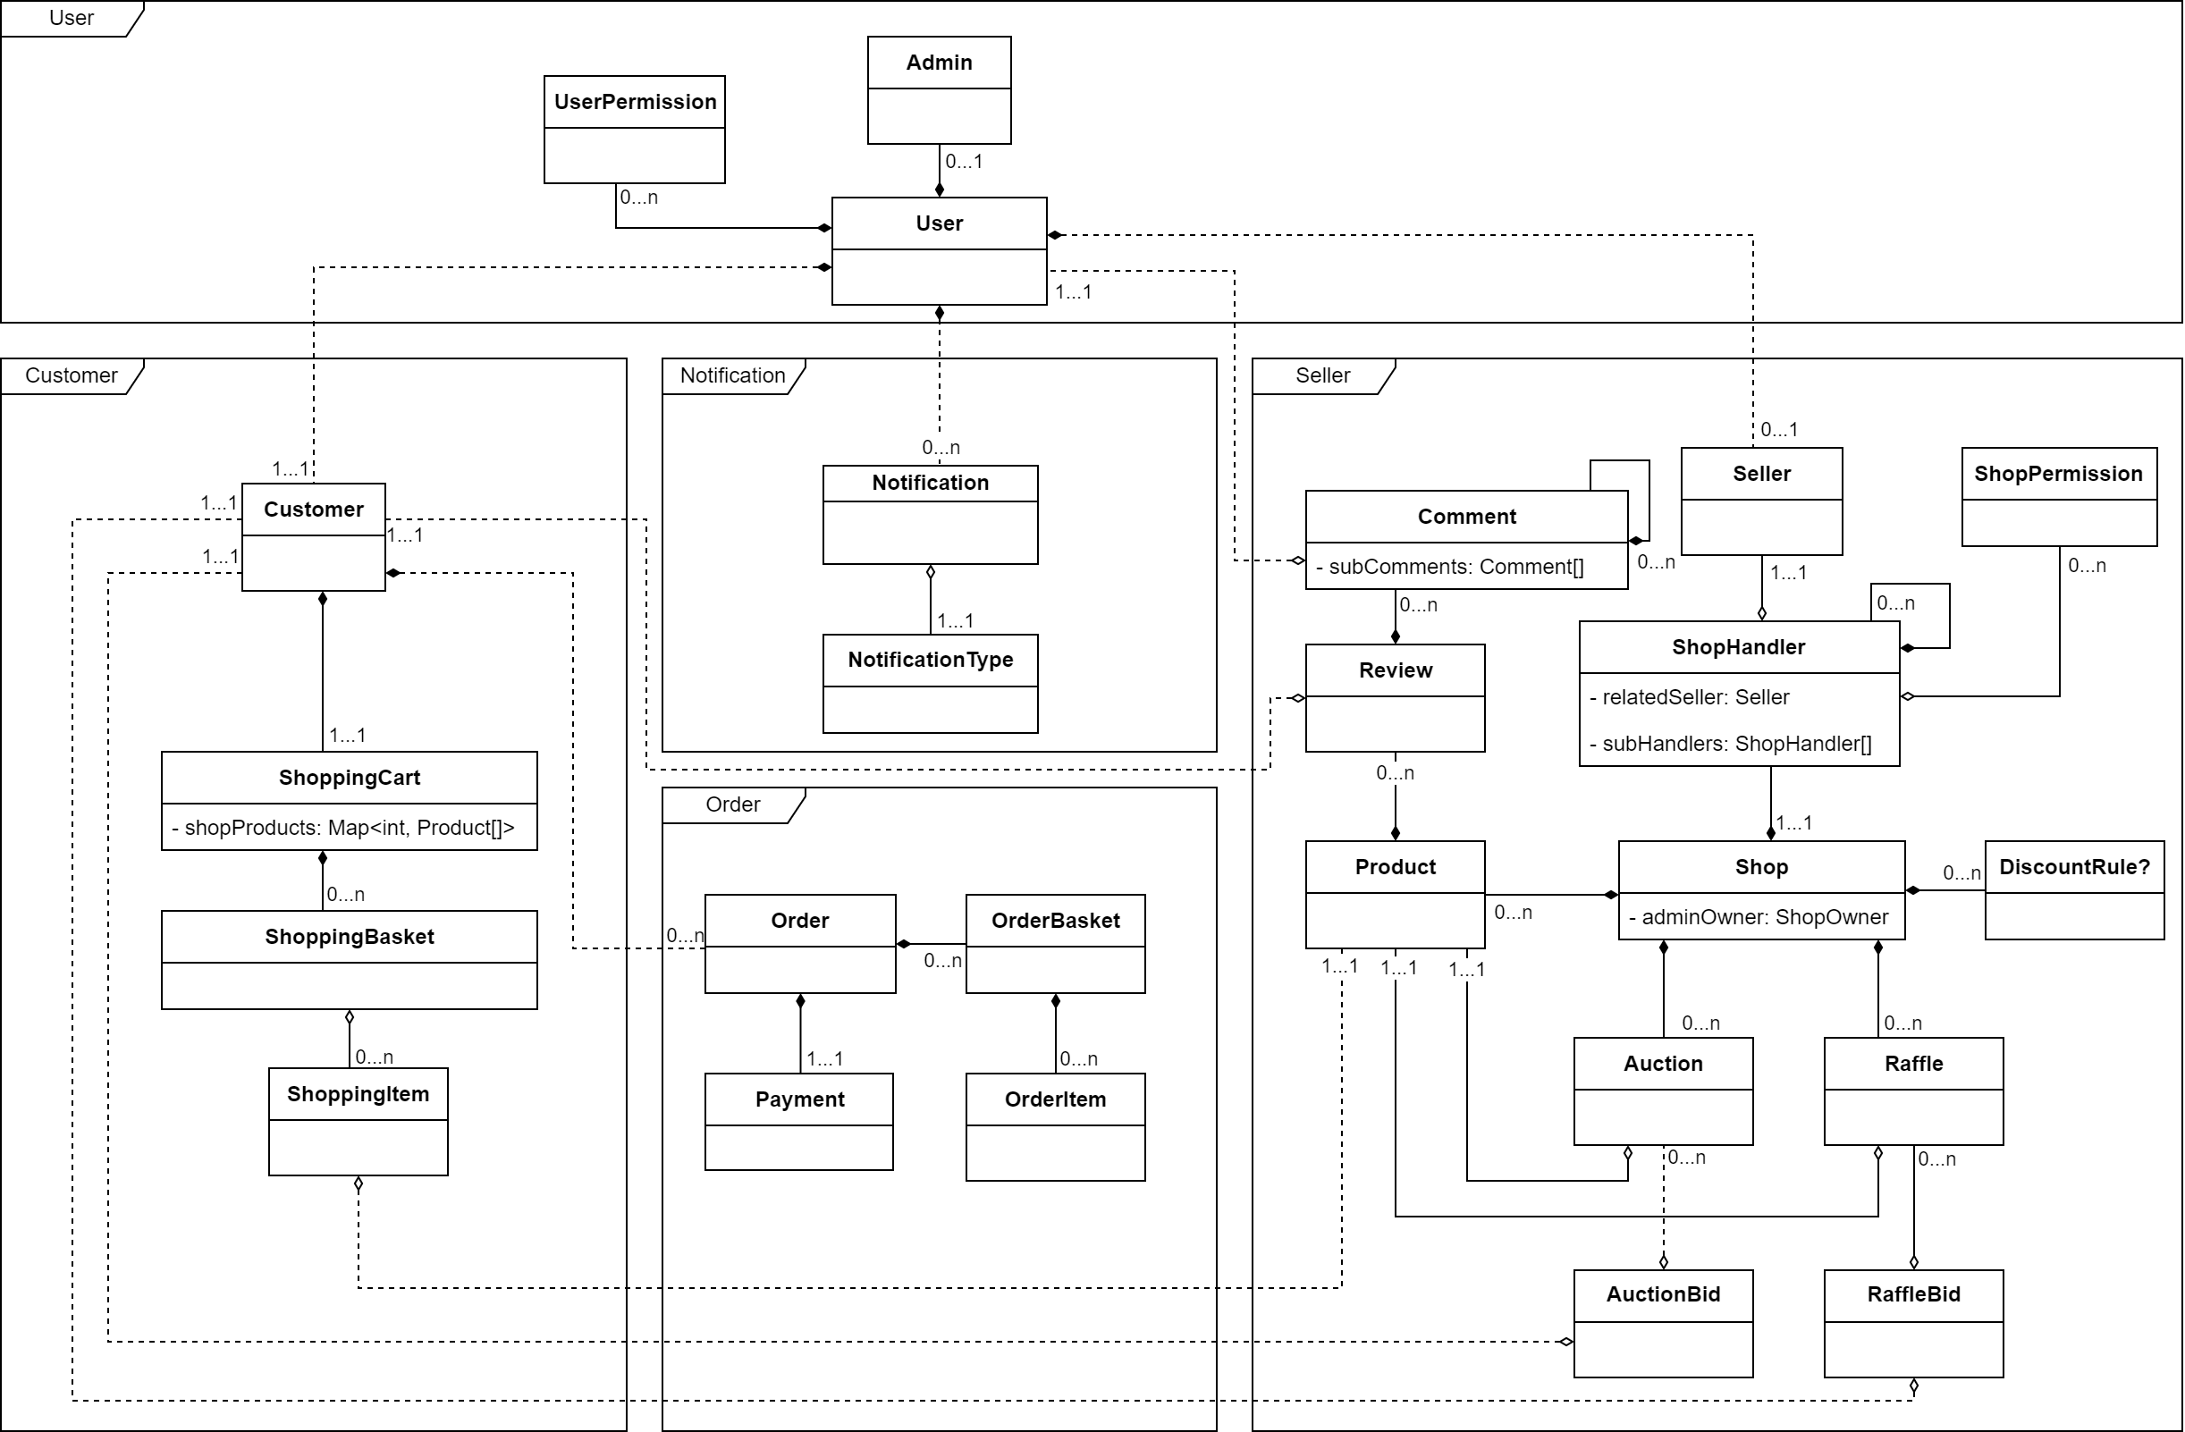
System Design
Models Structure

