Slide 1
The RUST project
By Aleksei Vasiukóv

Slide 2
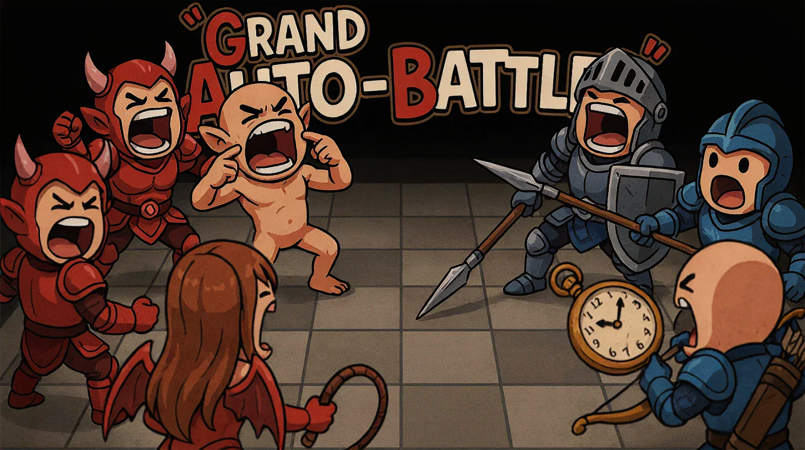

Slide 3
“Grand Auto-Battler”
Data-driven journalling game engine for automatic simulation of the turn-based battle sequences. Core library, backend and console/webUI clients.
Planned technologies
Planned: RustV1.97, TOML, JSON, Tokio, AXUM, ratatui, gRPC, llama.cpp, Angular(WebUI JSframework), sCSS, docker/podman, VPS hosting with domain name

Slide 4
MOTIVATION
Video games are my hobby. (to keep motivation)
This game genre (auto-battler) is allowing me to start from console app with TUI, and continue with complexing things up with WebUI.
Memory allocation and effective caching – are important skills to train for any programming language.

Slide 5
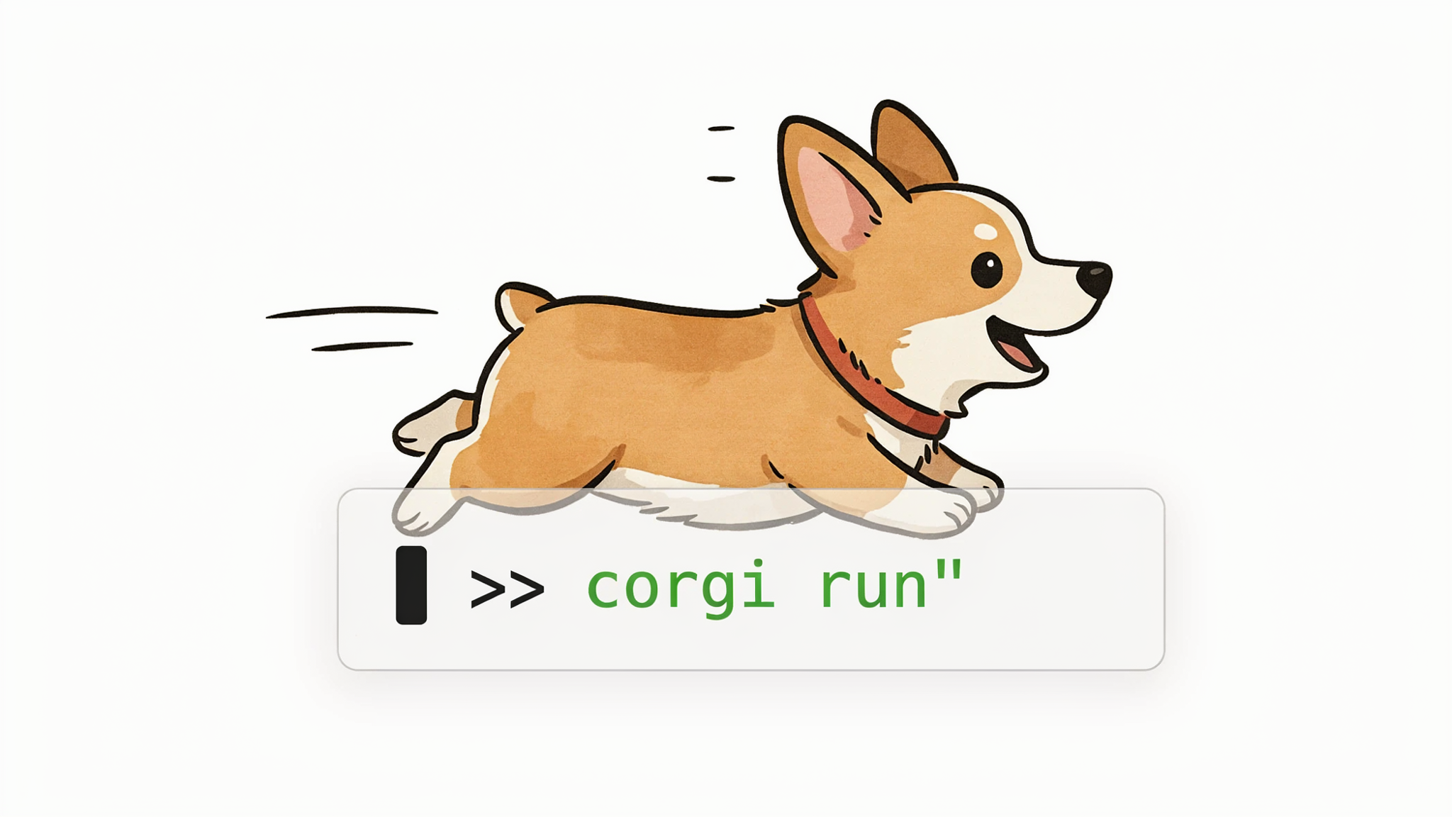
RUST RELATION these will be done with rust
Game Engine: All game mechanics will be implemented with Rust language and cargo crates:
  TOML-files parsing,
  Characters generation with their type-specific parameters ,
  Concatenation of their random names,
  Generating battle and its command-pattern journal,
  Keeping games data for multiple parallel instances
Console App:
  Input/output done with crossterm crate and with ratatui later.
  State machine of main game cycle will be written in rust
Backend Server:
  Maintaining asynchronous work with engine with tokio.
  Processing REST requests with Axum.

Slide 6
OTHER PLANNED TECHNOLOGIES
Game engine is client-agnostic and shipped with wrapper: console or webUI backend server.
Rest Backend server:
  will utilize JSON for data serialization, as industry standard
  Planned to be placed on VPS hosting with dedicated domain name (not Microsoft/azure/aws/capgemini servers), to keep full control over it, so it’s linux, nginx, ssh, https
  If time constrains will allow – make it containerized with podman (to be independent from Docker’s policies).
WebUI
  Component-based Typescript-powered engine, like Angular or React.
  sCSS as styles framework, for modern appearance, while keeping it simple.
  Hosted on Netlify with dedicated Domain name

Slide 7
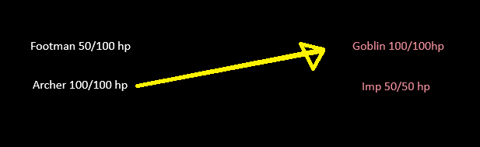
GAMEPLAY
Game is auto-battler, but simplified, since you only have one interactive action – set up your team roster. You are choosing your fighters and after that game is generating whole battle for you against random enemies. Whatever would be the outcome – the next you will be prompted to set up a new team to start battle against new enemies. Even with concept so simple, it’s still engaging to try out all possible combinations, and game have potential for visual richness in webUI, including special effects made with CSS.

Slide 8
Gameplay. Calculations
Every unit is balanced to have equal parameters point spread in the way, specific to his proficiency.
Health, Attack, Range and Defense (making together H.A.R.D system) allowing game units to be distinguished and balanced in the same time.
Range and Defense are calculating chance to be hit and amount of damage based on Attack against another’s hitpoints initially defined by Health.
Even having proficiency, we still make characters differ within their proficiency, adding 3 bonus points to random parameters and 1 penalty point to the rest parameter. So, If you have 4 knights, they will be unique.

Slide 9
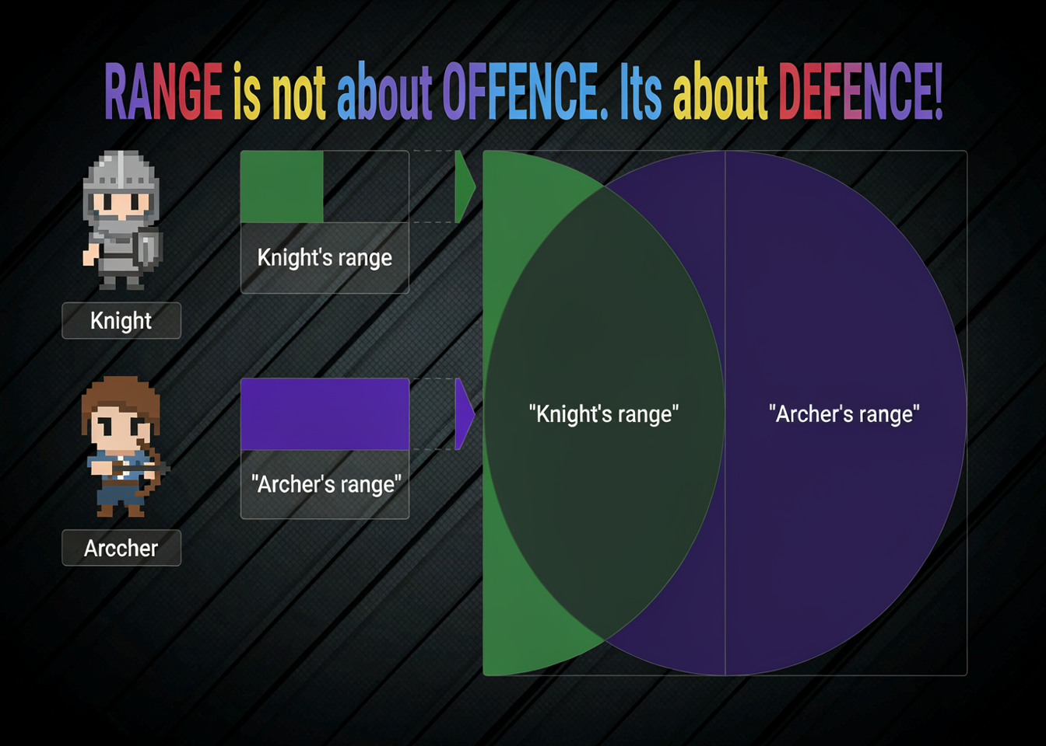

Slide 10
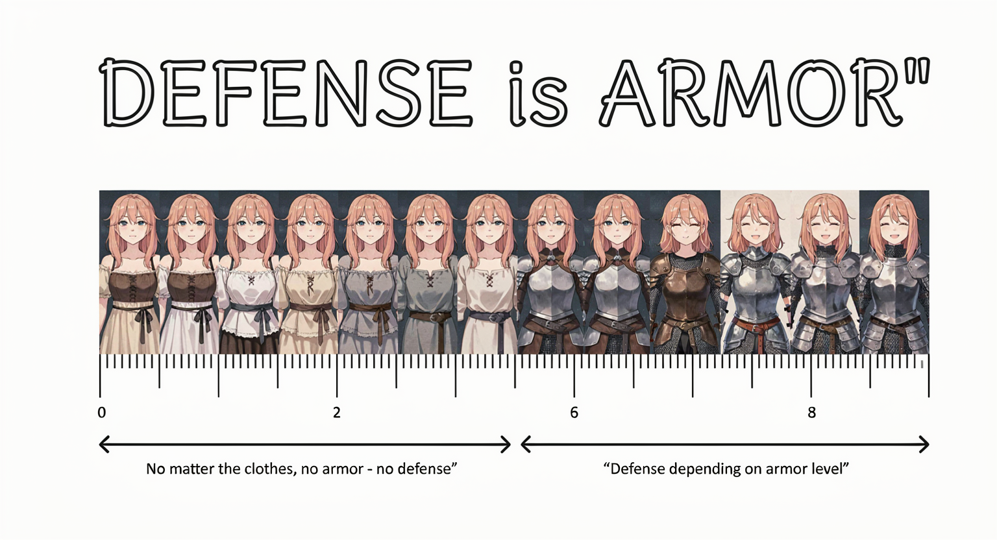
If you are not wearing an armor of any type, you cannot be considered as protected, and your Defense is 0, because you are vulnerable for any weapon blow

Slide 11
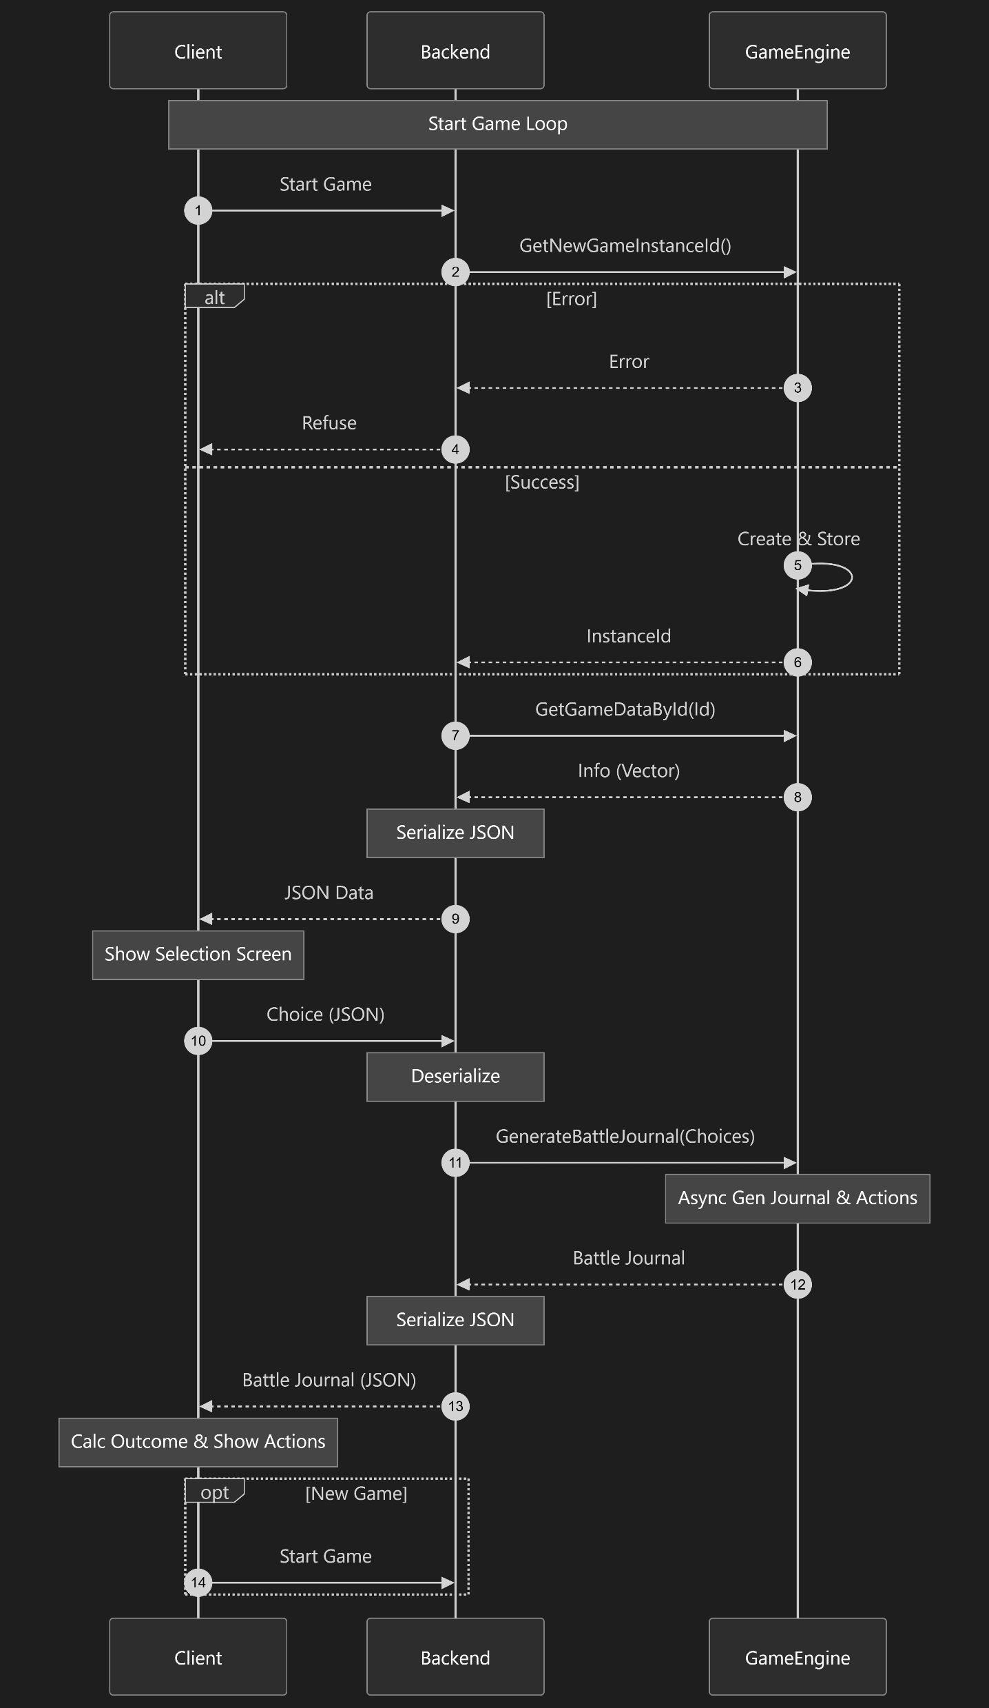
Web UI planned architecture

Slide 12
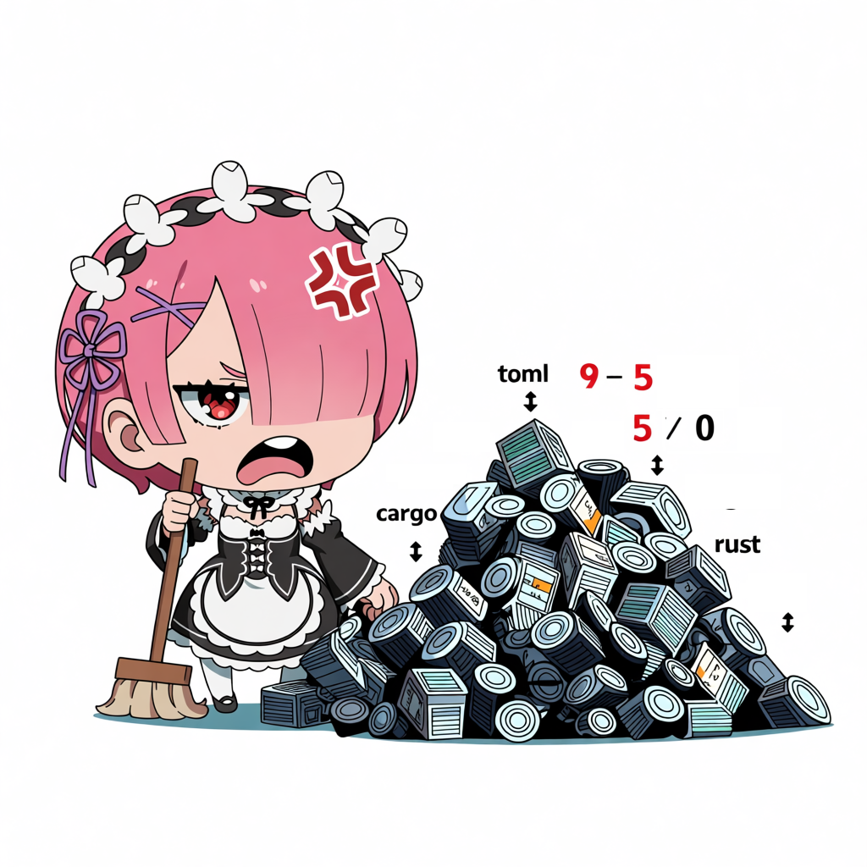
Thank you for attention!
Any questions?

