Slide 1
Decoder Side Motion Vector Refinement for Versatile Video Coding
Aleksei Zhuravlev 15.03.2023

Slide 2
Introduction
Intra picture and inter picture prediction are used to exploit the spatial and temporal correlation found in video sequences
In block-based motion compensated prediction (MCP), a picture of a video sequence is first divided into non-overlapping rectangular blocks
A corresponding block in the previous decoded picture is determined as the prediction for the block in the current picture. The position of the block in the previous decoded picture is indicated by a motion vector (MV)
The MV is usually calculated in the encoder by a motion estimation algorithm and encoded into the bitstream. During decoding, the MV is decoded from the bitstream and used for MCP

Slide 3
Introduction - 2
The bitrate required for MV signaling increases significantly for larger image resolutions.
HEVC and VVC introduce a merge mode to reduce the number of bits required for MV coding (with reduced precision).
In the paper, a template matching-based and a bilateral matching-based decoder side motion vector refinement (DMVR) method are proposed.
Decoded MVs are refined in both DMVR methods using the previous decoded reference pictures on the decoder side.

Slide 4
Inter picture prediction in VVC
Inter picture prediction in VVC is based on translatory motion of the image blocks between pictures.
The MV describes the translatory motion between the reference block in an already decoded picture and the current block.
The previous decoded pictures are denoted with reference indices refIdxL0 and refIdxL1, where L0 and L1 denote the reference lists.
The reference indices and lists of previous decoded pictures and the related MVs are included in the motion information of the current block.
One set of motion information is used for uniprediction
bi-prediction involves two sets of motion information both from list L0 and list L1 to generate two prediction signals, which are then averaged

Slide 5
Merge mode in VVC
In VVC, a merge mode is used to exploit the spatial and temporal correlation in the motion model parameters of a block partition.
A list of motion information candidates (merge candidates list) is constructed from the already decoded neighboring blocks of the current block.
Instead of the motion information, the index of the candidate is encoded in the bitstream.

Slide 6
Decoder side motion vector derivation (DMVD)
DMVD flag is put in the bitstream to indicate that the DMVD mode is applied on the current block.
When the DVMD flag is true, the top and left decoded neighboring samples of the current block are used as a DMVD template.
A motion estimation between the DMVD template and the decoded samples in the previous reference pictures is performed on the decoder side.
The MVs with lowest distortion are selected as the final MVs of the current block

Slide 7
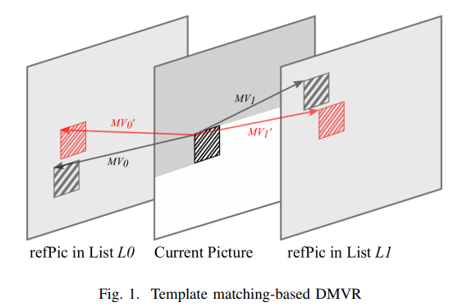
TEMPLATE MATCHING-BASED DMVR: Template matching
Two MVs of the bi-prediction coded block are further refined by a template matching process.
Template is generated as the average of the two initial predicted blocks from the initial MV0 of the reference picture list L0 and initial MV1 of the reference picture list L1.
Distortion between the generated template and the sample region around the initial prediction block in the reference pictures is calculated.
The refined MVs that yield the minimum distortion are considered as the updated MVs (MV′0 and MV′1).
The updated MVs are used to generate the bi-prediction signal

Slide 8
Multi-stage and multi-iteration
The refinement resolution of a MV can be integer-pel or half-pel accuracy.
In the initial integer-pel stage, DMVR is performed with multiple iterations surrounding the initial MVs with integer-pel step length.
After the refined MVs with lowest cost are found, half-pel DMVR is performed surrounding the found refined MVs with half-pel step length
The process is iterated until the MVs no longer change

Slide 9


MV difference mirroring
In natural video sequences, the movement of an object between subsequent pictures is often approximately uniform
Bi-prediction: one past reference picture and one future reference picture are used to predict the block in the current picture
MVs of the current block from both reference pictures are likely approximately mirrored.
Iteration 1: Iteration 2:
By applying MV difference mirroring, half of the MRSAD calculations of template matching-based DMVR are saved

Slide 10
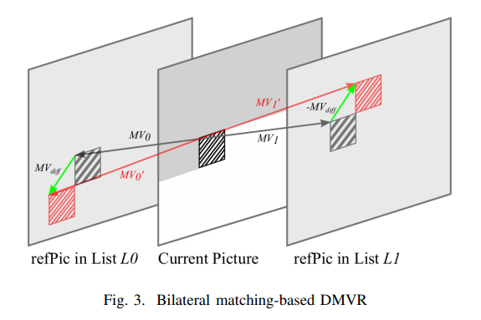

BILATERAL MATCHING-BASED DMVR
a refined MV is searched around the initial MV in the reference picture list L0 and reference picture list L1, and the distortion between the two candidate blocks is directly calculated
The search points that are surrounding the initial MV and searched by bilateral matching-based DMVR obey the MV difference mirroring rule. Any points that are checked by DMVR, denoted by candidate MV pair (MV ′ 0 , MV ′ 1 ) obey
A multi-stage and multi-iteration approach is also applied

