Slide 1


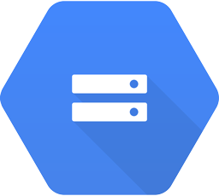

Oracle to Snowflake Data Synchronization
Architecture: Partition-Based CDC
Oracle Database
PARTITIONED_TABLE_A
Parquet Files Cloud Storage
PARTITIONED_TABLE_A
Sync Files
PARTITIONED_TABLE_A
2023_03_01.parquet
PARTITIONED_TABLE_B
PARTITIONED_TABLE_B
2023_03_02.parquet
PARTITIONED_TABLE_B
2023_03_01.parquet
1
Data operations in the source database (insert/update/delete/truncate)
4
Deleting changed partitions in the Snowflake target database
3
Exporting changed partitions into Parquet files
2
Detecting changed partitions
5
Importing data into Snowflake from Parquet files

Slide 2
Title bar, Footer bar, Project Zone, Notes, Markers, and Legend
Architecture: App Engine and Cloud Endpoints
Use this note to call out or clarify parts of a diagram
Queuing / Scheduler
Launch VMs
DRM on VM
If DRM is Windows based, a separate VM can be used
Copy Files Locally
Copy Files Cloud Storage
Output is multiple codecs, resolutions, and bit rates
ffmpeg command
Shutdown VM
Quality Assurance
Ready for Streaming
1
2
3
4
5
6
7
1 Commit code
2 Detect code change
3 Build immutable image
4 Launch test instance from image
5 Run tests
6 Perform rolling update of image to autoscaler
Markers to be use with the legend to the right

