Slide 1
MongoDB Tutorial for beginners
09-2021
Aleksey Potapov EPAM

Slide 2
NoSQL. History
Non-SQL
Not only SQL
Non-Relational
Not RDBSM
Notes:
Such databases have existed since the late 1960s, but the name "NoSQL" was only coined in the early 21st century, triggered by the needs of Web 2.0 companies
NoSQL databases are increasingly used in big data and real-time web applications
NoSQL systems are also sometimes called "Not only SQL" to emphasize that they may support SQL-like query languages or sit alongside SQL databases in polyglot-persistent architectures
Relational Database Management System (RDBMS) is an advanced version of a DBMS system. It came into existence during 1970’s.
Non-relational databases grew in popularity due to their ability to meet the aggressive scaling needs of web applications appearing on popular websites (e.g. social media). They also are suited to support Big Data applications with their high throughput of unstructured data. Non-relational databases can also store data in memory for persistence, to more easily read this fast-moving data. Finally, popular non-relational databases are open source and present little or no upfront cost, and no licensing fees.

Slide 3
NoSQL. Guarantees
CAP
Consistency
Availability
Partition Tolerance
BASE
Basically Available
Soft state
Eventually consistent
Notes:
Basically Available: basic reading and writing operations are available as much as possible (using all nodes of a database cluster), but without any kind of consistency guarantees (the write may not persist after conflicts are reconciled, the read may not get the latest write)
Soft state: without consistency guarantees, after some amount of time, we only have some probability of knowing the state, since it may not yet have converged
Eventually consistent: If the system is functioning and we wait long enough after any given set of inputs, we will eventually be able to know what the state of the database is, and so any further reads will be consistent with our expectations

Slide 4
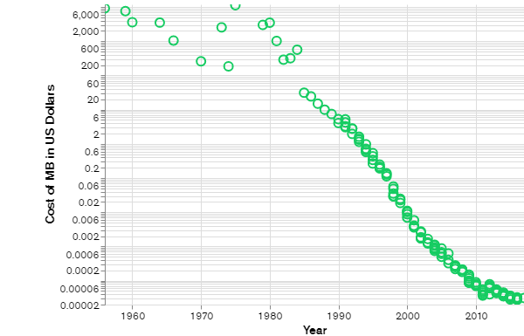
NoSQL. Why it is popular

Slide 5
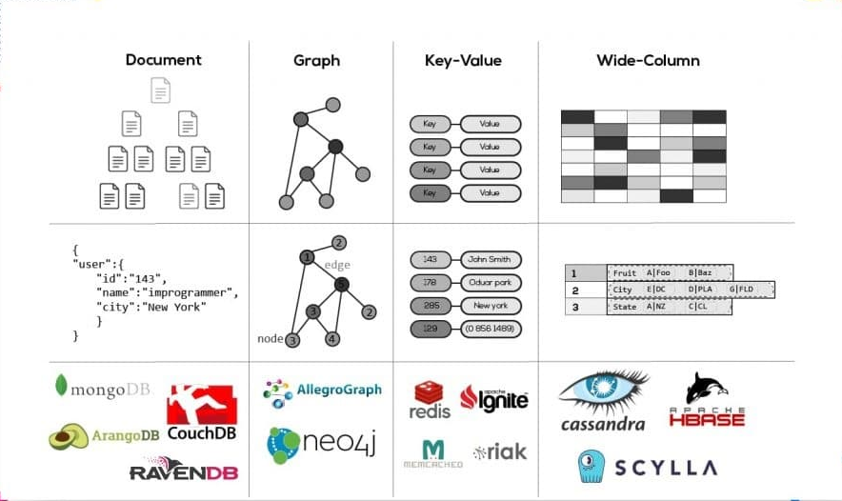
NoSQL. Who are they?

Slide 6
MongoDB. Inside
Document-oriented database
JS Engine Spider Monkey
Written using C++
Open-source
Cross platform
Notes:
Humongous

Slide 7
MongoDB. Advantages
Flexible Schemas
Better operational performance
High Scalability
High Accessibility
Security

Slide 8
MongoDB. Document
{
"_id": ObjectId("5f065633404c3e4aaac69142"),
"type": "Journal",
"title": "Exploring how and why young people use social networking sites",
"authors": [ "Gray, L" ],
"publicationDate": ISODate("2018-04-03T00:00:00.000Z")
"volume": 34,
"issue": 2,
"pages": {
"start": 175,
"end": 194}}
Notes:
Returns a new ObjectId value. The 12-byte ObjectId value consists of:
a 4-byte timestamp value, representing the ObjectId's creation, measured in seconds since the Unix epoch
a 5-byte random value
a 3-byte incrementing counter, initialized to a random value

Slide 9
MongoDB. Types
ObjectId String Object Array
Boolean Date Timestamp Regular
Double 32-bit int 64-bit int Decimal128
JavaScript Expression Min key Max key
Binary data Null

Slide 10
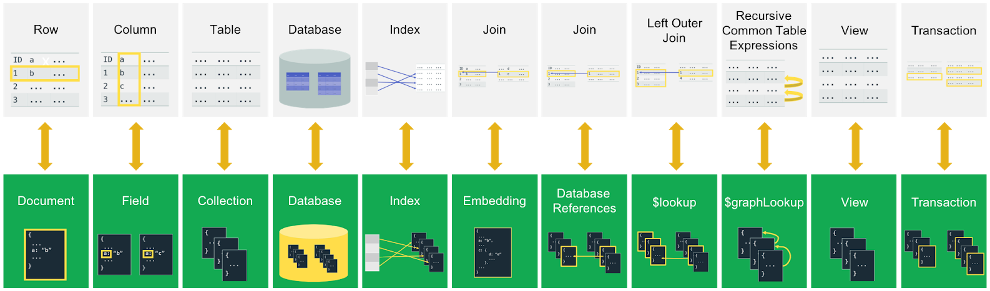
MongoDB vs SQL

Slide 11
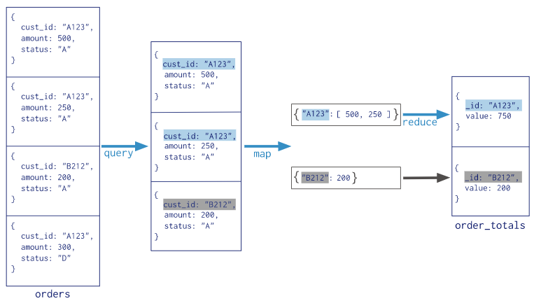
MongoDB. MapReduce

Slide 12
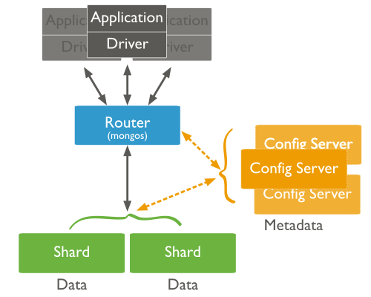
MongoDB. Typical schema

Slide 13
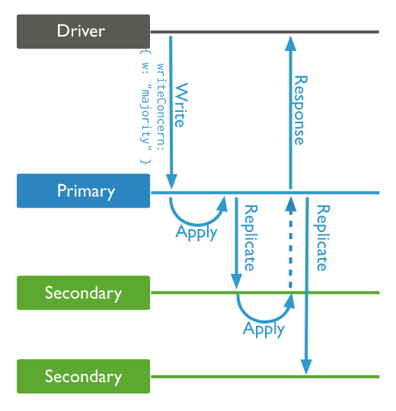
MongoDB. Write concern

