Slide 1

DriverPass System Analysis
Alexander Ahmann
Notes:
Hello, I am Alexander Ahmann, and I will be here to demonstrate the DriverPass web service.

Slide 2

System Requirements
Functional Requirements:
Interface to database management system
Method to get student data
Method to allow student to sign up for account
Non-functional Requirements:
LAMP Stack
In-house system administrator team
Cloud computing environment
SSH Login
DevOps style CI/CD deployment
Notes:
First off, we need to properly define a software engineering problem, and their functional and non functional requirements. I post that the software interfaces with some database management system, typically shortened to DBMS, that a method to get student data is included, and that a method allowing students to sign up is included. Regarding the non-functional requirements, or the requirements not directly involved in coding the web application, the software and service will run on a cloud computing environment with a Linux, Apache, MySQL and PHP stack installed, and will have an in-house development team with our company deploy new versions of the codebase and third-party updates through CI/CD and SSH tunneling.

Slide 3
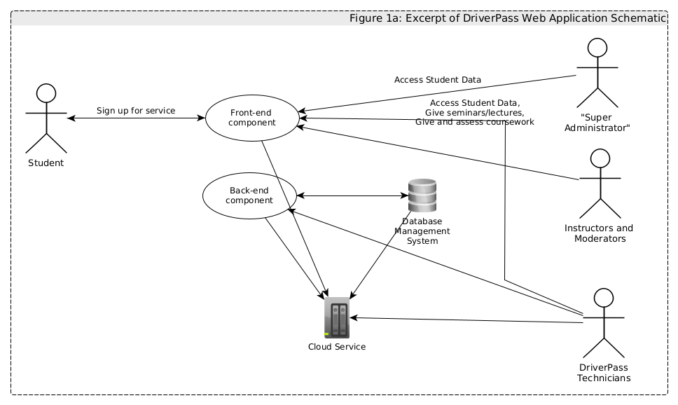
Use Case Diagram
Notes:
The users of the system will be students, the super administrator, the instructors and content moderators, and the technicians. Figure 1a shows a brief relationship between these different entities.

Slide 4
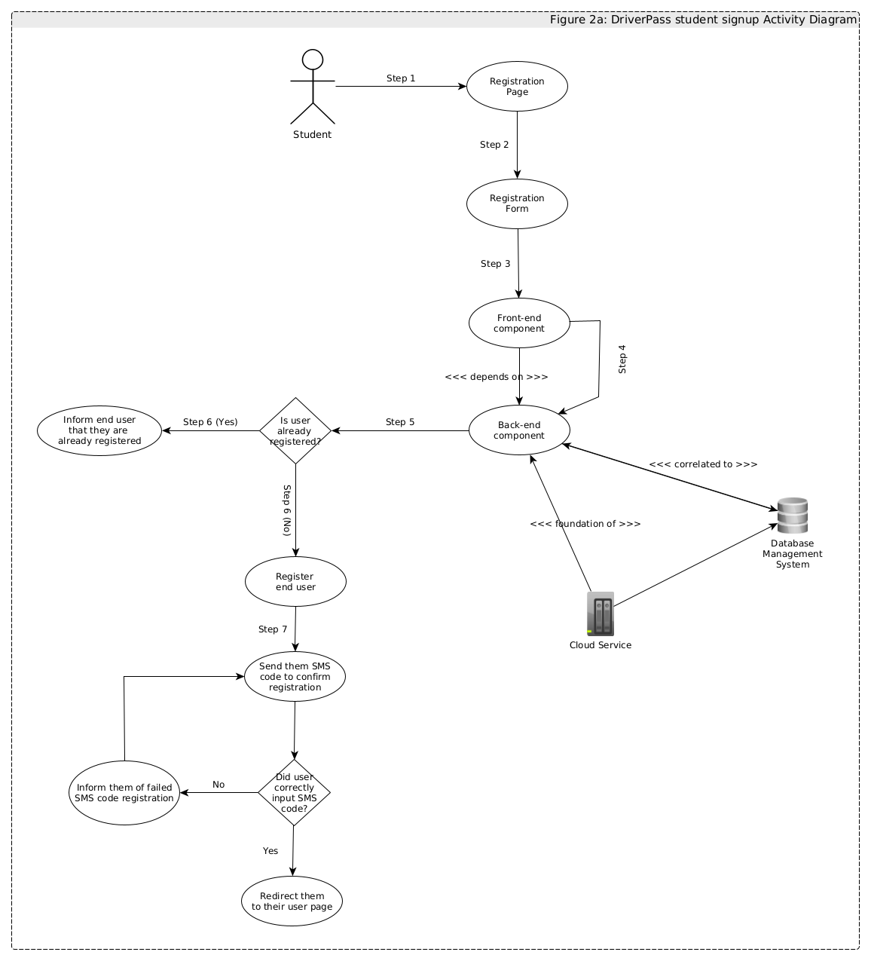
Activity Diagram
Notes:
In this example, I will go over one particular function of the system: student sign ups. The student will first go onto a registration page and then fill out a form requesting for a new account. The frontend component will send a request to the backend component requesting to add a new account. If the account already exists, then the system will inform the student end-user and terminate. If the account does not exist, it will input student info into the SQL database, and then send an SMS code to verify their identity.

Slide 5
Security
Rate limiting
Firewall
Web Application Firewall
Network Intruder Detection System
Endpoint Detection Response
System Hardening
Load Balancer
Cloud Distribution Network
CDNs can act as a reverse proxy
Notes:
Security is a major problem regarding the system. I intend to use rate limiting to prevent hackers from making too many connections to the service – something that they typically do in their work. I will also use intruder detection systems both at the network and host level to identify hackers, who I can block by making certain changes to the firewall's rules. I can also use what security professionals call a "web application firewall" to stop certain kinds of attacks targeting the web application itself. I will also use a cloud distribution network, think CloudFlare or Impervia, to distribute the web application and improve its quality of service.

Slide 6
System Limitations
System assumes that end-users know how to use a computer system.
System may not scale up if resources are not properly allocated.
Notes:
Our software assumes that end-users have basic computer literacy and that resources can scale if need be. If this is not the case, then the system will either not work or not be accessible to a subset of up-and-coming drivers.

