Slide 1

CNN architectures.
Image segmentation

Slide 3
Disclaimer
Materials on the slides are taken from the following sources:
Convolutional Neural Networks (Course 4 of the Deep Learning Specialization)
CS231n: Deep Learning for Computer Vision - Stanford University
Introduction to Deep Learning by Sebastian Raschka
Dive into Deep Learning - Zhang, Lipton, Li

Slide 4
Agenda
Recap
More on CNNs
More on Normalizations
Inception
MobilNet

Slide 5
Recap
Convolution Operation
Padding/Stride
Convolutional Layer
ImageNet
LeNet 5

Slide 6
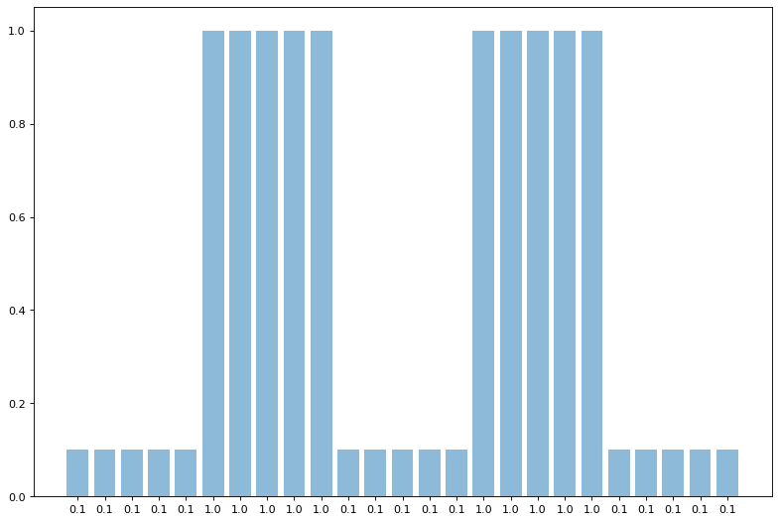
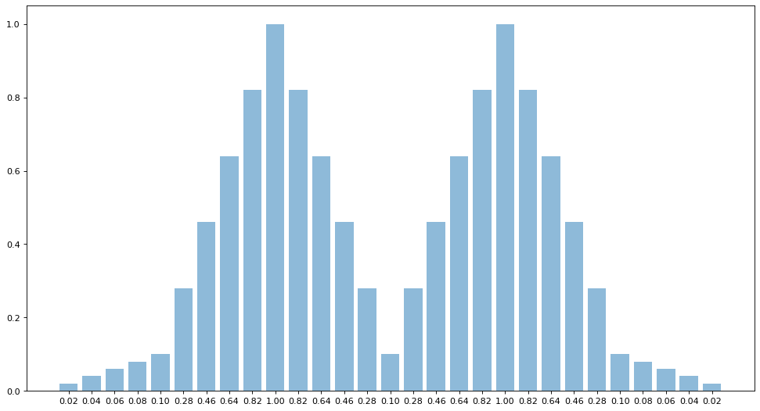
Recap: 1D Discrete Convolution
[0.2, 0.2, 0.2, 0.2, 0.2]

Slide 7
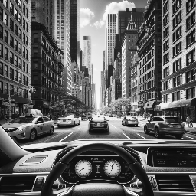

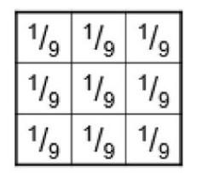
Recap: 2D Discrete Convolution - uniform filter

Slide 8
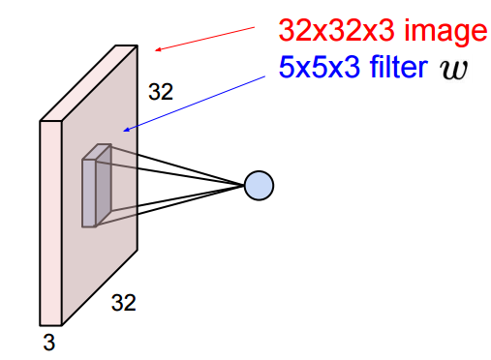

Recap: Convolutional Operation
1 number:
The result of taking a dot product between the filter and a small 5x5x3 chunk of the image (i.e. 5*5*3 = 75-dimensional dot product + bias)

Slide 9
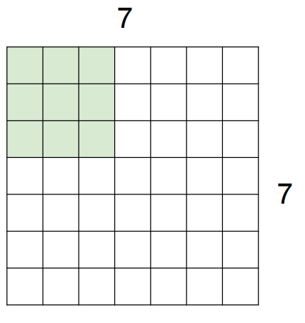
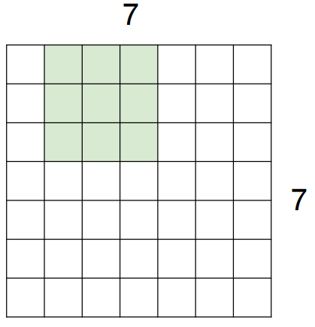
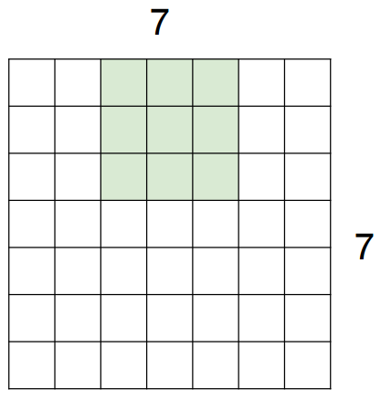
Recap: Applying convolutional filter
Example: Input = 7x7, Kernel Size = 3x3
Output = 5x5
Formula: N - K + 1
N - input size, K - kernel size
7 - 3 + 1 = 5

Slide 10
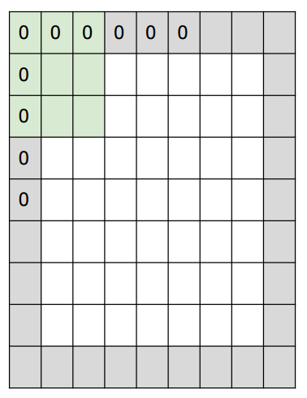
Recap: Padding
Add pixels on the border
Usually zeros (other options used as well)
Example: Input = 7x7, Padding = 1, Kernel Size = 3x3
Formula: N - K + 2 * P + 1
N - input size, K - kernel size, Padding size
7 - 3 + 2 * 1 + 1 = 7
Output size: 7x7

Slide 11
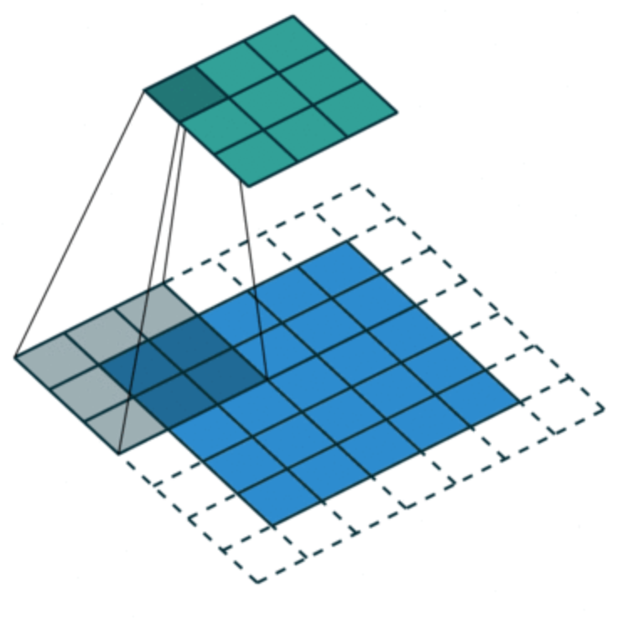
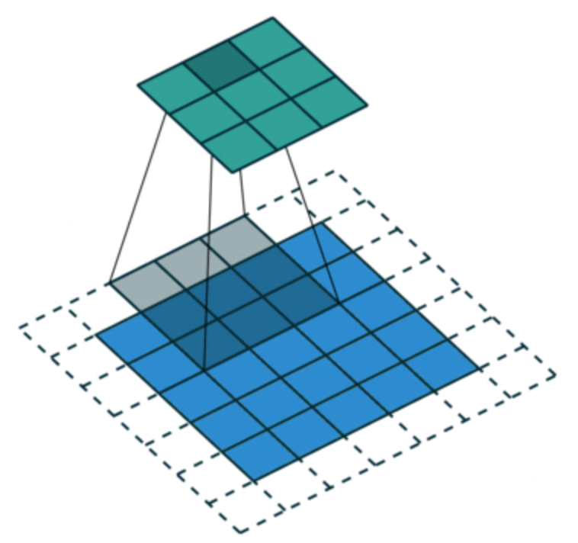
Recap: Stride
Skip L starting positions when aligning the kernel with the input
L = 2 => skip every second starting position
Example: Input = 5x5, Kernel Size = 3x3, Stride = 2, Padding = 1
Output size:
(N - K + 2*P) / stride + 1
N - input size K - kernel size
(5 - 3 + 2* 1) / 2 + 1
Output 3x3

Slide 12
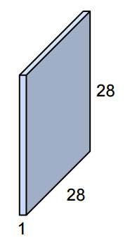
Recap: Convolutional Layer
Activation map
convolve (slide) over all spatial locations

Slide 13
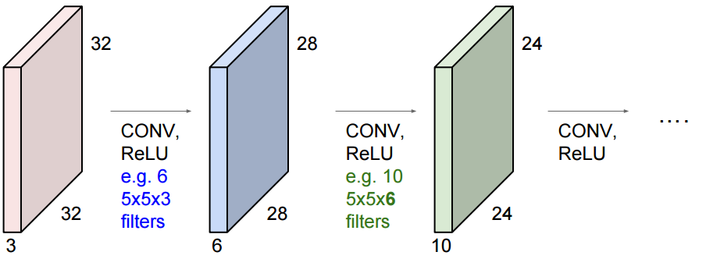
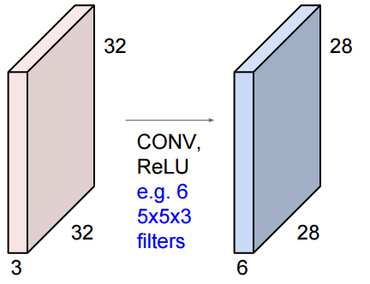
Recap: Convolutional Neural Network
ConvNet is a sequence of Convolution Layers, interspersed with activation functions

Slide 14
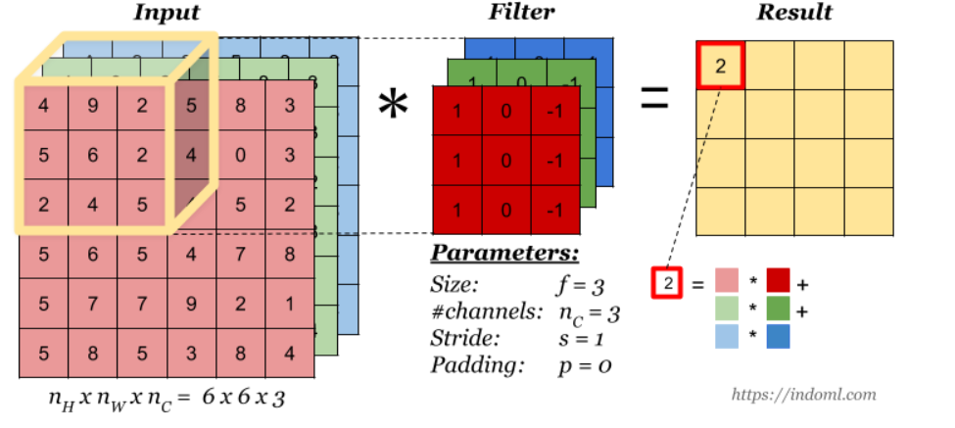
Recap: Convolutions with Color Channels

Slide 15
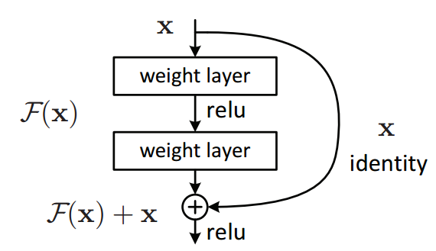
Recap:(ResNet)
Residual layer
The layer is called residual because it has to learn the residual mapping F(x)= H(x) - x

Slide 16
More on CNNs

Slide 17
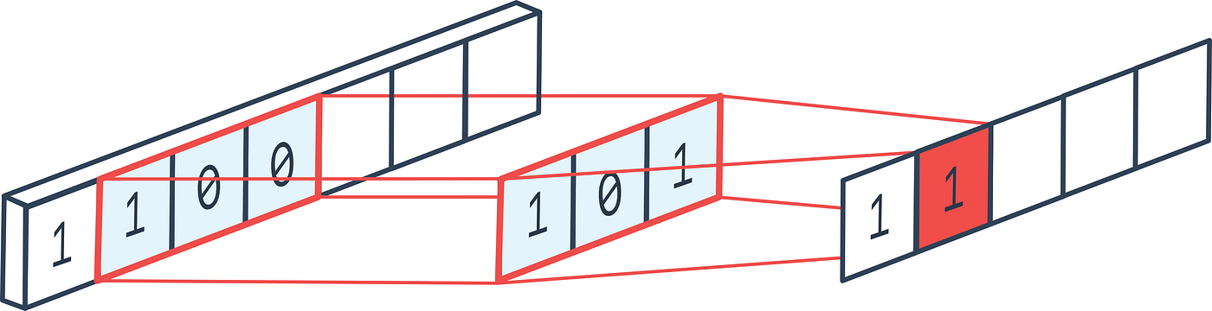
1D CNNs - torch.nn.Conv1d
Used with 1D signals - time series, text, etc.
The kernel moves over one spacial dimension
Notes:
Like complex culinary concoctions, written recipes can only get one so far. The skill in the deep learning world, like in the culinary one, lies in the ability to improvise and intuit slight tweaks that make the difference between something that merely somewhat works and a seminal advance.

Slide 18
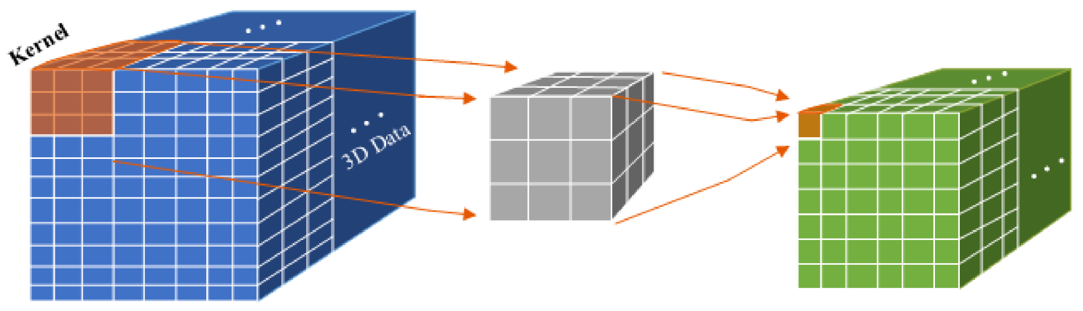
3D CNNs - torch.nn.Conv3d
Video has 3 spatial dimensions - time, height, width
Used with 3D input - e.g. medical images
A pixel in 3D space is called a voxel
The kernel moves over 3 spatial dimensions
Notes:
Like complex culinary concoctions, written recipes can only get one so far. The skill in the deep learning world, like in the culinary one, lies in the ability to improvise and intuit slight tweaks that make the difference between something that merely somewhat works and a seminal advance.

Slide 19
Grouped Convolutions
Parameter in Conv2d. Defaults to 1. (groups=1)
The deeper the networks becomes, the more features it usually has.
Groups controls the connection between the inputs and outputs. in_channels and out_channels must be divisible by groups
When groups==in_channels, the operation is known as “depthwise convolution”
https://www.youtube.com/watch?v=vVaRhZXovbw
Notes:
Like complex culinary concoctions, written recipes can only get one so far. The skill in the deep learning world, like in the culinary one, lies in the ability to improvise and intuit slight tweaks that make the difference between something that merely somewhat works and a seminal advance.

Slide 20
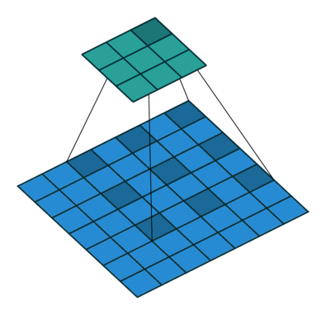
Dilated Convolutions
Parameter in Conv2d. Defaults to 1. (dilation=1)
Controls the spacing between the kernel points
Allows covering larger context without increasing the kernel size
Have been successfully applied in audio generation (WaveNet )
Notes:
Like complex culinary concoctions, written recipes can only get one so far. The skill in the deep learning world, like in the culinary one, lies in the ability to improvise and intuit slight tweaks that make the difference between something that merely somewhat works and a seminal advance.

Slide 21
More on Normalizations

Slide 22


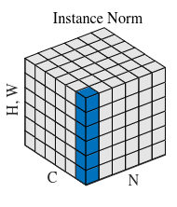
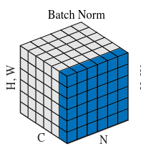
Instance Normalization
Permorms BN-like normalization but only for each sample
In BN where S_{i} is the set of pixels that the mean and std are calculated over.
i_{C} denotes the sub-index of i along the C axis.
Pixels sharing the same channel index are normalized together
IN:
Notes:
Like complex culinary concoctions, written recipes can only get one so far. The skill in the deep learning world, like in the culinary one, lies in the ability to improvise and intuit slight tweaks that make the difference between something that merely somewhat works and a seminal advance.

Slide 23

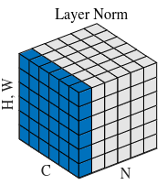
Layer Normalization
Computes mean and std along the (C,H,W) axes for each sample.
BN is tricky to apply to sequences, where each input sequence can be different length
BN is not trivial to parallelize
Used in Transformers
Notes:
Like complex culinary concoctions, written recipes can only get one so far. The skill in the deep learning world, like in the culinary one, lies in the ability to improvise and intuit slight tweaks that make the difference between something that merely somewhat works and a seminal advance.

Slide 24

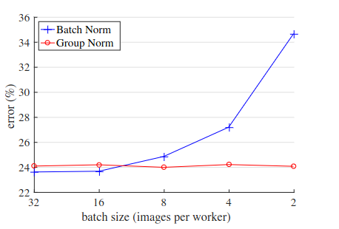
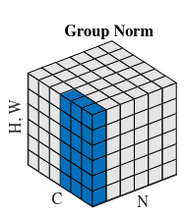
Group Normalization
G is the number of groups
GN becomes LN when G=1, GN becomes IN when G=C
Wu et al https://arxiv.org/pdf/1803.08494.pdf
Notes:
Like complex culinary concoctions, written recipes can only get one so far. The skill in the deep learning world, like in the culinary one, lies in the ability to improvise and intuit slight tweaks that make the difference between something that merely somewhat works and a seminal advance.

Slide 25
Inception

Slide 26
GoogLeNet (Inception)
Winner of the ILSVRC 2014 image classification competition
Novel layer called Inception
22 layers deep
Achieves 6.66 % Top-5 error rate

Slide 27
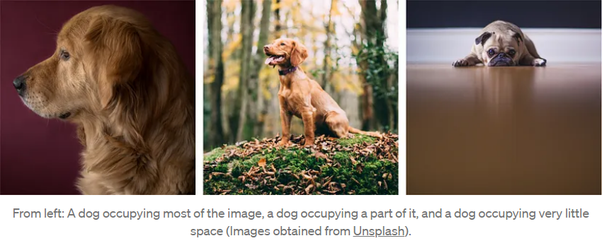
GoogLeNet (Inception) Motivation
The variation in the location of information, makes choosing the right kernel size tough.
A larger kernel is preferred for information that is distributed more globally
A smaller kernel is preferred for information that is distributed more locally.

Slide 28
GoogLeNet (Inception) Solution
For effective recognition of variable-sized feature, we need different kernels operating on the same level.
Multiple kernels of different sizes are implemented within the same layer.

Slide 29
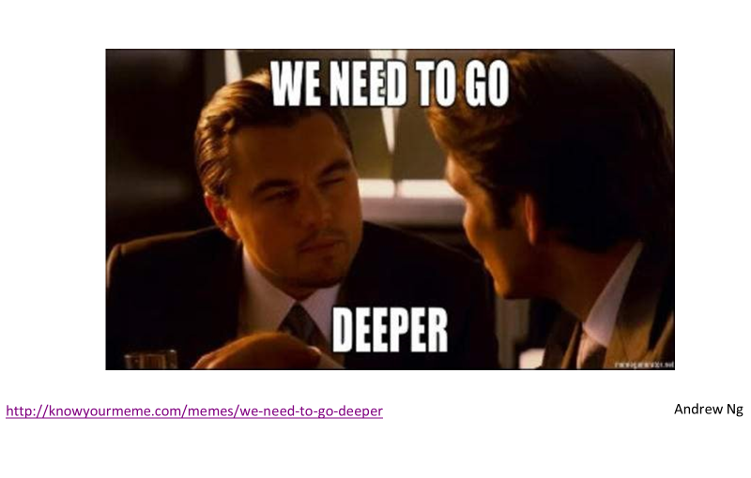
GoogLeNet (Inception)
Fun fact, this meme was referenced in the first inception net paper.

Slide 30
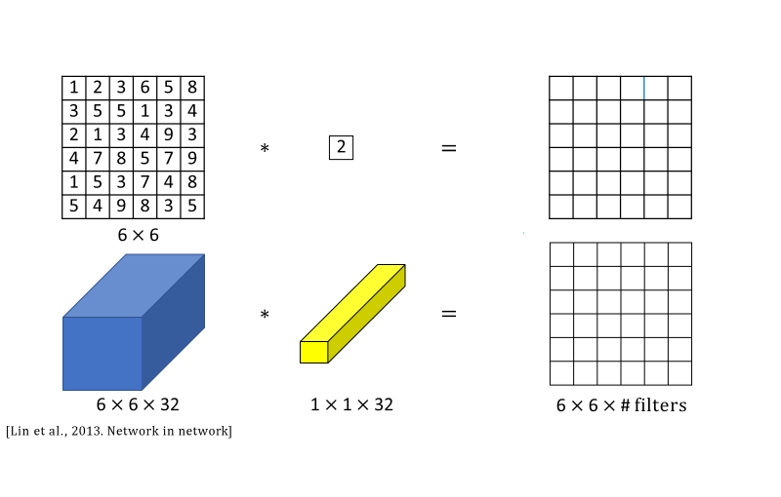
What does a 1 × 1 convolution do?

Slide 31
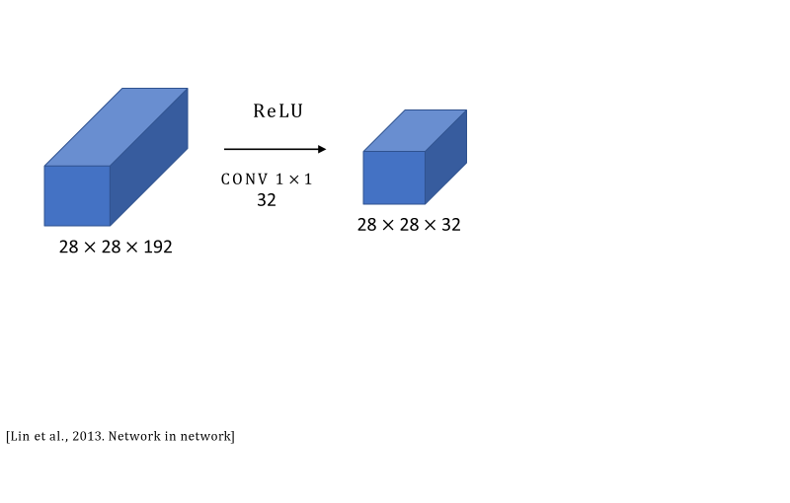
Using 1×1 convolutions to control the number of channels

Slide 32
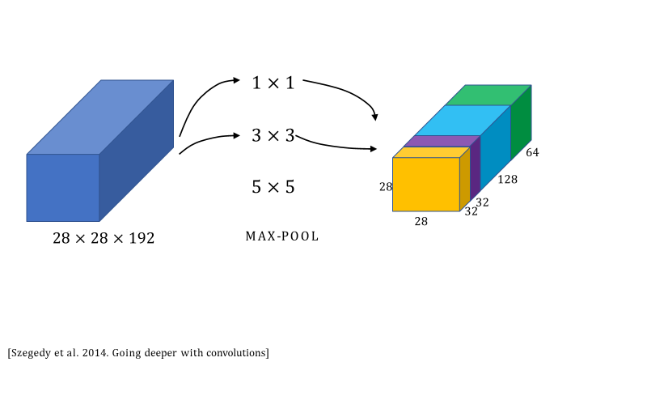
Inception Layer

Slide 33
Inception Layer
Each inception module consists of four operations in parallel
1x1 conv layer
3x3 conv layer
5x5 conv layer
max pooling but with padding ‘same’

Slide 34
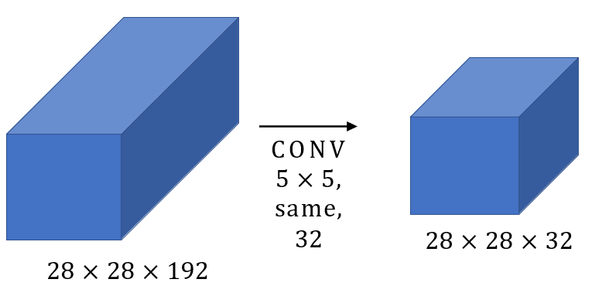
Problems with Computation
Filters - 32 Filter Size - 5x5x192
Total Multiplications:28*28*32*5*5*192 120 million operations

Slide 35
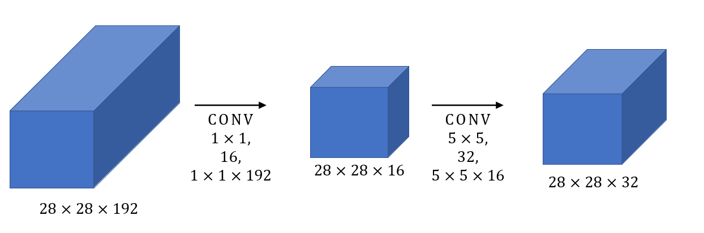
Problem with Computational Cost
Filters : 16
Size: 1X1
Multiplications: 28 *28*16 * 192 = 2.4m
Filters : 32
Size: 5x5
Multiplications: 28 *28*32 * 5*5*16= 10m

Slide 36
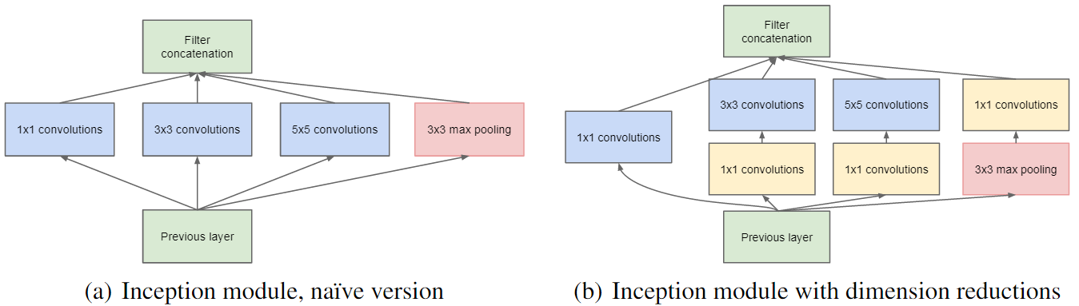
Inception Layer
1x1 convolutions are used to reduce the dimensions of the feature maps resulting in less computations overall

Slide 37
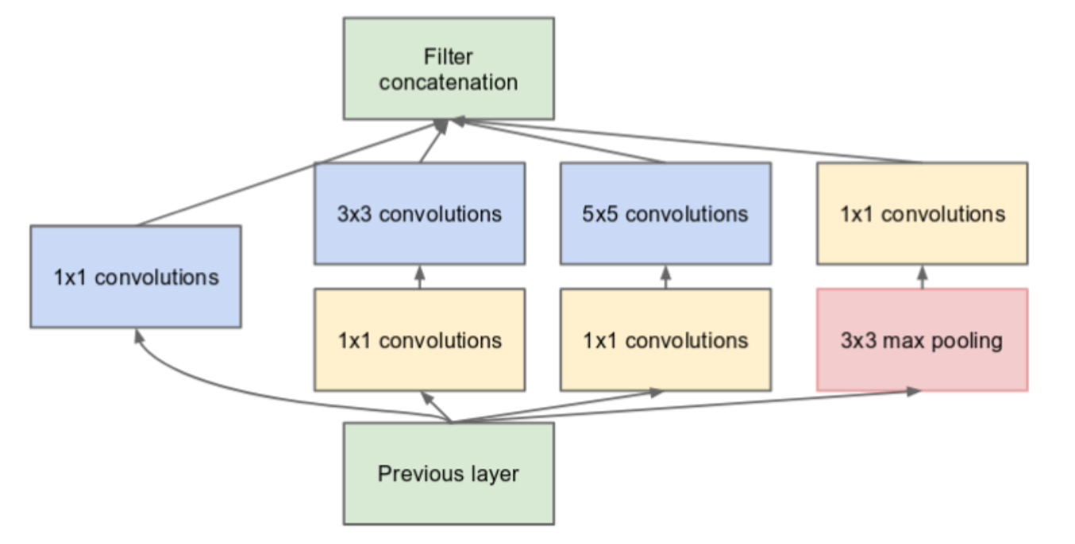
GoogleNet: Representational Bottleneck
If the dimensional reduction from the 1x1 convolution is too high the network loses too much information.
This is known as the representational bottleneck

Slide 38
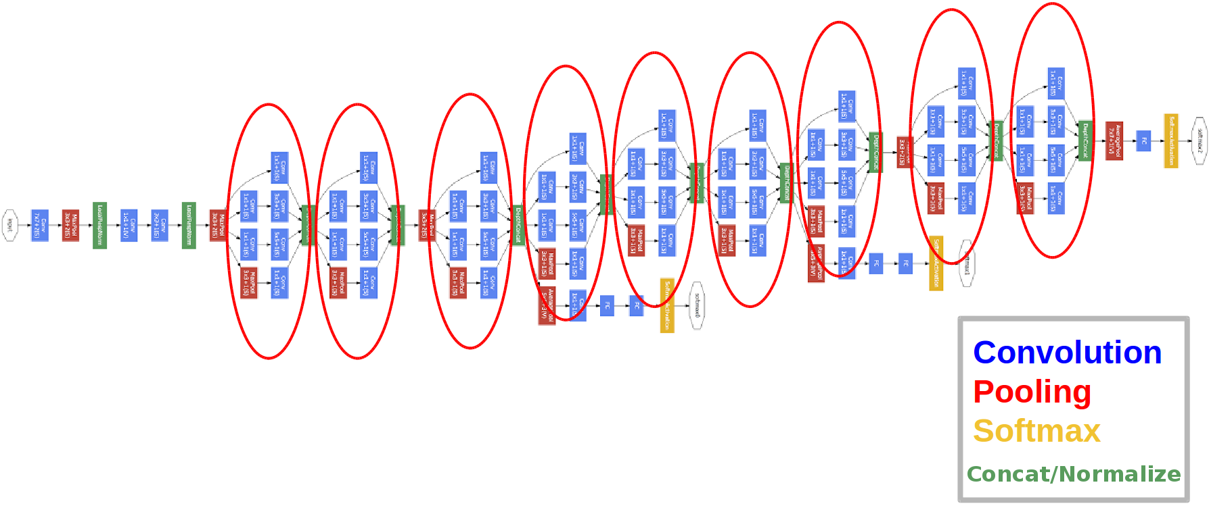
GoogLeNet (Inception v1)
9 Inception blocks 22 Layers in total

Slide 39
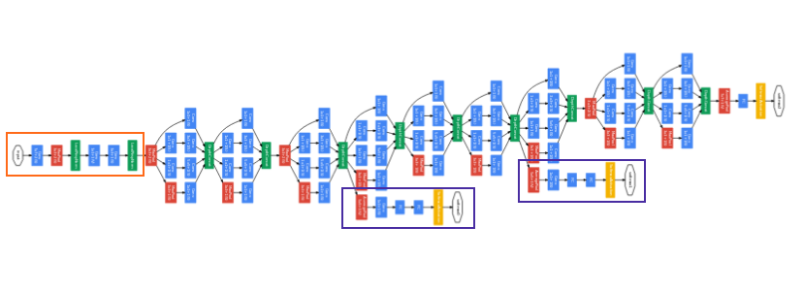
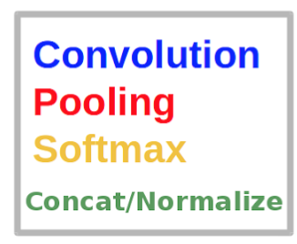
GoogleNet: Auxiliary classification heads
Deeper networks suffer from the vanishing gradient problem => Improve feedback flow by adding classification heads spanning from early layers

Slide 40
GoogleNet: Auxiliary classification heads
GoogLeNet is a deep classifier and suffers from vanishing gradient
To prevent the middle part of the network from “dying out”, two auxiliary classifiers were introduced
The total loss is a weighted sum of the auxiliary loss and the real loss.
Weight value used in the paper was 0.3 for each auxiliary loss.
total_loss = real_loss + 0.3 * aux_loss_1 + 0.3 * aux_loss_2
The auxiliary loss is purely used for training purposes, and is ignored during inference.

Slide 41
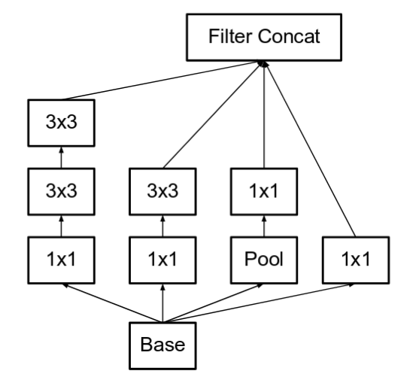
Inception v2
Published in 2015
Factorize the 5x5 convolution to a cascade of 2 3x3 convolutions
Improves speed by factorization
2.78 faster to apply 2 3x3 than 1 5x5

Slide 42
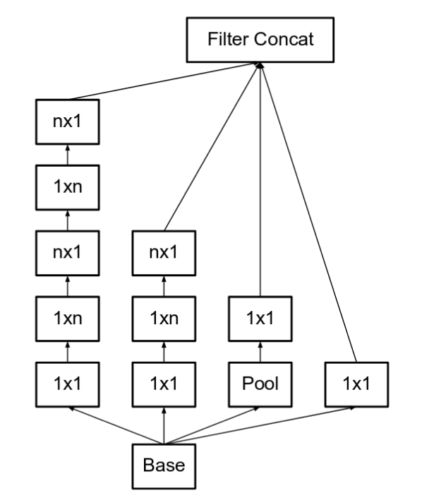
Inception v2: Further factorization
They factorize convolutions of filter size nxn to a combination of 1xn and nx1 convolutions.
A 3x3 convolution is equivalent to first performing a 1x3 convolution, and then performing a 3x1 convolution on its output.
This method to be 33% cheaper than the single 3x3 convolution.

Slide 43
Inception v3
Published in 2015
In addition to v2 improvements:
RMSProp Optimizer
Factorized 7x7 convolutions.
BatchNorm in the Auxiliary Classifiers.
Label Smoothing the ground-truth label (i.e., the correct class label) for a training example with a smoothed distribution over all classes - the ground-truth label [1, 0, 0] is replaced with a smoothed distribution, such as [0.9, 0.05, 0.05] or [0.7, 0.1, 0.2]

Slide 44
MobileNet

Slide 45
MobileNet Motivation
Published in 2019
Low computational cost at deployment
Useful for mobile vision applications
The big idea behind MobileNet is that convolutional layers, which are expensive to compute be replaced by so-called depthwise separable convolutions.

Slide 46
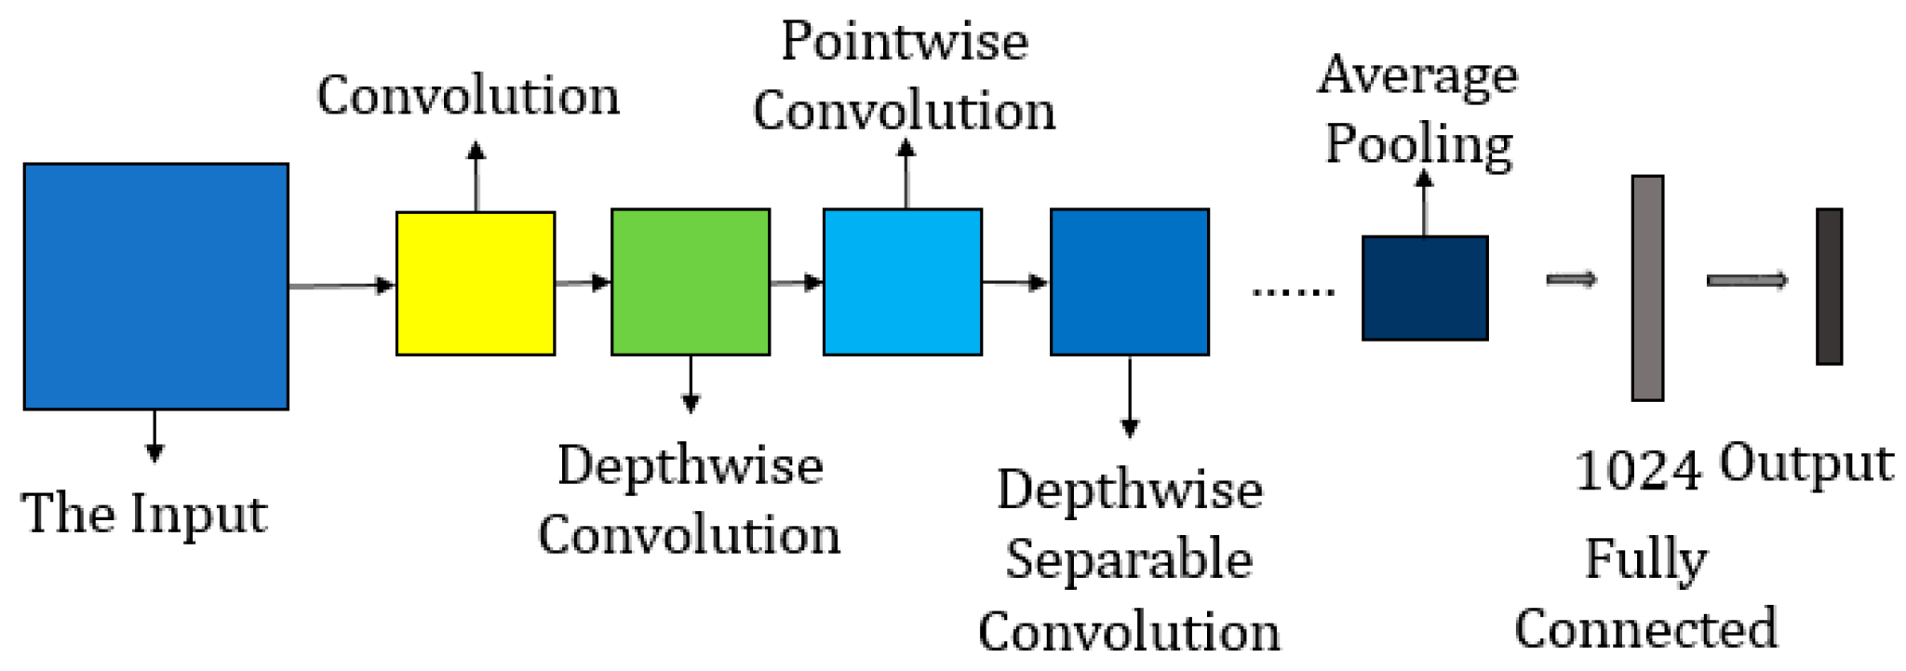
MobileNet Idea
The job of the convolution layer is split into two subtasks:
Depthwise and pointwise form a “depthwise separable” convolution block
Depthwise separable block does the same as traditional convolution but faster.

Slide 47
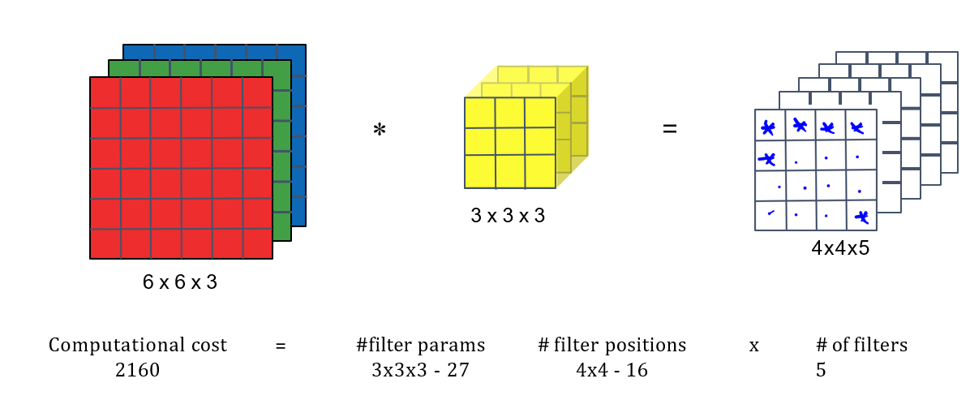
Normal Convolution

Slide 48
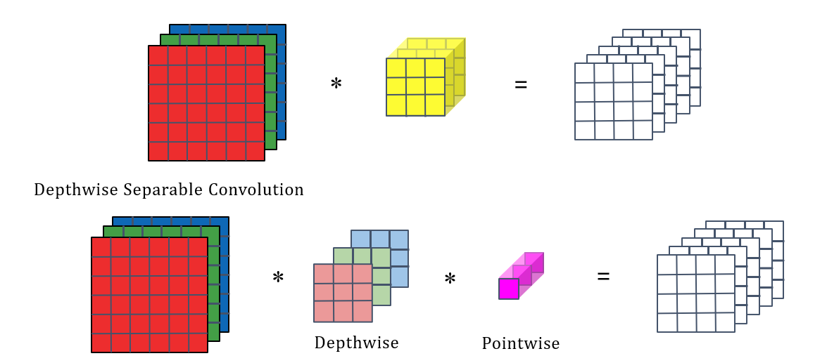
Depthwise Separable Convolution

Slide 49
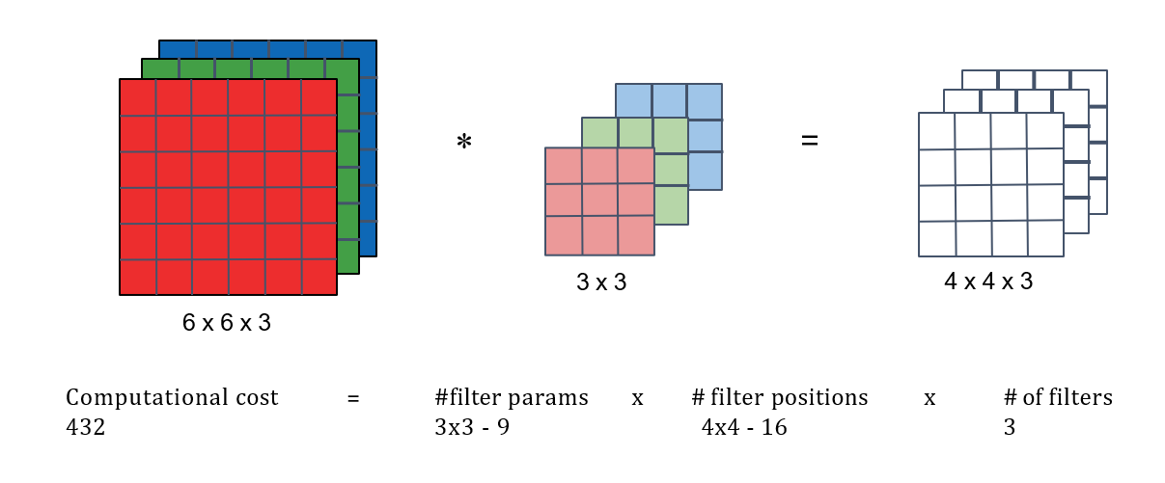
Depthwise Convolution

Slide 50
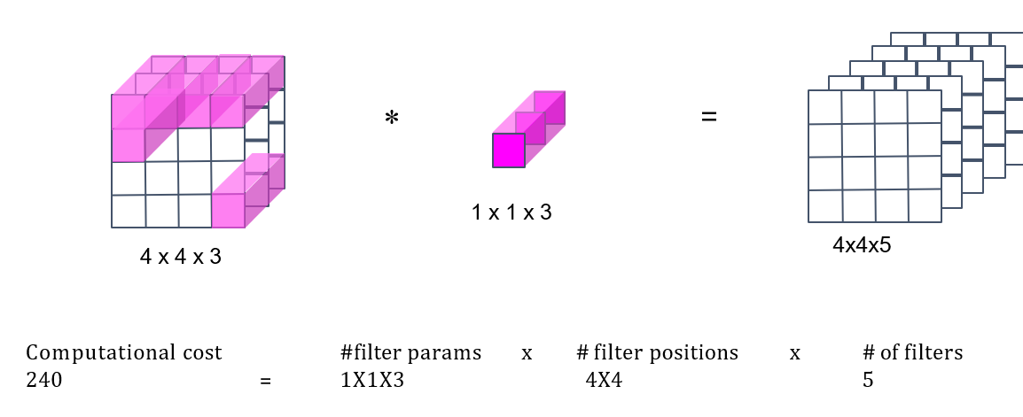
Pointwise Convolution

Slide 51
Cost Of Computation Summary
Cost of normal convolution - 2160
Cost of depthwise separable convolution = 432 (depth) + 240 (point) = 672

Slide 52
MobileNet V1 Architecture
MobileNet architecture has 13 times “depthwise separable” convolution block
There are no pooling layers instead a stride of 2 is used
When that happens, we doubles the number of output channels.
Input image: 224×224×3 -> Output: 7×7×1024

Slide 53
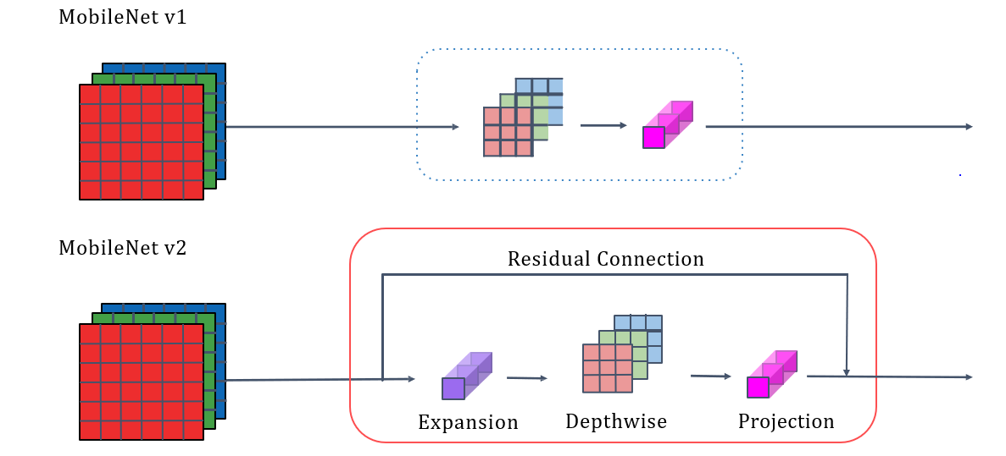
MobileNet Architecture V1 and V2

Slide 54
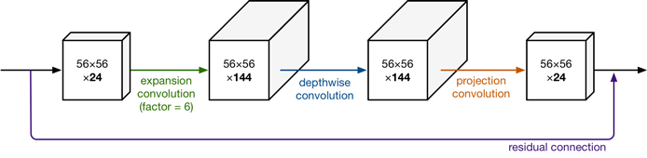
MobileNet Architecture V2
The expansion layer acts as a decompressor of the data
Depthwise layer performs the filtering at this stage of the network
The projection layer compresses the data to make it small again.
The second new thing in MobileNet V2’s building block is the residual connection.

Slide 55
MobileNet Architecture V2
The full MobileNet V2 architecture consists of 17 blocks in a row.
This is followed by a regular 1×1 convolution, a global average pooling layer, and a classification layer.

Slide 56
EfficientNet

Slide 57
EfficientNet Main Idea
Developed in 2019
Compound scaling - uniformly scale all dimensions using a compound coefficient.
Depth - number of layers
Width - the number of channels
Resolution - width and length of the input to each layer
For big images the network needs more layers to increase the receptive field and more channels to capture more fine-grained patterns.

Slide 58
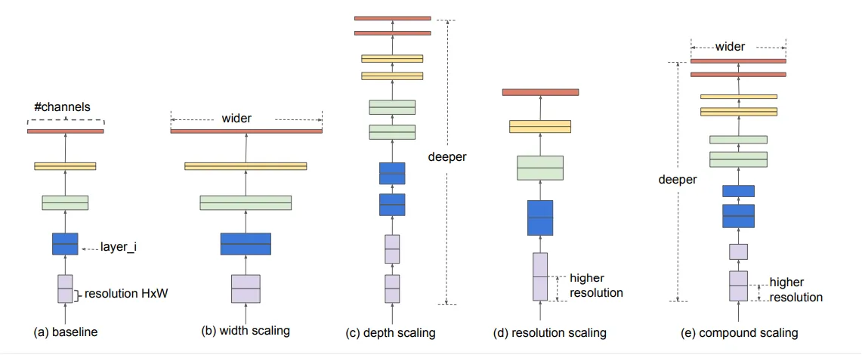
Scaling Network Dimensions

Slide 59
EfficientNet Main Additional Improvements
Architecture Search - a process that automatically searches for the best neural network architecture for a given task.
The compound scaling method is justified by Efficient Blocks: based on the inverted bottleneck residual blocks of MobileNetV2

Slide 60
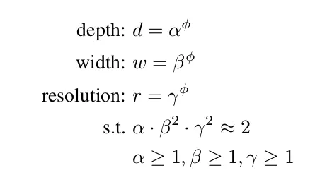
Compound Scaling
α, β, and γ are network’s depth, width, and resolution
α, β, and γ are determined using grid search with ɸ=1 (AutoML)
Then the compound coefficient ɸ can be increased to get larger models
ɸ is a user-defined, global scaling factor that controls how many resources are available
This was how EfficientNet-B1 to EfficientNet-B7 are constructed

Slide 61
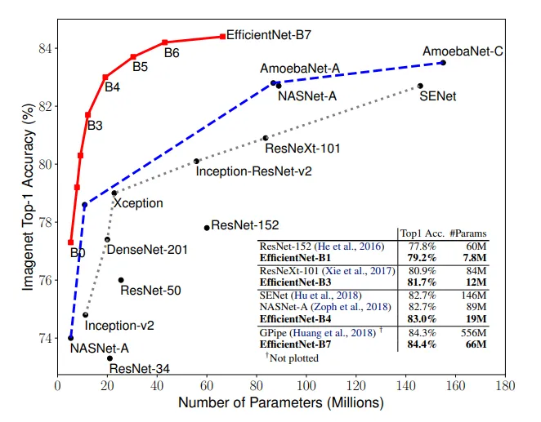
EfficientNet Performance

Slide 62
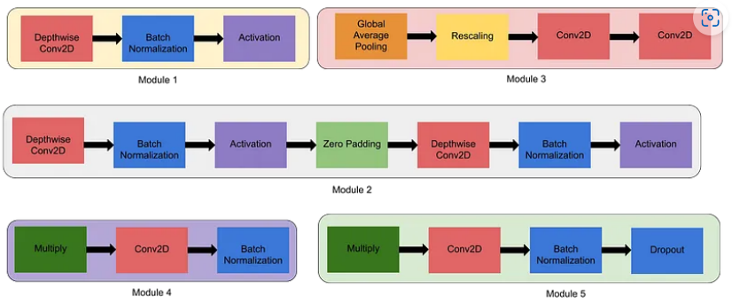
Modules in EfficientNet

Slide 63
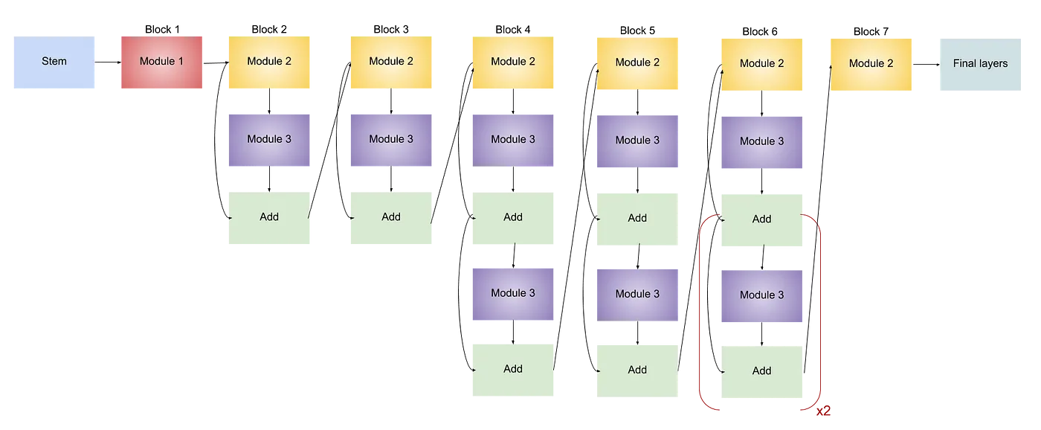
EfficientNet B0 Architecture

Slide 64

EfficientNet B7 Architecture

Slide 65
History of Model Performance Top 5 Error Rate
2010, the best-performing model 28.2%.
2012 AlexNet 15.3%
2014 GoogLeNet (Inception-v1) 6.7%
2015, Inception-v2 4.0%.
2016 ResNet-152 3.0%.
2019 EfficientNet-B7 1.5%.
Human 5.1%

Slide 66


Vision Transformer (ViT): An Image is Worth 16x16 words
Naive application of self-attention would require each pixel to attend on every other. This does not scale!
Solution: Break down image in patches.
The Transformer’s sequence length is inversely proportional to the square of the patch size.
Smaller patches -> slower.

Slide 67


Swin Transformer: Hierarchical Vision Transformer using Shifted Windows
The main drawback of Vision Transformer (ViT) is the model still requires a lot of training data.
The main idea behind the Swin transformer is to use window attention and to merge the patches

Slide 68

Swin Transformer: Hierarchical Vision Transformer using Shifted Windows
The main drawback of Vision Transformer (ViT) is the model still requires a lot of training data.
The main idea behind the Swin transformer is to use window attention, shifted window attention and to merge the patches

Slide 69

A ConvNet for the 2020s
Convolutional neural networks are still state of the art for a lot of CV tasks if trained efficiently

Slide 70

A ConvNet for the 2020s
Larger kernels
Replacing ReLU with GELU
Fewer activation functions
Fewer normalization layers
Substituting BN with LN
Separate downsampling layers

Slide 71
MaxViT: Multi-Axis Vision Transformer
Transformers are back!

Slide 72

MaxViT: Multi-Axis Vision Transformer Architecture

Slide 73

MaxViT: Multi-Axis Vision Transformer Tricks
Both window and grid attention.

Slide 74
Semantic segmentation with UNet

Slide 75

Slide from: DeepLearning.ai

Slide 76

Slide from: DeepLearning.ai

Slide 77

Slide from: DeepLearning.ai

Slide 78

Slide from: DeepLearning.ai

Slide 79

Before Unet

Slide 80
Transposed Convolution
torch.nn.ConvTranspose2d
Projects feature map to a higher-dimensional space
Sometimes it’s referred to as “deconvolution”, although it’s not an actual deconvolution operation, i.e. it does not compute the true inverse of the convolution

Slide 81

Regular Convolution
output
input
Dumoulin et al. “A guide to convolution arithmetic for deep learning”

Slide 82

Transposed Convolution
output
input
Dumoulin et al. “A guide to convolution arithmetic for deep learning”

Slide 83

Transpose Convolution (emulated with direct conv)
output
input
Dumoulin et al. “A guide to convolution arithmetic for deep learning”

Slide 84


Transpose Convolution and Checkerboard artifacts
https://distill.pub/2016/deconv-checkerboard/

Slide 85
Idea: Interpolation(upsampling) + Regular conv
torch.nn.Upsample
Possible upsampling algorithms: linear, bilinear, bicubic, nearest neighbour

Slide 86

Fully Convolutional Networks

Slide 87

Slide from: DeepLearning.ai

Slide 88

Slide from: DeepLearning.ai

Slide 89

Slide from: DeepLearning.ai

Slide 90

Unet

Slide 91
Unet tricks
Weighted by class loss
Dice loss or separation border loss
Gradient accumulation
Data augmentation

Slide 92


Unet tricks separation border loss

Slide 93

Unet tricks

Slide 94

Dice Loss

Slide 95
Unet tricks Gradient accumulation
Simulates larger batch sizes by accumulating the gradients from multiple smaller batches before performing a weights update.
Helps you work around the hardware limitations
If the batch size that fits in memory is large enough, gradient accumulation is not necessary.
Unet uses a physical batch size of 1

Slide 96
Unet tricks Data Augmentation
The training samples used where only 30 but through data augmentation sufficient results were achieved
“In case of 6 microscopical images we primarily need shift and rotation invariance as well as robustness to deformations and gray value variations. Especially random elastic deformations of the training samples seem to be the key concept to train a segmentation network with very few annotated images. We generate smooth deformations using random displacement vectors on a coarse 3 by 3 grid. The displacements are sampled from a Gaussian distribution with 10 pixels standard deviation. Per-pixel displacements are then computed using bicubic interpolation. Drop-out layers at the end of the contracting path perform further implicit data augmentation.”

Slide 97

Unet Results

Slide 98

Unet Results

Slide 99
Questions?

