Slide 1
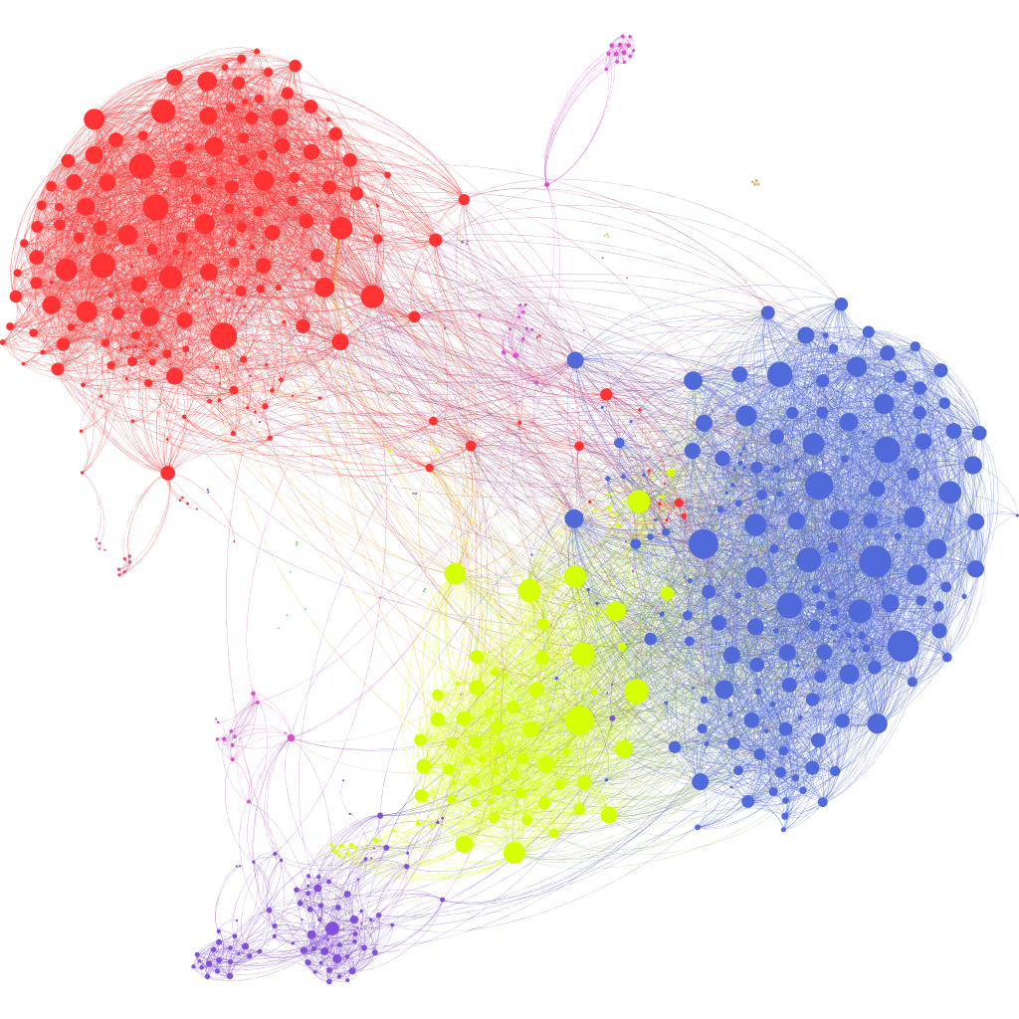
Intro to NLP Word Embeddings
Natural Language Processing

Slide 2
Agenda
Statistical Language Models
N-gram Language Models
Fixed-window Neural Language Model
Word Embeddings
Random Indexing
Word2Vec

Slide 3
Statistical Language Model

Slide 4
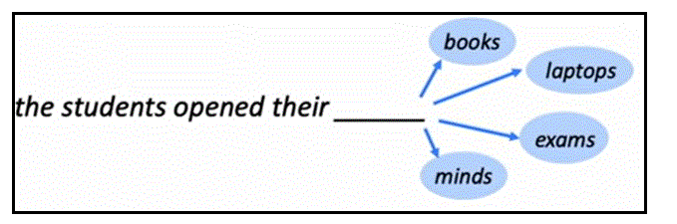
Language Model
A (statistical/stochastic/probabilistic) language model predicts the probability of the next word, based on the preceding words.

Slide 5
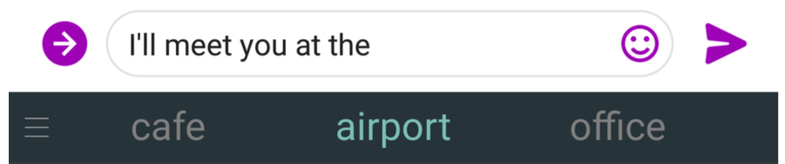
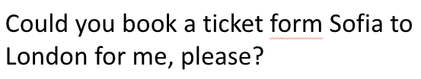
Real life examples

Slide 6

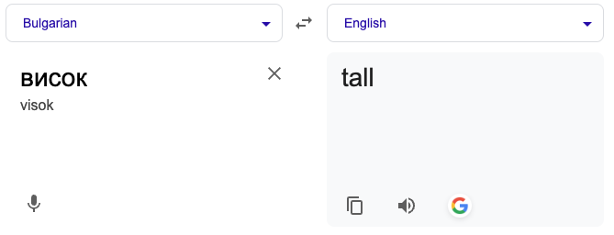
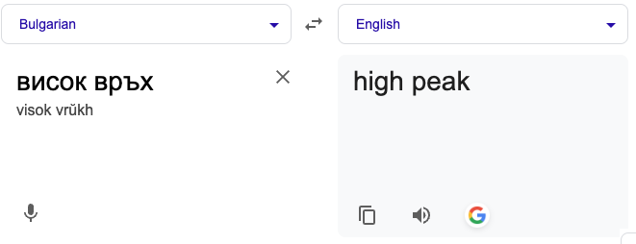
Real life examples
It is hard to recognize speech vs.
It is hard to wreck a nice beach

Slide 7

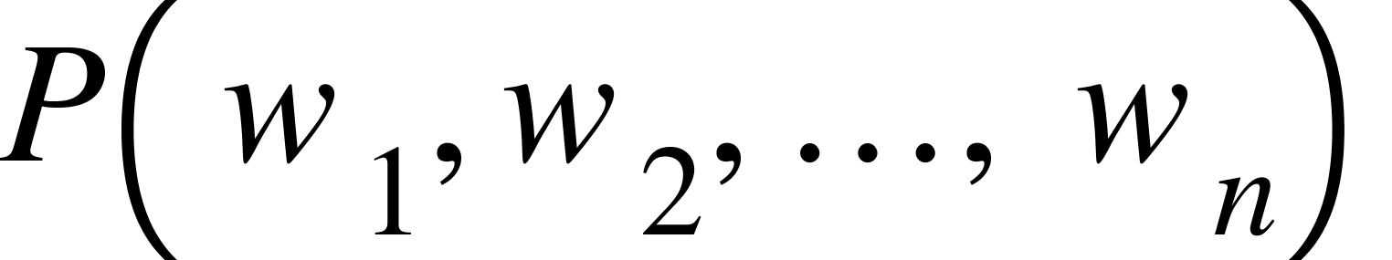
Some definitions
The probability of the word w. Picking a random word from a text, what is the probability that that word will be w?
The probability of the sequence w₁w₂ . . . w_{n}. Picking a random sequence of n words from a text, what is the probability that that sequence will be w₁w₂ . . . w_{n}?

Slide 8
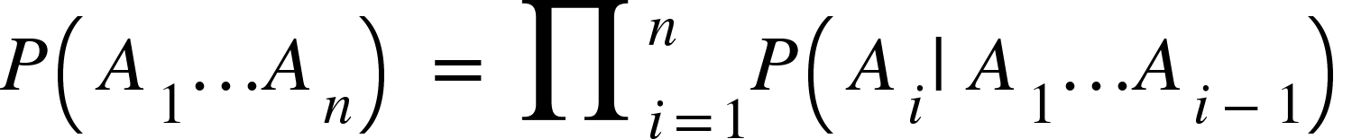
A little probability
The chain rule rewrites a joint probability into a product of conditional probabilities:
In general:

Slide 9
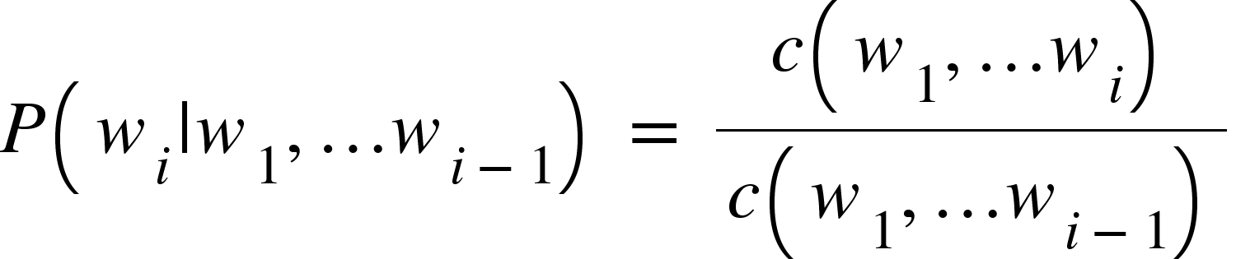
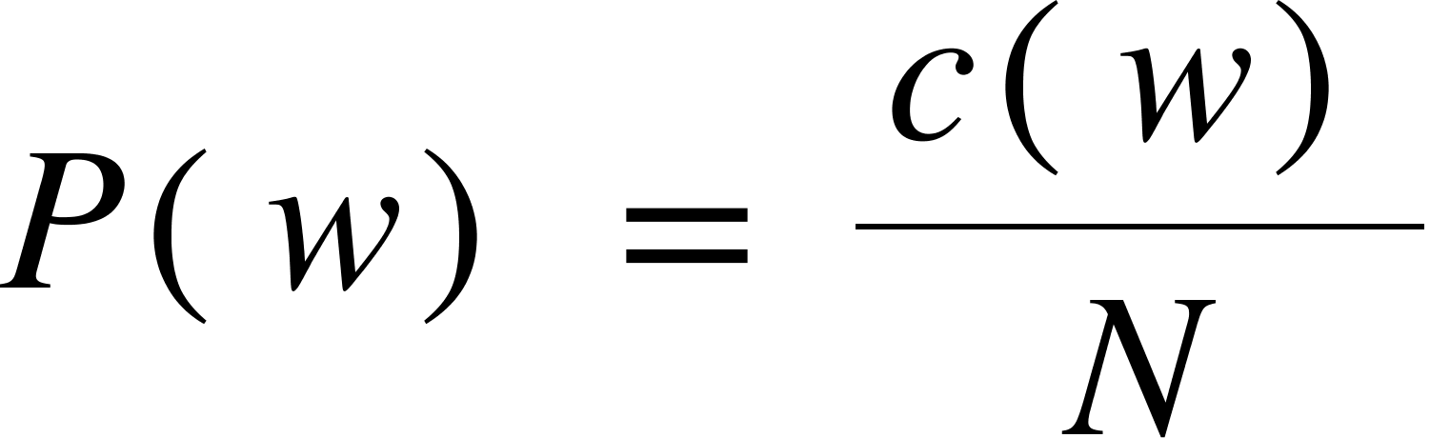
Practically…
The way we estimate this is via maximum likelihood estimation (MLE)
And for word probabilities:
where N is the size of the corpus

Slide 10
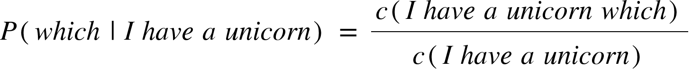
Practically we have a problem
The way we estimate this is via maximum likelihood estimation (MLE)
Let us take the sentence “I have a unicorn which is blue”
We have never seen the combination of words “I have a unicorn”

Slide 11
n-gram Language Model

Slide 12
n-gram Language Models
The idea is to consider limited context before the word
unigrams - we do not consider the context
bigrams - we consider only the previous word
trigrams - we consider only the previous 2 words
4-grams - we consider only the previous 3 words
etc.

Slide 13
n-gram Language Models
In our unicorn example
unigrams:
bigrams:
trigrams:
4-grams:
etc
We do this again my MLE, which is reduced to counting the number of appearances of each n-gram.

Slide 14
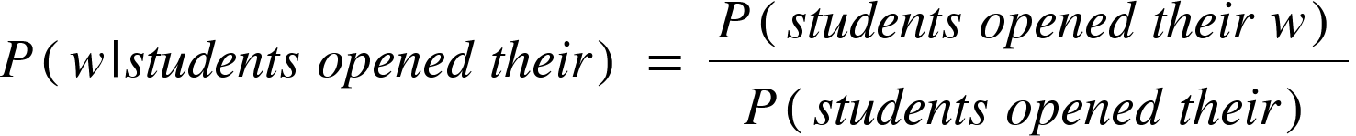
n-gram Language Models
Back to our students example:
The students opened their _______
Let’s use a 4-gram language model:
students opened their appears 100 times in the corpus
students opened their books appears 40 times → 0.4
students opened their exams appears 21 times → 0.21
students opened their laptops appears 15 times → 0.15
students opened their minds appears once → 0.01

Slide 15
Text Generation

Slide 16
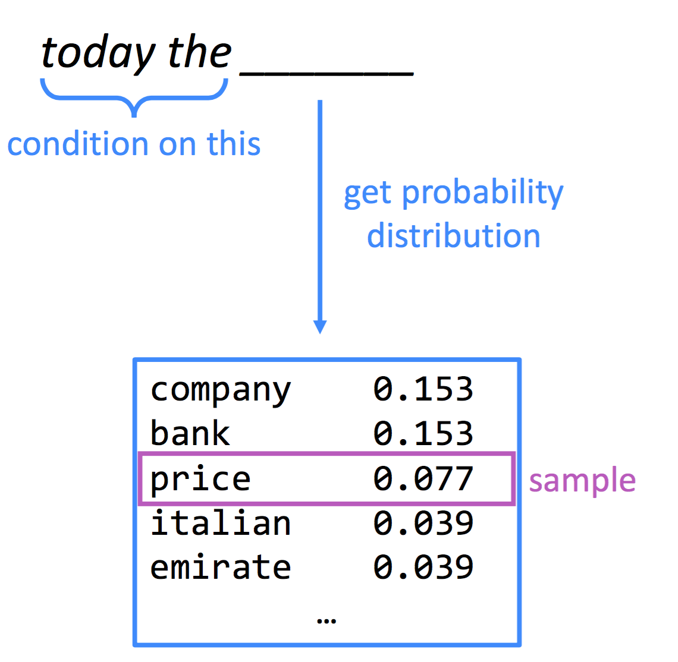
Generating text with Language models

Slide 17
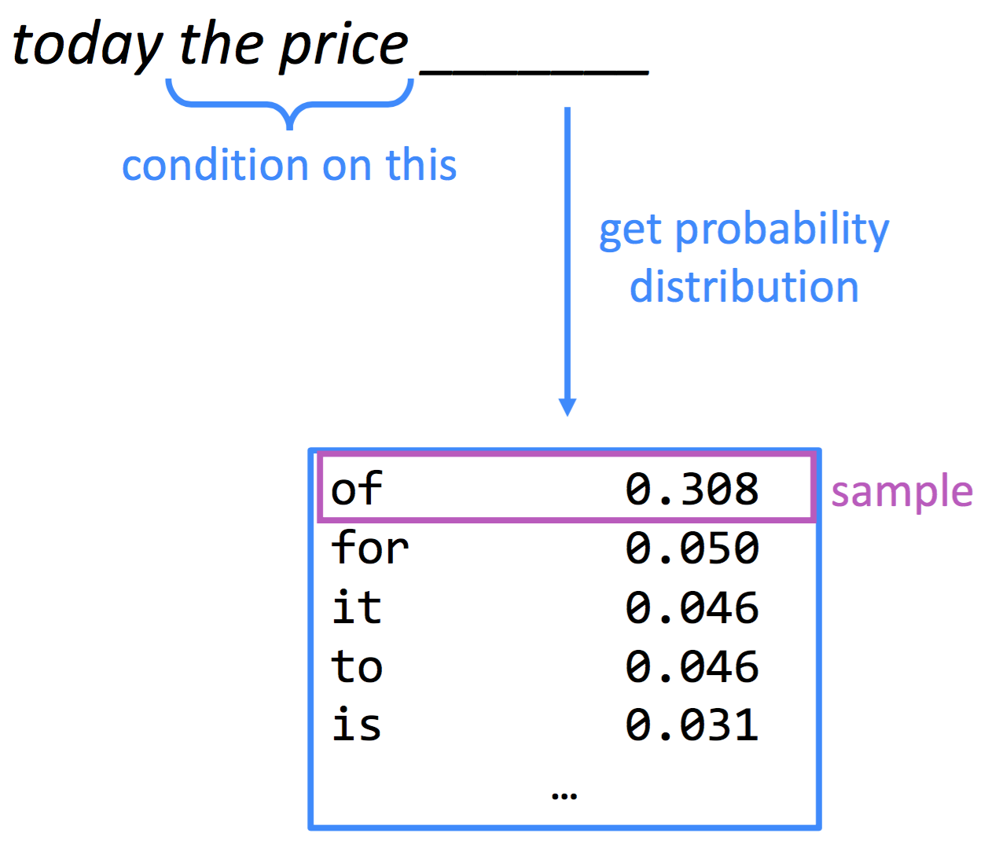
Generating text with Language models

Slide 18
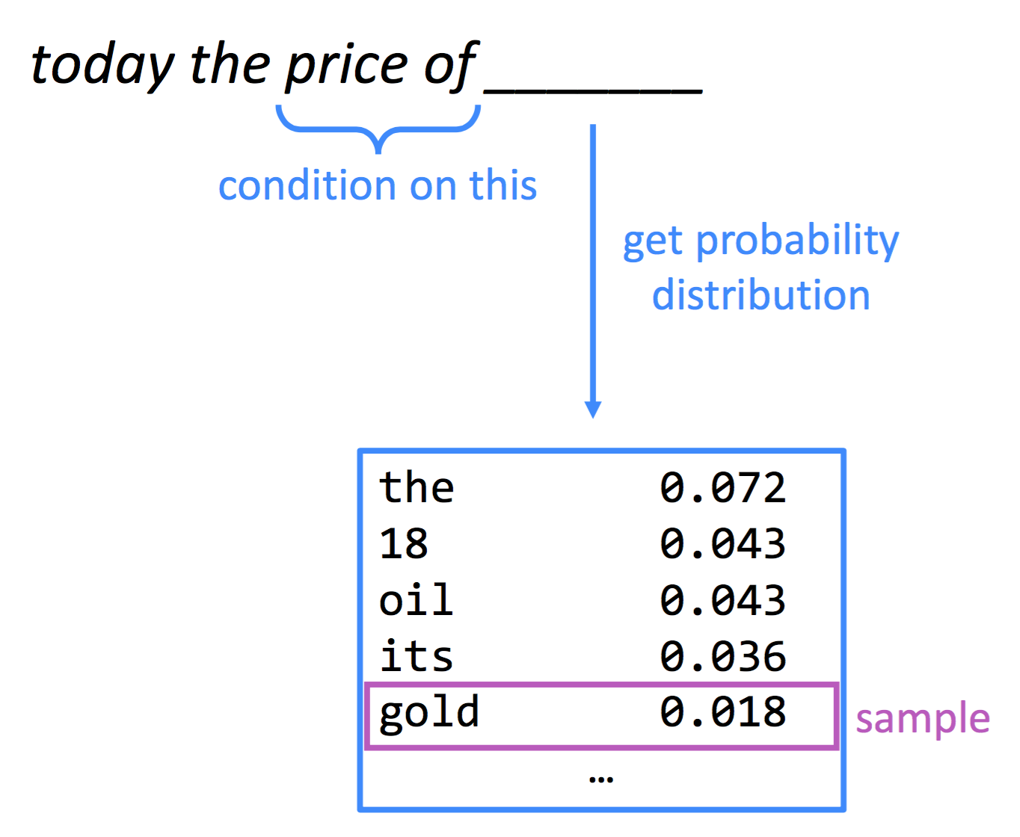
Generating text with Language models

Slide 19
Problems with n-gram Language Models
Sparsity:
what if “students opened their w_{j}” never occurred in the corpus
what if “students opened their” never occurred in the corpus
increasing n only makes the sparsity problem worse
Storage:
need to store count for every n-gram
increasing n makes the model bigger

Slide 20
Fixed-window Neural Language Model

Slide 21
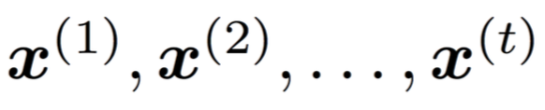

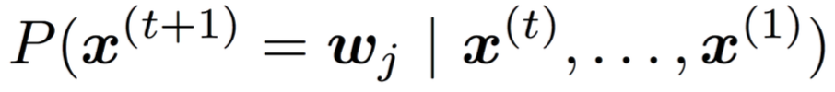
Fixed-window Neural Language Model
Input: sequence of words
First layer: concatenation of the vector representation of each word x of the input.
Output: probability distribution of the next word

Slide 22
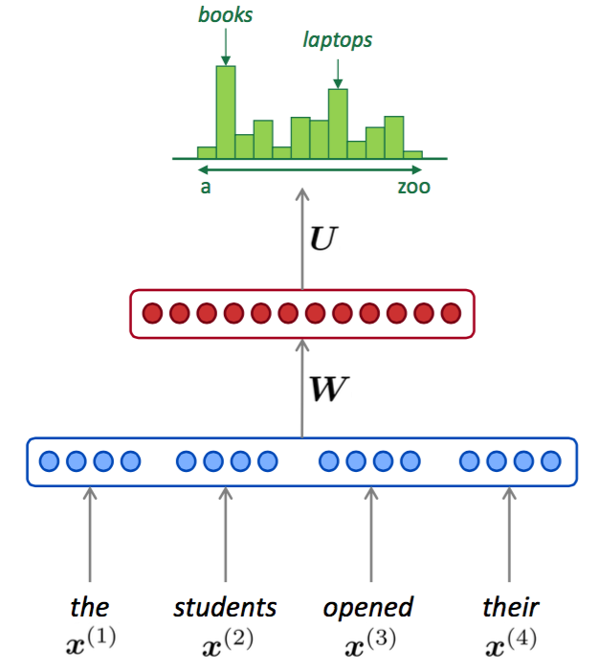
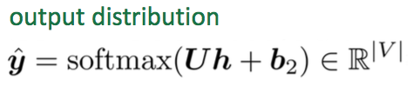
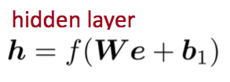

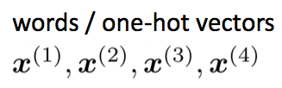
Fixed-window Neural Language Model

Slide 23
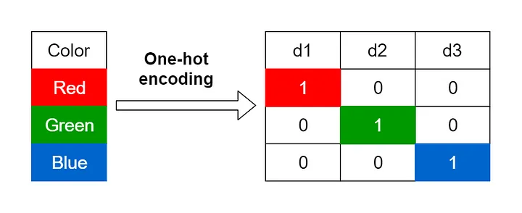
One-hot vector
This is a vector with exactly one 1 and everything else is zero
d4
0
0
0
Yellow
0
0
0
1
Image from https://towardsdatascience.com/encoding-categorical-variables-one-hot-vs-dummy-encoding-6d5b9c46e2db

Slide 24
Embedding
This is a non-sparse vector representation (of a word/token in NLP)
d4
Embedding
0
0
0
Yellow
1
1
0
1
Image from https://towardsdatascience.com/encoding-categorical-variables-one-hot-vs-dummy-encoding-6d5b9c46e2db

Slide 25
Semantic Embeddings

Slide 26
Word meaning
John Rupert Firth:
“You shall know a word by the company it keeps.”

Slide 27
Word2Vec

Slide 28
Word2Vec
Mikolov et al 2013a Efficient Estimation of Word Representations in Vector Space
Learning representation of words via its context
Context is the words (typically 1-5 words before AND after the target word)
Two model objectives
Continuous Bag of Words (CBOW)
Skip-gram

Slide 29
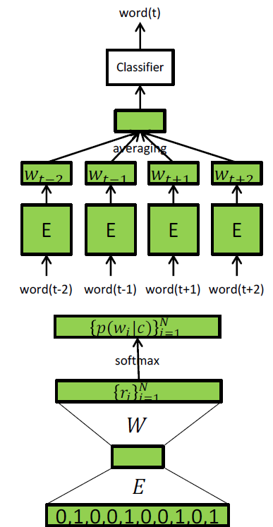
CBOW
Idea: train a classifier
Input: the context
Target: predict target word via its context
… Mrs. Dursley, of number four, Privet Drive,...
Input: Dursley, of, four, Privet
Target: number

Slide 30
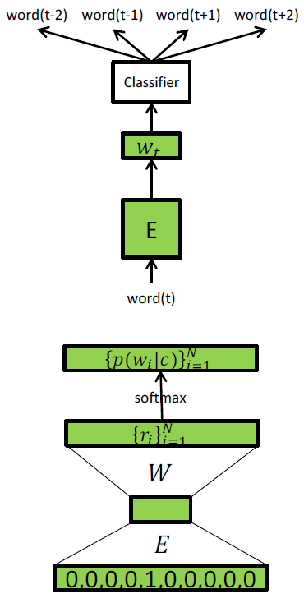
Skip-gram
Input: the focus word
Target: predict the context
… Mrs. Dursley, of number four, Privet Drive,...
Input: number
Target: Dursley, of, four, Privet

Slide 31
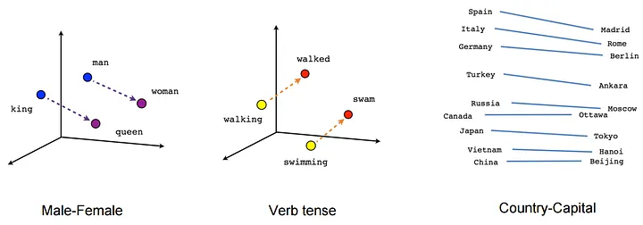
Geometry of the Embedding Space
Image from https://towardsdatascience.com/creating-word-embeddings-coding-the-word2vec-algorithm-in-python-using-deep-learning-b337d0ba17a8

