Slide 1
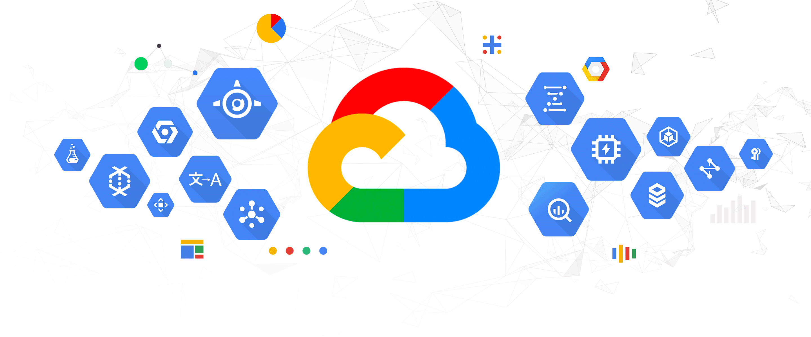
GOOGLE CLOUD PLATFORM

Slide 2




GROUP - 8
Team Members:
Sai Chandhu Gampa Sai Jyothsna Mathi Alekya Pochampally Dheeraj Edupuganti

Slide 3
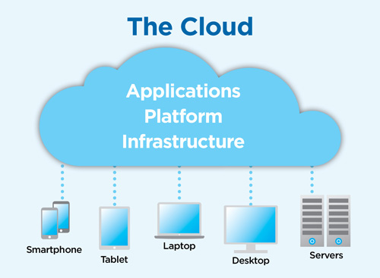
What is the Cloud?
"The Cloud" refers to software and databases that run on servers which are accessed over the Internet.
Cloud servers are located in data centers all over the world.
Sai Chandu Gampa

Slide 4
What is Cloud Computing:
Cloud Computing is the use of hardware and software to deliver a service over a network (typically the Internet).
With cloud computing, users can access files and use applications from any device that can access the Internet..
Sai Chandu Gampa

Slide 5
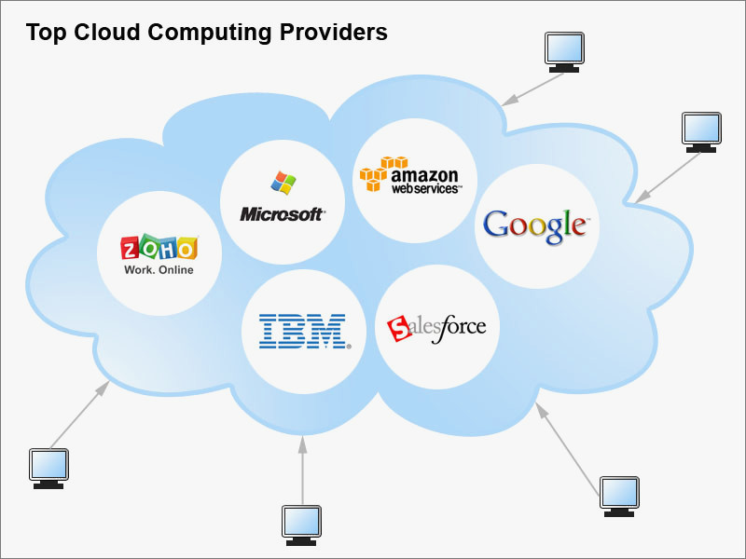
Cloud Computing Providers:
Sai Chandu Gampa

Slide 6
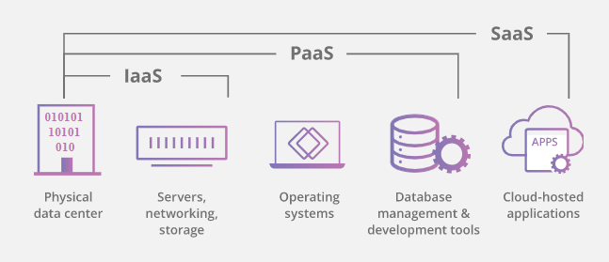
Cloud Industry Service Levels:
SaaS: Software as a Service
  SaaS utilizes the internet to deliver applications, which are managed by a third-party vendor, to its users.
PaaS: Platform as a Service
  PaaS delivers a framework for developers that they can build upon and use to create customized applications.
IaaS: Infrastructure as a Service
  IaaS is fully self-service for accessing and monitoring computers, networking, storage, and other services.
Sai Chandu Gampa

Slide 7
What is GCP..??
Google Cloud Platform is a suite of public cloud computing services offered by Google.
The platform includes a range of hosted services for compute, storage and application development that run on Google hardware.
Dheeraj Edupuganti

Slide 8
Why GCP?
Run on Google’s Infrastructure
Build on the same infrastructure that allows Google to serve billions of users in milliseconds.
Global Redundancy
Redundancy
Innovative Infrastructure.
Dheeraj Edupuganti

Slide 9
2)Focus on your product:
Rapidly develop, deploy and iterate your applications without worrying about system administration.
Managed services
Developer Tools and SDKs
Console and Administration
Dheeraj Edupuganti

Slide 10
3)Mix and Match Services:
Virtual Machines, Managed Platform, Blob Storage, Block Storage, NoSQL data store. GCP has all the services your application needs.
Compute
Storage
Services
Dheeraj Edupuganti

Slide 11
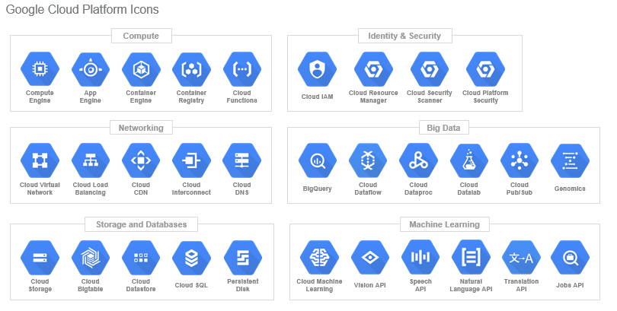
GCP Icons:
Each Google Cloud Platform product and service have a unique Blue hexagonal icon.
Dheeraj Edupuganti

Slide 12
HOSTING A STATIC WEBSITE:
STEP 1:
Creating a CNAME record
A CNAME record is a type of DNS record. It directs traffic that requests a URL from your domain to the resources you want to serve.
STEP 2:
Creating a bucket
Create a bucket whose name matches the CNAME you created for your domain.
For example, if you added a CNAME record pointing www.example.com to c.storage.googleapis.com., then create a bucket with the name "www.example.com".
Sai Jyothsna Mathi

Slide 13
HOSTING A STATIC WEBSITE:
STEP 3:
Uploading your site's files.
Open the Cloud Storage browser in the Google Cloud Platform Console.
OPEN THE CLOUD STORAGE BROWSER.
In the list of buckets, click on the name of the bucket that you created.
Click the Upload files button in the Objects tab.
After the upload completes, you should see the file name along with file information displayed in the bucket.
Sai Jyothsna Mathi

Slide 14
DATABASE SERVICES ON GCP
GCP provides a variety of SQL and NoSQL database services:
MySQL
PostgreSQL
A fully managed, mission-critical, relational database service in Cloud Spanner that offers transactional consistency at global scale, schemas, SQL querying, and automatic, synchronous replication for high availability.
We can setup MongoDB for NOSQL as well.
Sai Jyothsna Mathi

Slide 15
GOOGLE STORAGE -PRICING
Storage
$0.17/GB/Month
Network
Upload-$0.10/GB
Download
$0.30/GB APAC
$0.15/GB Americas/EMEA
Requests
PUT,POST,LIST-$0.01/1,000 Requests
GET,HEAD-$0.01/1,000 Requests
Sai Jyothsna Mathi

Slide 16
GCP-AWS Comparison
AWS Instance Type | Monthly$ | GCP Instance Type | Monthly | GCP is x% Less Expensive
M4 “Standard” | $87.60 | Custom 2 core,8gb | $54.82 | 37.42%
R3 “HighMem” | $121.18 | n1-Standard-4 | $102.20 | 15.66%
Sai Jyothsna Mathi

Slide 17
Advantages:
Good documentation
Good prices
Different storage classes for each necessity
High durability
Many regions available to store your data
One of the best free layers in the industry
Disadvantages:
Support fee is quite hefty
Downloading data from Google Cloud Storage is expensive
It has a complex pricing schema
Sai Jyothsna Mathi

Slide 18
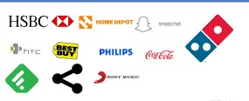
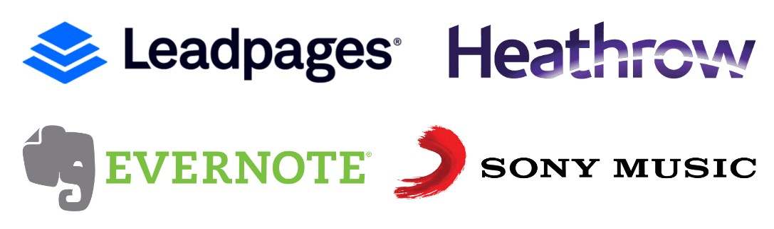
Sai Jyothsna Mathi

Slide 19
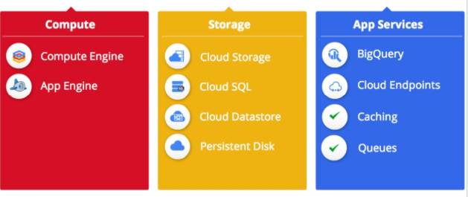
Insight of google platform services:
Alekya Pochampally

Slide 20
Compute:
Cloud platform offers both a fully managed platform and flexible virtual machines, allowing you to choose a system that meets your needs.
Use App Engine, a Platform-as-a-service, when you just want to focus on your code and not worry about patching or maintenance. Or get access to raw virtual machines with Compute Engine and have the flexibility to build anything you need.
Storage:
GCP provides a range of storage services that allow you to maintain easy and quick access to your data.
Alekya Pochampally

Slide 21
App Services:
Use Google’s API’s and services to quickly enable a wide range of functionality for your application. You need not build these from scratch, just take the advantage of easy integration within cloud platform.
Alekya Pochampally

Slide 22
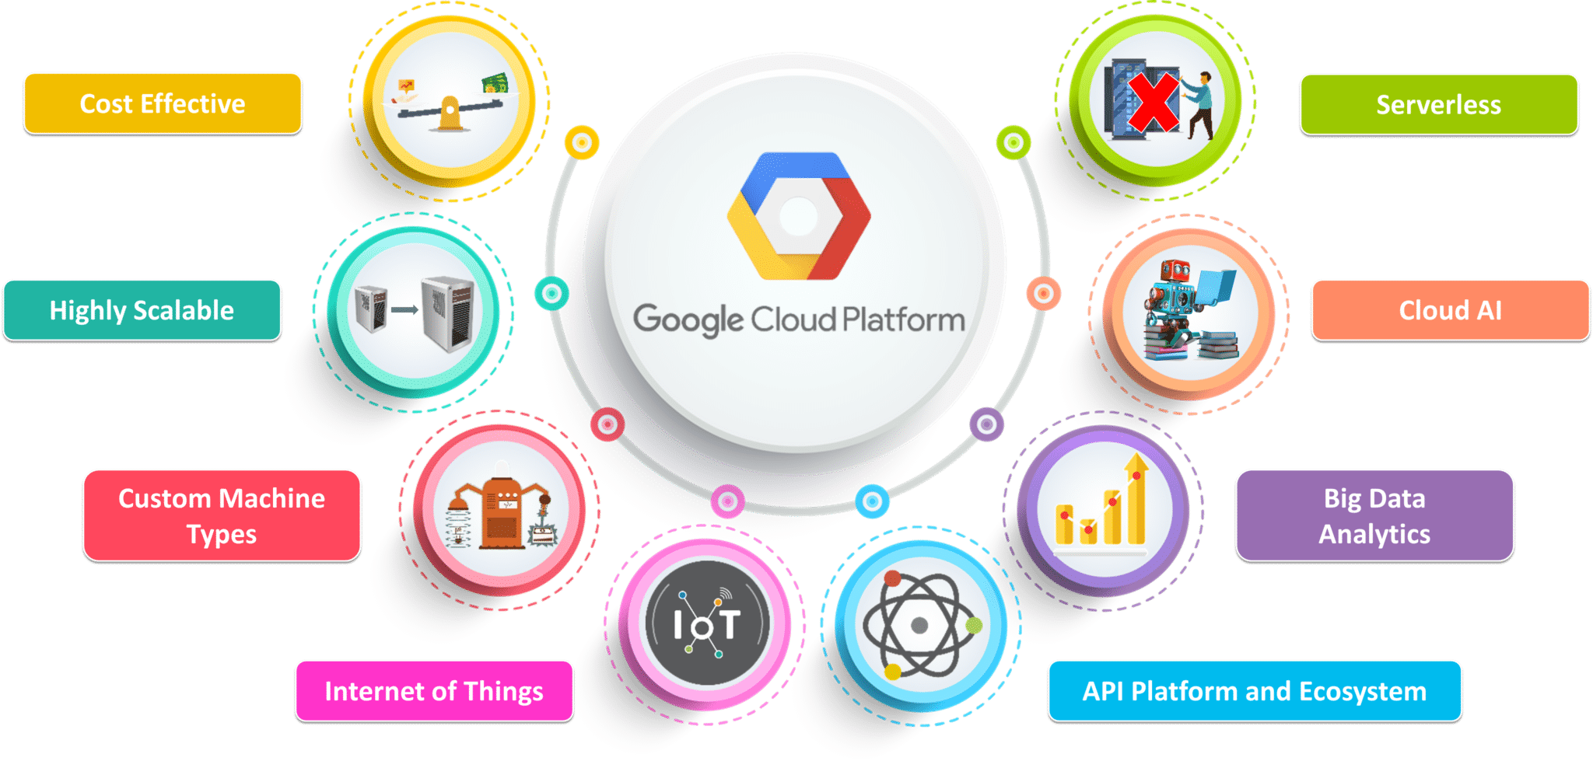
Overview of Google Cloud Platform offerings
Alekya Pochampally

Slide 23
Google compute engine, which is an infrastructure-as-a-service (Iaas) offering that provides users with virtual machine instances for workload hosting.
Google App Engine, which is a platform-as-a-service (Pass) offering that gives software developers access to Google's scalable hosting. Developers can also use a software developer kit (SDK) to develop software products that run on App Engine.
Alekya Pochampally

Slide 24
Google cloud storage which is a cloud storage platform designed to store large, unstructured data sets. Google also offers database storage options, including Cloud Datastore for NoSQL nonrelational storage, Cloud SQL for MySQL fully relational storage and Google's native Cloud Bigtable database.
Google Container Engine, which is a management and orchestration system for Docker containers that runs within Google's public cloud. Google Container Engine is based on the Google kubernetes container orchestration engine.
Alekya Pochampally

Slide 25
Any Queries????

Slide 26
References:
https://cloud.google.com/products/
https://github.com/GoogleCloudPlatform/
https://en.Wikipedia.org/wiki/Google_Cloud_Platform

Slide 27

Thank you..!

