Slide 1
Facial Feature Analysis for Age Group Classification Using UTKFace
A Comparative Study of Classical Machine Learning and Pretrained Deep Learning Models
Name :Alekya Akkala
Student ID : 22031645

Slide 2
Introduction
Age classification is a growing field in computer vision with applications in security, retail, and healthcare.
Objective: Compare classical machine learning models (e.g., SVM, Random Forest) with pretrained deep learning models (e.g., VGG16, ResNet50).
Research motivation: Classifying age groups from facial images is a complex and useful task.
Objectives:
Pre-process and explore the UTKFace dataset.
Train classical machine learning models for age group classification.
Fine-tune pretrained deep learning models for age group classification.
Compare and evaluate the accuracy, F1-score, and other metrics of both types of models.
Discuss potential benefits, drawbacks, and areas for improvement in both approaches.

Slide 3
Research Question
Research Question: "How do classical machine learning models compare to pretrained deep learning models in classifying age groups based on facial features extracted from the UTKFace dataset?"
Hypothesis:
Pretrained deep learning models will perform better due to their ability to capture complex patterns in image data.

Slide 4

Data Collection and Storage
Source: Downloaded from Kaggle UTKFace Dataset.
Format: JPEG images with annotations.
Storage: Data and code will be stored on GitHub and backed up on GoogleDrive. Code will be version controlled using GitHub with regular weekly commits.
Metadata:
Format: JPEG for images, CSV for labels.
Size: Approximately 500MB of image data.
Document Control: Weekly commits to GitHub, with clear naming conventions (e.g., model_training_v1.py, data_preprocessing.ipynb).

Slide 5
Dataset Overview
Dataset: UTKFace
Number of Images: 20,000+ facial images with labels for age, gender, and ethnicity.
Age Range: 0-116 years.
Preprocessing Steps:
Resize images to 224x224 pixels.
Group continuous ages into discrete ranges (e.g., 0-10, 11-20, etc.).
Split into training (70%), validation (15%), and test (15%) sets.

Slide 6
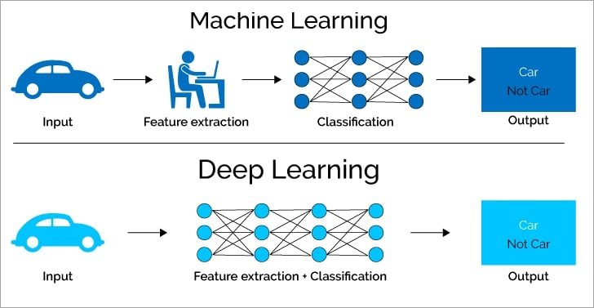
Methodology Overview
Two Approaches:
Classical machine learning models (SVM, Random Forest, Logistic Regression).
Pretrained deep learning models (VGG16, ResNet50).
Preprocessing for Classical Models: Feature extraction using Histogram of Oriented Gradients (HOG) or Local Binary Patterns (LBP).
Deep Learning Models: Fine-tuning pretrained models using transfer learning.

Slide 7
Classical Machine Learning Models
Models Trained:
Support Vector Machine (SVM)
Random Forest
Logistic Regression (Baseline)
Feature Extraction: Histogram of Oriented Gradients (HOG) for feeding into classical models.
Metrics: Accuracy, F1-score

Slide 8
Pretrained Deep Learning Models
Models Used:
VGG16
ResNet50
Approach: Transfer learning by freezing base layers and fine-tuning final layers.
Data Augmentation: Used to increase variability (rotation, flipping).
Evaluation Metrics: Accuracy, F1-score, Confusion Matrix.

Slide 9
Ethical Considerations
Data Privacy: UTKFace contains no personally identifiable information (PII), only facial images.
Public Dataset: Dataset is used for research purposes and adheres to GDPR regulations.
Data Security: Version control on GitHub, backed up on GoogleDrive.

Slide 10
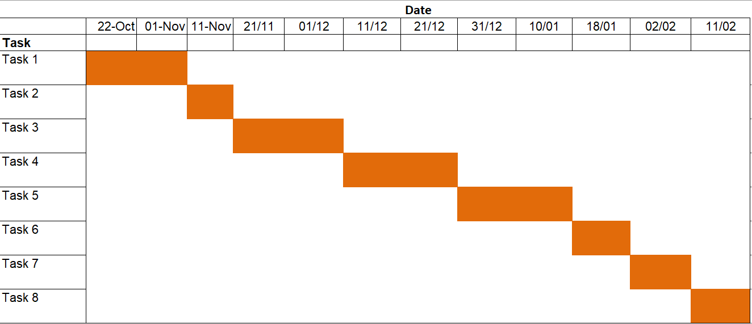
Timeline
Task 1 | 1. Week 1-2: Literature review on age classification using machine learning and deep learning techniques.
Task 2 | 2. Week 3: Data collection and exploration.
Task 3 | 3. Week 4-5: Train classical machine learning models.
Task 4 | 4. Week 6-7: Train and fine-tune pretrained deep learning models.
Task 5 | 5. Week 8-9: Model evaluation and comparison.
Task 6 | 6. Week 10: Ethical review and documentation.
Task 7 | 7. Week 11: Final report writing.
Task 8 | 8. Week 12: Presentation preparation.

Slide 11
References
Kaggle. (2018, August 16). Utkface. https://www.kaggle.com/datasets/jangedoo/utkface-new
Kotsiantis, S. B. (2007). "Supervised machine learning: A review of classification techniques," Informatica.
Simonyan, K., & Zisserman, A. (2014). "Very Deep Convolutional Networks for Large-Scale Image Recognition," arXiv preprint arXiv:1409.1556.
Zhang, Z., Song, Y., & Qi, H. (2017). "Age Progression/Regression by Conditional Adversarial Autoencoder," IEEE CVPR.

Slide 12
Thank You!
Questions?
GitHub link :

