Slide 1
PROJECT TITLE
CAPSTONE PROJECT
Presented By: Alekya puram
Student Name : Alekya puram
College Name & Department : Sree chaitanya college of engineering & CSE

Slide 2
OUTLINE
Problem Statement
Technology used
Wow factor
End users
Result
Conclusion
Git-hub Link
Future scope

Slide 3
Problem Statement
Develop an image-based steganography system that securely embeds a secret message into an image by modifying its pixel values. The system should allow encryption by converting the message into pixel data and decryption by retrieving the original message using a passcode. It must ensure that only authorized users with the correct passcode can decode the message. The implementation should handle different operating systems for opening the encrypted image and prevent unauthorized access to the hidden information.

Slide 4
Technology used
1. Hardware Requirements: Processor: A multi-core processor (i5 or above for better performance).
RAM: At least 4 GB (8 GB recommended for handling larger encryption tasks).
Storage: Minimal space required (10–20 MB), but enough disk space to store data files or logs.
Network: A stable internet connection is recommended for downloading external libraries or services.
2. Software Requirements:
Operating System:
Windows 10 or above, Linux, or macOS.
Programming Environment:Python 3.x version (recommended to use a virtual environment for managing dependencies).
Python Libraries:OpenCV: For reading, modifying, and saving images.
OS: For handling file operations and opening images based on the operating system.
Platform: For detecting the user's operating system to execute appropriate commands.
String: For character mapping and processing.

Slide 5
Wow factors
End-to-End Steganography (E2ES):
The secret message is embedded into the image at the sender's side and can only be extracted at the receiver's end using a passcode, ensuring confidentiality.
Hybrid Security Model:
The system can be enhanced by combining steganography with encryption (e.g., AES or RSA) for an extra layer of security, making it difficult to intercept or alter hidden messages.
Real-Time Secure Image Messaging:
Allows users to share encrypted images in real time, ensuring that only authorized recipients can extract the hidden message while keeping it invisible to attackers.

Slide 6
End users
Individuals seeking secure communication for personal data and private messages.
Businesses handling sensitive customer data, requiring robust encryption for transactions and internal
communications.
Financial institutions that need to protect sensitive financial transactions and records.
Government agencies that need to secure confidential documents and classified communications.
Developers who integrate encryption into applications or systems to ensure secure user data handling.

Slide 7
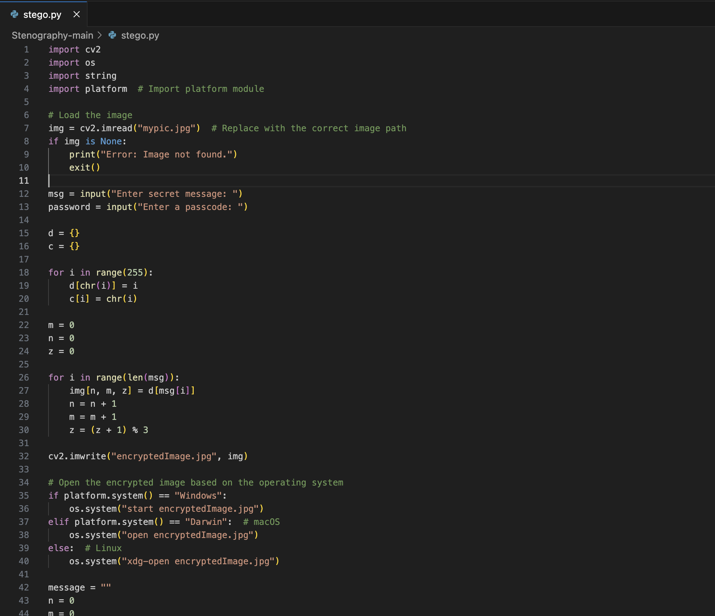
Results

Slide 8
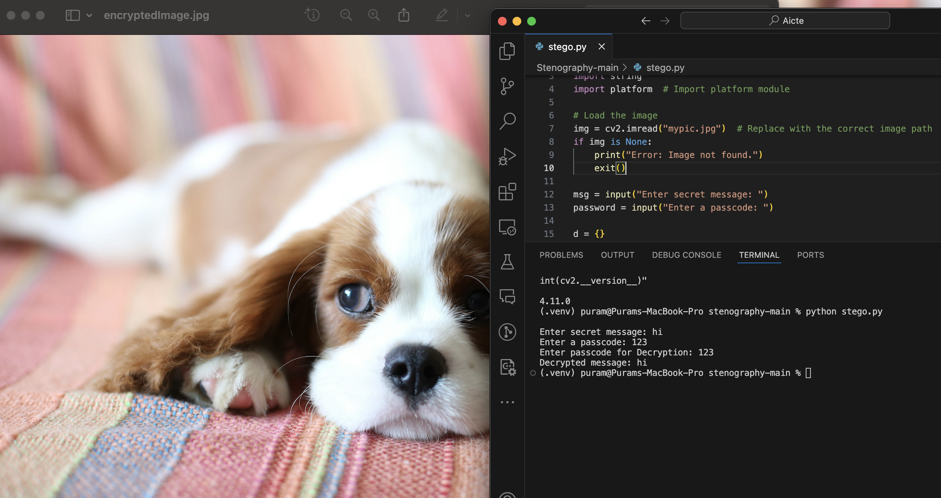
Encryption code

Slide 9
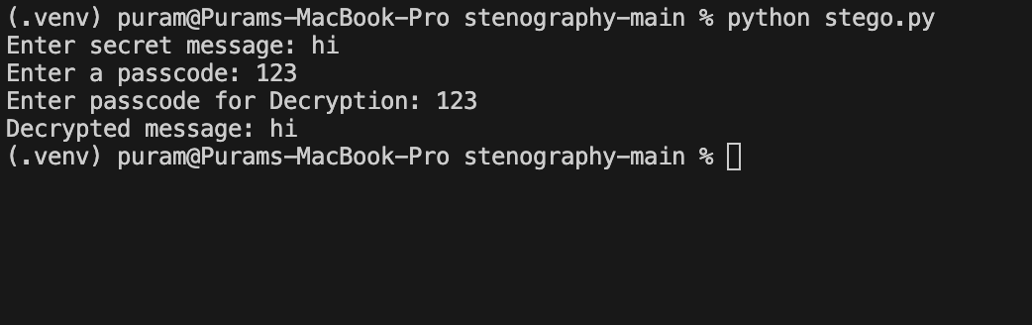
output

Slide 10
Conclusion
This image-based steganography system provides a secure way to embed and retrieve hidden messages within images, ensuring confidentiality and protection from unauthorized access.
With its cross-platform compatibility, password protection, and minimal data footprint, the system offers an efficient and stealthy solution for secure communication across various domains.

Slide 11
GitHub Link
https://github.com/Alekyapuram/project-aicte-25.git

Slide 12
Future scope(optional)
Enhanced Steganography Techniques:
Implement advanced methods like Least Significant Bit (LSB) and DCT-based steganography for improved security and stealth.
Dual-Layer Security with Encryption:
Integrate AES or RSA encryption alongside steganography for a more robust, dual-layer protection system, ensuring data confidentiality.
Real-Time Messaging & AI Integration:
Expand to **real-time secure messaging platforms with AI-powered detection and extraction, offering advanced security features and efficient communication.

Slide 13
THANK YOU

