Slide 1
Spike sorting: “A consensus-based approach”
MSc. Adrián Alemán-Zapata
PhD Candidate
Genzel Lab
Donders Institute of Brain, Cognition and Behaviour
April 2021
Genzel Lab
Spikes/Ephys big meeting

Slide 2
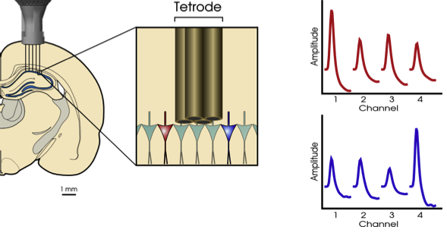
Neural data acquisition

Slide 3
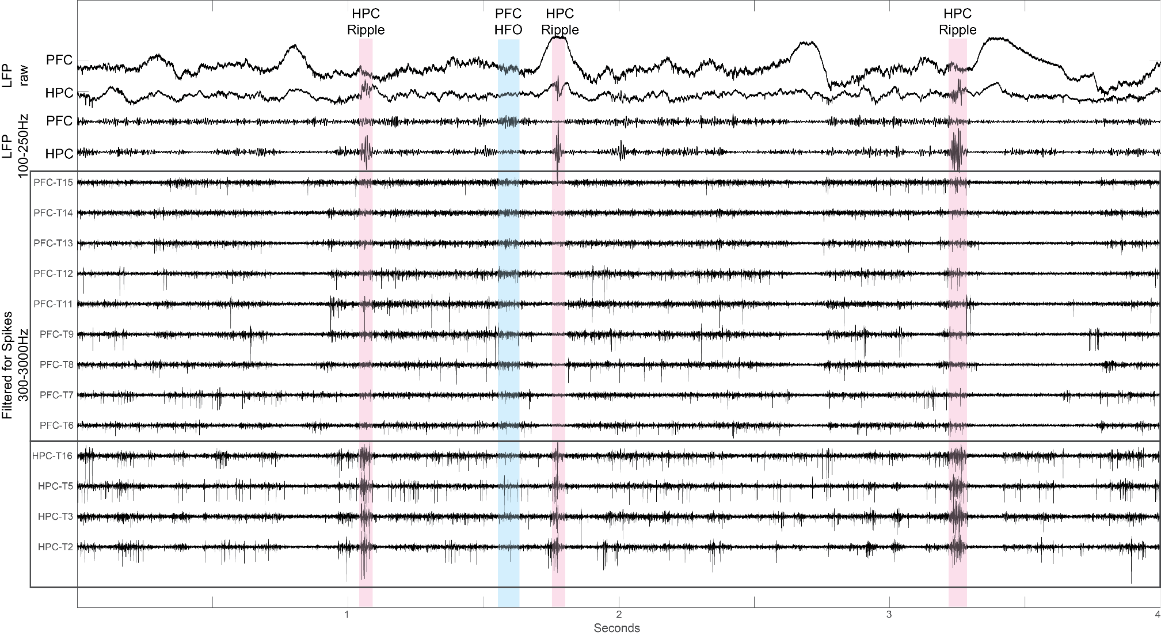
Motivation
Sample traces of RGS14 Rat3 SD15 during NREM
Genzel Lab
Spikes/Ephys big meeting

Slide 4
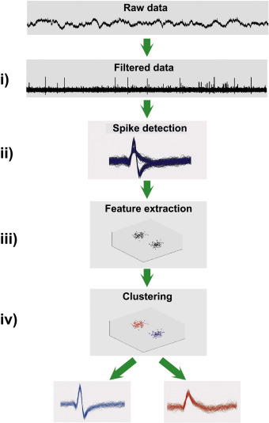
General process of a spike sorter
Raw ephys data-> Individual neuronal activity.
Gonzalo-Rey, "Past, present and future of spike sorting techniques.", 2015
Genzel Lab
Spikes/Ephys big meeting

Slide 5
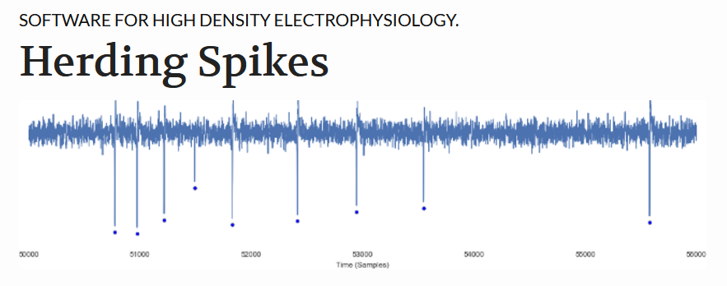

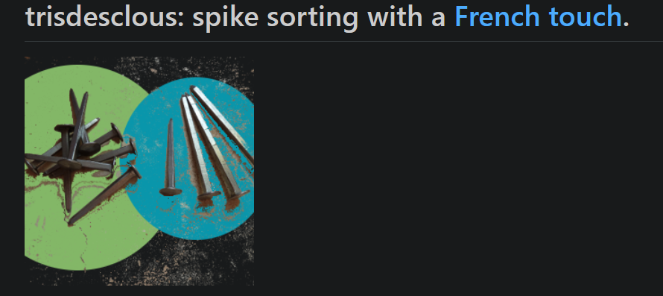

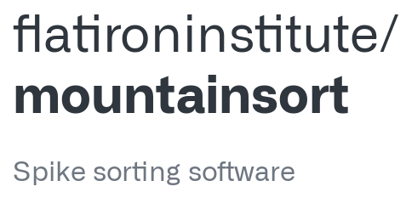

Spike sorters

Slide 6
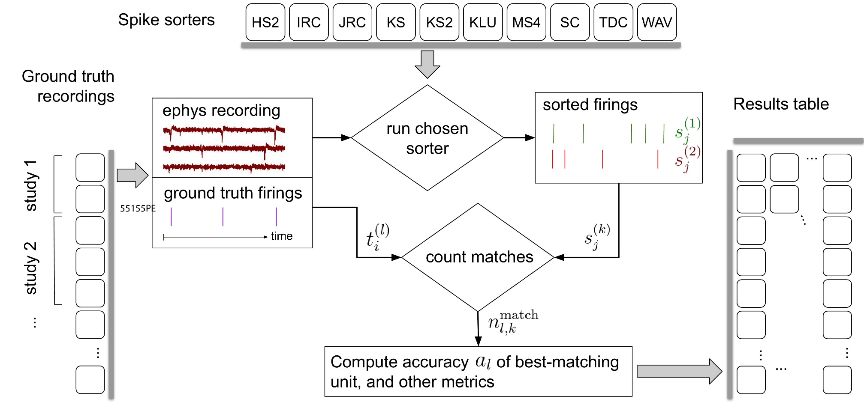
SpikeForest
Benchmark performance with ground truth
Magland et. al, eLife, 2020

Slide 7
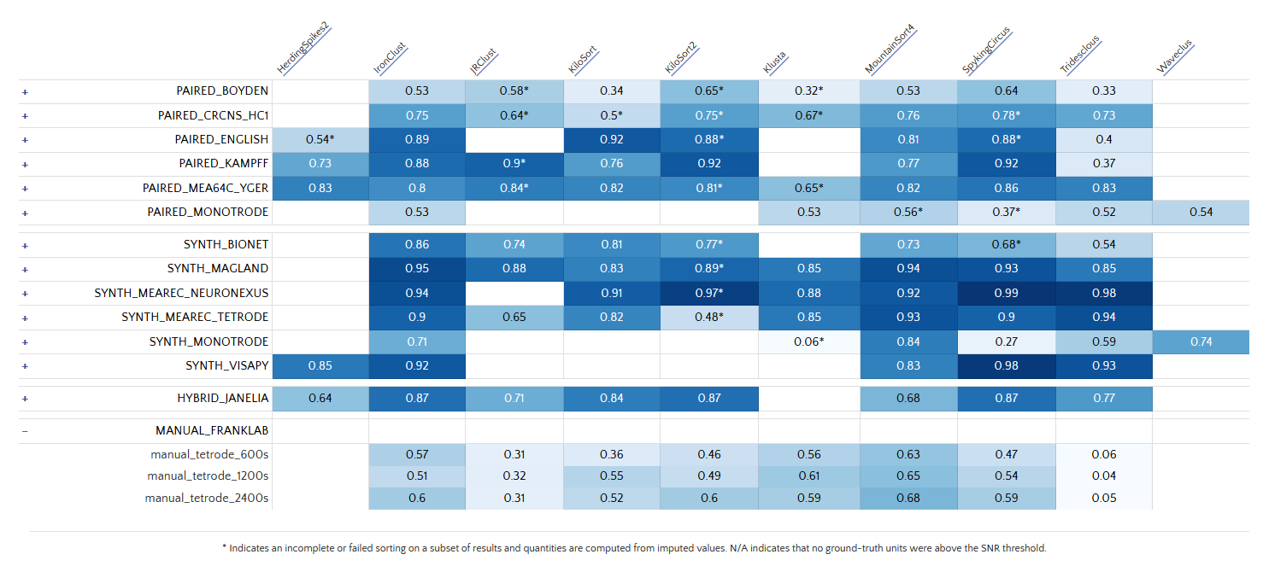
SpikeForest
Average accuracy over SNR threshold

Slide 8
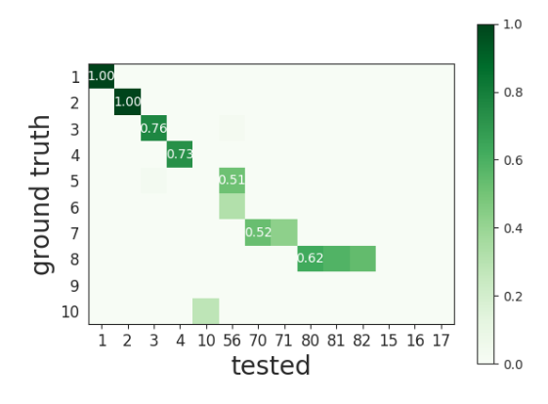
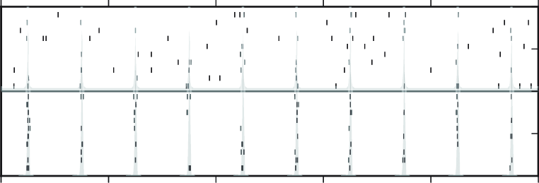

Comparing spike trains
Agreement score (Accuracy)
$score=\frac{\#n_{matches}}{\#n_{1}+\#n_{2}−\#n_{matches}}$= $\frac{TP}{TP+FP+FN}$
Match when spikes occur within time window (0.4 ms)

Slide 9
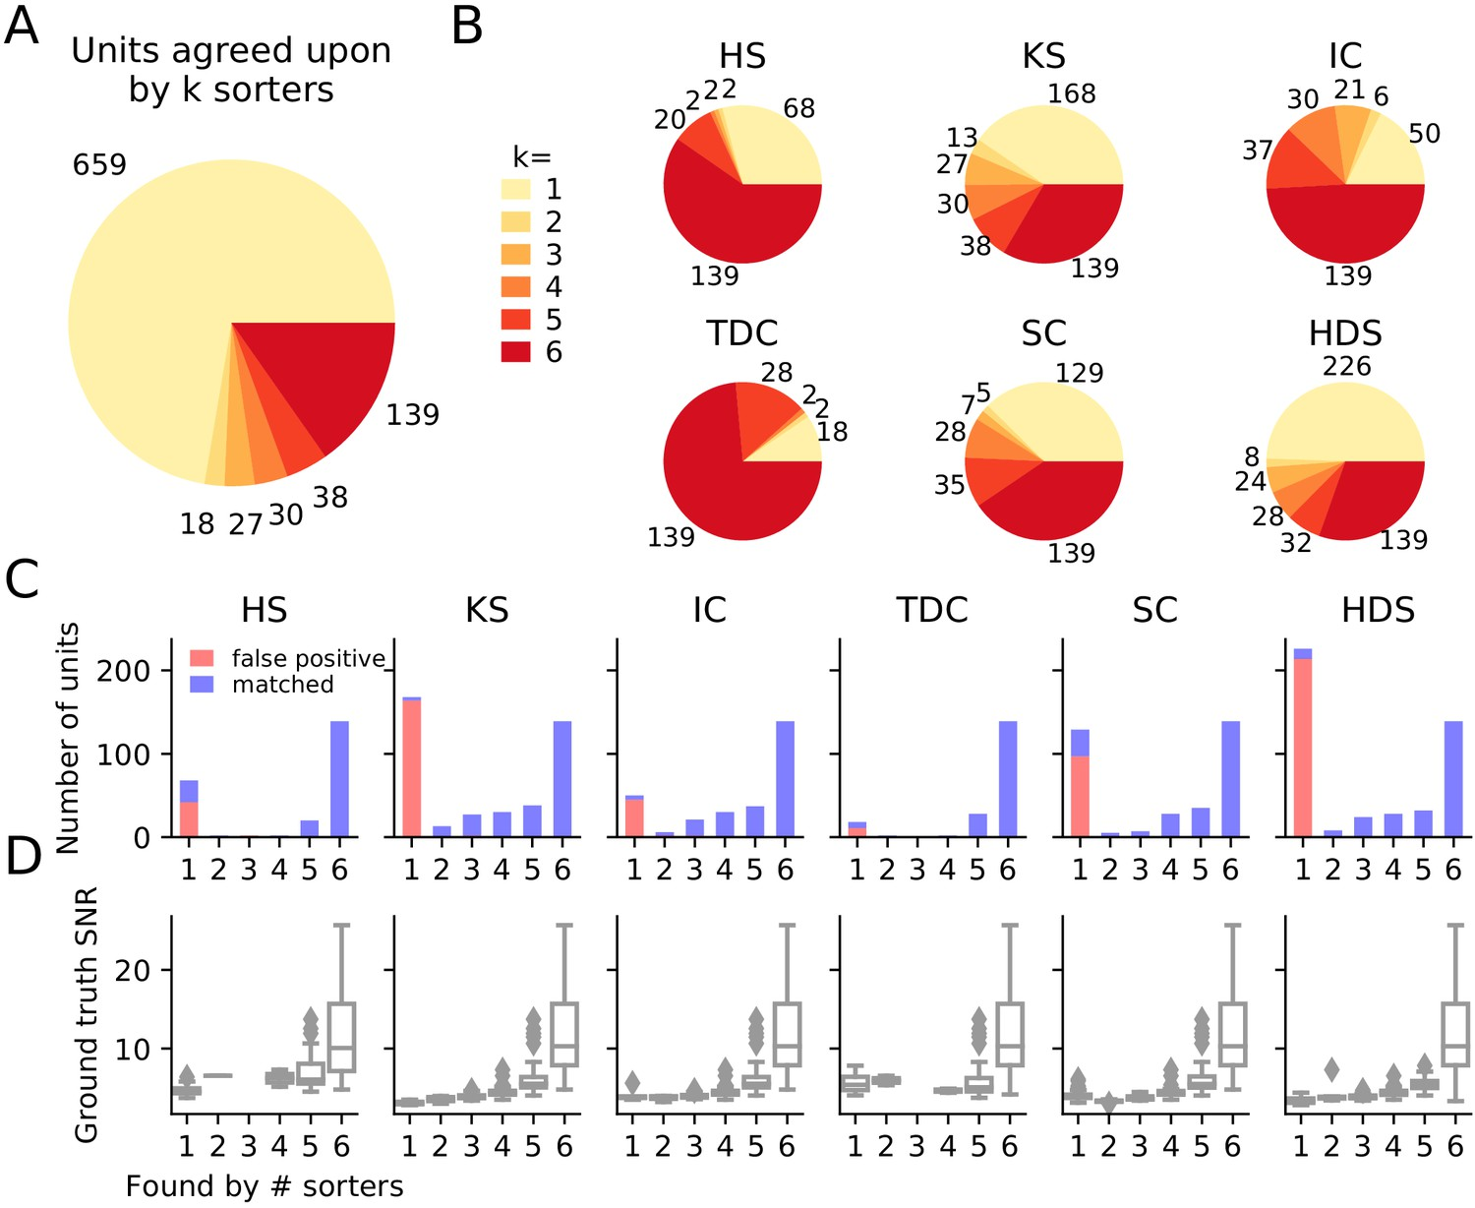
SpikeInterface
Buccino et al., eLife, 2020

Slide 10
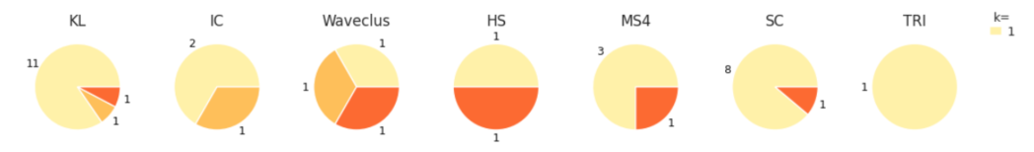
SpikeInterface

Slide 11
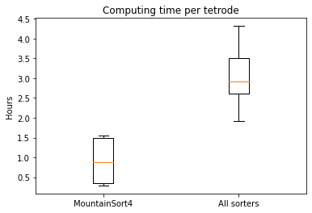
Computation time
PC: Intel core I5, 64GB RAM, SSD.

Slide 12
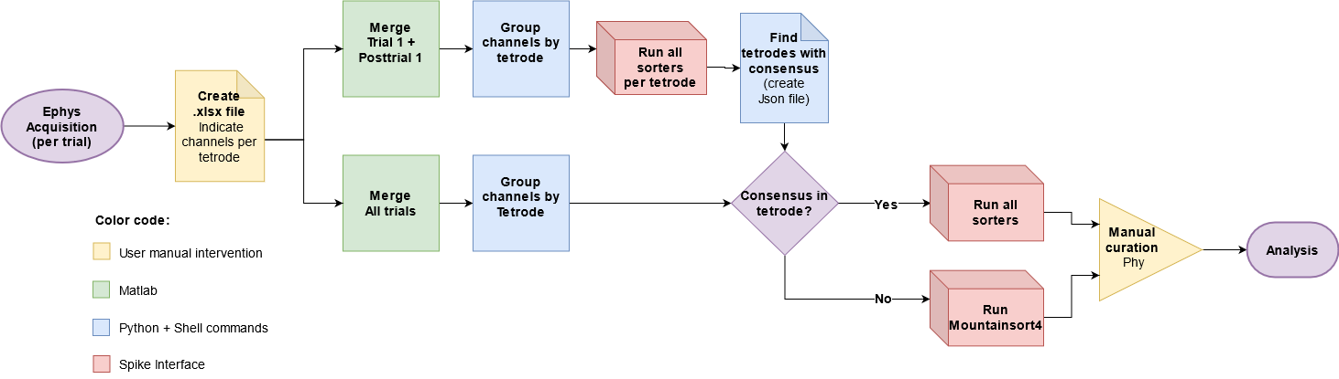
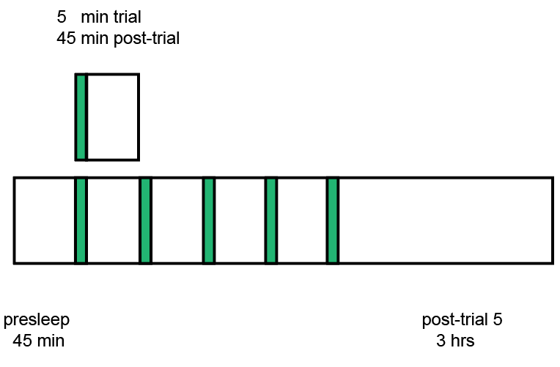
Pipeline for Object Space Task

Slide 13
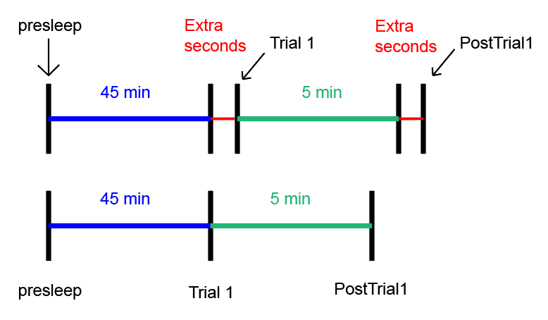
Discard and merge

Slide 14
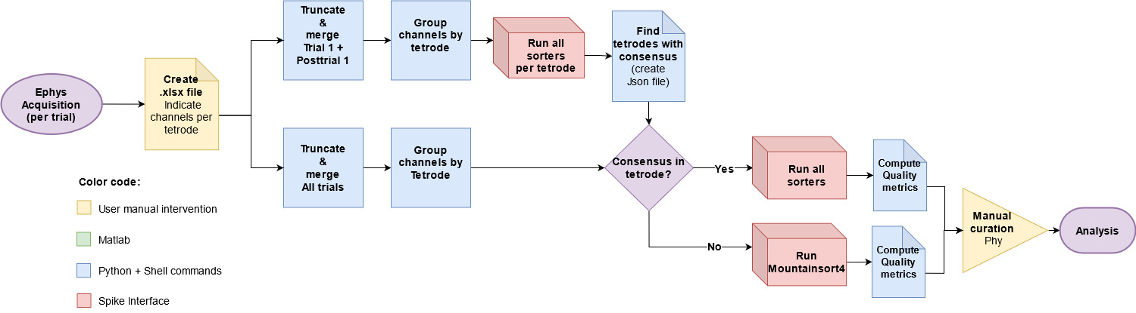
Pipeline for Object Space Task 2.0

Slide 15
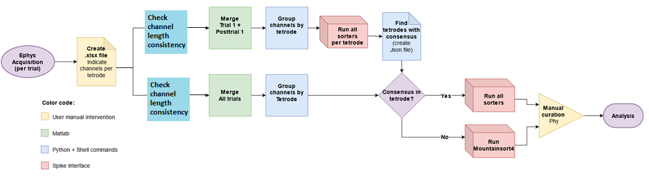
Pipeline for Object Space Task 2.1

Slide 16
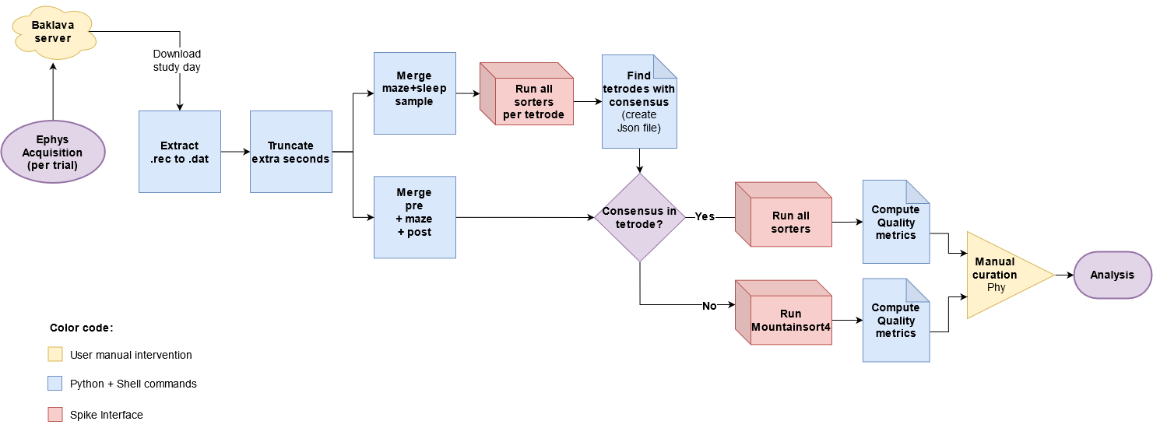
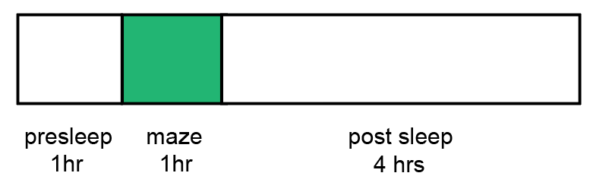
Pipeline for Hexmaze

Slide 17
Quality metrics
ISI violations
The rate of inter-spike-interval (ISI) refractory period violations.
Isolation Distance
Radius of the smallest ellipsoid that contains all the spikes from a cluster and an equal number of spikes from other clusters.
L-ratio
Assuming that the distribution of spike distances from a cluster center is multivariate normal, L-ratio is the average value of the tail distribution for non-member spikes of that cluster.

Slide 18
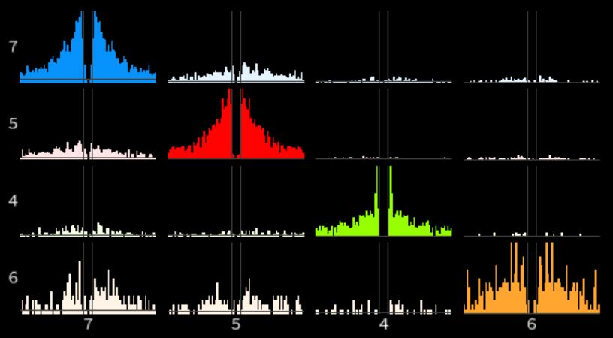
Questions?

