Slide 1
LAN Switching and VLAN

Slide 2

Table of Contents
Switching
The Spanning-Tree Protocol
VLAN
Introduction of VLAN
VLAN Architecture
VLAN Implementation
Routing Between VLANs

Slide 3
Switch Operation
Switches perform two basic functions:
Building and maintaining switching tables (similar to a bridge table) based on MAC addresses
Switching frames out the interface to the destination

Slide 4
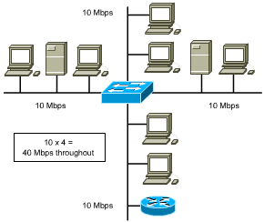
Symmetric Switching
symmetric switching provides switched connections between ports with the same bandwidth (10/10 Mbps or 100/100 Mbps)
can cause bottlenecks as users try to access servers on other segments.
potential bottlenecks
Notes:
Cisco catalyst 都是非对称的

Slide 5
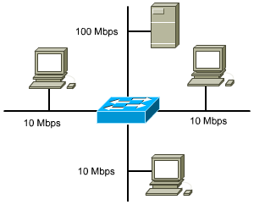
Asymmetric Switching
asymmetric switching reduces the likelihood of a potential bottleneck at the server by attaching the segment with the server to a higher bandwidth port (100 Mbps)
asymmetric switching requires memory buffering in the switch

Slide 6
Memory Buffering
Area of memory in a switch where destination and transmission data are stored until it can be switched out the correct port.
Port-based memory buffering
packets are stored in a queue on each port
possible for one packet to delay transmission of other packets because of a busy destination port
Shared memory buffering
common memory buffering shared by all ports
allows packets to be RX on one port and TX out another port without changing it to a different queue.
Notes:
Port-based memory buffering可能会由于目的端口堵塞而导致源端口的帧不得转发而耽误源端口后面的帧不得正常发送。
Shared memory buffering动态分配各个端口所需要的缓存内存量

Slide 7
Switching Methods
Store-and-Forward
The switch receives the entire frame, calculating the CRC at the end, before sending it to the destination
Cut-through
A switch adds latency. It can be reduced by using cut-through switching method
Fast forward switching--only checks the destination MAC before immediately forwarding the frame
Fragment Free--reads the first 64 bytes to reduce errors before forwarding the frame
Notes:
Cisco catalyst 只用存储转发

Slide 8
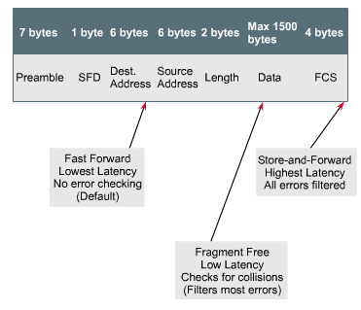
Two Switching Methods

Slide 9
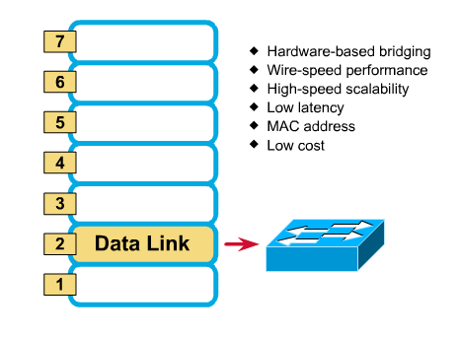
Layer 2 Switching
Notes:
二层交换机：一个mac 三层交换机：一个端口一个mac 路由器：一个以太网口一个mac，桥接口、串行口没有mac

Slide 10
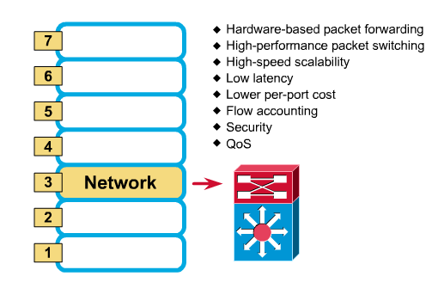
Layer 3 Switching
Notes:
路由特有建立与远程网络和设备的远程访问连接，是接入WAN的唯一选择
从技术上讲，路由器和三层交换机在数据包交换操作上存在着明显区别。路由器一般由基于微处理器的软件路由引擎执行数据包交换，而三层交换机通过硬件执行数据包交换。
三层交换机在对第一个数据流进行路由后，它将会产生一个MAC地址与IP地址的映射表，当同样的数据流再次通过时，将根据此表直接从二层通过而不是再次路由，从而消除了路由器进行路由选择而造成网络的延迟，提高了数据包转发的效率。同时，三层交换机的路由查找是针对数据流的，它利用缓存技术，很容易利用ASIC技术来实现，因此，可以大大节约成本，并实现快速转发。而路由器的转发采用最长匹配的方式，实现复杂，通常使用软件来实现，转发效率较低。
正因如此，从整体性能上比较的话，三层交换机的性能要远优于路由器，非常适用于数据交换频繁的局域网中；而路由器虽然路由功能非常强大，但它的数据包转发效率远低于三层交换机，更适合于数据交换不是很频繁的不同类型网络的互联，如局域网与互联网的互联。如果把路由器，特别是高档路由器用于局域网中，则在相当大程度上是一种浪费（就其强大的路由功能而言），而且还不能很好地满足局域网通信性能需求，影响子网间的正常通信

Slide 11
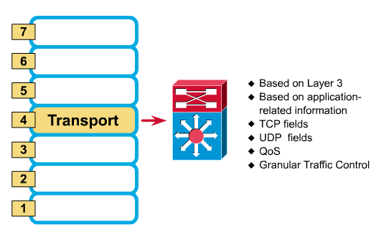
Layer 4 Switching
Notes:
第二层交换机和第三层交换机都是基于端口地址的端到端的交换过程，虽然这种基于MAC地址和IP地址的交换机技术，能够极大地提高各节点之间的数据传输率，但却无法根据端口主机的应用需求来自主确定或动态限制端口的交换过程和数据流量，即缺乏第四层智能应用交换需求。
第四层交换机不仅可以完成端到端交换，还能根据端口主机的应用特点，确定或限制它的交换流量。简单地说，第四层交换机是基于传输层数据包的交换过程的，是一类基于TCP/IP协议应用层的用户应用交换需求的新型局域网交换机。第四层交换机支持TCP/UDP第四层以下的所有协议，可识别至少80个字节的数据包包头长度，可根据TCP/UDP端口号来区分数据包的应用类型，从而实现应用层的访问控制和服务质量保证。所以，与其说第四层交换机是硬件网络设备，还不如说它是软件网络管理系统。也就是说，第四层交换机是一类以软件技术为主，以硬件技术为辅的网络管理交换设备。

Slide 12
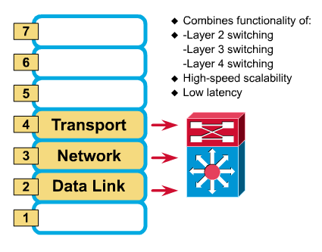
Multilayer Switching

Slide 13
Table of Contents
Switching
The Spanning-Tree Protocol
VLAN
Introduction of VLAN
VLAN Architecture
VLAN Implementation
Routing Between VLANs

Slide 14
Bridging Loops
Loops may occur in a network for a variety of reasons.
Usually loops in networks are the result of a deliberate attempt to provide redundancy.
Can also occur by configuration error
Two primary reasons loops can be absolutely disastrous in a bridged network:
broadcast loops
bridge-table corruption

Slide 15
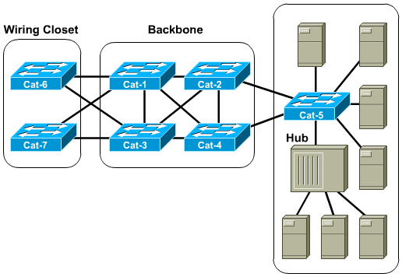
Redundancy Creates Loops

Slide 16
L2 Loops
Broadcasts and Layer 2 loops can be a dangerous combination.
Ethernet frames have no TTL field
After an Ethernet frame starts to loop, it will probably continue until someone shuts off one of the switches or breaks a link
The switches will flip flop the bridging table entry for Host A (creating extremely high CPU utilization).

Slide 17
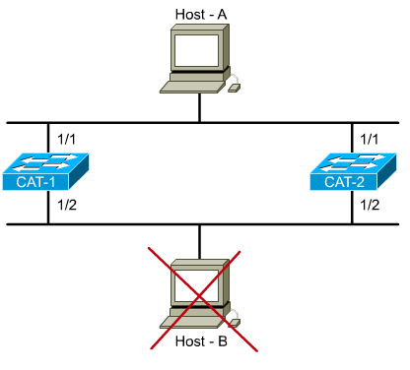
L2 Loops - Flooded unicast frames
Where’s Host B? FLOOD
Where’s Host B? FLOOD
Where’s Host B? FLOOD
Where’s Host B? FLOOD
And the floods continue
Uh oh.
Removed from the network

Slide 18
Overview of STP
Elements of the Spanning Tree Protocol
Main function: allow redundant paths in a switched/bridged network without incurring latency from the effects of loops.
STP prevents loops by calculating a stable spanning-tree network topology
Spanning-tree frames (called bridge protocol data units--BPDUs) are used to determine the spanning-tree topology

Slide 19
STP Decision Sequence
Spanning Tree always uses the same four-step decision sequence:
Lowest root BID (Bridge Identification)
Lowest path cost to root bridge
Lowest sender BID
Lowest port ID
Notes:
STP 使用生成树算法 (STA) 计算网络中的哪些交换机端口应配置为阻塞才能防止环路形成。STA 会将一台交换机指定为根桥，然后将其用作所有路径计算的参考点
所有参与 STP 的交换机互相交换 BPDU 帧，以确定网络中哪台交换机的网桥 ID (BID) 最小。BID 最小的交换机将自动成为 STA 计算中的根桥。

Slide 20
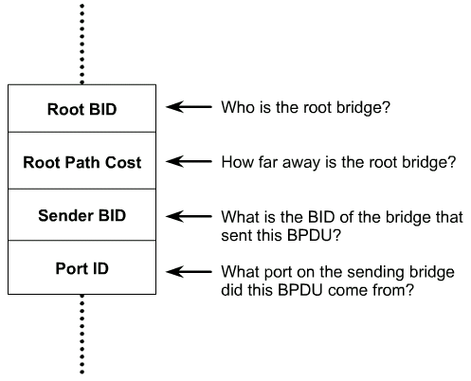
BPDUs
STP establishes a root node, called the root bridge
The resulting tree originates from the root bridge.
Redundant links that are not part of the shortest path tree are blocked.
Data frames received on blocked links are dropped.
The message that a switch sends, allowing the formation of a loop free logical topology, is BPDU
BPDUs are switch-to-switch traffic; they do not carry end-user traffic.
Notes:
前四个字段标识协议、版本、消息类型和状态标志。
接下来的四个字段用于标识根桥以及到根桥的路径开销。
最后四个字段全是计时器字段，用于确定 BPDU 消息的发送频率、通过 BPDU 过程（下一主题介绍）收到的信息保留多长时间。计时器字段的作用将在本课程的后续内容中详细介绍。

Slide 21
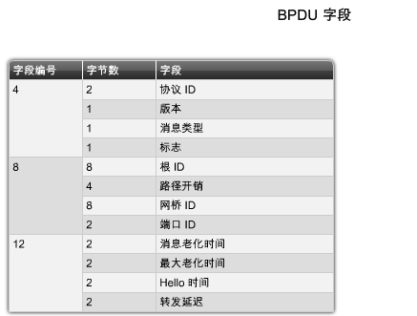
STP BPDU
Notes:
广播域中的每台交换机最初都会将自己视为生成树实例中的根桥，因此其送出的 BPDU 帧中将自己的 BID 作为根 ID。默认情况下，BPDU 帧是在交换机启动后每 2 秒发送一次，也就是说 BPDU 帧中 hello 计时器的默认值是 2 秒。每台交换机都维护着有关其 BID、根 ID 以及到根桥的路径开销的本地信息.
当邻接交换机收到 BPDU 帧时，它们会将 BPDU 帧内的根 ID 与本地根 ID 比较。如果 BPDU 中的根 ID 比本地根 ID 更小，交换机便更新本地根 ID 以及它送出的 BPDU 消息内的根 ID。这些消息的作用是告诉网络新的根桥。此外，路径开销也会更新，以指出到根桥的距离。
交换机的根 ID 更新后，其送出的所有后续 BPDU 帧都会包含新的根 ID 以及更新后的路径开销。

Slide 22
Bridge Identification/BID
A Bridge ID (BID): 8 bytes
The high-order BID subfield(2 bytes): bridge priority
2¹⁶ possible values: 0-65,535 (default: 32,768)
Typically expressed in a decimal format
The low-order subfield(6 bytes): a MAC address assigned to the switch
Expressed in hexadecimal format
STP cost values: lower costs are better.

Slide 23
Electing the Root Switch
The switches elect a single root switch by looking for the switch with the lowest BID (often referred to as a root war).
If all the switches are using the default bridge priority of 32,768, the lowest MAC address serves as the tie-breaker.

Slide 24
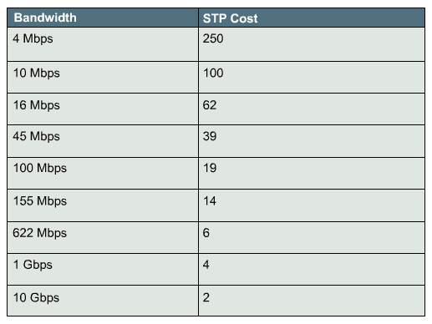
Path Cost
Bridges use the concept of cost to evaluate how close they are to other bridges.

Slide 25
Five STP States
States are established by configuring each port according to policy
Then the STP modifies the states based on traffic patterns and potential loops
The default order of STP states are:
Blocking--no frames forwarded, BPDUs heard
Listening--no frames forwarded, listening for data frames
Learning--no frames forwarded, learning addresses
Forwarding--frames forwarded, learning addresses
Disabled--no frames forwarded, no BPDUs heard
blocking
20s
15s
15s
forwarding
Notes:
阻塞 － 该端口是非指定端口，不参与帧转发。此类端口接收 BPDU 帧来确定根桥交换机的位置和根 ID，以及最终的活动 STP 拓扑中每个交换机端口扮演的端口角色。
侦听 － STP 根据交换机迄今收到的 BPDU 帧，确定该端口可参与帧转发。此时，该交换机端口不仅会接收 BPDU 帧，它还会发送自己的 BPDU 帧，通知邻接交换机此交换机端口正准备参与活动拓扑。
学习 － 端口准备参与帧转发，并开始填充 MAC 地址表。
转发 － 该端口是活动拓扑的一部分，它会转发帧，也会发送和接收 BPDU 帧。
禁用 － 该第 2 层端口不参与生成树，不会转发帧。当管理性关闭交换机端口时，端口即进入禁用状态。

Slide 26
Initial STP Convergence
When the network first starts, all the bridges flood the network with a mix of BPDU information.
Immediately, they apply the decision sequence allowing them to hone in on the set of BPDUs that form a single spanning tree for the entire network.
(Step 1) Root switch decision: A single root bridge is elected to act as the central point of this network
(Step 2) Electing the root ports: All the remaining bridges calculate a set of root ports
(Step 3) Electing the designated ports: All the remaining bridges calculate a set of designated ports
Notes:
Hone：磨练

Slide 27
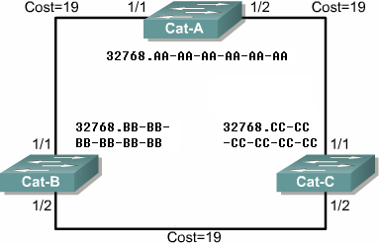
Step1: Root Switch Decision
Announce itself as the root
Checking all BPDUs received on the port as well as the BPDU that would be sent on that port
For each arrived BPDU, if it is lower in value than the existing BPDU saved for the port
The old value is replaced
The sender of BPDU is accepted as the new root
Root

Slide 28
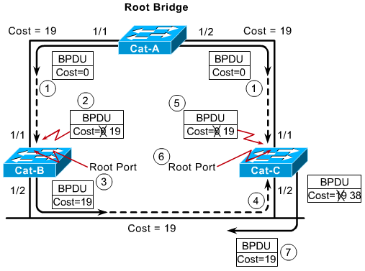
Step2: Electing the Root Ports
Every non-root bridge must select one root port.
The root port of a bridge is the port that is closest to the root bridge.
The root path cost is the cumulative cost of all links to the root bridge.
STP costs are incremented as BPDUs are received on a port, not as they are sent out a port.
Notes:
ROOT port选择时可能要比较端口号，可以配置交换机各个端口的优先级。默认是128

Slide 29
Step3: Electing Designated Ports(I)
Each segment has one designated port
Functions as the single bridge /switch port that both sends and receives traffic to and from that segment and the root bridge.
The bridge/switch containing the designated port for a given segment is referred to as the designated bridge for that segment.
All the bridges/switches will block the non-designated ports on them
Every active port on the root bridge becomes a designated port

Slide 30
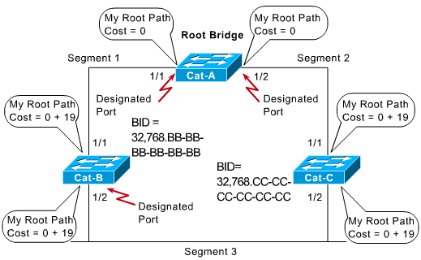
Step3: Electing Designated Ports(II)
Blocked
Notes:
比较BID

Slide 31
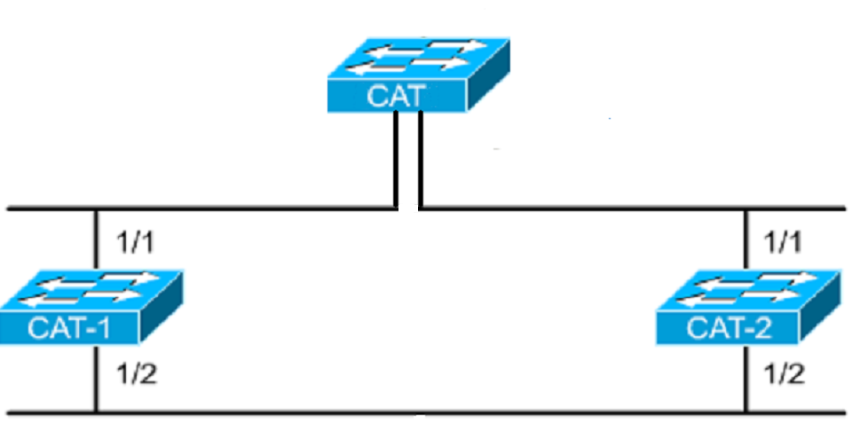
An Example of STP
MAC: 0c00c8111110
Priority: 32768
Root switch
Designated port
Designated port
Root port
100BaseT
Root port
MAC: 0c00c8111111
Priority: 32768
MAC: 0c00c8211112
Priority: 32768
Blocked
Designated port
10BaseT
Non-designated port

Slide 32
Table of Contents
Switching
The Spanning-Tree Protocol
VLAN
Introduction of VLAN
VLAN Architecture
VLAN Implementation
Routing Between VLANs

Slide 33
Existing Shared LAN Configurations
In a typical shared LAN...
Users are grouped physically based on the hub they are plugged into
Routers segment the LAN and provide broadcast firewalls
In VLANs...
you can group users logically by function, department or application in use
configuration is done through proprietary software

Slide 34
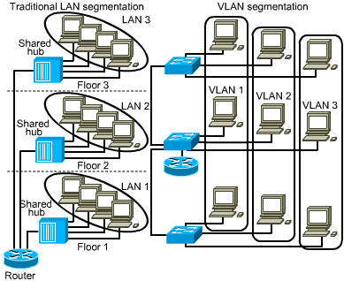
Differences between LANs & VLANs
VLANs...
work at Layer 2 & 3
control network broadcasts
allow users to be assigned by net admin.
provide tighter network security. How?
Notes:
安全
成本降低
性能提高
广播风暴防范
提高IT员工的效率
简化项目管理或应用管理

Slide 35
VLANs (IEEE 802.1q)
Characteristics
A logical grouping of network devices or users that are not restricted to a physical switch segment.
The devices or users in a VLAN can be grouped by function, department, application, and so on, regardless of their physical segment location.
A VLAN creates a single broadcast domain that is not restricted to a physical segment and is treated like a subnet.
VLAN setup is done in the switch by the network administrator using the vendor’s software.

Slide 36
Grouping Users
VLANs can logically segment users into different subnets (broadcast domains)
Broadcast frames are only switched between ports on the switch or switches with the same VLAN ID.
Users can be logically group via software based on:
port number
MAC address
protocol being used
application being used

Slide 37
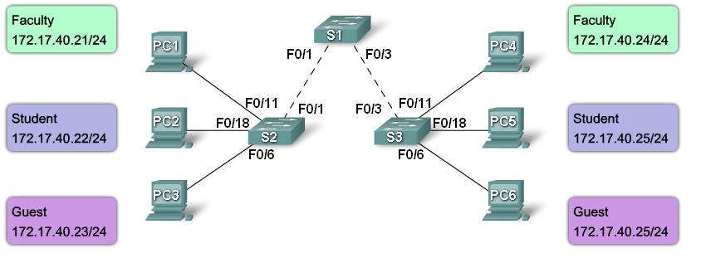
没有VLAN 时的网络广播

Slide 38
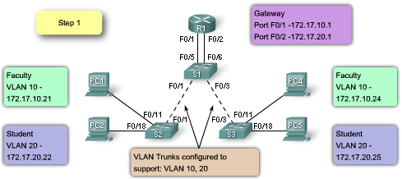


划分了VLAN的网络广播

Slide 39
VLAN 间通信

Slide 40
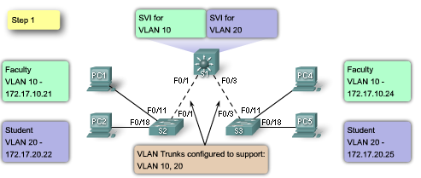
VLAN 和第 3 层转发来控制广播域

Slide 41
Table of Contents
Switching
The Spanning-Tree Protocol
VLAN
Introduction of VLAN
VLAN Architecture
VLAN Implementation
Routing Between VLANs

Slide 42
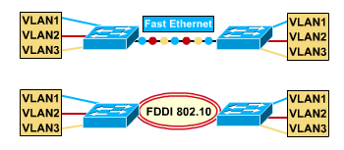
VLANs Across the Backbone
VLAN configuration needs to support backbone transport of data between interconnected routers and switches.
The backbone is the area used for inter-VLAN communication
The backbone should be high-speed links, typically 100Mbps or greater

Slide 43
Router’s Role in a VLAN
A router provides connection between different VLANs
For example, you have VLAN1 and VLAN2.
Within the switch, users on separate VLANs cannot talk to each other (benefit of a VLAN!)
However, users on VLAN1 can email users on VLAN2 but they need a router to do it.

Slide 44
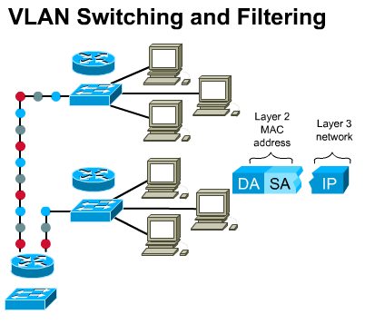
How Frames are Used in a VLAN
Switches make filtering and forwarding decisions based on data in the frame.
There are two techniques used.
Frame Filtering--examines particular information about each frame (MAC address or layer 3 protocol type)
Frame Tagging--places a unique identifier in the header of each frame as it is forwarded throughout the network backbone.

Slide 45
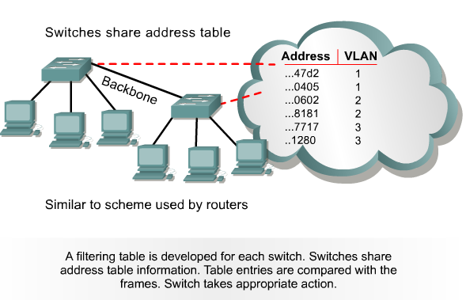
Frame Filtering

Slide 46
Frame Tagging
Frame tagging implementation process:
Places a VLAN identifier in the header of each frame as it is forwarded throughout the network backbone.
The identifier is understood and examined by each switch.
When the frame exits the network backbone, the switch removes the identifier before the frame is transmitted to the target end station.
Frame tagging functions at Layer 2 and requires little processing or administrative overhead.

Slide 47
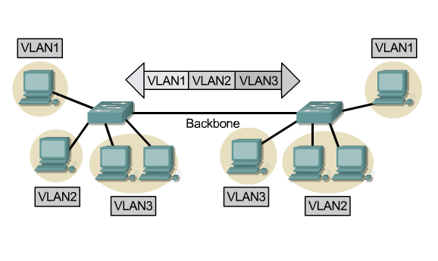
Frame Tagging

Slide 48
Frame Tagging– IEEE802.1Q and ISL
IEEE802.1Q
IEEE Standard, insert a label of VLAN to the header to identify the VLAN belonging to. (Frame Tagging)。
ISL(Inter-Switch Link)
Cisco proprietary. ISL add a header of 26 bytes in front of the data frame, and appends a CRC(4 byte) at the end.
Name | Encapsulation | Label | Media
802.1Q | No | Yes | Ethernet
ISL | Yes | No | Ethernet

Slide 49
Table of Contents
Switching
The Spanning-Tree Protocol
VLAN
Introduction of VLAN
VLAN Architecture
VLAN Implementation
Routing Between VLANs

Slide 50
Ports, VLANs, and Broadcasts
Methods for implementing VLANs
Static
Dynamic
Each switched port can be assigned to a VLAN. This...
ensures ports that do not share the same VLAN do not share broadcasts.
ensures ports that do share the same VLAN will share broadcasts.

Slide 51
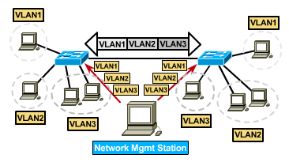
Static VLANs

Slide 52
Static VLANs
Defined
Static VLANs are when ports on a switch are administratively assigned to a VLAN
Benefits
secure, easy to configure and monitor
works well in networks where moves are controlled

Slide 53
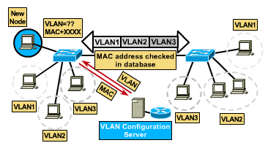
Dynamic VLANs

Slide 54
Dynamic VLANs
When a station is initially connected to an unassigned port, the switch checks an entry in the table and dynamically configures the port with the right VLAN
Benefits
less administration (more upfront) when users are added or move
centralized notification of unauthorized user
Notes:
Upfront:前期

Slide 55
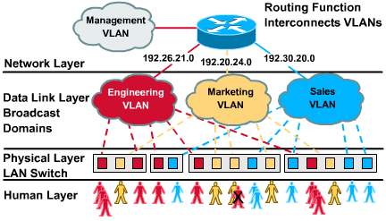
Port-Centric VLANs
3 Port-Centric VLANs

Slide 56
Benefits of Port-Centric VLANs
All nodes in the same VLAN are attached to the same router interface
Makes management easier because...
Users are assigned by router port
VLANs are easy to admin.
provides increased security
packets do not “leak” into other domains

Slide 57
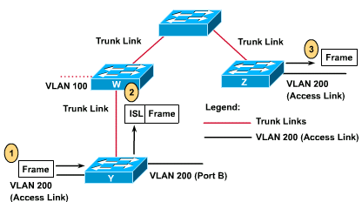
Access and Trunk Links

Slide 58
Access Links
An access link is a link on the switch that is a member of only one VLAN.
This VLAN is referred to as the native VLAN of the port.
Any device that is attached to the port is completely unaware that a VLAN exists.

Slide 59
Trunk Links
A trunk link is capable of supporting multiple VLANs.
Trunk links are typically used to connect switches to other switches or routers.
Switches support trunk links on both Fast Ethernet and Gigabit Ethernet ports.
Access and trunk links exist, too

Slide 60
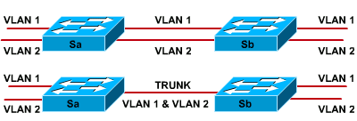
Trunk Links
Without trunking
With trunking
A trunk is a point-to-point link that supports several VLANs
A trunk is to saves ports when creating a link between two devices implementing VLANs

Slide 61
Trunk Links
A trunk link does not belong to a specific VLAN.
Acts as a conduit for VLANs between switches and routers.
The trunk link can be configured to transport all VLANs or to transport a limited number of VLANs.
A trunk link may, however, have a native VLAN.
The native VLAN of the trunk is the VLAN that the trunk uses if the trunk link fails for any reason.
Notes:
本征VLAN（Native Vlan）分配给 802.1Q中继端口。802.1Q中继端口支持来自多个VLAN的流量（有标记流量），也支持来自VLAN以外的流量（无标记流量）。802.1Q中继端口会将无标记流量发送到本征VLAN。如果交换机端口配置了本征VLAN，则连接到该端口的计算机将产生无标记流量。本征VLAN在IEEE 802.1Q规范中说明，其作用是向下兼容传统LAN方案中的无标记流量。对我们来说，本征 VLAN 的目的是充当中继链路两端的公共标识。最佳做法是使用VLAN 1以外的VLAN作为本征VLAN

Slide 62
Configuration in Switch 29xx
The following guidelines must be followed when configuring VLANs on Cisco 29xx switches:
The maximum number of VLANs is switch dependent.
VLAN 1 is one of the factory-default VLANs.
VLAN 1 is the default Ethernet VLAN.
Cisco Discovery Protocol (CDP) and VLAN Trunking Protocol (VTP) advertisements are sent on VLAN 1.
The Catalyst 29xx IP address is in the VLAN 1 broadcast domain by default.

Slide 63
VLAN Configuration
Step1: The steps necessary to create the VLAN. A VLAN name may also be configured, if necessary.
Switch# vlan database Switch(vlan)# vlan vlan_number Switch(vlan)# exit
Step2: Assign the VLAN to one or more interfaces:
Switch(config)# interface fastethernet 0/9 Switch(config-if)# switchport access vlan vlan_number

Slide 64
Adding a VLAN Example
cat2950#vlan database
cat2950(vlan)#vlan 9 name switchlab90
VLAN 9 added:
Name: switchlab90
cat2950(vlan)#?
VLAN database editing buffer manipulation commands:
abort Exit mode without applying the changes
apply Apply current changes and bump revision number
exit Apply changes, bump revision number, and exit mode
reset Abandon current changes and reread current database
cat2950(config)#interface fa 0/2
cat2950(config-if)# switchport access vlan 9
Notes:
Layer 1 of 2
Emphasize: Each VLAN has a unique, four-digit number that can be from 1 to 1001. To add a VLAN to the VLAN database, the minimum parameter required is the VLAN number.

Slide 65
Verifying a VLAN
Switch# show vlan [vlanid]
cat2950#sh vlan
VLAN Name Status Ports
---- ------------------------ ------------ ------------
Default active Fa0/1, Fa0/3
9 switchlab90 active Fa0/2
1002 fddi-default active
1003 token-ring-default active
1004 fddinet-default active
1005 trnet-default active
Notes:
Layer 1 of 2

Slide 66
Deleting VLANs
When a VLAN is deleted any ports assigned to that VLAN become inactive. The ports will, however, remain associated with the deleted VLAN until assigned to a new VLAN.
switch(vlan)# no vlan vlanid [name vlan-name]
cat2950(vlan)#no vlan 9
Deleting VLAN 9...
cat2950(vlan)#exit
APPLY completed.
Exiting....
cat2950#

Slide 67
Table of Contents
Switching
The Spanning-Tree Protocol
VLAN
Introduction of VLAN
VLAN Architecture
VLAN Implementation
Routing Between VLANs

Slide 68
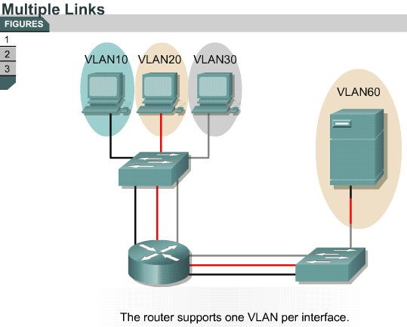
Routing Between VLANs
Notes:
传统路由要求路由器具有多个物理接口，以便进行 VLAN 间路由。 路由器通过每个物理接口连接到唯一的 VLAN，从而实现路由。 各接口配置有一个 IP 地址，该 IP 地址与所连接的特定 VLAN 子网相关联。由于各物理接口配置了 IP 地址，各个 VLAN 相连的网络设备可通过连接到同一 VLAN 的物理接口与路由器通信。本配置中，网络设备可将路由器用作网关，以访问与其它 VLAN 相连接的设备

Slide 69
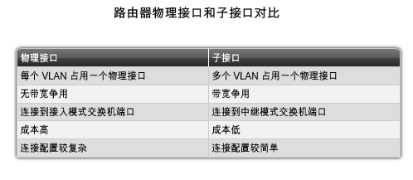
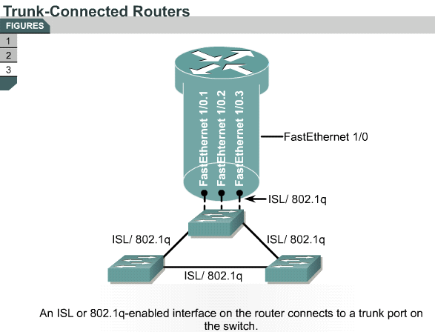
Routing Between VLANs
Notes:
子接口是基于软件的虚拟接口，可分配到各物理接口。 每个子接口配置有自己的 IP 地址、子网掩码和唯一的 VLAN 分配，使单个物理接口可同属于多个逻辑网络。 这种方法适用于在网络中有多个 VLAN 但只有少数路由器物理接口的 VLAN 间路由。

Slide 70
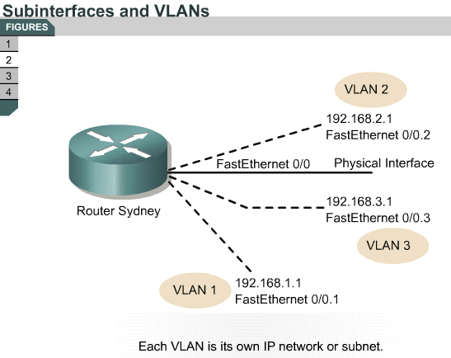
Subinterfaces

Slide 71
Configuring Inter-VLAN Routing
Step1: Identify the interface.
Router(config)#interface fastethernet port-number. subinterface-number
Step2: Define the VLAN encapsulation.
Router(config-if)#encapsulation dot1q vlan-number
Step3: Assign an IP address to the interface
Router(config-if)#ip address ip-address subnet-mask

Slide 72
Configuring Inter-VLAN Routing
Sydney(config)#interface FastEthernet 0/0
Sydney(config-if)#full duplex
Sydney(config-if)#no shut
Sydney(config-if)#interface FastEthernet 0/0.1
Sydney(config-subif)#encapsulation 802.1q 1
Sydney(config-subif)#ip address 192.168.1.1 255.255.255.0
Sydney(config-if)#interface FastEthernet 0/0.2
Sydney(config-subif)#encapsulation 802.1q 20
Sydney(config-subif)#ip address 192.168.2.1 255.255.255.0
Sydney(config-if)#interface FastEthernet 0/0.3
Sydney(config-subif)#encapsulation 802.1q 30
Sydney(config-subif)#ip address 192.168.3.1 255.255.255.0

Slide 73


谢 谢！

