Slide 1


Detonation and Rotating Detonation Engines
A rigorous thermo-gasdynamic treatment — from Chapman–Jouguet theory to engine thrust models
Alessandro Montanari Sapienza University of Rome
Graduate lecture · 90 minutes

Slide 2

Outline
Five movements, one thread — the entropy of a combustion wave
I
Detonation as a thermo-gasdynamic phenomenon
III
The thermodynamic advantage of detonation
Jump conditions & the heat release q · Rayleigh line & Hugoniot curve · Chapman–Jouguet · ZND structure
Fickett–Jacobs / Humphrey / Brayton · standing vs. rotating waves · entropy partition · the EAP metric
II
Worked examples — SD Toolbox / Cantera
IV
Thrust models for RDEs
CJ states for twelve propellant combinations · one-γ check · parametric sweeps · models & assumptions map
Shepherd–Kasahara (pressure-history & axial-flow) · Stechmann–Heister rocket performance & nozzles
V
RDE engineering practice (Wolański)
History · annulus principle & wave number · injection dynamics · chamber geometries · standing & pulsed alternatives
Notes:
Five movements: phenomenology (jump conditions -> CJ -> ZND), worked SD-Toolbox examples, cycle thermodynamics (including the standing/rotating inversion and EAP), the two thrust-model frameworks (Shepherd-Kasahara, Stechmann-Heister), and Wolanski's engineering survey. The single thread: where the entropy of a combustion wave is generated, and who pays for it.

Slide 3
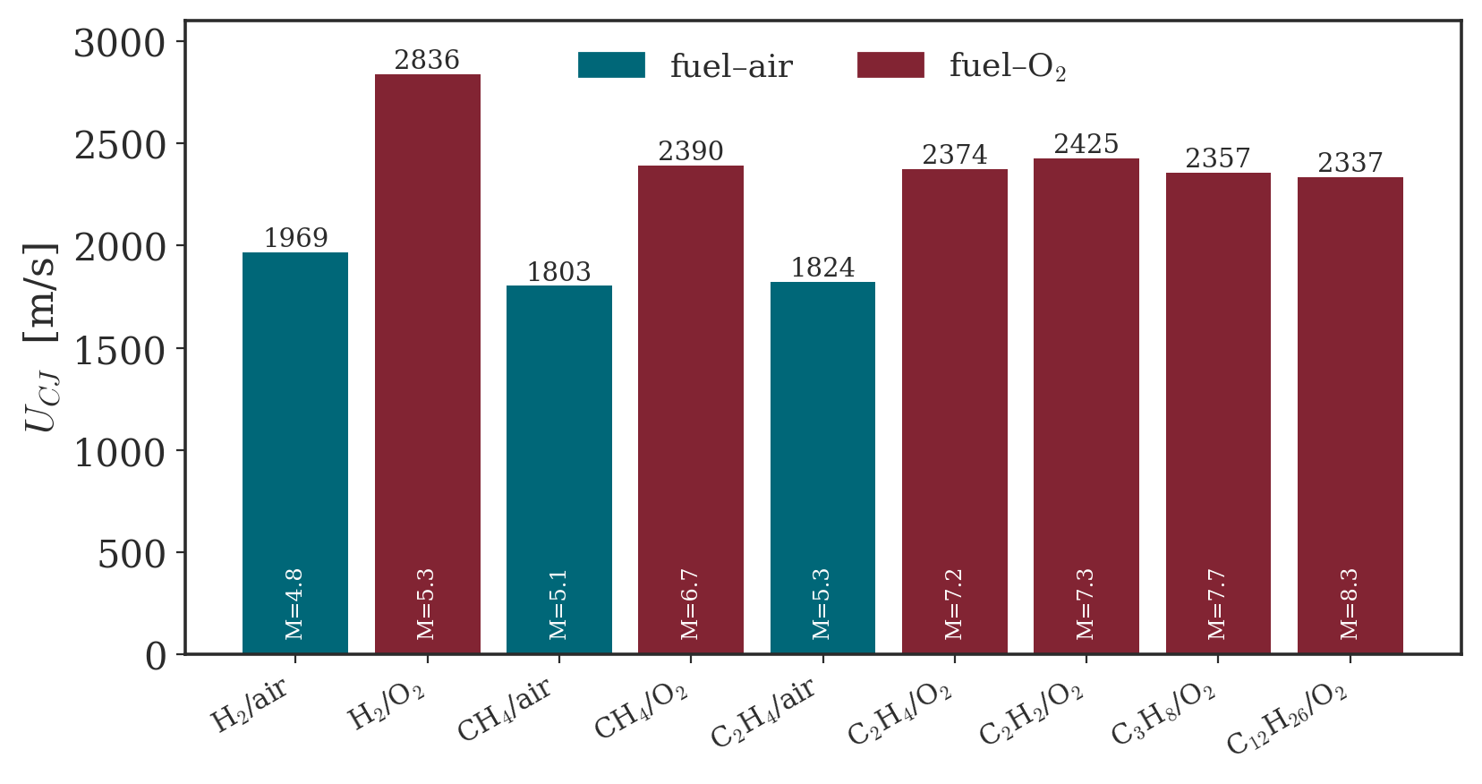
Why detonation for propulsion?
Combustion approaching constant volume: pressure gain, not loss
• Conventional engines burn at nearly constant pressure (Brayton). A deflagration is a subsonic, diffusion-controlled flame — small total-pressure loss, no compression.
• A detonation is a supersonic shock–reaction complex: it compresses and heats the gas at once, approaching the constant-volume (Humphrey) limit.
• Constant-volume heat addition raises the mean effective pressure for the same heat release → higher ideal efficiency: “pressure-gain combustion”.
• The Rotating Detonation Engine realises this continuously in a compact annulus — one or more detonations sweeping a fresh reactant layer at ~kHz.
CJ detonation speeds, 9 propellant pairs — computed live (SD Toolbox / Cantera)
Notes:
Wolanski (2013): detonation is a supersonic, shock-coupled reaction that RAISES pressure and density, whereas a deflagration lowers them. At equal compression the ideal-cycle efficiency gain is ~20-23% (Fickett-Jacobs > Humphrey > Brayton). Motivating question for the whole lecture: how much of this ideal advantage survives real gas dynamics and real nozzles? (Answer, Part IV: a few percent of Isp, if the nozzle adapts.)

Slide 4
Part I
Detonation as a thermo-gasdynamic phenomenon
A combustion wave is a discontinuity constrained by conservation laws. Everything follows from mass, momentum and energy.

Slide 5
Deflagration vs. detonation
Two branches of the same conservation laws — typical values
Property | Deflagration | Detonation
Propagation (lab) | subsonic, M₁ < 1 | supersonic, M₁ = M_CJ ≈ 5–8
Wave speed | Sₗ ≈ 0.4–3 m/s | D_CJ ≈ 1.8–2.9 km/s
Driving mechanism | diffusion of heat & radicals | shock-induced auto-ignition
Pressure ratio p₂/p₁ | ≲ 1 (slight drop) | 15 – 41 (strong rise)
Volume ratio v₂/v₁ | > 1 (expansion) | < 1 (compression, ≈ 0.55)
Total-pressure loss | small | large (leading shock)
Internal structure | preheat + reaction zone | shock + induction + reaction (ZND)
• Same jump conditions — different branch of the Hugoniot.
• Deflagration expands and slightly decompresses the gas.
• Detonation compresses it: this is the thermodynamic prize.
• The two are separated by a forbidden region (no real Rayleigh line).
Notes:
Both are solution branches of the SAME Rankine-Hugoniot jump conditions. Key contrast: deflagration is subsonic, diffusion-controlled, expands and slightly decompresses the gas; detonation is supersonic, shock-ignited, compresses it. Typical: S_L ~ 0.4-3 m/s vs D_CJ ~ 1.8-2.9 km/s; p2/p1 = 15-41 across our twelve mixtures (fuel-O2 upper end).

Slide 6
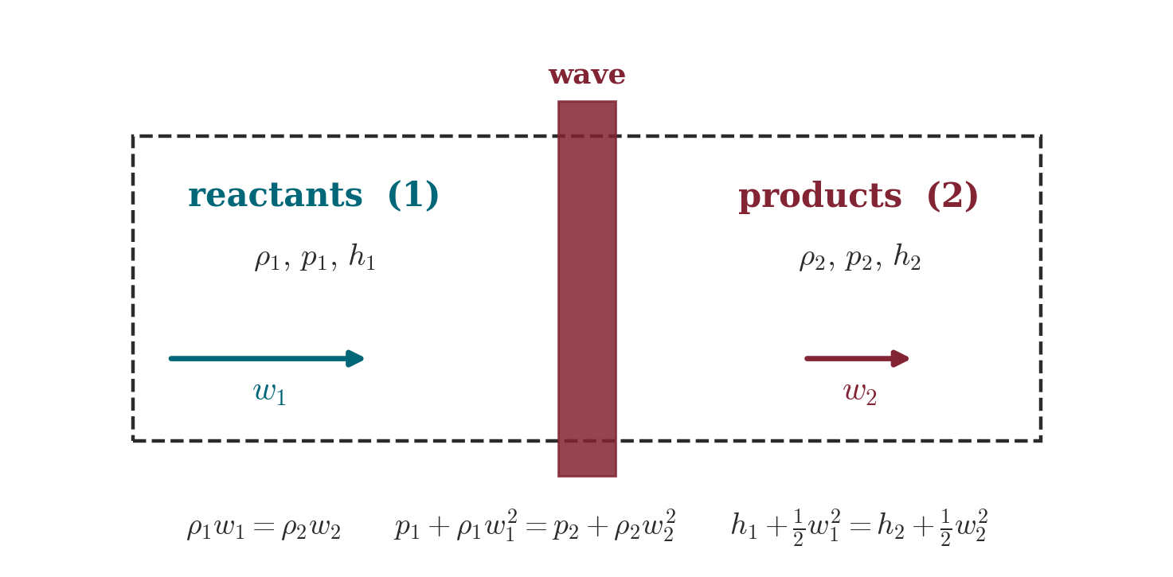
The combustion wave as a discontinuity
Control volume in the wave-fixed frame
• Wave frame: reactants enter at w₁ = U − u₁, products leave at w₂ = U − u₂; integrating over the control volume gives three jump conditions relating states 1 and 2 — independent of internal structure.
Notes:
The wave-fixed control volume gives three algebraic relations independent of the internal structure. This is why an 'ideal' detonation can be treated as a jump: the reaction-zone thickness (sub-mm) is tiny next to engine scales.

Slide 7
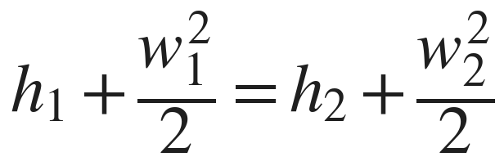
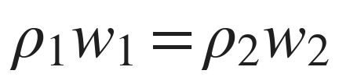
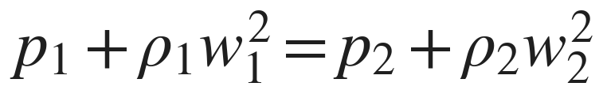
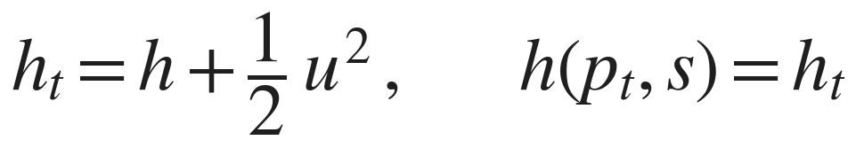
Rankine–Hugoniot jump conditions
Mass, momentum, energy — written with the total enthalpy
… the energy equation in one stroke: the total enthalpy is conserved across the wave.
• Three equations, four unknowns (p₂, v₂, w₂ and the wave speed): a one-parameter family of solutions, not a point.
• Closure needs an equation of state h = h(p,ρ) and, for reacting gas, the heat release q; admissible states must satisfy s₂ ≥ s₁.
• Eliminating the velocities collapses momentum + energy into two geometric objects in the (p, v) plane: the Rayleigh line and the Hugoniot curve.
Notes:
Three equations, four unknowns (p2,v2,w2,U): a one-parameter family of solutions, not a point. The total-enthalpy form ht1 = ht2 is the compact statement of the energy jump - and returns in Part IV as the rothalpy argument of the axial-flow model. Closure needs an equation of state and the heat release q, plus s2>=s1.

Slide 8
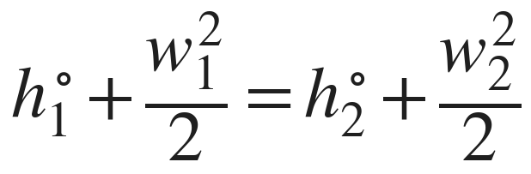
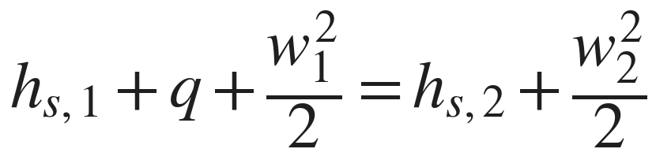
The heat-release parameter q
From formation enthalpies to the single scalar driving the wave
fold the chemistry into the enthalpy: h = h_sens + Δh_f → a single q appears in the energy jump
the formal definition (W&S, Eq. B1)
… equal to the formation-enthalpy (LHV) value: deviation 0.00% across all 12 mixtures at 300 K.
• q_c ≡ h₁(T₁,p₁) − h₆(T₁,p₁): reactants minus equilibrium products at the same initial state — the rigorous route from Δh_f to q.
• Stoichiometric, 300 K, 1 bar: q_c = 3.42 (H₂/air) · 2.76 (CH₄/air) · 13.42 (H₂/O₂) MJ/kg → q̃ = q_c/c_pT₁ = 4.0 · 4.4 · 7.4.
Notes:
Rigorous definition (Wintenberger-Shepherd Eq. B1): q_c = h1(T1,P1) - h6(T1,P1), reactants minus EQUILIBRIUM products at the same initial state, per kg of mixture. At 300 K the equilibrium products are the major species (CO2, H2O vapour, N2), so q_c coincides with the formation-enthalpy (LHV) heat release: deviation 0.00% across all 12 mixtures (q_mapping audit). Non-dimensionalisations used by the papers: q-tilde = q_c/(cp T1) on the classical Hugoniot and in the FJ closed form; q_t-tilde = q_c/(cp Tt1) on the stagnation Hugoniot with existence limit q_t-tilde < 1/(gamma^2-1); q_c/(R T1) = gamma/(gamma-1) q-tilde labels the Fig. A22 family. Numbers: H2/air 3.42, CH4/air 2.76, H2/O2 13.42 MJ/kg -> q-tilde 4.03/4.40/7.36.

Slide 9
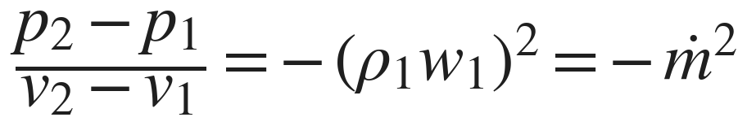
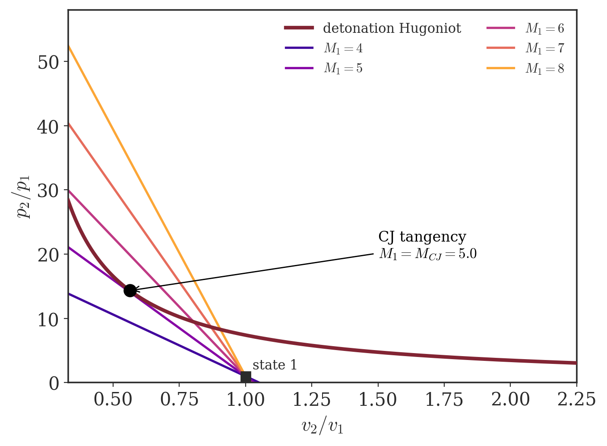
The Rayleigh line
Mass + momentum ⟹ a straight line in the (p, v) plane
• Mass + momentum eliminate the velocities: the end state lies on a line through (p₁,v₁) with slope −ṁ² = −(ρ₁w₁)².
• The slope fixes the mass flux, hence the wave speed U = v₁√[(p₂−p₁)/(v₁−v₂)] — a steeper line is a faster wave.
• A real (negative) slope forbids the quadrants p₂>p₁, v₂>v₁ and its opposite: the forbidden region.
• Detonation compresses (v₂<v₁); deflagration expands (v₂>v₁).
Notes:
Slope = -(rho1 w1)^2: it encodes the mass flux, hence the wave speed. Steeper line = faster wave (right figure). A real (negative) slope forbids two quadrants -> the forbidden region between the CJ points.

Slide 10
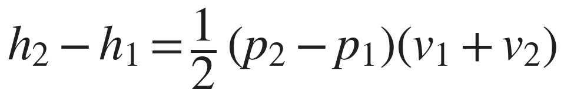
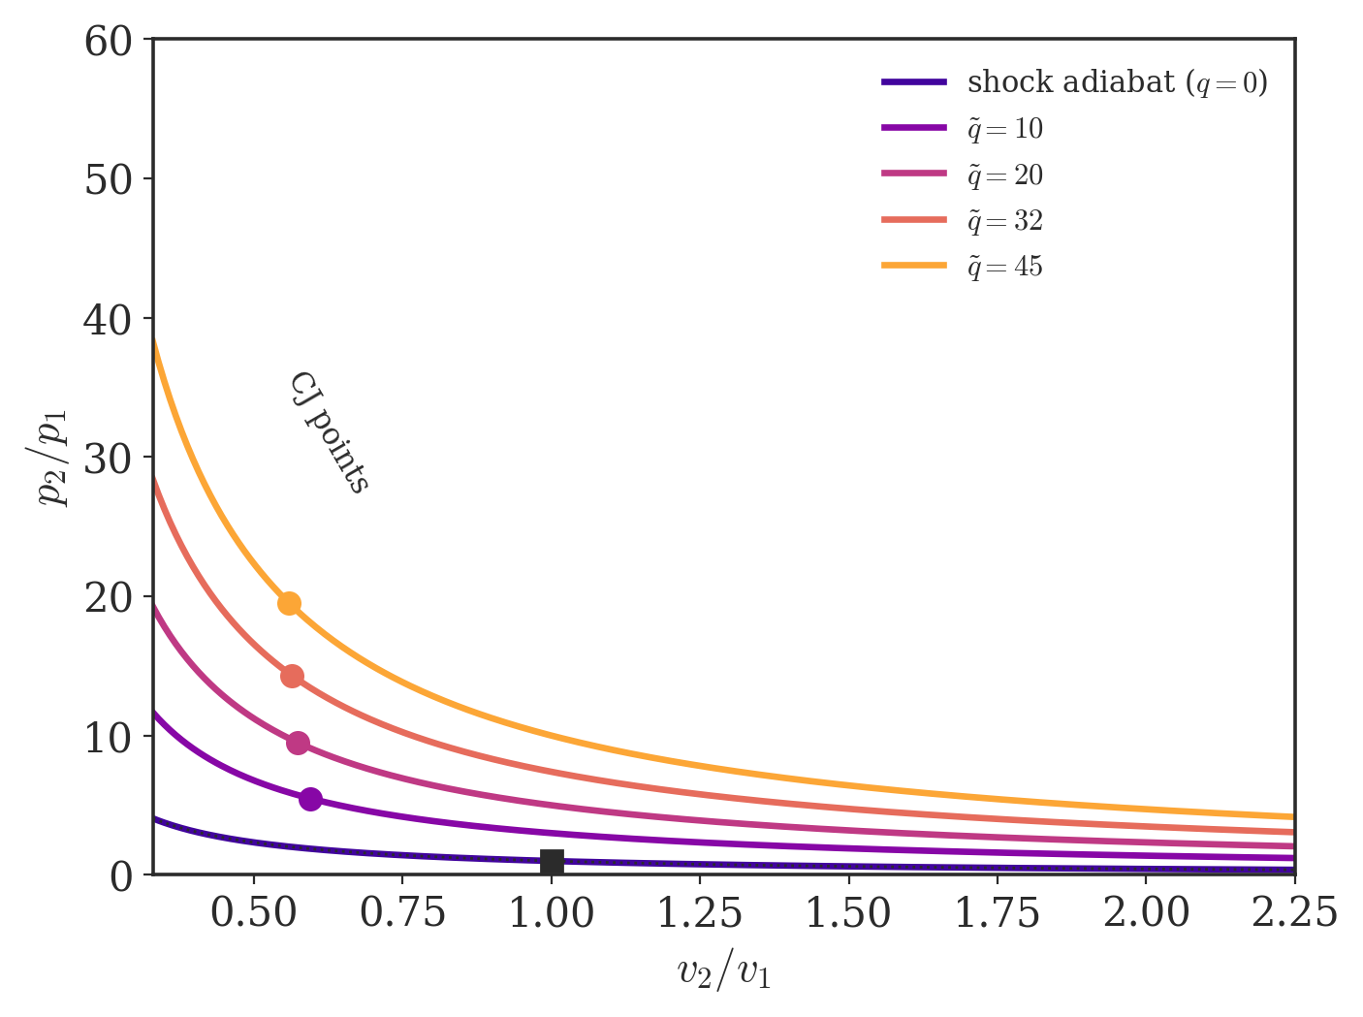
The Hugoniot curve
Mass + momentum + energy ⟹ the locus of end states
• All three laws combined give the Hugoniot — the locus of admissible end states for a given heat release q.
• With q>0 it detaches from state 1, splitting into an upper detonation branch and a lower deflagration branch.
• Larger heat release lifts the curve and drives the CJ point higher — the dependence shown at right.
• The solution is a Rayleigh line tangent/secant to the Hugoniot; the wave speed stays free until one more condition fixes it.
Notes:
With heat release the Hugoniot detaches from state 1. Right figure: increasing q lifts the whole curve and drives the CJ tangent point up and to the left (stronger compression). The wave speed is still free - one more condition (CJ) is needed.

Slide 11
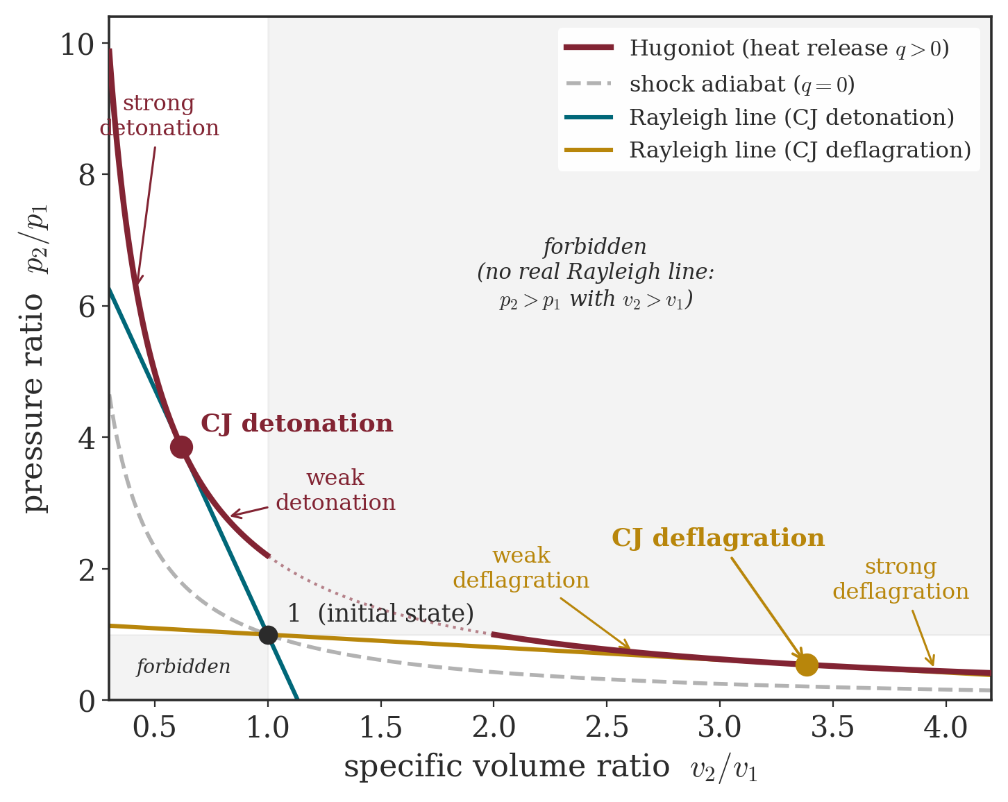
Rayleigh line meets Hugoniot
The complete solution map — five regions, two tangencies
• A Rayleigh line can cut the detonation branch twice (strong + weak), touch it once (CJ), or miss it.
• Tangency defines the two Chapman–Jouguet points — minimum wave speed on each branch.
• Between the tangents lies the forbidden region: no real Rayleigh line exists.
• Regions: strong / weak detonation, CJ, weak / strong deflagration.
Notes:
A Rayleigh line can be secant (two solutions: strong+weak), tangent (CJ), or miss the branch. The two tangencies are the CJ detonation and CJ deflagration. Between them: no real Rayleigh line (forbidden). Five regions: strong/weak detonation, forbidden, weak/strong deflagration.

Slide 12
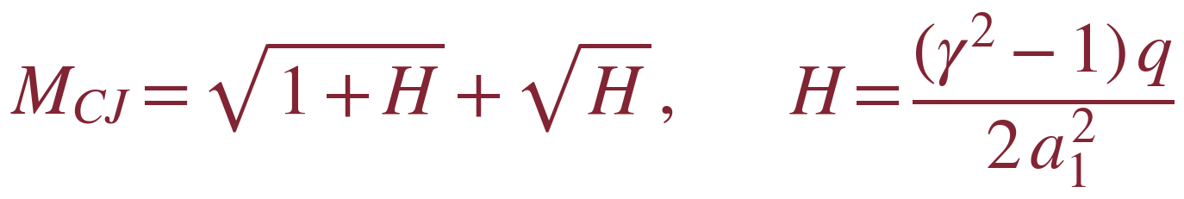
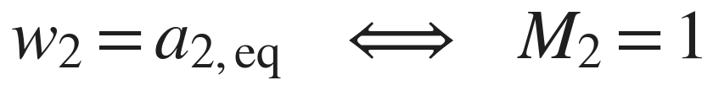
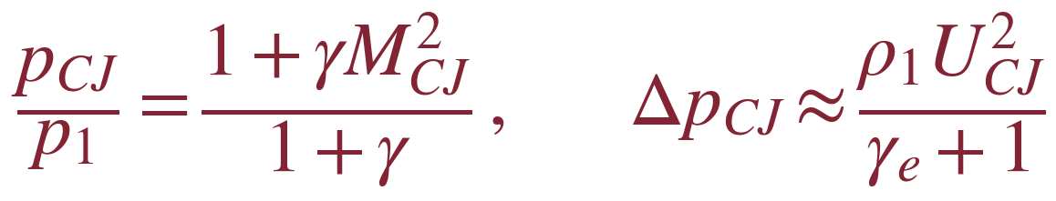
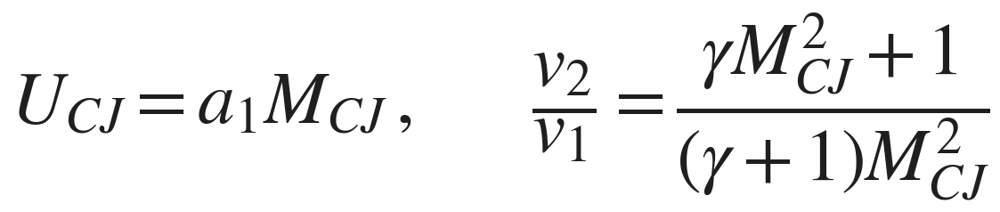
The Chapman–Jouguet condition
Tangency = sonic outflow = minimum wave speed — and the CJ state
• At tangency the Rayleigh line and the Hugoniot share a slope: the outflow is exactly sonic in the wave frame, w₂ = a₂ (equilibrium sound speed). A self-sustaining wave selects this point — Jouguet’s hypothesis.
• Upper branch: strong (overdriven) detonations decay to CJ; weak ones are unreachable through a normal reaction zone. Lower branch: weak deflagrations are the ordinary flames; strong ones are forbidden.
• For a perfect gas the one-γ model gives M_CJ, p_CJ and Δp_CJ ≈ ρ₁U²/(γ_e+1) in closed form — reused by the thrust models of Part IV.
Notes:
Jouguet's hypothesis: the self-sustaining wave sits at the tangent point where the downstream flow is exactly sonic in the wave frame (w2 = a2, EQUILIBRIUM sound speed - with the frozen sound speed the same point reads M2 ~ 0.965, see the validation slide). Classification: strong (overdriven) detonations decay to CJ unless supported; weak detonations unreachable through a normal reaction zone; strong deflagrations forbidden. The one-gamma forms for M_CJ, p_CJ and Delta-p_CJ ~ rho1 U^2/(gamma_e+1) are reused verbatim by the Part-IV thrust models - with gamma_e the EQUILIBRIUM products exponent (1.13-1.17), not the frozen cp/cv.

Slide 13
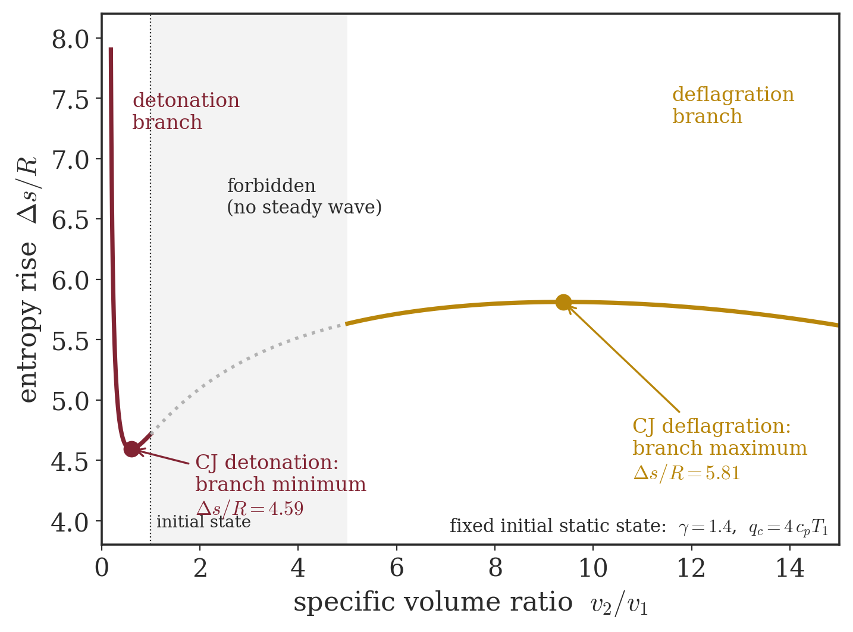
Chapman–Jouguet as an entropy extremum
Why the wave settles on the tangent point
• Along the Hugoniot the entropy rise Δs has a minimum on the detonation branch and a maximum on the deflagration branch.
• Both extrema coincide exactly with the CJ (tangent) points — a theorem of the Hugoniot geometry.
• The CJ detonation is therefore the lowest-entropy self-sustaining detonation: the least dissipative, and the key to its cycle advantage (Part III).
Notes:
A theorem of the Hugoniot geometry: entropy is minimum on the detonation branch exactly at the CJ tangent point (and maximum at CJ deflagration). This entropy minimum is the CRUX of the thermodynamic advantage (Part III) - but it is necessary, not sufficient, for a good steady engine: see the standing-detonation slides for the inversion.

Slide 14
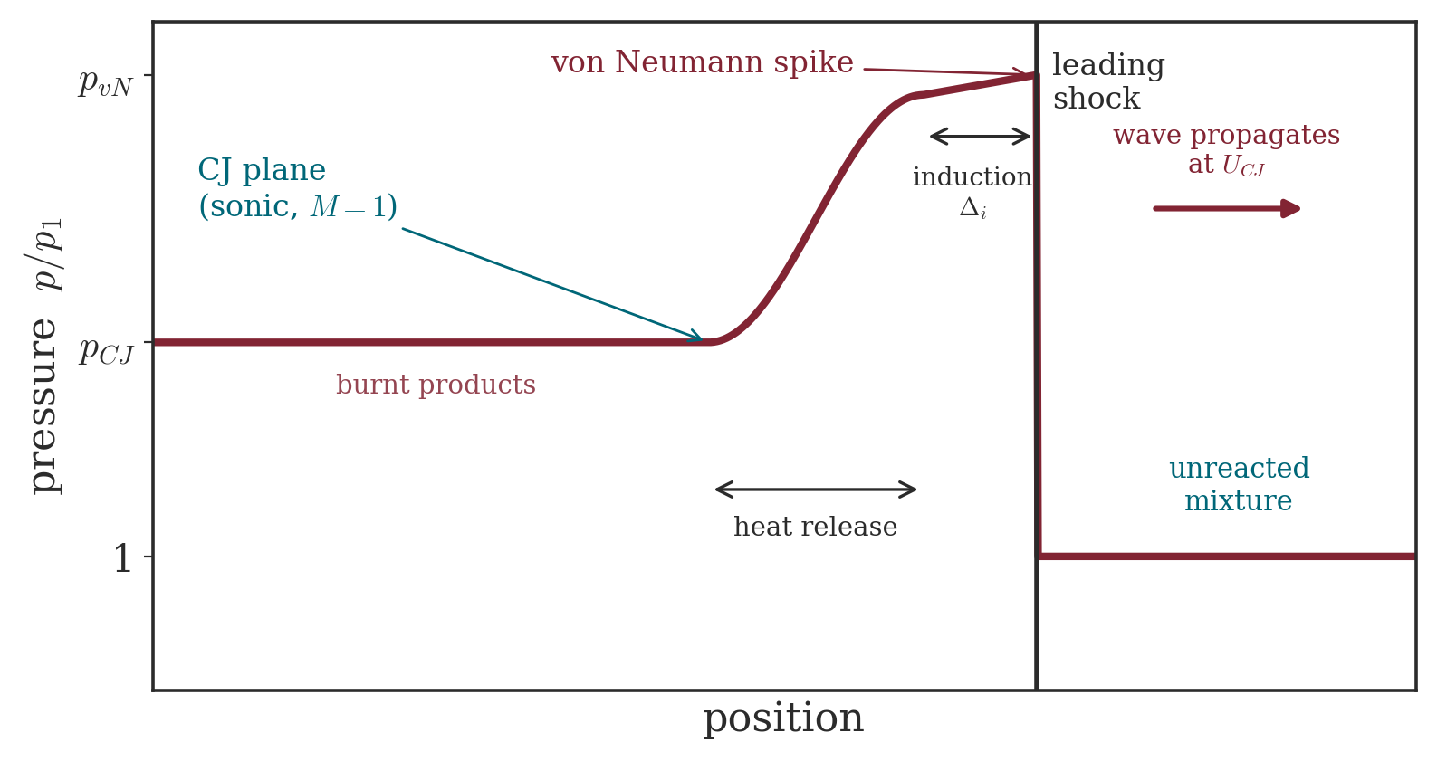
Resolving the wave: the ZND model
Zel’dovich – von Neumann – Döring: a shock followed by reaction
• The CJ jump hides internal structure. ZND resolves it as an inert shock + a finite reaction zone.
• The lead shock compresses reactants to the von Neumann spike (p_vN ≈ 2 p_CJ) — no reaction yet.
• An induction zone (near-frozen) is followed by rapid heat release; the flow accelerates to sonic exactly at the CJ plane.
• The reaction-zone thickness sets cell size, initiation limits, and RDE channel sizing.
Notes:
ZND resolves the jump: inert lead shock -> von Neumann spike (p_vN ~ 2 p_CJ, no reaction) -> induction zone -> rapid heat release -> sonic CJ plane. The reaction-zone length sets the detonation cell size and the initiation limits - the practical constraint on RDE channel dimensions.

Slide 15
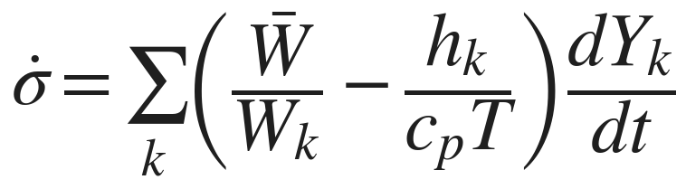
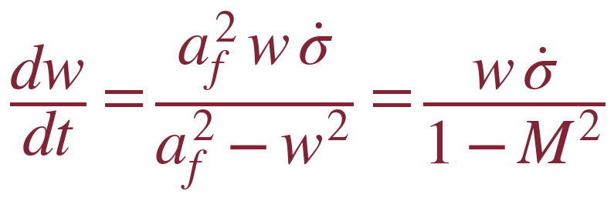
ZND governing equations
Reacting flow behind the shock — thermicity drives the eigenvalue
• The thermicity σ̇ measures how strongly chemistry pushes the flow: it couples species production rates to pressure and density changes (SD Toolbox Eq. 9.45).
• Integrated in time behind the frozen shock, the velocity ODE carries the factor 1/(1−M²): as reaction proceeds the frozen Mach number rises toward 1, and the thermicity must vanish exactly as M→1.
• This sonic/thermicity balance is the ZND expression of the CJ condition — the regularity condition solved numerically by the SD Toolbox zndsolve.
Notes:
Thermicity sigma-dot (SD Toolbox Eq. 9.45): term I = volume change from composition change, term II = internal-energy/chemistry exchange. zndsolve integrates the ODEs in TIME behind the frozen shock (Eq. 11.45-11.48): dw/dt = w sigma-dot/(1-M^2) with M the frozen Mach number. Regularity at eta = 1-M^2 -> 0 demands sigma-dot -> 0 simultaneously: the sonic/thermicity balance IS the CJ condition seen from inside the wave, and the numerical eigenvalue of the toolbox.

Slide 16
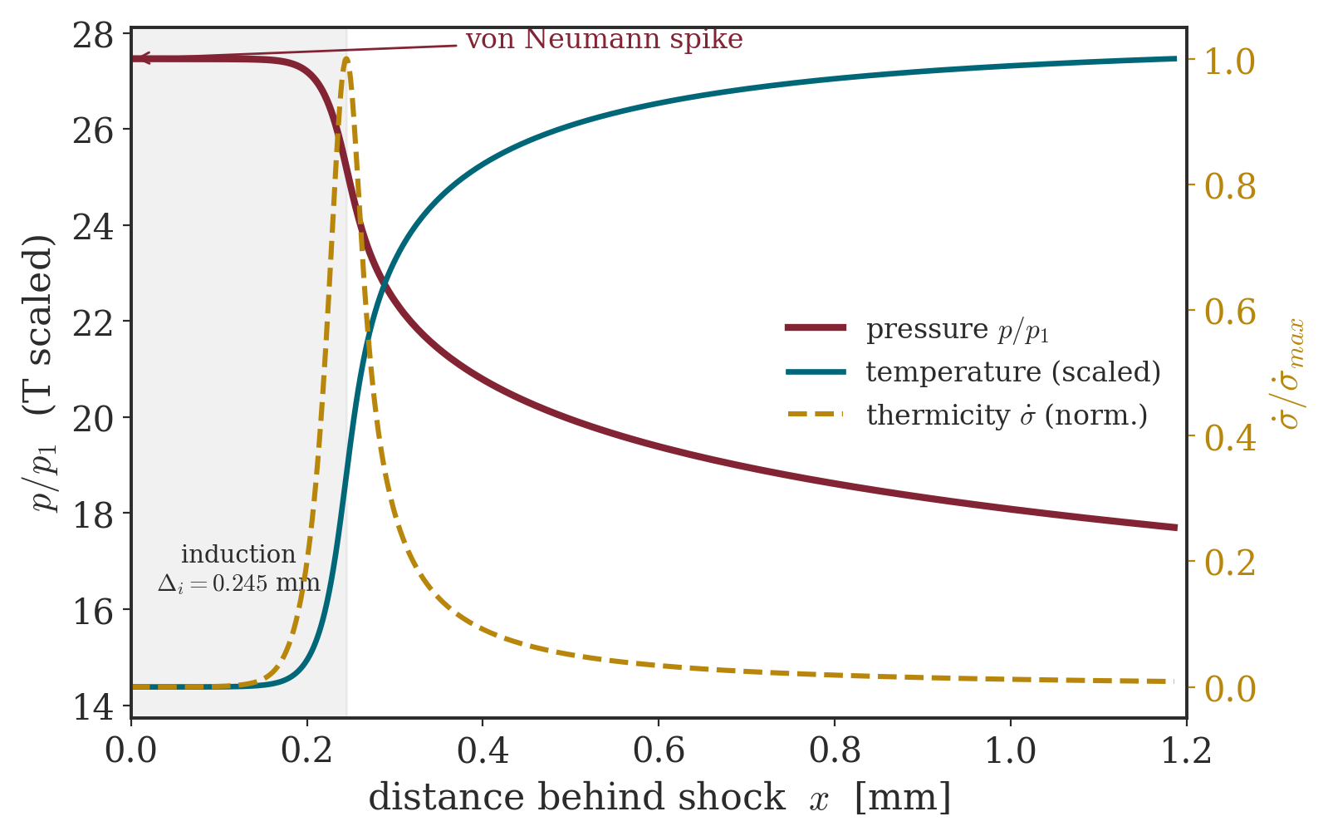
ZND structure — computed
Stoichiometric H₂/air — official SD Toolbox zndsolve (GRI-Mech 3.0)
• von Neumann spike p_vN/p₁ ≈ 27, T_vN ≈ 1530 K — the frozen shocked state.
• Thermicity peaks at the end of the induction zone (Δᵢ ≈ 0.24 mm here), marking the main heat release.
• Pressure relaxes from the spike toward p_CJ/p₁ ≈ 15 as the flow reaches the sonic CJ plane.
• Induction length shrinks by ~5× for H₂/O₂ — hotter, faster chemistry.
Notes:
Computed with the official Caltech SD Toolbox zndsolve on Cantera 3.2 (GRI-Mech 3.0). H2/air: von Neumann p_vN/p1 = 27.5, T_vN = 1532 K; induction length (peak thermicity) 0.245 mm; pressure relaxes to p_CJ/p1 = 15.5 at the sonic plane. H2/O2: induction 0.050 mm, ~5x shorter.

Slide 17
Part II
Worked examples — SD Toolbox / Cantera
Rigorous CJ, von Neumann and ZND states from the equilibrium Hugoniot — cross-checked against the published literature.

Slide 18
Computing the CJ state
The official SD Toolbox CJspeed / PostShock on Cantera 3.2
• For each trial compression v₂/v₁, solve the chemical-equilibrium Hugoniot h₂ − h₁ = ½(p₂−p₁)(v₁+v₂) for T₂ with products in equilibrium.
• The Rayleigh slope gives the wave speed U(v₂); CJspeed takes the minimum of U over the Hugoniot — equivalently the tangency / sonic point (more robust than iterating on the equilibrium sound speed).
• von Neumann state: the frozen (unreacted) shock solution PostShock_fr at U = U_CJ.
• Implemented on Cantera 3.2 (GRI-Mech 3.0; n-dodecane surrogate for kerosene) — the algorithm documented in the SD Toolbox report.
Validation vs. Caltech database
H₂/air: 1969 m/s (ref 1971)
H₂/O₂: 2836 m/s (ref 2836)
CH₄/air: 1803 m/s (ref 1804)
T₂, p₂/p₁, ρ₂/ρ₁ within 0.5%
The minimum-speed point returns M₂ ≈ 0.965 on the frozen sound speed — exactly the equilibrium-sound-speed sonic condition.
Notes:
Official SD Toolbox CJspeed: minimises the Rayleigh wave speed over the equilibrium Hugoniot (density-ratio sweep + least-squares parabola). The report calls this Definition I and prefers it because it needs no equilibrium-sound-speed iteration. PostShock_fr at U_CJ gives the frozen von Neumann state. Validated to <0.5% vs the Caltech detonation database. The frozen-vs-equilibrium sonic check (M2 = 0.965 frozen, 1.000 equilibrium) is a teaching hook for the gamma_e discussion two slides ahead.

Slide 19
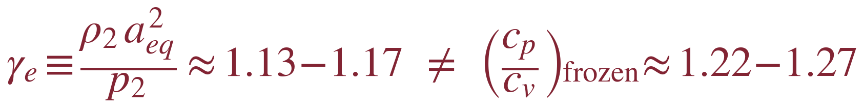
CJ states — twelve propellant combinations
p₁ = 1 atm, T₁ = 300 K, φ = 1 — equilibrium products (SD Toolbox)
Mixture | U_CJ [m/s] | M_CJ | p₂/p₁ | T₂ [K] | ρ₂/ρ₁ | γ_e (equil.) | γ_fr (cp/cv)
H2/air | 1969 | 4.82 | 15.5 | 2944 | 1.80 | 1.163 | 1.242
H2/O2 | 2836 | 5.26 | 18.6 | 3678 | 1.84 | 1.129 | 1.213
CH4/air | 1803 | 5.09 | 17.0 | 2778 | 1.80 | 1.168 | 1.248
CH4/O2 | 2390 | 6.71 | 29.1 | 3723 | 1.85 | 1.131 | 1.217
C2H4/air | 1824 | 5.27 | 18.2 | 2924 | 1.81 | 1.161 | 1.252
C2H4/O2 | 2374 | 7.23 | 33.2 | 3934 | 1.85 | 1.139 | 1.236
C2H2/air | 1867 | 5.39 | 19.0 | 3112 | 1.82 | 1.158 | 1.258
C2H2/O2 | 2425 | 7.33 | 33.6 | 4211 | 1.84 | 1.153 | 1.270
C3H8/air | 1800 | 5.29 | 18.1 | 2821 | 1.81 | 1.166 | 1.249
C3H8/O2 | 2357 | 7.66 | 35.9 | 3825 | 1.86 | 1.134 | 1.223
Kerosene/air | 1796 | 5.40 | 18.6 | 2836 | 1.81 | 1.165 | 1.251
Kerosene/O2 | 2341 | 8.31 | 40.6 | 3882 | 1.86 | 1.137 | 1.229
γ_e = equilibrium isentropic exponent of the products at CJ (a_eq = equilibrium sound speed): 1.13–1.17. Not the frozen cp/cv (1.22–1.25). Minimum γ_e: H₂/O₂ = 1.13.
Notes:
All twelve computed live with the official SD Toolbox on Cantera 3.2 (kerosene = n-dodecane surrogate, +0.19% on U_CJ vs the full mechanism). Trends: fuel-O2 -> higher T2, p2/p1, M_CJ (no N2 to heat); kerosene/O2 peaks at p2/p1 = 40.6. THE COLUMN PAIR gamma_e vs gamma_fr is the point of this slide (gamma audit): gamma_e = rho2 a_eq^2/p2 at CJ = 1.13-1.17 is what Shepherd-Kasahara's equations require; the frozen cp/cv 1.22-1.25 fed to their Eq. 19-22 fails to reproduce their own Table 1. Minimum gamma_e: H2/O2 = 1.129 (NOT kerosene - the old deck bullet was wrong). CJ is sonic w.r.t. the equilibrium sound speed.

Slide 20
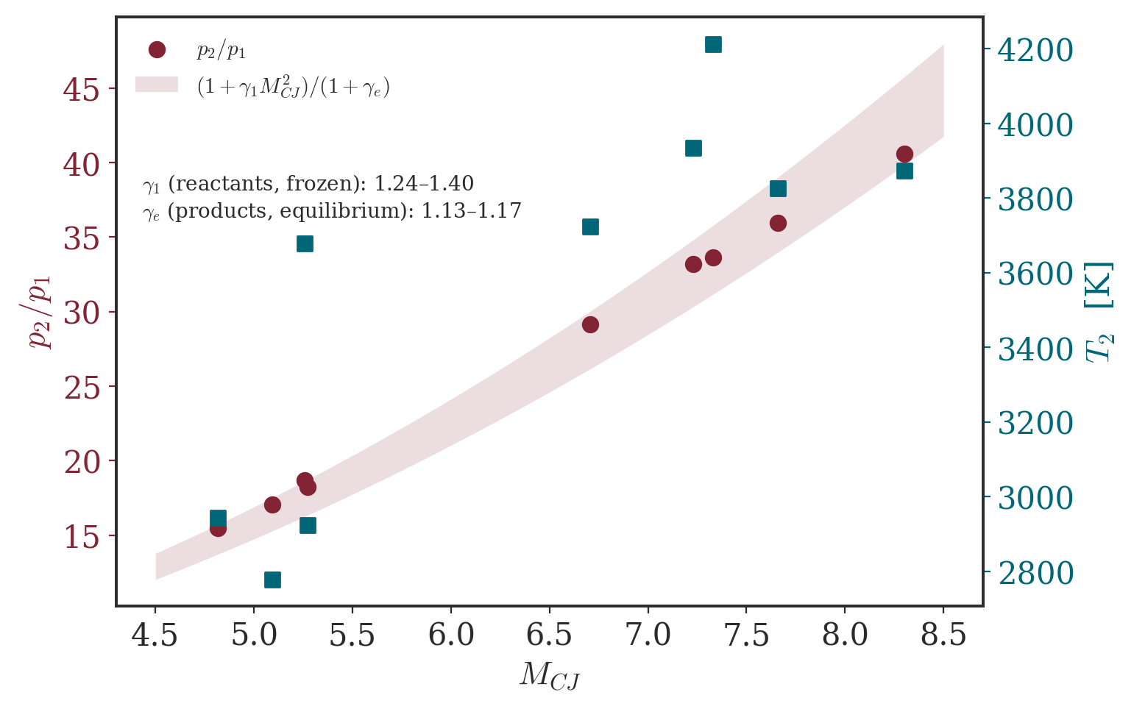
SD Toolbox vs. published values
Convergence with Shepherd–Kasahara (GALCIT FM2017.001, Table 2)
Mixture | U_CJ SDT | U_CJ lit. | T₂ SDT | T₂ lit. | p_CJ SDT | p_CJ lit. | err
H2/air | 1969 | 1968 | 2945 | 2943 | 1.57 | 1.55 | 1.2%
C2H4/air | 1824 | 1823 | 2924 | 2923 | 1.85 | 1.82 | 1.5%
H2/O2 | 2836 | 2836 | 3679 | 3675 | 1.89 | 1.86 | 1.7%
C2H4/O2 | 2374 | 2373 | 3934 | 3930 | 3.37 | 3.31 | 1.7%
C3H8/O2 | 2357 | 2356 | 3825 | 3822 | 3.65 | 3.59 | 1.5%
Every SD Toolbox CJ speed reproduces the published value within 0.1% and every CJ pressure within 1.7% — the detonation inputs feeding the thrust models are validated against the literature. Pressures in MPa.
Notes:
Adversarial V&V: every SD Toolbox CJ speed matches Shepherd-Kasahara's published Table 2 to <=0.1%, and P_CJ to <=1.7% (5 mixtures). This validates the detonation inputs that feed the thrust models - no hallucinated numbers. Right figure: post-shock Mach behaviour confirming the frozen/equilibrium sonic distinction.

Slide 21
The one-γ model vs. real thermochemistry
A closed-form check — and exactly where it breaks down
Mixture | M_CJ (SDT) | M_CJ (1-γ, γ=1.2) | Δ | q_eff/q_c
H2/air | 4.82 | 4.80 | -0% | 1.22
CH4/air | 5.09 | 4.94 | -3% | 1.26
C2H4/air | 5.27 | 5.24 | -1% | 1.24
H2/O2 | 5.26 | 7.03 | +34% | 0.82
CH4/O2 | 6.71 | 8.98 | +34% | 0.81
Kerosene/O2 | 8.30 | 10.78 | +30% | 0.84
• One-γ model: M_CJ = √(1+H)+√H with H = (γ+1)q̃/2 and γ = 1.2 (fuel–air detonation products, W&S).
• Fuel–air: excellent (≤2%) — dissociation is weak and the γ=1.2 calibration absorbs the reactant-vs-product sound-speed mismatch.
• Fuel–O₂: over-predicts by 25–40%. Dissociation withholds part of the release: the wave “sees” only q_eff ≈ 0.6–0.8 q_c.
• Lesson: closed forms for scaling and intuition; equilibrium thermochemistry for numbers.
Notes:
One-gamma with gamma = 1.2 (the W&S products value for the fuel-air class): fuel-air M_CJ within 2% - the 1.2 calibration silently absorbs the reactant-vs-product sound-speed mismatch (physical M_CJ is referenced to the reactants' a1 with gamma1 ~ 1.39-1.40, the model implies a1 = sqrt(gamma_e R T1); that is why the q_eff inversion gives q_eff/q_c = 1.18-1.30 > 1 for fuel-air). Fuel-O2: over-predicts by 25-40% because dissociation withholds part of the release - q_eff/q_c = 0.63-0.84. Same story as the FJ-efficiency penalty in Part III. Use closed forms for scaling; equilibrium thermochemistry for numbers.

Slide 22
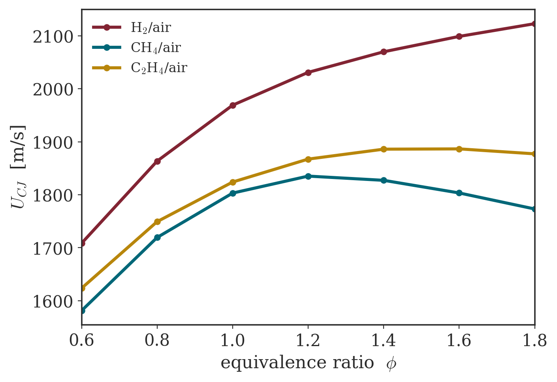
Effect of equivalence ratio
CJ speed peaks slightly rich — energy content vs. product mass
• U_CJ tracks the balance of heat release q_c and the upstream sound speed a₁.
• Fuel–O₂ curves lie far above fuel–air: no nitrogen to heat, higher a₁ and q_c.
• Maxima sit modestly rich (φ ≈ 1.1–1.6): light intermediate species (H, H₂) lower the product molar mass and raise the sound speed.
• These trends propagate directly into specific thrust (Part IV).
Notes:
U_CJ tracks the balance of heat release and upstream sound speed. Maxima sit modestly rich (phi ~ 1.1-1.6): light intermediate species (H, H2) lower the product molar mass and raise the sound speed. These trends propagate directly into specific thrust (Part IV).

Slide 23
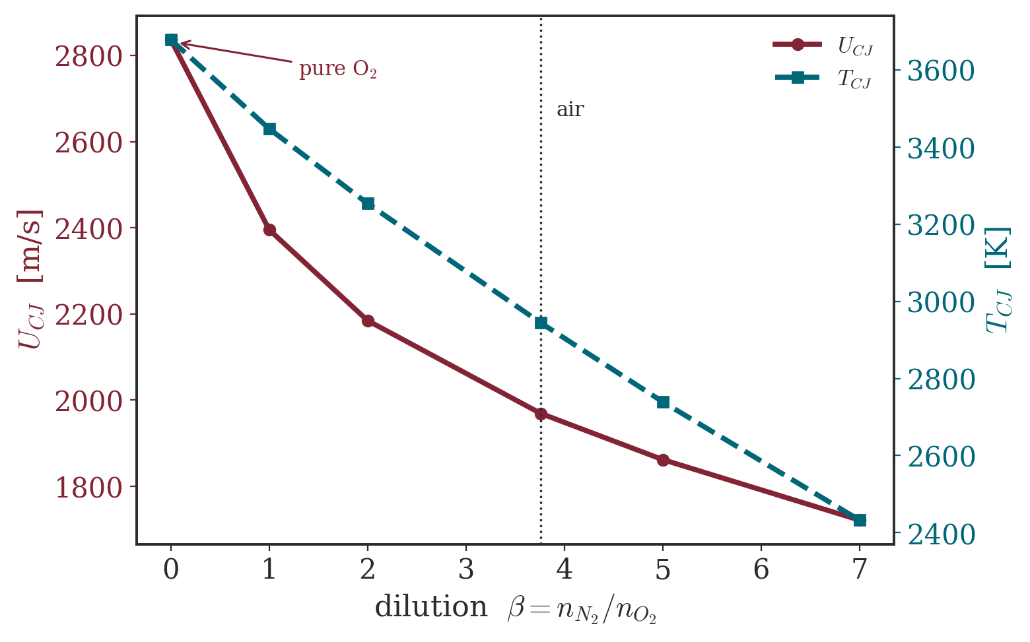
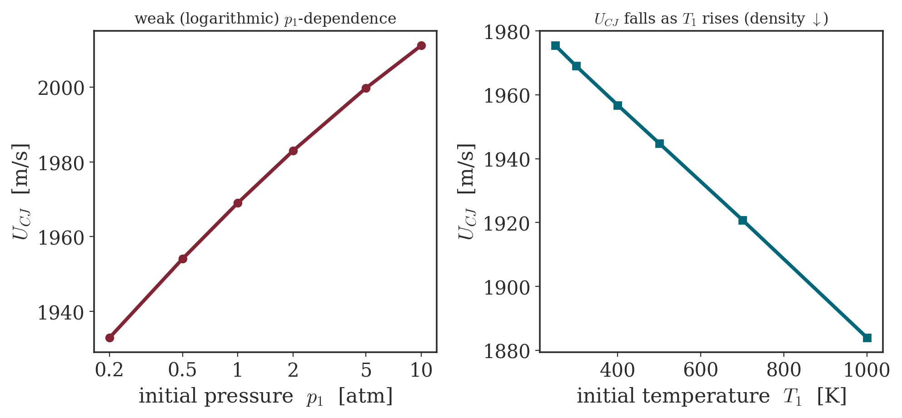
CJ speed — dilution and initial state
Dominant parameters mapped with the SD Toolbox
Inert dilution is the strongest lever (2836 → 1721 m/s from O₂ to heavy N₂); the CJ speed rises weakly (log-like) with p₁ and falls slowly with T₁.
Notes:
Dominant levers (SD Toolbox sweeps): inert dilution is strongest (2836 -> 1721 m/s from O2 to heavy N2); U_CJ rises only weakly (log-like) with p1 and falls slowly with T1 (density drops faster than sound speed rises). Note for Part IV: specific PERFORMANCE of the pressure-history model is nearly independent of upstream p,T; the axial model instead gains strongly with p1/pa (deeper expansion).

Slide 24
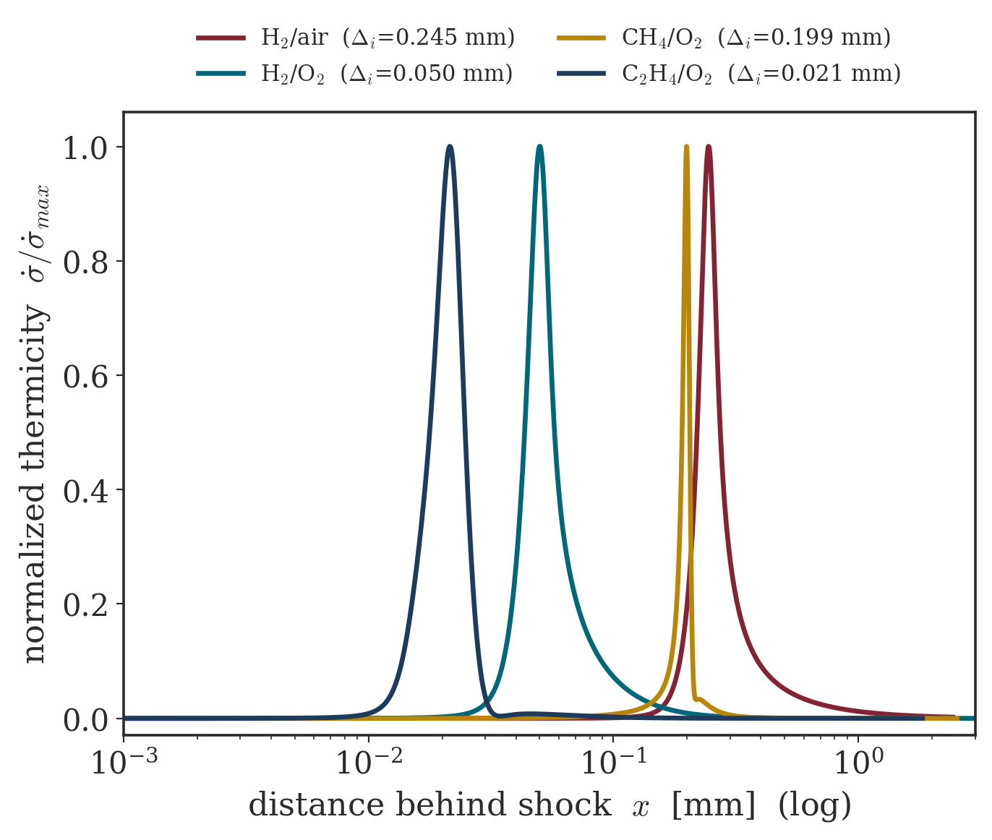
ZND reaction zones across propellants
The length scale that sizes an RDE channel
• Induction length Δᵢ (distance to peak thermicity) spans ~12× across these mixtures: 0.021 mm (C₂H₄/O₂) to 0.245 mm (H₂/air).
• Δᵢ sets the detonation cell size λ ~ 10–50 Δᵢ, hence the minimum channel width and layer height for a self-sustained wave.
• Fuel–O₂ mixtures (hotter, faster chemistry) have the shortest zones — easiest to detonate in small hardware.
• All profiles from the official SD Toolbox zndsolve with GRI-Mech 3.0.
Notes:
Induction length Delta_i spans ~12x across these mixtures: 0.021 mm (C2H4/O2), 0.050 (H2/O2), 0.199 (CH4/O2), 0.245 mm (H2/air) - zndsolve, GRI-3.0. Cell size lambda ~ 10-50 Delta_i sets the minimum channel width/height for a self-sustained wave (Bykovskii). This ties chamber geometry hard to mixture detonability - it returns as l_cr inside Wolanski's Wave Number in Part V.

Slide 25
Models & assumptions map
Which thermochemistry, which γ, where — one honest table
Quantity / model | Thermochemistry and γ | Anchor / V&V
D_CJ and CJ states | equilibrium Hugoniot — SD Toolbox CJspeed + PostShock_eq | vs. Caltech & SK: ≤ 0.1%
von Neumann state | frozen shock (PostShock_fr) at U_CJ | ZND inputs (p_vN, T_vN)
ZND structure | detailed kinetics, GRI-Mech 3.0 (zndsolve) | Δᵢ vs. published scales
Quantitative cycles | Cantera piecewise: frozen reactant compression · equilibrium jump · shifting-equilibrium product expansion | 96/96 checks
Analytic cycle family | one-γ, γ = 1.2 (detonation products, W&S prescription) | A22/B3 anchors 8/8
Steady-flow benchmark | one-γ, γ = 1.4 (reactants/air — the papers’ steady analysis) | A5–A12 anchors
SK pressure-history | γ_e = ρ₂a²_eq/p₂ at CJ + Term II (u_c = 300 m/s) | Table 1: γ_e to 3 d.p., Isp −0.1%
SK axial flow | no constant γ: equilibrium isentrope s = s₂ through CJ | Table 1: ±0.2% on 4/4
Stechmann–Heister | equilibrium (CEA-style) products; γ, M frozen along the nozzle | Table 1: 18/18 rows
EAP (Kaemming–Paxson) | mass-flux-weighted ideal stream thrust — never an averaged p_t | worked example −0.4%
Phase rule: compression sees reactants, the jump sees equilibrium with q, the expansion sees equilibrium products — no γ crosses a phase boundary.
Notes:
The methodological backbone (gamma_phase_audit, 96/96 checks). Phase rule: compression uses the REACTANTS (frozen isentrope, gamma1 ~ 1.39-1.40), the combustion jump uses equilibrium chemistry with q, the expansion uses EQUILIBRIUM PRODUCTS (shifting). The analytic family is one-gamma 1.2 by W&S prescription - faithful to the paper but biased on the compression leg: it understates eta_FJ by ~0.10-0.15 at pi_c = 5-20 (two-gamma variant matches Cantera to +0.003). Heiser-Pratt's gamma = 1.4 everywhere errs the opposite way (+0.13). The deprecated 0.0136 total-pressure claim was exactly this bias in loss form: products' gamma = 1.2 applied to the reactants' ram compression, overstating the loss 3.9x (supported values: 0.074 classical, 0.054 stagnation).

Slide 26
Part III
The thermodynamic advantage of detonation
Same heat release, different combustion mode. The advantage — and its reversal — live entirely in the entropy.

Slide 27
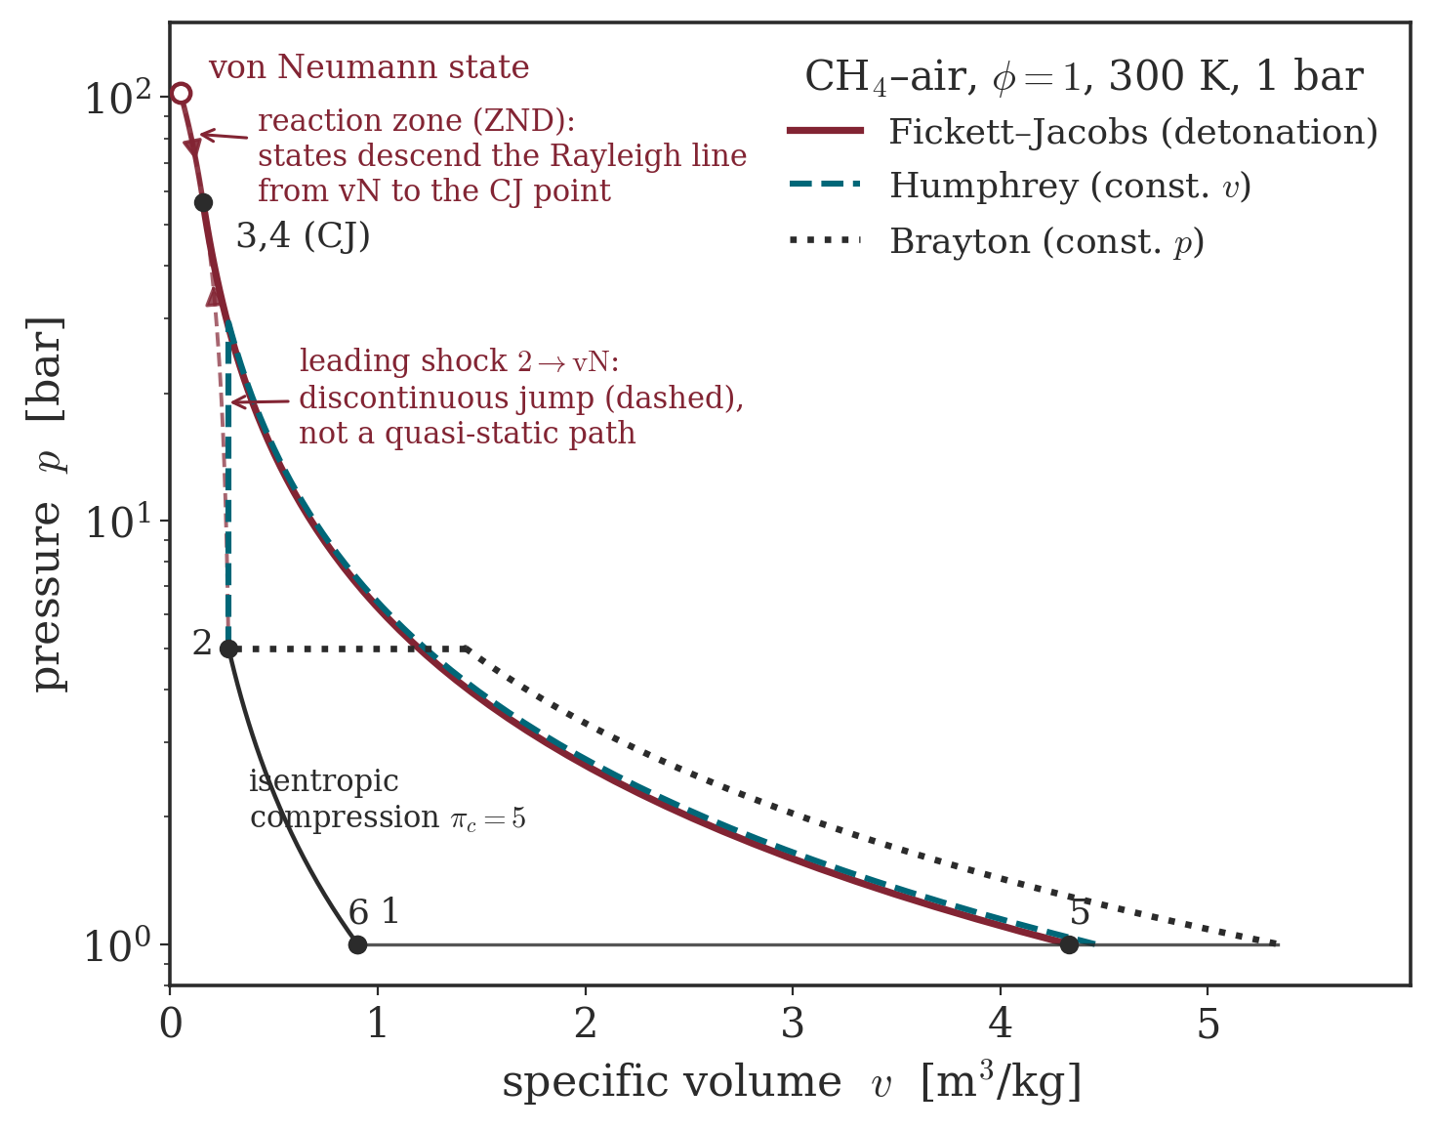
Three idealised combustion cycles
Compress → burn → expand → reject, differing only in the burn
• Brayton — constant-pressure burn (ramjet / turbojet).
• Humphrey — constant-volume burn (raises pressure).
• Fickett–Jacobs / detonation — the Rayleigh→CJ jump: compression + heat addition in one step (the ZND states lie on that chord).
• Real CH₄–air chemistry, π_c = 5: the detonation reaches p_CJ ≈ 56 bar — the highest combustion pressure for the same precompression, enclosing the largest work area.
Notes:
All three compress, burn, expand and reject - differing only in the burn. Brayton: constant pressure. Humphrey: constant volume. Fickett-Jacobs/detonation: the Rayleigh->CJ jump (compression + heat addition in one step) - the dash-dot chord is an artifice, the actual ZND states lie on it. Display case: CH4-air, phi = 1, pi_c = 5, real equilibrium chemistry: P_CJ = 56.4 bar, eta_FJ = 0.475 (validation anchor C3H8-air: 61.1 bar, matching Paper A Fig. 25).

Slide 28
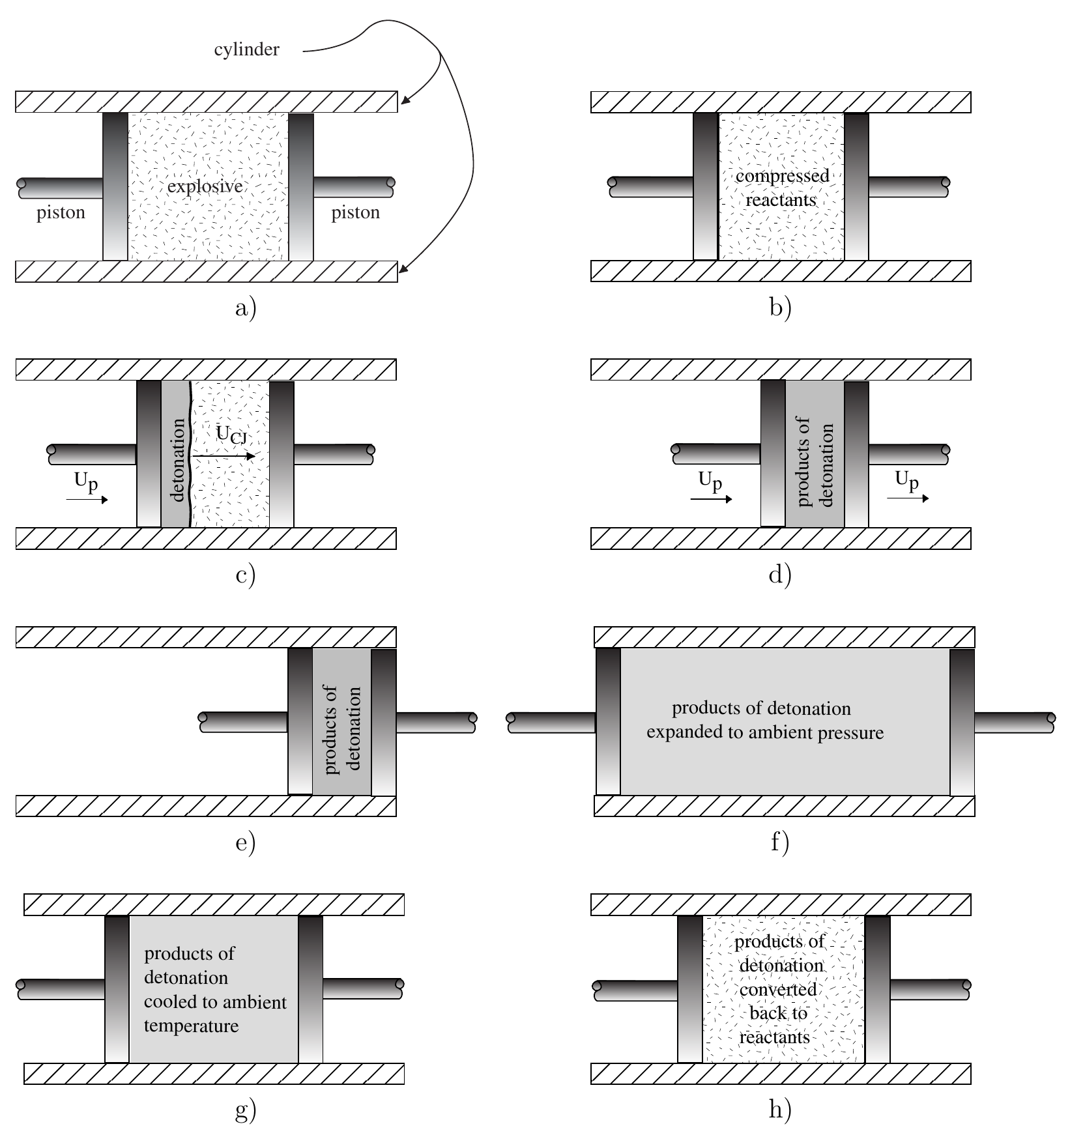
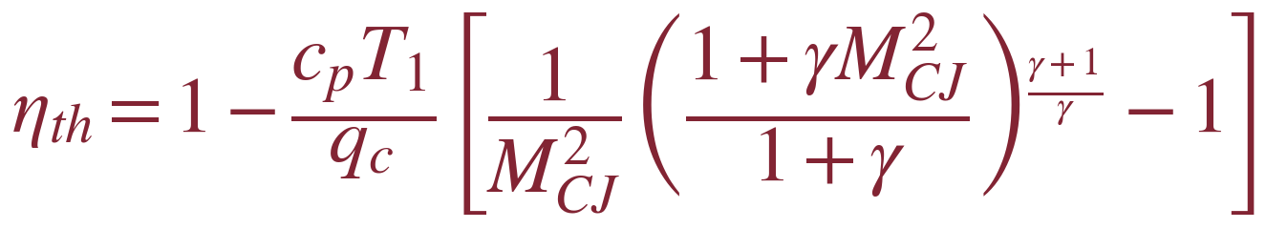
The Fickett–Jacobs cycle
An upper bound on the work from a propagating detonation
• Detonate a fixed mass in a piston-cylinder, harvest the kinetic energy, expand, reject heat: every step reversible except the detonation itself → w_net = h₁ − h₅ is an upper bound.
• The one-γ efficiency depends only on M_CJ and γ — and rises with M_CJ (stronger expansion, less heat rejected).
• Computed here (Cantera, equilibrium): η ≈ 0.28–0.31 (fuel–air) but only 0.19–0.24 (fuel–O₂). Counter-intuitively fuel–air wins — dissociation in the hotter fuel–O₂ products stores energy and rejects it as heat.
• Fuel–O₂ still delivers 2–4× more work per unit mass (larger q_c).
Adapted from Wintenberger & Shepherd, J. Propul. Power 22(3) (2006), Fig. 1
Notes:
FJ is a closed-system cycle bounding the work from detonating a fixed mass: w_net = h1-h5, every step reversible except the detonation (Zel'dovich 1940 got the identical result). One-gamma efficiency depends only on M_CJ and gamma; the piston bookkeeping and the black-box First Law agree (A43-A55) - the elegance worth showing. Realistic values (equilibrium): 0.28-0.31 fuel-air, 0.19-0.24 fuel-O2 - counter-intuitively fuel-air wins, because dissociation in the hotter fuel-O2 products stores energy and rejects it as heat during the constant-p leg (radicals only partially recombine). Fuel-O2 still gives 2-4x more specific work (larger qc). N2-dilution sweep is the cleanest proof: adding inert gas RAISES eta monotonically toward the air value.

Slide 29
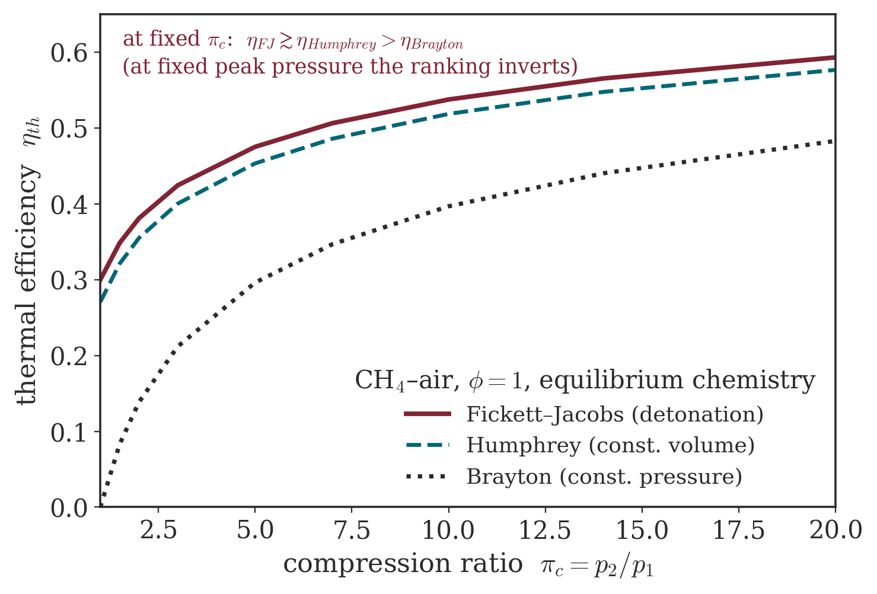
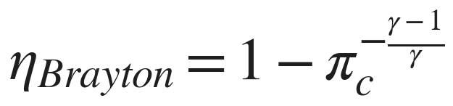
Cycle efficiency compared
At fixed compression ratio: detonation ≳ Humphrey > Brayton
• For a fixed precompression π_c the detonation cycle is the most efficient — narrowly above constant-volume, well above constant-pressure (CH₄–air: 0.30 vs 0.27 vs 0 at π_c = 1).
• Root cause: at a fixed upstream state the CJ detonation adds heat at the highest temperature with the lowest entropy rise (Part I).
• Caveat: ranked instead at fixed peak pressure, the order inverts — Brayton wins. The comparison basis matters.
Notes:
At a fixed compression ratio: FJ >~ Humphrey > Brayton (CH4-air: 0.300/0.271/0 at pi_c=1; 0.593/0.577/0.483 at 20), because at a fixed upstream state the CJ detonation adds heat at the highest temperature with the lowest entropy rise. CRUCIAL caveat: ranked at fixed PEAK pressure the order inverts (Brayton > Humphrey > FJ, verified in our JSON on C3H8-air) - detonation's huge CJ spike buys the least precompression at a given material stress. The comparison basis is everything; precompression is the real efficiency lever (0.30 -> 0.59 by pi_c = 20).

Slide 30
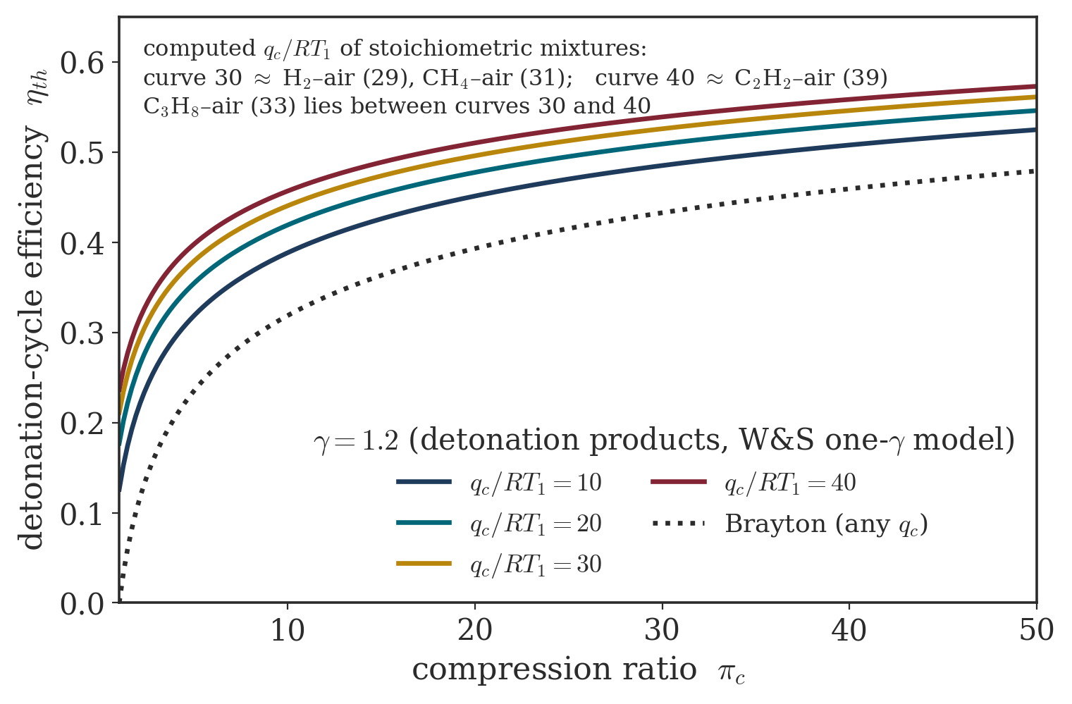
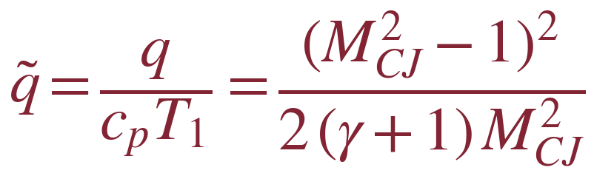
The one-γ cycle family and q̃
Heat release made dimensionless — and mapped to real mixtures
Mixture | q_c/RT₁ | q̃
H₂/air | 28.7 | 4.03
CH₄/air | 30.6 | 4.40
H₂/O₂ | 64.6 | 7.36
• The exact inverse of M_CJ(q̃) tags each family curve with real mixtures: curve 30 ≈ H₂/CH₄–air, curve 40 ≈ C₂H₂–air.
• Fuel–O₂ lies far above the family (q_c/RT₁ = 65–156) with γ_e ≈ 1.13, not 1.2: it is a fuel–air-class model.
One-γ family, γ = 1.2 (detonation products, W&S); dotted: Brayton.
Notes:
Fig. A22 recreated: eta_FJ(pi_c) for q_c/RT1 = 10-40, one-gamma gamma = 1.2 (detonation products, W&S prescription - labeled on the figure). The exact inverse q-tilde = (M_CJ^2-1)^2/(2(gamma+1)M_CJ^2) maps the curves to real mixtures: curve 30 ~ H2-air (28.7) and CH4-air (30.6), curve 40 ~ C2H2-air (39.1). Fuel-O2 lies far above (65-156) AND has gamma_e ~ 1.13, not 1.2: the family is a fuel-air-class model - quoting it for fuel-O2 would double-count energy that dissociation withholds.

Slide 31
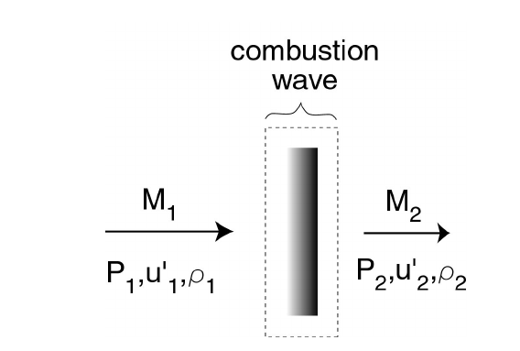
A crucial subtlety
What is held fixed — the static state, or the stagnation state?
• The cycle advantage above assumes a fixed STATIC state upstream, with the reactants essentially at rest — the frame of a propagating (or rotating) detonation.
• In a steady air-breathing engine the flight condition fixes the STAGNATION state, and the combustor must process a fast-moving stream.
• A detonation standing in that stream must ingest supersonic flow at M₁ = M_CJ ≈ 5: the leading shock then destroys most of the total pressure.
• Same wave, opposite verdict. The next slides make this quantitative — and explain why rotating beats standing.
Adapted from Wintenberger & Shepherd, AIAA 2004-1033 (2004), Fig. 2
Notes:
The deepest insight of Wintenberger-Shepherd: the cycle advantage assumes a fixed STATIC state (reactants at rest) - the frame of a rotating/propagating detonation. Fix instead the STAGNATION state (steady flow, standing wave) and the verdict INVERTS: the classical Hugoniot comparison is unfair for engines because each solution implies a different flight condition. Both papers state the dichotomy explicitly; the rotating-wave reading is the lecture's (well-founded) interpretive step - the papers predate RDEs.

Slide 32
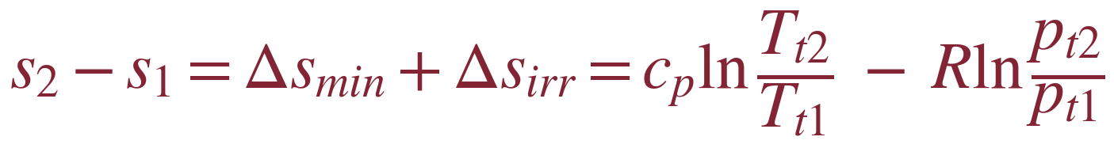
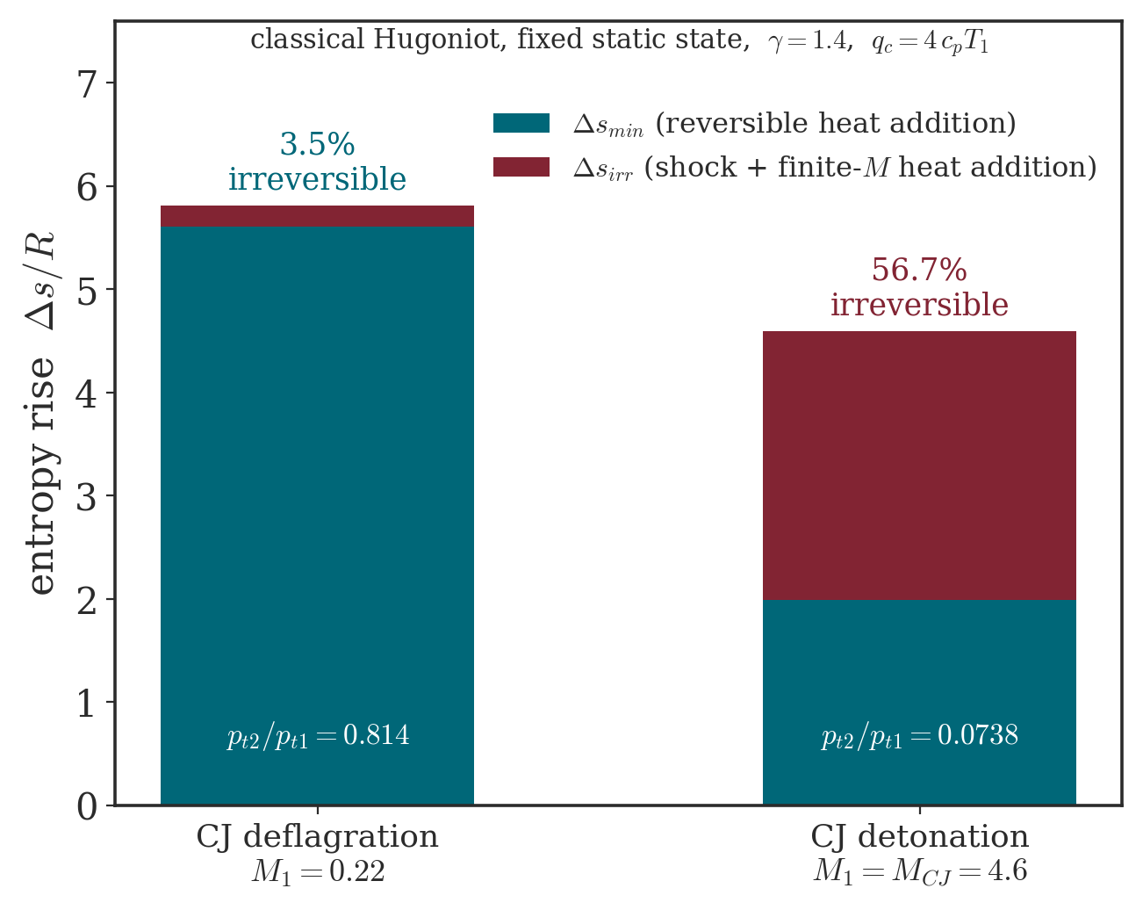
The entropy penalty of a standing detonation
Reversible vs. irreversible entropy at fixed stagnation state
• Split the entropy rise: Δs_min (reversible heat addition, fixed by q̃ alone) + Δs_irr (irreversible, ⇔ total-pressure loss).
• Deflagration: Δs_irr ≈ 3.5% of the rise — almost fully reversible.
• CJ detonation at fixed stagnation state: Δs_irr ≈ 57%, dominated by the leading shock (γ = 1.4, q̃ = 4 benchmark).
• Work is maximised when irreversibility is minimised: the standing detonation is penalised exactly where the flame is clean.
Notes:
Split s2-s1 = Delta_s_min (reversible, = cp ln(1+q_c/cpTt1), CONSTANT along the stagnation Hugoniot) + Delta_s_irr (= -R ln pt2/pt1). Benchmark gamma=1.4, q-tilde=4: CJ detonation 56.7% irreversible vs 3.5% for CJ deflagration (pt ratios 0.0738 vs 0.814). Availability argument (Clarke-Horlock): work is maximised when irreversibility is minimised. Subtlety worth teaching: on the CLASSICAL Hugoniot detonation's TOTAL Delta-s is lower, yet its IRREVERSIBLE share is far higher - the efficient-looking total hides the worst irreversibility.

Slide 33
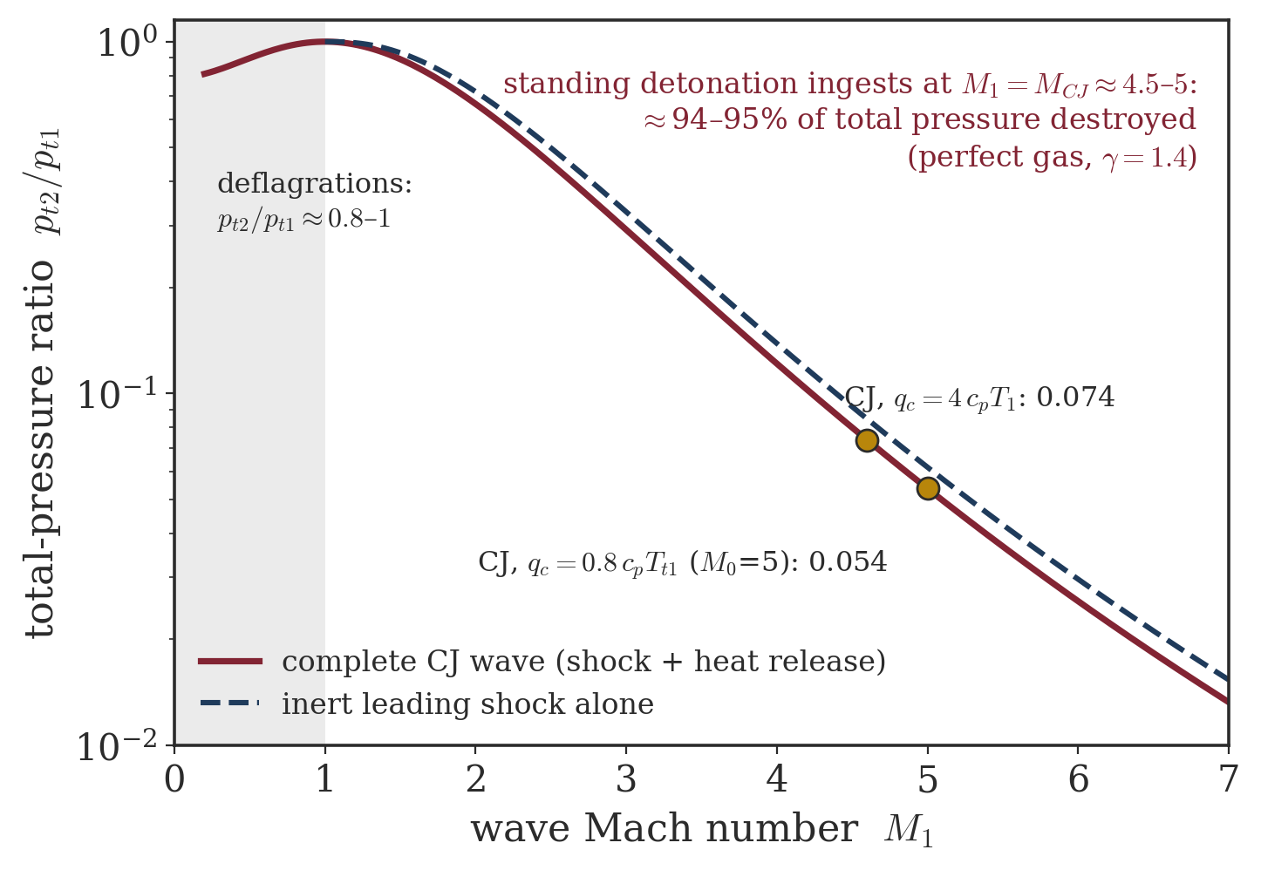
Where the total pressure goes
Leading-shock stagnation-pressure loss vs. approach Mach
• A standing CJ detonation ingests its reactants at M₁ ≈ 4.6–5: across the wave p_t2/p_t1 ≈ 0.074 (classical, q̃ = 4) and ≈ 0.054 on the stagnation Hugoniot (q̃_t = 0.8) — about 93–95% of the total pressure destroyed.
• This is the thermodynamic reason steady standing-detonation ramjets under-perform conventional ramjets.
• A deflagration ingests subsonic flow: no shock, p_t2/p_t1 ≈ 0.81–0.87.
Notes:
Supported numbers (thermo audit): across a standing CJ wave pt2/pt1 = 0.074 (classical benchmark, q-tilde = 4, M1 = 4.60) and 0.054 (stagnation Hugoniot, q_t-tilde = 0.8, M1 = 5.00) - i.e. ~93-95% of the total pressure destroyed, dominated by the leading shock. The old '~99% / 0.0136' claim is NOT in the assigned papers: it was a one-gamma artifact (gamma = 1.2 of the products applied to the reactants' ram compression, overstating the loss 3.9x) - possibly echoing AIAA 2003-0714, not assigned. A deflagration ingests subsonic flow: pt2/pt1 = 0.81-0.87.

Slide 34
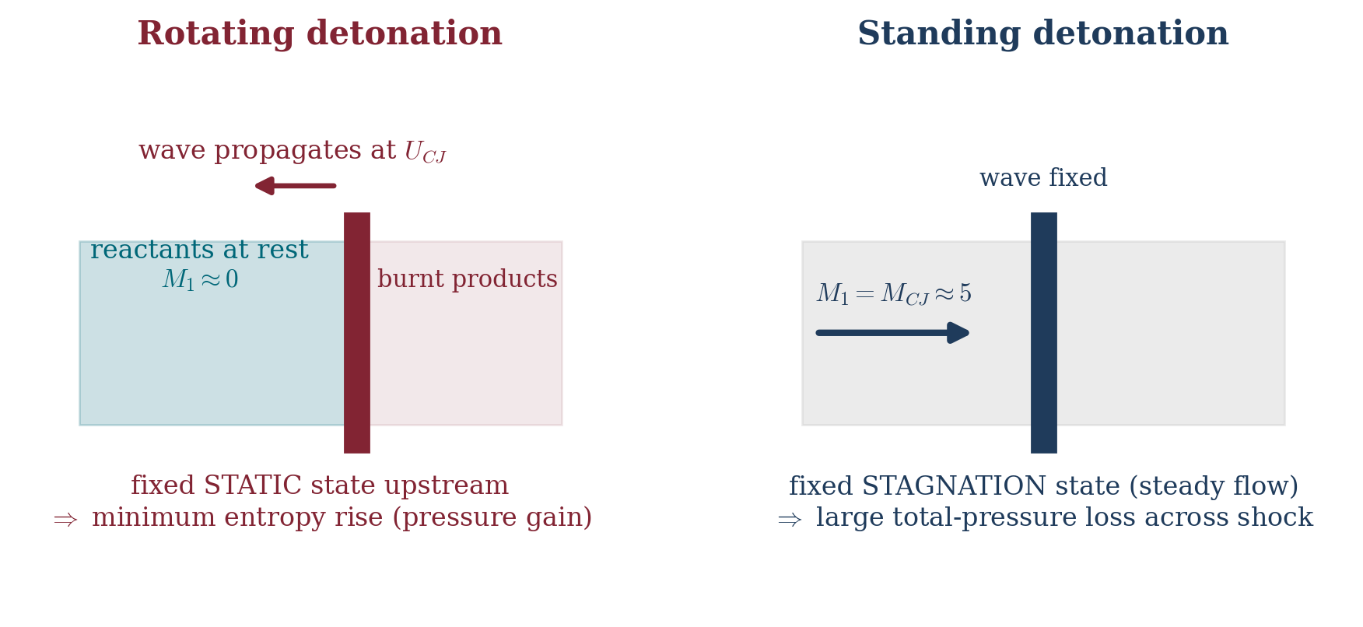
Rotating vs. standing detonation
The reference frame is the whole story
The reference frame decides: rotating keeps the fixed-static-state pressure gain; standing forfeits it to the leading-shock total-pressure loss.
Notes:
Reference frame decides everything. Rotating: reactants enter essentially at rest (fixed static state) -> pressure gain applies. Standing: fixed stagnation forces M1 ~ M_CJ -> the shock dumps the total pressure. Also (Wolanski): the standing wave is drag-limited to M ~ 5-7 flight; the rotating wave, once initiated, gives continuous thrust decoupled from flight Mach.

Slide 35
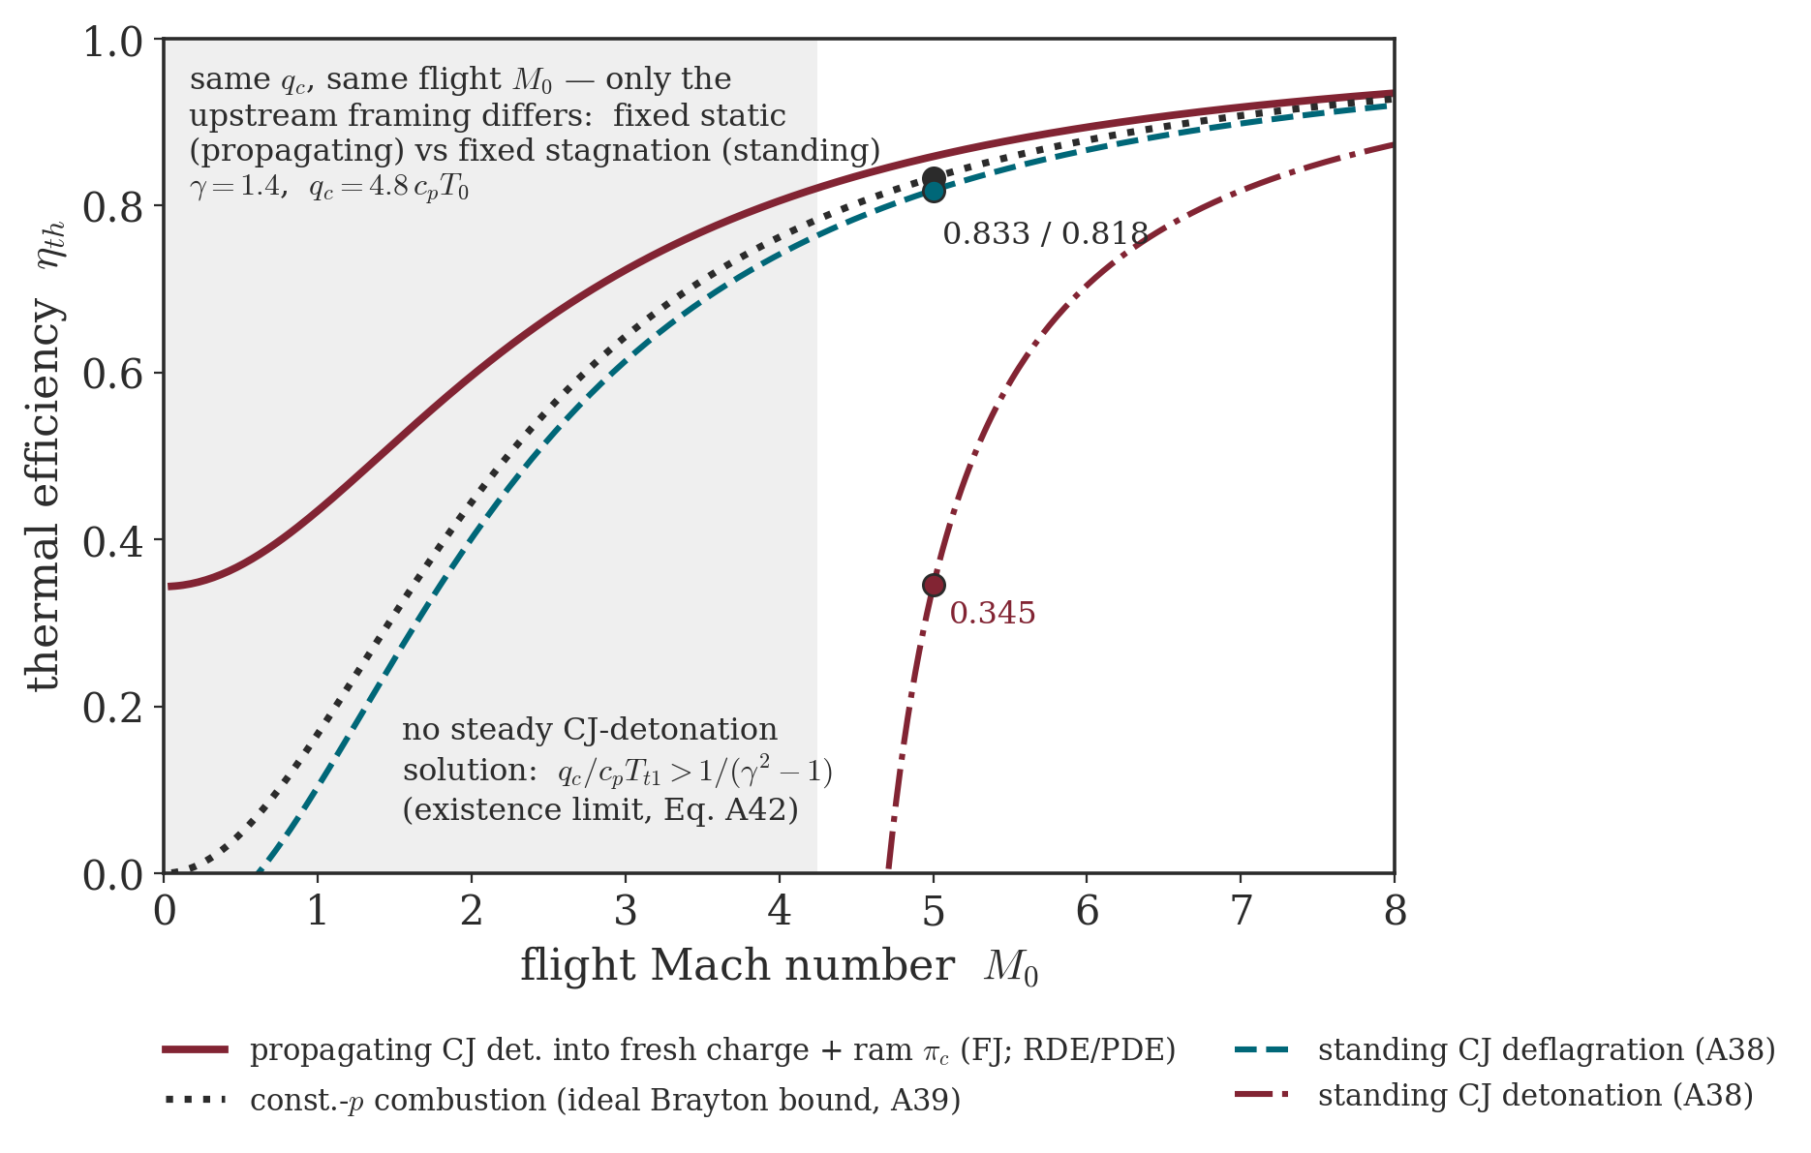
Same cycles, two verdicts
Fixed static vs. fixed stagnation state — the ranking inverts
• Same heat release (q_c = 4.8 c_pT₀, γ = 1.4), swept in flight Mach M₀ with ram precompression.
• At M₀ = 5: propagating FJ cycle η = 0.86 ≥ Brayton bound 0.83 ≈ standing CJ deflagration 0.82 — but a standing CJ detonation delivers only 0.35.
• A steady CJ detonation solution even ceases to exist below M₀ ≈ 4.25 (q̃_t < 1/(γ²−1) fails).
• The rotating wave burns reactants essentially at rest and keeps the propagating-cycle ranking at every M₀.
Notes:
New synthesis figure (gamma = 1.4, q_c = 4.8 cpT0, ram precompression): eta vs flight Mach. At M0 = 5: propagating FJ 0.859 >= Brayton bound 0.833 ~ standing CJ deflagration 0.818 >> standing CJ detonation 0.345 (factor 2.4). The standing CJ detonation only EXISTS for M0 > 4.25 (existence condition q_t-tilde < 1/(gamma^2-1), Eq. A42) - a structural, not merely quantitative, argument against standing-detonation engines. All curves are ideal thermal efficiencies: upper bounds, not propulsive predictions.

Slide 36
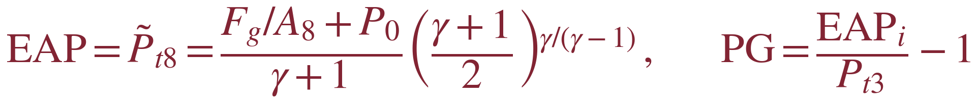
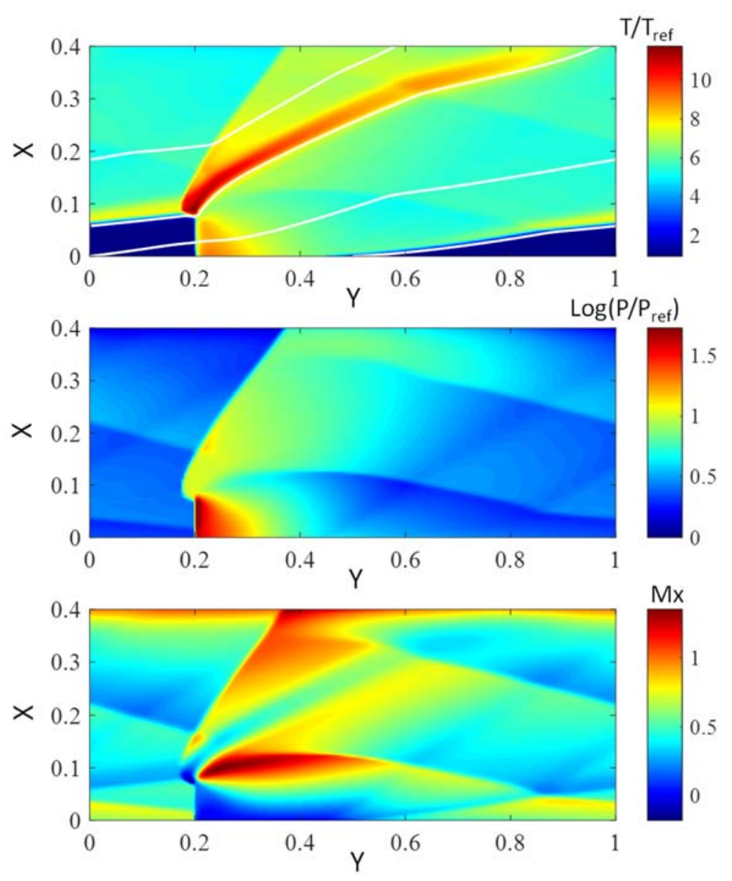
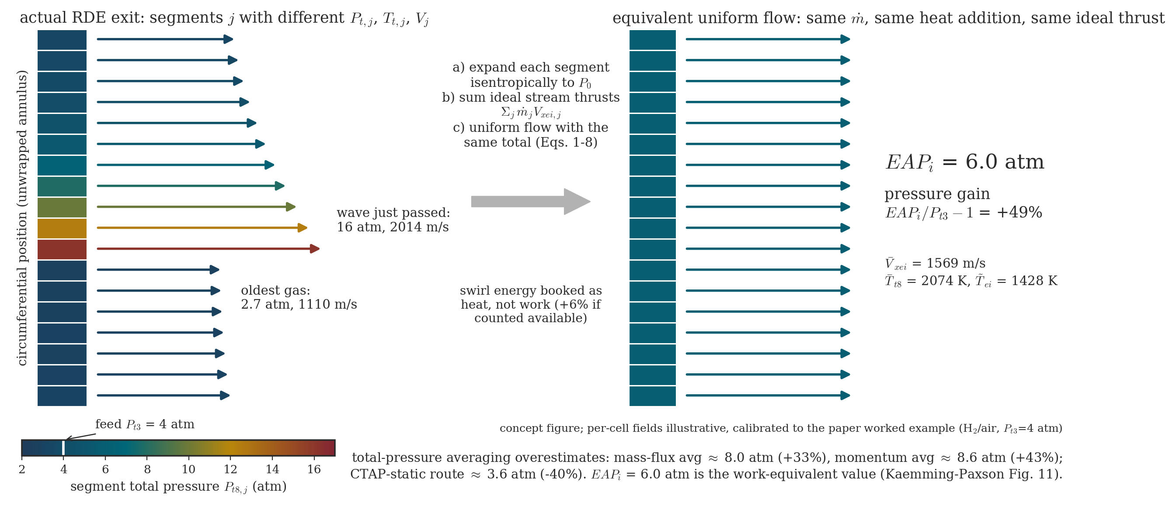
Quantifying pressure gain — EAP
Equivalent Available Pressure (Kaemming & Paxson)
• RDE exit flow: p_t spans 2–93 atm depending on station.
• EAP_i collapses the cloud to one defensible number.
Adapted from Kaemming & Paxson, AIAA 2018-4567 / NASA 20180006890, Fig. 1
EAP_i = the steady, uniform total pressure delivering the same ideal stream thrust at the same mass flow — worked case: 6.0 atm from a 4-atm feed (+49%). Averaging p_t is wrong: mass/momentum-flux averages read +33/+43%, CTAP −40%.
Notes:
Kaemming-Paxson EAP_i: the steady uniform total pressure giving the same IDEAL stream thrust at the same mass flow - the pressure analogue of ideal exit velocity / turbine spouting velocity. Segment-wise: expand every exit cell isentropically to p0, mass-flux-average the ideal axial velocity, rebuild one equivalent pressure. Worked case (stoich H2/air, feed 4 atm): EAP_i = 6.0 atm, +49%. Averaging exit pt is WRONG: mass-flux +33%, momentum-flux +43% (optimistic - they over-weight the spikes), CTAP-style static route -40% (pessimistic). Availability, not pressure, must be averaged. Swirl is booked as heat (conservative; +6% if credited). Experimental route: thrust-based EAP with M8x = 1 is conservative within 5.4%; base drag (~12% of gross thrust) can corrupt the demonstrated gain by up to 38% - the biggest test-stand pitfall.

Slide 37
Part IV
Thrust models for Rotating Detonation Engines
From detonation physics to engine performance — two complementary analytical frameworks, then the rocket bookkeeping.

Slide 38
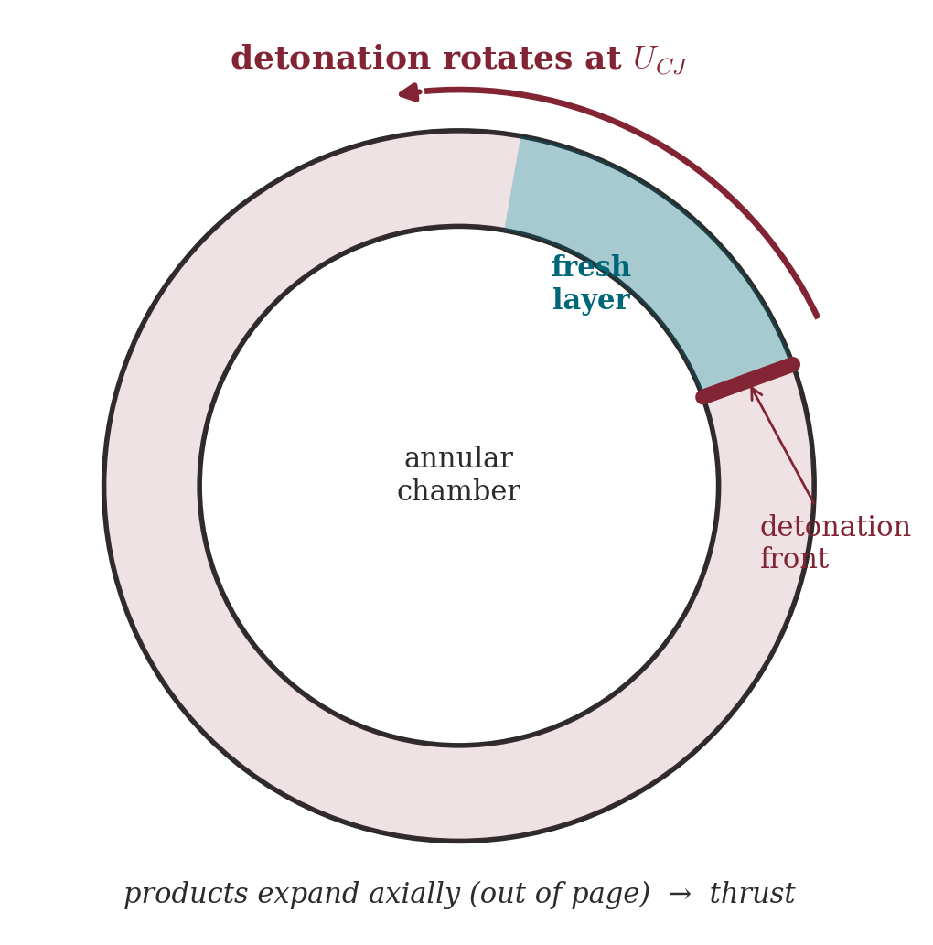
The Rotating Detonation Engine
One or more detonations sweeping an annular reactant layer
• Propellant is injected axially into an annulus; a detonation propagates azimuthally at ≈ U_CJ, consuming a fresh layer of height H.
• Behind the front: an oblique shock in the burned gas and an expansion fan that turns the flow axial — the thrust-producing exhaust.
• Steady mean operation, kHz wave frequency, compact — no valves, unlike the pulsed PDE.
• Performance question: given the detonation physics, what average thrust and I_sp result?
Notes:
One or several detonation heads ride an annulus at ~kHz on a freshly injected reactant layer, initiated once (unlike the PDE). Behind the front: oblique shock + expansion fan turning the flow axial. Performance question for the two frameworks that follow: given mixture, mass flow and geometry, what mean thrust and Isp?

Slide 39
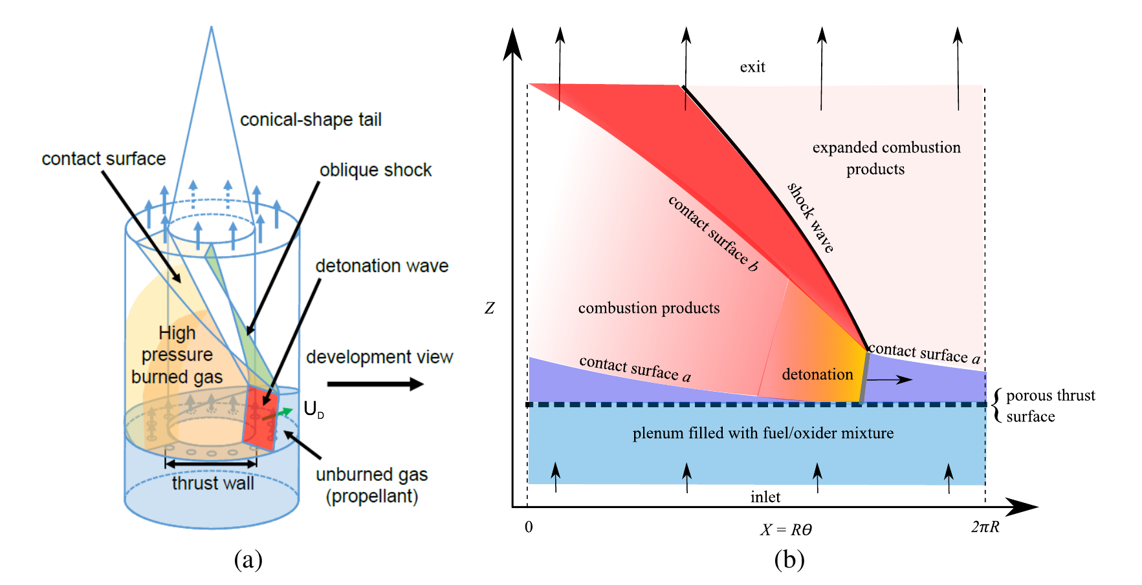
The Shepherd–Kasahara model problem
An experiment-shaped fixture, unwrapped onto a periodic plane
Adapted from Shepherd & Kasahara, GALCIT Report FM2017.001 (2017), Fig. 1
Goal: closed-form mean thrust and Isp from mixture, mass flow and annulus geometry alone — no CFD.
Notes:
Fig. 1 of GALCIT FM2017.001 (Ishihara fixture): the annulus unwrapped onto the theta-z plane - fresh triangular layer, detonation of height H at its tall end, oblique shock sweeping to the exit, periodic boundaries. Two independent closed-form models are built on this picture (inlet-face and exit-plane control volumes) and both collapse to T/Mdot ~ U_CJ - the PDE scaling. This is THE back-of-the-envelope RDE tool: thrust, Isp, layer height, effective stagnation pressure, throat sizing - no CFD.

Slide 40
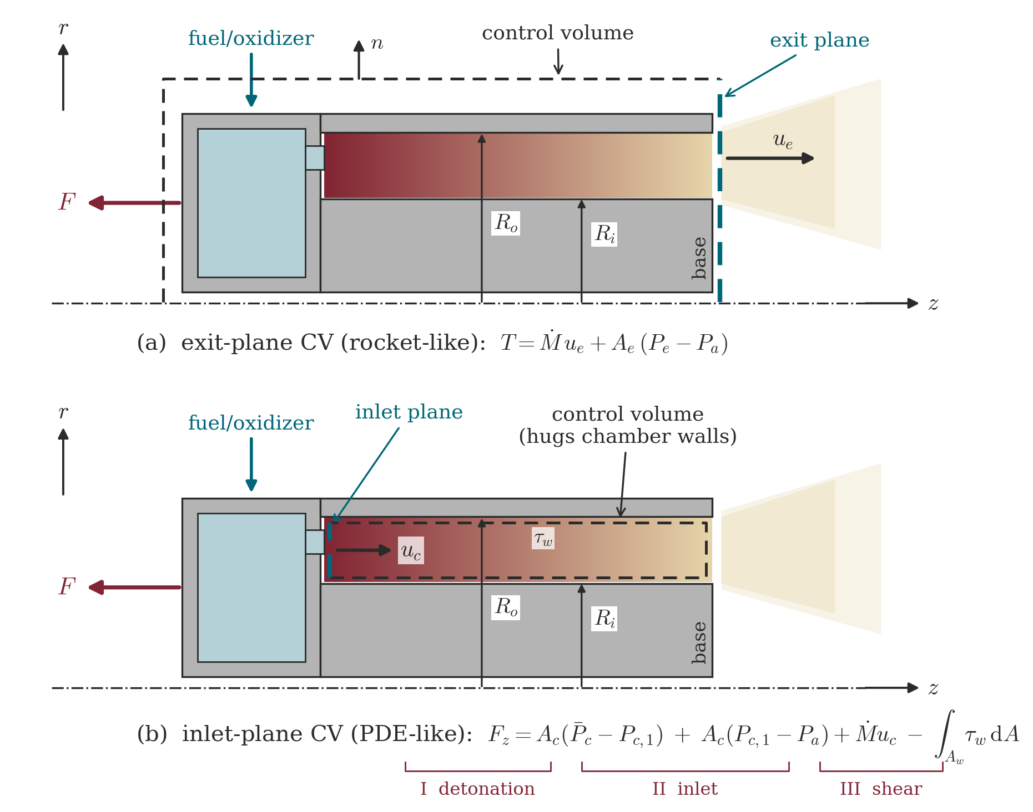
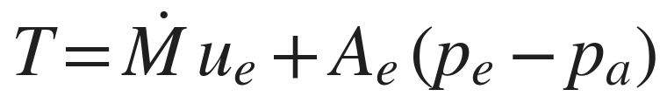
Thrust from a control-volume balance
Two equivalent control volumes — exit plane vs. injector face
• Exit-plane CV: the familiar rocket form T = Ṁu_e + A_e(p_e−p_a) — the basis of the axial-flow model.
• Inlet-plane CV: thrust from the pressure on the injector (thrust) wall. Term I = detonation overpressure dominates; Term II (inlet momentum + pressure) is 5–10× smaller but still 15–20% of thrust; Term III (wall shear) is negligible.
• The two views give the pressure-history and the axial-flow model respectively.
Notes:
Two equivalent control volumes (SK Fig. 2). Exit-plane CV -> rocket form T = Mdot u_e + A_e(p_e-p_a) (axial-flow model). Inlet/thrust-wall CV -> pressure-history model. Term I (detonation overpressure) dominates; Term II (inlet momentum + inlet-vs-ambient pressure) is 5-10x smaller but still 15-20% of thrust (H2-air 20%, C3H8-O2 15%) - dropping it visibly biases predictions (the Term-I-only curve runs below Rankin's data in the validation slide precisely for this reason). Term III (wall shear) is 1-2 orders below; chamber assumed adiabatic.

Slide 41
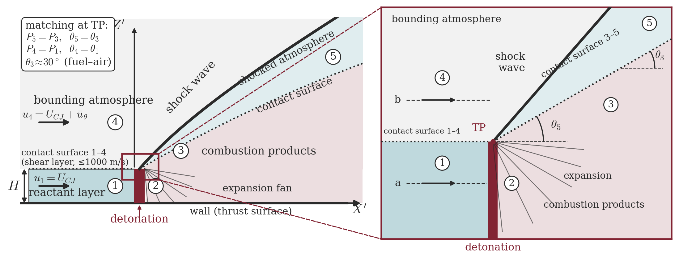
Detonation of a layer: the triple point
The gasdynamic heart of the pressure-history model
• In the wave frame a CJ detonation consumes a layer of height H under a bounding atmosphere: oblique shock above, Prandtl–Meyer expansion behind, and a self-similar triple point where they meet (states 1–5).
• Self-similarity near the triple point ⇒ only H and Δp_CJ matter — the whole pressure field collapses onto one decay function ψ(x/H).
Notes:
SK Fig. 3: in the wave frame a CJ detonation consumes a layer of height H under a bounding atmosphere; oblique shock above, PM expansion behind, self-similar triple point. Matching: P5 = P3, theta5 = theta3 (3-5 contact) and P4 = P1 (1-4 contact). Sichel-Foster: thin reaction zone => only H and Delta-p_CJ are relevant scales => a near-universal decay function psi(x/H) per oxidiser family exists - K is born here. Note of merit: the 1-4 contact is a shear layer with up to ~1000 m/s slip (u4 = U_CJ + mean u_theta) - a real mixing/loss mechanism the model smooths over.

Slide 42
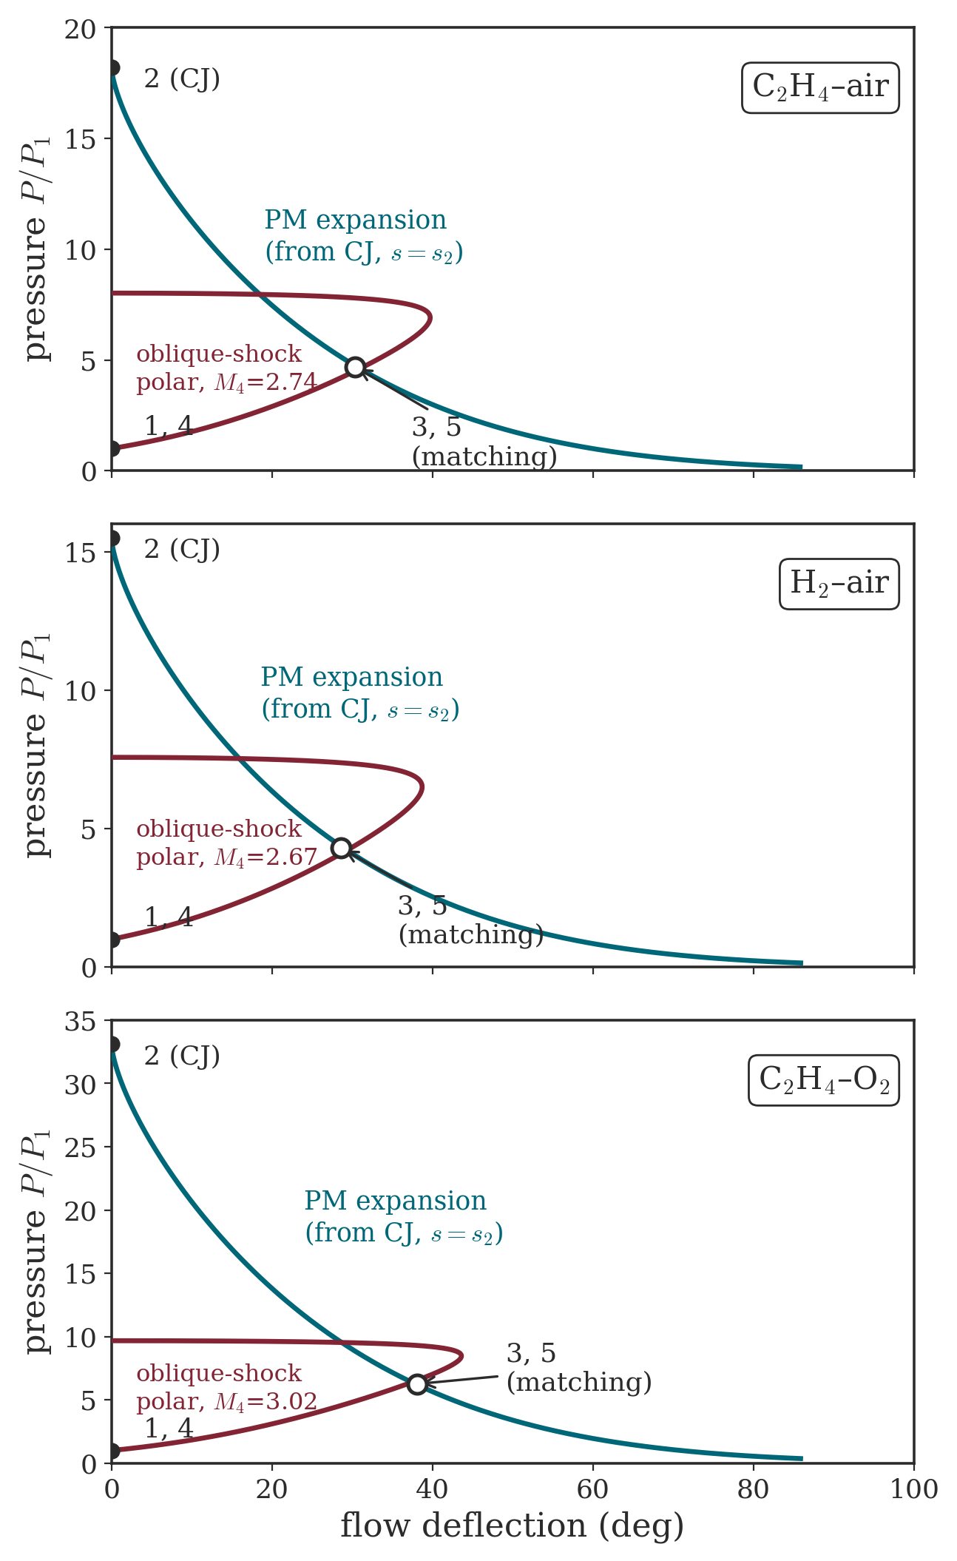
Shock-polar matching at the triple point
PM expansion from CJ meets the bounding-gas shock polar
• Matching conditions across the contacts: p₅ = p₃ and θ₅ = θ₃ (products/shocked atmosphere), p₄ = p₁ (expanded products/reactants).
• Graphical solution: the Prandtl–Meyer expansion from the CJ point intersects the oblique-shock polar of the bounding gas; nature picks the lower, attached (supersonic) intersection.
• Deflections grow with energy content: θ₃ ≈ 29–30° (fuel–air) vs. 33–39° (fuel–O₂), with higher p₃ — the signature that pushes the decay constant K from 1.02 to 1.54.
• Real thermochemistry (SD Toolbox) for all three panels: C₂H₄–air, H₂–air, C₂H₄–O₂.
Notes:
SK Fig. 3: in the wave frame a CJ detonation consumes a layer of height H under a bounding atmosphere; oblique shock above, PM expansion behind, self-similar triple point. Matching: P5 = P3, theta5 = theta3 (3-5 contact) and P4 = P1 (1-4 contact). Sichel-Foster: thin reaction zone => only H and Delta-p_CJ are relevant scales => a near-universal decay function psi(x/H) per oxidiser family exists - K is born here. Note of merit: the 1-4 contact is a shear layer with up to ~1000 m/s slip (u4 = U_CJ + mean u_theta) - a real mixing/loss mechanism the model smooths over.

Slide 43



Pressure-history model
Average thrust from the detonation overpressure on the injector
• Model the decay behind the front as ψ(ξ)=e^(−αξ); its integral K ≈ 1/α sets the mean thrust-wall pressure.
• K = 1.02 (fuel–air), 1.54 (fuel–O₂) — fits to Schwer & Kailasanath traces; Sichel–Foster gives 1.3.
• Result: F_I = Δp_CJ·W·H·K — and the number of waves N cancels exactly (H_i = H/N).
Injector-face pressure: exponential-decay model vs. the CFD traces it was fitted to (stylised).
Notes:
psi(xi) = exp(-alpha xi); K = integral ~ 1/alpha (2piR/H = 10-20 makes the upper limit effectively infinite). K = 1.02 (fuel-air, alpha 0.98), 1.54 (fuel-O2, alpha 0.65) from Schwer-Kailasanath traces; Sichel-Foster's colder analysis gives 1.3. The leading-shock spike is deliberately ignored (negligible impulse - same choice as PDE models). Note of merit: the number of waves N drops out EXACTLY - each layer is H/N but the nondimensional tail 2piR/H is N-independent (Eqs. 23-32), so F_I = Delta-p_CJ W H K for any N; simulation-confirmed. H is not free either: H = Mdot/(rho_c W U_CJ).

Slide 44


Pressure-history performance maps
Specific thrust and fuel-based impulse vs. equivalence ratio
Term-I maps (as SK Fig. 6). At φ = 1, H₂/air: 928 m/s, 3319 s (Eqs. 20/22, γ_e).
• Specific thrust scales linearly with U_CJ — F_I/Ṁ ≈ K·U_CJ/(γ_e+1): mixture enters only through U_CJ and γ_e.
• Fuel-based Isp is driven by 1/Y_f: fuel–air ranks far above fuel–O₂ even though its specific thrust is lower.
Notes:
SK Fig. 6 replica (Term I only, Eqs. 20/22, gamma_e of EQUILIBRIUM): F_I/Mdot ~ K U_CJ/(gamma_e+1). At phi = 1, H2-air: 928 m/s and Isp_f 3319 s (with gamma frozen it would read 896 m/s - the paper's own Fig. 6a is consistent only with the equilibrium gamma_e; gamma audit). Fuel-based Isp is driven by 1/Y_f: fuel-air ranks far above fuel-O2. For the deck's I+II numbers at phi=1 (e.g. H2/air 4268 s with u_c = 300 m/s as in SK Table 1) see the literature-table slide: the 3203->4268 jump vs the old deck is dominated by Term II (+1072 s), not by the gamma fix (+3.6%, largely cancelled by the exact Delta-p_CJ).

Slide 45


Axial-flow model
Ideal quasi-1D expansion of the detonation products
Annular chamber and (r, θ, z) coordinates.
• Zero net swirl: period-averaging the angular-momentum balance kills the azimuthal mean far downstream — the exhaust is axial (rothalpy: the RDE is a rotor-less turbomachine).
• Total enthalpy on streamlines + chemical equilibrium ⇒ w = √[2(h₁ − h(p, s₂))]: expansion along the equilibrium isentrope THROUGH THE CJ STATE (shocks cost ~7% p_t ⇒ <1% on T).
• Specific thrust follows the rocket form T/Ṁ = w + (p−p_a)/(ρw), a function of exit pressure only.
Notes:
Zero net swirl: period-averaging the angular-momentum balance kills u_theta far downstream (S&K 2011 CFD: u_z fluctuates about a positive mean, u_theta about zero). Energy: lab-frame h + (v^2+w^2)/2 - v U_D = h1 is the ROTHALPY of turbomachinery with U_D as blade speed - the RDE is a rotor-less turbomachine. Equilibrium (flow time >> chemical time) => h = h(P,s); shocks cost ~7% of pt => <1% on isentropic T => s = s2: the expansion runs on the EQUILIBRIUM ISENTROPE THROUGH THE CJ STATE, not off a naive reservoir. Unwrapping is not innocent: v^2/r = (1/rho) dP/dr is left unbalanced, formally removed for large R-bar.

Slide 46


The CJ isentrope, Pₘ and the sonic maps
An effective stagnation pressure emerges: Pₘ ≈ 0.24 p₂
• No axial solutions exist for Pₘ < p < p_CJ: the isentrope crosses h = h₁ at Pₘ — an effective 1-D stagnation pressure (C₂H₄–air: Pₘ/p₁ = 4.18, replicated 4.181; H₂/air: Pₘ = 0.234 p₂).
• T/Ṁ(p) shows a wide plateau: specific thrust is nearly independent of exit pressure — quote it at the sonic point.
• Hidden regularities across mixtures: p* ≈ 0.13 p₂ and w* ≈ 0.48 U_CJ — with Pₘ ≈ 0.24 p₂, handy first-cut design rules (throat sizing, Kato test reconstruction).
• Bottom: sonic-model sensitivity at φ = 1 — T₁ is weak and inverse, p₁ strong and direct (deeper expansion): chamber pressurisation pays.
Notes:
The h(P,s2) curve crosses h1 at P_m: NO axial solutions for P_m < P < P_CJ, and P_m acts as the effective 1-D stagnation pressure (w = 0 there). C2H4-air: P_m/P1 = 4.18 (replicated 4.181); wide-composition rule P_m ~ 0.22-0.25 P2 (ours 0.218-0.234). Specific thrust T/Mdot = w + (P-Pa)/(rho w) has a wide plateau -> nearly independent of exit pressure: quote it at the sonic point without exit BCs. Hidden Table-2 regularities: P* ~ 0.13 P2, w* ~ 0.48 U_CJ - with P_t ~ 0.24 P2 these are the first-cut design rules (throat sizing; used in reverse to reconstruct Kato's unmeasured pre-detonation state). Bottom panels (SK Figs. 9-10 content, recomputed at phi=1): T1 sensitivity is weak and INVERSE (via M_CJ); P1 is strong and DIRECT - but only through the expansion ratio (P2/P1 is nearly P1-independent), so pressurisation pays. The phi-maps of the sonic model show the same trends as pressure-history, 15-30% higher fuel-air.

Slide 47

Validation against CFD and experiment
Kato et al. tests and Rankin data bracket the models
• Kato C₂H₄–O₂ tests: pressure-history over-predicts by 20–60% — non-ideal mixing, sub-CJ waves.
• Rankin H₂–air RDE and Schauer PDE data: bracketed by Term-I (low) and axial-sonic (high) curves.
• Red ×: Term I+II at φ = 1 — 4706 s (Table 1), replicated to −0.1%.
• The models are upper bounds: discrepancies measure injector mixing quality and the unknown pre-detonation state — exactly the quantities a designer must engineer.
Notes:
SK Fig. 11-12 recreated (representative points from the declared deviations, not digitised). Kato C2H4-O2 tests: pressure-history over-predicts 20-60% - attributed to non-ideal detonation (sub-CJ speeds from imperfect impinging-jet mixing) and the reconstructed pre-detonation state (P1 inferred 35-70 kPa via P_t = 0.24 P_CJ). Rankin H2-air RDE + Schauer PDE data: bracketed by Term-I (low, because Term II could not be evaluated from published info) and axial-sonic (high, ~+10%). Red X: our Term I+II at phi=1, 4706 s -> -0.1%. Models are upper bounds; the gap measures injector quality.

Slide 48

Thrust models vs. literature
Replication of Shepherd–Kasahara Table 1 — with one anomaly
Case | U_CJ me/SK | Isp PH me/SK [s] | ΔPH | Isp AX me/SK [s] | ΔAX | CFD [s]
H₂–air | 1983 / 1982 | 4702 / 4706 | −0.1% | 5395 / 5383 | +0.2% | 4860
C₂H₄–air | 1836 / 1836 | 1957 / 1975 | −0.9% | 2285 / 2280 | +0.2% | 1990
C₂H₄–O₂ | 2403 / 2402 | 937 / 704* | +33% | 912 / 911 | +0.1% | 700
C₃H₈–O₂ | 2384 / 2383 | 974 / 1016 | −4.1% | 953 / 952 | +0.1% | 1070
• Axial model reproduced to ±0.2% on 4/4; pressure-history on 3/4.
• *The published 704 s is inconsistent with the paper’s own equations and its twin case C₃H₈–O₂ — a documented anomaly (our faithful evaluation: 937 s).
• Right: all combos share one linear law, F/Ṁ ∝ U_CJ (slope 1.10, γ_e-corrected).
Notes:
Replication at SK Table-1 conditions (1.5 atm / 255 K, u_c = 300 m/s): axial model within +-0.2% on 4/4; pressure-history on 3/4 with H2-air at -0.1%. The published C2H4-O2 pressure-history value of 704 s is NOT reproducible from the paper's own equations (we get 937 s) and is internally inconsistent with its twin C3H8-O2 (1016 s) - documented anomaly A1; shown with an asterisk, never propagated. Right: F/Mdot ~ U_CJ linearity (slope 1.10) across all combos with the corrected gamma_e (+2.4-3.9% vs the old frozen-gamma figure). PDE bridge: (I/M)_PDE ~ 1.5 Delta-p_CJ/(rho_c U_CJ) - same form, K = 1.5: why the PDE model correlates RDE data.

Slide 49




Stechmann–Heister performance model
Quasi-steady, mass-weighted rocket performance for RDEs
• Apply the classical 0-D rocket chain instantaneously: F(t) = ṁ(t)·C_F(t)·c*(t), all three factors time-varying.
• Traceable to standard practice: c*, C_F, Isp, O/F.
Adapted from Stechmann, Heister & Harroun, J. Spacecr. Rockets 56(3) (2019), Fig. 1
• Isp must be MASS-WEIGHTED, not time-averaged: ṁ, c* and C_F peak simultaneously in the high-pressure fraction of the cycle — and the formulation collapses exactly to the constant-pressure rocket when Pc = const (built-in fair comparison).
Notes:
First rocket-traceable (c*, C_F, Isp, O/F) quasi-steady RDE model. Note of merit #1: Isp must be MASS-WEIGHTED, not time-averaged - the impulse arrives preferentially in the high-pressure fraction where mdot, c* and C_F are simultaneously above average; a time average undercounts the dominant instants (mw/time-avg ratio ~ 1.20-1.22 in our replication). Cycle time cancels in Eq. 4 -> scale/wave-count independence. Assumptions: quasi-steady isentropic blowdown with exponential decay, choked at all times (thermal throat at the exit plane), equilibrium products (CEA), gamma and M frozen along the nozzle. Collapse to the constant-pressure result when Pc = const: the built-in fair-comparison check.

Slide 50


Cycle histories: chamber pressure and c*
Detonation jump, exponential blowdown, periodic refill
• Pc(t) = PR·P_init·e^(−λt) with λ = ln(PR)/t_c: the chamber returns to P_init exactly as the next wave arrives.
• Anchors: P₀ = 71.8 vs 72 atm; c*(0) = 2329 vs 2330 m/s; γ = 1.135 vs 1.14 (H₂–O₂, t_c = 120 μs).
• c*(0) is nearly Ti-independent (chemistry-set); colder propellant buys PRESSURE RATIO, hence a steeper decay.
Each annular segment behaves as a small choked rocket at its instantaneous chamber state (CEA-style equilibrium products; γ, M frozen along the nozzle).
Notes:
Pc(t) = PR Pinit e^(-lambda t), lambda = ln(PR)/tc (periodicity: chamber back to Pinit as the next wave arrives); tc = 120 us from Stechmann's Purdue experiments; decay shape validated on side-relief tests and Sichel-Foster. Replication anchors: P0 = 71.8 vs 72 atm (-0.3%), c*(0) = 2329 vs 2330 m/s, gamma = 1.135 vs 1.14. Note of merit #10: c*(0) is nearly Ti-INDEPENDENT (reaction enthalpy dwarfs reactant sensible enthalpy - same reason CP engines barely care about Ti), but colder propellant buys a larger PR, hence a steeper c*(t) decay: cold buys pressure ratio, not initial c*.

Slide 51

Mass flux and the matching protocol
Equal cycle mass flow and throat area — not equal mean pressure
• ṁ/A(t) = Pc/c*: choked at all times — the RDE exit plane is the effective (thermal) throat.
• Anchor: 72 atm / 2330 m/s → 0.31 kg/cm²·s (model 0.312, +0.7%).
• P_init is iterated until the cycle mass equals a constant-pressure combustor with the SAME throat: the honest basis for every comparison that follows.
• Every Ti-family pivots about a common crossing (~35–40 μs): colder propellant gives a higher peak AND a deeper tail — a constrained comparison, visualised.
Notes:
Fair-comparison protocol: detonation and CP cases matched on equal TOTAL CYCLE MASS FLOW and THROAT AREA - not equal mean pressure (mean pressure is 'not a good metric', Conclusion 2). mdot/A = Pc/c* choked throughout (channel-choking margin dips marginally below threshold only in the 20-atm hydrocarbon tails - paper's own choice, replicated). The equal-mass constraint forces every Ti-family to pivot about a common crossing (~35-40 us): colder propellant = higher peak AND deeper tail. Anchor: 72 atm / 2330 m/s -> 0.31 kg/cm2/s (model 0.312).

Slide 52

The DC shift
Detonation raises the mean chamber pressure — by a few percent
• At matched mass flow and throat area, the detonation cycle’s mean pressure sits 2.5–4.5% above the equivalent constant-pressure chamber: the “DC shift”.
• Replication: all 12 paper points within ±0.05 pt (H₂, φ = 1, 200 K: 2.65% exact).
• It is a combustion-side gain only — not additive to the nozzle benefit, and NOT the Isp benefit itself.
• Mean pressure is therefore a poor RDE metric — and capillary (CTAP) probes likely cannot even capture this shift.
Notes:
At matched flow and throat the detonation mean pressure sits 2.5-4.5% above the CP chamber: the DC shift (analogous to steep-fronted combustion-instability rectification). Replication: all 12 paper points within +-0.05 pt. Distinctions to insist on: it is a mass-weighted c*-side gain only, NOT additive to the nozzle benefit and NOT the Isp benefit. Kerosene shows +20% peak pressure vs H2 at equal flow - but smaller than the CJ-ratio gap: denser products blow down faster (lower pre-wave Pinit). CTAP warning: capillary-tube averaged pressure instrumentation damps the nonlinearity and likely cannot capture the shift at all.

Slide 53

Transient thrust coefficient and Isp(ε)
A fixed bell is on-design at only one instant of the cycle
• Bell C_F falls through 1 at ~85 μs and keeps dropping: deep over-expansion in the tail.
• Aerospike holds p_e = p_a across the swing.
• Isp(ε): bell +2.6%, aerospike +7.3% over CP (CH₄, 20 atm, 200 K).
• The nozzle pressure ratio is now time-varying: transient under/over-expansion is what erodes the ideal (Humphrey-like) cycle gain down to a few percent.
Notes:
The NPR is time-varying, so any fixed nozzle is on-design at one instant - 'the biggest challenge in capturing the performance potential of the RDE'. Bell C_F crosses 1 at ~85-86 us and keeps falling (no separation model - paper's choice, replicated; a real bell would separate and lose less, so the tabulated bell penalty is a worst case). Ideal aerospike: Pe(t) = Pa continuously below max expansion -> vacuum C_F anchor 1.627 vs 1.62-1.65. Isp(eps) mass-weighted (CH4, 20 atm, 200 K): bell +2.6% at eps_opt 4.0; aerospike +7.3% at eps_opt 11.6 ~ 3x CP. Tempting fix - a long homogenising chamber - destroys most of the benefit: capture the work potential when and where it forms.

Slide 54

Nozzle optimisation — bell vs. aerospike
Replication of Stechmann Table 1: 18 of 18 rows reproduced
Prop. | P_cp [atm] | Δbell pap/mod | Δspike pap/mod
H₂ | 20 | 9.0 / 8.9% | 12.2 / 12.2%
H₂ | 200 | 8.0 / 8.0% | 9.7 / 9.7%
CH₄ | 20 | 4.4 / 4.4% | 9.2 / 9.1%
CH₄ | 200 | 3.7 / 3.8% | 6.2 / 6.3%
RP-1 | 20 | 4.0 / 4.0% | 9.6 / 9.6%
RP-1 | 200 | 3.3 / 3.2% | 6.2 / 6.1%
Isp benefits vs. the matched CP engine; |ΔIsp| ≤ 1.2%, ε_opt within 10% — 18/18 PASS.
• Detonation ε_opt is far larger for the aerospike (≈ 3× the CP value: capture the peak); Isp(ε) saturates instead of peaking — ideally, oversizing costs nothing.
• In vacuum every nozzle has a fixed pressure ratio: the benefit collapses to 2.5–7.9% and the aerospike advantage disappears.
Notes:
Independent replication of Stechmann Table 1: 18/18 rows PASS (|dIsp| <= 1.2%, eps within 10%, benefit within 0.12 pt). Bell optimum cross-checked against the model identity NPR(eps_opt) = mean(Pc)/Pa; aerospike optimum = saturation knee NPR(eps_opt) = Pmax/Pa (closed form). Aerospike eps_opt grows ~3x the CP value and Isp(eps) saturates monotonically - ideally oversizing costs nothing (vehicle weight/base area do). Vacuum rows: benefit 2.5-7.9% and NO aerospike-over-bell advantage (fixed pressure ratio for every nozzle). RP-1 modeled as gaseous n-dodecane: the coarsest surrogate, still within +1.2%.

Slide 55

Aerospike nozzles and model results
Pressure-adaptive expansion captures the cycle peak
• Realisable Isp benefit: ≈ 6% for hydrocarbon boosters, ≈ 8% for H₂ upper stages — far below ideal-cycle promises, because transient nozzle losses erode the gain.
• Aerospikes are the preferred RDE nozzle: thermodynamically (self-adaptation) and geometrically (annular-to-annular integration).
• RDEs optimise fuel-RICH, and cold/dense (cryogenic) propellants widen the pressure swing — the sweet spot for pressure gain.
• Measurement warning: if thrust + mass-flow uncertainty exceeds a few percent, the predicted benefit is experimentally undetectable.
Adapted from Stechmann, Heister & Harroun, J. Spacecr. Rockets 56(3) (2019), Fig. 2
Notes:
Bottom line: ~6% Isp benefit for hydrocarbon boosters, ~8% for high-area-ratio H2 stages; aerospike-over-bell ~2-3%; ideal upper bound (H2/O2, 20 atm, sea level, aerospike) ~12%. RDEs optimise FUEL-RICH (largest shift for H2); cryogenic/dense propellants widen the pressure swing - the sweet spot. Geometric bonus: the annular RDE exit integrates naturally with a plug/aerospike (supersonic exit -> no C-D nozzle needed, Wolanski). Measurement-precision warning (Conclusion 8): cumulative thrust+massflow uncertainty above a few percent makes the benefit experimentally undetectable - the accuracy bar for any RDE test campaign.

Slide 56
Part V
RDE engineering practice
Sixty years of hardware, one stability parameter, and the reasons the rotating wave won — Wolański’s survey (Proc. Combust. Inst. 34, 2013).

Slide 57

From spin detonation to the RDE
Sixty years from Voitsekhovskii’s six heads to flight hardware
• 1940 · Zel’dovich: efficiency of detonative combustion.
• 1958 · Nicholls (Michigan): first PDE bursts; standing-wave rocket concepts.
• 1960–63 · Voitsekhovskii, Mitrofanov & Topchiyan (Novosibirsk): continuous spin detonation — six heads in a disk chamber.
• 1964–66 · Michigan rotating-detonation rocket study: “nothing fundamental stands in the way”.
• 2004/05 · Tobita–Fujiwara–Wolański RDE patent; 2008 · first PDE-powered flight (Mojave).
• Today: rockets, ramjets and gas turbines — the annular chamber at right is the canonical research configuration.
Adapted from Wolański, Proc. Combust. Inst. 34 (2013), Fig. 28
Notes:
History anchors (Wolanski's reference list): Berthelot/Vieille/Mallard/Le Chatelier 1881 (detonation identified), CJ theory ~20 years later; Zel'dovich 1940 (cycle efficiency); Nicholls 1958 (first PDE bursts, Michigan; standing-wave rocket concepts); Voitsekhovskii 1960-63 (continuous spin detonation, SIX heads in a disk chamber, drum-camera compensation photography - the founding experiment); Michigan 1964-66 rotating-rocket feasibility: 'nothing fundamental stands in the way'; ~20 years of dormancy (cheap oil); Eidelman PDE revival mid-80s; near-simultaneous RDE resurgence Russia/Poland/France early 2000s; Tobita-Fujiwara-Wolanski patent applied 2004/issued 2005; first PDE-powered flight Mojave, January 2008.

Slide 58



The unrolled annulus and the wave number
How many heads? W compares the lap time to the refill time
Adapted from Wolański, Proc. Combust. Inst. 34 (2013), Fig. 43
• The thin channel is unrolled to a periodic 2-D plane: fresh triangular layer, front normal to the wall, oblique shock, K–H billows on the contact surface.
Adapted from Wolański (2013), Fig. 37
• W ≈ n → n co-rotating heads; W slightly < 1 → galloping; W ≪ 1 → deflagration.
Notes:
Unrolled 2-D domain (Fig. 43): periodic boundaries = azimuth; fresh triangular layer along the injector wall; front normal to the wall; oblique shock into the products; Kelvin-Helmholtz billows on the contact surface; injection blocked just behind the front. KEY CFD RESULT: product outflow is essentially AXIAL - very little energy stays in rotation, so the pressure gain is available for thrust. Wave Number W = t_rev/t_refill (Eqs. 4-5): W ~ n integer -> n co-rotating heads; W slightly <1 -> galloping (starve -> decelerate -> longer lap -> over-fill -> accelerate); W << 1 -> collapse to deflagration. l_cr scales with cell size: W ties chamber size + feed + mixture detonability - the quiet ceiling on RDE miniaturisation.

Slide 59


Feeding the wave: injection and geometry
Choked, subsonic, briefly reversed — once every lap
• Each injector sees a pressure sawtooth per lap: choked → subsonic → briefly REVERSED just behind the front.
• Fuel and oxidiser enter separately: they must re-mix into a detonable layer within ONE revolution.
• Beyond the annulus: cone inserts, disk chambers fed from centre or rim, plain cylinders.
Adapted from Wolański, Proc. Combust. Inst. 34 (2013), Figs. 31 & 30
Notes:
Injection states vs wall pressure (Fig. 31): (a) p_w < p_cr choked sonic feed far from the front; (b) subsonic as the front nears; (c) p_w > p_o just behind it -> NO injection, brief REVERSE flow of products into the feed system, then recovery. Fuel and oxidiser enter through separate orifices and must re-mix into a detonable layer thicker than critical within ONE revolution - 'crucial for supporting the continuous and steady rotation'. Geometry zoo (Fig. 30): annulus (most common), cone insert, disk fed from centre or rim (Voitsekhovskii's original was disk-like!), plain cylinder (waves split and counter-rotate). Channel DEPTH is a real 3-D parameter: thin ~ 2-D, deeper develops radial transverse structure. Engineering bottlenecks: feed-system pressure loss (must not eat the gain) and wall heat transfer/cooling - the gating problems for real engines.

Slide 60


Standing waves and pulsed engines
Why the survey’s verdict favours the rotating wave
• Left: oblique-detonation ramjet. Right: the six-phase PDE cycle.
Adapted from Wolański, Proc. Combust. Inst. 34 (2013), Figs. 6 & 14
• Standing wave: frame-locked — inflow must arrive at ≥ M_CJ, and above M ≈ 7–8 envelope drag exceeds thrust: usable only at M ≈ 5–7 (“very limited, if any, applications”).
• Pulsed: re-initiation every cycle, valves and purge at 10–100 Hz, stoichiometric operation. Rotating: initiated ONCE, kHz sweep, lean or rich — detonation sustainment decoupled from flight Mach.
Notes:
SDWE/ODWE: wave frame-locked to the engine -> inflow must arrive at >= M_CJ (no self-start) and above M ~ 7-8 the conical envelope's drag exceeds the propulsive force: usable window M ~ 5-7 steady cruise only - Wolanski's verdict 'very limited, if any, applications' (consistent with Part III: the existence limit and the 0.35 efficiency at M0 = 5). PDE: re-initiation EVERY cycle, valves/purge, 10-100 Hz, stoichiometric operation (DDT reliability) -> high NOx, dilution air before turbines; flight-proven (Mojave 2008), and PDC-turbine coexistence is easier than feared (neighboring-tube overpressure ~3% of vN spike). RDE: initiated once, kHz, lean or rich, quasi-steady thrust, decoupled from flight Mach - Table 3's clean sweep.

Slide 61
Summary
The entropy of a combustion wave, from theory to thrust
• A detonation is the CJ solution of the Rankine–Hugoniot jump conditions — the sonic, minimum-speed, minimum-entropy self-sustaining wave; ZND resolves its shock + induction + reaction structure.
• Computed CJ speeds span 1.8–2.9 km/s with p₂/p₁ = 15–41 over twelve propellant combinations; the equilibrium γ_e = 1.13–1.17 (not the frozen cp/cv) feeds every thrust model.
• At a fixed static state the detonation cycle wins (FJ ≳ Humphrey > Brayton); at a fixed stagnation state a standing wave loses ~93–95% of its total pressure to the leading shock and the verdict inverts. The RDE keeps the advantage because it burns reactants essentially at rest — EAP makes the gain measurable.
• Thrust scales as T/Ṁ ∝ U_CJ (Shepherd–Kasahara, both control volumes, bracketing CFD and data); mass-weighted transient-nozzle bookkeeping (Stechmann–Heister) leaves a realistic few-percent Isp benefit, best captured by an aerospike.
• The modelling chain of this lecture: jump conditions → CJ/ZND → cycle analysis → EAP → control-volume thrust → engine Isp.
Notes:
The thread: a detonation is the CJ (sonic, minimum-entropy) solution of the jump conditions, resolved by ZND. Twelve-mixture CJ table with the EQUILIBRIUM gamma_e = 1.13-1.17. At a fixed static state the detonation cycle is the most efficient; at a fixed stagnation state a standing wave loses ~93-95% of total pressure to its shock (0.074/0.054) - the RDE wins because it burns reactants at rest, and EAP_i is the honest scalar for the gain (+49% worked case). Thrust scales as U_CJ (SK, both CVs, models bracket CFD/data; 704 s anomaly documented); Stechmann-Heister's mass-weighted transient-nozzle bookkeeping leaves ~6-8% realistic Isp benefit, aerospike preferred, rich operation. Wolanski: wave number W sets the head count; injection reverses each lap; standing/pulsed alternatives lose on frame-locking and re-initiation.

Slide 62
References
Primary sources and figure attributions
Detonation theory & SD Toolbox
Kao, Ziegler, Bitter, Schmidt, Lawson & Shepherd, “SD Toolbox — Numerical Tools for Shock and Detonation Wave Modeling,” GALCIT Report FM2018.001 (rev. 2025); Browne, Ziegler & Shepherd, GALCIT FM2006.006.
Fickett & Davis, Detonation: Theory and Experiment, Dover, 2001.
Thermodynamic cycles & pressure gain
Wintenberger & Shepherd, “Thermodynamic Cycle Analysis for Propagating Detonations,” J. Propulsion & Power 22(3), 2006.
Wintenberger & Shepherd, “Thermodynamic Analysis of Combustion Processes for Propulsion Systems,” AIAA 2004-1033.
Kaemming & Paxson, “Determining the Pressure Gain of Pressure Gain Combustion,” AIAA 2018-4567 / NASA 20180006890.
RDE & thrust models
Shepherd & Kasahara, “Analytical Models for the Thrust of a Rotating Detonation Engine,” GALCIT Report FM2017.001, 2017.
Stechmann, Heister & Harroun, “Rotating Detonation Engine Performance Model for Rocket Applications,” J. Spacecraft & Rockets 56(3), 2019.
Schwer & Kailasanath, “Fluid Dynamics of Rotating Detonation Engines with Hydrogen and Hydrocarbon Fuels,” Proc. Combust. Inst. 34, 2013 (CFD reference data).
Wolański, “Detonative Propulsion,” Proc. Combust. Inst. 34 (2013) 125–158.
Original paper figures are reproduced with per-slide attributions; all computed figures and tables are traceable to the open companion scripts (SD Toolbox + Cantera 3.2).
Notes:
All numerical results in the deck are recomputed from the primary sources with the official SD Toolbox on Cantera 3.2 and validated: CJ vs Caltech database and SK Table 2 (<=0.1%/1.7%), cycles 96/96 checks, SK Table 1 replicated (axial +-0.2%, PH 3/4 with the 704 s anomaly documented), Stechmann Table 1 18/18, EAP worked example -0.4%. Original paper figures carry per-slide attributions.

