Slide 1


Rotating Detonation Engine Activities – T(H)RUST
Alessandro Montanari, Marco Grossi, Alex Falco, Francesco Nasuti

Slide 2
Research Roads
Group Overview
“Newborn” RDE activity
Numerical focus
International network
About 1.5 years of active R&D on Rotating Detonation Engines
URANS / low-order in-house modelling of RDEs, oriented to industrially-relevant challenges
Joint RDE activities with BEFAST Lab (NC State, Prof. James Braun), RMIT (Quentin Michalski) and ISAE-ENSMA (Prof. Marc Belleonue)
HYPERDE
Open research lines
A hybrid-dimensional CFD modelling framework that solves chamber, injector, plenum and expansion with a consistent low-order formulation
Study of hot topics of the RDE community: refill region, supersonic bladeless turbines, disk RDEs, nozzle design, heat flux
HEM modeling for subcritical flows in liquid rocket engine cooling systems
2/17

Slide 3
Code Development and Capabilities
HYPERDE (HYbrid-dimensional PERformance-predictive numerical framework for Rotating Detonation Engines)
Rationale: each engine subsystem is solved at its most informative dimensionality
Chamber
Plenum
3D / Q2D (unwrapped)
3D / Q2D
Fully 3D or “unwrapped” Q2D URANS/Eulerian solver for the annular chamber
Fully 3D (2D for unwrapped) solver for the upstream feed plenum
Injectors
Expansion System
3D / Q2D / Eulerian quasi-1D
3D URANS / Q2D chamber coupling
Quasi-1D solver captures the longitudinal transient response in strongly injector-coupled cases
3D URANS solver coupled with the chamber 3D/Q2D exhaust (choked and unchoked outflows)
HEM modeling for subcritical flows in liquid rocket engine cooling systems
3/18

Slide 4
Code Development and Capabilities
General features of the solvers’ suite
• Finite volume method
• Flexible pre-processing tool, full integration with .yaml chemical datasets
• II order in space, up to III order in time
• Strong CPU parallelization (OpenMP + MPI)
• Several turbulence models (easily extendable; strong modularity)
• Lots of degrees of freedom on numerics: Riemann solvers, integrated quantities, stiff chemical ODE solver, …
• Tabulated thermo properties, thermally perfect gas
+
• Interface with other in-house solvers (solid, multiphase, real-fluid)
HEM modeling for subcritical flows in liquid rocket engine cooling systems
4/18

Slide 5
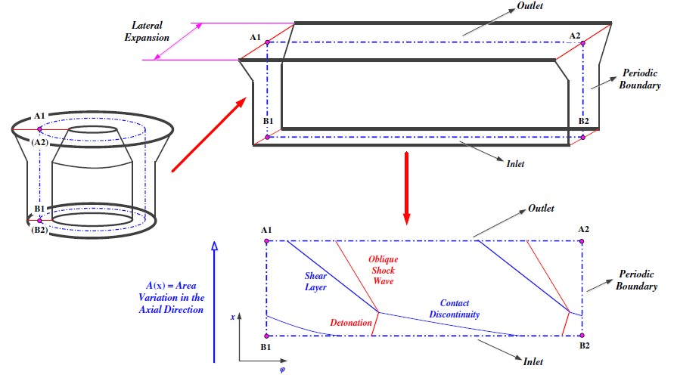
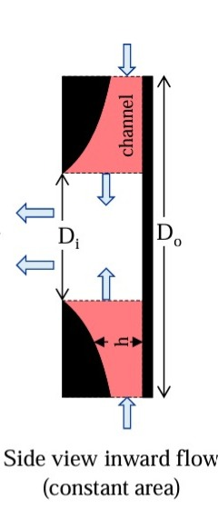
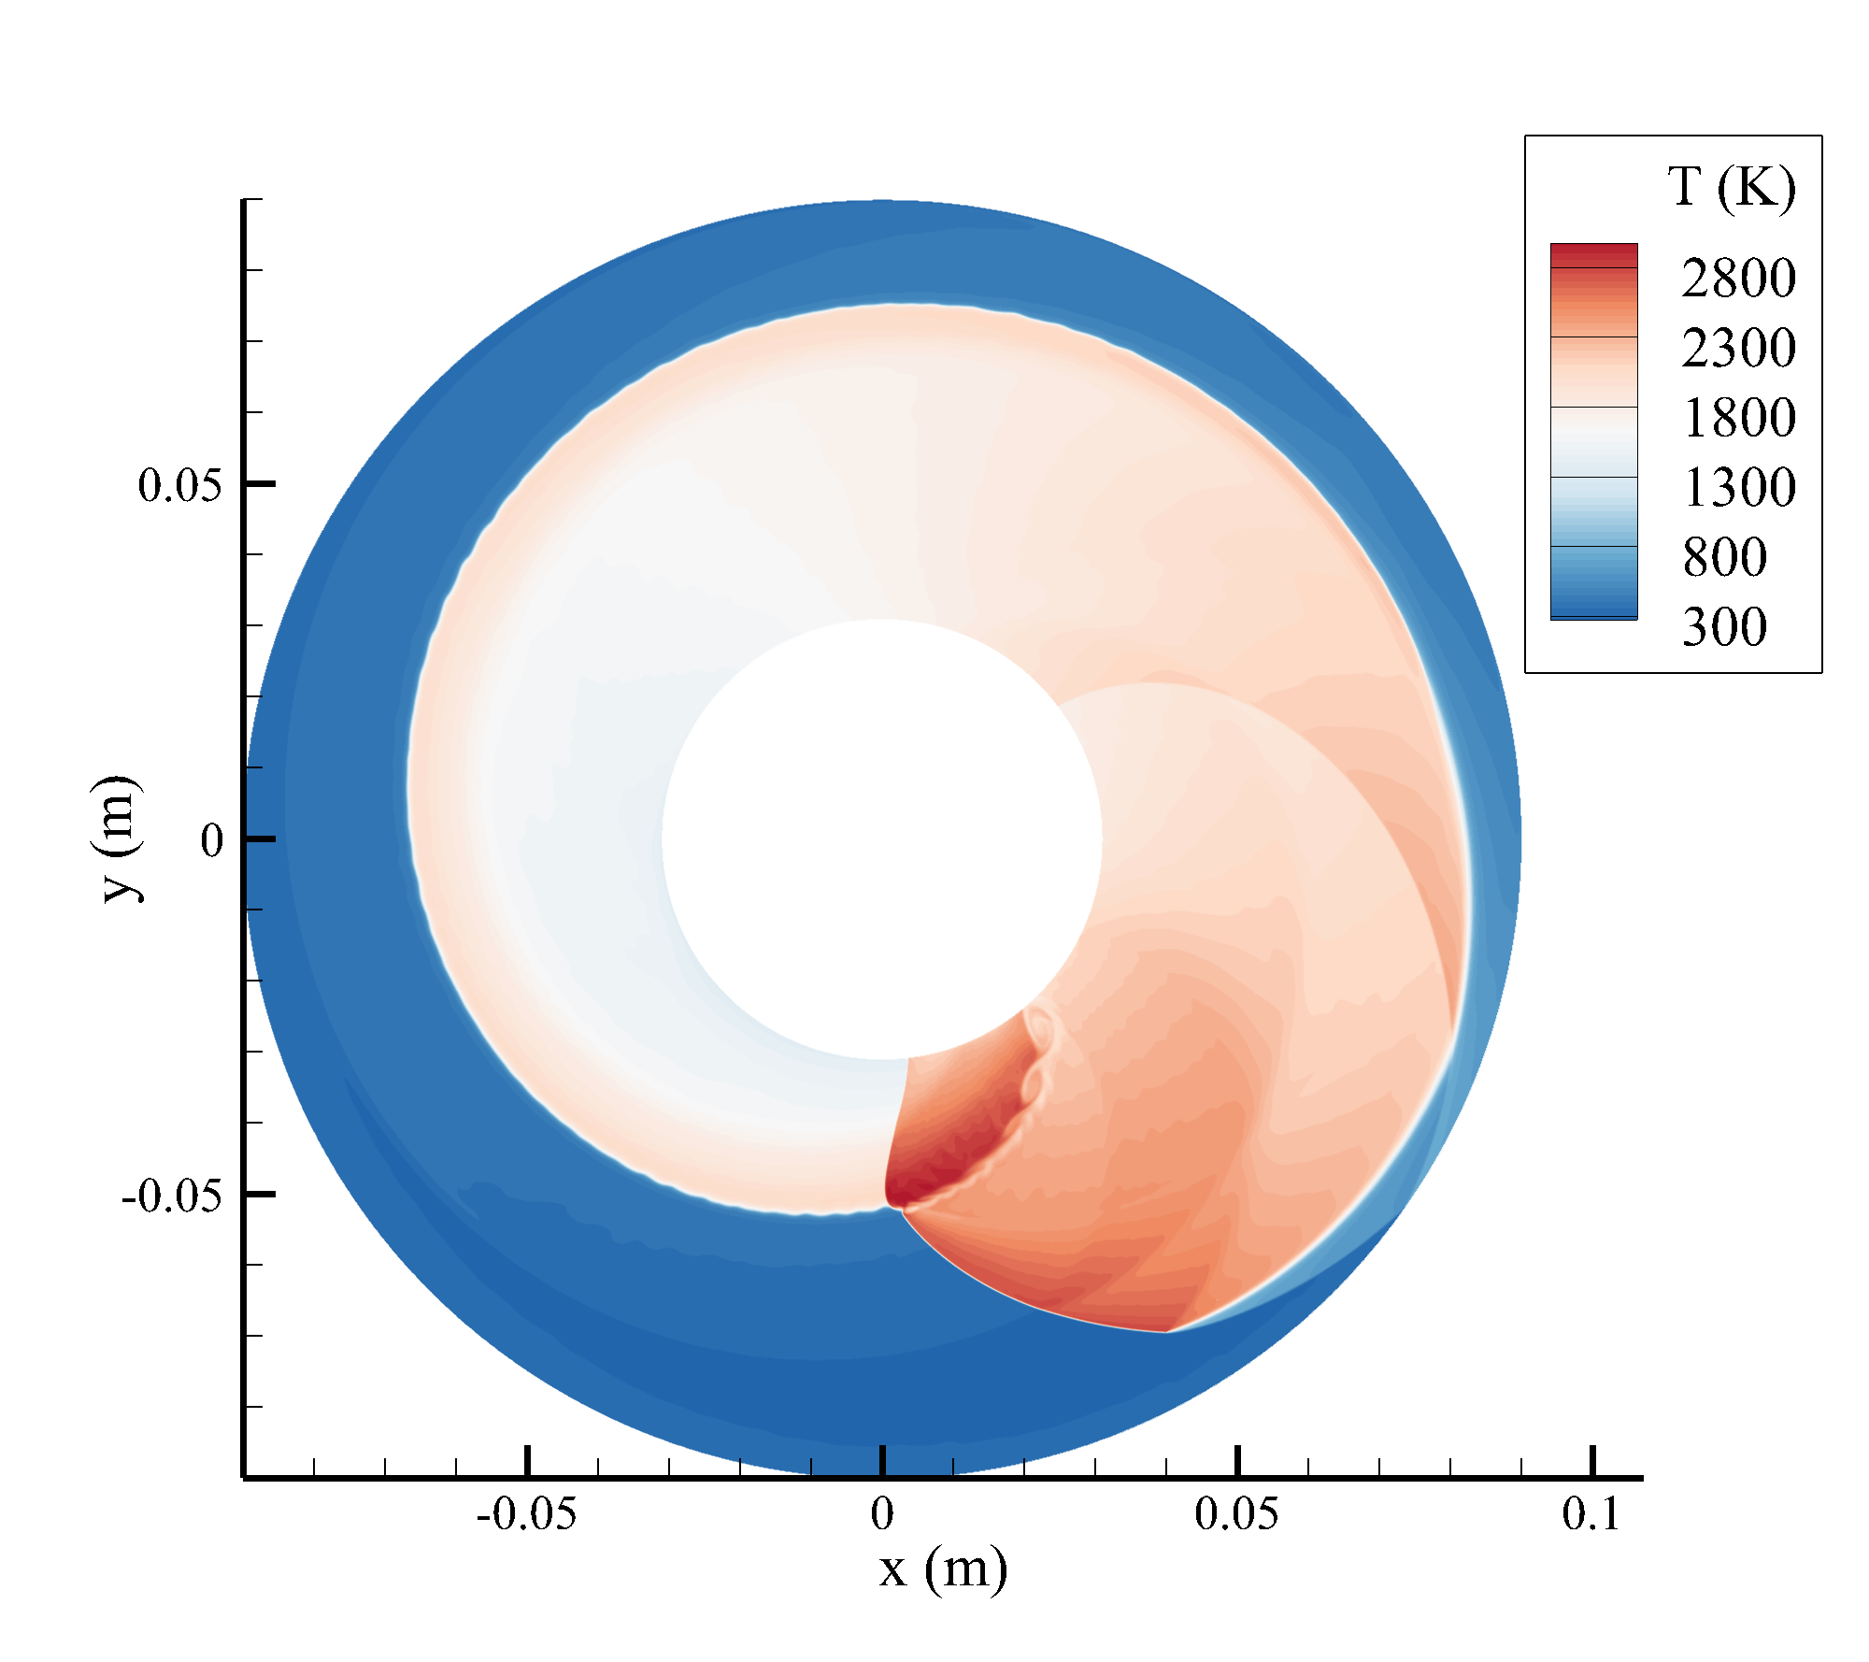
Code Development and Capabilities
Q2D solver — innovation w.r.t. recent literature
• Rigorous treatment of diffusive fluxes and generic RANS equations
• General derivation with z = z(x,y) — valid for generic width variations
• Adaptation to CFD of the non-isentropic BFS boundary condition [1]
[1] Fievisohn & Yu, “Steady-state analysis of RDE flowfields with the method of characteristics,” J. Propulsion and Power 33(1), 89–99, 2017.
HEM modeling for subcritical flows in liquid rocket engine cooling systems
5/18

Slide 6
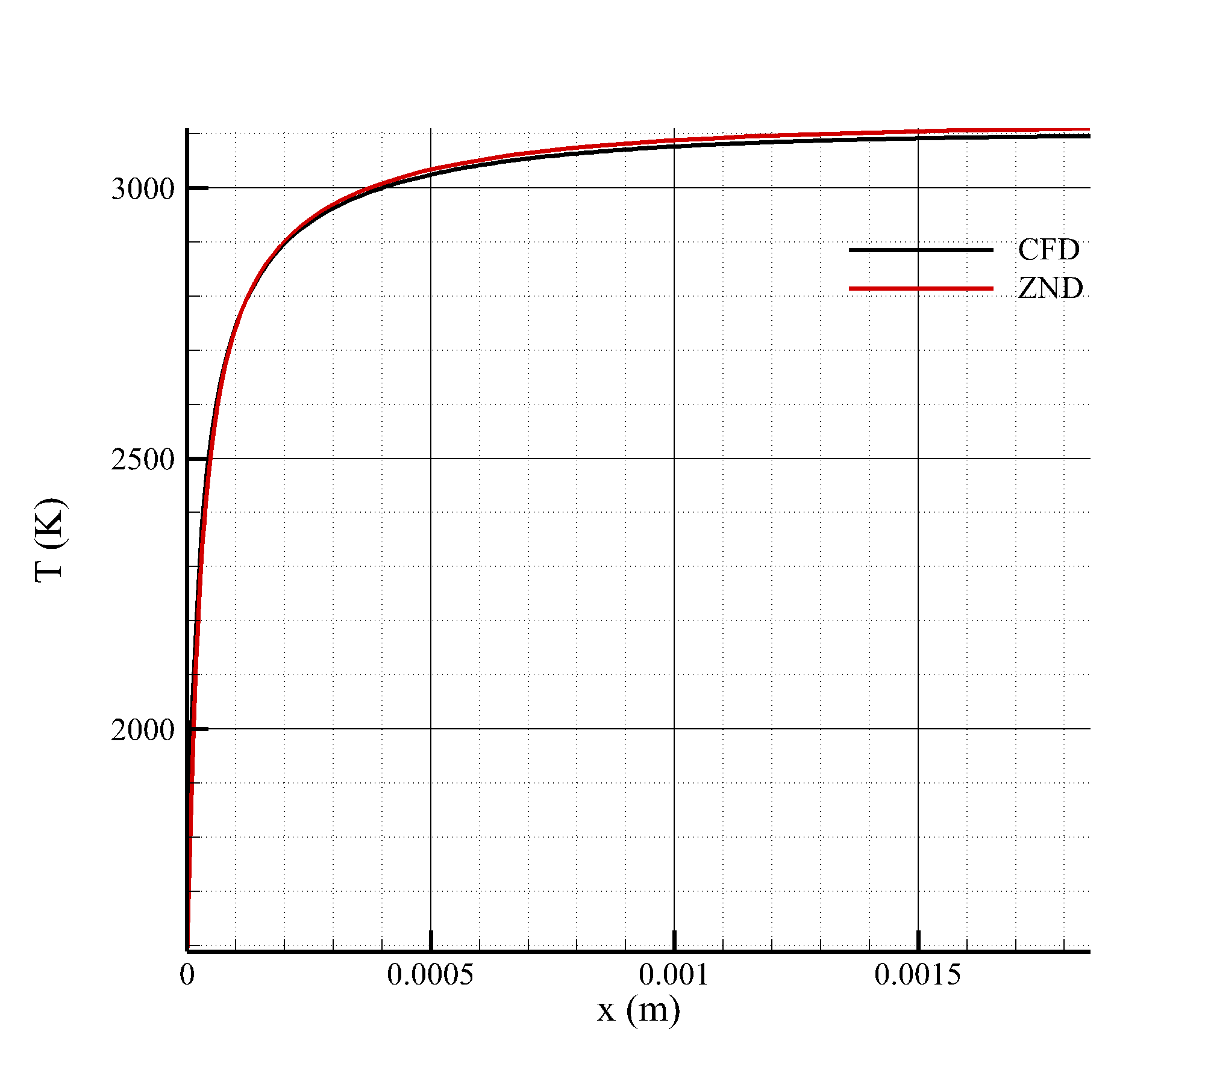
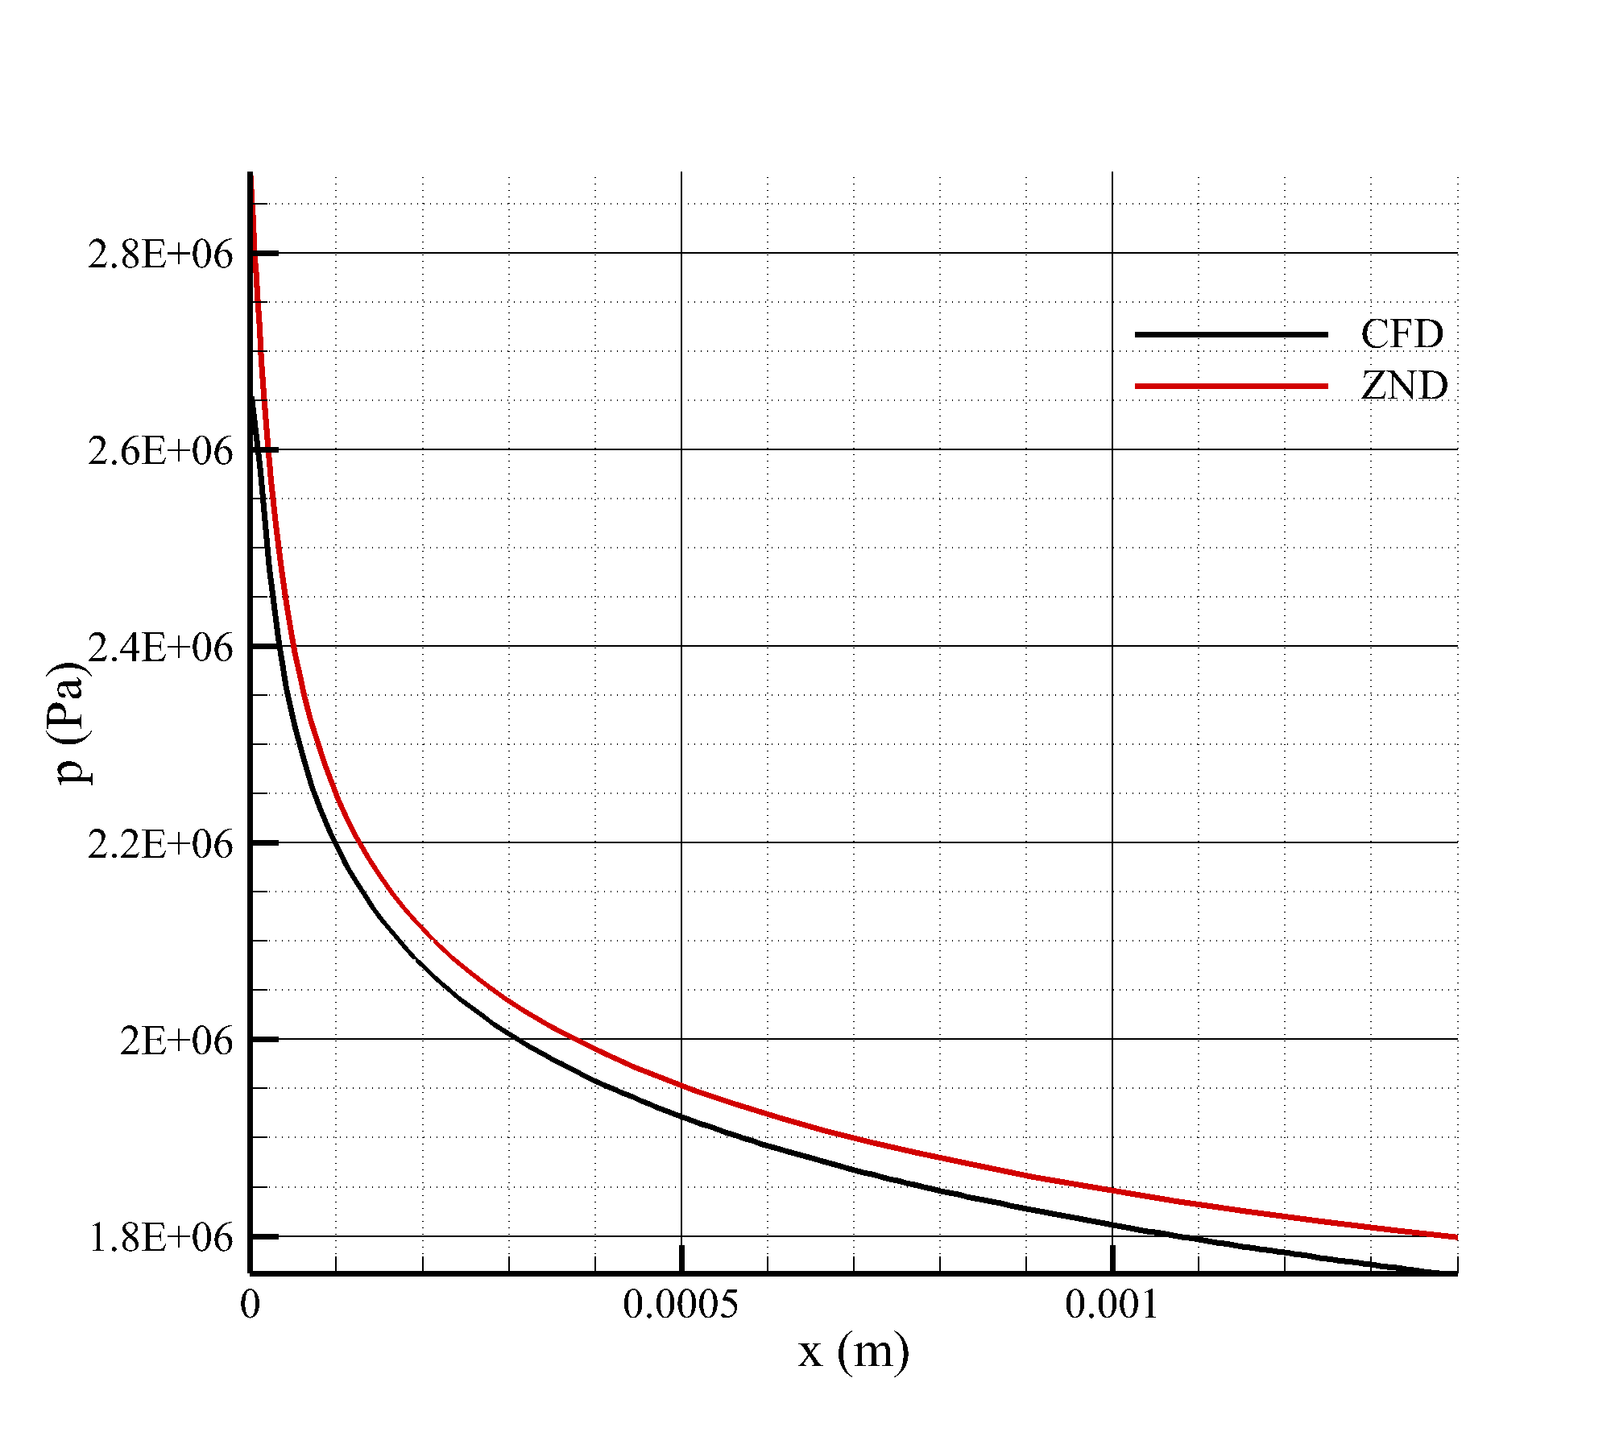
Code Development and Capabilities
V&V
• Validation against 1D ZND H2/Air detonation from SDT
HEM modeling for subcritical flows in liquid rocket engine cooling systems
6/18

Slide 7
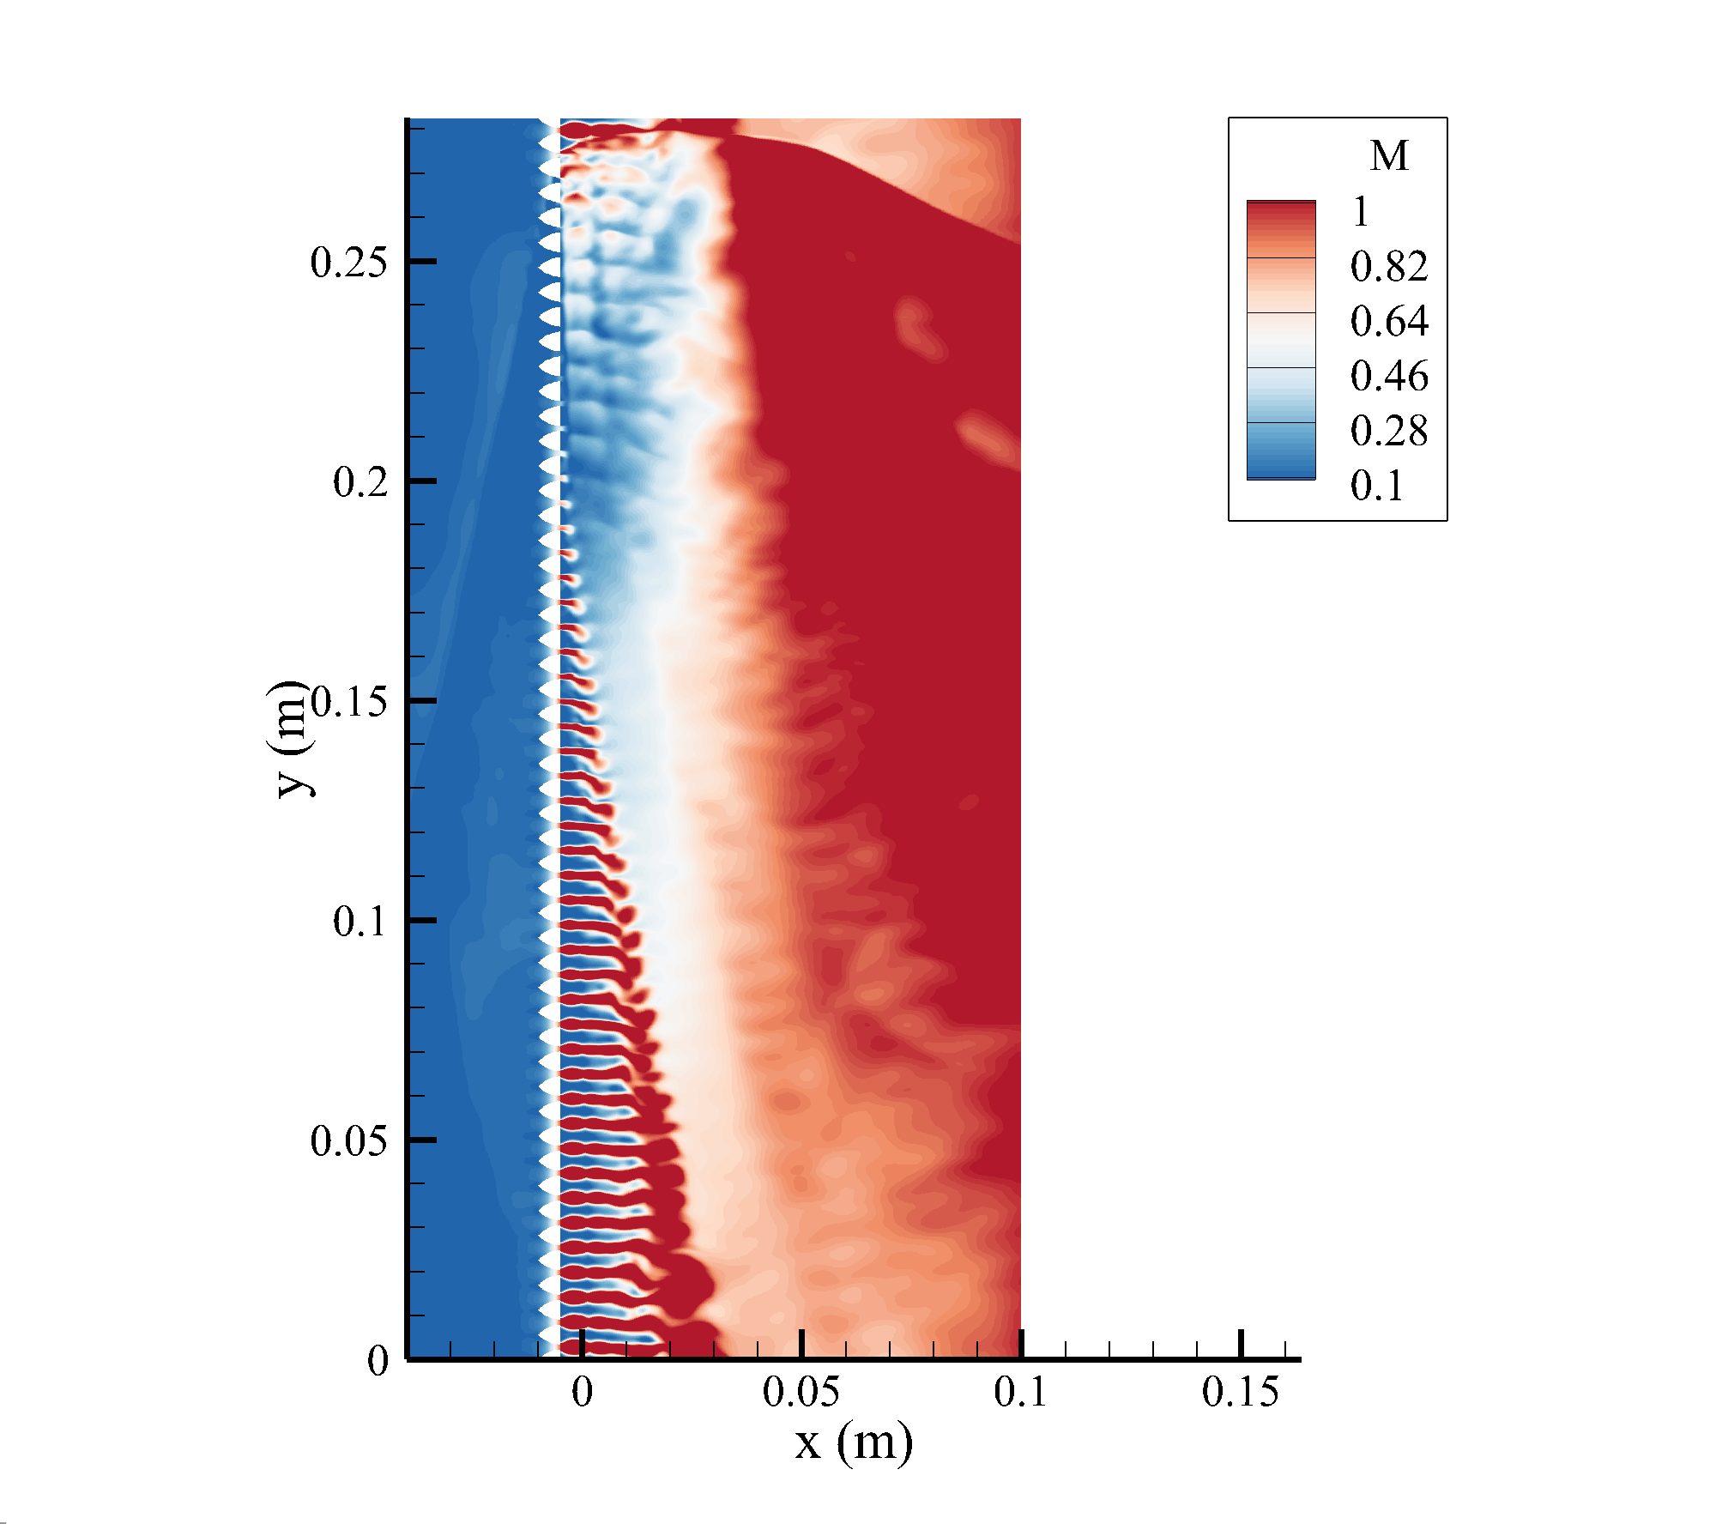
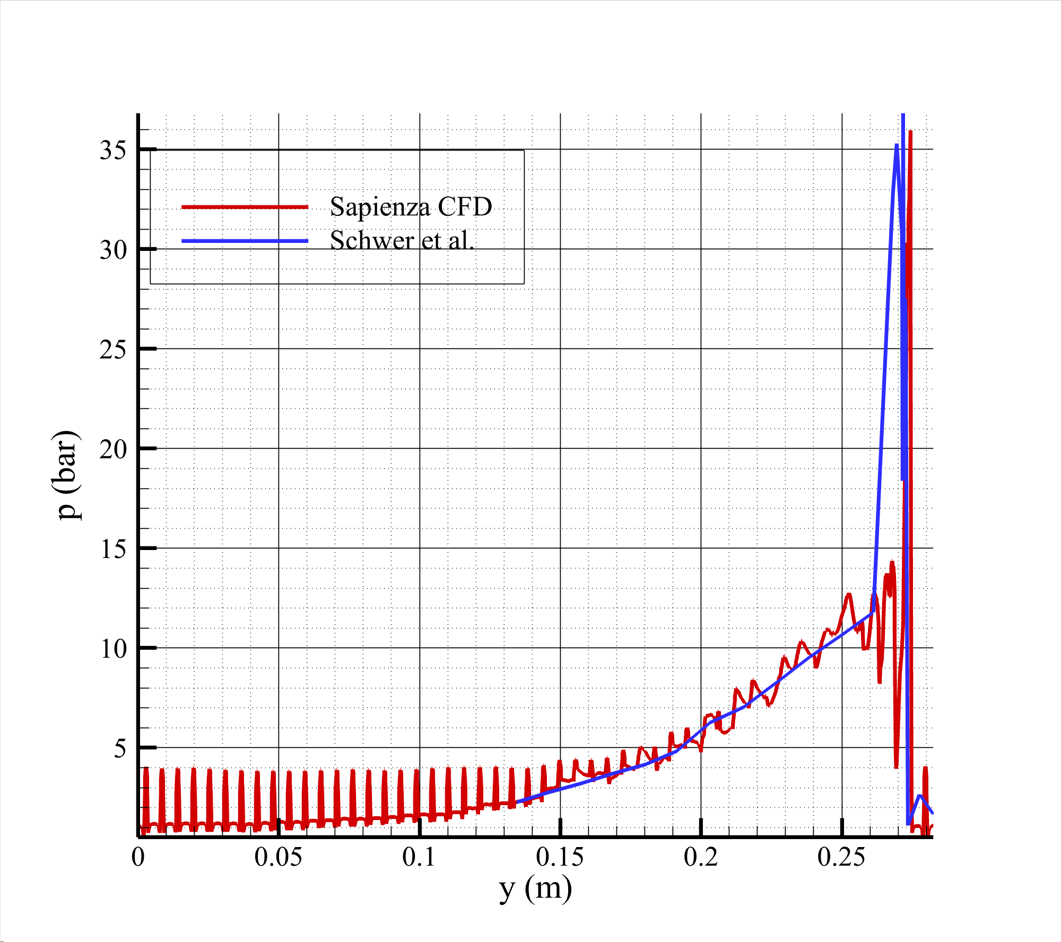
Code Development and Capabilities
V&V
• Validation against “unwrapped” literature test cases [2]
[2] D. Schwer and K. Kailasanath, “Feedback into mixture plenums in rotating detonation engines,” 50th AIAA Aerospace Sciences Meeting, 2012.
HEM modeling for subcritical flows in liquid rocket engine cooling systems
7/18

Slide 8
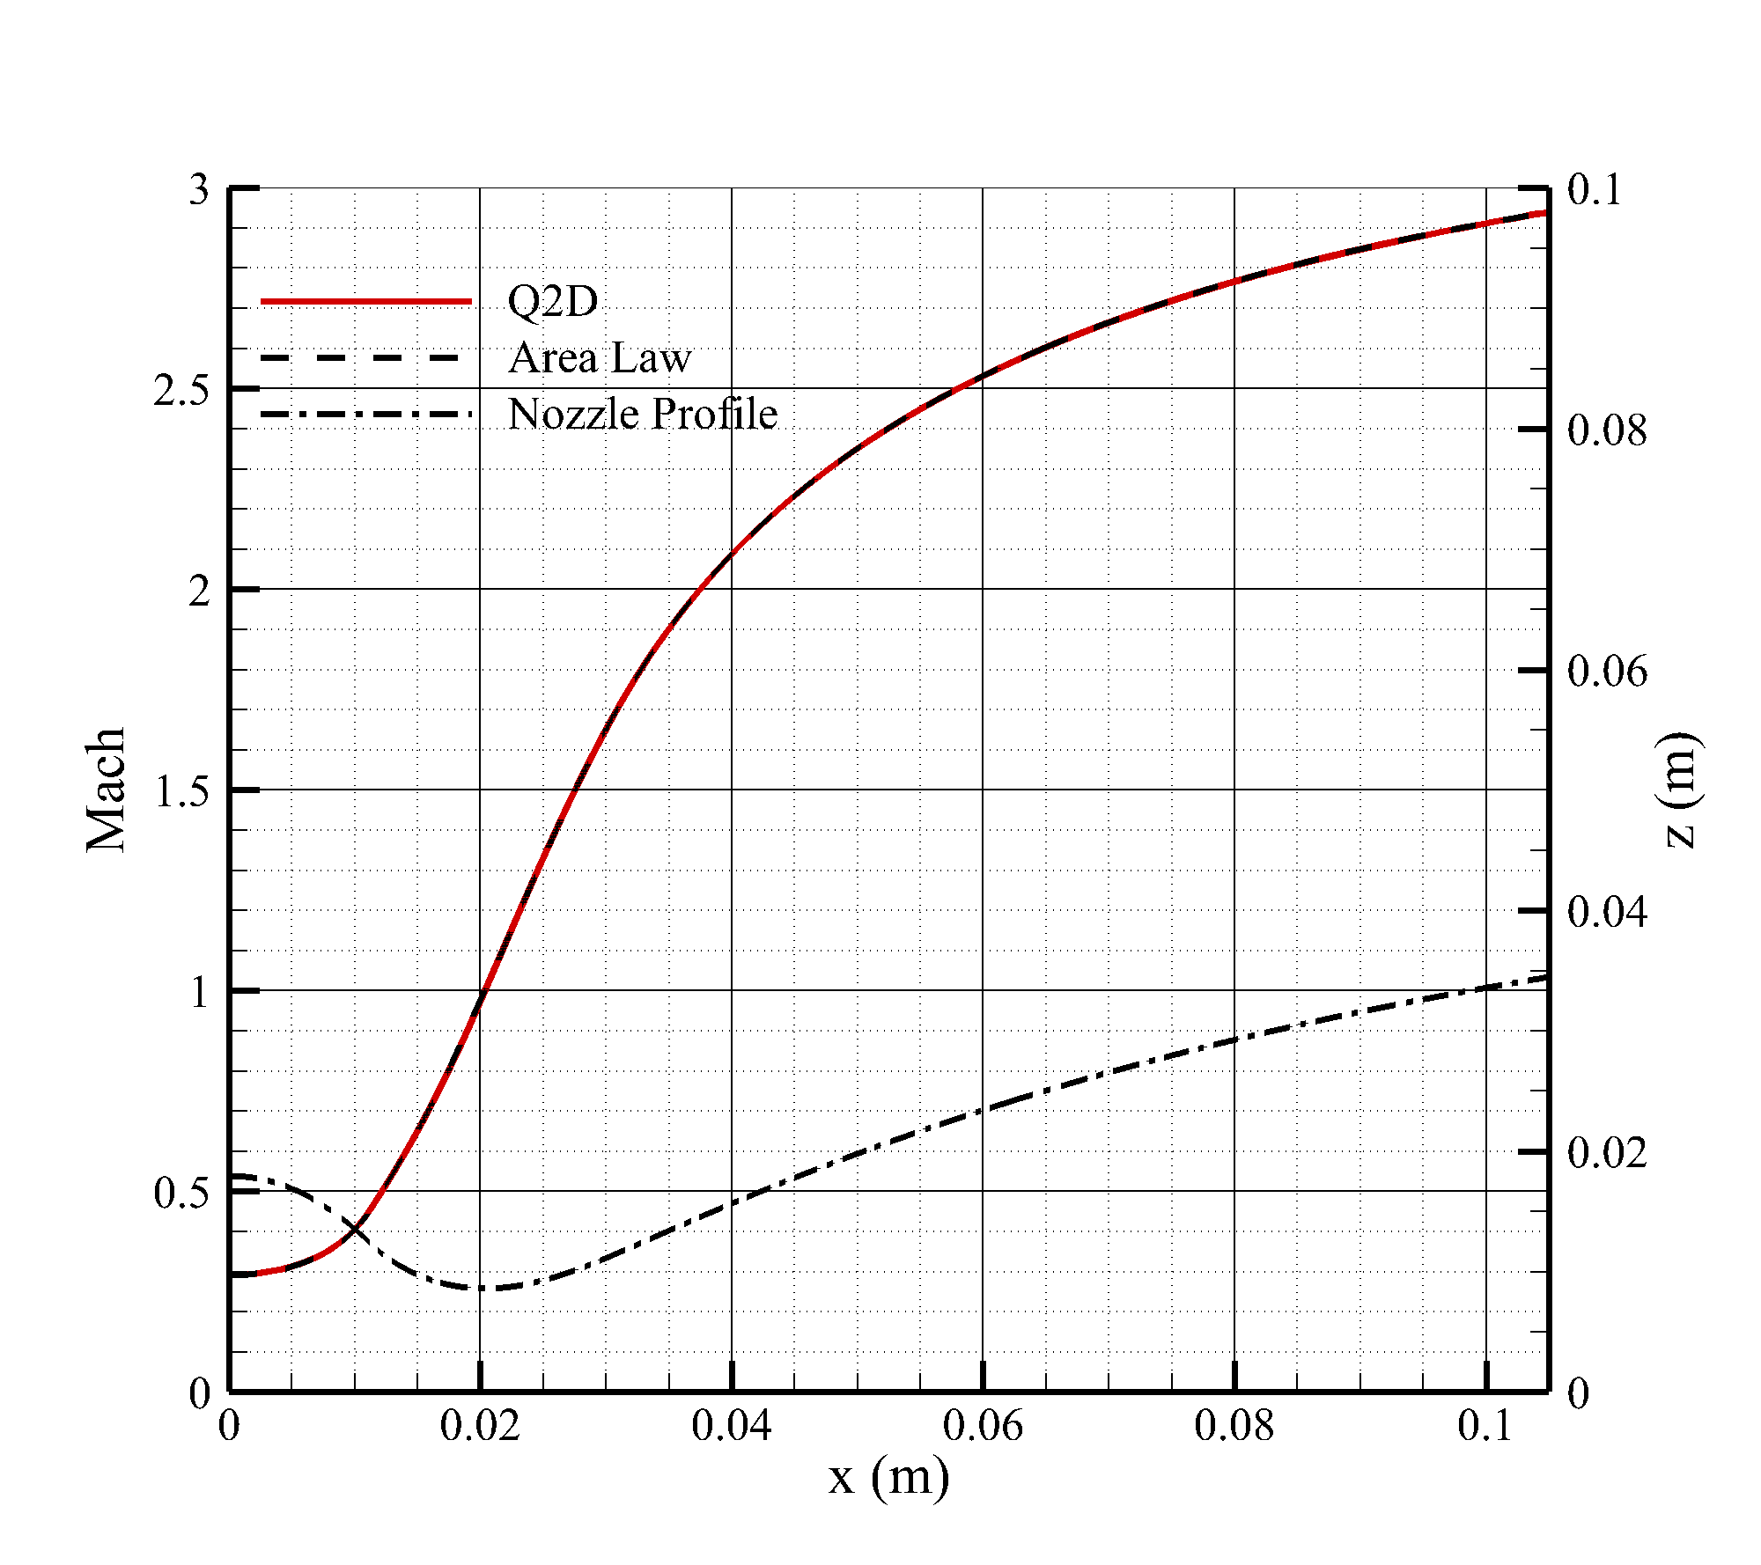
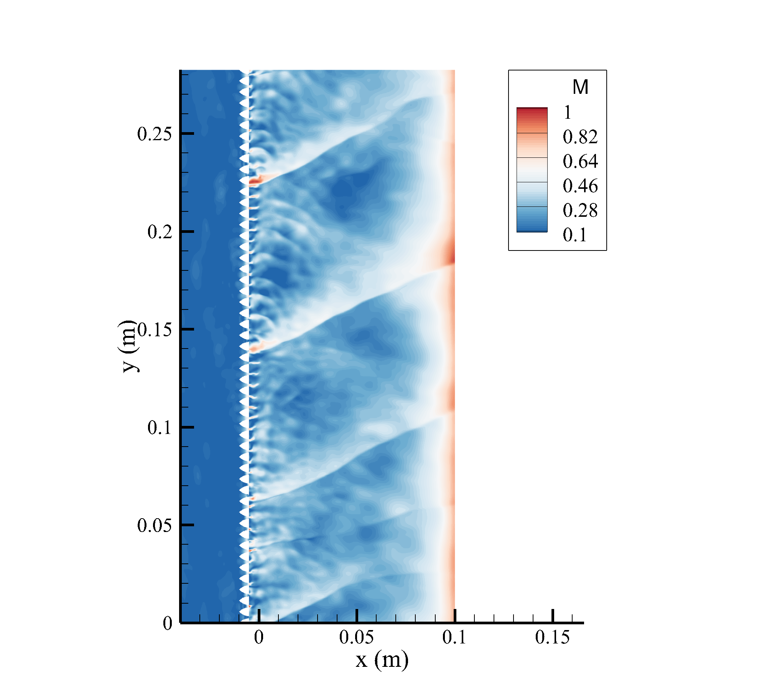
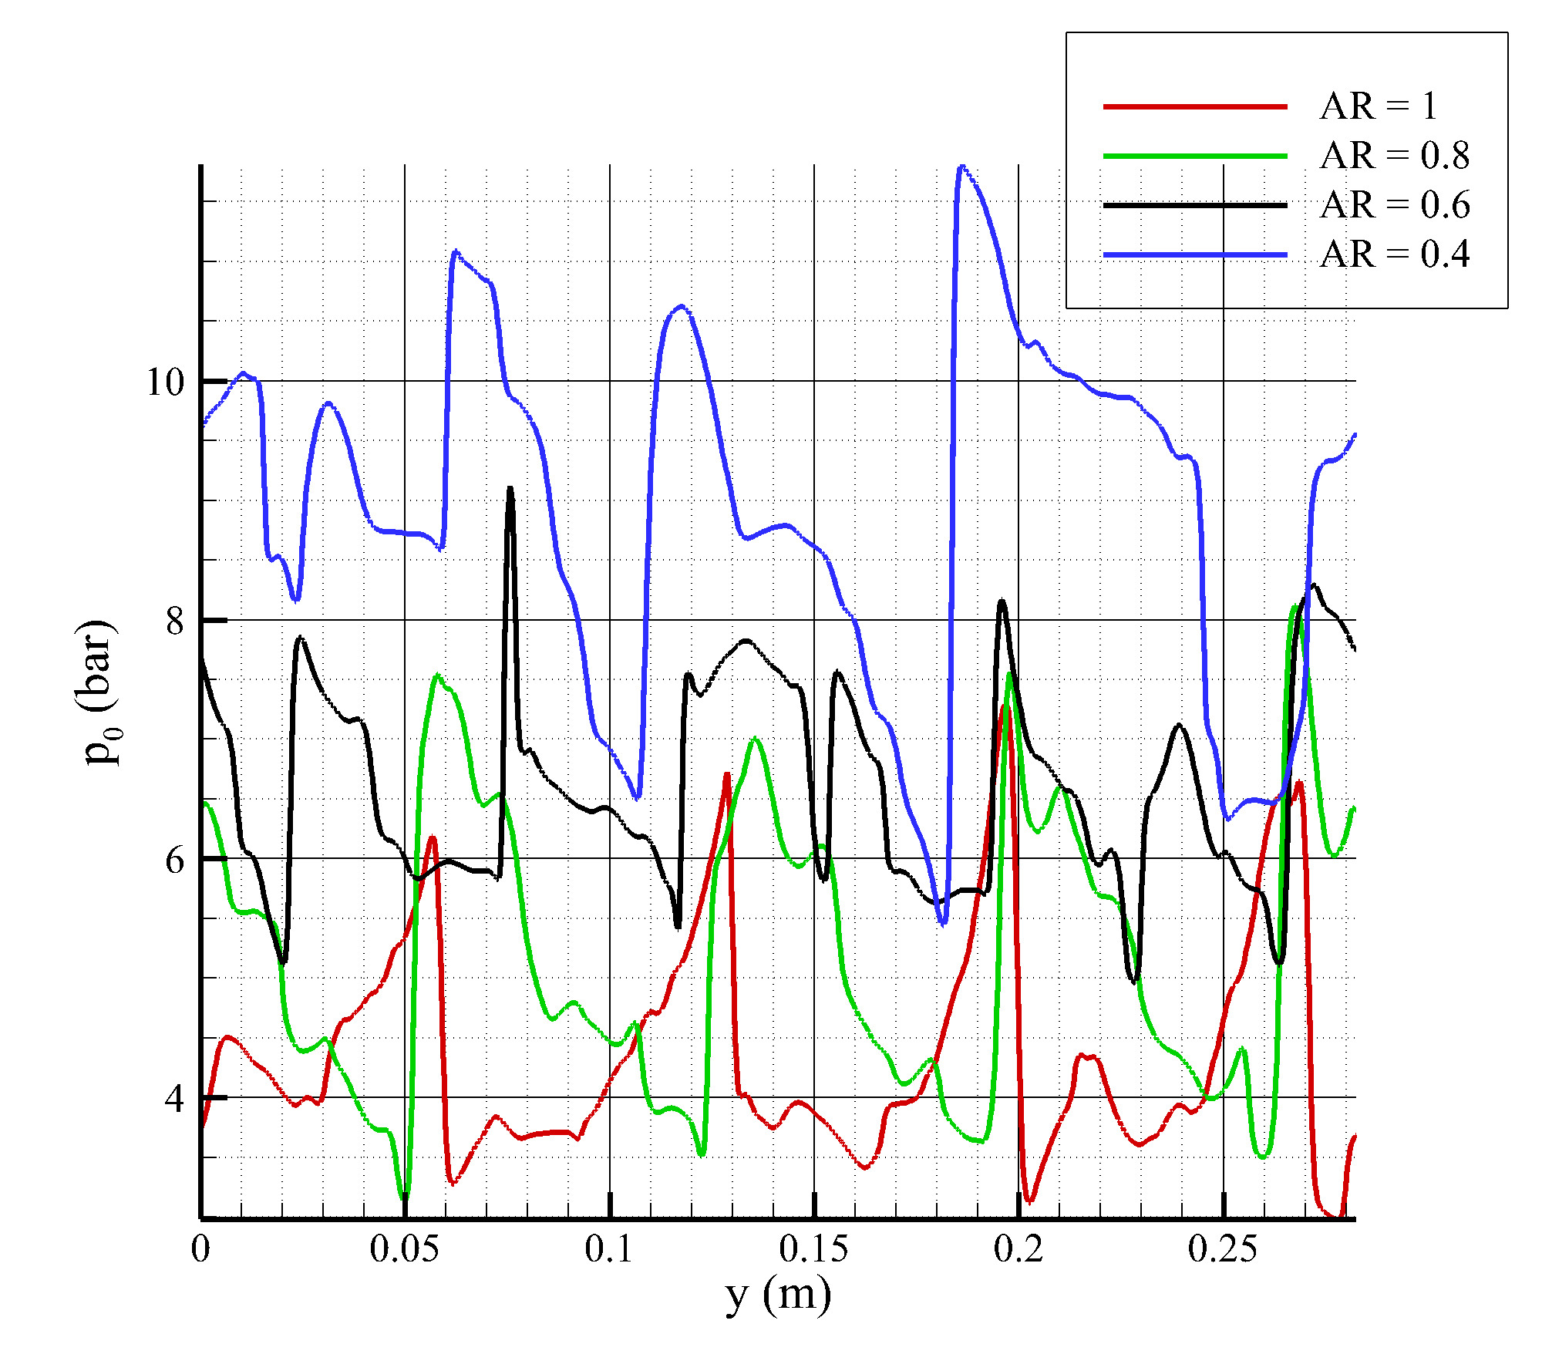
Code Development and Capabilities
V&V
• Extensive assessment of HYPERDE features (Q2D source terms, Q1D injectors-chamber, Q2D-3D connection)
AR = 0.4
HEM modeling for subcritical flows in liquid rocket engine cooling systems
8/18

Slide 9
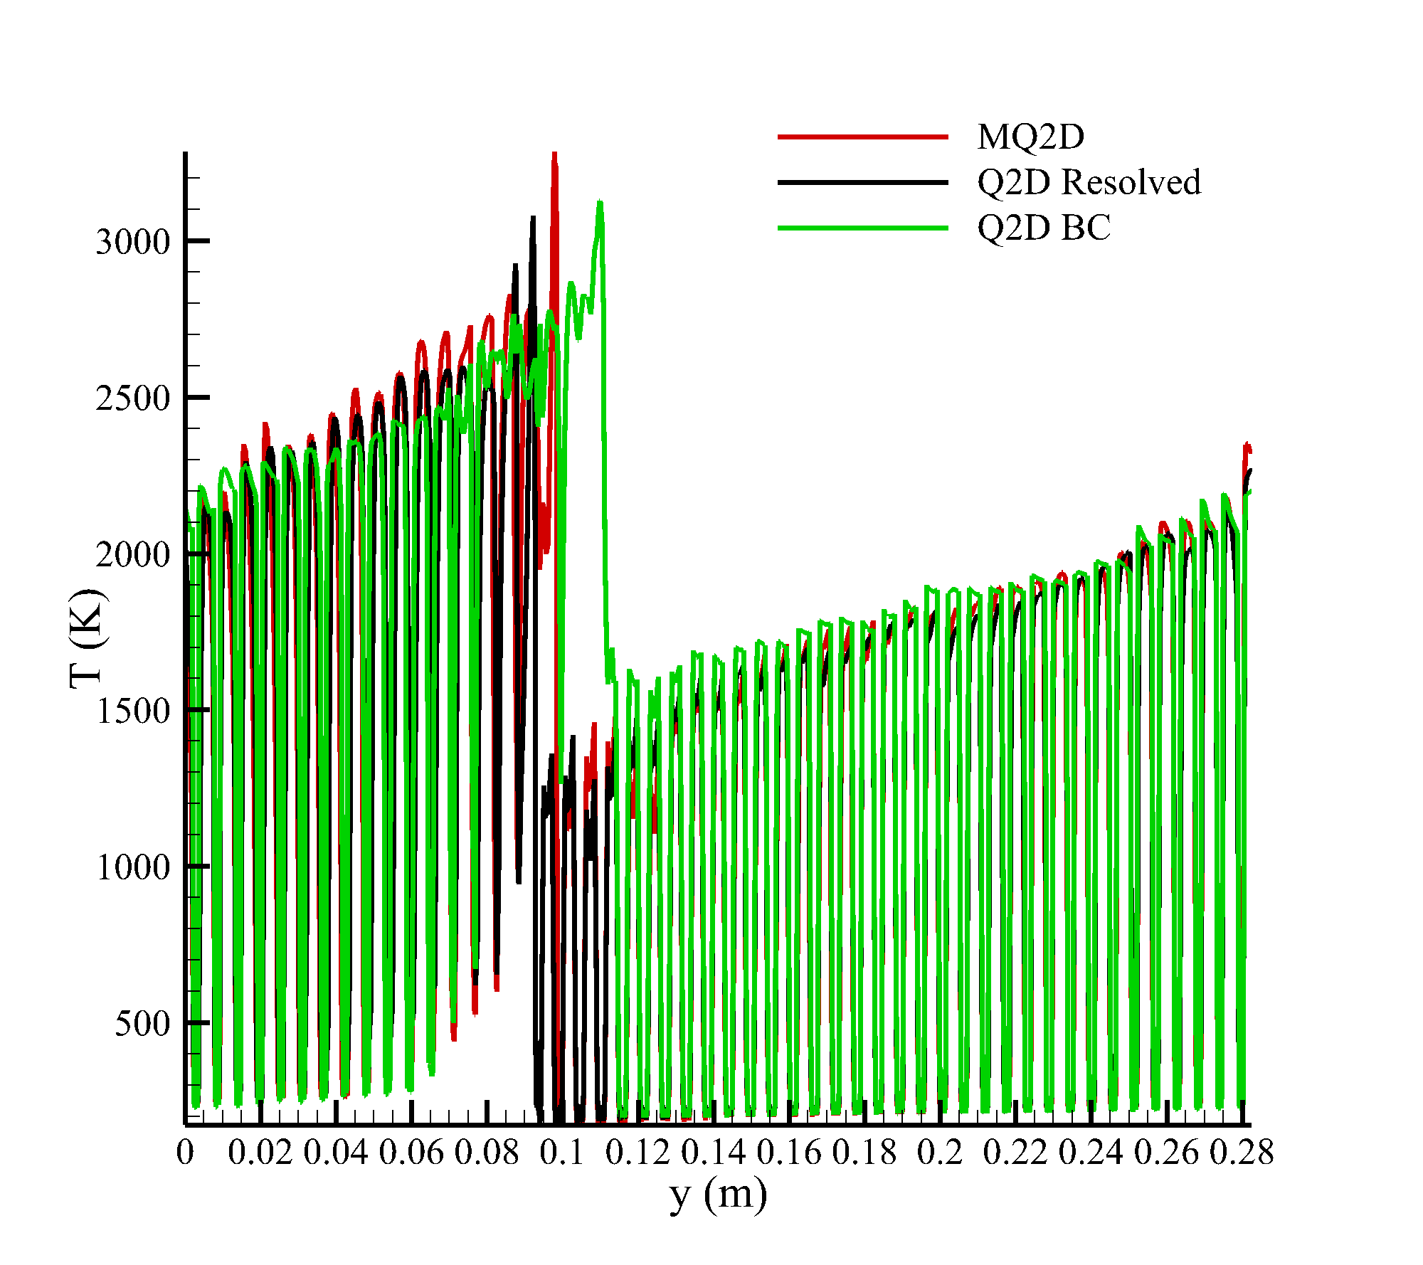
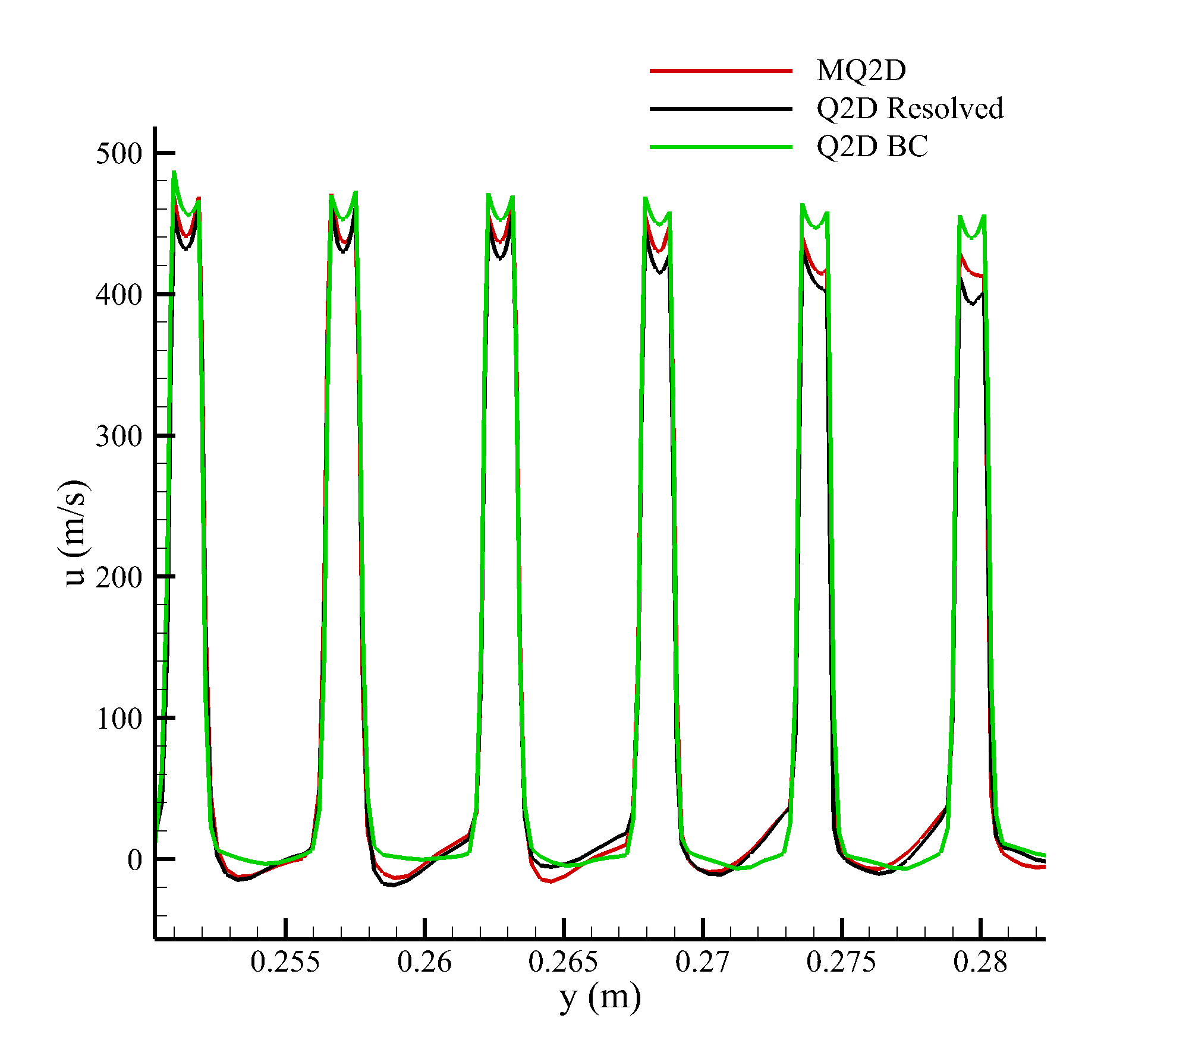
Code Development and Capabilities
V&V
• Extensive assessment of HYPERDE features (Q2D source terms, Q1D injectors-chamber, Q2D-3D connection)
HEM modeling for subcritical flows in liquid rocket engine cooling systems
9/18

Slide 10
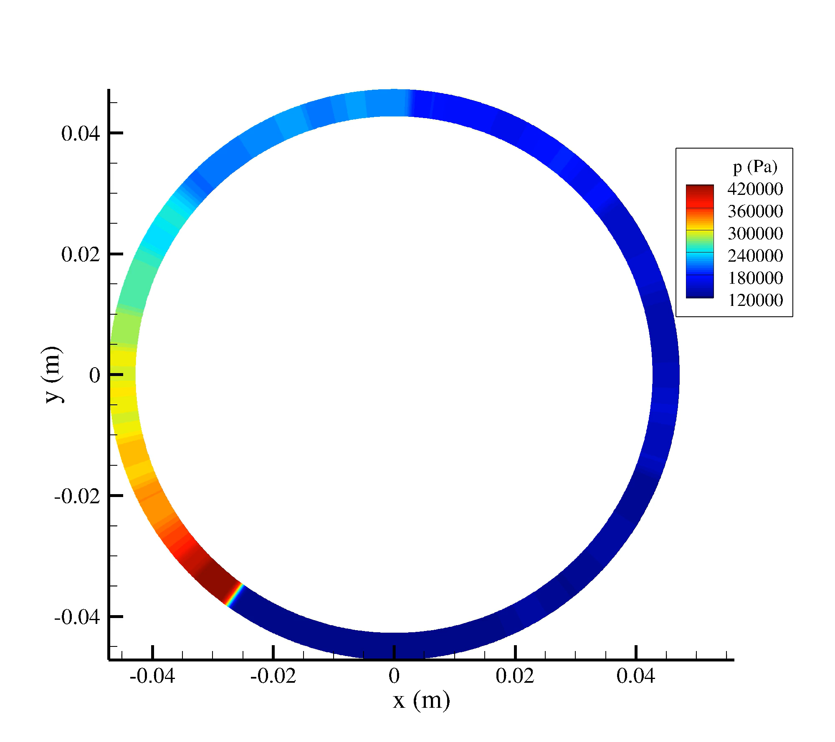
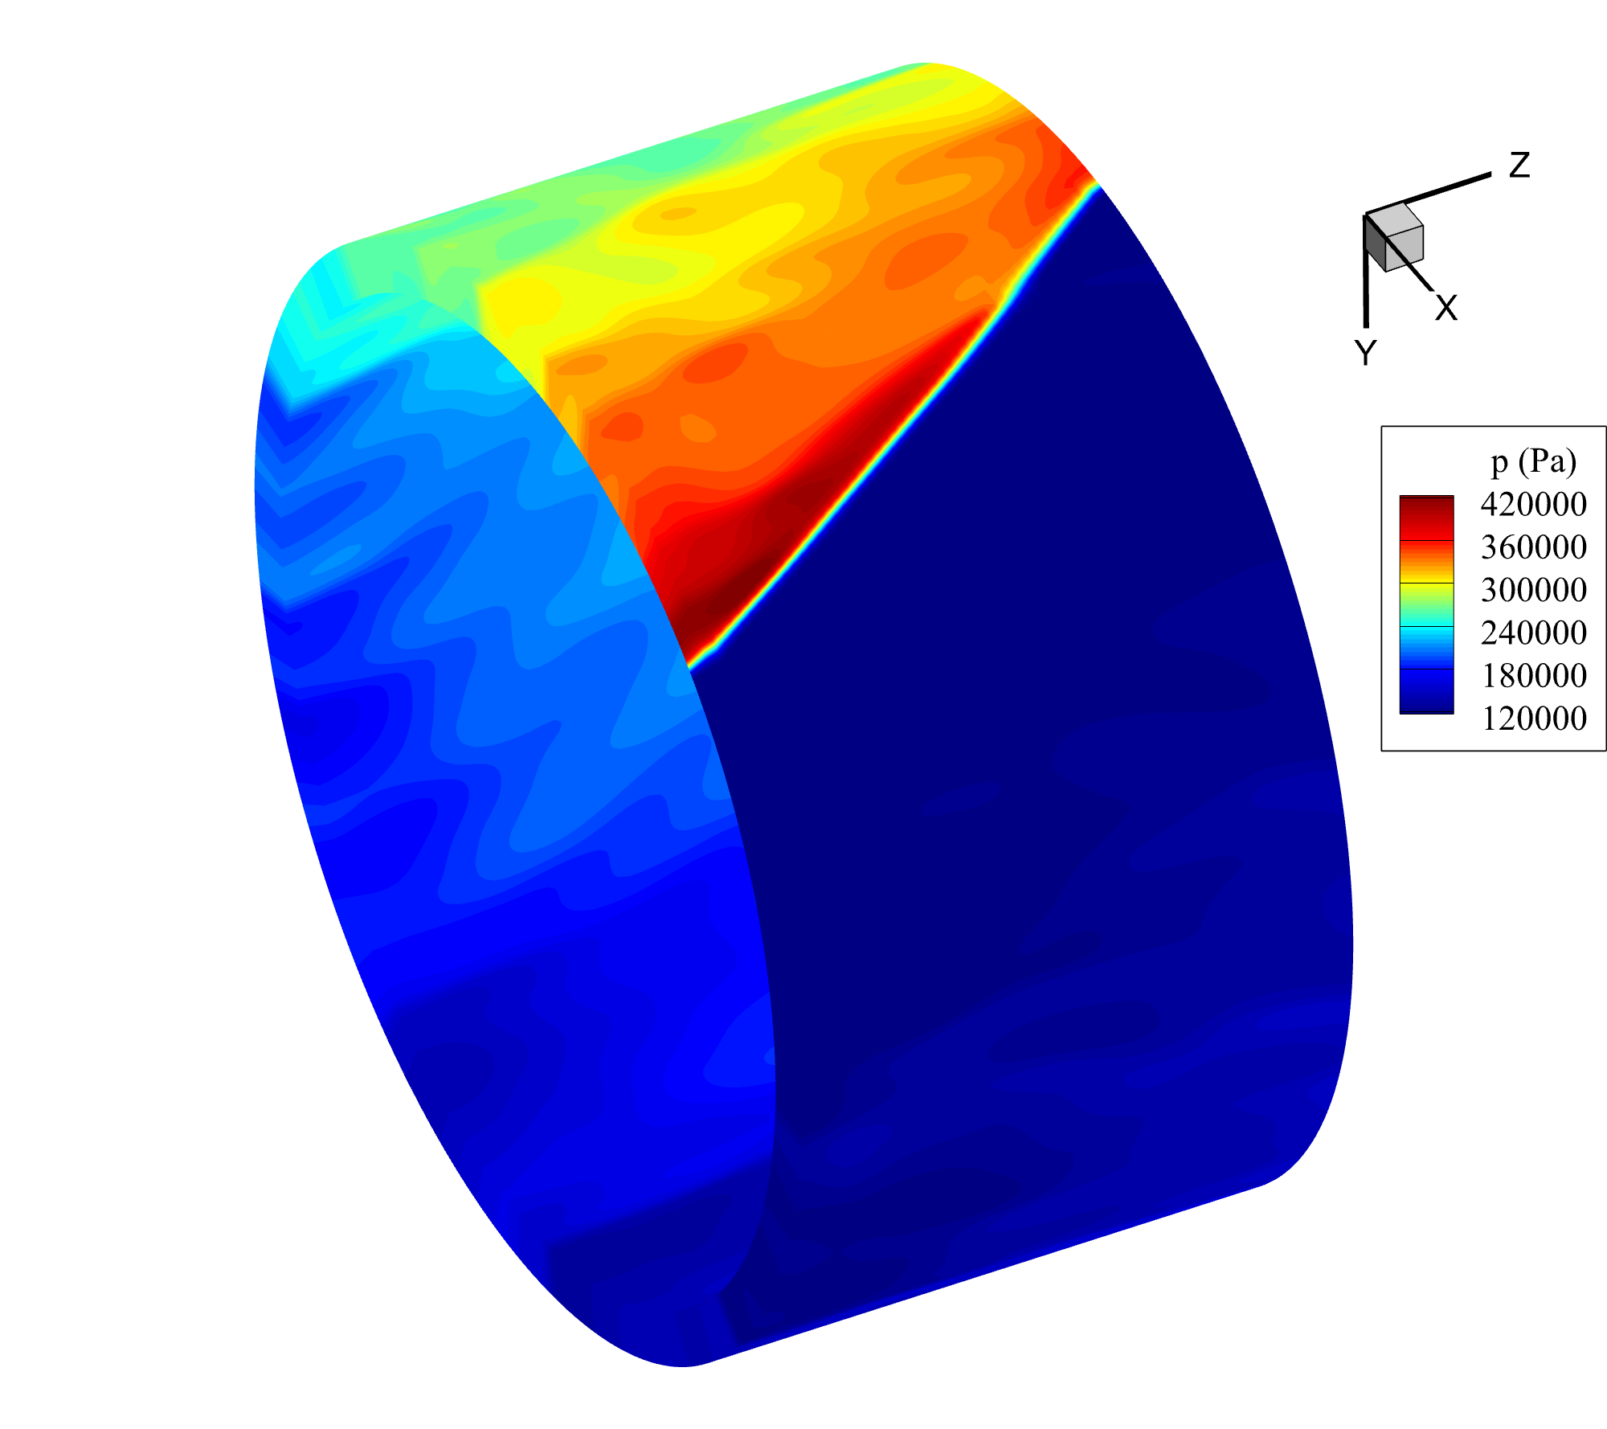
Code Development and Capabilities
V&V
• Extensive assessment of HYPERDE features (Q2D source terms, Q1D injectors-chamber, Q2D-3D connection)
HEM modeling for subcritical flows in liquid rocket engine cooling systems
10/18

Slide 11
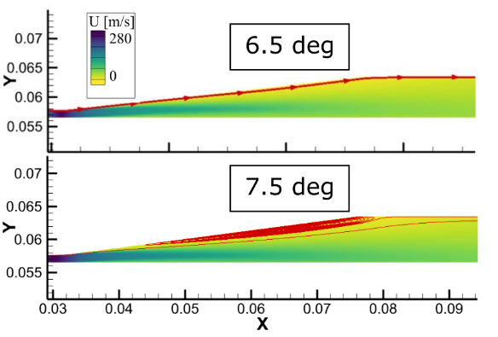
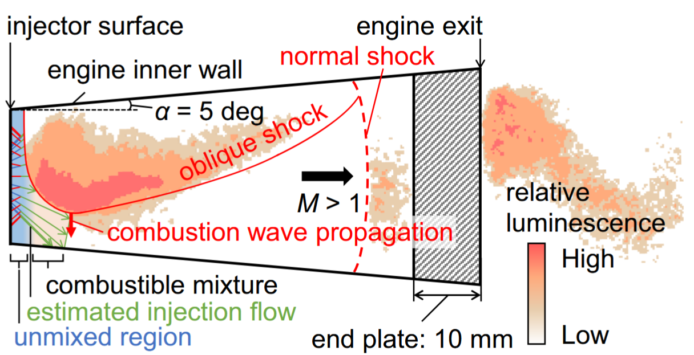
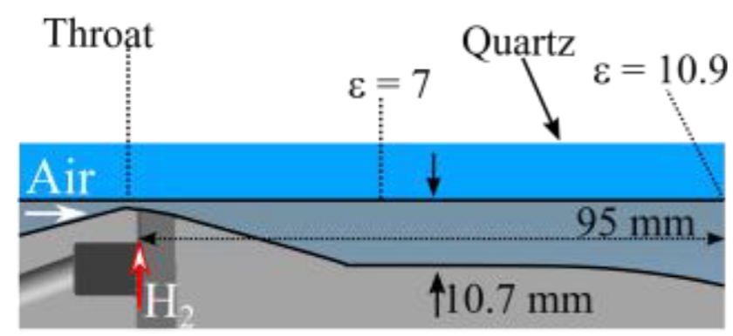
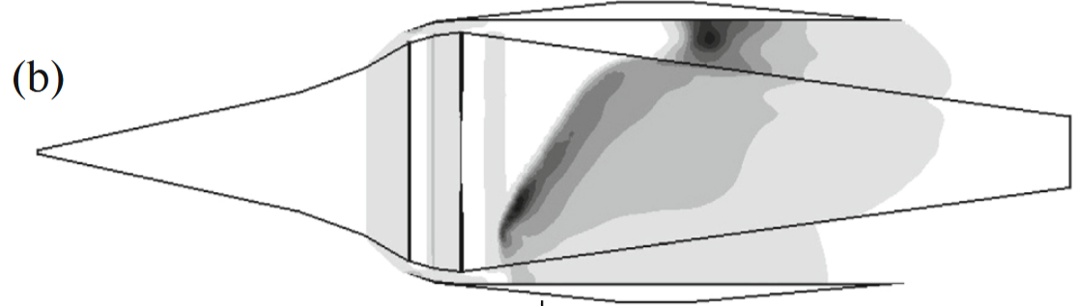



Characterization of Refill Region Dynamics (with RMIT and NCSU)
Understanding physics of RDE refill regions with diverging inlets
Introduced to mitigate separation losses associated with backward-facing steps
Experimental and numerical evidence instead reports degraded overall performance
How does the geometry affect the refill region expansion process?
What happens if/when expansion yields supersonic Mach number in the layer?
Can the process be modelled?
How does the overall phenomenology impact the stagnation pressure losses?
$$\vec{y}$$
$$\vec{x}$$
$$\vec{z}$$
Inlet extension added for supersonic cases
HEM modeling for subcritical flows in liquid rocket engine cooling systems
11/18

Slide 12
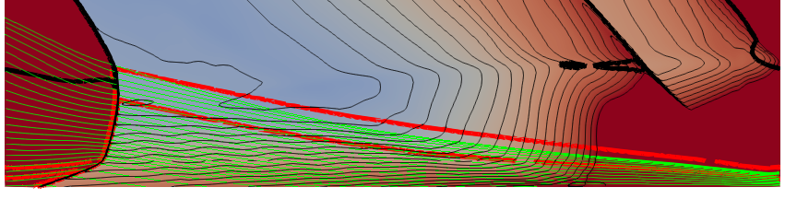
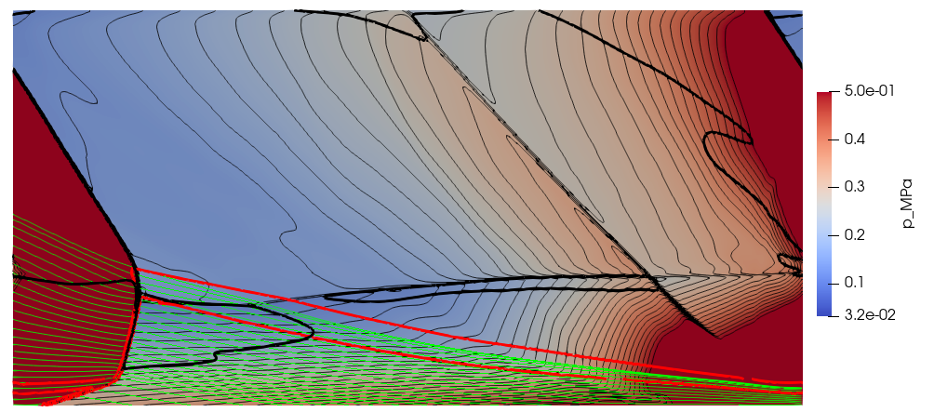
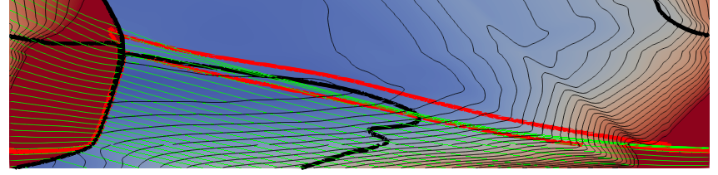
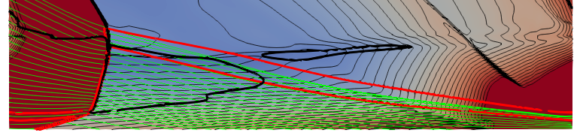
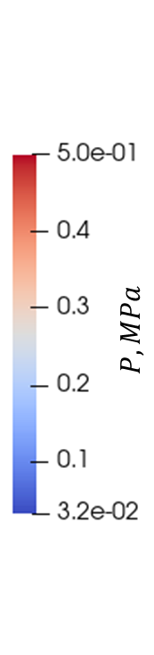
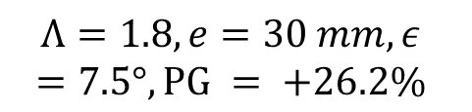
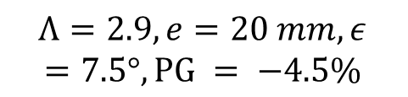



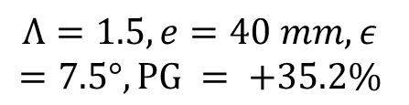
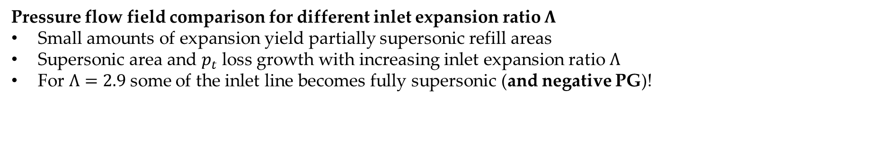
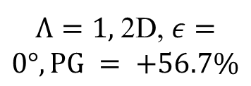

Characterization of Refill Region Dynamics
Pressure flow field comparison for different inlet expansion ratio $Λ$
Small amounts of expansion yield partially supersonic refill areas
Supersonic area and $p_{t}$ loss growth with increasing inlet expansion ratio $Λ$
For $Λ=2.9$some of the inlet line becomes fully supersonic (and negative PG)!
$$p_{t}=5 bar$$
$T_{t}=330 K$
premixed $H_{2}/air$
$$φ=1$$
$Λ=1,$ 2D, $ε=0°, PG = +56.7\%$
$$Λ=1.5,e=40 mm, ε=7.5°,PG = +35.2\%$$
$$Λ=2.9,e=20 mm, ε=7.5°,PG = −4.5\%$$
$$Λ=1.8,e=30 mm, ε=7.5°,PG = +26.2\%$$
Inlet line
$$M=1$$
$$φ=0.99$$
$$φ=0.2$$
HEM modeling for subcritical flows in liquid rocket engine cooling systems
12/18

Slide 13
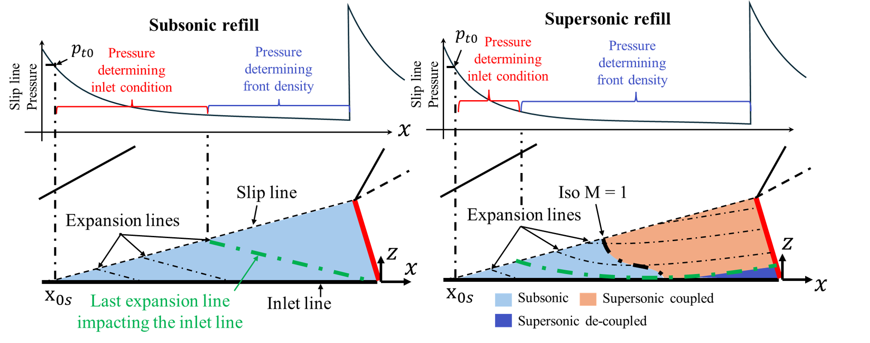
Characterization of Refill Region Dynamics
HEM modeling for subcritical flows in liquid rocket engine cooling systems
13/18

Slide 14
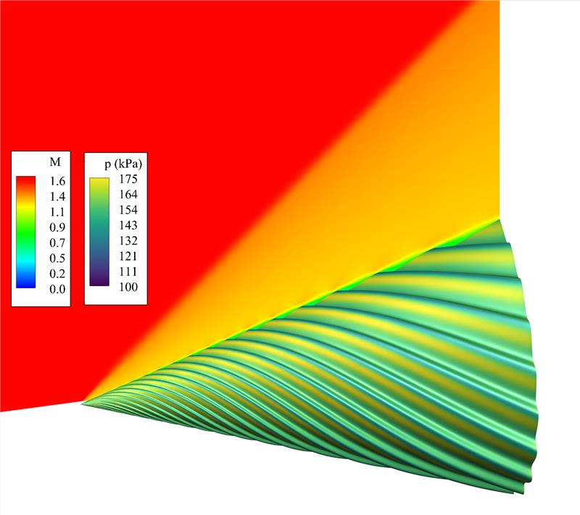
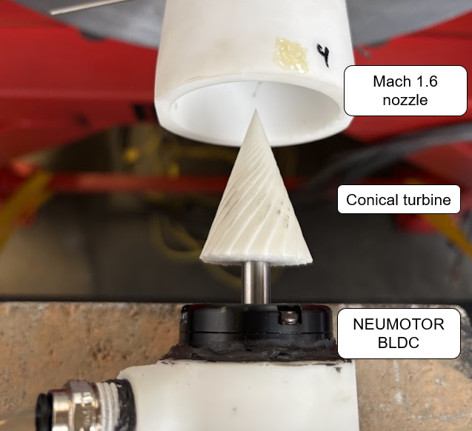
Supersonic Bladeless Turbines (with NCSU)
CFD based design of NCSU supersonic wind tunnel
Capability up to Mach 4 for steady non-reactive flow
Swappable nozzle and second-throat diffuser system allowing for low feed pressure
Numerical analysis of phenomenology and working principle of bladeless turbines
HEM modeling for subcritical flows in liquid rocket engine cooling systems
14/18

Slide 15
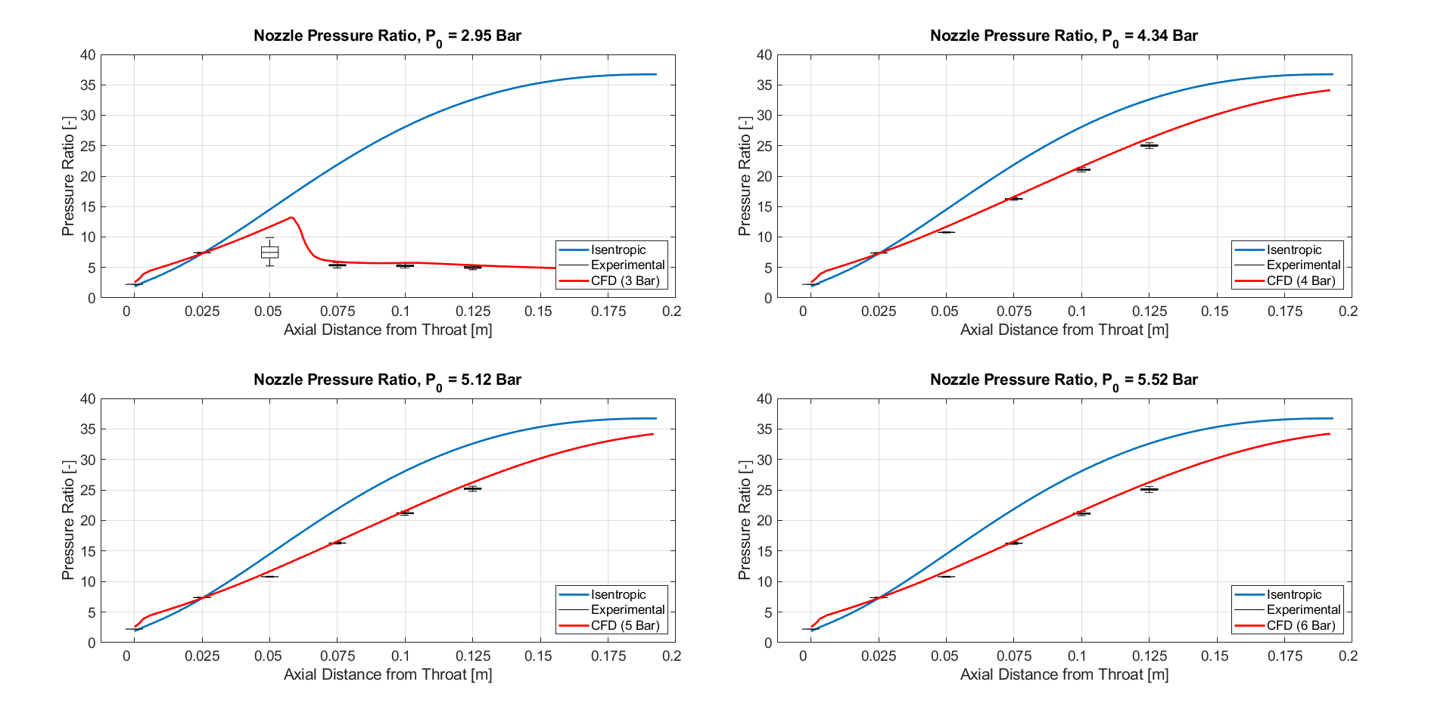
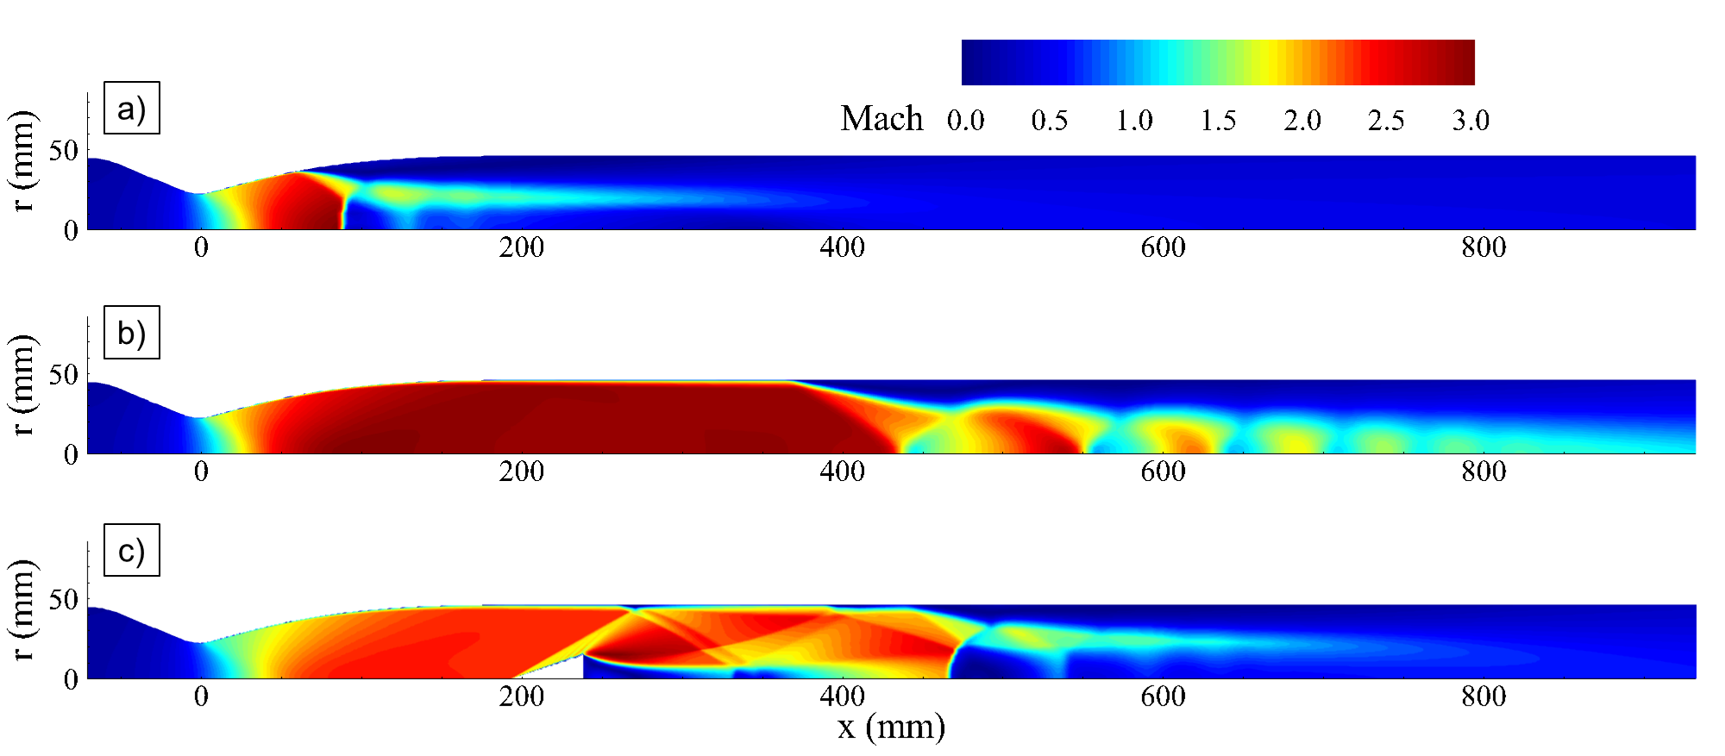
Supersonic Bladeless Turbines (with NCSU)
CFD based design of NCSU supersonic wind tunnel
Capability up to Mach 4 for steady non-reactive flow
Swappable nozzle and second-throat diffuser system allowing for low feed pressure
Numerical analysis of phenomenology and working principle of bladeless turbines
p₀ = 3 bar
p₀ = 4 bar
HEM modeling for subcritical flows in liquid rocket engine cooling systems
15/18

Slide 16
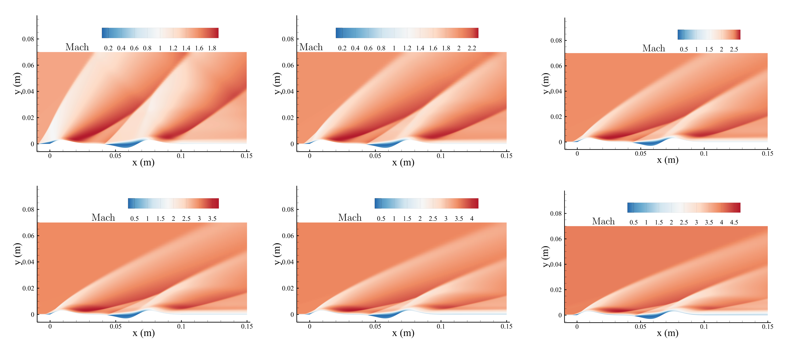
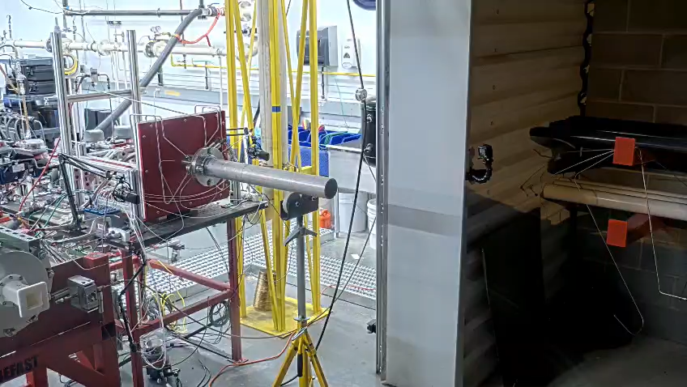
Supersonic Bladeless Turbines (with NCSU)
Ongoing
Bladeless turbine shape optimization
CFD analysis and design of ejector-diffuser system for RDE testing
HEM modeling for subcritical flows in liquid rocket engine cooling systems
16/18

Slide 17
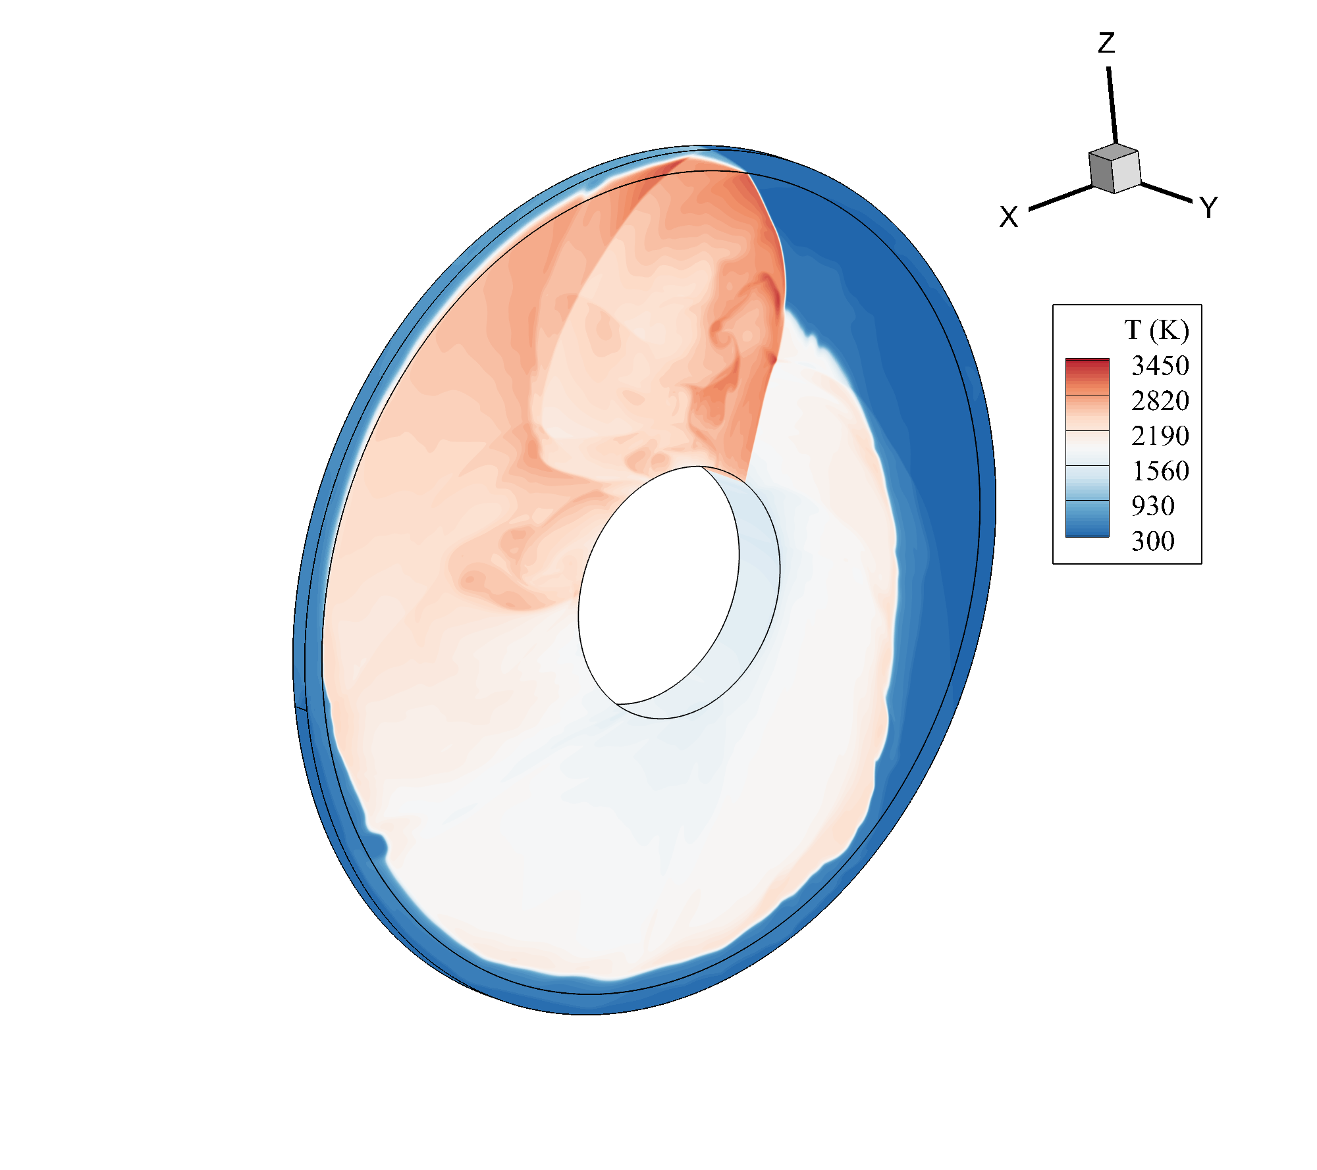
Disk RDEs (with RMIT and ISAE-ENSMA)
Collaboration with PPRIME lab
CFD lead on design and analysis of disk RDEs operating with H2/Air
3D URANS (or Euler)
Q2D URANS (or Euler)
HEM modeling for subcritical flows in liquid rocket engine cooling systems
17/18

Slide 18
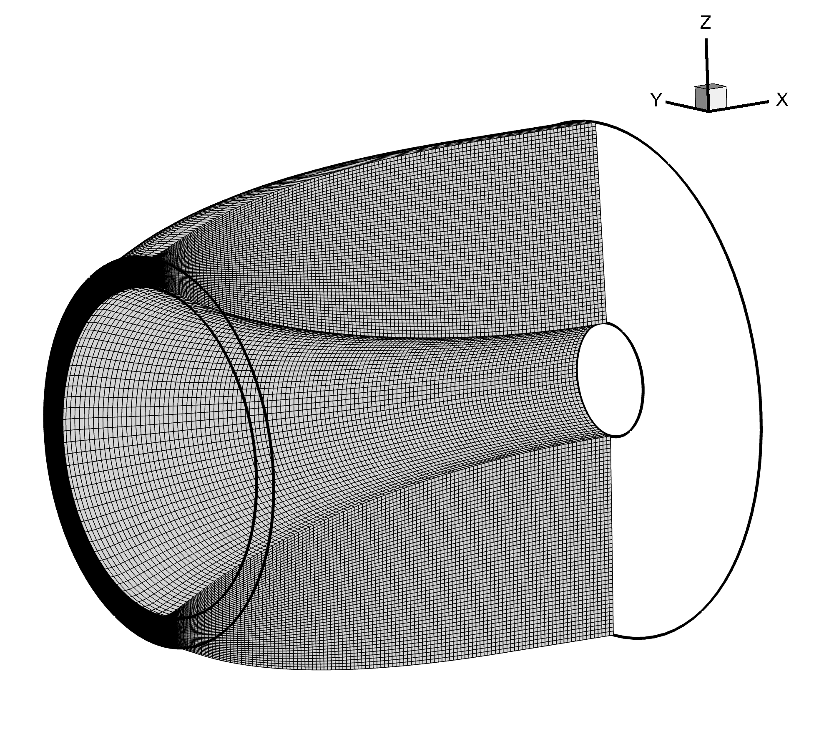
Nozzle Design for RDEs
• Fully non-isentropic three-waves 2D / 2D-axisymmetric MoC solver developed as an in-house API
• Primary application: nozzle design for ideal, TIC and optimized configurations
• Implemented families: ideal (bell, plug, shrouded plug), Rao (optimal bell and plug) and Veen (optimal shrouded plug)
Open questions (and possible research paths)
• Separation dynamics/topology in plug / shrouded plug (effect of rotating oblique shock on incipient separation [3])
• Does an “optimal” profile exist for an RDE exhaust?
• CFD exploration of the theoretical findings in [4]
Optimized shrouded plug
[3] A. J. Harroun, S. D. Heister, J. H. Ruf, “Computational and experimental study of nozzle performance for rotating detonation rocket engines,” J. Propulsion and Power 37(5), 660–673, 2021.
[4] D. P. Stechmann, S. D. Heister, A. J. Harroun, “Rotating detonation engine performance model for rocket applications,” J. Spacecraft and Rockets 56(3), 887–898, 2019.
HEM modeling for subcritical flows in liquid rocket engine cooling systems
18/18

