Slide 1


Rotating Detonation Engine Activities – T(H)RUST
Alessandro Montanari, Marco Grossi, Alex Falco, Francesco Nasuti
ESA Technical Briefing — September 2026 — v1.0
Notes:
SCRIPT: Good morning. This is the rotating-detonation work of the T(H)RUST group at Sapienza - Montanari, Grossi, Falco, Nasuti. Today: the group's full-engine RDE activity, and then, in depth, the nozzle design programme and what we are asking of you.
[PROVENANCE] Host-group title slide (Heister deck S1); form-only edits: frontmatter line with version/date/venue (audit criterion (n)); master defaults cleaned (fix 3).

Slide 2
Research Roads
Group Overview
“Newborn” RDE activity
Numerical focus
International network
About 1.5 years of active R&D on Rotating Detonation Engines
URANS / low-order in-house modelling of RDEs, oriented to industrially-relevant challenges
Joint RDE activities with BEFAST Lab (NC State, Prof. James Braun), RMIT (Quentin Michalski) and ISAE-ENSMA (Prof. Marc Bellenoue)
HYPERDE
Open research lines
A hybrid-dimensional CFD modelling framework that solves chamber, injector, plenum and expansion with a consistent low-order formulation
Study of hot topics of the RDE community: refill region, supersonic bladeless turbines, disk RDEs, nozzle design (→ dedicated section today), heat flux
Notes:
SCRIPT: Five research roads, one framework underneath. Everything you will hear today is numerical, oriented to industrially relevant questions, and run with an international network - NC State, RMIT, ISAE-ENSMA. The 'nozzle design' line in the open-research card is the one we expand today in a dedicated section.
[PROVENANCE] Host-group slide (Heister S2), content invariant; form fixes: 'Belleonue'->'Bellenoue' (fix 6), open-lines card carries pointer to the nozzle section (fix 9).

Slide 3
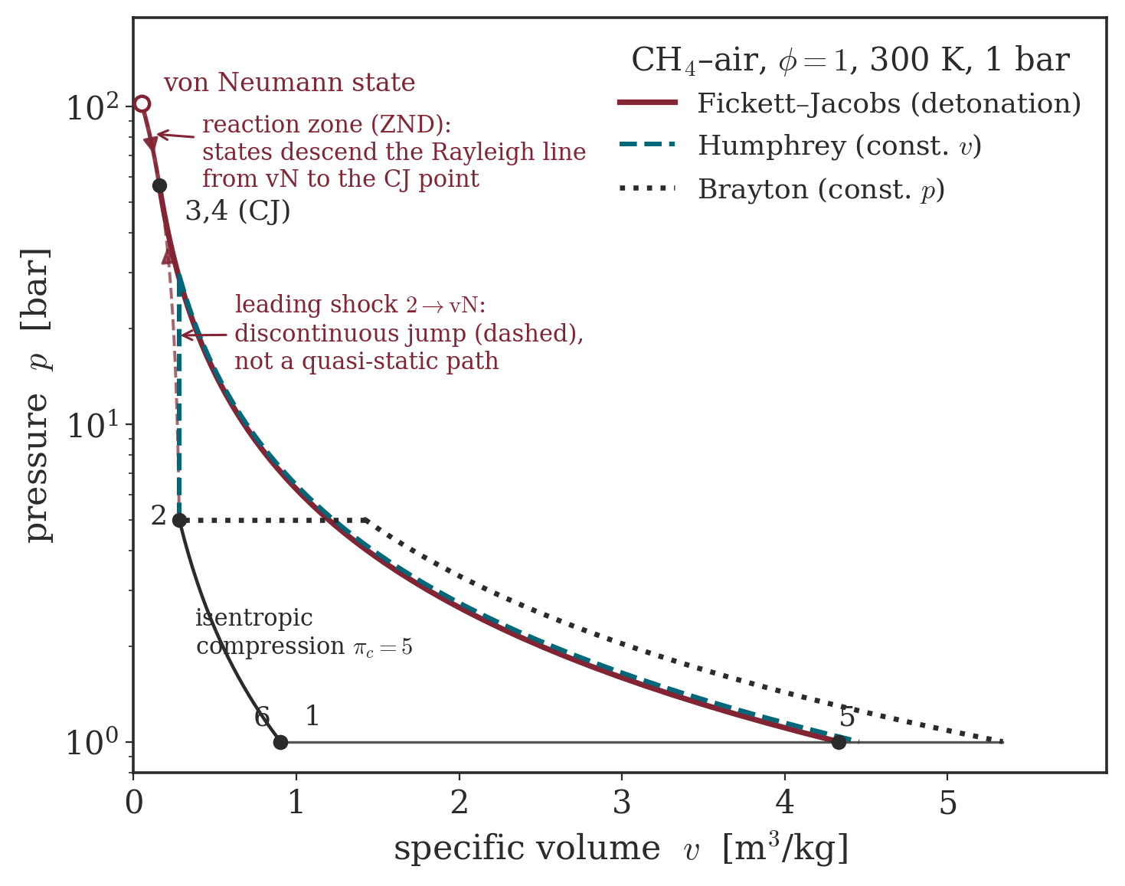
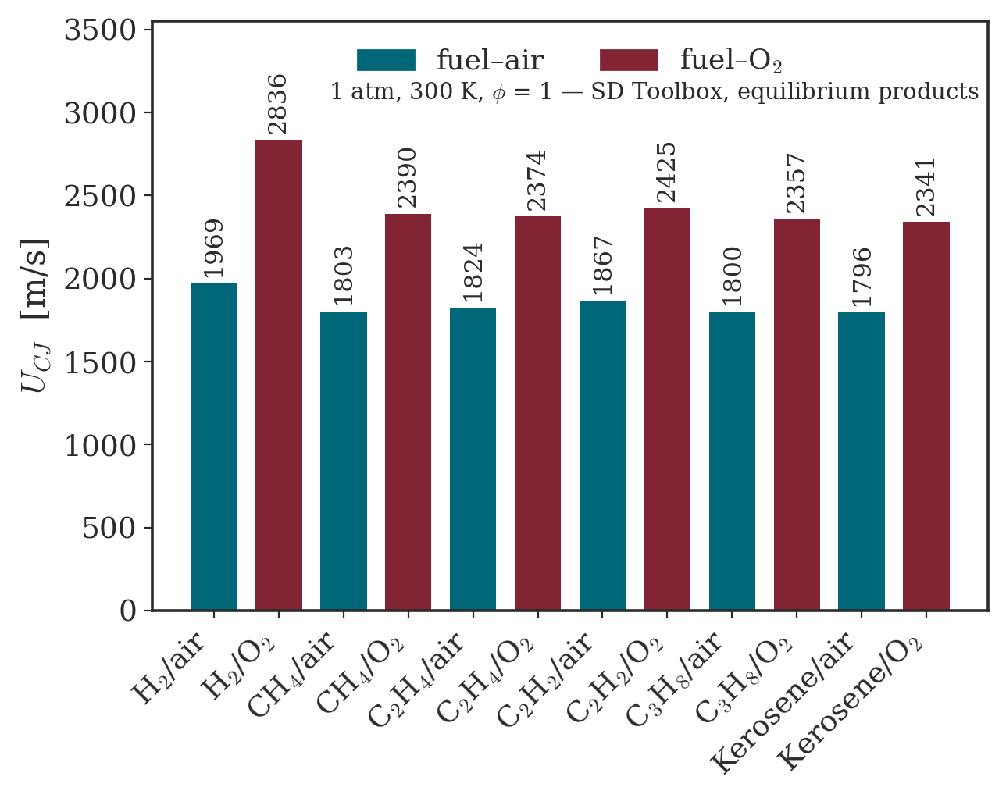
Detonation compresses by itself: pressure-gain combustion
p–v plane: Brayton vs Humphrey vs detonation (FJ) cycles — group figure
CJ speeds across fuels — group figure
• Near-constant-volume burn: pressure rises without a compressor.
• Higher ideal efficiency at the same pre-compression.
Rotating Detonation Engine Activities
T(H)RUST team
13/29
Notes:
SCRIPT: For anyone new to detonation engines: a deflagration burns at roughly constant pressure - you pay a compressor for every bar. A detonation burns so fast the volume cannot follow: the burn itself compresses. On the p-v plane the detonation cycle encloses more work at the same pre-compression. That thermodynamic premium - pressure-gain combustion - is what the whole field is chasing.
[PROVENANCE] Primer class: standard literature material already validated in the group's CVA lecture deck (figures of the house pipeline: fig_cycles_pv, fig_ucj_bar; every number in them traced to committed scripts in that pipeline). Zero new claims (v1 A6 NOTA CLASSE).
[GUARD 18] cycle-efficiency numbers live in the figure annotations (physical numbers), none of our programme accounting here.

Slide 4
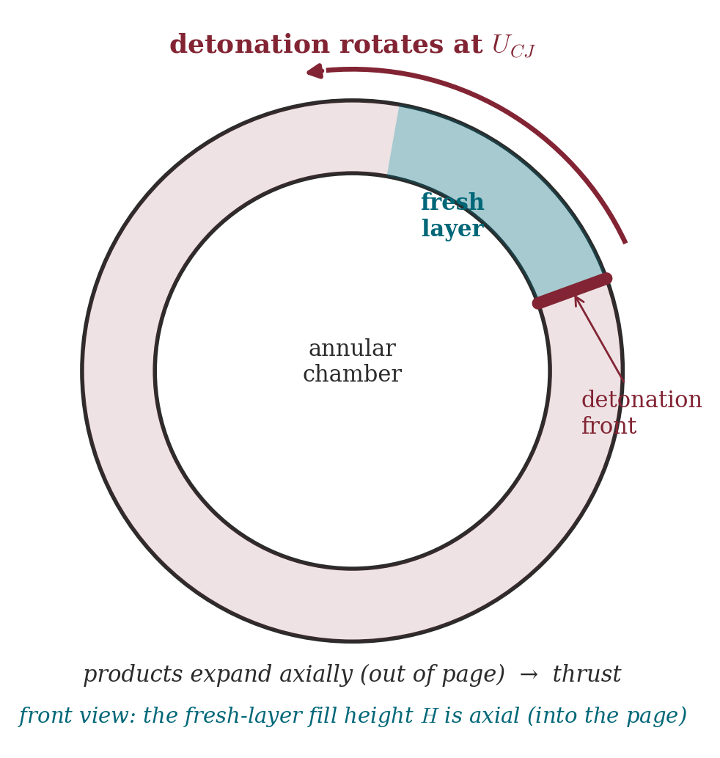
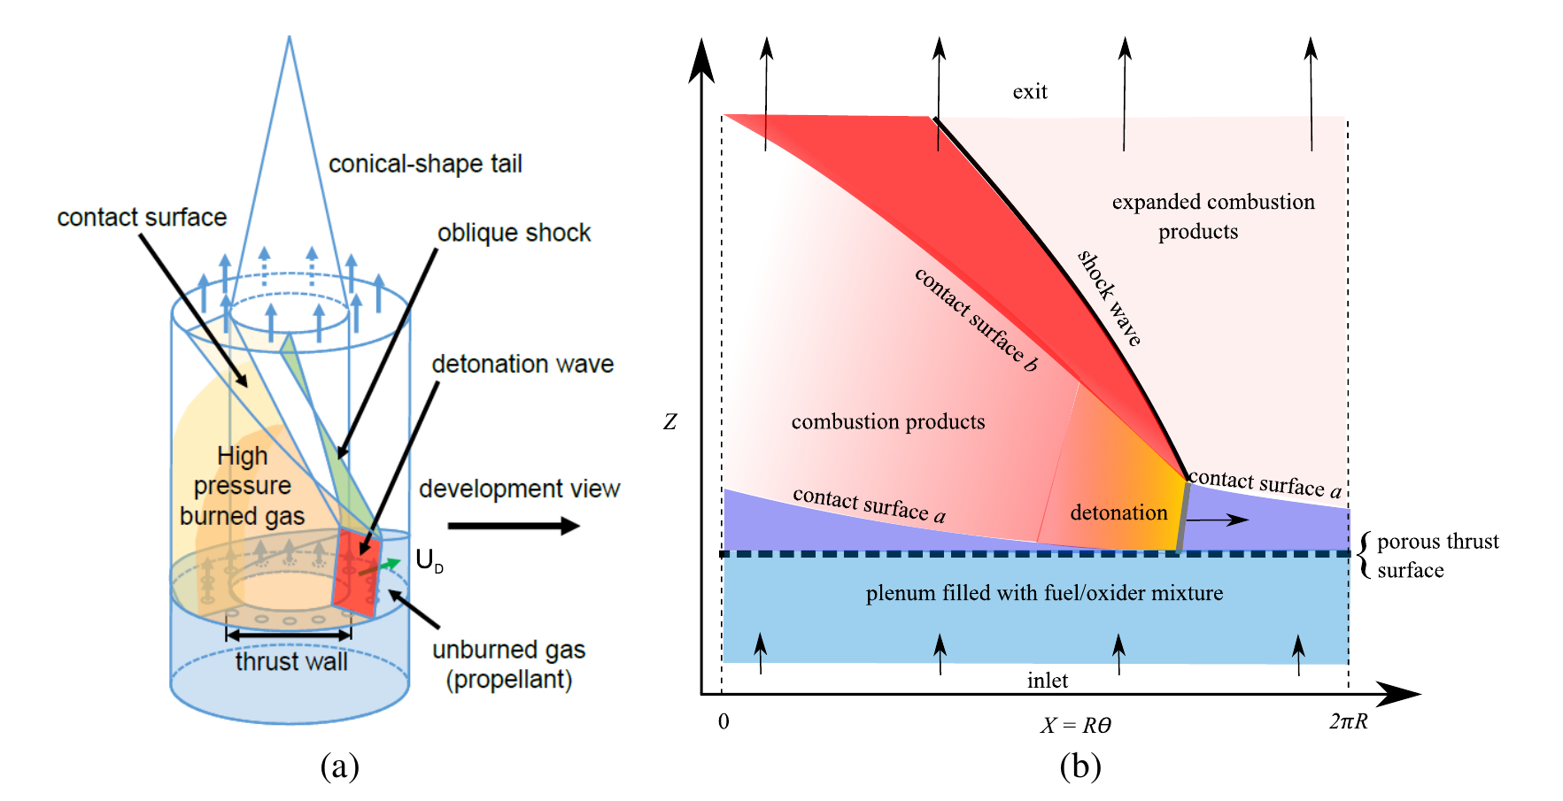
The RDE: a detonation made steady in a rotating frame
Annular RDE: rotating front, continuous refill — group figure
Unwrapped RDE flowfield — Shepherd & Kasahara, GALCIT FM2017.001 (2017)
• A front rotates at near-CJ speed (kHz); continuous refill behind it.
• Axial, continuous exhaust — no valves.
Rotating Detonation Engine Activities
T(H)RUST team
13/29
Notes:
SCRIPT: The RDE traps that premium in a ring. The front rotates at nearly the Chapman-Jouguet speed - several kilohertz around a typical annulus - while injection refills continuously behind it. In the frame rotating with the wave the picture is steady. Keep that sentence: it is the seed of everything in the nozzle section.
[PROVENANCE] Primer class, standard material validated in the CVA deck. Right figure: paper crop, full citation on slide, CT-6 (shown for discussion, not re-derived). The 'steady in the rotating frame' seed anticipates C8's exact-quotient claim - stated here only phenomenologically (fluency seeding, CKP-S2-4).

Slide 5
Code Development and Capabilities
HYPERDE (HYbrid-dimensional PERformance-predictive numerical framework for Rotating Detonation Engines)
Rationale: each engine subsystem is solved at its most informative dimensionality
Chamber
Plenum
3D / Q2D (unwrapped)
3D / Q2D
Fully 3D or “unwrapped” Q2D URANS/Eulerian solver for the annular chamber
Fully 3D (2D for unwrapped) solver for the upstream feed plenum
Injectors
Expansion System
3D / Q2D / Eulerian quasi-1D
3D URANS / Q2D chamber coupling
Quasi-1D solver captures the longitudinal transient response in strongly injector-coupled cases
3D URANS solver coupled with the chamber 3D/Q2D exhaust (choked and unchoked outflows)
3/29
Notes:
SCRIPT: HYPERDE in one picture: each subsystem solved at its most informative dimensionality - 3D or unwrapped quasi-2D chamber, quasi-1D injectors when the coupling is longitudinal, 3D URANS expansion - inside one consistent formulation.
[PROVENANCE] Host slide (Heister S3); form-only: card text lightened toward the ≤60-word budget, no content removed.

Slide 6
Code Development and Capabilities
General features of the solvers’ suite
• Finite volume method
• Flexible pre-processing tool, full integration with .yaml chemical datasets
• II order in space, up to III order in time
• Strong CPU parallelization (OpenMP + MPI)
• Several turbulence models (easily extendable; strong modularity)
• Lots of degrees of freedom on numerics: Riemann solvers, integrated quantities, stiff chemical ODE solver, …
• Tabulated thermo properties, thermally perfect gas
+
• Interface with other in-house solvers (solid, multiphase, real-fluid)
4/29
Notes:
SCRIPT: The solver suite under it: finite volume, second order in space, up to third in time; tabulated thermally-perfect thermo; turbulence models swappable; OpenMP plus MPI; interfaces to the in-house solid, multiphase and real-fluid solvers.
[PROVENANCE] Host slide (Heister S4), content invariant, text tightened (v1: 'testo asciugato').

Slide 7
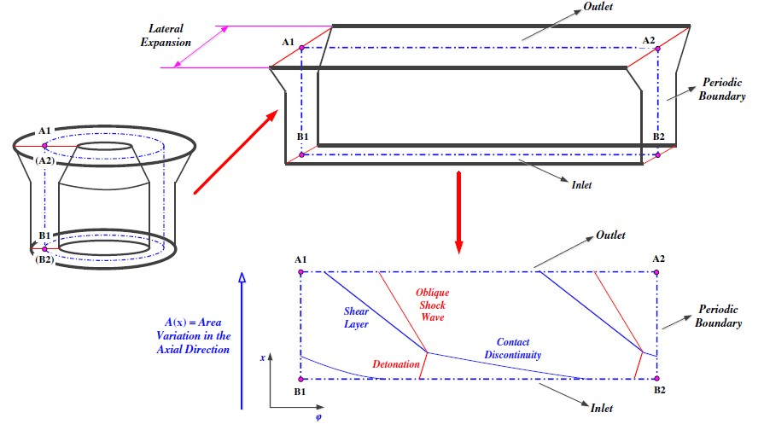
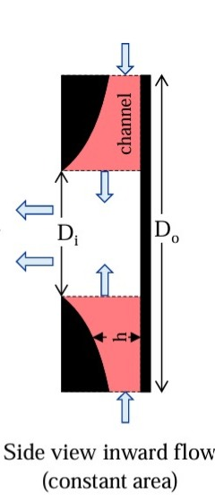
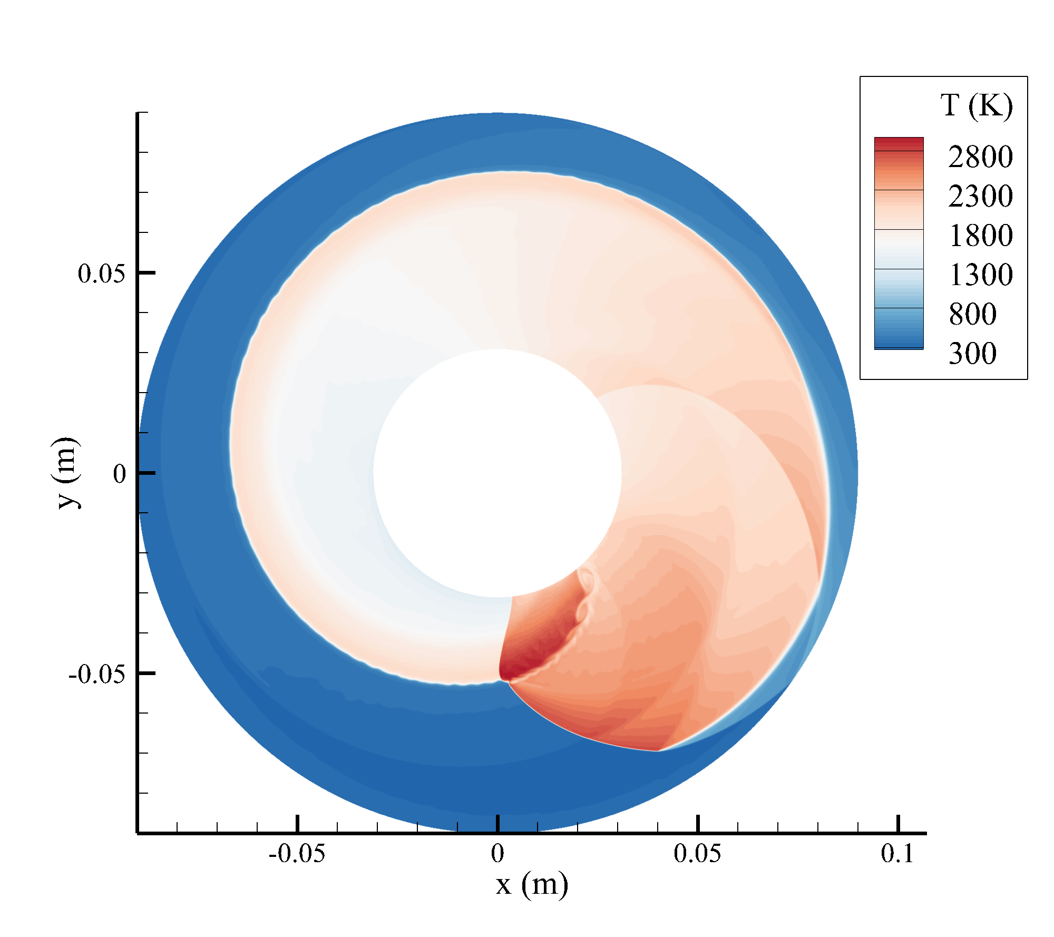
Code Development and Capabilities
Q2D solver — innovation w.r.t. recent literature
• Rigorous treatment of diffusive fluxes and generic RANS equations
• General derivation with z = z(x,y) — valid for generic width variations
• Adaptation to CFD of the non-isentropic BFS boundary condition [1]
[1] Fievisohn & Yu, “Steady-state analysis of RDE flowfields with the method of characteristics,” J. Propulsion and Power 33(1), 89–99, 2017.
5/29
Notes:
SCRIPT: Where the quasi-2D solver goes beyond recent literature: rigorous diffusive fluxes and generic RANS closure, a general z(x,y) width law, and the non-isentropic backward-facing-step boundary condition adapted from Fievisohn & Yu's method-of-characteristics analysis.
[PROVENANCE] Host slide (Heister S5); citation [1] Fievisohn & Yu JPP 33(1) 2017 already on slide. Note for Q&A: Fievisohn's wave-frame MoC is also the closest ancestor of our per-phase view - that thread returns in the nozzle section (C7-bis-pre).

Slide 8
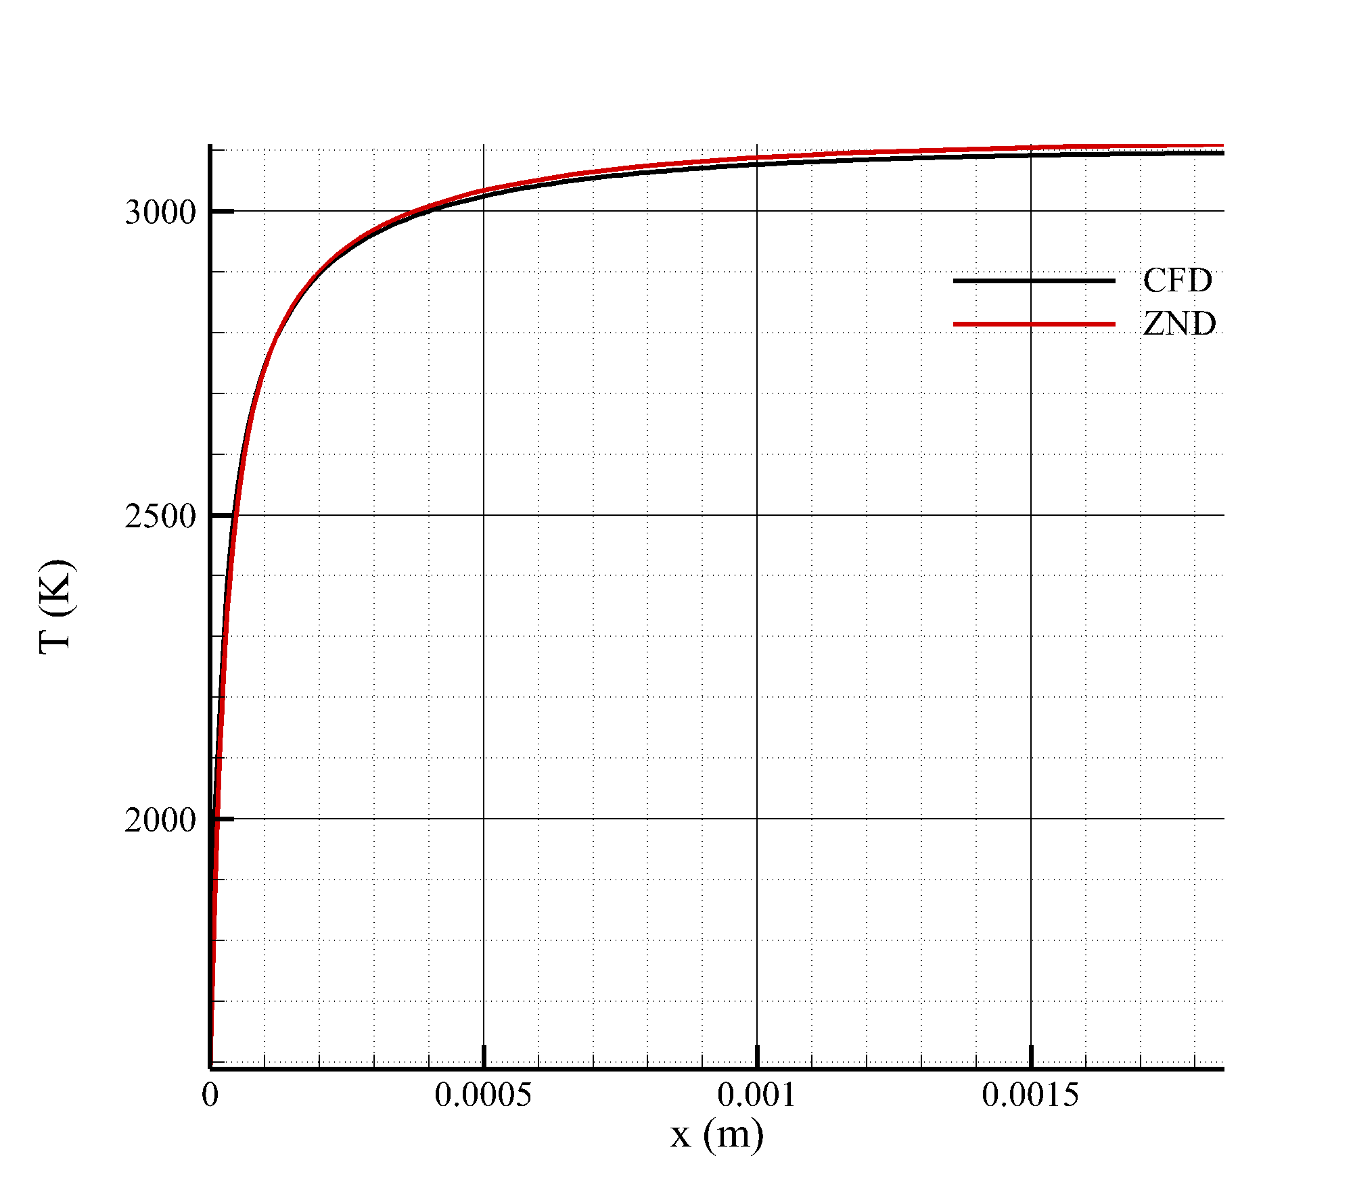
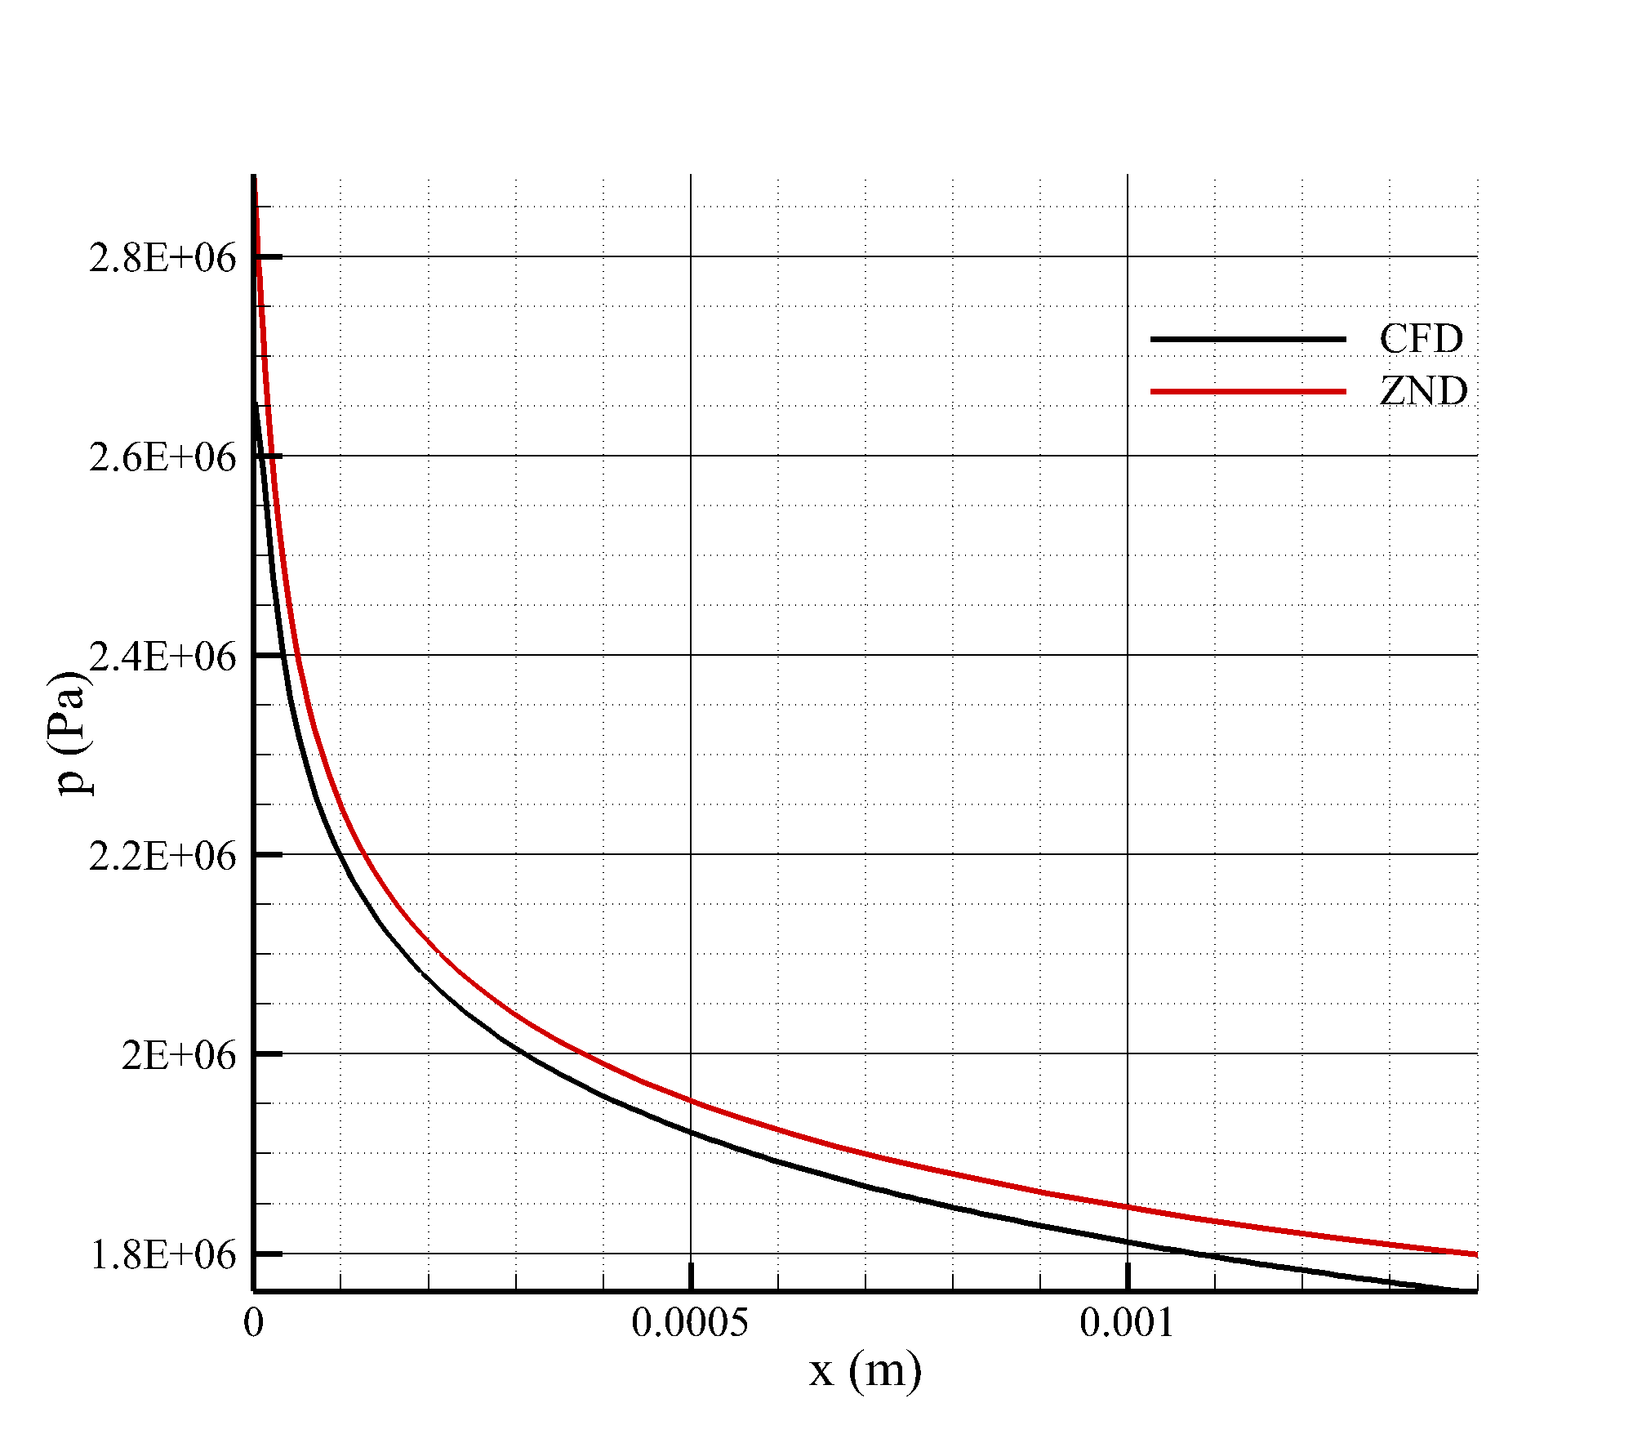
Code Development and Capabilities
V&V
• Validation against 1D ZND H2/Air detonation from SDT
6/29
Notes:
SCRIPT: Verification and validation, first rung: the chamber solver against 1-D ZND structure from the Shock & Detonation Toolbox - overlaid profiles.
[PROVENANCE] Host V&V slide (Heister S6), invariant.

Slide 9
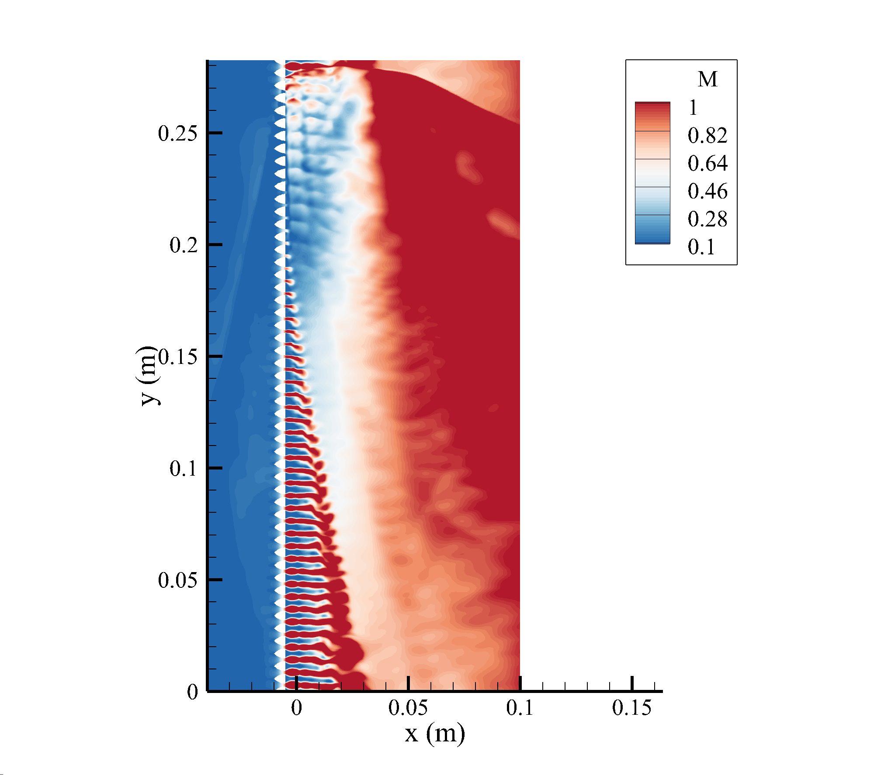
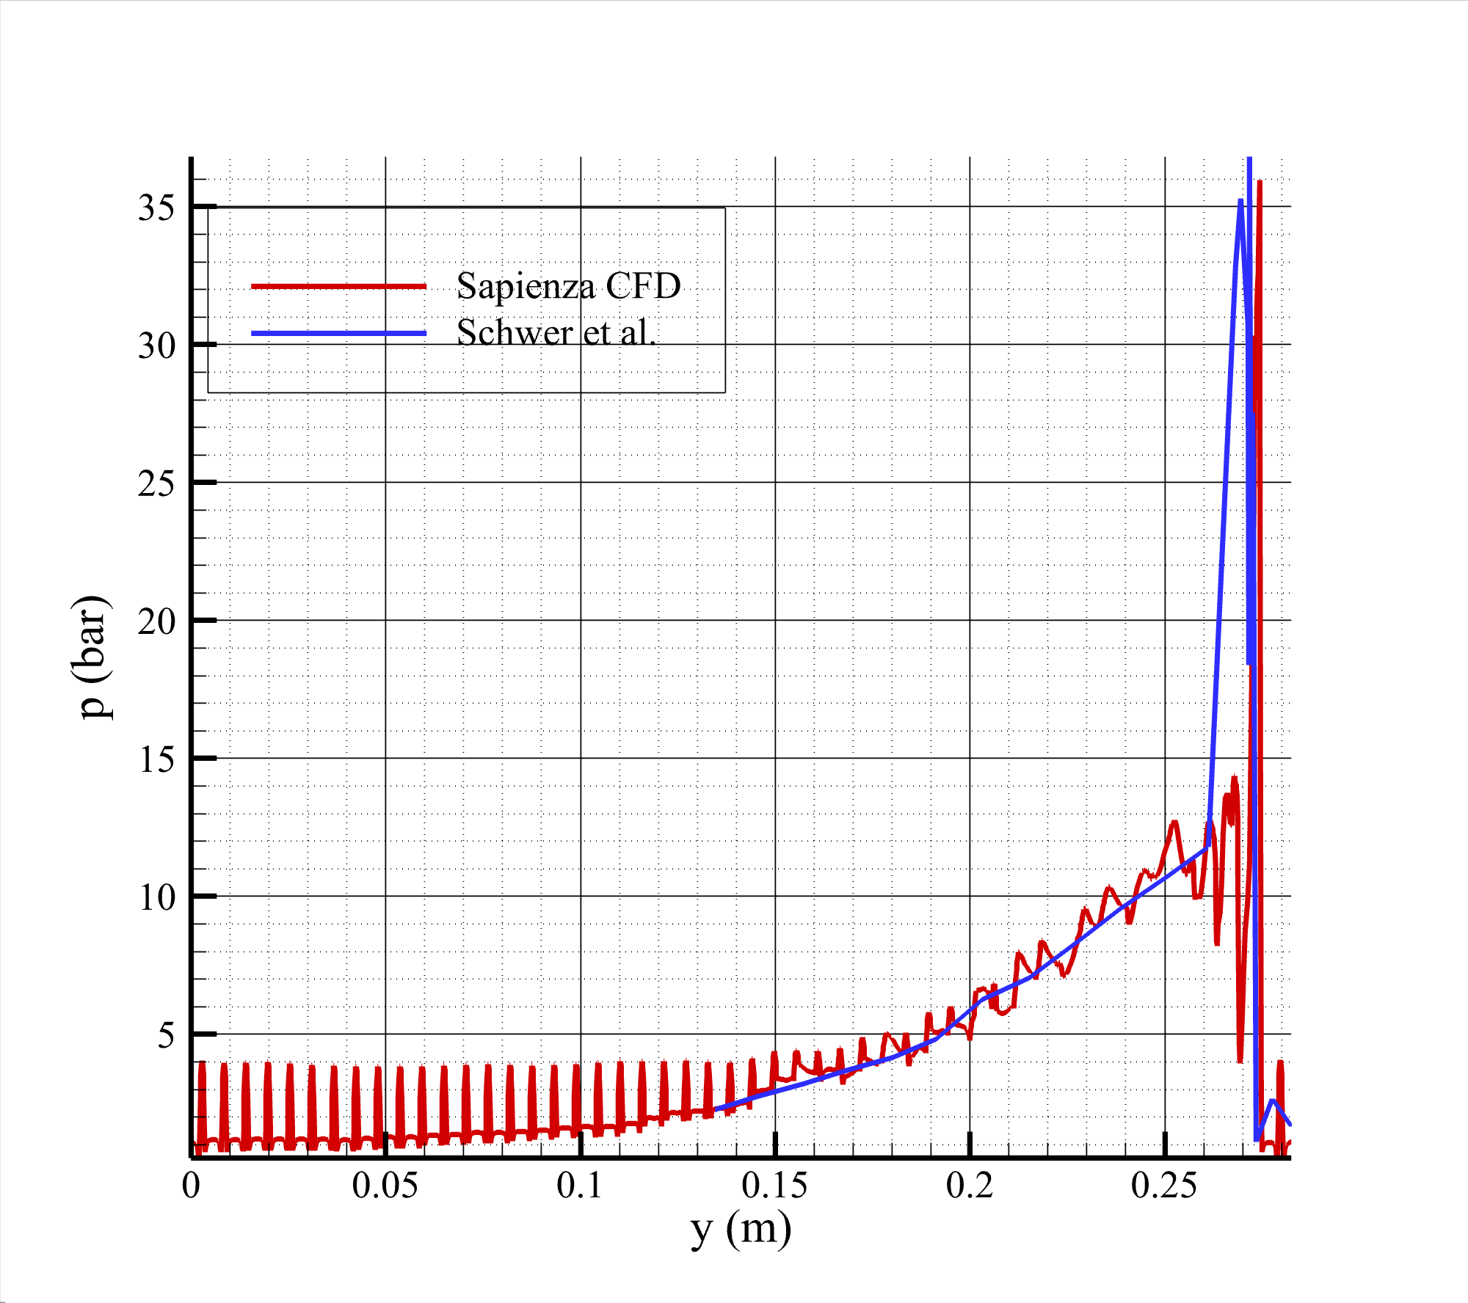
Code Development and Capabilities
V&V
• Validation against “unwrapped” literature test cases [2]
[2] D. Schwer and K. Kailasanath, “Feedback into mixture plenums in rotating detonation engines,” 50th AIAA Aerospace Sciences Meeting, 2012.
7/29
Notes:
SCRIPT: Second rung: unwrapped literature test cases - Schwer & Kailasanath's plenum-feedback configuration - reproduced.
[PROVENANCE] Host V&V slide (Heister S7), invariant; citation [2] on slide.

Slide 10
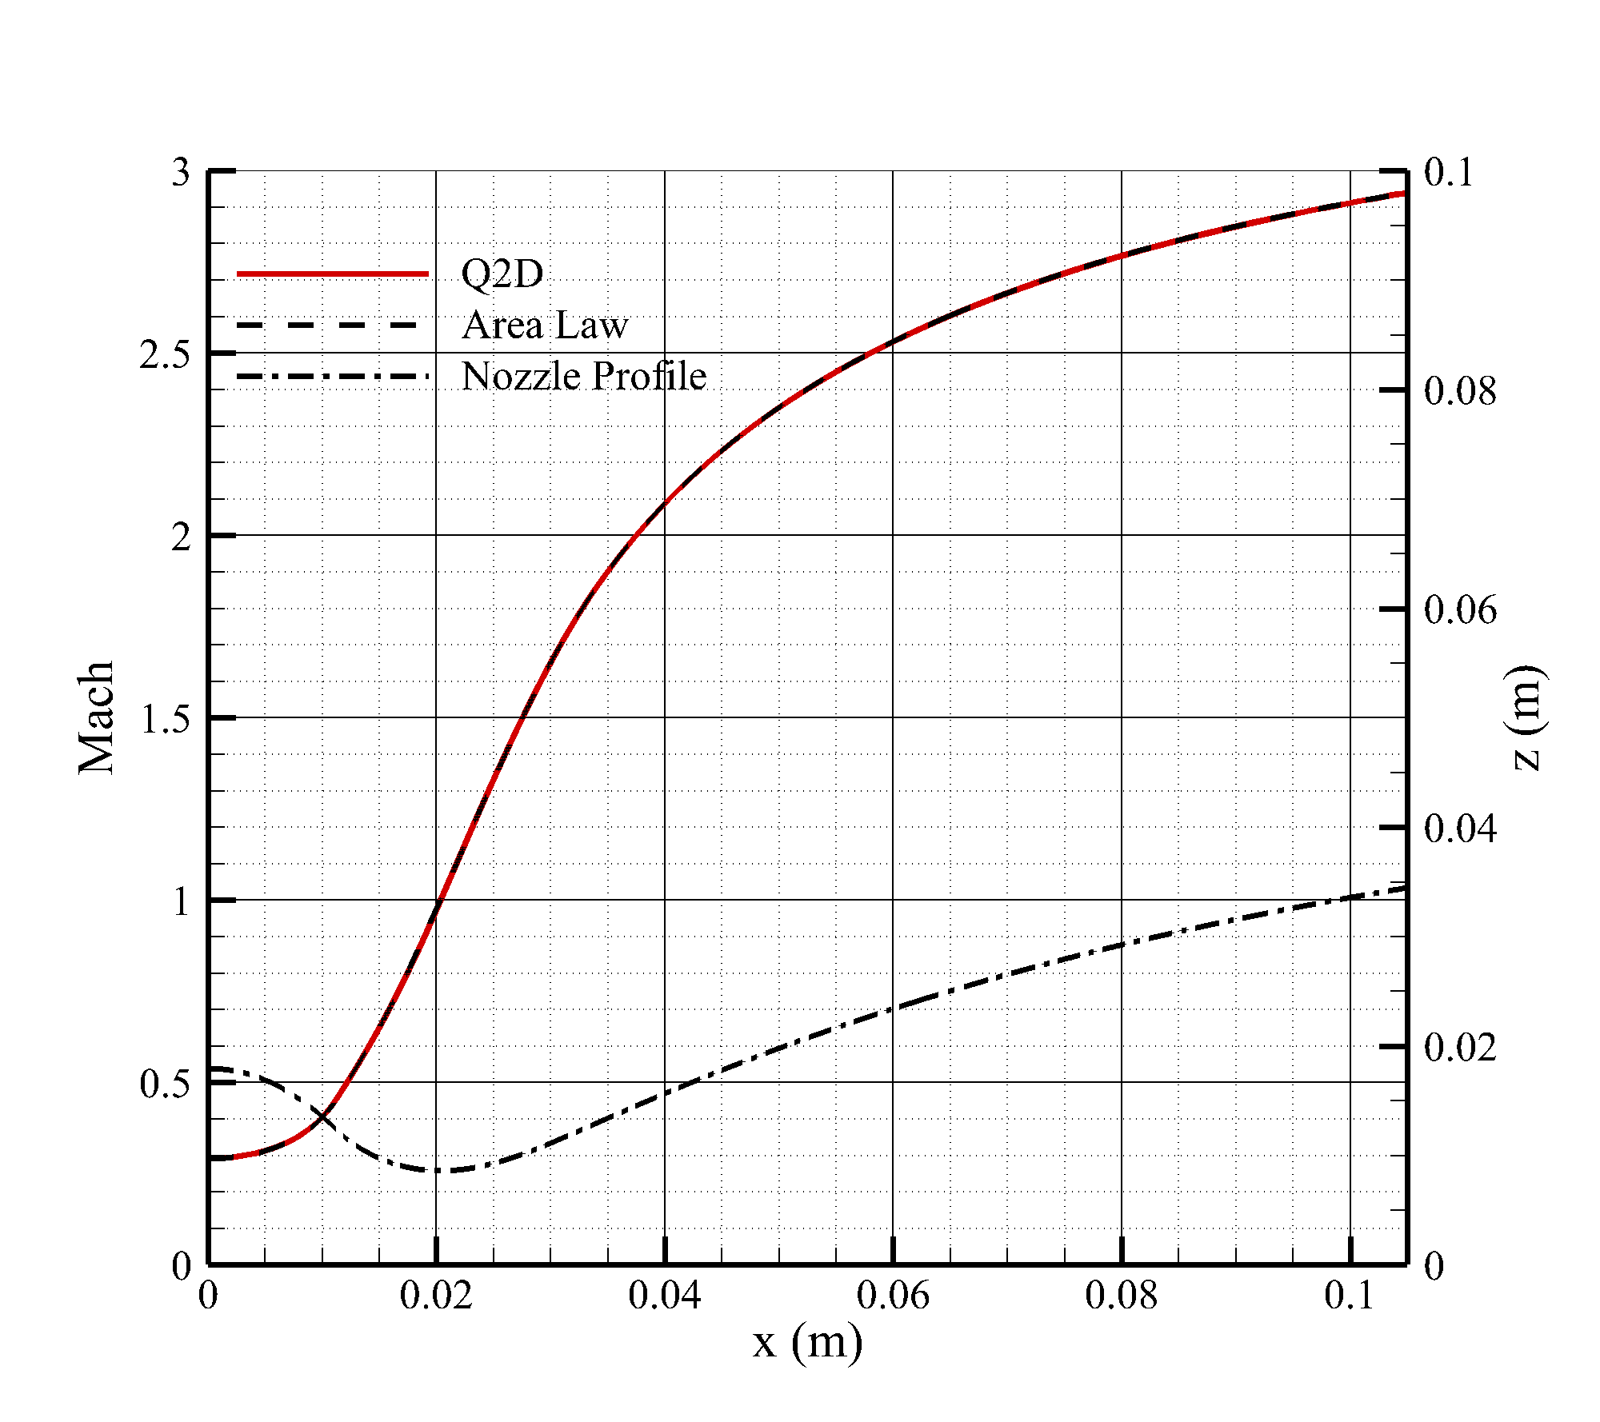
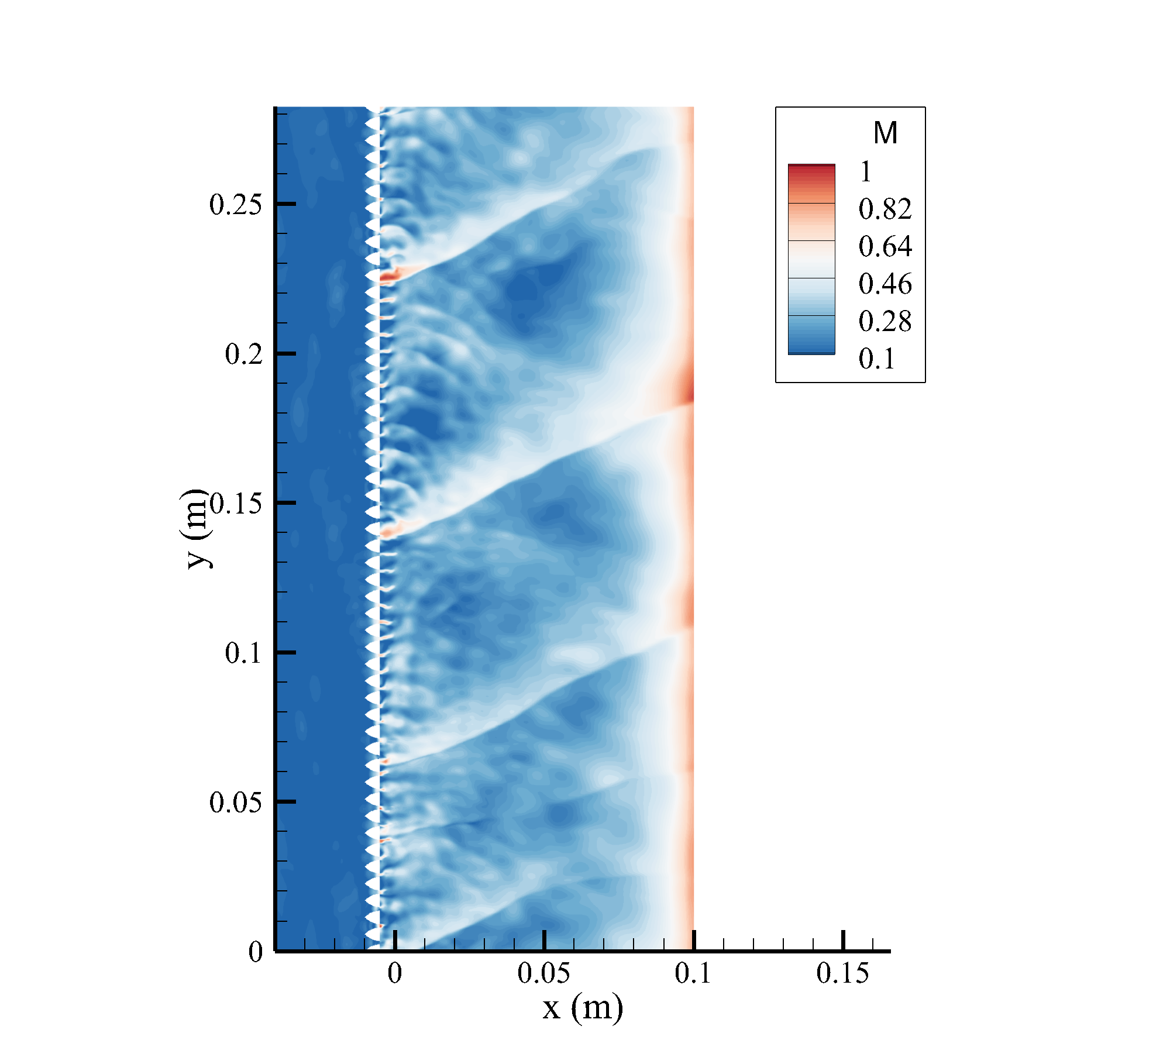
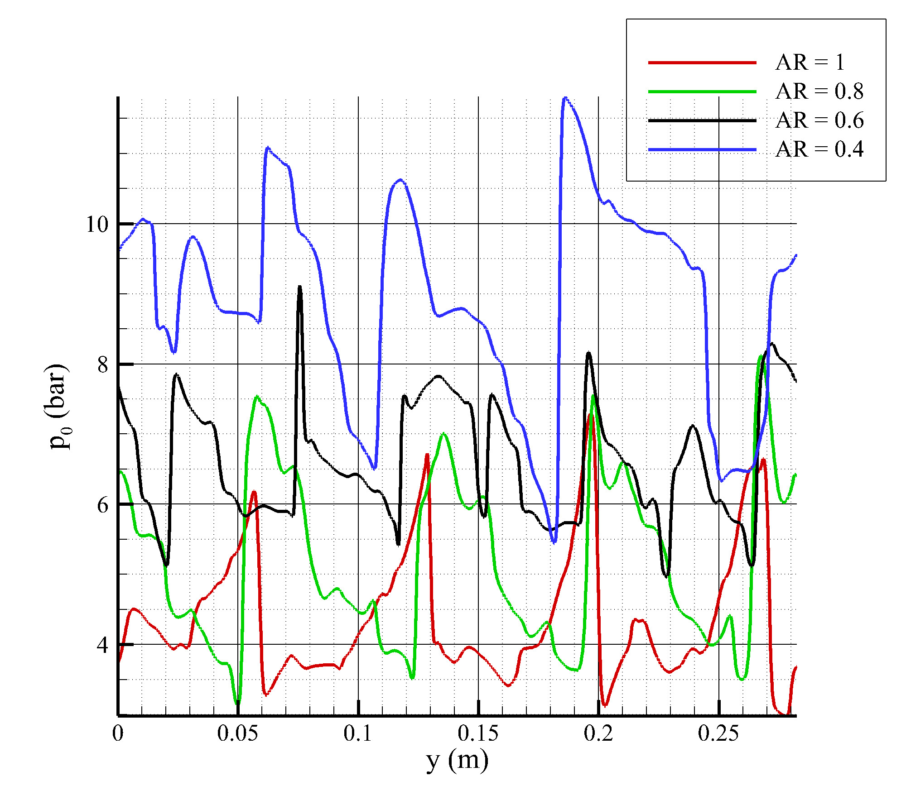
Code Development and Capabilities
V&V
• Extensive assessment of HYPERDE features (Q2D source terms, Q1D injectors-chamber, Q2D-3D connection)
AR = 0.4
8/29
Notes:
SCRIPT: Third rung, HYPERDE-specific features. Here the quasi-2D source terms: Mach field and stagnation-pressure traces across aspect ratios against the resolved reference.
[PROVENANCE] Host V&V slide (Heister S8). DECLARED authoring decision (v1 A12 clause): the S8+S9 fusion was measured against the 3-metre legibility criterion and REJECTED - six dense plots on one 16:9 slide push axis labels below readable size; the two slides stay (A12a/A12b), the minute is recovered on the A14-A20 pace as budgeted in v3.1.

Slide 11
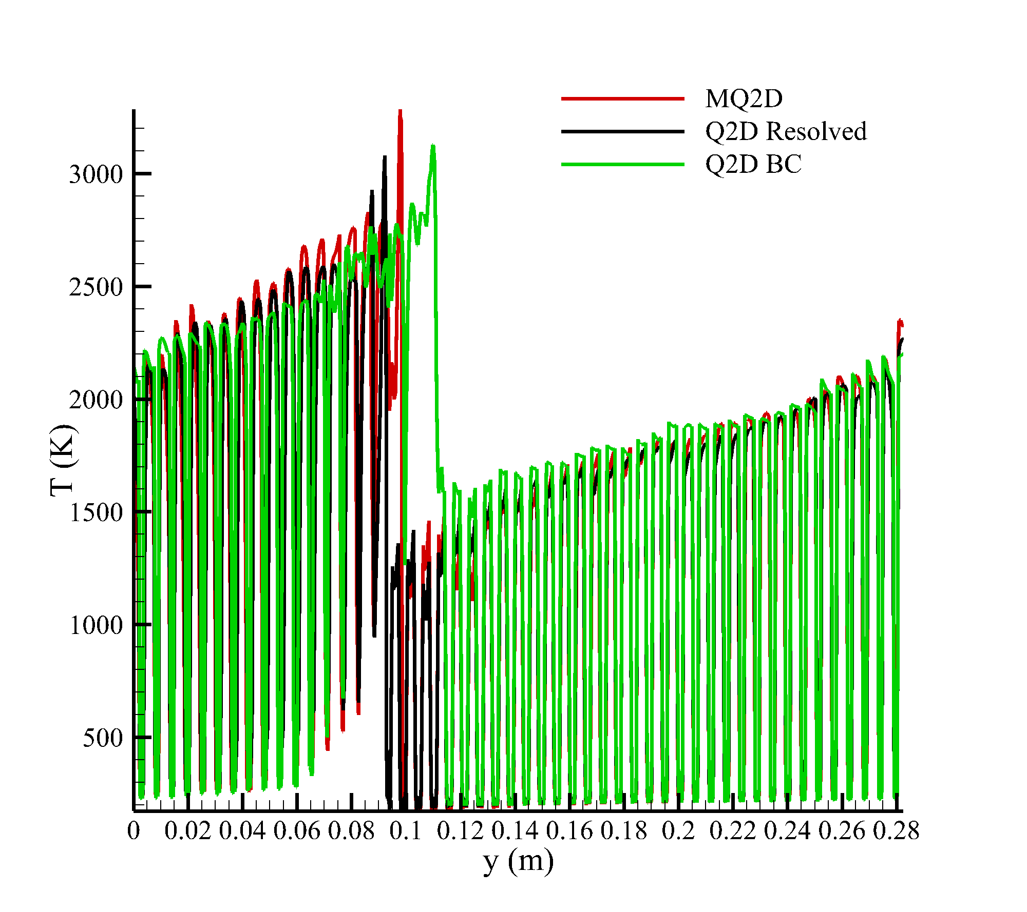
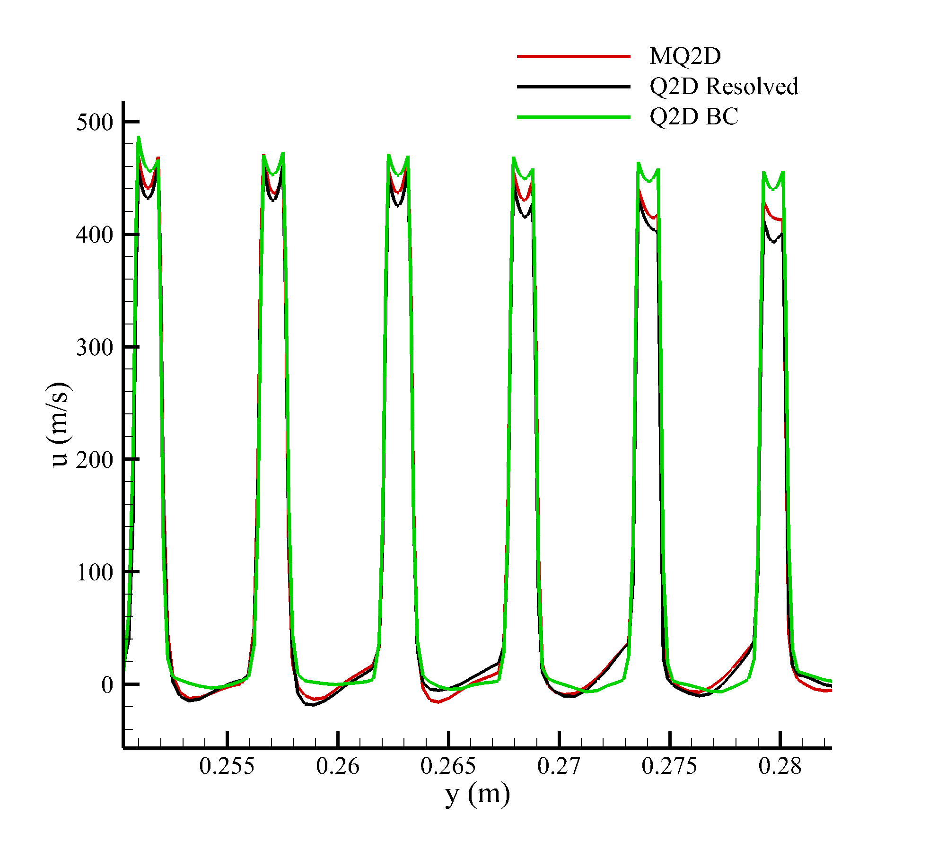
Code Development and Capabilities
V&V
• Extensive assessment of HYPERDE features (Q2D source terms, Q1D injectors-chamber, Q2D-3D connection)
9/29
Notes:
SCRIPT: And the quasi-1D injector-chamber coupling: temperature and velocity profiles, modelled versus resolved versus boundary-condition-only - the three collapse.
[PROVENANCE] Host V&V slide (Heister S9); see A12a note for the declared fusion decision.

Slide 12
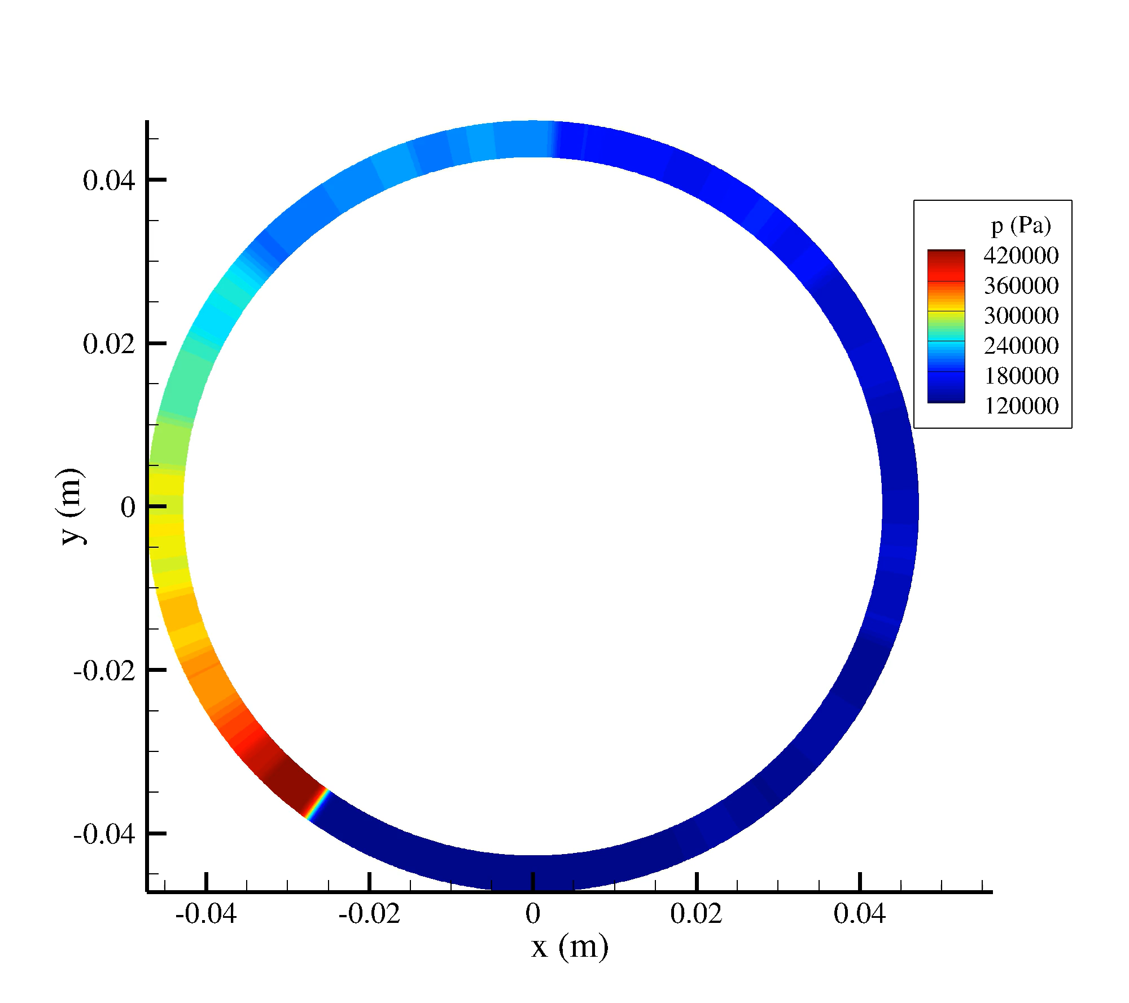
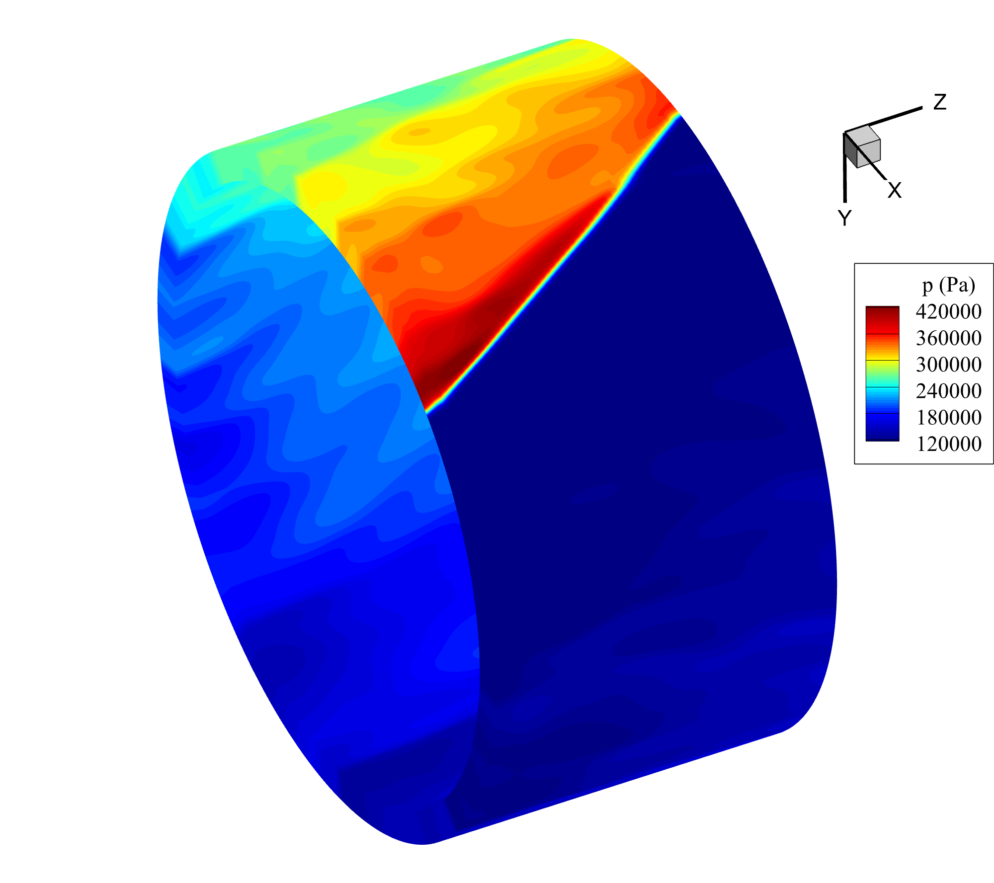
Code Development and Capabilities
V&V
• Extensive assessment of HYPERDE features (Q2D source terms, Q1D injectors-chamber, Q2D-3D connection)
10/29
Notes:
SCRIPT: Fourth rung: quasi-2D to full-3D connection - and the 26-second video of the coupled solution. [PLAY VIDEO]
[PROVENANCE] Host V&V slide (Heister S10), media preserved.

Slide 13
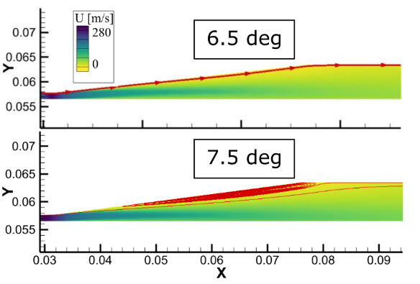
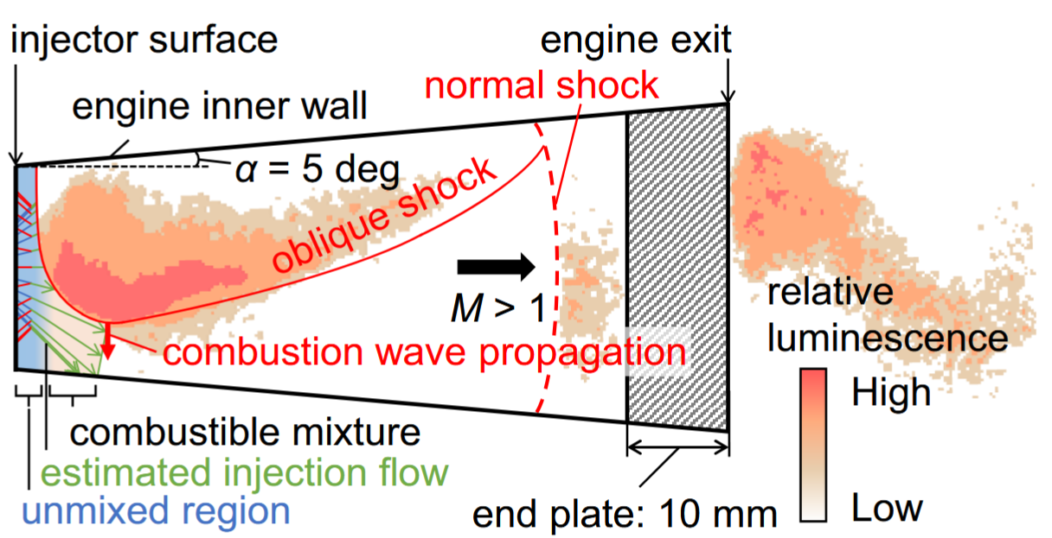
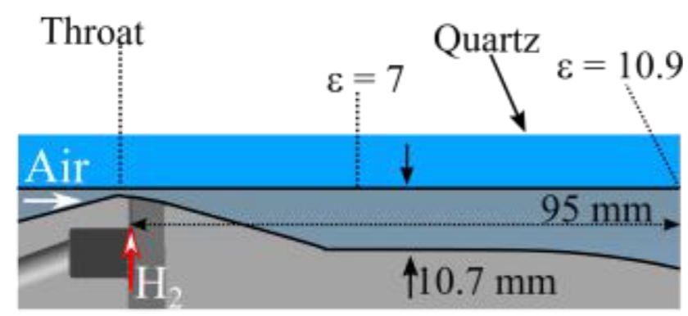
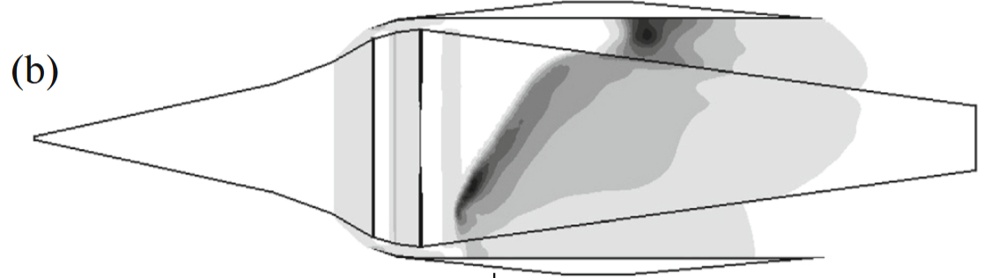



Characterization of Refill Region Dynamics (with RMIT and NCSU)
Understanding physics of RDE refill regions with diverging inlets
Introduced to mitigate separation losses associated with backward-facing steps
Experimental and numerical evidence instead reports degraded overall performance
How does the geometry affect the refill region expansion process?
What happens if/when expansion yields supersonic Mach number in the layer?
Can the process be modelled?
How does the overall phenomenology impact the stagnation pressure losses?
$$\vec{y}$$
$$\vec{x}$$
$$\vec{z}$$
11/29
Notes:
SCRIPT: The refill region, with RMIT and NC State: four questions on how geometry shapes the refill expansion - and the counter-intuitive datum that diverging inlets, introduced to cut step losses, degrade overall performance instead.
[PROVENANCE] Host slide (Heister S11); form fix 5: the off-canvas text box ('Inlet extension added for supersonic cases') removed from the canvas - its content preserved here: the inlet extension is added for the supersonic cases of the sweep.

Slide 14
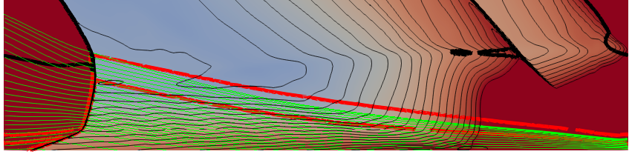
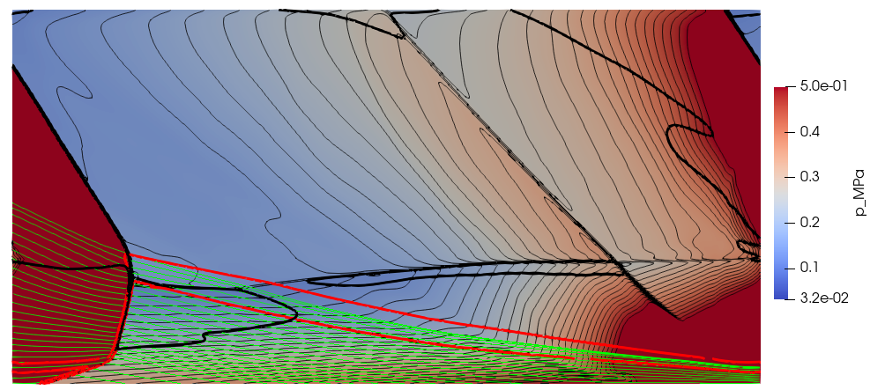
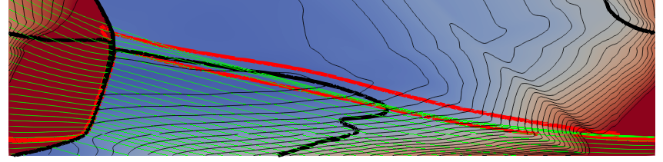
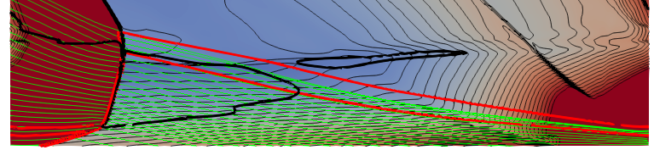
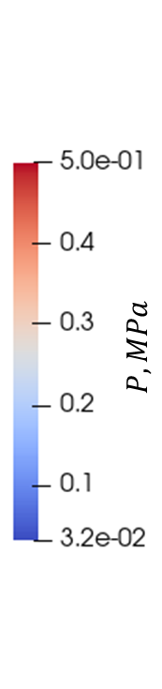
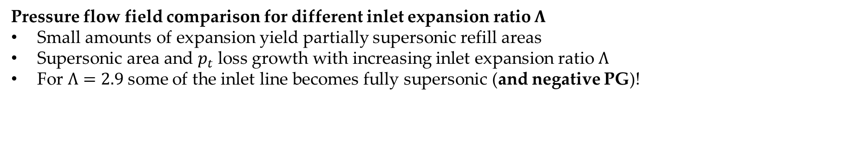
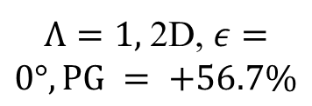
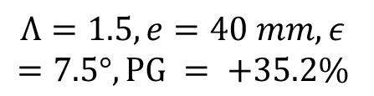
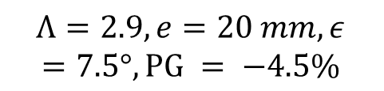
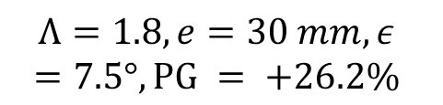




Characterization of Refill Region Dynamics
Pressure flow field comparison for different inlet expansion ratio $Λ$
Small amounts of expansion yield partially supersonic refill areas
Supersonic area and $p_{t}$ loss growth with increasing inlet expansion ratio $Λ$
For $Λ=2.9$some of the inlet line becomes fully supersonic (and negative PG)!
$$p_{t}=5 bar$$
$T_{t}=330 K$
premixed $H_{2}/air$
$$φ=1$$
$Λ=1,$ 2D, $ε=0°, PG = +56.7\%$
$$Λ=1.5,e=40 mm, ε=7.5°,PG = +35.2\%$$
$$Λ=2.9,e=20 mm, ε=7.5°,PG = −4.5\%$$
$$Λ=1.8,e=30 mm, ε=7.5°,PG = +26.2\%$$
Inlet line
$$M=1$$
$$φ=0.99$$
$$φ=0.2$$
12/29
Notes:
SCRIPT: The wave-number sweep: stagnation-pressure losses grow with Λ; at Λ = 2.9 the inlet turns entirely supersonic and the pressure gain goes negative.
[PROVENANCE] Host slide (Heister S12); form fix 4: native heading added (Λ as native text in the template font - no raster heading).

Slide 15
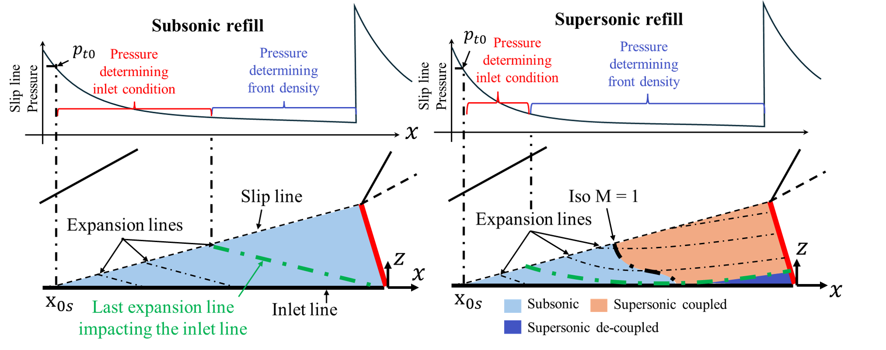
Characterization of Refill Region Dynamics
13/29
Notes:
SCRIPT: The group's synthesis model of the refill region: the subsonic/supersonic expansion picture in one figure.
[PROVENANCE] Host slide (Heister S13), invariant.

Slide 16
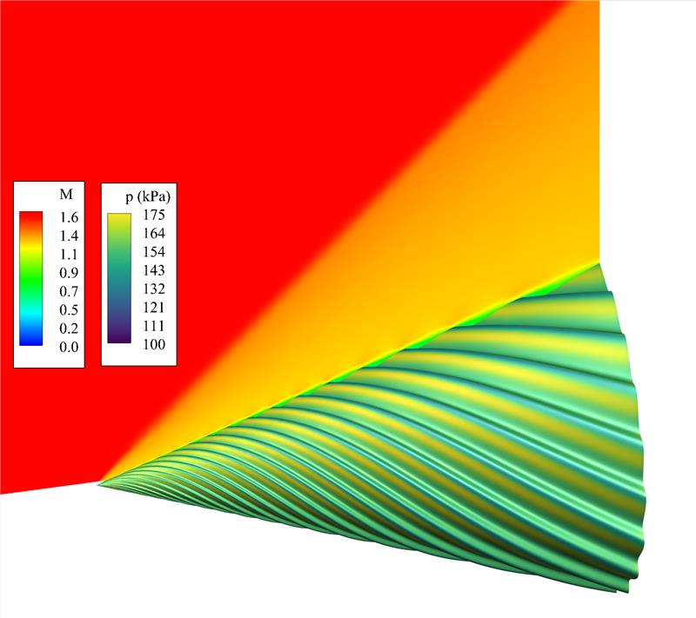
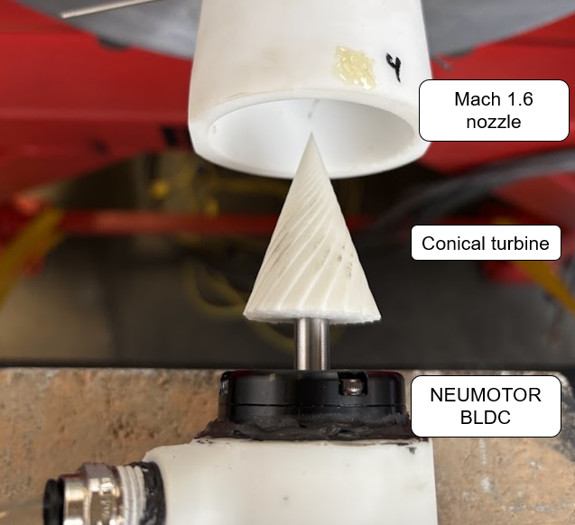
Supersonic Bladeless Turbines (with NCSU)
CFD based design of NCSU supersonic wind tunnel
Capability up to Mach 4 for steady non-reactive flow
Swappable nozzle and second-throat diffuser system allowing for low feed pressure
Numerical analysis of phenomenology and working principle of bladeless turbines
14/29
Notes:
SCRIPT: Supersonic bladeless turbines with NC State: CFD-designed Mach-4 wind tunnel, swappable nozzle and second-throat diffuser - real hardware, real photographs.
[PROVENANCE] Host slide (Heister S14), invariant.

Slide 17
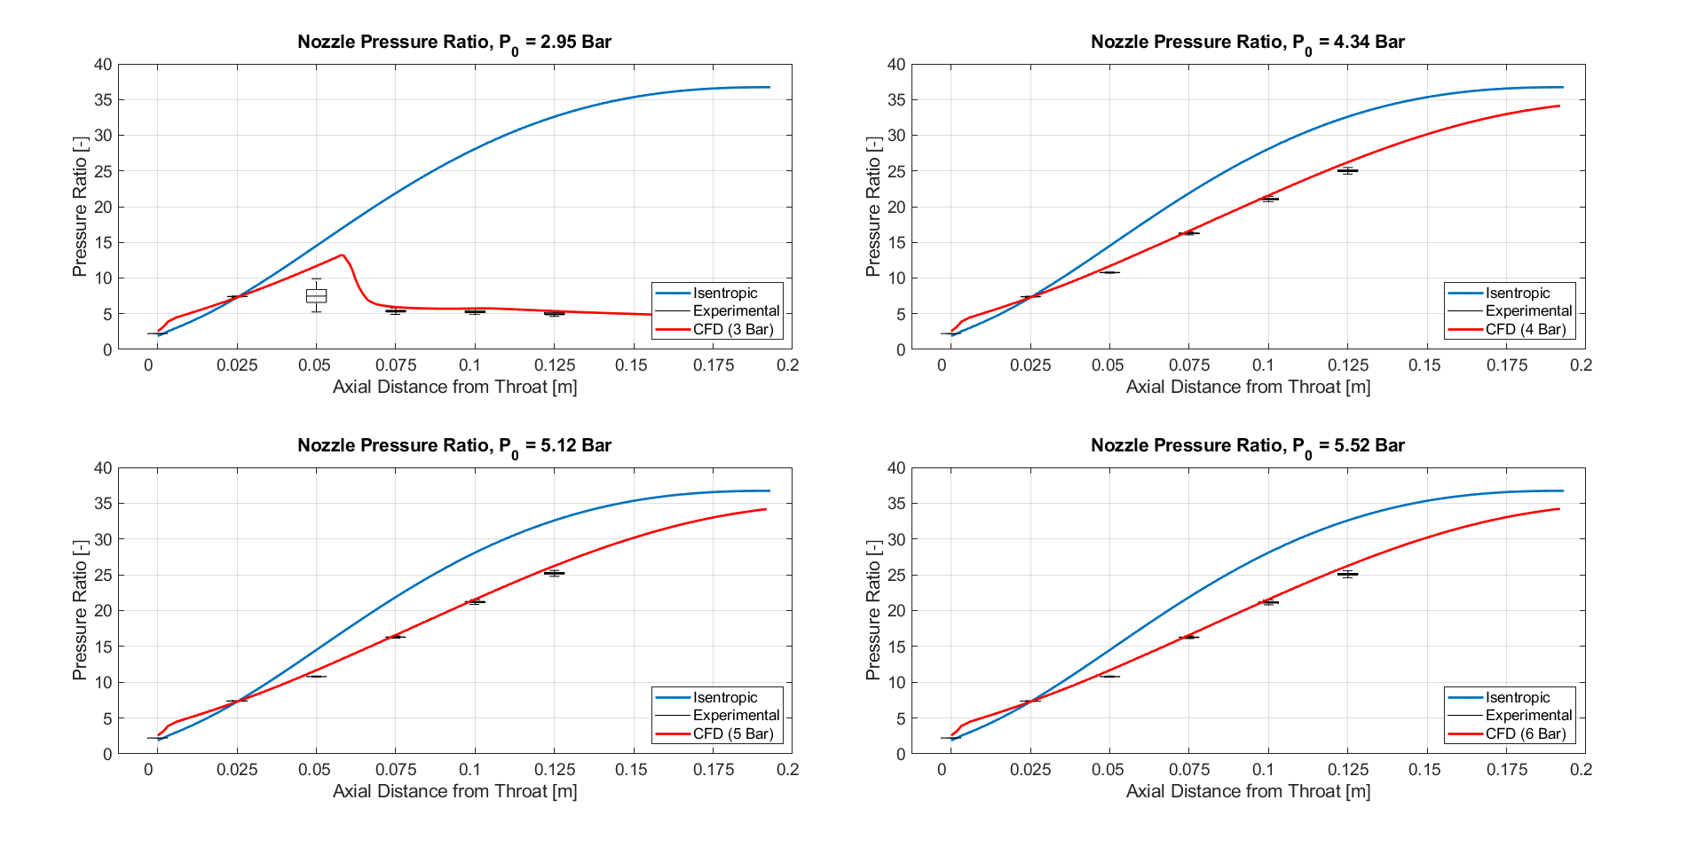
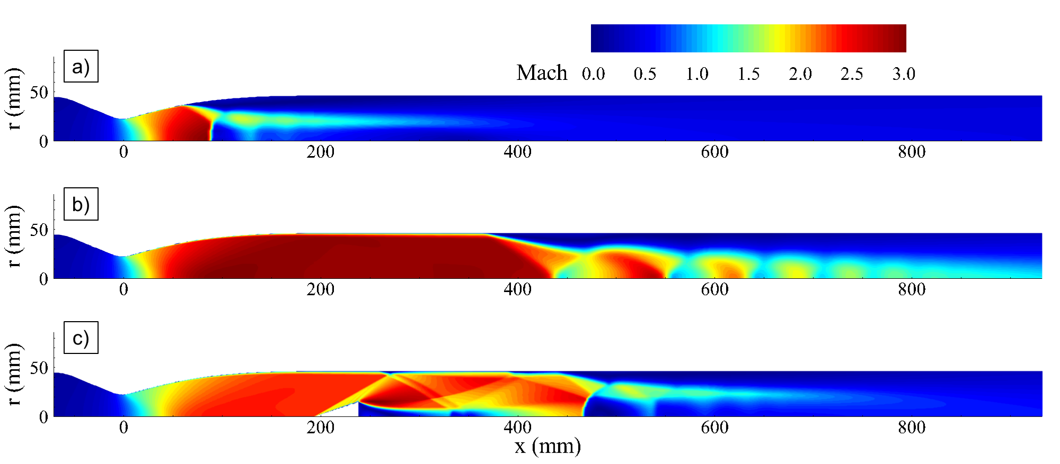
Supersonic Bladeless Turbines (with NCSU)
CFD based design of NCSU supersonic wind tunnel
Capability up to Mach 4 for steady non-reactive flow
Swappable nozzle and second-throat diffuser system allowing for low feed pressure
Numerical analysis of phenomenology and working principle of bladeless turbines
p₀ = 3 bar
p₀ = 4 bar
15/29
Notes:
SCRIPT: Tunnel validation: isentropic prediction versus experiment versus CFD at 3 and 4 bar feed.
[PROVENANCE] Host slide (Heister S15), invariant.

Slide 18
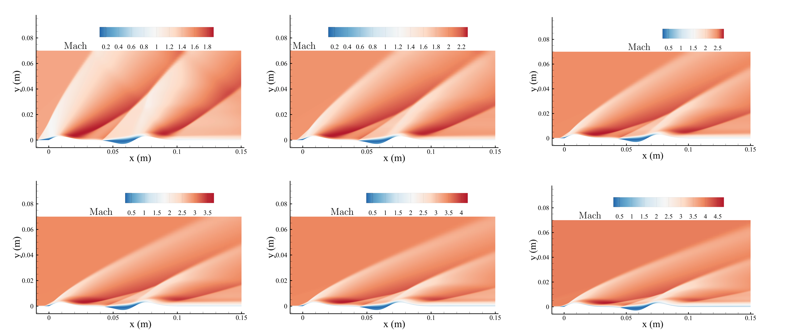
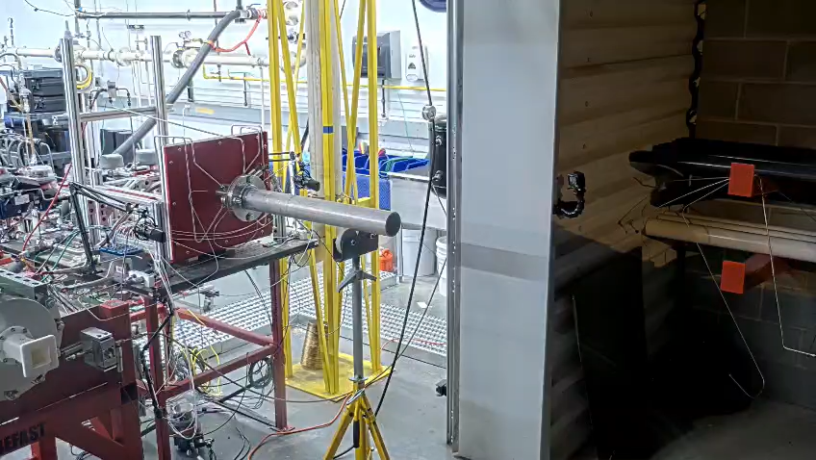
Supersonic Bladeless Turbines (with NCSU)
Ongoing
Bladeless turbine shape optimization
CFD analysis and design of ejector-diffuser system for RDE testing
16/29
Notes:
SCRIPT: Ongoing: bladeless-turbine shape optimization and the ejector-diffuser system for RDE testing - 14-second video. [PLAY VIDEO]
[PROVENANCE] Host slide (Heister S16), media preserved.

Slide 19
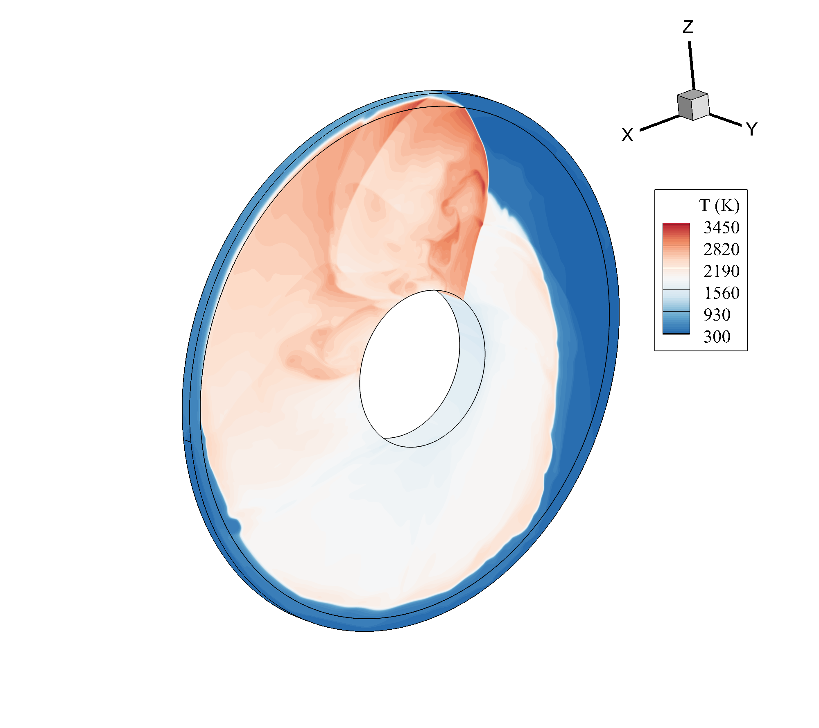
Disk RDEs (with RMIT and ISAE-ENSMA)
Collaboration with PPRIME lab
CFD lead on design and analysis of disk RDEs operating with H2/Air
3D URANS (or Euler)
Q2D URANS (or Euler)
17/29
Notes:
SCRIPT: Disk RDEs with RMIT, ISAE-ENSMA and PPRIME: 3D URANS versus quasi-2D on the same disk configuration.
[PROVENANCE] Host slide (Heister S17), invariant.

Slide 20
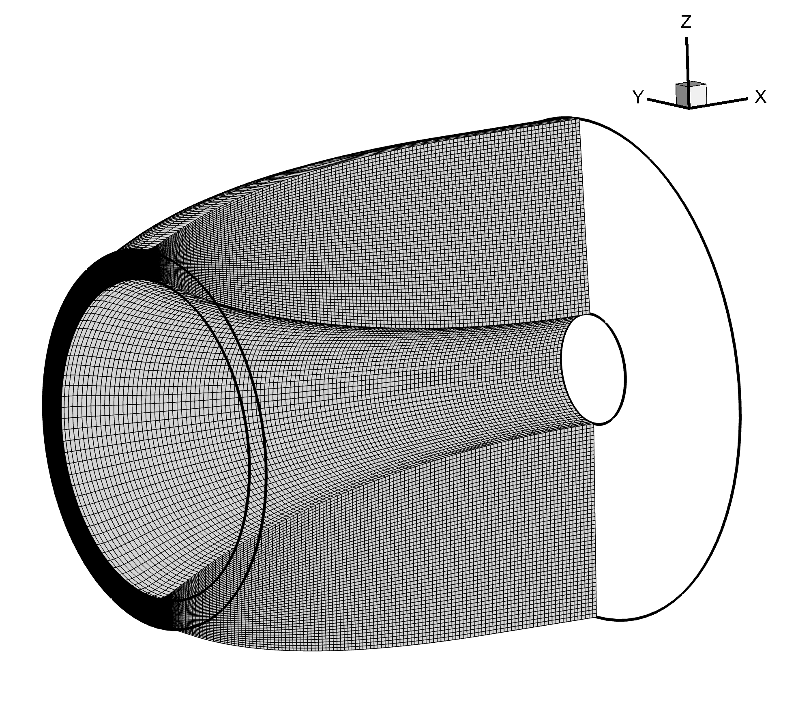
Nozzle Design for RDEs
• Fully non-isentropic three-waves 2D / 2D-axisymmetric MoC solver developed as an in-house API
• Primary application: nozzle design for ideal, TIC and optimized configurations
• Implemented families: ideal (bell, plug, shrouded plug), Rao (optimal bell and plug) and Veen (optimal shrouded plug)
Open questions (and possible research paths)
• Separation dynamics/topology in plug / shrouded plug (effect of rotating oblique shock on incipient separation [3])
• Does an “optimal” profile exist for an RDE exhaust?
• CFD exploration of the theoretical findings in [4]
Optimized shrouded plug
[3] A. J. Harroun, S. D. Heister, J. H. Ruf, “Computational and experimental study of nozzle performance for rotating detonation rocket engines,” J. Propulsion and Power 37(5), 660–673, 2021.
[4] D. P. Stechmann, S. D. Heister, A. J. Harroun, “Rotating detonation engine performance model for rocket applications,” J. Spacecraft and Rockets 56(3), 887–898, 2019.
The stakes are real: +4–7% Isp (choked interface) · 58.1→71.5% of ideal (shroud) — the next section is the group's answer
18/29
Notes:
SIGNPOST: agenda point 2 - the real RDE exhaust. SPEECH DUTY: read the open question aloud - 'Does an optimal profile exist for an RDE exhaust?' - as the question of the rest of this talk.
SIGNPOST: agenda point 2 - the real RDE exhaust. SPEECH DUTY: read the open question aloud - 'Does an optimal profile exist for an RDE exhaust?' - as the question of the rest of this talk.
SCRIPT: This slide closed the group deck; today it opens the main act. We have an in-house method-of-characteristics API - fully non-isentropic, three-wave, 2D and axisymmetric - with the ideal, Rao and Vander-Veen families implemented. And one open question: does an optimal profile exist for an RDE exhaust? Two published numbers say the stakes are real - four to seven percent of Isp on the choked-interface lever, and thirteen points of ideal from a shroud at fixed area ratio, unexplained by its own authors. The rest of this talk is the group's answer.
[PROVENANCE - guard 15] '+4-7% Isp choked lever' -> CH5 CT-1 (SYN:75-94): 'the largest published performance lever lives OUTSIDE the fixed-interface design class' - their numbers, CT-6; decider CFD-1. '58.1->71.5% at fixed AR' -> Paxson-Miki [REP page-verified] (findings_registry:2026; CH3 forchetta row). The two extremes stay SEPARATE with their own anchors - the unadjudicated '4-13 points' composite is banned (WA_A3 critic row 2, DISPOSED-VERIFIED). Citations [3][4] on slide + Paxson-Miki added to the reference line.
[GUARD 18] numbers on slide are physical/paper numbers (allowed); threat-ledger names (CT-1) live here only.

Slide 21
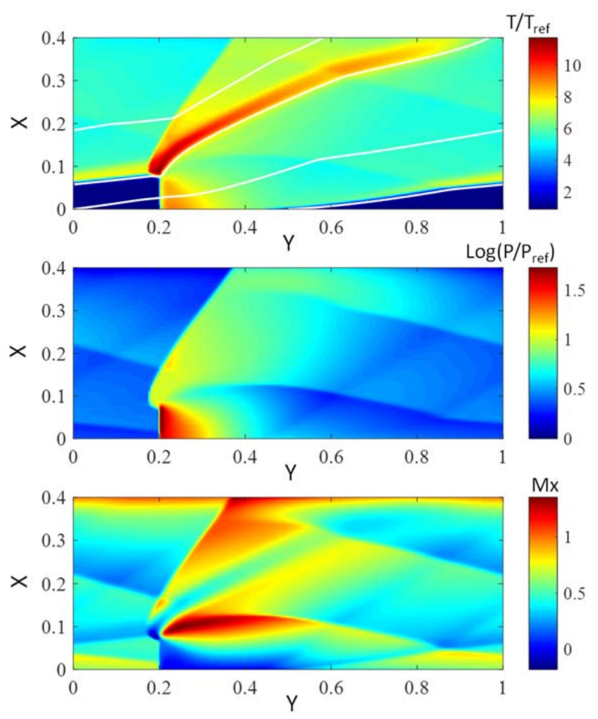
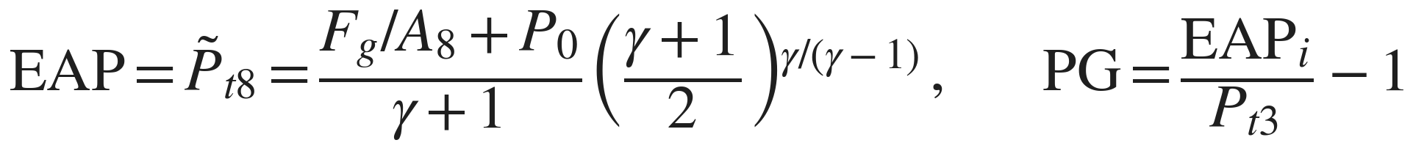
The RDE exhaust is periodic — the literature designs on its time-average
the literature's accepted average: one equivalent pressure for the whole cycle
• The real exhaust rotates at kHz: every flow quantity swings within each cycle.
• Every published nozzle-design route replaces it with a steady average before designing — the authors of the average themselves caution that naive averaging mis-states performance.
Nonuniform RDE exhaust — Kaemming & Paxson, AIAA 2018-1101 (Equivalent Available Pressure)
Rotating Detonation Engine Activities
T(H)RUST team
13/29
Notes:
SCRIPT (S4v2): Before the designs, one fact to hold. This exhaust is periodic, not steady: a detonation front rotates at kilohertz, and every quantity the nozzle sees swings within each cycle. The literature designs its nozzles by first replacing that flow with a steady time-average - every published route does. And the authors of the accepted average published the warning themselves: average the total pressure naively and you mis-state performance. Whether designing on ANY average is even the right problem - that is the question this section answers, formally. Keep it in mind for every slide that follows.
[CKP-S3-2 wired] A6 MOVED from primer-3 to post-B1 hinge (user order at the Block-1 loop: in the primer the averaging warning had no visible link; here it is the bridge into the nozzle section - declared deviation from v3.1 slide order, BUILD_LOG).
[PROVENANCE - guard 15] 'EAP caution by the metric's own authors' -> CH1-feed-5 + CH5-feed-7, [IO] remark of record, M0:2526-2544. 'No error bar on the mean' -> CH1-feed-7 NOT-FOUND(q) (search-proven; wording lives here). 'Our programme constructs it' -> P4 corrector (FD-1: sigla here only; owner F2). CT-6 citation on slide. 'Every design route starts from an averaged flow' -> C3/C3-bis record (declared anticipation, resolved two slides later).

Slide 22
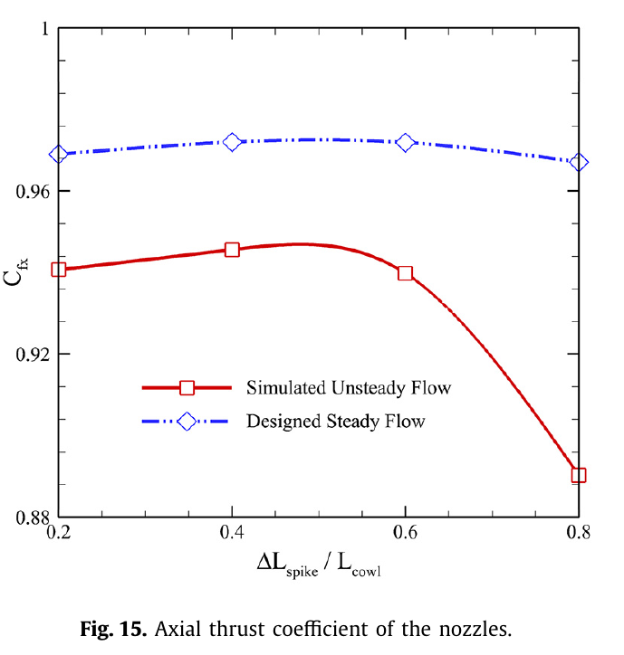
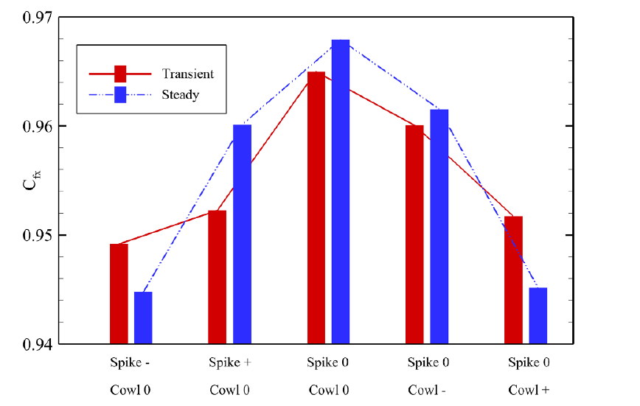
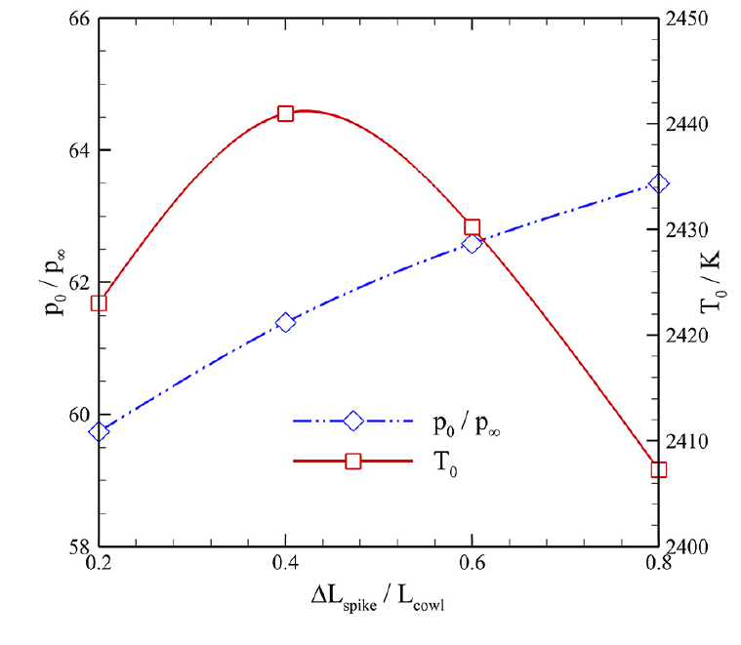
Checked on the literature's own data: the two answers differ
1 · Same solver, paired runs: the average-designed answer differs from the periodic one — the steady curve is flat where the true flow has an optimum and a cliff.
2 · The ranking of five geometries inverts between the two — and no published work quantifies this error.
Thrust coefficient, transient vs steady, five cowl/spike settings — Li, Xu et al., AST 158:109878 (2025), Fig. 13
3 · The literature's own verdict: classical nozzle theory 'approximately' applicable — sizing supported at ~1%; which geometry is best: open.
Steady vs transient thrust coefficient across truncation — Li, Xu et al., AST 136:108221 (2023), Fig. 15
Nozzle→chamber feedback with truncation — ibid. 2023, Fig. 16
Rotating Detonation Engine Activities
T(H)RUST team
13/29
Notes:
SCRIPT (S4v2, absorbs C7): Does the averaging matter? Check it on the literature's own data - same solver, paired runs. The steady, average-designed companion differs from the periodic flow; the steady curve is flat exactly where the true flow has a real optimum at forty percent truncation and a real cliff at eighty - the true optimum is invisible to the curve the literature designs on. And the ranking of five cowl-and-spike settings inverts between the two. Numbers on the slide: plus half a percent at the peak, minus five point eight at the cliff. No published work quantifies this error. The literature itself has reached the honest verdict: classical maximum-thrust theory is - their word - 'approximately' applicable: sizing is supported at the one-percent level, but WHICH geometry is best is open. Quantifying that adverb is this programme.
[S4v2 MERGE] C7 verdict band absorbed as step 3 (C7 full quote card in backup); 'approximately'/sizing-vs-ranking anchors = C7's notes (CH5-feed-3, [REP] quote page-verified; sizing ~1% [REP] Paxson-Miki 6.54 vs ~6.5).
[PROVENANCE - guard 15] Fig.15/Fig.13 -> CH5-feed-2 ([ADV], CT-6, page-verified pp.10-11); Fig.16 feedback -> CH5-feed-4 ([ADV-FIG], threat CT-1 adjacency). GUARD 17 (binding, user pin CKP-S2-1): NO decoupling/one-way-BC claim without the choking condition stated - upstream decoupling only under convergent pre-throat AND fully sonic/supersonic throat along cycle and azimuth; subsonic patches (even throatless) are the information channels upstream - binds the spoken line and every Q&A answer on this slide. Their steady companion is GLOBAL-averaged - cruder than our per-phase (honesty note, spoken if asked).
[GUARD 18] paper numbers on slide (allowed); threat ids here.

Slide 23
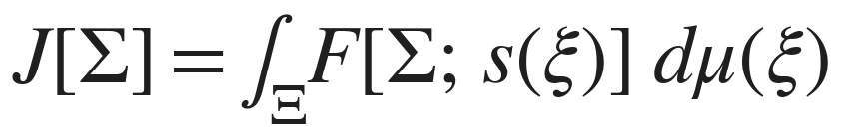
Designing on the average solves a different problem — provably
The field: average FIRST
Us: formulate the PERIODIC optimum
the cycle
the cycle
collapse to ONE mean field
per-phase family (phases stay separate)
apply steady optimality (Rao / Veen)
cycle-averaged thrust functional
the optimum of a SUBSTITUTE problem
ITS optimality conditions: averaged transversality & corner
the error on the argmax has no bar
conditions never written before
The deciding theorem: no single phase satisfies its own wall condition — the weighted mean does. The cycle-optimal nozzle is optimal at no single operating point.
Rotating Detonation Engine Activities
T(H)RUST team
13/29
Notes:
SPEECH DUTY (F-10): stop and read the theorem band verbatim; then give the room its take-away: 'the cycle-optimal nozzle is optimal at no single operating point'.
SPEECH DUTY (F-10): stop and read the theorem band verbatim; then give the room its take-away: 'the cycle-optimal nozzle is optimal at no single operating point'.
SCRIPT: The heart slide. Left, the field's route - including the best of those four papers: collapse the cycle into one mean field, then apply to it the steady optimality conditions of the fifties. You solve the optimum of a SUBSTITUTE. Right, ours: keep the phases separate as a family sharing one wall, define the cycle-averaged thrust functional, and derive ITS optimality conditions - transversality and corner conditions, averaged. To our census, never written. And the theorem that decides it: no single phase satisfies its own wall condition - the weighted mean does. The cycle-optimal nozzle is nobody's single-point optimal nozzle.
[PROVENANCE - guard 15] Ladder I4 vs I2/I3 -> CH1-feed-1; '(**') weighted-mean wall condition necessary; no phase satisfies its own' -> CH2-feed-1 (THEOREM* T-T7FS(b)); boxed warning (substitute problem) -> CH1-feed-4; 'three ways to average, one survives; collapse class' -> CH2-feed-2 (THEOREM* [T-T3], degenerate case = pressure-scaling similarity class). 'Never written' -> litmap C2 NOT-FOUND(q) 'averaged Rao-type wall/corner conditions - zero hits' (query-bounded, guard 9).
[GUARD 18] class sigle (THEOREM*, ids) and 'zero hits' in notes only; on-slide says 'proven / never written before' in plain engineering register.

Slide 24
Where the difference is a theorem — and where it is an open, measured question
area ratio only — no contouring
full adapted plug
TRUNCATED plug — our configuration
the two problems coincide — proven
still coincide — proven, perimeter declared
the coincidence breaks — proven
even here the wrong mean moves the optimum area ratio by +44–87% (3–10 s of Isp) — measured on our numerical test bench
the peak-phase design is optimal
the first genuinely averaged shape problem opens
The head-to-head — our per-phase design vs the classical design at cycle-mean p₀/T₀, identical constraints — has never been computed, by anyone. First signal, simplest rung: the wrong mean moves the optimum area ratio by +44–87% (3–10 s of Isp). The machine is ready: it is the first campaign.
Rotating Detonation Engine Activities
T(H)RUST team
13/29
Notes:
SCRIPT: Honesty about where this is a theorem. Rung one: no contouring, only the area ratio - not a Rao nozzle - there the two problems coincide by construction; and even there, using the wrong mean moves the optimum area ratio by up to eighty-seven percent and costs up to ten seconds of Isp, measured on our numerical test bench with rejecting checks. Same pattern as Humphreys: mobile argmax at flat value - a pattern, not the proof of the general case. Full adapted plug: still coincide - peak-phase design is optimal, perimeter declared. Truncated plug - OUR configuration: the coincidence breaks, proven, and the first genuinely averaged shape problem opens. Its size at contouring is open, the record does not call it small, and no expectation of smallness is anywhere in our records. The machine is ready; that comparison is the first campaign of the phase opening now.
[PROVENANCE - guard 15] Coincidence/breaks map -> CH1-feed-3 (THEOREM [T-T7RED] rung; THEOREM* [T-T4] nesting + break; sharpness clause declared); primacy claims in locked form D-06 -> CH1-feed-10 (notes+Q&A only). Bench inset -> CH2-feed-3 (PRACTICE with rejector; dIsp +3.33..+9.71 s on 6 cases, carrier suite, measured 2026-08-22; stage: verified). Cycle-wall 2-D -> CH2-feed-8 (OPEN, owner F2). Strictness clause -> CH6-feed-8 (carrier PB-2 OPEN). Excursions 10:1/6:1/20:1 -> CH5-feed-9 (CT-6, their BCs/data). Panel quote -> swirl5f panel of record ('single-digit % plausible on-ray, >10% not excluded off-ray; could be large - not refutable by theory today').
[GATE DECISION WIRED] Twin PB-2 = (b) honest form (user decision of record, S2 gate): NO pre-milestone number; the slide carries 'machine ready, first campaign of the phase opening now' - the bifurcation declared at the S2 gate is RESOLVED here; C17's twin card carries the same form.
[GUARDS] 2/3 wired in the panel-1 wording (pattern-only, never '1-DOF nozzle case'); FD-5(i) wired ('numerical test bench'). Guard 18: 'PB-2', class sigle here only.

Slide 25
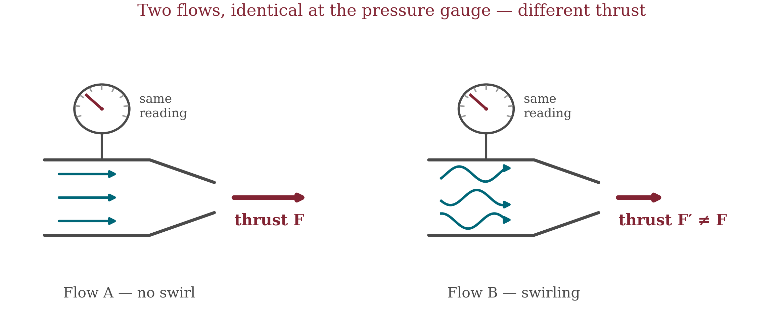
Same pressure reading, different thrust
• A gauge at the inlet reads the same for both flows — but one swirls, and thrust differs (1.5–3%).
• Pressure alone cannot rank designs: the boundary must carry the full state — which swings p₀ ~4:1 and T₀ ~40% within one cycle (published).
• Feeding recorded chamber data to the nozzle is established practice (Miki 2020; Paxson & Miki 2022) — our own Q2D chamber solver produces it in-house.
Rotating Detonation Engine Activities
T(H)RUST team
13/29
Notes:
SCRIPT (rebuilt per CKP-S3-5(d) - explain, not enumerate): Imagine two inlet flows and one pressure gauge. The gauge reads exactly the same for both. But one flow goes straight in and the other arrives swirling - and they give different thrust, because swirl carries momentum the gauge cannot see. No CFD run is needed to establish this: it is a counting argument on the states compatible with one pressure trace. Consequence: any design method fed only pressure at the boundary cannot rank designs - the boundary must carry the full state: pressure, temperature, all velocity components. Stakes: one-and-a-half to three percent of thrust. Feasibility - and this matters: taking the CHAMBER state and imposing it at the nozzle inlet is established field practice. NASA recorded a full periodic state - total pressure, total temperature, velocities, species - from their Q2D chamber code and replayed it as the nozzle inlet condition (Miki 2020); the same architecture drives the shrouded-plug redesign of Paxson and Miki 2022; Harroun imposes an analytic pressure-only law. We stand on that practice with two upgrades: the data must be FULL-state (exactly what pressure-only imposition throws away), and it enters through a contract with rejecting checks instead of being fed in unaudited. And the source is in house: our group's validated Q2D chamber solver - the one shown in the code section - produces precisely this class of data.
[PROVENANCE - guard 15] Fiber non-degeneracy + separation -> CH3-feed-3, REPAIRED FORM of record (REFUTE_CH10 F1, classes PER LEG): T-DISC-1 THEOREM* (fibers non-degenerate); T-DISC-2 split-grade SCOPED (in-fiber separation, booking-level, physical-h0-fixed); T-DISC-3(b) SCHEMA with premise (DR) - never bare 'THEOREM'. Exoneration -> CH10-feed-5 (T-DISC-4(b) SCHEMA). Stakes 1.5-3% / up to 9% -> [SE] scaling estimates (M0:1140-1151; swirl5f B1/B2). Weights -> CH7-feed-2 ([SE]). Imposed-BC precedent -> CH10 lineage LL-24 (Miki 2020 = operative ancestor: recorded Q2D limit-cycle replayed as unsteady inlet BC, THROAT_HARVEST A.6 [REP p.5]); LL-5 (Paxson-Miki 2022 same architecture, 'unsteady (but periodic) inlet boundary condition', radially uniform, A.8); LL-6 (Harroun Eq.7 analytic p-only end-member, A.5). In-house Q2D source = host credential A9 (HYPERDE Q2D, V&V A10-A13); capability claim is CLASS-level (same data class as Miki's Q2D source), no campaign promised - user order 2026-08-23 in-window (S4 lot 2).
[GUARD 18] internal names (T-DISC legs, LL-*, harvest ids) live here; on-slide only author-year forms.

Slide 26
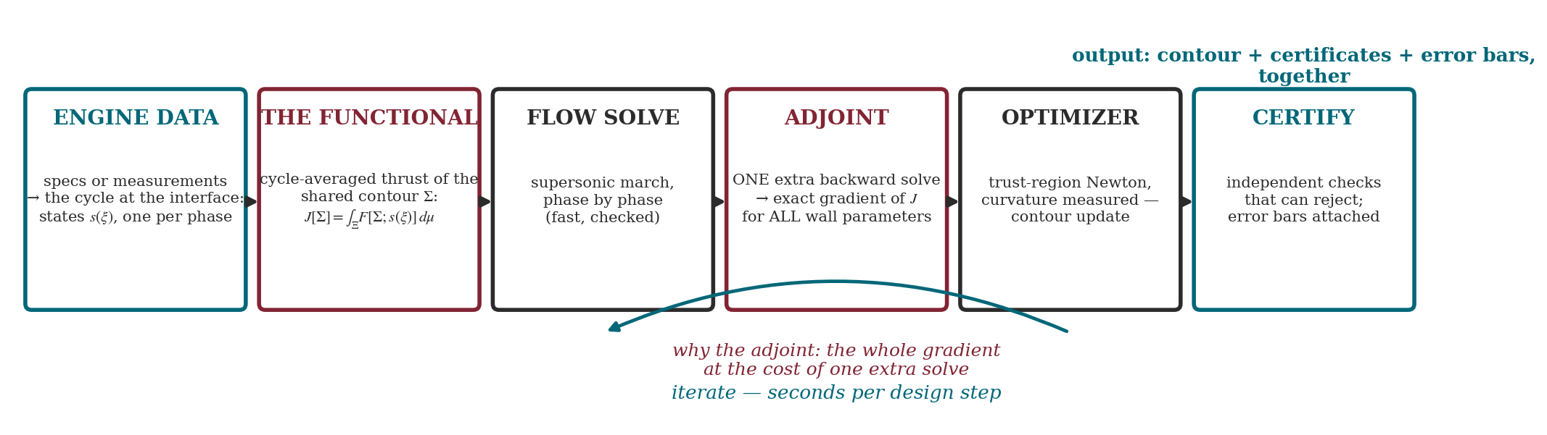
From theory to a design machine: every choice on record
six stages shown — the full eight-stage engineering record is in backup
• The objective is one number: J, the cycle-averaged thrust of the shared wall.
• The adjoint: one forward + one backward solve → the exact dJ/d(shape) for every wall parameter — trust-region Newton climbs it in seconds.
• Every choice sits on a register with alternatives and a test that can reject it.
Rotating Detonation Engine Activities
T(H)RUST team
13/29
Notes:
SIGNPOST: agenda point 4 - the design machine.
SIGNPOST: agenda point 4 - the design machine.
SCRIPT: The machine, end to end. Engine data give the cycle at the interface - one state per phase. We form the cycle-averaged thrust of the shared contour: that integral IS the objective. A fast supersonic march solves each phase. Then the adjoint - and here is why: ONE extra backward solve returns the exact gradient of the objective with respect to ALL wall parameters at once; it is Hoffman's 1967 multiplier fields, made exact for the discrete problem (identity verified at machine precision). A trust-region Newton with measured curvature updates the contour - robust where curvature is irregular, with steps you can certify. And nothing ships alone: independent checks that can reject, error bars attached. Iterations take seconds.
[CKP-S3-3/-4 wired] C13-pre MERGED here (user cut order): its four concepts (adjoint / discrete-exact / optimizer / certificate) live in the flow blocks and this script; its provenance rows absorbed below. Status-graphs -> backup only.
[PROVENANCE - absorbed from C13-pre] reverse-AD = transposed adjoint -> CH9-feed-4 (THEOREM T-LEMB; mesh-limit SCHEMA S-LBML); continuous-first / per-role AD -> CH2-feed-5 (C56 CLOSED; O3.1 PRACTICE); optimizer adjudication -> C31 card (full card in backup).
[PROVENANCE - guard 15] 62 typed choices, tally 12 DECIDED / 36 MIXED / 12 NEVER / 2 SINGLE-AUTHOR, 48 adjudicated -> CH4-feed-1 ([REP]; the WHOLE tally lives here and in backup, never on slide - CKP-S2-3). STATUS SEMANTICS of record (choice_ledger.yaml:20-27, user challenge 2026-08-23): DECIDED = converged-panel/constructional/measured verdict (12); MIXED = operative branch DECIDED, a sibling branch NEVER (36) - so rows with a convergence-adjudicated branch = 48 (12+36), never say bare '12 decided' as the machine's state, and never 'each with alternatives+falsifier' (the 12 NEVER rows are open, owner+trigger). 'No rejecting chain in the field' -> CH9-feed-8 (NOT-FOUND(q), query-bounded - wording here). Graph = extracted from pipeline_graph.json, assert-gated 18/18 at build (DERISK §1-§4; C46 footnote on render; never hand-typed). CH4 W2-R2 form preserved in the document for retro-audit (WA_A3 critic 3).
[GUARD 18] tally numbers and NOT-FOUND(q) here only.

Slide 27

Before going where Rao cannot, the machine reproduces Rao
• By a route independent of the classical construction, the machine recovers Rao's contour: max deviation ~2·10⁻³ of throat radius.
• Two routes, one contour — the literature's benchmark, passed.
• And it is fast: one design segment in 15–20 s; a full validation campaign in 10–14 minutes.
Variational contour vs classical Rao contour, with deviation panel — in-house, two independent routes
Rotating Detonation Engine Activities
T(H)RUST team
13/29
Notes:
SCRIPT: Before trusting a machine where no benchmark exists, ask it to pass the benchmark that does. On the classical maximum-thrust problem - the reduced case - our optimizer, by a route completely independent of Rao's construction, finds Rao's contour: maximum deviation two parts in a thousand of the throat radius, inside the error band we derived from the cross-code comparison. The picture is ours, of record. This is the credibility bridge: the method goes where Rao cannot, standing on a machine that reproduces Rao where he can.
[F-6] On-slide figure = fig_c13val_clean.png: presentation relabel of the record figure (title + legend text plain-English; internal ids GENO/S18/K_RICH and the 91/91 count moved here; DATA PIXELS UNTOUCHED - relabel script relabel_c13val.py, declared in BUILD_LOG).
[PROVENANCE - guard 15] Source figure = validation/brick2_profiles_record.png, record run S18 [X-TOCV] (carrier validation/PROGRESS_2026-08-06_S18_brick2run.md). Run verification counts (oracle 91/91, KKT vs derived threshold) live HERE, not on slide (guard 18). Used AS-IS (record figure; light restyle only if visual QA demands, no regeneration outside contract - BUILD_LOG decision).

Slide 28
Where the remaining error lives, source by source
source | best | worst | how estimated
Mean azimuthal residual | exactly 0 | exactly 0 | proven (hypotheses stated)
Swirl thrust unmodelled | 1.5% of thrust | 3% of thrust | order estimate
Input-data bias | 0.6% of pressure | 9% of pressure | order estimate + literature
Jumps at the wave fronts | no number yet — derivation planned | — | open
Designing the nozzle alone | ~1% | ~1% | literature, page-verified
Optimum shift | first campaign measures it | — | open
• Sources do not add: best case single-digit %; with strong swirl, >10% not excluded.
• Largest adverse signal published: +13 points of ideal from a shroud, unexplained (Paxson & Miki 2022).
• No published benchmark separates this prediction from the true unsteady flow — we measure it ourselves.
Rotating Detonation Engine Activities
T(H)RUST team
13/29
Notes:
SCRIPT (S4 rework): This is our error budget: every source of error we know, its best and worst case, and how each number was obtained - a theorem, an order estimate, or a published datum. Start with the two rows that have no number yet: for the jumps at the wave fronts, the derivation that will produce the number is already laid out; for the shift of the optimum, the measurement is in the plan two slides ahead. These sources do not add into a single figure - they are different physics at different confidence levels - so the summary is a band: best case, with weak swirl, single-digit percent overall is plausible; with strong swirl, more than ten percent is not excluded. One computed case of ours gained +0.51 percent - and the uncertainty on that figure is about thirty percent of the value itself, relative, so read it as roughly half a percent, not as a promise of more. And that case sits in a design class where the certification boundary binds before the periodic physics can differentiate the contours - a property of that class, measured as such, not a ceiling of the method: at the simplest rung the wrong mean already moves the optimum area ratio by 44 to 87 percent, worth 3 to 10 seconds of Isp. For scale: Rao's classical method is credited with 0.04 to 0.34 percent - their numbers, in their regime. The largest published signal in the adverse direction: Paxson and Miki, 2022, add a shroud at fixed area ratio and the plug gains thirteen points of ideal - unexplained by the authors; if swirl content is doing that, it is exactly the worst row of this table. And note what the literature does not contain: no published benchmark separates a phase-averaged prediction like ours from the true unsteady three-dimensional flow. So nobody else can settle this table for us - the measurements that fill it are ours to make, and they come next.
[PROVENANCE - guard 15] Table cells -> CH3-feed-4 (classes per cell, forchetta §; CH7 PART 5 headline :1731-1743): mean channel THEOREM* (K-bar=0, perimeter H-RED-2); swirl-thrust row (was 'booking debt', plain-word relabel, same 1.5-3% [SE]); input bias 0.6-9% p [SE]+lit; wave-front jumps (was 'heel') delta/L_H UNDERIVED -> CH3-feed-5 (SCHEMA + derivers named: five-field -> route-B -> M-RED -> R22-CFD - the 'derivation planned' cell; NO forward pointer to the plan slide for this row); 'Designing the nozzle alone' (was 'sizing level', same ~1% [REP], substitution reading cross-consistent with C17 card 3); optimum-shift row -> C17 card 2 head-to-head (:1506), the only row resolving there. +0.51%+-~30% -> CH1-feed-9 (band-underinclusion declared; +-30% RELATIVE, said in script). Class-diagnosis sentence -> [C-O33] quantified, cause = design class (cert-limited, margin inactive; 3 instances S20/S22/S24 of record; M0 tier ladder) - context weld, weakens the small number's reading, adds no claim; rung-1 44-87% / 3-10 s -> CH2-feed-3 (PRACTICE with rejector, same anchor as C7-ter panel 1). Rao 0.04-0.34% their numbers (CT-6). No-benchmark bullet -> CH5-feed-10 + CT-3 STRICT form: no published referee THAT DISCRIMINATES the per-phase-averaged prediction against 3D-unsteady truth (restrictive clause on-slide: 'this prediction ... from the true unsteady flow'). Conditional spine C-D25U -> CH2-feed-7 (here only). Guard 6 / D-44: the slide shows a band, never claims adequacy.
[S4 BUDGET NOTE] honesty_table sits near the ~100 declared cap after trims - measured at build; exemption declared in BUILD_LOG if exceeded, never silent.
[GUARD 18] class sigle/registry ids here; table uses plain words only.

Slide 29
Four measurements, in order — consequences fixed before the data
1 · Residual
2 · Head-to-head
3 · Coupled pair
4 · Full 3D reference
how much the phase-averaged equations miss, on nozzles already solved
small → error bars tighten; large → dominant source named
first — cheapest
our per-phase design vs the classical design at cycle-mean p₀/T₀ — identical constraints; no such number exists yet
either result publishable
machine ready — first campaign
same nozzle with and without the combustor: the cost of designing alone
~1% holds → estimate stands; exceeded → step 4 moves up
after step 1
~12M-cell reference the literature lacks
inside its band → the error band closes; outside → failing source named
route chosen now; commit decided after step 1
Ours vs time-averaged: measurable in-house. The true 3D optimum: computable by no one — we bound it.
Stop criterion: measured gain below ~1% Isp → effort pivots to certification and operability.
First per-phase variational design method for RDE nozzles — the head-to-head number comes next. Thank you.
Rotating Detonation Engine Activities
T(H)RUST team
13/29
Notes:
SCRIPT (S4 rework): This is the measurement plan, and the order is the content: four steps, each with its two possible outcomes and what each outcome triggers - fixed now, before any data arrive. Step one, the cheapest: measure the residual - take nozzle families the machine has already solved and checked, put them back into the full phase-averaged equations, and read how much is missed. Small residual: the error bars tighten and the family is promoted with a stated bar; large residual: it names which error source dominates - either outcome is informative, and it also builds the referee that the literature does not contain. Step two, the head-to-head - the reason this programme exists: our per-phase design against the classical variational design built on cycle-mean stagnation pressure and temperature, identical constraints, swirl bracketed out - does the optimal contour move, and how much thrust does the difference carry? Today no such number exists, on any side; a material gap pays for the method, a small gap proves standard practice right at that rank and we would be the first to prove it - both results are publishable. Step three: a paired simulation of the same nozzle with and without the combustor coupled, on the kind of template the field already uses - it prices what we give up by designing the nozzle alone. If the literature's roughly one-percent estimate holds, that row of the error table stands; if it is exceeded, the big reference run moves up the queue. Step four, the largest: a twelve-million-cell unsteady reference simulation - the benchmark the field lacks; today we choose only how to procure it, partner or purchase - whether to commit the run is decided after step one. One distance we can measure entirely in-house - ours against the time-averaged design; the other - the distance to the true three-dimensional optimum - no one can compute, so we bound it. And the stop criterion is fixed in advance: if the measured gain falls below about one percent of Isp, we stop pushing performance and pivot to certification and operability. The campaign has just opened: none of these results is promised as acquired.
[S4 HEAD-TO-HEAD FORM] card 2 comparator = atlas CH6 :440 (I4 = Rao/GENO design on cycle-mean (<Pc>, T0, gamma)) + :490 (twin PB-2 at IDENTICAL constraints: same eps, L, closure); 'ZERO computed instances' of the comparator in the record (CH6 :712). Twin-first = kill-or-validate (CH6 :223-225). Internal names (I4, twin PB-2) here only.
[GATE DECISION WIRED] Twin (b): card 2 reads 'first campaign' - NOT 'if ordered'; consistent with C7-ter and the backup open-decisions slide.
[PROVENANCE - guard 15] Order of the four steps -> CH6-feed-9 (on-slide word 'roadmap' dropped, order kept); G2 value gate -> CH6-feed-6; value condition armed-rejector, today undecidable -> CH6-feed-7 (D-44 gated; 'consequences fixed before the data' = plain form of the pre-registration of record); M-RED derived bands B-1..B-4 -> CH3-feed-6; twin kill-or-validate both-informative -> CH6-feed-4; B-lite cheap lever -> CH3-feed-10 + CH1-feed-8 (notes only). Card 4 'inside its band -> the error band closes' = Guard 6 / D-44 form (band closure, never a validation verdict). Internal names (M-RED / CFD-2 / CFD-1 / twin PB-2 / I4) live HERE; slides carry speaking forms (guard 18).
[GAP-LETTERS MAP - FD-4/CW-4, S4 UPDATE] Gap letters A/B appear NOWHERE on slide or in speech anymore (S4 rework): band 1 says the two distances in words ('ours vs time-averaged' / 'the true 3D optimum'). Historical namespace (A = distance to true 3D optimum; B = ours vs mean-state) kept HERE for Q&A cross-reference only; C17-pre's frame letters are inverted vs this namespace - always words, never letters.

Slide 30
Backup Slides
Rotating Detonation Engine Activities
T(H)RUST team
Notes:
Divider - backup section begins (S4 order: main-only numbering; backup slides carry B-n).

Slide 31

Backup — design pipeline, stage 1 in depth
walkable graph: every node card carries its choice, alternatives and falsifier; long-range links labelled with their target stage
Rotating Detonation Engine Activities
T(H)RUST team
B-1
Notes:
Backup L1 graph, stage 1. Populated from pipeline_graph.json (assert-gated extraction, never hand-typed). Stage 6 carries the 3-panel split of record (DERISK §3.1); long-range edges E9/E28/E29 stub-labelled (DERISK §5). Serve on drill-down questions about the machine; L2 card slides follow.

Slide 32

Backup — design pipeline, stage 2 in depth
walkable graph: every node card carries its choice, alternatives and falsifier; long-range links labelled with their target stage
Rotating Detonation Engine Activities
T(H)RUST team
B-2
Notes:
Backup L1 graph, stage 2. Populated from pipeline_graph.json (assert-gated extraction, never hand-typed). Stage 6 carries the 3-panel split of record (DERISK §3.1); long-range edges E9/E28/E29 stub-labelled (DERISK §5). Serve on drill-down questions about the machine; L2 card slides follow.

Slide 33

Backup — design pipeline, stage 3 in depth
walkable graph: every node card carries its choice, alternatives and falsifier; long-range links labelled with their target stage
Rotating Detonation Engine Activities
T(H)RUST team
B-3
Notes:
Backup L1 graph, stage 3. Populated from pipeline_graph.json (assert-gated extraction, never hand-typed). Stage 6 carries the 3-panel split of record (DERISK §3.1); long-range edges E9/E28/E29 stub-labelled (DERISK §5). Serve on drill-down questions about the machine; L2 card slides follow.

Slide 34

Backup — design pipeline, stage 4 in depth
walkable graph: every node card carries its choice, alternatives and falsifier; long-range links labelled with their target stage
Rotating Detonation Engine Activities
T(H)RUST team
B-4
Notes:
Backup L1 graph, stage 4. Populated from pipeline_graph.json (assert-gated extraction, never hand-typed). Stage 6 carries the 3-panel split of record (DERISK §3.1); long-range edges E9/E28/E29 stub-labelled (DERISK §5). Serve on drill-down questions about the machine; L2 card slides follow.

Slide 35

Backup — design pipeline, stage 5 in depth
walkable graph: every node card carries its choice, alternatives and falsifier; long-range links labelled with their target stage
Rotating Detonation Engine Activities
T(H)RUST team
B-5
Notes:
Backup L1 graph, stage 5. Populated from pipeline_graph.json (assert-gated extraction, never hand-typed). Stage 6 carries the 3-panel split of record (DERISK §3.1); long-range edges E9/E28/E29 stub-labelled (DERISK §5). Serve on drill-down questions about the machine; L2 card slides follow.

Slide 36

Backup — design pipeline, stage 6 in depth
walkable graph: every node card carries its choice, alternatives and falsifier; long-range links labelled with their target stage
Rotating Detonation Engine Activities
T(H)RUST team
B-6
Notes:
Backup L1 graph, stage 6. Populated from pipeline_graph.json (assert-gated extraction, never hand-typed). Stage 6 carries the 3-panel split of record (DERISK §3.1); long-range edges E9/E28/E29 stub-labelled (DERISK §5). Serve on drill-down questions about the machine; L2 card slides follow.

Slide 37

Backup — design pipeline, stage 7 in depth
walkable graph: every node card carries its choice, alternatives and falsifier; long-range links labelled with their target stage
Rotating Detonation Engine Activities
T(H)RUST team
B-7
Notes:
Backup L1 graph, stage 7. Populated from pipeline_graph.json (assert-gated extraction, never hand-typed). Stage 6 carries the 3-panel split of record (DERISK §3.1); long-range edges E9/E28/E29 stub-labelled (DERISK §5). Serve on drill-down questions about the machine; L2 card slides follow.

Slide 38

Backup — design pipeline, stage 8 in depth
walkable graph: every node card carries its choice, alternatives and falsifier; long-range links labelled with their target stage
Rotating Detonation Engine Activities
T(H)RUST team
B-8
Notes:
Backup L1 graph, stage 8. Populated from pipeline_graph.json (assert-gated extraction, never hand-typed). Stage 6 carries the 3-panel split of record (DERISK §3.1); long-range edges E9/E28/E29 stub-labelled (DERISK §5). Serve on drill-down questions about the machine; L2 card slides follow.

Slide 39
Backup — Boundary-condition licence follows the flow
Boundary-condition licence follows the flow
single-wave → full certificate; RPO → declared practice; multistable → robust layer; chaotic → HONEST REFUSAL
Rotating Detonation Engine Activities
T(H)RUST team
B-9
Notes:
L2 node card (CH1-feed-6). Declared to-backup consumption of the storyboard join table [F-des-4]: this card is the landing site of a feed consumed at backup-with-reason. Compression is cite-only from the atlas/pipeline_graph fields (≤40 words per field). Q&A mapping to be refined by the Block-2 red-team pass (edits, never silent drops).

Slide 40
Backup — Why the lip multiplier vanishes (f2 = −λ2)
Why the lip multiplier vanishes (f2 = −λ2)
the elegant identity at the lip — technical Q&A card
Rotating Detonation Engine Activities
T(H)RUST team
B-10
Notes:
L2 node card (CH2-feed-4). Declared to-backup consumption of the storyboard join table [F-des-4]: this card is the landing site of a feed consumed at backup-with-reason. Compression is cite-only from the atlas/pipeline_graph fields (≤40 words per field). Q&A mapping to be refined by the Block-2 red-team pass (edits, never silent drops).

Slide 41
Backup — The corrector as a perturbation of the steady sweep
The corrector as a perturbation of the steady sweep
algorithmic detail — Q&A card
Rotating Detonation Engine Activities
T(H)RUST team
B-11
Notes:
L2 node card (CH3-feed-8). Declared to-backup consumption of the storyboard join table [F-des-4]: this card is the landing site of a feed consumed at backup-with-reason. Compression is cite-only from the atlas/pipeline_graph fields (≤40 words per field). Q&A mapping to be refined by the Block-2 red-team pass (edits, never silent drops).

Slide 42
Backup — Theory-as-code: the registry lint layer
Theory-as-code: the registry lint layer
internal governance — process Q&A card
Rotating Detonation Engine Activities
T(H)RUST team
B-12
Notes:
L2 node card (CH9-feed-9). Declared to-backup consumption of the storyboard join table [F-des-4]: this card is the landing site of a feed consumed at backup-with-reason. Compression is cite-only from the atlas/pipeline_graph fields (≤40 words per field). Q&A mapping to be refined by the Block-2 red-team pass (edits, never silent drops).

Slide 43
Backup — Data uncertainty enters the contract (C50)
Data uncertainty enters the contract (C50)
instantiation = duty of the opening phase — data Q&A card
Rotating Detonation Engine Activities
T(H)RUST team
B-13
Notes:
L2 node card (CH10-feed-8). Declared to-backup consumption of the storyboard join table [F-des-4]: this card is the landing site of a feed consumed at backup-with-reason. Compression is cite-only from the atlas/pipeline_graph fields (≤40 words per field). Q&A mapping to be refined by the Block-2 red-team pass (edits, never silent drops).

Slide 44
Backup — The optimizer choice, full record (C31 card + choice tally)
The optimizer choice, full record (C31 card + choice tally)
6-field decision card (incumbent / alternatives with survey data / verdict / recency check / falsifier / re-exam window) + the choice-ledger tally (62 = 12 decided / 36 mixed / 12 never / 2 single-author) — the accounting moved OFF-main lives HERE
Rotating Detonation Engine Activities
T(H)RUST team
B-14
Notes:
L2 node card (CH4-feed-9 + CH4-feed-1). Declared to-backup consumption of the storyboard join table [F-des-4]: this card is the landing site of a feed consumed at backup-with-reason. Compression is cite-only from the atlas/pipeline_graph fields (≤40 words per field). Q&A mapping to be refined by the Block-2 red-team pass (edits, never silent drops).

Slide 45
Backup — the honesty table, complete
source | best | worst | how estimated | what tightens it
Mean azimuthal residual | exactly 0 | exactly 0 | proven (hypotheses stated) | —
Swirl thrust unmodelled | 1.5% of thrust | 3% of thrust | order estimate | residual-measurement campaign
Input-data bias | 0.6% of pressure | 9% of pressure | order estimate + literature | data contract + campaign
Jumps at the wave fronts | no number yet | — | open — derivation planned | derivation chain, then campaign
Designing the nozzle alone | ~1% | ~1% | literature, page-verified | coupled-pair run
Optimum shift | no number yet | — | open | head-to-head comparison
all six error sources, best/worst, how estimated, and what tightens each — the main deck showed the highlights (C11)
Rotating Detonation Engine Activities
T(H)RUST team
B-15
Notes:
Full FORCHETTA (6 rows, verbatim cells with classes) -> CH3-feed-4 / CH7-feed-4 (CH7 PART 5 of record, :1458-1743 anchors). Cells carry bound-or-estimate declared + class + provenance + 'what tightens it'. Serve when C11 highlights are challenged; also home of C2/C12 integral versions if cut from main.

Slide 46
Backup — figure provenance & reuse methodology
Every third-party figure: full citation + non-reproduction caveat
manifest of reused figures with per-figure attribution and audit trail; our own figures traced to committed, tested scripts
Rotating Detonation Engine Activities
T(H)RUST team
B-16
Notes:
Reuse manifest -> deck_build/FIGS_MANIFEST.md (crops, full citations, CT-6 standing rule) + host-pipeline provenance discipline (validate_reused_figs pattern). Serve on any figure-rights / provenance question (audit criterion (e)).

Slide 47

Backup — what input the method needs: the reliability ladder
cases A–G: from engine specs alone to class-verified hot-fire data — the entry gate can reject
Rotating Detonation Engine Activities
T(H)RUST team
B-17
Notes:
Annex-B ladder moved from C18 (F-4: three asks = three cards; ladder legibility). Source: CH10-feed-1 specs ladder; entry gate G6 loud-reject (never exercised - said in C18 notes).

Slide 48
Today
1 The group and its tools
2 The real RDE exhaust
3 Our formulation
4 The design machine
5 Honesty, roadmap & requests
Three requests for the panel — at the end.
Rotating Detonation Engine Activities
T(H)RUST team
B-18
Notes:
SCRIPT: The plan for the hour: the group and its tools; then one research line in depth - what the RDE exhaust really is, how we formulate its design problem, the machine we built for it, and an honest account of limits; we close with three concrete requests.
[CKP-S3-2 wired] A2 = agenda only: no per-section minutes, no group-intro repetition (A3 does that better), no nozzle emphasis in the intro (user order at the Block-1 loop, 2026-08-23; supersedes the v3.1 mini-map-with-minutes form - declared deviation, BUILD_LOG).
[PROVENANCE] Ask preview -> MESSAGE_ARCHITECTURE §BLUF (asks return decision-ready in C18).

Slide 49



One nozzle, two flowfields
Instantaneous internal flow — Jourdaine et al., PCI 37 (2019), Fig. 9
Transient (left) vs reference steady state (right) — Li, Xu, Lv, Yu, Zhou, Aerosp. Sci. Technol. 158:109878 (2025), Fig. 10
Time-averaged exhaust — Jourdaine et al., PCI 37 (2019), Fig. 4
• Instantaneous: a rotating oblique shock. Time-averaged: a clean axisymmetric plume.
• And a third field exists: the steady state the field designs on (left figure, right panels).
• Even the throat is unsteady: a corrugated sonic surface, ~6:1 excursions — we design downstream of it.
Rotating Detonation Engine Activities
T(H)RUST team
B-19
Notes:
SCRIPT: Start from what the exhaust actually is. Freeze time: a rotating oblique shock, a helix through the nozzle - Jourdaine's Fig. 9. Average over a cycle: a clean, steady-looking axisymmetric plume - their Fig. 4. Both pictures are true; they are different fields. And the large figure shows a THIRD field: on its right panels, not the time-average but the reference STEADY state - the flow the field actually designs on. Keep the three apart: instantaneous, time-averaged, steady-equivalent. Four independent codes show the same phenomenology.
[USER CATCH 2026-08-23 - source-verified] P-C Fig.10 caption verbatim (pdf p.9): 'Mach numbers ... for transient (left) and reference steady states (right)' - the right panels are the STEADY COMPANION, not a time-average. Slide caption and bullets repaired accordingly; P-D Fig.4 caption verbatim: 'Time-averaged exhaust flow structure' (true average), Fig.9: instantaneous internal flow. FINDING vs frozen atlas (pending mint at R3 close, BUILD_LOG): CH5 §1 lists P-C Fig.10 among the 'istantaneo vs medio' dichotomy instances - at source it is transient-vs-reference-steady; P-B Fig.14 likely same class (to check at mint).
[PROVENANCE - guard 15] Dichotomy instances -> CH5 §1 anchors (with the correction above); class [ADV], CT-6 (their figures, full citations on slide). Convergence: 4-paper campaign, 0 BREAK (S-FOUNDATIONS-C4).
[GUARD 18] no process language on slide.

Slide 50



Not just pressure — the whole interface state varies
Corrugated sonic line — Kaemming & Paxson, AIAA 2018-1101, Fig. 6
Every quantity, not just pressure — ibid., Table 1
• Across one cycle: total pressure ~4:1, total temperature ~40%, Mach 0.85–1.33 (published).
• The sonic surface is corrugated: subsonic and supersonic bands coexist — 'choked' is not uniform.
• How much stays subsonic is set by geometry and operating point — published both ways. We measure it per phase, never assume it.
Rotating Detonation Engine Activities
T(H)RUST team
B-20
Notes:
SCRIPT (S4 rework, user order): Here is what the nozzle actually receives, in the field's own data. Not just a pressure trace: EVERY quantity varies across the cycle - total pressure four to one, total temperature by forty percent, axial Mach from zero-point-eight-five to one-point-three. And look at the sonic line: it is corrugated - subsonic and supersonic bands COEXIST at the same station; 'choked' is an average statement, not a uniform state. Whether any subsonic band survives depends on the geometry AND the operating point: at high stagnation pressure and mass flow the interface tends fully sonic-supersonic even WITHOUT a physical throat - the published NASA shrouded-plug case has no chamber throat and is supersonic at every phase (M 1.1-1.4) - while a low-contraction case keeps subsonic bands even when effectively choked, and a hard throat on a micro-scale chamber can drive the whole chamber subsonic with shocks running back upstream. No published study sweeps that transition - so our data contract MEASURES the phase-resolved Mach sign at the interface instead of assuming it, and we design at the station that is axially supersonic with margin, downstream of the heat release.
[PROVENANCE - guard 15] All-quantities spread + sonic corrugation -> KP18 Table 1 / Fig. 6 (THROAT_HARVEST A.7 [FIG/REP]: Pt 4.07/0.67/1.43, Tt 41%, Mx 0.86-1.33, sonic line crossed twice; 'both subsonic and supersonic portions' verbatim p. 10). Operating-point discriminator -> harvest B(c) operational monitor (i): 'configuration-dependent, must be measured, not assumed' (KP18-F6 yes-subsonic at low contraction vs PM22-F3 no-subsonic, throatless, M 1.1-1.4 at all phases, A.8 [REP/FIG]); high-p0 tendency SUPPORTED not proven: Jourdaine OPEN config 'principally sonic or supersonic' vs CHOKED micro config chamber 'mainly subsonic' + upstream reflected shock (A.1 [REP]); Liu M_t=1.0 even throatless = ASSERTION of record (A-L6, A.2). No sweep of the transition = gap G6/G7 (search-proven, harvest D). Guard 11: design interface = margin station per L4-DEFAULT, NOT the geometric throat; subsonic patches = declared case-class (D1 4.3bis O1-O4). CT-6: on-slide numbers are figure/table readings with author-year captions, no band inputs.
[GUARD 18] harvest ids, 'search-proven', class names in notes only.

Slide 51




How the field designs RDE nozzles today
Angelino-type ramp on averaged flow — Liu et al. 2022
Classical max-thrust MoC on averaged inflow — Li et al. 2023
Liu et al., Aerosp. Sci. Technol. 120:107300 (2022)
Li, Xu et al., Aerosp. Sci. Technol. 136:108221 (2023)
Non-optimized conical spike — Jourdaine et al. 2019
Manual CFD-guided redesign — Paxson & Miki 2022 (NASA)
Jourdaine et al., Proc. Combust. Inst. 37:3443 (2019)
Paxson & Miki, AIAA (2022)
Best of a sweep is not an optimum — and in a systematic census, no published work poses the optimum on the real RDE exhaust: the substitution error is never quantified.
Rotating Detonation Engine Activities
T(H)RUST team
B-21
Notes:
SCRIPT: The four published design routes, each with its own plot. Peking University: an Angelino-style ramp built on averaged flow. Nanjing: classical maximum-thrust surfaces - Rao, Vander Veen - fed with averaged inflow. KIT and Aoyama: a cone, declaredly not optimized. NASA Glenn: manual, CFD-guided redesign. All legitimate engineering - and none closes the loop: the best of a sweep is not an argmax.
[PROVENANCE - guard 15] The 4 methods -> v1 C3 rows + CH5 §1 (P-A/P-B/P-D/NASA-Glenn method attributions, id registry verbatim: PKU liu_2022; NUAA li_xu_lv_lv_song_2023; KIT/Aoyama jourdaine_2019; NASA-Glenn paxson_miki_2022). Best-of-sweep != argmax rule -> CH8-feed-5 (guard 8: sweep numbers presented as certified best-of-sweep, never global optimum without M1-M5 mechanism). Guard 4: field ALWAYS instantiated (PKU/NUAA/KIT-Aoyama/NASA-Glenn named, never 'the field' bare). CT-6 on all four crops.
[GUARD 18] guards cited here, not on slide.

Slide 52
The optimization that has never happened
published work | what is actually optimized
Liu et al. 2022 | trade study, 4 cases — no optimizer
Li et al. 2023 | classical steady surfaces on averaged inflow — the substitute problem
Li et al. 2025 | no new design
Jourdaine et al. 2019 | conical — declaredly not optimized
Paxson & Miki 2022 | manual CFD-guided redesign
nearest neighbours | an ideal bound (no design); direct search (no optimality conditions)
In a systematic census: no published work poses the optimum on the real RDE exhaust — and the substitution error is never quantified.
Rotating Detonation Engine Activities
T(H)RUST team
B-22
Notes:
SCRIPT: Sharper: who optimizes what. Nanjing deserves precision: that work DOES use classical variational calculus - what is missing is the optimization of the true problem. The two nearest works outside the quartet: Kraiko-Egoryan's ideal bound - a bound, not a design - and Levin's direct search without optimality conditions. Our central claim, within a systematic census: nobody poses the optimum on the real exhaust, and nobody prices the substitution.
[PROVENANCE - guard 15] Central claim -> CH5-feed-1, BINDING FORM WB1-C3-10 (never bare 'nobody optimizes'; ISABE [SE] caveat lives here, recallable aloud: ISABE-2003-117 near-miss named in litmap; claim query-bounded per guard 9 - three adversarial passes, G5 residual declared). P-B caveat -> CH4-feed-8 ([ADV]+[REP]: absorbed in the table cell 'does use variational calculus'). No globality mechanism in the four -> CH8-feed-6. Nearest neighbours -> v1 C3-bis (Kraiko-Egoryan 2020 bound; Levin et al. 2010 direct search).
[GUARD 18] 'NOT-FOUND(q)/query-bounded' wording in notes only; on-slide phrasing = 'as far as a systematic census allows us to verify'.

Slide 53



A 1971 warning: the closure alone moves the optimum
• Only the base-pressure model changes: the optimum moves ×2.45 (value: +0.26%).
• The same closure is still in use — and RDE hot-fire base pressure sits far from steady predictions: 0.59 vs 0.95 atm (Harroun et al. 2021).
Optimum shift under base-pressure model swap — Humphreys, Thompson & Hoffman, AIAA J. 9(8):1581 (1971), pp. 1586–87
Base pressure, steady vs RDE (CFD + five hot-fire tests) — Harroun, Heister & Ruf, JPP 37(5):660 (2021), Fig. 13
Rotating Detonation Engine Activities
T(H)RUST team
B-23
Notes:
SCRIPT: This fragility is not new. Nineteen seventy-one, Humphreys: change nothing but the base-pressure closure and the optimum moves by a factor two point four five, while the value moves a quarter of a percent. Flat value, mobile argmax - exactly the regime you just saw in the modern plots. The same closure - Veen's equation nine IS Humphreys' five-one - is still in today's papers, and the AGARD-class working group that re-evaluated it called it unreliable. And the RDE case is not hypothetical: the only hot-fire base-pressure data in the field - Harroun, Purdue - sit at zero-point-five-nine atmospheres where the steady-equivalent computation at the same mass flow says zero-point-nine-five: roughly an eightfold increase in base drag, with five hot fires following the detonation-wave curve. The mechanism is the RDE's own ejector action: the wave replenishes faster than the base region can adjust. So the closure is fragile AND the RDE sits far from where the inherited steady closure was calibrated - which is exactly why we refuse to let an uncertified closure pick the argmax.
[FIG ADD - user order 2026-08-23] Harroun Fig.13 on-slide: base pressure vs radius, constant-pressure CFD (solid) vs detonation-wave CFD (dashed) + 5 hot-fire tests following the RDE curve - the visual for the 0.59-vs-0.95 bullet (crop harroun_fig13_base.png, journal p.667, CT-6 full citation on slide).
[PROVENANCE - guard 15] x2.45/+0.26% -> CH5-feed-8 ([REP] primary source, pages verified 1586-87; WG10-FAILED verdict on the Veen-fit closure, choice_ledger:830 evidence note). Contract unimodality -> CH8-feed-7 (target M3 mechanism; CT-6 on their numbers). Harroun 0.59-vs-0.95 atm / ~8x base drag / 5 hot fires on the detonation-wave curve / ejector mechanism -> BASE_PRESSURE_HARVEST_c4.md:79-92 [ADV-CFD, experimentally refereed; atlas H21-F12/F13], Harroun-Heister-Ruf JPP 37(5) pp.666-667 page-verified. CAVEAT (binding, BPH:100-105): the departure is CONFIGURATION-DEPENDENT - Schwer et al. (AIAA 2018-4968) found NO substantial steady-vs-RDE base difference on a truncated airbreathing aerospike; Harroun attributes the disparity to feed pressure, wave strength, plug area ('an area demanding more focused study'). The datum is NOZZLELESS rocket-condition: it does not transfer to truncated plugs even directionally without the analogy label (R8: no hot-fire base measurement on truncated plug exists - our procurement ask). If asked 'so RDE base pressure is always lower': answer with the Schwer counter-finding, never overclaim.
[AUTHORING ENRICHMENT - declared] This Harroun link was added at authoring (S3 window, user catch 2026-08-23): the storyboard C5 join (CH5-feed-8 + CH8-feed-7) did not carry it; anchored to the committed harvest (b3da86d), consumed here because C5's argument (closure moves argmax) is load-bearing exactly where the RDE-vs-steady base departure is measured.
[F-19] Third bullet moved to speech: 'this is why our design contract demands unimodality of the working variable, not flatness' - the flatness-to-fragility link is spoken, not printed.
[GLOSS - FD-3] 'truncated plug' = plug nozzle with the spike cut at a declared fraction of full length (the programme's configuration, default cut 0.20); 'working variable' = the scalar design variable swept in that family (the truncation/area parameter the contract monitors) - gloss at first use, design space proper arrives in C8-bis.
[GUARD 18] closure names (Veen Eq.9/Humphreys 5.1, WG10) spoken, kept off slide.

Slide 54

Seventy years of variational design — extended to the periodic system
1958 · Rao
1967 · Hoffman
1970 · Kraiko–Osipov
1981 · Allman–Hoffman
1994–2002 · Kraiko–Tillyaeva school
now · this programme
the control surface EMERGES as a result of the variational problem
multiplier FIELDS along characteristics — the adjoint ante litteram
the time-weighted wall — the ancestor we always cite: no cycle measure, no quotient, no certificates
the direct route
field adjoint & shape gradient; non-uniform, vortical inflow
the same line, extended to the periodic system
A 1975 Russian precedent is still in procurement — not yet read against the original.
The transversality condition — Rao, Jet Propulsion 28(6), Eq. 14, p. 379 (1958)
Rotating Detonation Engine Activities
T(H)RUST team
B-24
Notes:
SCRIPT: We are not inventing a genre; we inherit one. Rao fifty-eight - the optimal contour where the control surface itself is an output. Hoffman sixty-seven - multiplier fields along the characteristics: the adjoint before the name existed; you will meet those fields again inside our machine. Allman-Hoffman for the direct route; the Kraiko-Tillyaeva school for the field adjoint with non-uniform vortical inflow. And the ancestor we always cite: Kraiko-Osipov nineteen-seventy, a wall weighted in time - missing the cycle measure, the quotient and the certificates. We extend this line to the periodic system. One Russian 1975 paper is still in procurement: we say so and do not summarize what we have not read.
[PROVENANCE - guard 15] K-O 1970 mandatory citation -> CH2-feed-6 (LL-1, ADJUDICATED); classical school -> CH5-feed-6 (LL-7/14/27); Tillyaeva 1975 -> CH7-feed-6 PENDING-PROCUREMENT (honest form on slide). Lineage claims ONLY from LINEAGE_LEDGER (guard 10; lint 7). 'No family-averaged classical contouring found' = query-bounded (guard 9) - wording lives here.
[GUARD 18] LL-ids and 'query-bounded' in notes only.

Slide 55
The field's own conclusion: 'approximately applicable' — with no error bar
“the maximum thrust theory… proposed by Veen et al. is approximately applicable to the RDE nozzle…”
Li, Xu, Lv, Yu, Zhou, Aerosp. Sci. Technol. 158:109878 (2025) — conclusions
SIZING — error ~1% — supported at this level
RANKING between geometries — fractions of a point — the question is OPEN, and nobody today can answer it
Our thesis: 'approximately' is an adverb to be quantified.
Rotating Detonation Engine Activities
T(H)RUST team
B-25
Notes:
SIGNPOST: agenda point 3 - our formulation.
SCRIPT: After that chain, read the field's own conclusion - verbatim: approximately applicable. No error bar accompanies the adverb, and in the whole literature the validity regime of the average used for design is never priced. Our thesis in one line: approximately is an adverb to be quantified. Two levels: at sizing, the error is about one percent - supported. At ranking between geometries - fractions of a point, where design decisions live - the question is open, and nobody today can answer it. This talk is about building the instrument that can.
[PROVENANCE - guard 15] Verbatim quote -> P-C p.11/16 concl.(3) (page-verified [IO]); 'regime never priced' -> CH1-feed-7 (NOT-FOUND(q), search-proven; K-O footnote unpriced) + carrier :178-180. Level-1 sizing ~1% -> [REP] (Paxson-Miki 6.54 vs ~6.5, CH3 forchetta row (v)); Level-2 ranking threshold -> OPEN R26 of record. Convergence: S-FOUNDATIONS lit campaign + refuter pass.
[GUARD 18] 'NOT-FOUND(q)', 'R26' in notes only.

Slide 56
The per-phase idea has ancestors — and we declare them
Stechmann et al. 2019
Harroun et al. 2021
Fievisohn & Yu 2017
This programme
0-D blowdown per phase, declared mass-weighted mean — on fixed nozzle families
2D-axi at cycle pressure ratios, then averaged thrust coefficients — but the mean of a ratio does not commute, and the weight is undeclared
wave-frame method of characteristics — the closest cousin: never design, never a family
the variational optimum on the family — never posed before
Rotating Detonation Engine Activities
T(H)RUST team
B-26
Notes:
SCRIPT: Before the heart of the method, the ancestry - declared by us before you ask, and both ancestors come from this very group's collaborators at Purdue. Stechmann: evaluate each phase with a zero-D blowdown, then a declared mass-weighted mean - but nozzle families are fixed. Harroun: two-D axisymmetric at the cycle's pressure ratios, then average the thrust coefficients - except the mean of a ratio does not commute, on ten-to-one cycles the bias is first order in the variance, and the paper does not declare its weight - a question we pose formally, with the source verification assigned. Fievisohn - whose boundary condition you saw in our code section - is the closest cousin: wave-frame characteristics, but never design, never a family. The quotient exists in the field; the edifice does not. We pose the variational optimum ON the family - and our simplest rung is exactly Stechmann's REDUCTION level, with the right mean proven.
[PROVENANCE - guard 15] -> checkpoint C-1 (:131-145); lineage LL-2/LL-3/LL-13 (guard 10, ledger ADJUDICATED); CH7-feed-7 (Fievisohn); Harroun weight/denominator UNDECLARED -> W-B.0 matrix (source pp.670-671, verification assigned). WA_A3 borderline fix incorporated: 'Stechmann's REDUCTION level', never 'rung-1 = a 1-DOF optimal nozzle' (guard 3). T1c (which mean, proven) stays in notes: pattern-level, guard 2.
[GUARD 18] LL-ids here; on-slide language engineering-only. Q&A: THE pre-cooked answer to the Purdue/Heister front (REFUTE_LINEAGE :549).

Slide 57

Per-phase is not an approximation — it is a change of coordinates
• In the declared class (pure rotating wave) the flow is steady in the wave frame: the family is an exact change of coordinates, with one declared approximation.
• The global time average mixes the phases — the cruder reduction, not ours.
Proof structure declared; complete proof in progress — stated openly.
Rotating Detonation Engine Activities
T(H)RUST team
B-27
Notes:
SCRIPT: Why is the family the right object and not an approximation? Remember the primer: in the frame rotating with the wave, this flow is steady. Within the declared data class - pure periodic rotating wave, monitored on the flatness of stagnation temperature - passing to the per-phase family is a change of coordinates, a quotient: exact, with one declared Strouhal-order approximation whose hypotheses are printed. The field's global time average MIXES phases - that is the crudest reduction, not ours. And the honest tag, on the slide by explicit order: this step has a declared proof structure - the equivariance route - not yet the complete proof.
[PROVENANCE - guard 15] Quotient + O(St) -> CH1-feed-2 (SCHEMA with route S1 named + [T-T0P-E] THEOREM leg); three-floor organizer -> CH7-feed-1 (what enters the state / what is lost / what climbing costs). On-slide tag = user decision :1450 (checkpoint :95-97, guard 12): two-stage claim at DECLARED SCHEMA class, proof route named, spoken form - the tag is the slide's honesty device, verbatim-stable.
[GUARD 18] 'SCHEMA', 'S1', ':1450' in notes; slide says it in words.

Slide 58

The design space: configurations are outputs, not inputs
• The design variable is a solid body inside an envelope: bell, plug, shrouded plug, expansion–deflection are not presupposed — they emerge as classes of the result.
• Sectors are finitely many: the global optimum is a tournament among sector optima — every delivered optimum declares its guarantee and its strength.
• First verdict on record: at certified closures the plug weakly dominates the bell, tie region characterized — closures at equal area ratio, never hardware.
• Route: certified splines per sector, no level-sets — an infinitesimal body in supersonic flow pays only wave drag: sectors are compared whole.
Honest state: the driver exercises one sector today (bell, 9 DOF); the others have named owners and windows.
Rotating Detonation Engine Activities
T(H)RUST team
B-28
Notes:
SCRIPT: What do we actually optimize over? A solid body inside an envelope. Bell, plug, shrouded plug, expansion-deflection are not menu choices - they are topological classes of the RESULT. The admissible classes are finitely many, so the global optimum is the winner of a finite tournament among sector optima - and whenever we say 'optimum' we attach which mechanism guarantees it and how strong it is. One tournament verdict already exists at the reduced rung: the plug weakly dominates the bell pointwise under certified closures, with the tie region characterized - mind: a ranking between closures at equal area ratio, never between hardware. On parameterization we chose certified splines per sector and refused topological derivatives: an infinitesimal body in supersonic flow pays only wave drag, so you compare whole sectors. Honest state: the discrete driver exercises one sector today - bell, nine degrees of freedom; plug truncated and shrouded are the named campaigns.
[PROVENANCE - guard 15] Configuration-free formulation -> CH8-feed-1 (flagship feed; problem book §5; uniform-cone pin, user 2026-08-02: cono/Chenais, Λ=cerchi); finite sectors + tournament -> CH8-feed-2 (THEOREM leg, carriers X-GRP10/12) + CH8-feed-3 (THEOREM* existence per sector); mechanism contract -> CH8-feed-4 (M1-M5: sigla here, concept on slide; guard 8); driver one-sector state -> CH8-feed-8; spline route + no-TD caution + classical datum -> CH8-feed-9 (LL-29).
[F-14] Qualifier prose moved OFF-slide (spoken): the tournament verdict is a ranking between CLOSURES at equal area ratio, never between hardware; every delivered optimum declares its guarantee mechanism and strength; the no-level-set reason: an infinitesimal body in supersonic flow pays only wave drag, so whole sectors are compared.
[GUARD 18] M1-M5/X-GRP ids in notes.

Slide 59


What the reduction drops is explicit — and measurable
Rotating lateral force, averaging to zero — Li, Xu et al., AST 158:109878 (2025), Fig. 21
• The discarded terms form an explicit operator; its mean channel is exactly zero — proven.
• Two first-order channels survive: front jumps (no number yet — our declared weak point) and covariance.
• Both are measurable — the campaign starting now measures them.
• Published face: lateral force 25–35% of axial, rotating, averaging to zero.
Rotating Detonation Engine Activities
T(H)RUST team
B-29
Notes:
SCRIPT: What exactly does the reduction throw away? Not a vague 'unsteadiness': an explicit operator - six advective lines plus front atoms - with identities verified by computer algebra. Its mean channel is exactly zero: proven. What survives at first order is exactly two channels: the jumps at the fronts - our declared heel, no number yet - and the covariance. So the residual is measurable, and measuring it is the first campaign of the phase opening now. The published face of the zero-mean theorem: the lateral force is a quarter to a third of axial instantaneously, rotates at wave frequency, and averages to zero.
[PROVENANCE - guard 15] Operator K explicit -> CH3-feed-1 (DEFINITION + THEOREM* identities, sympy witnesses); K-bar=0 + two channels (J)/(H) -> CH3-feed-2 (THEOREM* minted at record grade BV; SBV-conditional clause H-RED-2 declared); heel always co-stated -> CH7-feed-3 (guards 1/16: hierarchy never without the (J) heel; suppression-claim perimeter rule). Fig.21 -> CH5-feed-3 ([FIG]+[INFER], CT-6). M-RED consumption -> C17.
[GUARD 18] channel letters (J)/(H) and class names here; slide says 'jumps at the fronts' and 'covariance' in words.

Slide 60

The largest adverse signal is published: a shroud worth 13 points
• A shroud lifts a plug from 58.1% to ~71.5% of ideal at fixed area ratio — unexplained by the authors.
• On record as a candidate swirl-interaction effect.
Shroud effect at fixed area ratio — Paxson & Miki, AIAA (2022)
Rotating Detonation Engine Activities
T(H)RUST team
B-30
Notes:
SCRIPT: The largest signal in the worst direction is published: Paxson and Miki add a shroud at fixed area ratio and the plug jumps thirteen points of ideal - more than their whole area-ratio line buys - and the authors do not explain it. We register it as a candidate swirl-breaker: if swirl content is doing that, it is exactly the off-axis channel our bracket flags.
[PROVENANCE - guard 15] 58.1->71.5 at fixed AR, unexplained -> [REP] page-verified (findings_registry:2026; M0:1345, 1350-1353); shroud prediction pre-registered F2a; S-5F decision at F2-entry (user, of record). LL-5 note for Q&A: Paxson-Miki's metric IS our cycle-time-averaged thrust - published as a metric, never posed as a design functional (affilata form).
[GUARD 18] registry ids here.

Slide 61

What is an adjoint — the whole gradient for one extra solve
• The objective is one number: J, the cycle-averaged thrust of the shared wall.
• To improve a shape we need its slope dJ/d(shape) — for hundreds of wall parameters.
• The adjoint: one flow solve + one backward solve → every derivative at once, exact — the gradient a trust-region Newton then climbs.
Rotating Detonation Engine Activities
T(H)RUST team
B-31
Notes:
SCRIPT (first-encounter language, user order): Before showing the machine, the one idea it runs on. Everything we optimize is a single number: J, the cycle-averaged thrust delivered by the shared nozzle wall. To improve a shape you need to know which way to move it - the slope of J with respect to every wall parameter, and there are hundreds. The obvious route: wiggle one parameter, re-solve the flow, repeat - hundreds of flow solutions for a single design step. The adjoint route: solve the flow once forward, then solve ONE auxiliary problem backward - the adjoint - and it returns the derivative with respect to ALL parameters at once, exactly, for the price of roughly one extra solve. That exact gradient is what the trust-region Newton optimizer climbs, a few seconds per iteration. That is the entire trick - the rest of the machine is discipline around it.
[PROVENANCE - guard 15] Pedagogical slide: no new record claims. Adjoint-exactness anchor = same as C14 card 2 (discrete-exact gradient; CH9-feed-4 THEOREM T-LEMB, reverse-AD = transposed adjoint); cost structure (1 forward + 1 backward per gradient) = standard adjoint identity, program carrier X-TOCV first dJ/dW (S17/S18, of record). Figure = home schematic fig_cadj_cost.png (no data).
[GUARD 18] internal names (X-TOCV, T-LEMB) here only.

Slide 62
Inside the optimizer stage — including what we will re-examine
Why Newton with a trust region
Exact gradient underneath
What we will re-examine
curvature along these designs is irregular: measured curvature and a certifiable step beat quasi-Newton guesses
the adjoint gradient is exact for the discrete problem — the optimizer never chases noise
a 2026 solver candidate, comparison pre-registered at equal constraints — the solver census is dated
Rotating Detonation Engine Activities
T(H)RUST team
B-32
Notes:
SCRIPT: Zoom into the optimizer stage - three panels: the engine and driver, the numerics and tolerances, the design basis. Two things to read. First, the driver choice you already met. Second - and this is deliberate - the re-examination flag: at the next phase entry this cluster is re-adjudicated against a named 2026 candidate from the literature, with a pre-registered comparison at equal constraints. Our solver census has a date on it, and we say so.
[PROVENANCE - guard 15] C31 6-field card (incumbent TR-Newton; candidate Uno / MPC-2026; falsifier; re-exam window F2-entry) -> CH4-feed-9 - the COMPLETE card lives here and in backup (guard 14 satisfied in the layer); panel split of record -> DERISK §3.1 (24 nodes measured, 3 panels, ≤12 cards each); LL-15/LL-30.
[GUARD 18] cluster ids (C31/C57/C58/C60) in notes/backup; slide says 'this cluster', 'a 2026 candidate'.

Slide 63

How results are verified: certificates that can fail
• Gradient exact for the discrete problem; cross-checked on a second code, with negative controls.
• Thresholds are derived, and they bite: halving one flips the verdict.
• Discretization and model error never mixed — each has its own estimator or bracket.
• Results ship together: contour, certificates, bars, verdict.
Rotating Detonation Engine Activities
T(H)RUST team
B-33
Notes:
SCRIPT: Certification, stages four and five. The gradient: exact for the discrete problem, machine-precision verified, cross-checked against a second code with negative controls that actually reject. Thresholds: derived, and they bite - halve one and the verdict flips; a certificate that cannot fail is not a certificate. Errors are never mixed: discretization has its estimator and an independent referee; model error has the per-channel bracket you saw. The shock front is treated with the only scheme that can carry a gradient certificate - Giles and Ulbrich published why. And nothing ships alone: contour, certificates, bars, verdict travel together.
[PROVENANCE - guard 15] 52/52 + 218/218 checks -> CH4-feed-2 (numbers HERE); KKT 7.7e-2 vs derived 1.156e-1, oracle 91/91, stage V0 -> CH4-feed-3 (numbers here; guard 7: engine-level claims declare evidence stage); NTF threshold bites (η·κ_q; GAP-29) -> CH4-feed-5; DWR vs model-form separation -> CH3-feed-9 (C11 DWR); fitted-front for gradient certificate -> CH4-feed-10 (C49, LL-12; Giles-Ulbrich negative theorem, published reason); Verdict format -> CH9-feed-2; G1 absolute gate -> CH9-feed-3 (here only).
[GUARD 18] all counts in notes; slide keeps qualitative engineering statements + the Giles-Ulbrich name (published reason = a citation, allowed).

Slide 64

Speed was engineered, not found — validation becomes affordable
quantity | measured | target
evaluation + gradient | 0.45 s | —
one design segment | 15–20 s | ≤ 30 s
full campaign | 10–14 min | ≤ 25 min
vs reference run | 18× | —
Every speed lever passed an invariance gate: same results, same certificates. Our measurements, host declared.
Rotating Detonation Engine Activities
T(H)RUST team
B-34
Notes:
SCRIPT: Speed, because it changes what validation costs. Every acceleration lever had to pass an invariance gate - same results, same certificates - before adoption. Where we are: under half a second for an evaluation with gradient; a design segment in fifteen to twenty seconds against a thirty-second target; a full campaign in ten to fourteen minutes against twenty-five; eighteen times the reference run. Our measurements, host declared. The consequence is programmatic: validation campaigns become economic acts.
[PROVENANCE - guard 15] Speed chain -> CH4-feed-4 ([REP], host caveat; record chain 100.84 -> 32.09 -> 5.58 s lives here); targets MET formal (S25-bis, pessimistic-end criterion pre-registered). Suite state and [X-SPDB] ids in notes only (accounting, guard 18); stage 'verified' said aloud, P34 tag here (guard 7).

Slide 65
We commissioned a hostile audit — and the chain failed us
Audit 1 — self-check threat
Audit 2 — hostile, on the certification chain
we built the way our self-check could fail silently, exposed it, closed it with a solver-independent verification
verdict: not certifiable — two named defects; one repaired and declared, one with a named lead and date
• Audits must also reject falsehood: a planted decoy was rejected before verdicts counted.
• Cross-code agreement is never treated as truth.
• Across the audits, defects moved from the object to the certifier: the standard got stricter.
Rotating Detonation Engine Activities
T(H)RUST team
B-35
Notes:
SCOPE FIRST (speech duty, F-13): the audit judged our CERTIFIER, not the flow solutions - and it found the certifier wanting.
SCOPE FIRST (speech duty, F-13): the audit judged our CERTIFIER, not the flow solutions - and it found the certifier wanting.
SCRIPT: The slide I most want you to remember. We commissioned a hostile audit of our own certification chain - and the chain failed us: not certifiable, two named defects; one repaired in the same window and declared, one with an owner and a deadline. Before that, we had constructed ourselves the way our self-check could lie, exhibited it with a negative control, and closed it with a verification independent of the solver. Our audits are two-sided: they pass only if they confirm truth AND reject falsehood - a decoy built for the purpose was rejected before any verdict counted. We never treat agreement between our two codes as truth. And across the audits the defects moved from the certified object to the certifier itself - the floor rose. The system works because it fails us.
[PROVENANCE - guard 15] Chain-said-NO -> CH9-feed-1 (S-CERT verdict NON-CERTIFIABLE, 2 P0: (vii) repaired in-window; staleness import-closure owner F2 - internal audit names in notes only); claim-before-evidence incident caught by recount -> CH4-feed-6+CH4-feed-7 (paired as per feed); self-check-could-lie + dual-seed canary -> CH9-feed-5 + CH9-feed-7 (SEED-OMIT caught, SEED-DECOY not flagged - the decoy line); agreement != truth -> CH9-feed-6 (MoC-critical standing: independent invariants); progress across audits -> CH9-feed-10. '23/23', '2 P0' and audit names (S-CERT etc.) in notes only (guard 18).

Slide 66
Which gap dominates — and how we would find out
mean-state design
our per-phase design
true 3D optimum
designs to the time-averaged flow; never compared head-to-head, by anyone
this method
incomputable, for anyone
three distances: formulation (which problem you solve) · model (which physics you keep) · end to end, the total — the question is which dominates
Working hypothesis, testable: at fixed constraints the formulation gap dominates — three exact results each close a piece of the model gap (its smooth part); none touch formulation. Its weak point: the wave-front jumps carry no bound yet — if large, the model gap can win.
The programme fails only if two independent measurements both go against it: the head-to-head and the residual measurement.
Rotating Detonation Engine Activities
T(H)RUST team
B-36
Notes:
SCRIPT (S4 rework): Three designs on one axis: a design built on the time-averaged flow; ours, built phase by phase; and the true three-dimensional optimum, which nobody can compute. Between them, two gaps in series - a formulation gap: you asked the wrong question of the flow; and a model gap: you kept the wrong physics - and the end-to-end distance to the truth is their composition, the third thing on the map. The value question of the whole enterprise is which of these dominates. Note the left comparison first: nobody has ever computed a time-averaged design against a phase-resolved one at equal constraints - us included; it is the first measurement on our plan. Our working hypothesis - a hypothesis, not a theorem, and it can be proven wrong: at fixed constraints, the formulation gap dominates. The grounds: three of the results you have already seen close pieces of the model gap on its smooth part - the exact change of coordinates, the vanishing mean equation, the cleared full-state average - while nothing yet bounds the formulation gap. The weak point travels with the hypothesis, on the same slide: the jumps at the wave fronts are the one unbounded first-order piece of the model gap - if they turn out large, the model gap can dominate anyway. And the programme fails only if two independent measurements both go against it - the head-to-head and the residual measurement; each of them is on the plan that follows.
[FD-5(ii) wired] the spoken back-pointer to C8/C9/C10 is in the script above ('the three results you saw').
[PROVENANCE - guard 15] Three designs / three gaps -> CH6-feed-1 (scope 'in the record', repair WB1-C3-14) + CH6-feed-2 (hierarchy hypothesis); heel CO-PRESENCE on the SAME slide -> CH6-feed-3 (binding print in feeds; guard 1: hierarchy NEVER without the (J) heel - THIS slide is the enforcement site); two-failure death -> CH6-feed-4; field does not separate the gaps -> CH6-feed-5 (NOT-FOUND in notes).
[GAP-LETTERS MAP - FD-4 enforcement, CW-4] gap(A)=formulation / gap(B)=model of the three-design frame DO NOT coincide with the historical namespace Gap A / Gap B (inverted): on-slide and in speech use ONLY the words 'formulation'/'model', never bare letters. (S4: C17 no longer shows letters either - historical namespace lives in C17's note for Q&A only.)
[GUARD 18] channel letters and NOT-FOUND here.

Slide 67
Decisions we have not taken yet — said before you ask
The head-to-head choice is taken: no number exists before it runs — and it runs as the first campaign.
OPEN · Two technical roads — open, with criteria
OPEN · The data contract is not frozen
OPEN · One gate still lacks a rejecting threshold
the treatment of mean swirl, and the priority of one wall closure: presented with alternatives and the decision criterion, not yet decided — lead and date named
one physical hypothesis (full choking of the RDE interface) is declared open, with a named lead
we will derive it as a number
Rotating Detonation Engine Activities
T(H)RUST team
B-37
Notes:
SCRIPT: What we have NOT decided - said before you ask. The head-to-head choice we HAVE taken: no pre-milestone number; the machine is ready and it runs as the first campaign. Still open, deliberately: the treatment of mean swirl and the priority of one wall closure - both presented with alternatives and a decision criterion; the data contract - one physical hypothesis, full choking of the RDE interface, is open with an owner (and remember the condition from the feedback slide: decoupling is only assertable under verified choking); and one acceptance gate still lacks a rejecting threshold - we will derive it as a number.
[PROVENANCE - guard 15] S-5F path A/B/C + C51 priority -> CH7-feed-8 (non-adjudicated cards of record, F2-entry per user decision at gate - names in notes); U3' PREMISE-OPEN -> CH10-feed-7 (owner F2a); G3 without rejector -> CH3-feed-7 (F5b); twin cross-ref -> C7-ter (RESOLVED (b) at the S2 gate - intro line reflects the decision, no open bifurcation remains). Guard 17 rider on the choking hypothesis line (spoken).
[GUARD 18] internal names (S-5F, C51, U3', G3, PB-2) in notes only; cards carry speaking forms.

Slide 68
Three requests: a reference simulation, engine data, publication support
1 · Reference 3D simulation
2 · Engine test data
3 · Publication & access
What: ~12M-cell reference run, by collaboration or procurement
To decide: the route — partner or purchase; the commit is decided after the residual measurement
When: route now, run later
What: high-speed pressure traces or hot-fire imaging
To decide: which rig, which instrumentation
When: starting now
What: venues for the method papers; three key papers we cannot access
To decide: endorsement
When: at your convenience
'What input does the method need?' Specs suffice to design; each added measurement raises the confidence grade (scale in backup). Data outside the required class is rejected — not yet exercised on real data.
Rotating Detonation Engine Activities
T(H)RUST team
B-38
Notes:
[F-4] Open-items card moved OFF-slide (three asks means three cards): still open, said if asked - mean-swirl route; one wall closure; data contract (choking hypothesis, named lead); one gate threshold to be derived as a number. Full open-items slide in backup. Reliability ladder: backup slide (moved off the band per F-4 option b, S4).
SCRIPT (S4 rework): Three requests - for each: what we ask, what you would need to decide, and when. First, the reference simulation: today we ask only for the route - a collaboration or a procurement; the decision to actually run it comes after the residual measurement, exactly in the order of the plan you just saw. Second, engine test data in the class the method needs: high-speed pressure traces or hot-fire imaging, sufficient to verify that stagnation temperature is flat over a cycle and to read the cycle frequency. One property to be aware of: the input screen decides, it does not bless - it is built to reject data outside that class, and we expect real data to exercise it. That screening has not yet been tried on a real dataset. Third: publication venues for the method papers, and three key papers we currently cannot access. And the question every panel asks - what input does your method need: engine specifications alone are enough to produce a design; every additional measurement raises the confidence grade of the result, on a scale spelled out in the backup.
[PROVENANCE - guard 15] Specs-ladder Annex B -> CH10-feed-1 (the most valuable feed; stage P34 'prediction' declared - tag here, words on slide); G6 loud-reject never exercised -> CH10-feed-2 (spoken form on slide); TRIPLE monitor -> CH7-feed-5 (detail 'a Γ-only monitor would license the false' here, recallable); procurement Tier-1 names (Fotia/Goto/Ma) -> MESSAGE_ARCHITECTURE §ASK (notes).
[GUARD 18] P34/G6/monitor names in notes; card language engineering-only.

Slide 69
What we discard is measurable — validation costs minutes, not weeks
For the engineers
For the decision-makers
• the first per-phase variational design method for RDE nozzles
• what the reduction discards is an explicit, measurable operator
• an error budget, source by source, each with its estimate
• validation in minutes, not weeks
• a stepwise plan with known costs, fixed consequences, and a stop criterion
The method's limits are on these slides — each with a number, or the named way to get one.
Rotating Detonation Engine Activities
T(H)RUST team
B-39
Notes:
SCRIPT (S4 rework): Two things to retain. For the engineers: this is, as far as our search of the literature has found, the first per-phase variational design method for RDE nozzles. What the reduction throws away is not hand-waved - it is an explicit operator you can evaluate, so the approximation itself is measurable. The error budget is stated source by source, each entry with how it was estimated - a theorem, an order estimate, or a published datum - and where there is no number yet, the way to get one is named. For the decision-makers: the machine validates a design in minutes, not weeks - so testing this method is cheap. The plan is stepwise, its costs are known, and the consequence of each possible outcome is fixed before the data arrive - including the point where we would stop: below about one percent of measured Isp gain, effort pivots to certification and operability. How much better a nozzle designed this way will fly, nobody yet knows - no number exists, on any side, until the head-to-head runs; it is the first measurement of the campaign. That number is what we came here to go and get. Thank you.
[PROVENANCE - guard 15] Closing band = per-limit claim, verified at build (heel: road named on C11; optimum shift: campaign on C17; input screen: real data on C18; formulation gap: head-to-head on C17); the open-decisions backup slide is NOT claimed by the main slides. Instrumented honesty -> CH6-feed-10 (D-44 / P34 / card discipline - shown by the band's content, the word 'honesty' never said; sigle here; guard 18); dual takeaway -> MESSAGE_ARCHITECTURE. 'First' SPOKEN in the D-06 locked, query-bounded form (guard 9), rendered in the script verbatim ('as far as our search of the literature has found') - POINTER RECONCILED S4: A2 as built is agenda-only (CKP-S3-2) and carries no primacy sentence; the old note 'spoken as in A2' is superseded by this in-script rendering. Closing question answered by abstention (no gain number claimed) -> C17 card 2 anchor.

