Slide 1
Towards Better Product Quality
Identifying Legitimate Quality Issues using NLP & Machine Learning
Presented by: Sandeep Nidheesh | Sachin Saji | Alen Sam | Vijeesh K S

Slide 2
INTRODUCTION
Objective:
Simulate the classification of technical service repair job data using NLP & ML
Detect whether a report indicates a product quality issue or a non-quality issue
Key Benefits:
Reduces manual effort
Ensures consistency in quality evaluation
Enhances reliability of product monitoring
Approach / Highlights:
Multilingual preprocessing pipeline for global reports
Data augmentation to address class imbalance
Benchmarking multiple feature extraction methods: TF-IDF, Word2Vec, GloVe, Doc2Vec
Achieved high accuracy and macro F1-score

Slide 3
Motivation
Problem:
Manual classification of service reports is time-consuming and inconsistent
Reviews are often subjective, leading to variation in decisions
The dataset is large, multilingual, and contains short, domain-specific text, making human review difficult
Need:
Develop a fast, automated, and accurate system to classify reports
Automatically identify genuine product quality issues in real time
Impact / Benefits:
⚙️ Early Design Feedback – Quickly flag recurring or critical faults for faster improvement
😊 Customer Satisfaction – Reduce downtime and address root causes faster
📈 Scalability & Consistency – Standardize the quality assurance process across regions

Slide 4
Project Scope
Solution Overview:
Automates the identification of real product faults from raw service job data
Integrates NLP and ML for intelligent report classification
Key Capabilities:
🌍 Multilingual Handling: Designed to process reports in multiple languages using translation and text normalization techniques
🔧 Actionable Feedback: Generates product design insights by identifying recurring and critical faults
📈 Scalable Framework: Can be adapted for other domains such as:
General maintenance logs
Warranty claim analysis
Other text-based operational records

Slide 5
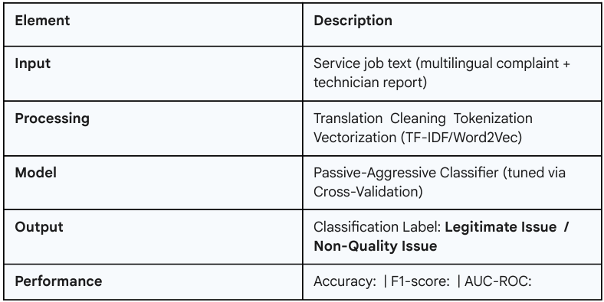
Minimum Viable Product (MVP)
The MVP demonstrates the core functionality using a tested classification model.

Slide 6
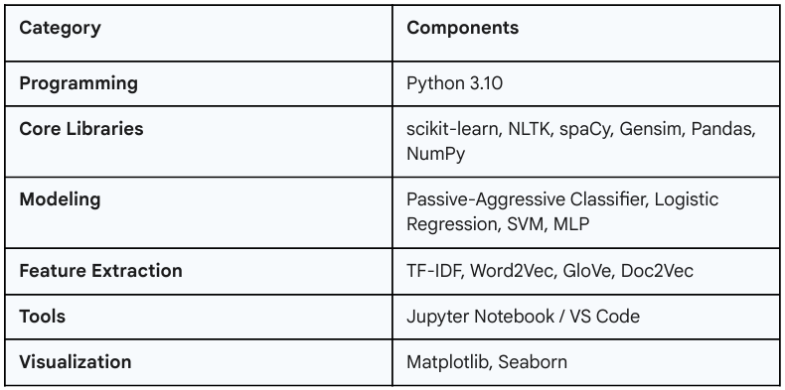
Technology Stack and Requirements

Slide 7
Safety Checklist
Safety and data privacy are paramount, especially when handling multilingual service reports.
Data privacy maintained; no personal identifiable information (PII).
Proper anonymization of text ensured before model training.
Ethical AI practices followed (e.g., no bias amplification).
Transparent and interpretable ML model implementation.
Secure storage of models and datasets with controlled access.

Slide 8
Reference
[1] A. Ittoo, A. van den Bosch et al., “Text analytics in industry: Challenges, desiderata and trends,” Computers in Industry, vol. 78, pp. 96–107, 2016.
[2] M. Anandarajan, C. Hill, T. Nolan, M. Anandarajan, C. Hill, and T. Nolan, “Text preprocessing,” Practical text analytics: Maximizing the value of text data, pp. 45–59, 2019.
[3] M. K. Dalal and M. A. Zaveri, “Automatic text clas sification: a technical review,” International Journal of Computer Applications, vol. 28, no. 2, pp. 37–40, 2011.

Slide 9
Thank You
Questions & Discussion

