Slide 1
Mobile Software Engineering
SoundView
Track A - Team 09
Alen Bisanovic,
Vlad Popescu-Vifor

Slide 2

SoundView
Ever had an image in your mind when listening to a song and wondered how an AI would perceive it?
Everyone has a different, unique imaginary illustration of a song and SoundView can either help you print out your imagination or offer you different perspectives that still relate to the song.

Slide 3
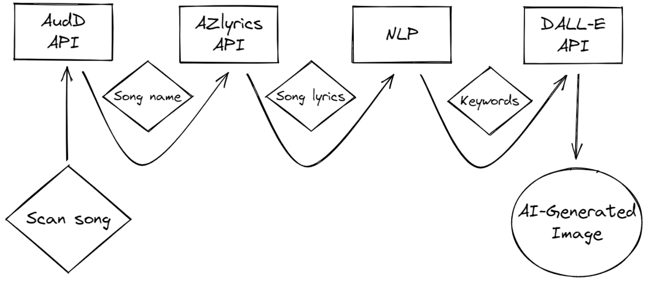
Overview of the app workflow

Slide 4

SoundView Demo

Slide 5
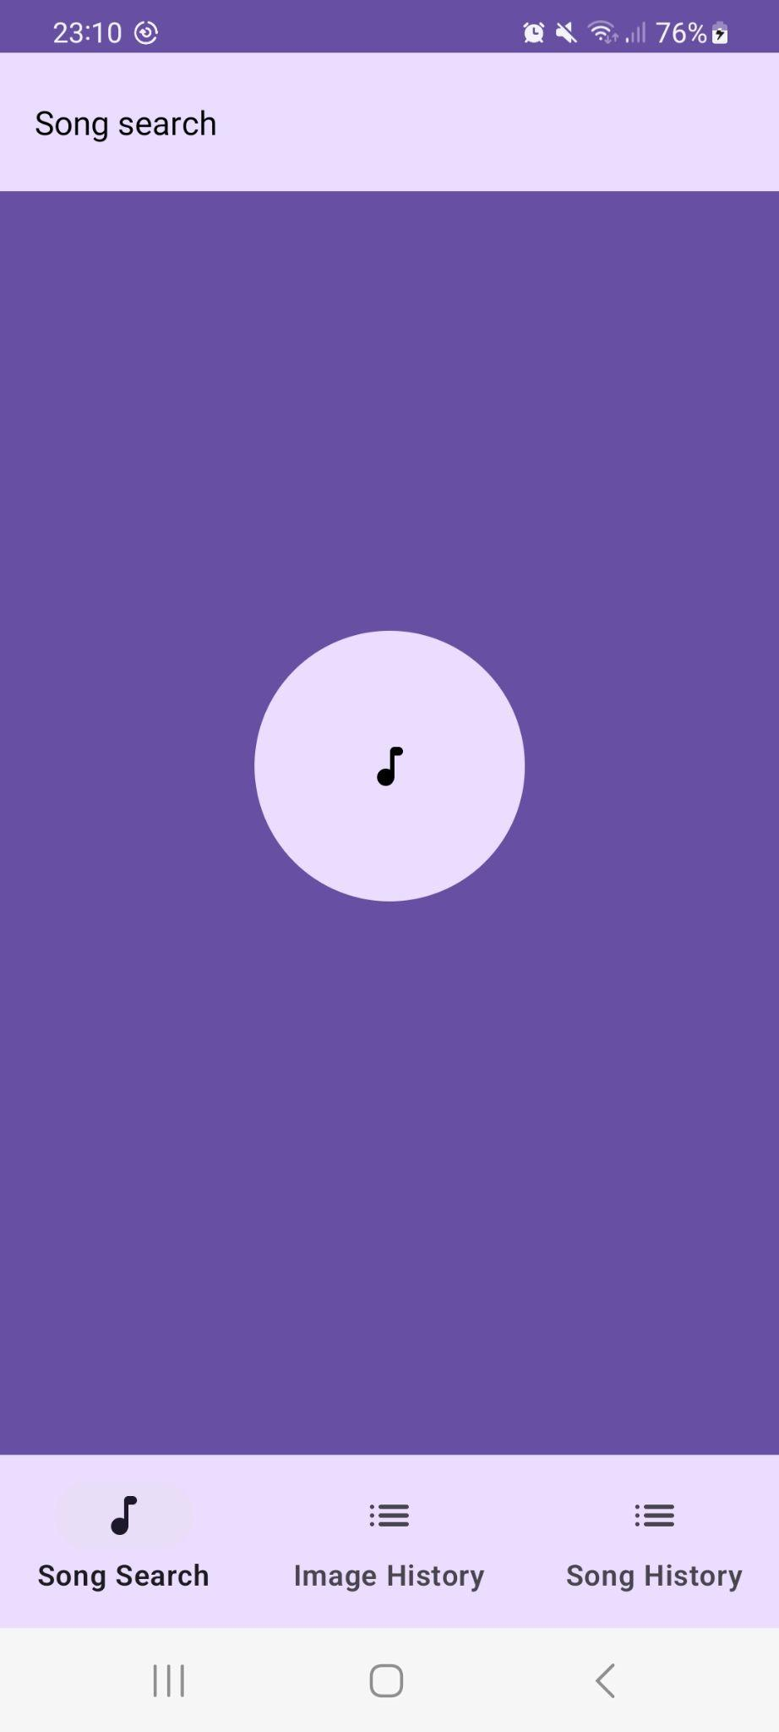
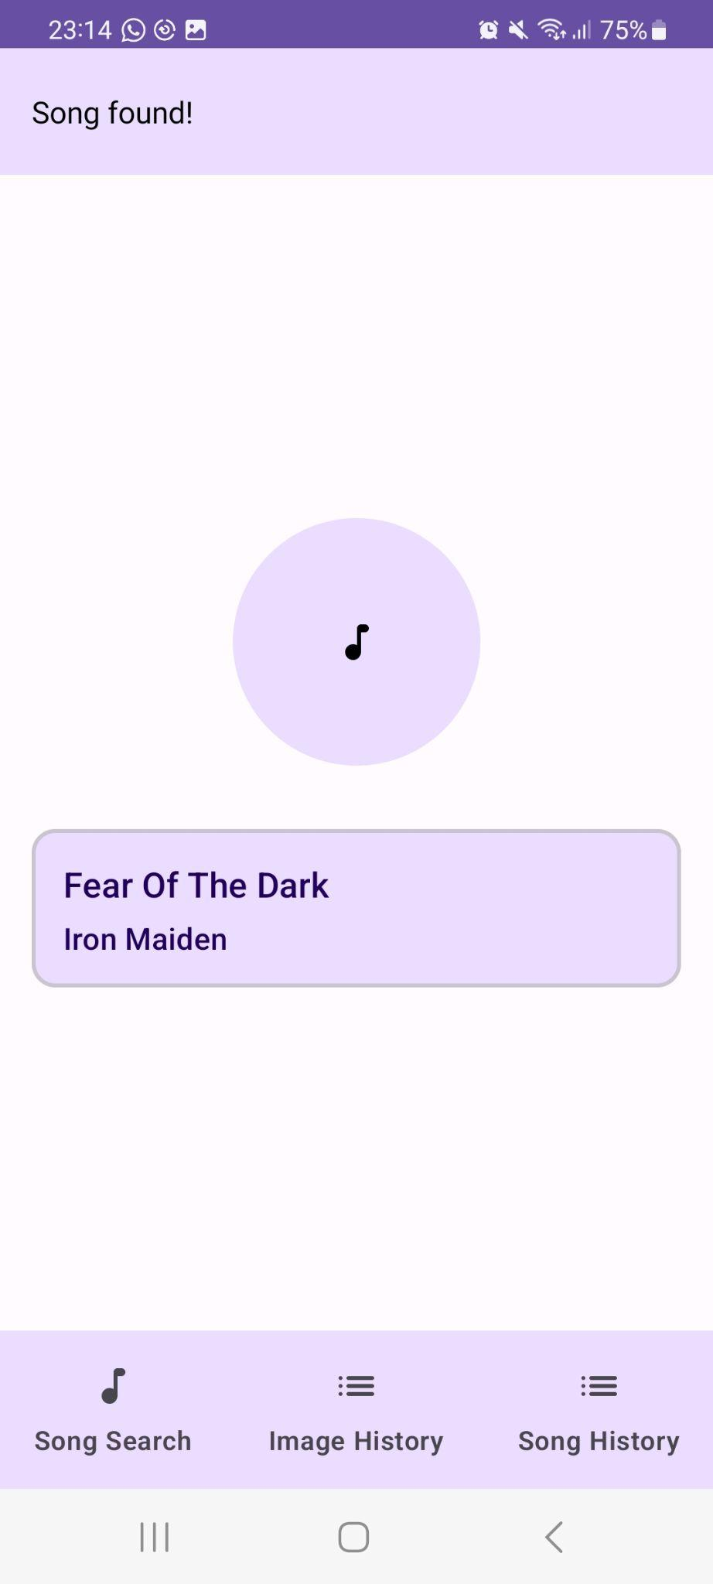
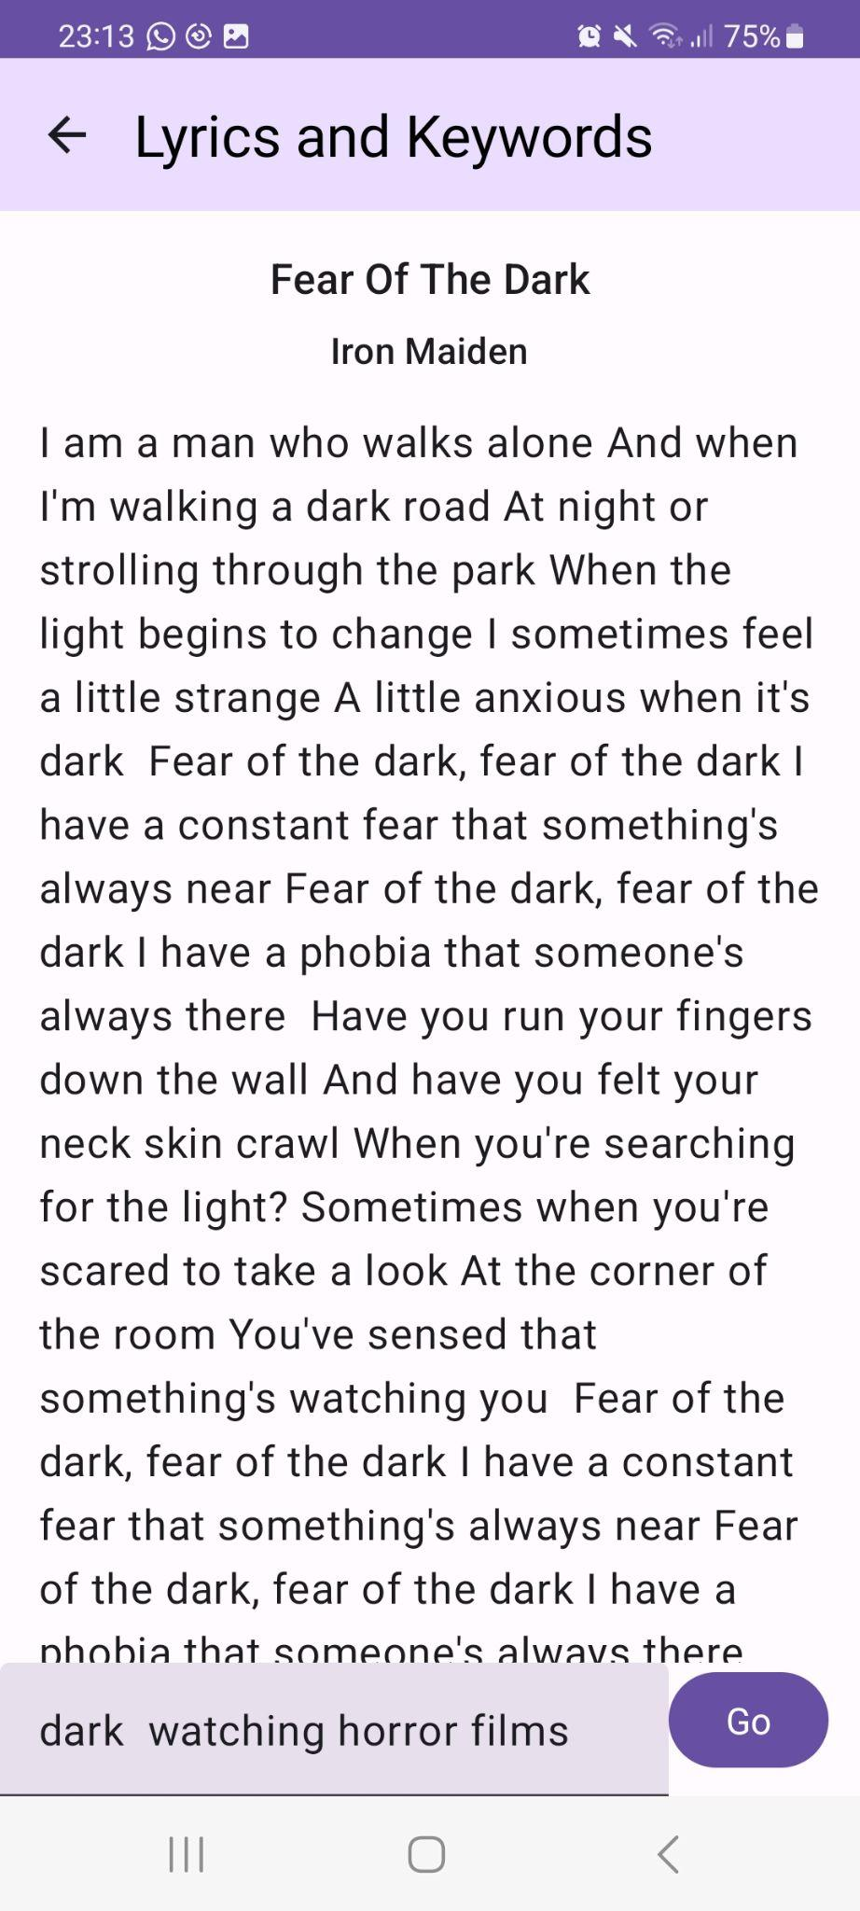
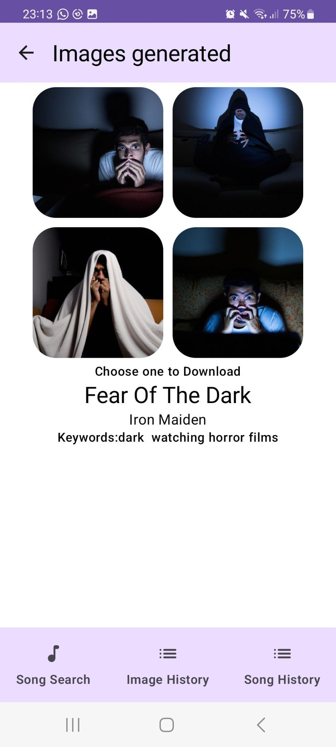
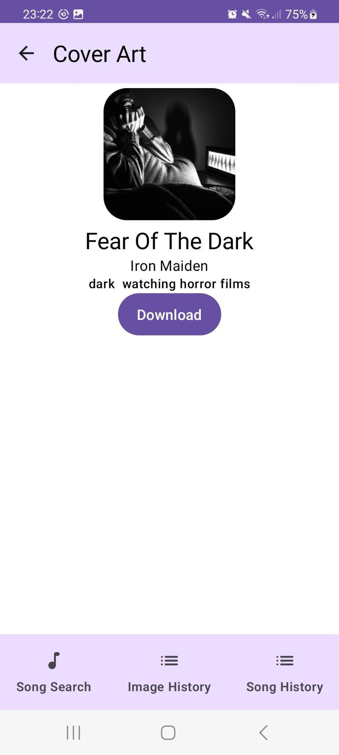
Overview of the app workflow

Slide 6
SoundView - Use Cases
Use Cases
Generating fitting album artwork for favourite songs
Customizing image generation with manual keyword input
Obtaining the main message of the song text through NLP
Creating a vast collection of unique, AI generated images

Slide 7
SoundView - Technical Aspects and Limitations
Migrating the UI from XML to Jetpack Compose
Better understanding of Kotlin
Implementation of Python scripts containing packages essential for app, ex. NLP
Configuring API interaction, inputs and outputs

Slide 8
Thank you for your attention!

