Slide 1
Random Numbers

Slide 2
This week
Project 2 Interviews: until Nov 4th
Homework 7: Nov 4th
Quiz 7: due Sunday, Nov 6th
Project 3 - CYO
Design Meeting: Nov 7th – Nov 9th
Code Skeleton due on Nov 10th

Slide 3
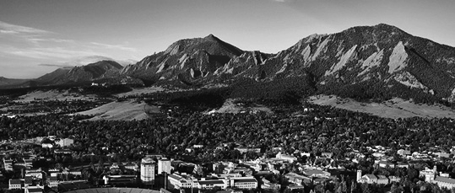
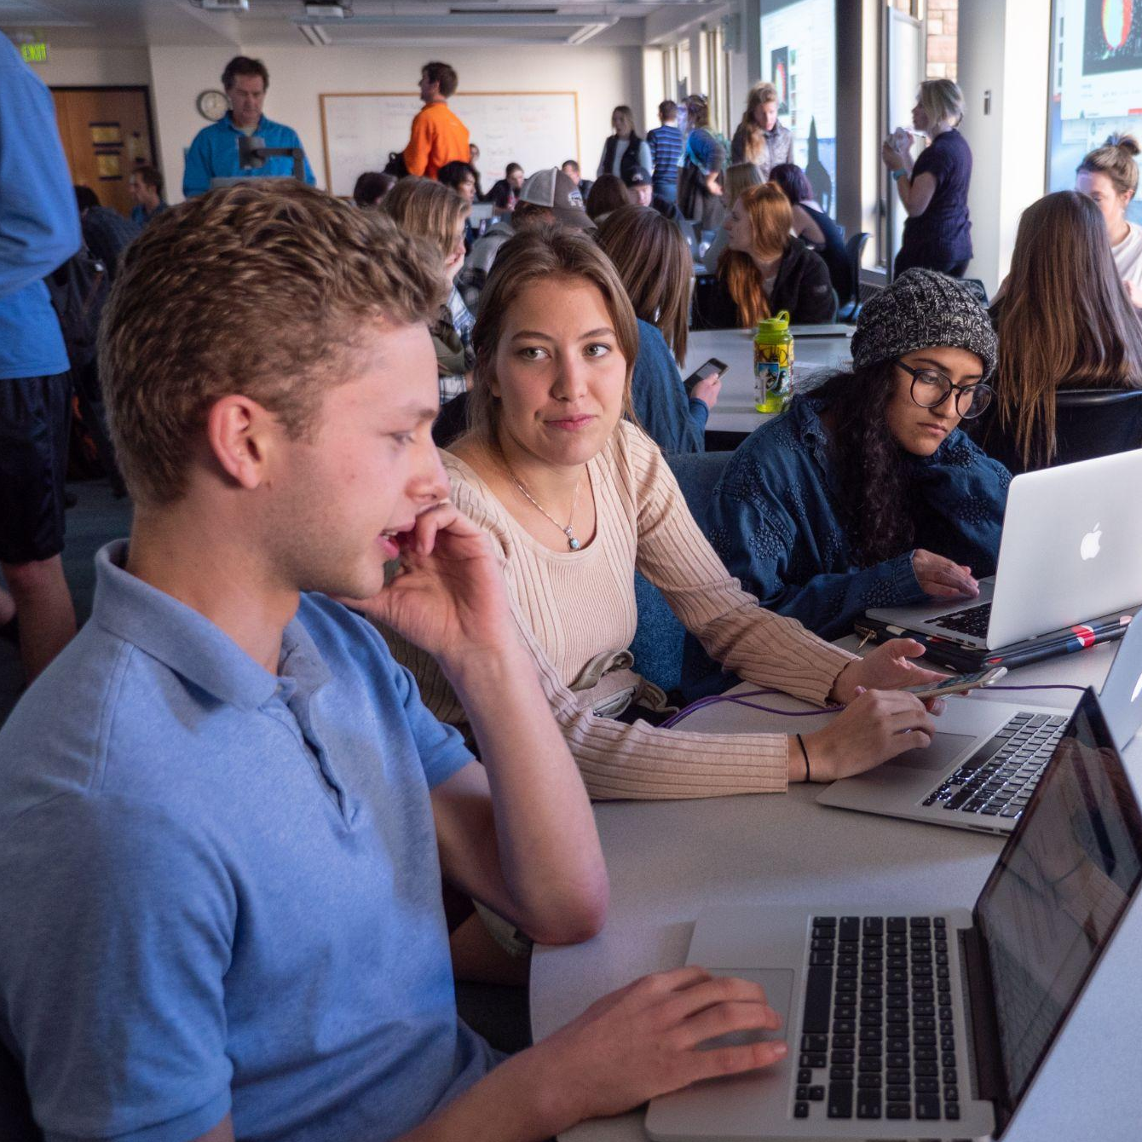
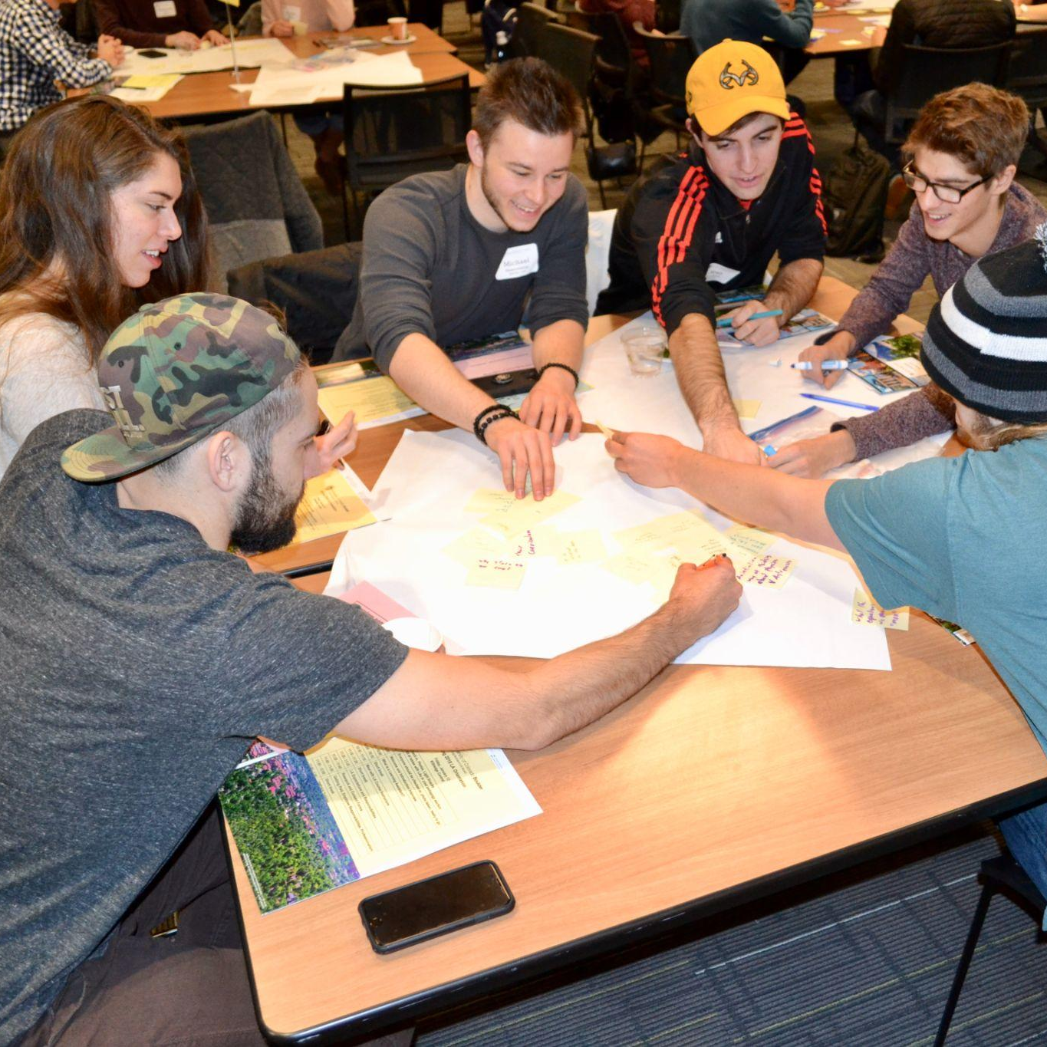


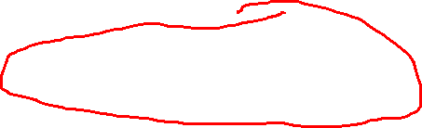
Undergrads, join our community!
Apply to be a Learning Assistant (LA) in Spring 2023
Get paid to collaborate with faculty to support in-class student learning and success!
Engage in training and support to help you do this important, fun, and challenging work!
Hiring Departments:
APPM
ASTR
BCHM
BCOR
CHEM
CSCI
COMM
ENGL
ENVS
GRMN
HIST
MATH
MCDB
NRSC
PSYC
PHYS
WRTG
Applications open:
October 28, 2022
*Some appointments in Continuing Education Online Learning
Priority application deadline:
November 7, 2022 for full consideration
Scan me to learn more!
https://www.colorado.edu/program/learningassistant/

Slide 4
Design Meetings
Your idea: what’s the story (at least a written outline)
Classes skeleton:
Data members
Member function stubs
Main class: “Game, World, Universe, …”
How you will meet requirements
What will you read from a file?
Where do the data come from/look like?
What will you write to a file?
Code skeleton: pseudocode
Game flow -- what functions?
Optional: Class diagrams

Slide 5
Today
Classes that have array of objects from another class as data members
Random numbers - To use a computer for simulations

Slide 6
Objects inside of objects
In Project 2:
in main()
Song songs[50];
Listener listeners[100];
above main()
int getSongPlayCount(string songName, string listenerName, Listener listeners[], Song songs[], int numListeners, int numSongs)

Slide 7
Objects inside of objects
Alternatively:
class Database
{
public:
int getSongPlayCount(string song, string listener);
…
private:
Song songs[50];
Listener listeners[100];
int numSongs;
int numListeners;
}

Slide 8
More examples
Card Deck – array of objects as a data member + random numbers
Voting – array of objects as a data member + random numbers
Town – vectors + sorting

Slide 9
Objectives
To understand the potential applications of simulation as a way to solve real-world problems.
To understand pseudorandom numbers and their application in simulations.
To understand and be able to apply top-down and spiral design techniques in writing complex programs.
Based on “racquetball” simulation: Zelle, Python Programming, 3e

Slide 10
Simulating Tennis Game
Simulation can solve real-world problems by modeling real-world processes to provide otherwise unobtainable information.
What are simulations used for?

Slide 11
Simulating Tennis Game
Simulation can solve real-world problems by modeling real-world processes to provide otherwise unobtainable information.
Computer simulation is used to predict the weather, design aircraft, create special effects for movies, etc.

Slide 12
A Simulation Problem
Susan often plays tennis with players who are slightly better than she is.
Susan usually loses her matches!
Shouldn’t players who are a little better win a little more often?
Michelle suggests that they write a simulation to see if slight differences in ability can cause such large differences in scores.

Slide 13
Analysis and Specification
Tennis is played between two players using a racquet to hit a ball in a court, across the net.
One player starts the game by putting the ball in motion – serving.
Players try to alternate hitting the ball to keep it
in play, referred to as a rally. The rally ends when
one player hits a shot out, or in the net.

Slide 14

Analysis and Specification
Players alternate serve. First to win 6 games wins the set.
There must be at least a 2 games gap. 6-5 would not be a valid set score.
Tiebreak, or 2 games advantage, i.e 8-6
The first player to win 3 sets wins the match

Slide 15
Analysis and Specification
In our simulation, the ability level of the players will be represented by the probability that the player wins their serve when they serve.
Example: Players with a 0.60 probability win 60% of their serves.
The program will prompt the user to enter the service probability for both players and then simulate multiple matches of tennis.
The program will then print a summary of the results.

Slide 16
Analysis and Specification
Input:
The program prompts for and gets the service probabilities of players A and B. The program then prompts for and gets the number of matches to be simulated.

Slide 17
Analysis and Specification
Output: The program then prints out a nicely formatted report showing the number of games simulated and the number of wins and the winning percentage for each player.
Matches simulated: 500 Wins for A: 268 (53.6%) Wins for B: 232 (46.4%)
Notes:
All inputs are assumed to be legal numeric values, no error or validity checking is required.
In each simulated game, player A serves first.

Slide 18
PseudoRandom Numbers
When we say that player A wins 50% of the time, that doesn’t mean they win every other game. Rather, it’s more like a coin toss.
Overall, half the time the coin will come up heads, the other half the time it will come up tails, but one coin toss does not effect the next (it’s possible to get 5 heads in a row).

Slide 19
PseudoRandom Numbers
A similar approach is used to generate random (technically pseudorandom) numbers.
A pseudorandom number generator works by starting with a seed value. This value is given to a function to produce a “random” number.
The next time a random number is required, the current value is fed back into the function to produce a new number.

Slide 20
PseudoRandom Numbers
What do we need:
#include <stdlib.h> // for the rand() function
#include <time.h> // for time() function
rand()
srand()

Slide 21
PseudoRandom Numbers
Example: tennis_v0.cpp

Slide 22
Top-Down Design
In top-down design, a complex problem is expressed as a solution in terms of smaller, simpler problems.
These smaller problems are then solved by expressing them in terms of smaller, simpler problems.
This continues until the problems are trivial to solve. The little pieces are then put back together as a solution to the original problem!

Slide 23
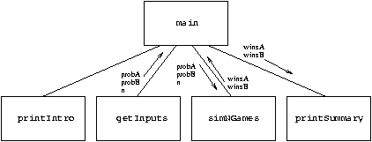
Separation of Concerns

Slide 24
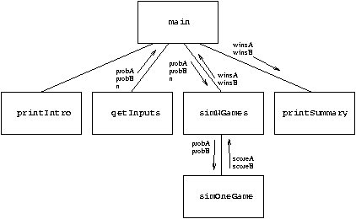
Designing simNGames

Slide 25
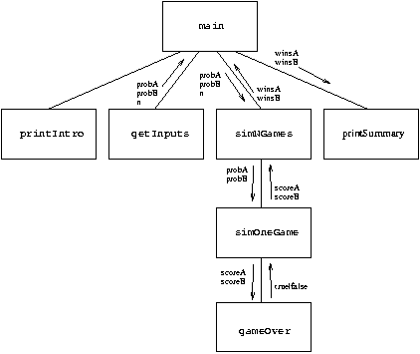
Third-Level Design

Slide 26
Summary of the Design Process
We start at the highest level of our structure chart and work our way down.
At each level, we begin with a general algorithm and refine it into precise code.
This process is sometimes referred to as step-wise refinement.

Slide 27
Summary of the Design Process
Express the algorithm as a series of smaller problems.
Develop an interface for each of the small problems.
Detail the algorithm by expressing it in terms of its interfaces with the smaller problems.
Repeat the process for each smaller problem.

Slide 28
Other Design Techniques
Top-down design is not the only way to create a program!

Slide 29
Prototyping and Spiral Development
Another approach to program development is to start with a simple version of a program, and then gradually add features until it meets the full specification.
This initial stripped-down version is called a prototype.

Slide 30
Prototyping and Spiral Development
Prototyping often leads to a spiral development process.
Rather than taking the entire problem and proceeding through specification, design, implementation, and testing, we first design, implement, and test a prototype. We take many mini-cycles through the development process as the prototype is incrementally expanded into the final program.

Slide 31
Prototyping and Spiral Development
How could the tennis simulation been done using spiral development?
Write a prototype where you assume there’s a 50-50 chance of winning any given point, playing 30 serves.
Add on to the prototype in stages, including awarding of points, change of service, differing probabilities, etc.

Slide 32
Prototyping and Spiral Development
Examples:
tennis_v1.cpp
tennis_v2.cpp
tennis_v3.cpp
tennis_v4.cpp
tennis_v5.cpp
tennis_v6.cpp

Slide 33
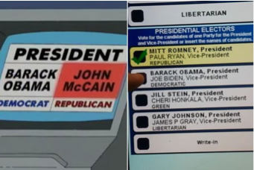
Let’s simulate an Election
Example: Write code to simulate an election.

Slide 34
Let’s simulate an Election
Example: Write code to simulate an election.
Wait! .. That’s it? Okay …
What do we need to get started?

Slide 35
Let’s simulate an Election
Example: Write code to simulate an election.
Wait! .. That’s it? Okay …
What do we need to get started?
Voting Machines
Voting Centers
Simulation of voter choices

Slide 36
Let’s simulate an Election
Example: Write code to simulate an election.
Wait! .. That’s it? Okay …
What do we need to get started?
Voting Machines
Voting Centers
Simulation of voter choices
Classes for voting machines and centers
rand() simulation for who votes for what

