Slide 1
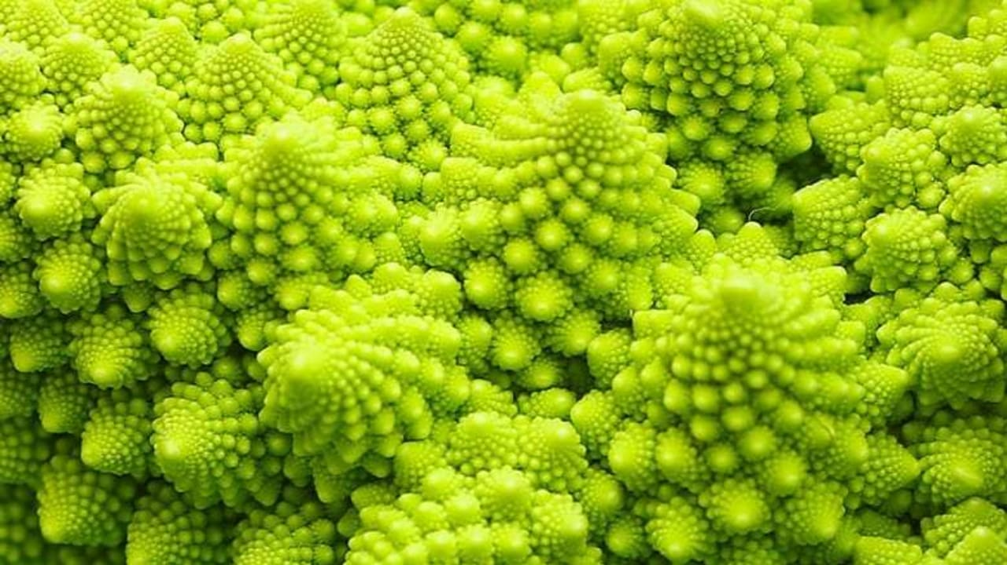
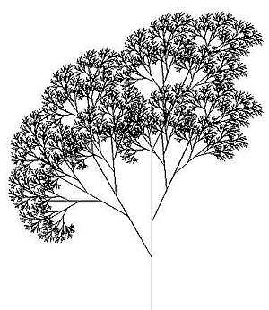
Recursion

Slide 2
Recursive Functions
A recursive function is a function that calls itself, reducing the problem a bit on each call:
void solveIt(the-Problem)
{
. . .
solveIt(the-Problem-a-bit-reduced);
}
Of course, there’s a lot/little more to it than this.

Slide 3

Recursion
Recursion is a powerful technique for breaking up complex computational problems into simpler ones,
where the “simpler one” is the solution to the whole problem!
Recursion is often the most natural way of thinking about a problem, and there are some computations that are difficult to perform without recursion.

Slide 4
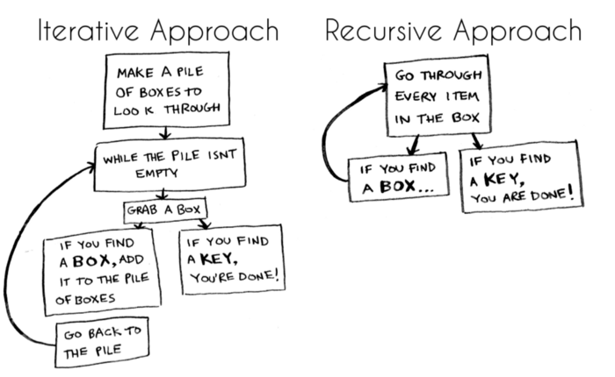

Slide 5
How to think recursively? The Three Laws
The two keys requirements for a successful recursive function:
A recursive algorithm must have a base case
A recursive algorithm must change its state and move toward the base case
A recursive algorithm must call itself, recursively

Slide 6
Base case vs. recursive case
Every recursive call must simplify the task in some way.
There must be special cases to handle the simplest tasks directly so that the function will stop calling itself.
base case(s ) – simplest task(s)
recursive case – break problem into smaller version of itself

Slide 7
Thinking Recursively – Palindromes
Palindrome: a string that is equal to itself when you reverse all characters
Example: Madam, I’m Adam

Slide 8
Thinking Recursively – Palindromes (1)
The problem: Write a function to test if a string is a palindrome.
bool is_palindrome(string s)

Slide 9
Thinking Recursively – Palindromes – an aside: iteratively
The problem: Write a function to test if a string is a palindrome.
bool is_palindrome(string s)

Slide 10
Thinking Recursively – Palindromes: recursively
The problem: Write a function to test if a string is a palindrome.
bool is_palindrome(string s)
Step 1: Break the input into parts that can themselves be inputs to the problem.
Focus on a particular input or set of inputs for the problem.
Think how you can simplify the inputs in such a way that the same function can be applied to the simpler input.

Slide 11
Thinking Recursively – Palindromes (2)
To get simpler inputs, how about :
Remove the first character?
Remove the last character?
Remove a character from the middle?
Cut the string into two halves?
Remove both the first and the last character?

Slide 12
Thinking Recursively – Palindromes (3)
Every palindrome’s first half is the same as its other half.
In this problem, chopping in half seems to be a good way to reduce the problem. But:
"rotor"
(chop)
"rot" "or"
Not sure how chopping in half gets us closer to a way to determine a palindromic situation.

Slide 13
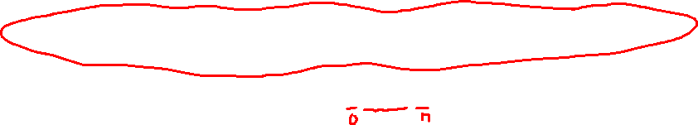
Thinking Recursively – Palindromes (4)
One character at a time seems not so good.
How about chopping off BOTH ends at the same time?
"rotor"
(chop) (chop)
"r" "oto" "r"
We can reduce the problem to the “middle” of the string for the recursive call.

Slide 14
Thinking Recursively – Palindromes (5)
Step 2: Combine solutions with simpler inputs to a solution of the original problem.
"rotor"
(chop) (chop)
"r" "oto" "r"
If the end letters are the same AND is_palindrome( the middle word ) then the string is a palindrome!

Slide 15
Thinking Recursively – Palindromes (6)
Step 3: Find solutions to the simplest inputs.
A recursive computation keeps simplifying its inputs.
Eventually it arrives at very simple inputs. To make sure that the recursion comes to a stop, deal with the simplest inputs separately.
That leaves us with two possible end situations, both of which are palindromes themselves:
string of length 0, and string of length 1
bool is_palindrome(string s)
{
// Separate case for shortest strings
if (s.length() <= 1 ){ return true; }
...

Slide 16
Thinking Recursively – Palindromes (7)
Step 4: Implement the solution by combining the simple cases and the reduction step.
. . .
// Get first and last character, converted to lowercase
char first = tolower(s[0]);
char last = tolower(s[s.length() - 1]);
if (first == last)
{
string shorter = s.substr(1, s.length() - 2);
return is_palindrome(shorter);
}
else
{
return false;
}
}

Slide 17
Iteration vs. Recursion
So is the iterative solution always faster than the recursive?
Look at the iterative palindrome solution
bool is_palindrome(string s)
{
int start = 0;
int end = s.length() - 1;
while (start < end)
{
if (s[start] != s[end]) { return false; }
start++;
end--;
}
return true;
}

Slide 18
Iteration vs. Recursion (2)
If a palindrome has n characters,
the iteration executes the loop n/2 times.
the recursive solution calls itself n/2 times, because two characters are removed in each step.

Slide 19

The Fibonacci Sequence
Recursion can lead to simpler solutions to problems, but recursive algorithms many perform poorly.
The Fibonacci sequence is a sequence of numbers defined by the equations:
f₁ =1
f₂=1
f_{n} = f_{n-1} + f_{n-2}
Each value in the sequence is the sum of the 2 preceding.
The first ten terms of the sequence:
1, 1, 2, 3, 5, 8, 13, 21, 34, 55,…

Slide 20
Fibonacci Call Tree

Slide 21
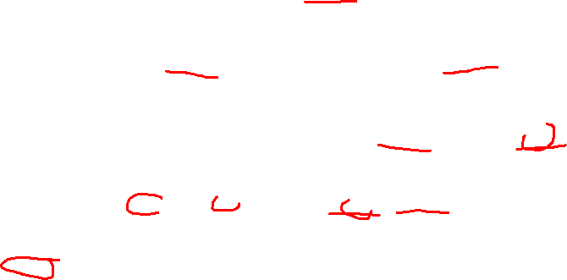
Fibonacci Call Tree
This can be shown more clearly as a call tree.
Notice that the same values, for example, fib(2), are computed over and over, and each recursive call generates 2 more calls

