Slide 1
AQO

Slide 2
Немного об оптимизаторе
Оптимизатор – это модуль в системе управления базами данных, который получает дерево запросов, переданное из модуля синтаксического анализа и на основе его выполняет эквивалентные логические преобразования и отображает физический путь выполнения, а также передает выбранный оптимальный путь выполнения экзекютору. Короче говоря, оптимизатор запросов имеет дерево запросов в качестве входных данных и план выполнения запроса в качестве выходных данных.
Чем он хорош? Информация между оптимизатором запросов и пользователем базы данных асимметрична. В процессе оптимизации оптимизатор запросов будет ссылаться на статистику, автоматически генерируемую модулем статистики базы данных. Эти статистические данные описывают распределение данных в таблицах со всех сторон. Пользователь базы данных не может всесторонне понять распределение данных, и даже, если пользователь базы данных получит все статистические данные, оптимизатор запросов всесторонне рассмотрит различные данные в статистике, чтобы получить хороший план выполнения. Пользователь базы данных не может всесторонне понять распределение данных, даже если пользователь базы данных получает все статистические данные.

Slide 3
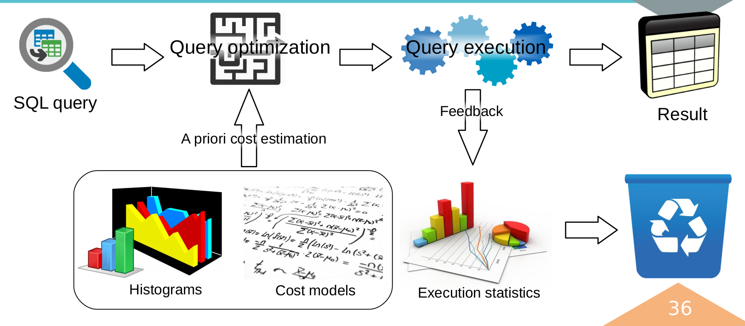
Немного об оптимизаторе
В качестве исходных данных использует статистику
Генерирует классы эквивалентности из заданных условий (x=y, y=z → x=z)
Материализует ноды, что сокращает количество повторений некоторых операций

Slide 4
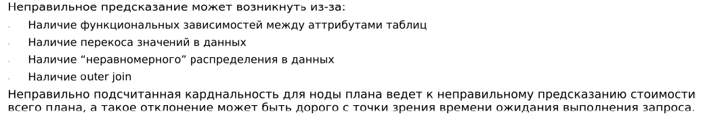
Оптимизатор. А какие сложности?
Query clauses
How good are query optimizers, really?
V. Leis, A. Gubichev,
A. Mirchev et al.
Cardinality estimation
Cost estimation
Information about stored data
PostgresSQL state

Slide 5
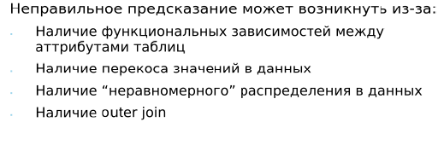

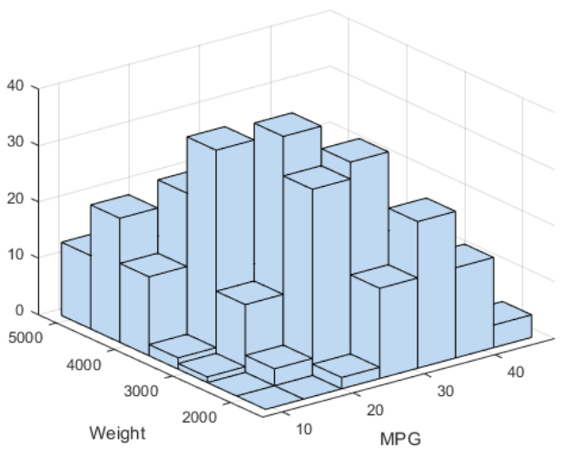


Оптимизатор. Но это же можно решить?.
Кто ее будет отследивать и вести?
Хватит ли место в памяти?
Когда будем ее актуализировать?
How good are query optimizers, really?
V. Leis, A. Gubichev,
A. Mirchev et al.
Query clauses
Когда будем ее вызывать?
Cardinality estimation
Cost estimation
А он везде хорош?
Почти...
Information about stored data
PostgresSQL state

Slide 6
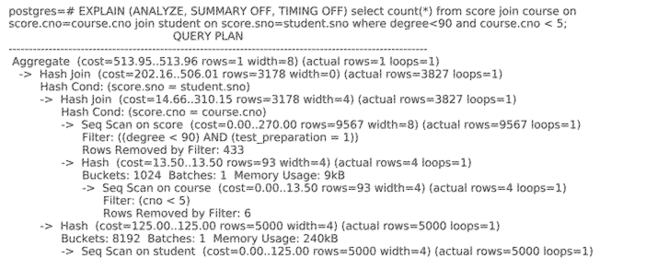
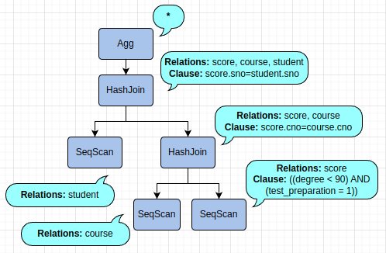
А как анализировать запросы?
AQO имеет свой Explain вывод. Его можно настроить с помощью:
  aqo.show_details = 'on'
  aqo.show_hash='on'

Slide 7
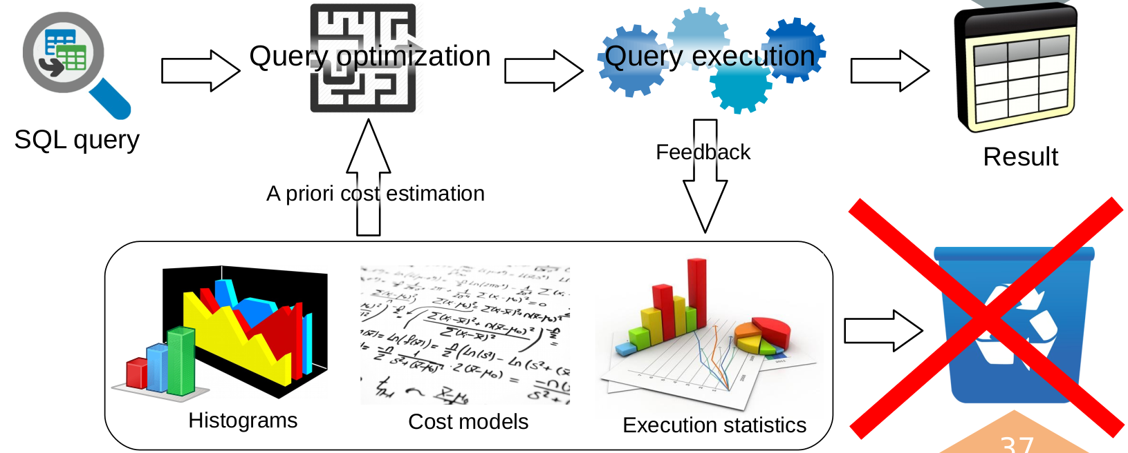
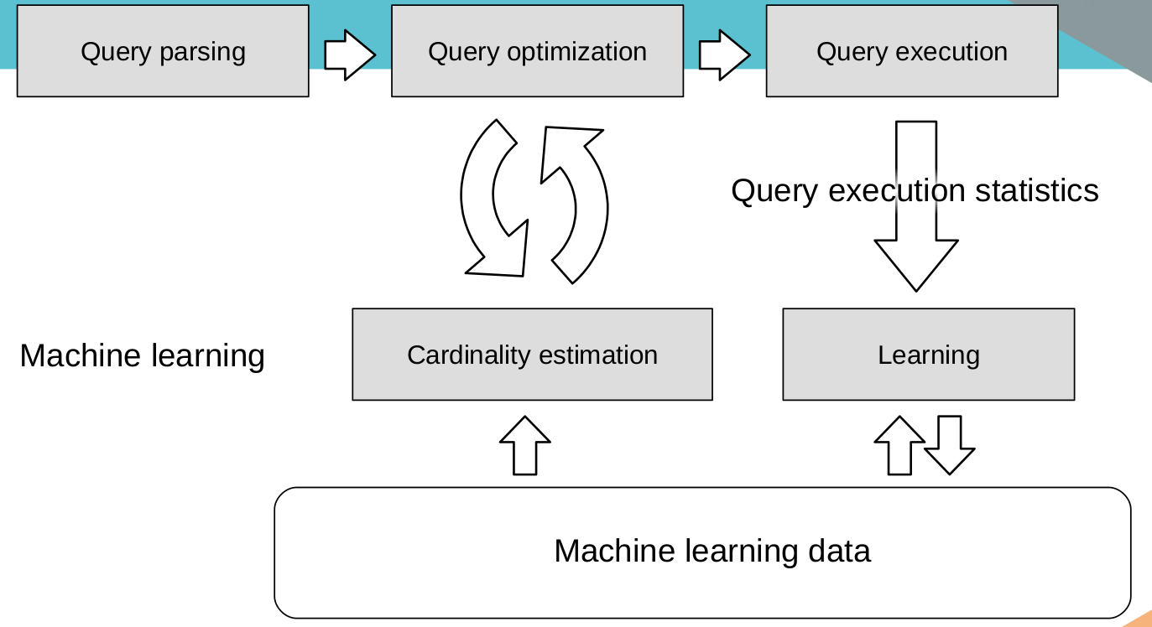
Что такое AQO? Чем он хорош?
Adaptive Query Optimization (AQO), 2016
Использует знания о ранее выполнявшихся запросах для оптимизации новых
Хранит сведения о результатах выполнения запросов в компактной форме

Slide 8
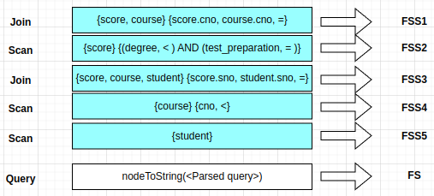
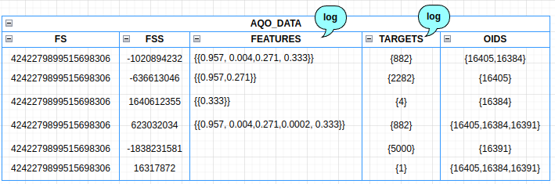
Как происходит магия?
postgres=# EXPLAIN (ANALYZE, SUMMARY OFF, TIMING OFF) select count(*) from score join course on score.cno=course.cno join student on score.sno=student.sno where test_preparation=1 and degree<90;
QUERY PLAN
----------------------------------------------------------------------------------------------------------
Aggregate (cost=519.04..519.05 rows=1 width=8) (actual rows=1 loops=1)
AQO not used, fss=0
-> Hash Join (cost=203.80..512.55 rows=2597 width=0) (actual rows=2282 loops=1)
AQO not used, fss=2128507884
Hash Cond: (score.sno = student.sno)
-> Hash Join (cost=16.30..318.22 rows=2597 width=4) (actual rows=2282 loops=1)
AQO not used, fss=-303037802
Hash Cond: (score.cno = course.cno)
-> Seq Scan on score (cost=0.00..295.00 rows=2597 width=8) (actual rows=2282 loops=1)
AQO not used, fss=-636613046
Filter: ((degree < 90) AND (test_preparation = 1))
Rows Removed by Filter: 7718
-> Hash (cost=12.80..12.80 rows=280 width=4) (actual rows=10 loops=1)
Buckets: 1024 Batches: 1 Memory Usage: 9kB
-> Seq Scan on course (cost=0.00..12.80 rows=280 width=4) (actual rows=10 loops=1)
AQO not used, fss=-1076069505
-> Hash (cost=125.00..125.00 rows=5000 width=4) (actual rows=5000 loops=1)
Buckets: 8192 Batches: 1 Memory Usage: 240kB
-> Seq Scan on student (cost=0.00..125.00 rows=5000 width=4) (actual rows=5000 loops=1)
AQO not used, fss=-1838231581
Using aqo: true
AQO mode: LEARN
Query hash: 7941266727477665893
JOINS: 2
(24 rows)

Slide 9
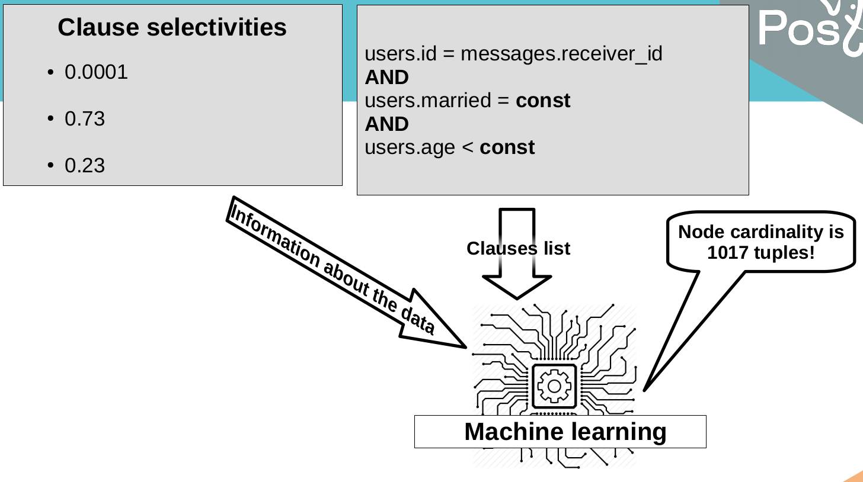
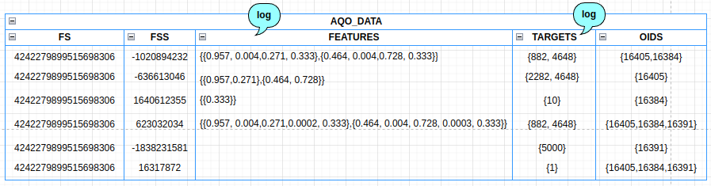
А если константы поменяются?
postgres=# EXPLAIN (ANALYZE, SUMMARY OFF, TIMING OFF) select count(*) from score join course on score.cno=course.cno join student on score.sno=student.sno where degree<70 and course.cno < 12 and test_preparation = 0;
QUERY PLAN
--------------------------------------------------------------------------------------------------------------
Aggregate (cost=492.93..492.94 rows=1 width=8) (actual rows=1 loops=1)
AQO not used, fss=0
-> Hash Join (cost=325.65..490.72 rows=882 width=0) (actual rows=4648 loops=1)
AQO: rows=882, error=-427%, fss=623032034
Hash Cond: (student.sno = score.sno)
-> Seq Scan on student (cost=0.00..125.00 rows=5000 width=4) (actual rows=5000 loops=1)
AQO: rows=5000, error=0%, fss=-1838231581
-> Hash (cost=314.63..314.63 rows=882 width=4) (actual rows=4648 loops=1)
Buckets: 8192 (originally 1024) Batches: 1 (originally 1) Memory Usage: 228kB
-> Hash Join (cost=13.55..314.63 rows=882 width=4) (actual rows=4648 loops=1)
AQO: rows=882, error=-427%, fss=-1020894232
Hash Cond: (score.cno = course.cno)
-> Seq Scan on score (cost=0.00..295.00 rows=2282 width=8) (actual rows=4648 loops=1)
AQO: rows=2282, error=-104%, fss=-636613046
Filter: ((degree < 70) AND (test_preparation = 0))
Rows Removed by Filter: 5352
-> Hash (cost=13.50..13.50 rows=4 width=4) (actual rows=10 loops=1)
Buckets: 1024 Batches: 1 Memory Usage: 9kB
-> Seq Scan on course (cost=0.00..13.50 rows=4 width=4) (actual rows=10 loops=1)
AQO: rows=4, error=-150%, fss=1640612355
Filter: (cno < 12)
Using aqo: true
AQO mode: LEARN
Query hash: 4242279899515698306
JOINS: 2
(25 rows)
Information about data
Node cardinality is 1017 tuples!
Clause list

Slide 10
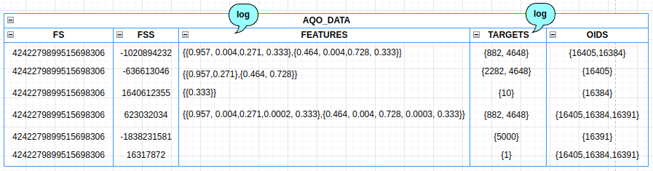
А тут уже ошибка 0!
postgres=# EXPLAIN (ANALYZE, SUMMARY OFF, TIMING OFF) select count(*) from score join course on score.cno=course.cno join student on score.sno=student.sno where degree<70 and course.cno < 12 and test_preparation = 0;
QUERY PLAN
---------------------------------------------------------------------------------------------------------
Aggregate (cost=532.31..532.32 rows=1 width=8) (actual rows=1 loops=1)
AQO not used, fss=0
-> Hash Join (cost=201.12..520.70 rows=4642 width=0) (actual rows=4648 loops=1)
AQO: rows=4642, error=-0%, fss=623032034
Hash Cond: (score.sno = student.sno)
-> Hash Join (cost=13.62..321.01 rows=4642 width=4) (actual rows=4648 loops=1)
AQO: rows=4642, error=-0%, fss=-1020894232
Hash Cond: (score.cno = course.cno)
-> Seq Scan on score (cost=0.00..295.00 rows=4645 width=8) (actual rows=4648 loops=1)
AQO: rows=4645, error=-0%, fss=-636613046
Filter: ((degree < 70) AND (test_preparation = 0))
Rows Removed by Filter: 5352
-> Hash (cost=13.50..13.50 rows=10 width=4) (actual rows=10 loops=1)
Buckets: 1024 Batches: 1 Memory Usage: 9kB
-> Seq Scan on course (cost=0.00..13.50 rows=10 width=4) (actual rows=10 loops=1)
AQO: rows=10, error=0%, fss=1640612355
Filter: (cno < 12)
-> Hash (cost=125.00..125.00 rows=5000 width=4) (actual rows=5000 loops=1)
Buckets: 8192 Batches: 1 Memory Usage: 240kB
-> Seq Scan on student (cost=0.00..125.00 rows=5000 width=4) (actual rows=5000 loops=1)
AQO: rows=5000, error=0%, fss=-1838231581
Using aqo: true
AQO mode: LEARN
Query hash: 4242279899515698306
JOINS: 2
(25 rows)
Тут планируется схемка про добавление еще строку в матрицу features, сглаживание предыдущих результатов на результат ошибки и сохранение новых результатов!

Slide 11
А тут уже ошибка 0!
postgres=# EXPLAIN (ANALYZE, SUMMARY OFF, TIMING OFF) select count(*) from score join course on score.cno=course.cno join student on score.sno=student.sno where degree<70 and course.cno < 12 and test_preparation = 0;
QUERY PLAN
---------------------------------------------------------------------------------------------------------
Aggregate (cost=532.31..532.32 rows=1 width=8) (actual rows=1 loops=1)
AQO not used, fss=0
-> Hash Join (cost=201.12..520.70 rows=4642 width=0) (actual rows=4648 loops=1)
AQO: rows=4642, error=-0%, fss=623032034
Hash Cond: (score.sno = student.sno)
-> Hash Join (cost=13.62..321.01 rows=4642 width=4) (actual rows=4648 loops=1)
AQO: rows=4642, error=-0%, fss=-1020894232
Hash Cond: (score.cno = course.cno)
-> Seq Scan on score (cost=0.00..295.00 rows=4645 width=8) (actual rows=4648 loops=1)
AQO: rows=4645, error=-0%, fss=-636613046
Filter: ((degree < 70) AND (test_preparation = 0))
Rows Removed by Filter: 5352
-> Hash (cost=13.50..13.50 rows=10 width=4) (actual rows=10 loops=1)
Buckets: 1024 Batches: 1 Memory Usage: 9kB
-> Seq Scan on course (cost=0.00..13.50 rows=10 width=4) (actual rows=10 loops=1)
AQO: rows=10, error=0%, fss=1640612355
Filter: (cno < 12)
-> Hash (cost=125.00..125.00 rows=5000 width=4) (actual rows=5000 loops=1)
Buckets: 8192 Batches: 1 Memory Usage: 240kB
-> Seq Scan on student (cost=0.00..125.00 rows=5000 width=4) (actual rows=5000 loops=1)
AQO: rows=5000, error=0%, fss=-1838231581
Using aqo: true
AQO mode: LEARN
Query hash: 4242279899515698306
JOINS: 2
(25 rows)

Slide 12
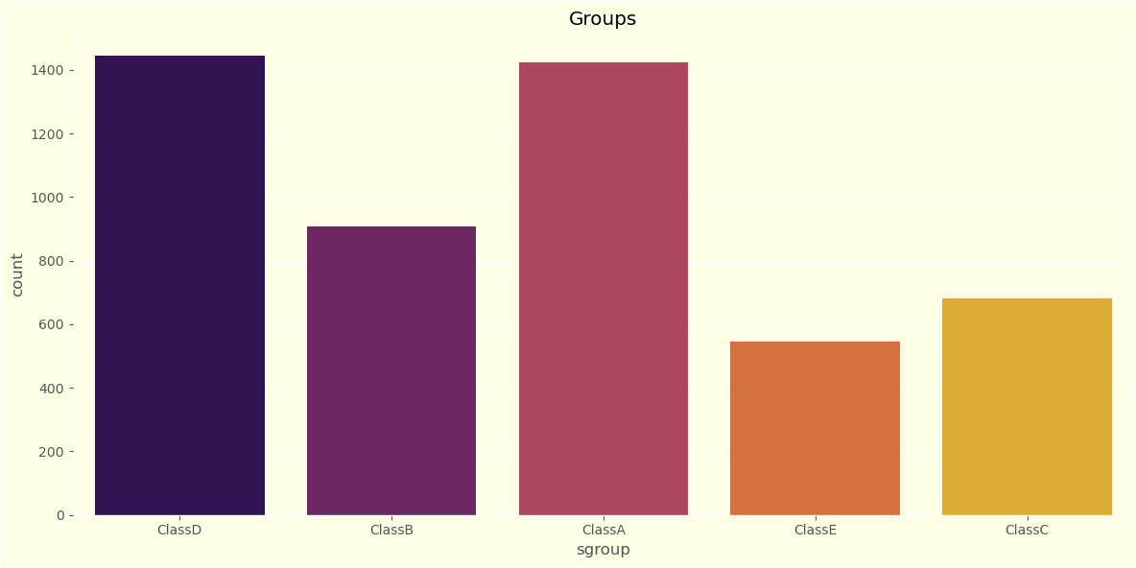
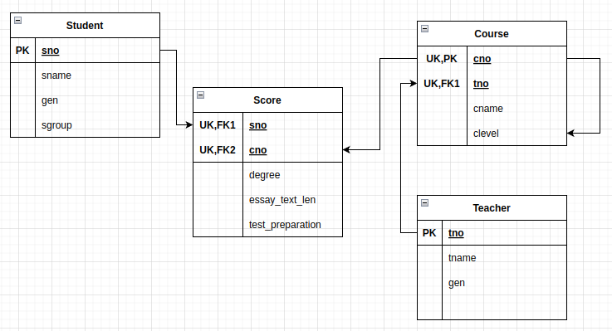
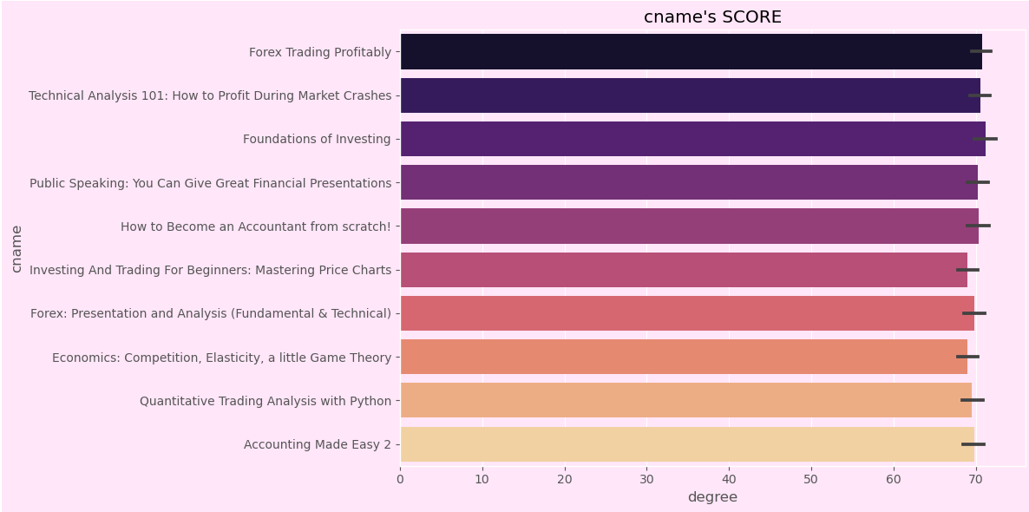
А теперь к проблемам... Описание схемы

Slide 13
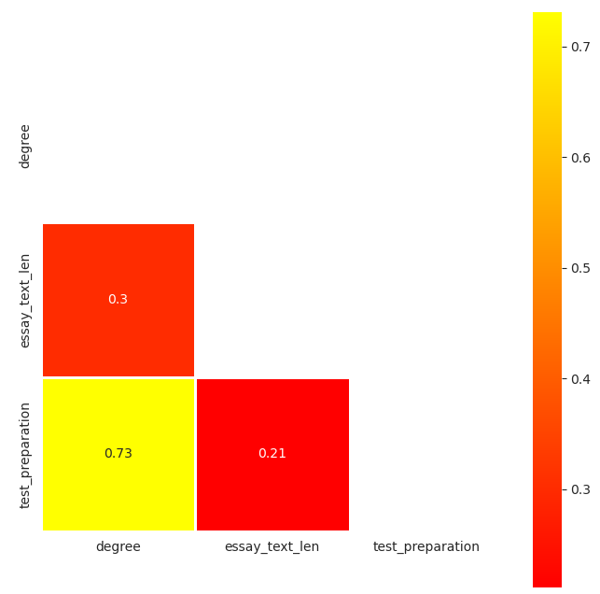
Запрос 1. Случай 1
Имеем наличие функциональных зависимостей между аттрибутами таблиц: test_preparaion и degree
postgres=# explain analyze select cname, avg(degree) from score, course where test_preparation=1
and degree<70 group by (cname);
QUERY PLAN
----------------------------------------------------------------------------------------------------------------
HashAggregate (cost=462.02..462.15 rows=10 width=77) (actual time=6.985..6.988 rows=0 loops=1)
Group Key: course.cname
Batches: 1 Memory Usage: 24kB
-> Nested Loop (cost=0.00..404.62 rows=11480 width=49) (actual time=6.980..6.983 rows=0 loops=1)
-> Seq Scan on score (cost=0.00..260.00 rows=1148 width=4) (actual time=6.978..6.979 rows=0 loops=1)
Filter: ((degree < 70) AND (test_preparation = 1))
Rows Removed by Filter: 9000
-> Materialize (cost=0.00..1.15 rows=10 width=45) (never executed)
-> Seq Scan on course (cost=0.00..1.10 rows=10 width=45) (never executed)
Planning Time: 0.325 ms
Execution Time: 7.142 ms
(11 rows)

Slide 14
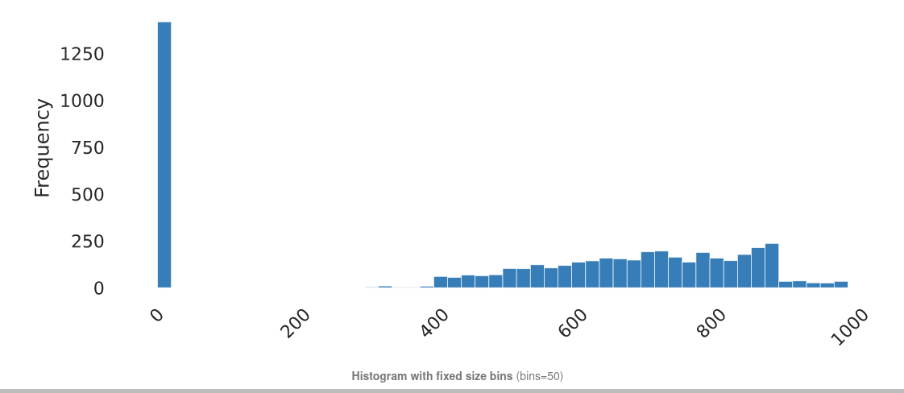
Запрос 2. Случай 2
Имеем наличие перекоса значений в данных: essay_text_len
postgres=# explain analyze select cname, avg(degree) from score, course where test_preparation=1 and essay_text_len<360 group by (cname);
QUERY PLAN
---------------------------------------------------------------------------------------------------------------------
HashAggregate (cost=397.27..397.40 rows=10 width=77) (actual time=23.730..23.745 rows=10 loops=1)
Group Key: course.cname
Batches: 1 Memory Usage: 24kB
-> Nested Loop (cost=0.00..358.38 rows=7780 width=49) (actual time=0.186..12.109 rows=7580 loops=1)
-> Seq Scan on score (cost=0.00..260.00 rows=778 width=4) (actual time=0.164..6.520 rows=758 loops=1)
Filter: ((essay_text_len < 360) AND (test_preparation = 1))
Rows Removed by Filter: 8242
-> Materialize (cost=0.00..1.15 rows=10 width=45) (actual time=0.000..0.002 rows=10 loops=758)
-> Seq Scan on course (cost=0.00..1.10 rows=10 width=45) (actual time=0.010..0.019 rows=10 loops=1)
Planning Time: 0.408 ms
Execution Time: 23.862 ms
(11 rows)
essay_text_len

Slide 15
Запрос 2. Случай 2
Имеем наличие перекоса значений в данных: essay_text_len
postgres=# explain analyze select cname, avg(degree) from score, course where test_preparation=1 and essay_text_len<500 group by (cname);
QUERY PLAN
---------------------------------------------------------------------------------------------------------------------
HashAggregate (cost=424.05..424.17 rows=10 width=77) (actual time=29.734..29.770 rows=10 loops=1)
Group Key: course.cname
Batches: 1 Memory Usage: 24kB
-> Nested Loop (cost=0.00..377.50 rows=9310 width=49) (actual time=0.189..15.111 rows=7580 loops=1)
-> Seq Scan on score (cost=0.00..260.00 rows=931 width=4) (actual time=0.168..8.148 rows=758 loops=1)
Filter: ((essay_text_len < 500) AND (test_preparation = 1))
Rows Removed by Filter: 8242
-> Materialize (cost=0.00..1.15 rows=10 width=45) (actual time=0.000..0.003 rows=10 loops=758)
-> Seq Scan on course (cost=0.00..1.10 rows=10 width=45) (actual time=0.010..0.019 rows=10 loops=1)
Planning Time: 0.392 ms
Execution Time: 29.910 ms
(11 rows)
essay_text_len

Slide 16
Запрос 2. Случай 2
Имеем наличие перекоса значений в данных: essay_text_len
postgres=# explain analyze select cname, avg(degree) from score, course where test_preparation=1 and essay_text_len<800 group by (cname);
QUERY PLAN
---------------------------------------------------------------------------------------------------------------------
HashAggregate (cost=609.03..609.15 rows=10 width=77) (actual time=31.076..31.091 rows=10 loops=1)
Group Key: course.cname
Batches: 1 Memory Usage: 24kB
-> Nested Loop (cost=0.00..509.62 rows=19880 width=49) (actual time=0.266..16.141 rows=7580 loops=1)
-> Seq Scan on score (cost=0.00..260.00 rows=1988 width=4) (actual time=0.232..8.878 rows=758 loops=1)
Filter: ((essay_text_len < 800) AND (test_preparation = 1))
Rows Removed by Filter: 8242
-> Materialize (cost=0.00..1.15 rows=10 width=45) (actual time=0.000..0.003 rows=10 loops=758)
-> Seq Scan on course (cost=0.00..1.10 rows=10 width=45) (actual time=0.019..0.030 rows=10 loops=1)
Planning Time: 0.373 ms
Execution Time: 31.267 ms
(11 rows)
essay_text_len

Slide 17
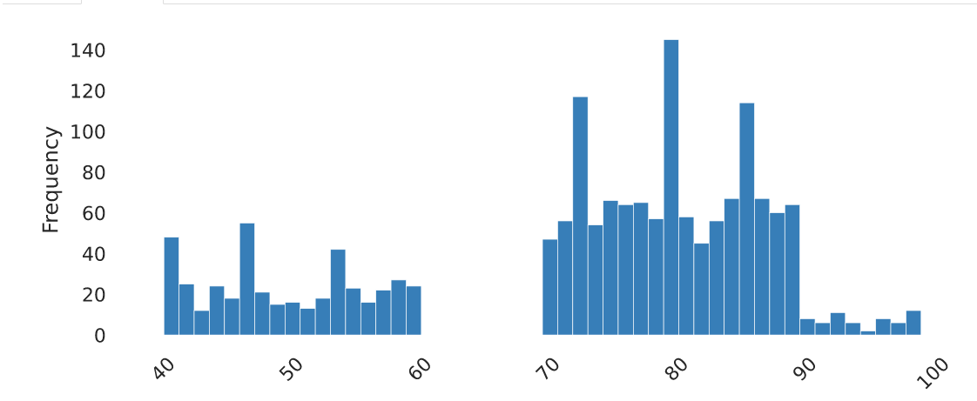
Запрос 3. Случай 3
Имеем наличие неравномерного распределения: degree при sgroup=’ClassB’
postgres=# explain analyze select cname, avg(degree) from score, course, student where score.sno = student.sno and degree < 60 and test_preparation=0
and sgroup='ClassB' group by (cname);
QUERY PLAN
------------------------------------------------------------------------------------------------------------------------------
HashAggregate (cost=403.33..403.46 rows=10 width=77) (actual time=22.205..22.241 rows=10 loops=1)
Group Key: course.cname
Batches: 1 Memory Usage: 24kB
-> Nested Loop (cost=85.42..388.33 rows=3000 width=49) (actual time=3.371..14.985 rows=4190 loops=1)
-> Hash Join (cost=85.42..349.71 rows=300 width=4) (actual time=3.334..11.646 rows=419 loops=1)
Hash Cond: (score.sno = student.sno)
-> Seq Scan on score (cost=0.00..260.00 rows=1627 width=8) (actual time=0.151..7.130 rows=2262 loops=1)
Filter: ((degree < 60) AND (test_preparation = 0))
Rows Removed by Filter: 6738
-> Hash (cost=78.50..78.50 rows=554 width=4) (actual time=3.157..3.159 rows=554 loops=1)
Buckets: 1024 Batches: 1 Memory Usage: 28kB
-> Seq Scan on student (cost=0.00..78.50 rows=554 width=4) (actual time=0.062..2.602 rows=554 loops=1)
Filter: ((sgroup)::text = 'ClassB'::text)
Rows Removed by Filter: 2446
-> Materialize (cost=0.00..1.15 rows=10 width=45) (actual time=0.000..0.003 rows=10 loops=419)
-> Seq Scan on course (cost=0.00..1.10 rows=10 width=45) (actual time=0.022..0.031 rows=10 loops=1)
Planning Time: 0.965 ms
Execution Time: 22.434 ms
(18 rows)
Degree, when sgroup=’ClassB’

Slide 18
Запрос 3. Случай 3
Имеем наличие неравномерного распределения: degree при sgroup=’ClassB’
postgres=# explain analyze select cname, avg(degree) from score, course, student where score.sno = student.sno and degree > 70 and test_preparation=0
and sgroup='ClassB' group by (cname);
QUERY PLAN
------------------------------------------------------------------------------------------------------------------------------
HashAggregate (cost=464.25..464.38 rows=10 width=77) (actual time=31.727..31.762 rows=10 loops=1)
Group Key: course.cname
Batches: 1 Memory Usage: 24kB
-> Nested Loop (cost=85.42..433.15 rows=6220 width=49) (actual time=3.220..19.289 rows=6240 loops=1)
-> Hash Join (cost=85.42..354.28 rows=622 width=4) (actual time=3.192..13.561 rows=624 loops=1)
Hash Cond: (score.sno = student.sno)
-> Seq Scan on score (cost=0.00..260.00 rows=3368 width=8) (actual time=0.159..8.714 rows=2155 loops=1)
Filter: ((degree > 70) AND (test_preparation = 0))
Rows Removed by Filter: 6845
-> Hash (cost=78.50..78.50 rows=554 width=4) (actual time=3.004..3.006 rows=554 loops=1)
Buckets: 1024 Batches: 1 Memory Usage: 28kB
-> Seq Scan on student (cost=0.00..78.50 rows=554 width=4) (actual time=0.046..2.531 rows=554 loops=1)
Filter: ((sgroup)::text = 'ClassB'::text)
Rows Removed by Filter: 2446
-> Materialize (cost=0.00..1.15 rows=10 width=45) (actual time=0.000..0.003 rows=10 loops=624)
-> Seq Scan on course (cost=0.00..1.10 rows=10 width=45) (actual time=0.017..0.025 rows=10 loops=1)
Planning Time: 0.984 ms
Execution Time: 31.950 ms
(18 rows)
Degree, when sgroup=’ClassB’

Slide 19
Запрос 3. Случай 3
Имеем наличие неравномерного распределения: degree при sgroup=’ClassB’
postgres=# explain analyze select cname, avg(degree) from score, course, student where score.sno = student.sno and degree > 80
and test_preparation=0 and sgroup='ClassB' group by (cname);
QUERY PLAN
----------------------------------------------------------------------------------------------------------------------
HashAggregate (cost=410.13..410.26 rows=10 width=77) (actual time=6.626..6.632 rows=0 loops=1)
Group Key: course.cname
Batches: 1 Memory Usage: 24kB
-> Nested Loop (cost=85.42..393.33 rows=3360 width=49) (actual time=6.622..6.627 rows=0 loops=1)
-> Hash Join (cost=85.42..350.21 rows=336 width=4) (actual time=6.620..6.624 rows=0 loops=1)
Hash Cond: (score.sno = student.sno)
-> Seq Scan on score (cost=0.00..260.00 rows=1818 width=8) (actual time=6.619..6.619 rows=0 loops=1)
Filter: ((degree > 80) AND (test_preparation = 0))
Rows Removed by Filter: 9000
-> Hash (cost=78.50..78.50 rows=554 width=4) (never executed)
-> Seq Scan on student (cost=0.00..78.50 rows=554 width=4) (never executed)
Filter: ((sgroup)::text = 'ClassB'::text)
-> Materialize (cost=0.00..1.15 rows=10 width=45) (never executed)
-> Seq Scan on course (cost=0.00..1.10 rows=10 width=45) (never executed)
Planning Time: 0.944 ms
Execution Time: 6.795 ms
(16 rows)
Degree, when sgroup=’ClassB’

Slide 20
Запрос 4. Случай 4
Имеем дополнительную таблицу отчисленных в ходе подготовки к экзамену
  create table broke_down_course(cno INT, sno INT);
  insert into broke_down_course select cno, sno from SCORE where test_preparation = 0 order by random() limit 1000;
Просматриваем средий балл студентов, которые не завершили подготовку через outer join
postgres=# explain analyze select cname, avg(degree) from course, student,score join broke_down_course on
(score.cno=broke_down_course.cno and score.sno=broke_down_course.sno) where score.sno = student.sno group by (cname);
QUERY PLAN
------------------------------------------------------------------------------------------------------------------------------------------------------
HashAggregate (cost=507.08..507.20 rows=10 width=77) (actual time=46.509..46.527 rows=10 loops=1)
Group Key: course.cname
Batches: 1 Memory Usage: 24kB
-> Nested Loop (cost=364.68..491.12 rows=3192 width=49) (actual time=21.615..31.977 rows=10000 loops=1)
-> Hash Join (cost=364.68..450.12 rows=319 width=4) (actual time=21.563..25.200 rows=1000 loops=1)
Hash Cond: (student.sno = score.sno)
-> Seq Scan on student (cost=0.00..71.00 rows=3000 width=4) (actual time=0.073..1.242 rows=3000 loops=1)
-> Hash (cost=360.69..360.69 rows=319 width=12) (actual time=21.446..21.449 rows=1000 loops=1)
Buckets: 1024 Batches: 1 Memory Usage: 51kB
-> Hash Join (cost=30.00..360.69 rows=319 width=12) (actual time=2.484..19.863 rows=1000 loops=1)
Hash Cond: ((score.cno = broke_down_course.cno) AND (score.sno = broke_down_course.sno))
-> Seq Scan on score (cost=0.00..215.00 rows=9000 width=12) (actual time=0.184..5.254 rows=9000 loops=1)
-> Hash (cost=15.00..15.00 rows=1000 width=8) (actual time=2.220..2.221 rows=1000 loops=1)
Buckets: 1024 Batches: 1 Memory Usage: 48kB
-> Seq Scan on broke_down_course (cost=0.00..15.00 rows=1000 width=8) (actual time=0.053..0.674 rows=1000 loops=1)
-> Materialize (cost=0.00..1.15 rows=10 width=45) (actual time=0.000..0.002 rows=10 loops=1000)
-> Seq Scan on course (cost=0.00..1.10 rows=10 width=45) (actual time=0.031..0.042 rows=10 loops=1)
Planning Time: 4.007 ms
Execution Time: 46.800 ms
(19 rows)

Slide 21
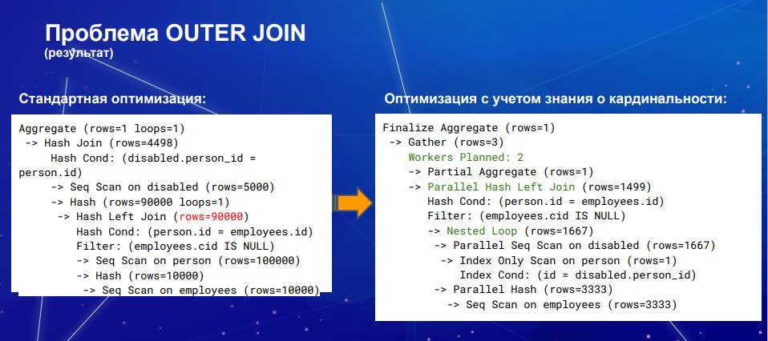
Мы запомнили, нужно позвать workers!

Slide 22
AQO
Когда AQO скорее вредит?
  Быстро обновляемые таблицы, которые чистятся и в них данные добаляются снова
  Временные таблицы – под них запомнать запросы особо не имеет смысла

Slide 23
Случай 1. Hot таблица SCORE
Студенты сдают курсовые – временная таблица на время сдачи: копия score
Добавляем 5000 строк (2000 оценки пониже)
select
Исправляем 2000 строк – на оценку повыше
Select, смотрим aqo - AQO догоняет кардинальность
Добавляем 1000 строк (троешники прибежали)
Перекочевываем данные, select, смотрим aqo_data (оно пропало)
Insert into score ~ 15000
Select
Update score ~ 15000
Select
Insert into score ~ 1000
Update score
Delete score_temp
Select

Slide 24
Настройка AQO. Функции
Что делать?
  Поправить кардинальность можно вручную, если скачок одиночный
    aqo_data_update()
  Отключать оптимизацию запросов для этих запросов - AQO перестанет пока предсказывать кардинальность
    aqo_enable_query(queryid bigint)
    aqo_disable_query(queryid bigint)
  Удалить инфрмацию об этом запросе - AQO начнет все делать заново
    aqo_drop_class(queryid bigint)
  Использовать специальный режим Force
    set aqo.mode = 'Force';
    select pg_reload();

Slide 25
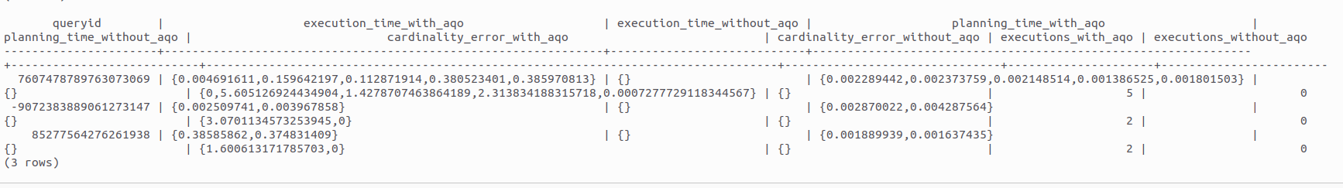
А еще AQO ведет свою статистику
aqo_cardinality_error(controlled boolean)
RETURNS TABLE(num integer, id bigint, fshash bigint, error double precision, nexecs bigint)
aqo_execution_time(controlled boolean)
RETURNS TABLE(num integer, id bigint, fshash bigint, exec_time double precision, nexecs bigint)

Slide 26
Полезные дополнительные функциональности
Look-a-like: делает предсказание кардинальности для нод плана, при совпадении количества опорных селективностей поднод и таблиц, вне зависимости от разницы в классах
Включается: wide_search = ‘on’
Когда полезно?
  Когда клаузы переставляются, а параметры не меняются сильно
  Когда много временных таблиц, игнорить совсем не хочется, а в некоторых нодах это дает ускорение
  Когда запросы идут “по одному” выполнению

Slide 27
Дополнительные возможности AQO
Statement timeout – функциональность для возможности обучения AQO в жестких временных ограничениях
Когда полезно:
  Когда стоит временной ограничитель на выполнение запросов
  Когда нужно отдельно обучить AQO на запросах.
  Smart statement timeout – похожая функцмиональность, но с автоматическим повышением timeout выполнения запросов. Лучше применять, когда нужно отдельно обучить AQO на запросах.

Slide 28
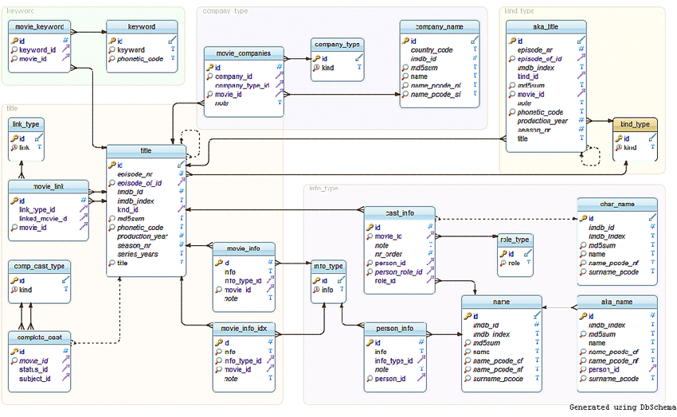
Тестирование на бенчмарках. JOB

Slide 29
Графики
вывести параметры настройки
сумма ошибки кардинальности с AQO и без AQO
усредненое время планирования/выполнения с AQO и без AQO
сколько запросов дошли до порогов ошибки кардинальности: 0.1, 0.05, 0.01 с AQO
количество запросов оптимизировалось (без aqo/c aqo):
  по кардинальности
    10%, 25%, 50%, 100%
    - 10%, -50%, -100%
  по времени планирования:
    10%, 25%, 50%, 100%
    - 10%, -50%, -100%
  по времени выполнения:
    10%, 25%, 50%, 100%
    - 10%, -50%, -100%
корреляция между ошибкой кардинальности и времени планирования/выполнения с AQO - чем выше, тем более заметно обучение aqo?
вывести имена запросов, на которых с AQO хуже:
  кардинальность
  время планирования
  время выполнения
  линии минимальной ошибки оптимизатора и AQO и итерация, на которой AQO сошлась
  ошибка кардинальности во время обучения для каждого класса запроса

Slide 30
TPC-DS, TPCH, HTAB?

