Slide 1
Convolutional neural networks

Slide 2
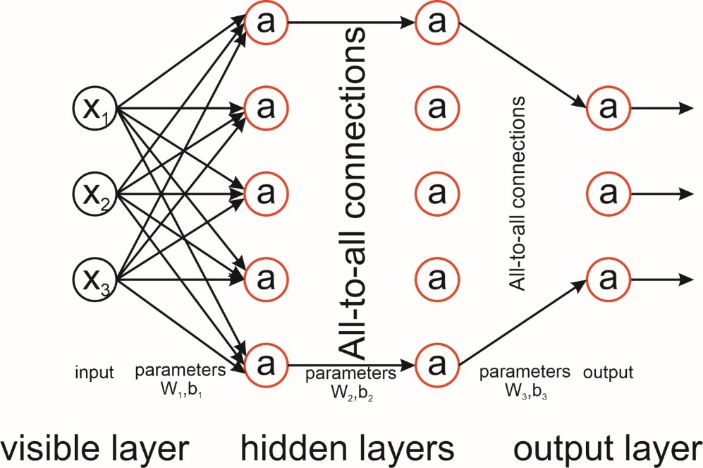

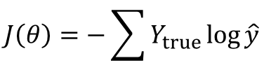

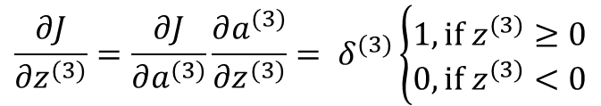







Recap
Forward path:
$$a^{(0)}=x$$
$$a^{(1)}=g(W_{1}a^{(0)}+b_{1})$$
$$a^{(2)}=g(W_{2}a^{(1)}+b_{2})$$
$$a^{(3)}=g(W_{3}a^{(2)}+b_{3})$$
$$\hat{y}=softmax\left(a_{3}\right)= \frac{e^{a}}{\sum{e^{a}}}$$
$$J\left(θ\right)=−\sum{Y_{true}}\log{\hat{y}}$$
Backward path:
$$\frac{∂J}{∂a^{(3)}}= \hat{y}−Y_{true}=δ^{(3)}$$
$$\frac{∂J}{∂z^{(3)}}=\frac{∂J}{∂a^{(3)}}\frac{∂a^{(3)}}{∂z^{(3)}}= δ^{(3)}\left\{\begin{aligned}1, if z^{(3)}≥0 \\ 0, if z^{(3)}<0\end{aligned}\right.$$
$\frac{∂J}{∂W^{(3)}}$= $\frac{∂J}{∂a^{(3)}}\frac{∂a^{(3)}}{∂z^{(3)}}\frac{∂z^{(3)}}{∂W^{(3)}}=δ^{(3)}a^{\left(2\right)T}$
$\frac{∂J}{∂b^{(3)}}$ = $\frac{∂J}{∂a^{(3)}}\frac{∂a^{(3)}}{∂z^{(3)}}\frac{∂z^{(3)}}{∂b^{(3)}}=δ^{(3)}$
$\frac{∂J}{∂a^{(2)}}$ = $\frac{∂J}{∂a^{(3)}}\frac{∂a^{(3)}}{∂z^{(3)}}\frac{∂z^{(3)}}{∂a^{(2)}}={W^{\left(3\right)T}δ}^{(3)}= δ^{(2)}$
etc …

Slide 3

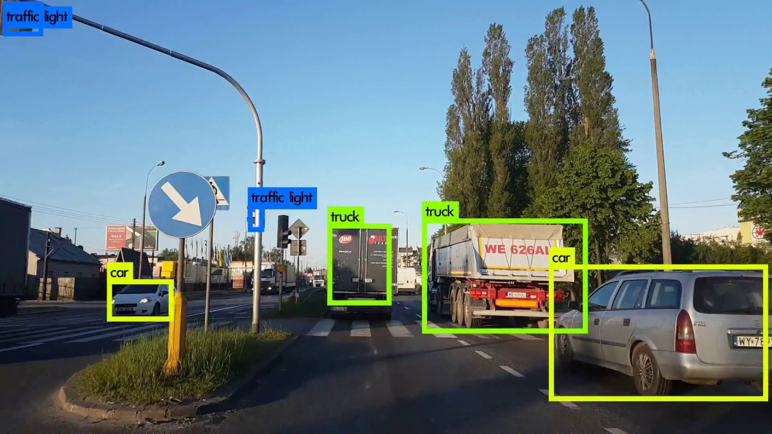
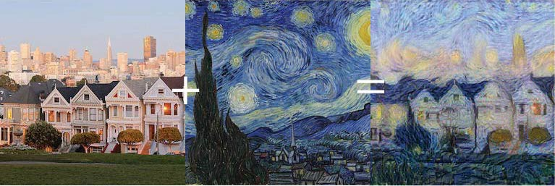
Computer vision task
Image classification
Object detection
Neural style transfer

Slide 4
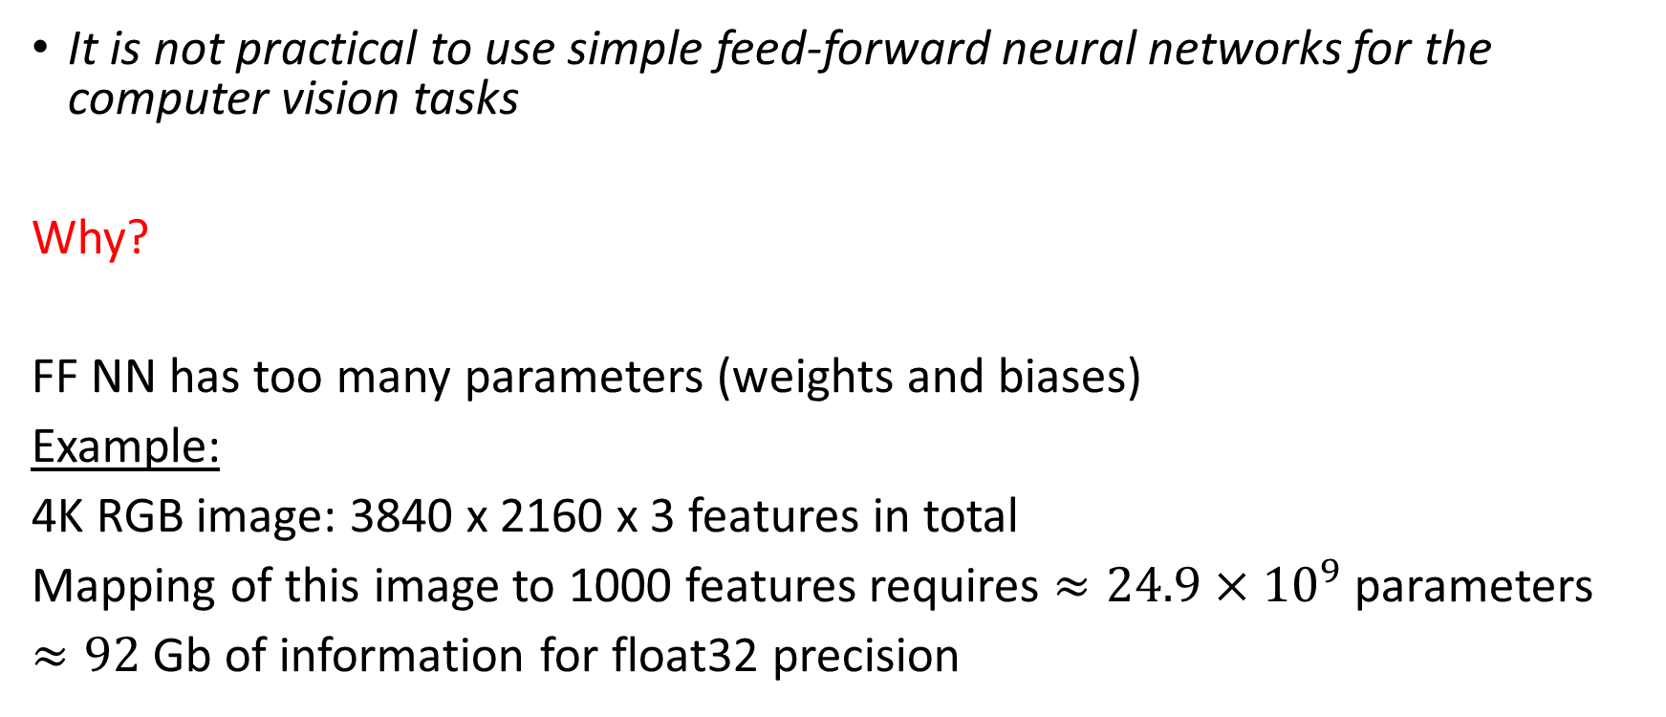
Computer vision task
It is not practical to use simple feed-forward neural networks for the computer vision tasks
Why?
FF NN has too many parameters (weights and biases)
Example:
4K RGB image: 3840 x 2160 x 3 features in total
Mapping of this image to 1000 features requires $≈24.9×{10}^{9}$ parameters
$≈92$ Gb of information for float32 precision

Slide 5
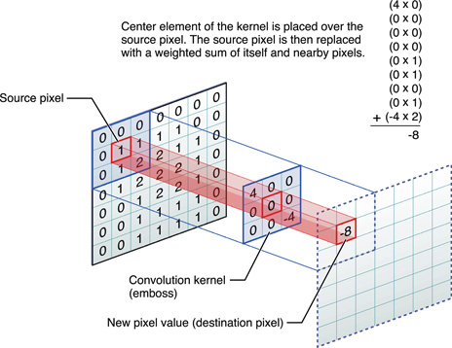
Convolution example

Slide 6
Convolution example
1 | 3 | 5 | 7 | 9 | 0
2 | 5 | 3 | 5 | 6 | 8
1 | 4 | 3 | 7 | 8 | 2
3 | 2 | 3 | 1 | 2 | 1
5 | 1 | 5 | 4 | 3 | 9
6 | 7 | 8 | 0 | 8 | 7
-7 | -7 | -12 | 9
… | … | … | …
… | … | … | …
… | … | … | -12
1 | 0 | -1
1 | 0 | -1
1 | 0 | -1
*
=
3x3 filter or kernel
4x4 image
Image 6x6 pixels

Slide 7
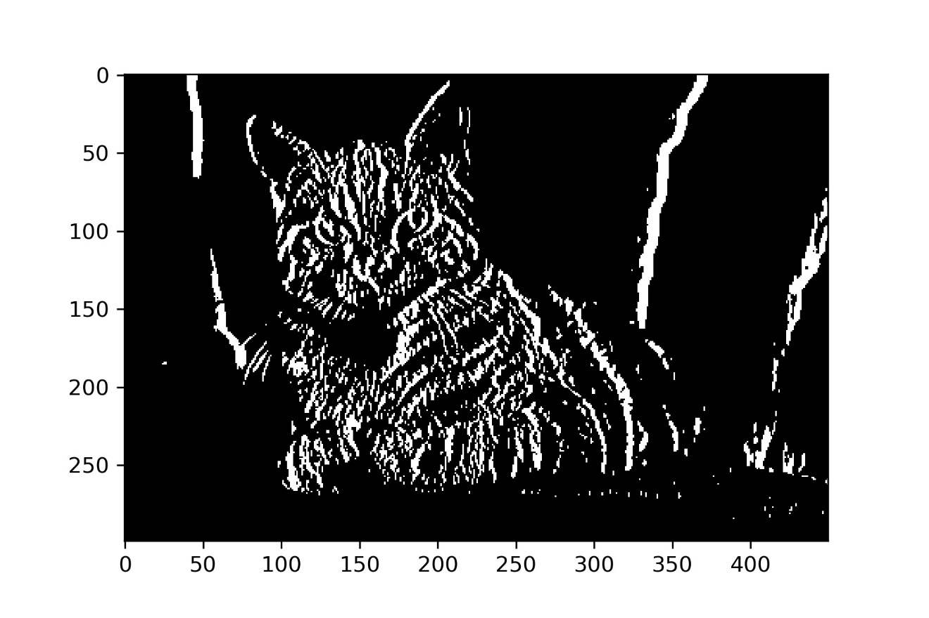

Vertical edge detector
1 | 0 | -1
1 | 0 | -1
1 | 0 | -1
*
=

Slide 8
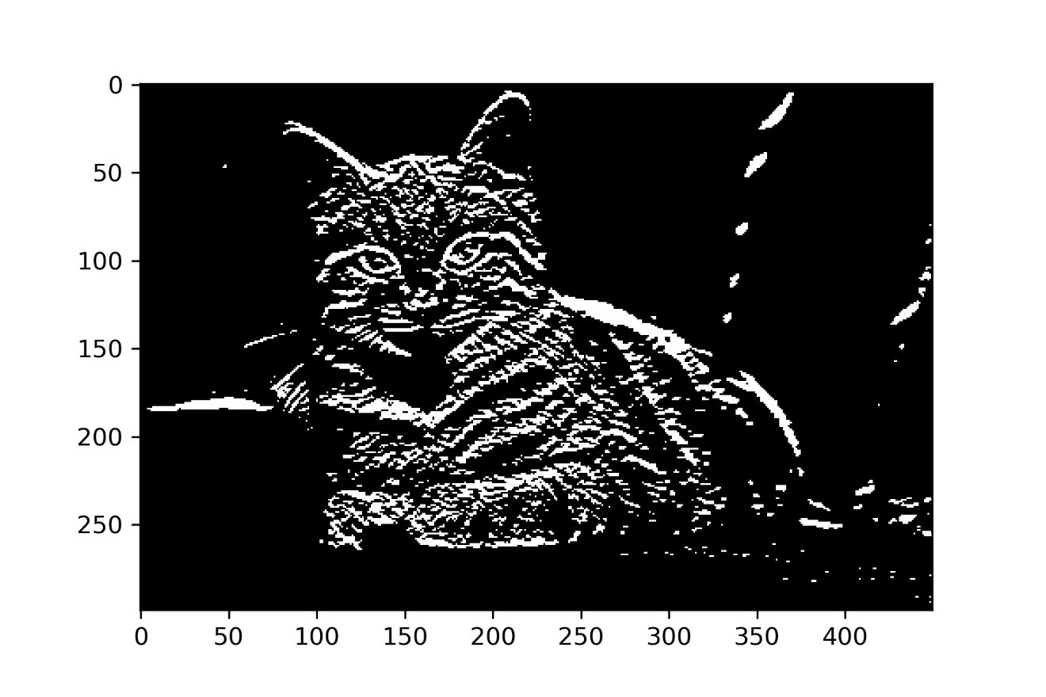
Horizontal edge detector
1 | 1 | 1
0 | 0 | 0
-1 | -1 | -1
*
=

Slide 9
Edge detectors
Vertical edge detector
Horizontal edge detector

Slide 10
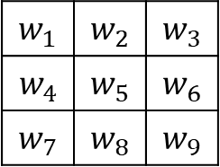
Learning filters
Again, hardcoded feature extraction is not a good solution.
A priori we don’t know which type of filter we need for a specific computer vision task.
Let’s treat filter parameters as weights and learn them.
1 | 3 | 5 | 7 | 9 | 0
2 | 5 | 3 | 5 | 6 | 8
1 | 4 | 3 | 7 | 8 | 2
3 | 2 | 3 | 1 | 2 | 1
5 | 1 | 5 | 4 | 3 | 9
6 | 7 | 8 | 0 | 8 | 7
… | … | … | …
… | … | … | …
… | … | … | …
… | … | … | …
$$w_{1}$$ | $$w_{2}$$ | $$w_{3}$$
$$w_{4}$$ | $$w_{5}$$ | $$w_{6}$$
$$w_{7}$$ | $$w_{8}$$ | $$w_{9}$$
*
=
3x3 filter or kernel
4x4 image
Image 6x6 pixels
(n x n) image * (f x f) filter -> (n-f+1 x n-f+1) image

Slide 11
Padding
3 x 3
Image 5 x 5 pixels
Image 5 x 5 pixels
Padding p = 1
(n x n) image * (f x f) filter -> (n + 2p – f + 1 x n + 2p – f + 1) image
“valid” convolution -> p = 0
“same” convolution -> dimensions of input and output images are the same

Slide 12
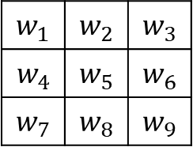
Stride
0 | 0 | 0 | 0 | 0 | 0 | 0
0 | 1 | 3 | 5 | 7 | 9 | 0
0 | 2 | 5 | 3 | 5 | 6 | 0
0 | 1 | 4 | 3 | 7 | 8 | 0
0 | 3 | 2 | 3 | 1 | 2 | 0
0 | 5 | 1 | 5 | 4 | 3 | 0
0 | 0 | 0 | 0 | 0 | 0 | 0
$$w_{1}$$ | $$w_{2}$$ | $$w_{3}$$
$$w_{4}$$ | $$w_{5}$$ | $$w_{6}$$
$$w_{7}$$ | $$w_{8}$$ | $$w_{9}$$
… | … | …
… | … | …
… | … | …
*
=
3x3 filter
3x3 image
Image 5x5 pixels
Stride s = 2
Padding p = 1
(n x n) image * (f x f) filter -> $\left[\frac{n+2p−f}{s}+1\right] × \left[\frac{n+2p−f}{s}+1\right]$ image

Slide 13
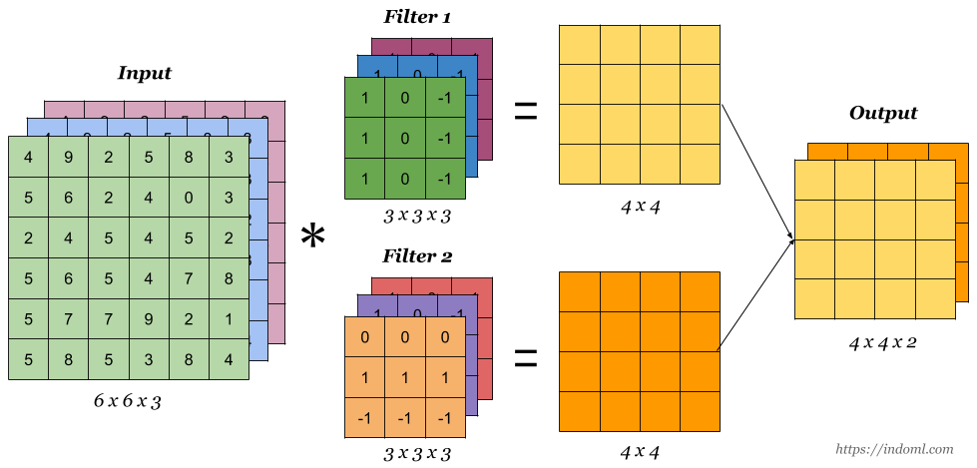
Multiple filters and multiple channels

Slide 14
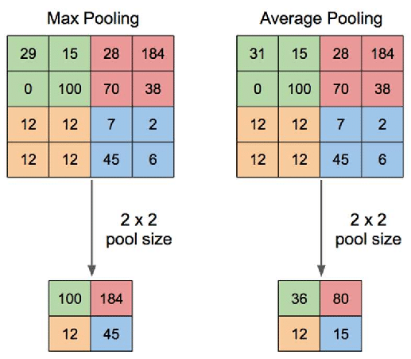
Pooling layers
f = 2 – filter size
s = 2 – stride
p = 0 – padding
There are no trainable parameters

Slide 15
CNN example

