Slide 1

Distributed Training
08.11.2021
Oleh Shliazhko

Slide 2
Today
Why distributed training?
Process Communication 101
Pytorch Distributed Data Parallel
Practice: Pytorch DDP
Beyond DDP: Deepspeed and Model Parallel

Slide 3
Why distributed training?
Training speed - samples/second
Bottleneck - batch size, due to GPU Memory
Solution
split batch between GPUs
copy model to all GPUs
update master parameters from all gradients
copy updated parameters back to GPUs

Slide 4
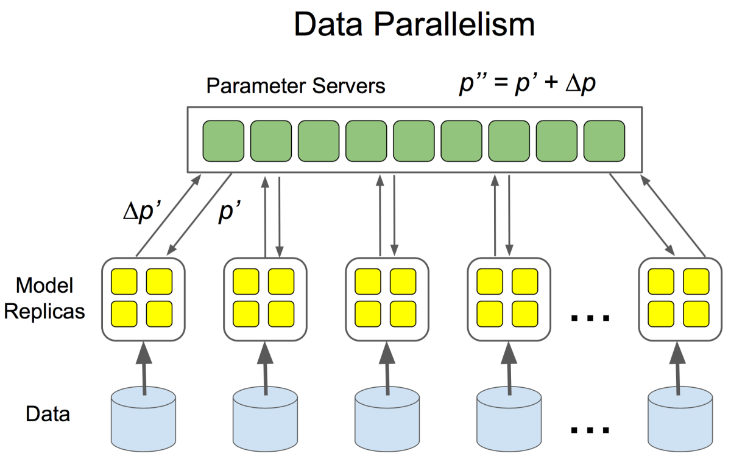
Why distributed training?

Slide 5
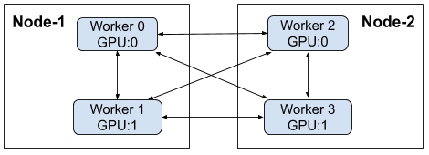
Why distributed training?
Single node case - master copy of weights in RAM
Bottleneck - number of GPUs on a single node
Solution:
GET MORE NODES
split batch between GPUs on all nodes
sync weight updates for all models in some way

Slide 6
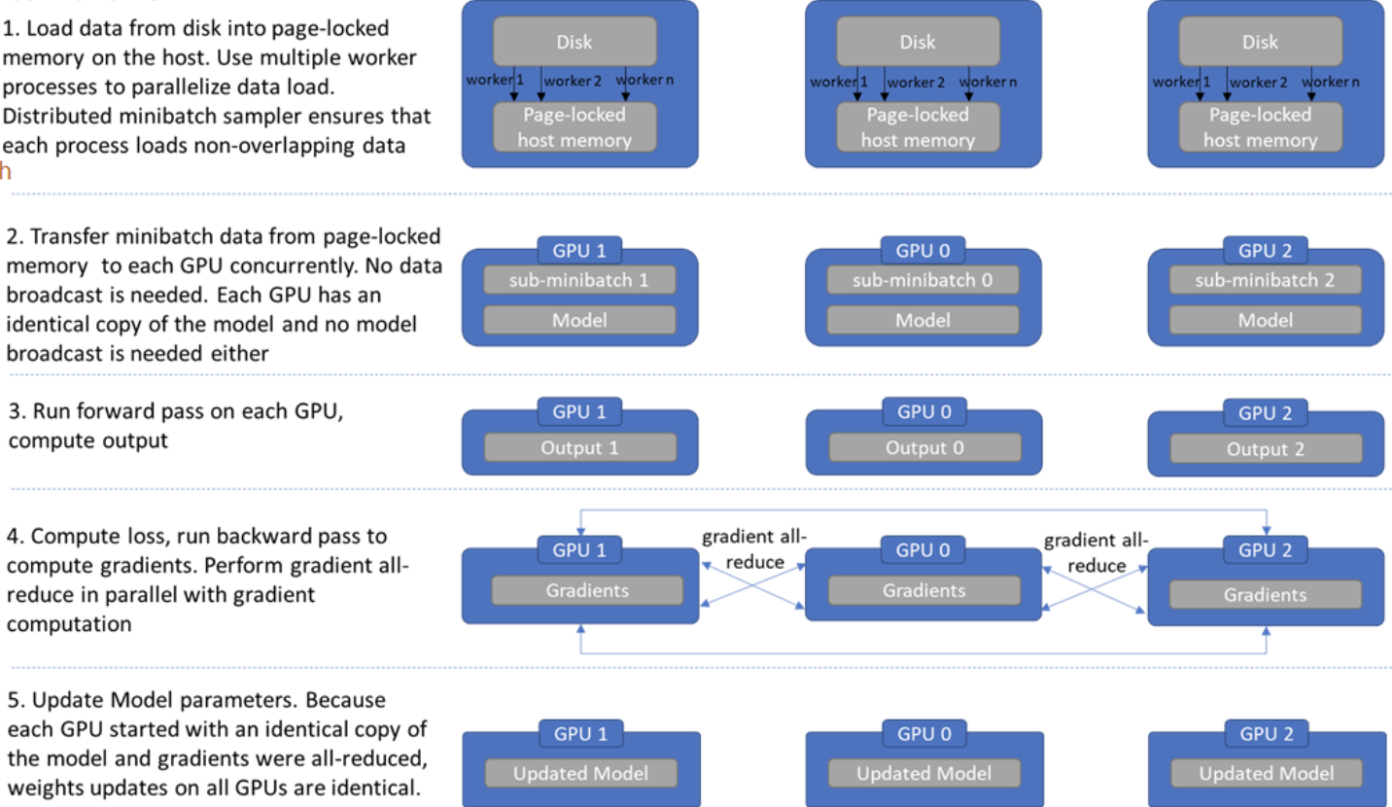
Why distributed training?

Slide 7
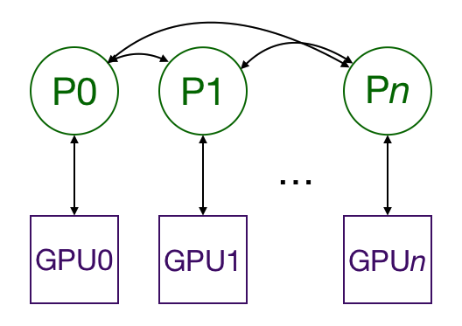
Why distributed training?
Could we get rid of single parameter server?
Let’s try put all gradients on all workers.
Pros:
No single point of failure
Nice identical code in each process (SIMD)
Cons:
A lot of networking

Slide 8
Why distributed training?
Single node algorithm
Get batch from dataloader
Forward pass
Backward pass
Get gradients from all GPUS
Compute gradients average
Update local weights

Slide 9
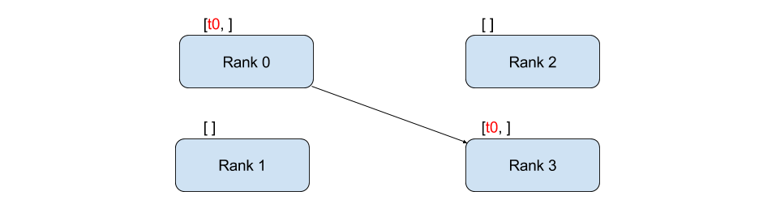
Process Communication 101
Point-to-Point Communication
Source: send(tensor, dest_rank)
Destination: recv(tensor, src_rank)

Slide 10
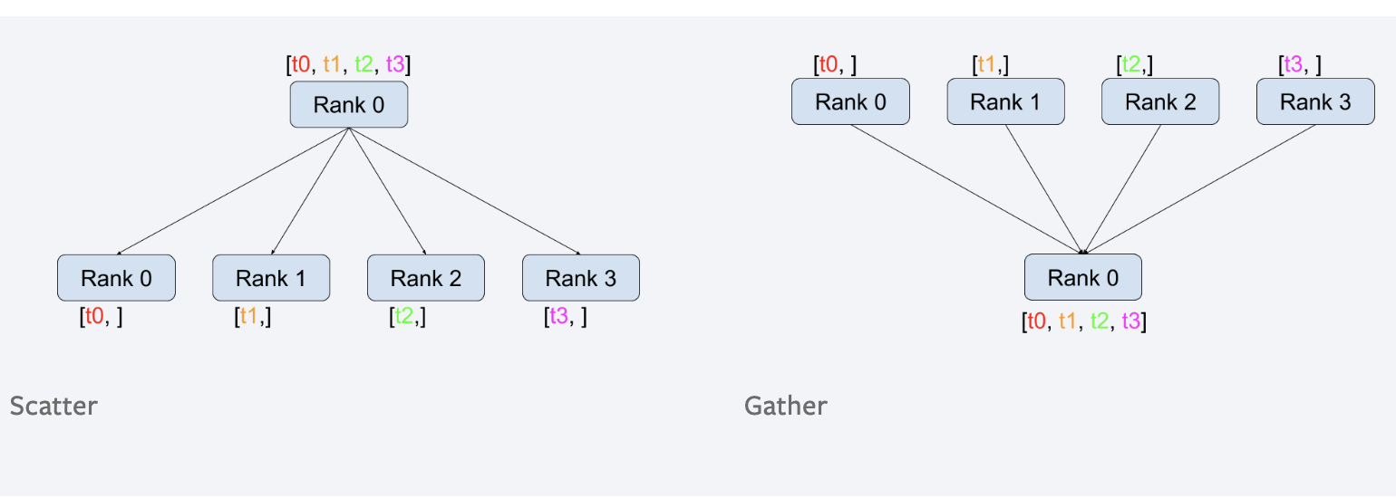
Process Communication 101
Collective Communication

Slide 11
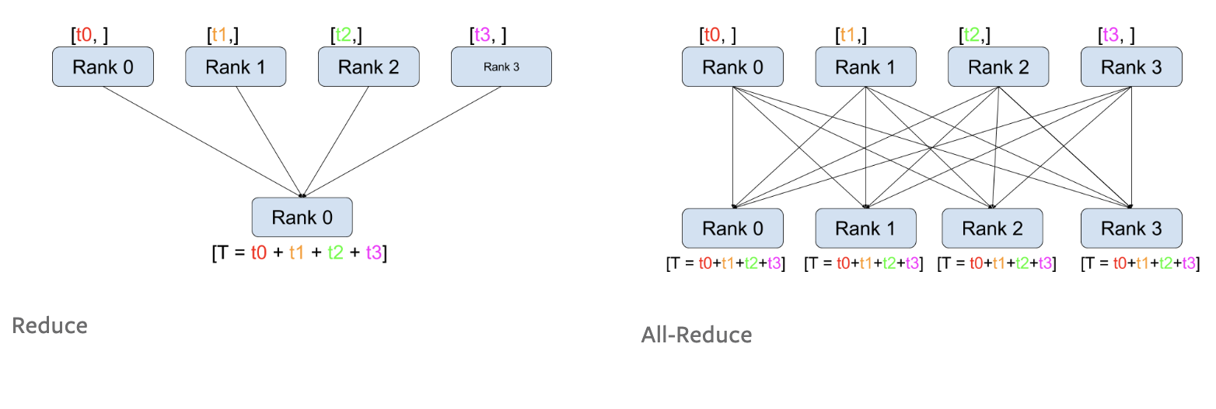
Process Communication 101
Collective Communication

Slide 12
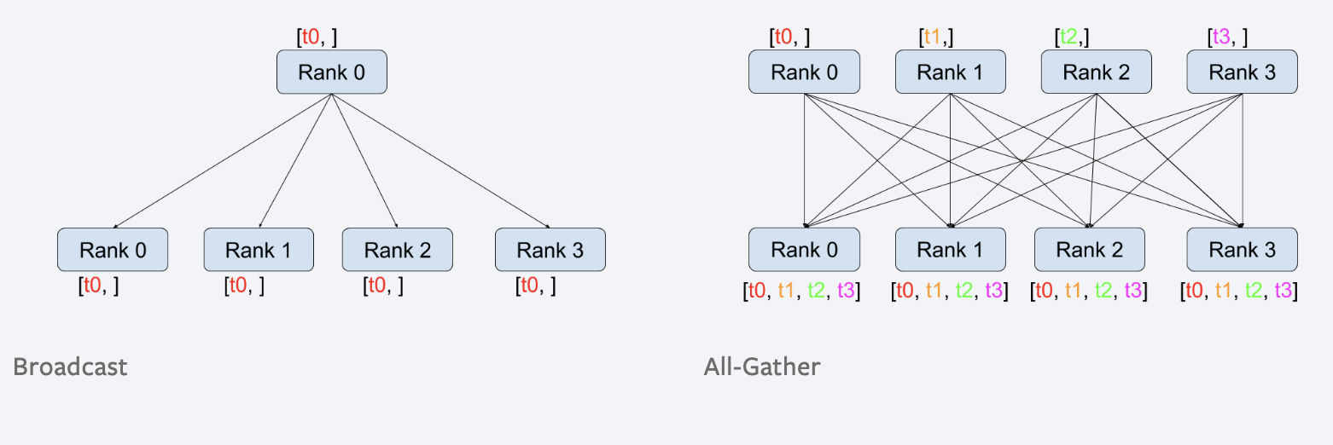
Process Communication 101
Collective Communication

Slide 13
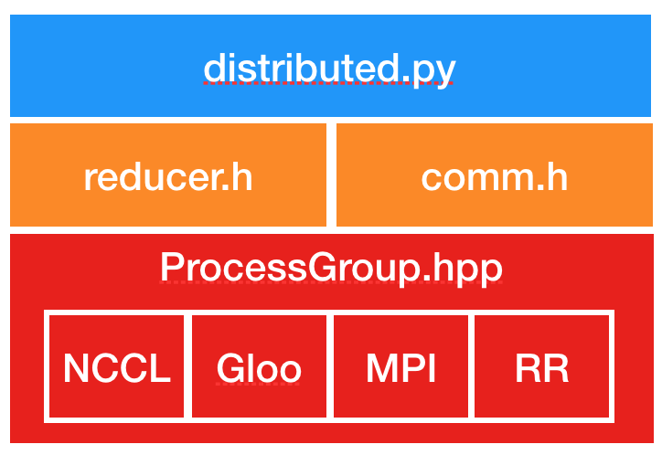
Pytorch Distributed Data Parallel
Backend-agnostic API
Broadcast/Gather/Reduce operations
Convenient Data Parallel Wrapper

Slide 14
Distributed Backends
Rule of thumb
Use the NCCL backend for distributed GPU training
Use the Gloo backend for distributed CPU training.
GPU hosts with InfiniBand interconnect
Use NCCL, since it’s the only backend that currently supports InfiniBand and GPUDirect.

Slide 15
Pytorch Distributed Data Parallel
Glossary:
world_size - total number of GPUs. Also a number of processes, assuming 1 process per GPU
global_rank - global process id, unsigned int from [0, world_size)
local_rank - local process id for current node,
unsigned int from [0, number_of_GPUs_per_node)
from torch.nn.parallel import DistributedDataParallel as DDP
dist.init_process_group(backend='nccl', init_method='env://')
torch.cuda.set_device(local_rank)
# Split dataset into world_size parts and read part number global_rank
dataloader = get_dataset_part(global_rank, world_size)
model = DDP(model, device_ids=[local_rank])

Slide 16
Practice: Pytorch DDP

Slide 17
Beyond DDP: Deepspeed & Model Parallel
GOTO: train_large_scale_gpt3

Slide 18
Questions

