Slide 1
DAT21303 WEB PROGRAMMING
1.0 INTRODUCTION TO WEB PROGRAMMING

Slide 2
1.1 Server and Client Side Programming
Client-server programming model is a distributed computing architecture that separate information users (clients) from information providers (servers).
A client is an application that needs something like a web page or IP address from a server. Clients may contact a server for this information at any time. Clients are information users.
A server is an application that provides information or resources to clients. It needs to be always up and running, waiting for requests from clients.

Slide 3
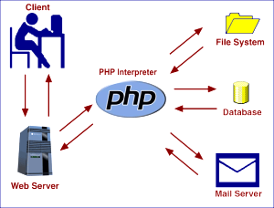
The user opens his web browser (the Client)
The user browses to http://google.com
The Client (on the behalf of the User), sends a request to http://google.com (the Server), for their home page
The Server then acknowledges the request, and replies the client with some meta-data followed by the page's source.
The Client then receives the page's source, and renders it into a human viewable website.
Notes:
Administrative metadata allows administrators to impose rules and restrictions governing data access and user permissions. It also furnishes information on required maintenance and management of data resources. Often used in the context of ongoing research, administrative metadata includes such details as date created, file size and type, and archiving requirements.
Descriptive metadata identifies specific characteristics of a piece of data, such as bibliographic data, keywords, song titles, volume numbers, etc.
Legal metadata provides information on creative licensing, such as copyrights, licensing and royalties.
Preservation metadata guides the placement of a data item within a hierarchical framework or sequence.
Process metadata outlines procedures used to collect and treat statistical data. Statistical metadata is another term for process metadata.
Provenance metadata, also known as data lineage, tracks the history of a piece of data as it moves throughout an organization. Original documents are paired with metadata to ensure that data is valid or to correct errors in data quality. Checking the provenance is a customary practice in data governance.
Reference metadata relates to information that describes the quality of statistical content.
Statistical metadata describes data that enables users to properly interpret and use statistics found in reports, surveys and compendium.
Structural metadata reveals how different elements of a compound data object are assembled. Structural metadata is often used in digital media content, such as describing how pages in an audiobook should be organized to form a chapter, and how chapters should be organized to form volumes, and so on. The term "technical metadata" is a synonym most closely associated with items in digital libraries.
Use metadata is data that is sorted and analyzed each time a user accesses it. Based on analysis of use metadata, business can pick out trends in customer behavior and more readily adapt their products and services to meet their needs.

Slide 4
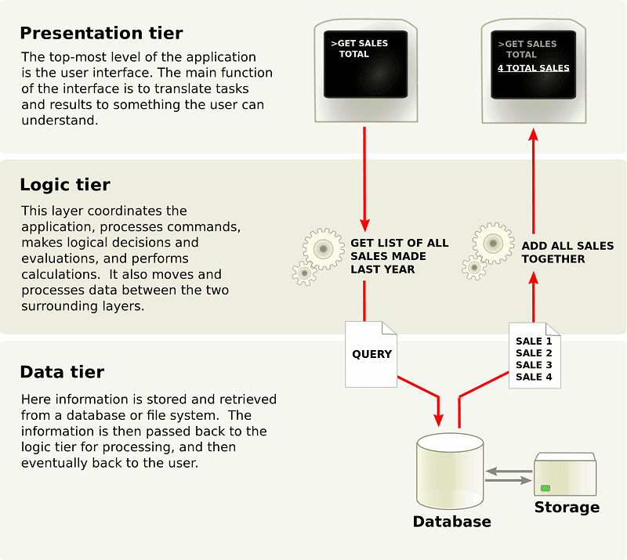
Three-tier architecture
Client applications communicate only with server applications and vice versa. Clients do not communicate directly with other clients.
Developed and maintained as independent modules, most often on separate platforms
Allow any of the three tiers to be upgraded or replaced independently in response to changes in requirements or technology.
Notes:
For example, a change of operating system in the presentation tier would only affect the user interface code.

Slide 5
Client Server Examples Example: DHCP Client Server
This is a common example of the client-server programming model. The dynamic host configuration protocol (DHCP) is the application responsible for requesting and offering IP addresses.
A DHCP client automatically requests an IP address from a DHCP server when a network is detected. A DHCP client could request a new IP address at any time, so the DHCP server must always be active and ready to respond to client requests. The DHCP server application typically exists in a router, but may also be found running on a network server for larger networks.

Slide 6
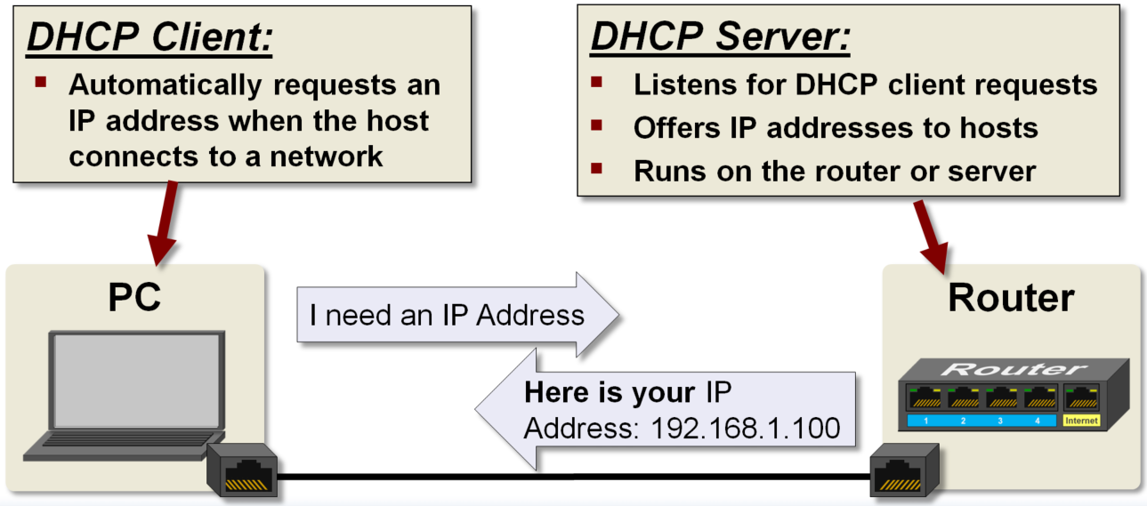

Slide 7
I can use an HTTP client running on a PC to control the lights at home. This example shows an HTTP client running on a home lighting control board, which has been configured to monitor a lighting control website running on an Internet web server to determine if lights should be on or off.
I browse to the same lighting control webpage being monitored by the lighting control board, enter my username and password, and now have the ability to change the webpage. The next time the control board checks this webpage it will see the change and control the lights appropriately.

Slide 8
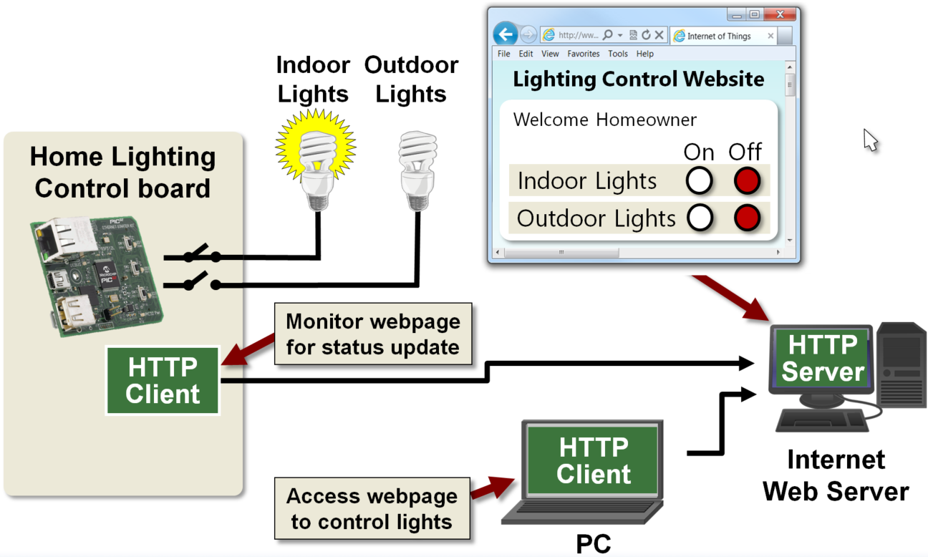
Example: HTTP Client and Server in the Same Local Host

Slide 9
A network host is usually either a client or a server but it is possible for a host to be both. Let’s see an example of this.
My control board may also have an HTTP Server running concurrently with the client. This could be used to serve a simple setup and configuration web page, which would allow me to change the website and log-in information the HTTP client uses to check for lighting control updates.

Slide 10
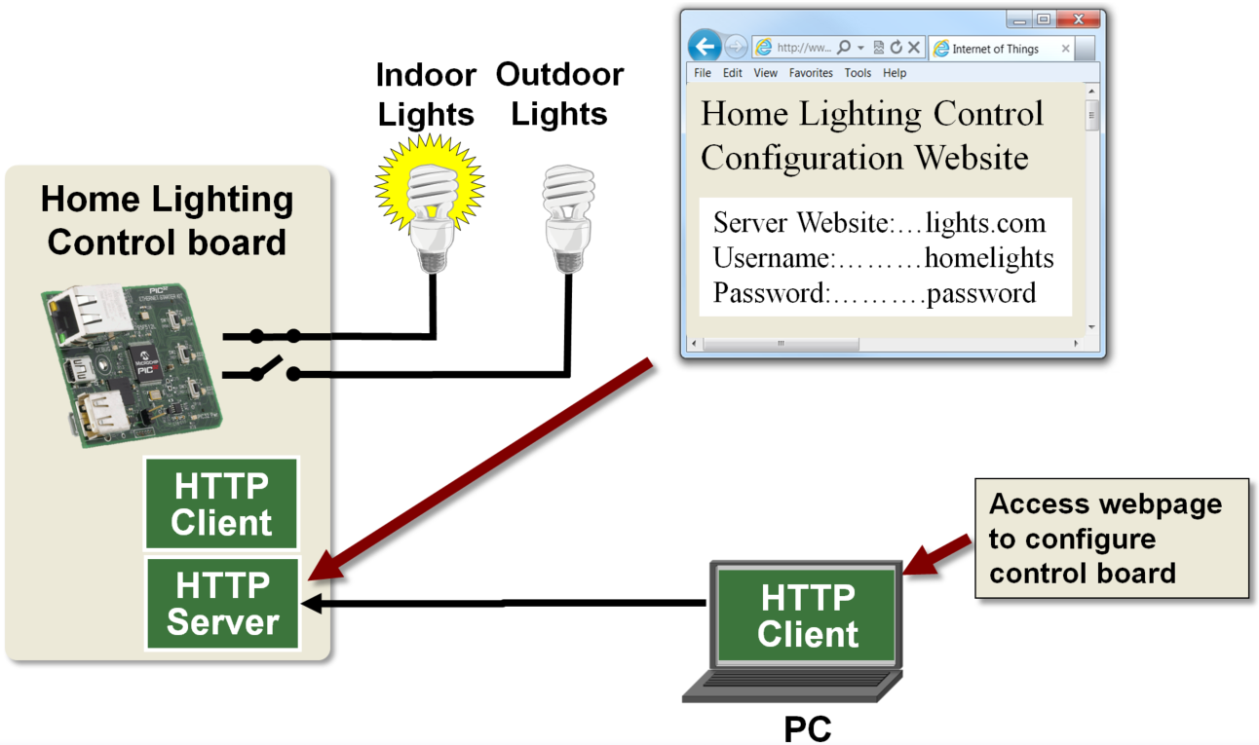
Example: Local Network HTTP Server

Slide 11
If you do have an HTTP server running on your embedded device, it could also be used to actually control the device.
This would allow you to eliminate the HTTP client application and Internet web server. At first, this may appear to be the best solution, but looks can be deceiving.
This is probably the easiest solution if the HTTP client is running on the same local network as the lighting control board. Unfortunately, this is not very common.

Slide 12
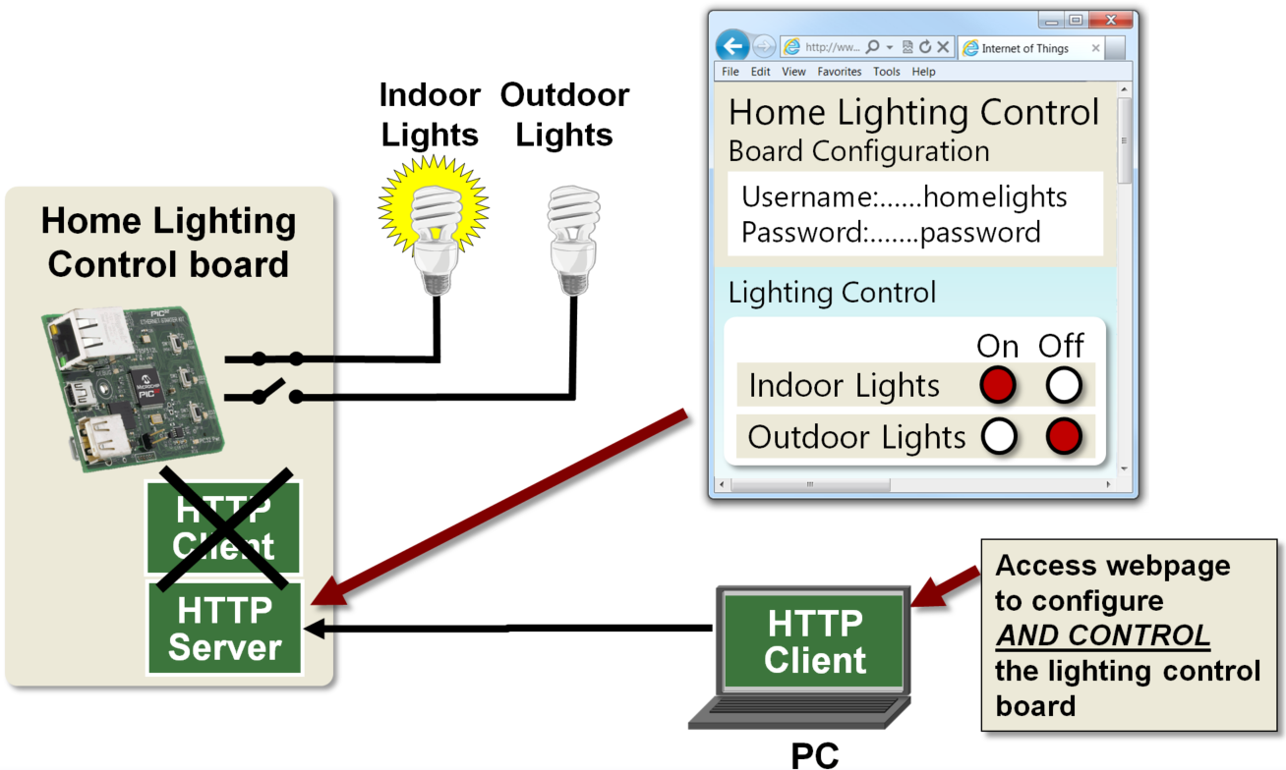
The ability to control the lights or anything else from a remote location over the internet is a more likely and useful scenario. Accessing a web server on a local network from the Internet can be done, but it’s not a trivial task. Deciding where to locate a web server must be carefully considered.

Slide 13
Server-side Programming
It is the program that runs on server dealing with content of web page
Querying the database
Operations over databases
Access/Write a file on server.
Interact with other servers.
Structure web applications.
Process user input.
The Programming languages for server-side programming are:
PHP
C++
Java and JSP
Python
Ruby on Rails
Notes:
Process user input. For example if user input is a text in search box, run a search algorithm on data stored on server and send the results.

Slide 14
Client-side Programming
It is the program that runs on the client machine (browser) and deals with the user interface/display and any other processing that can happen on client machine like reading/writing cookies.
Interact with temporary storage
Make interactive web pages
Interact with local storage
Sending request for data to server
Send request to server
Work as an interface between server and user
The Programming languages for client-side programming are:
JavaScript
VBScript
HTML
CSS
AJAX
Notes:
Cookies are text files with small pieces of data — like a username and password — that are used to identify your computer as you use a computer network. HTTP cookies are essential to the modern Internet but a vulnerability to your privacy. As a necessary part of web browsing, HTTP cookies help web developers give you more personal, convenient website visits. Cookies let websites remember you, your website logins, shopping carts and more. But they can also be a treasure trove of private info for criminals to spy on.

Slide 15
1.2 Basic Syntax of HTML5
What is HTML?
HTML is the standard markup language for creating Web pages.
HTML stands for Hyper Text Markup Language
HTML describes the structure of a Web page
HTML consists of a series of elements
HTML elements tell the browser how to display the content
HTML elements are represented by tags
HTML tags label pieces of content such as "heading", "paragraph", "table", and so on
Browsers do not display the HTML tags, but use them to render the content of the page
Notes:
Hypertext markup language

Slide 16
HTML Versions
Since the early days of the web, there have been many versions of HTML:
Version | Year
HTML | 1991
HTML 2.0 | 1995
HTML 3.2 | 1997
HTML 4.01 | 1999
XHTML | 2000
HTML5 | 2014

Slide 17
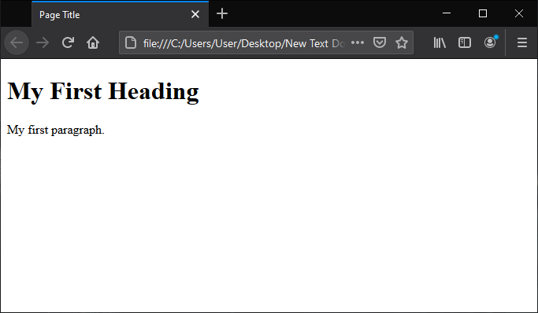
HTML code Example
<!DOCTYPE html>
<html>
<head>
<title>Page Title</title>
</head>
<body>
<h1>My First Heading</h1>
<p>My first paragraph.</p>
</body>
</html>
declaration defines that this document is an HTML5 document
root element of an HTML page
contains meta information about the HTML page
specifies a title for the HTML page (which is shown in the browser's title bar or in the page's tab)
defines the document's body, and is a container for all the visible contentselement defines a large heading
element defines a paragraph
Notes:
The <!DOCTYPE html> declaration defines that this document is an HTML5 document. declaration is not case sensitive. The purpose of DOCTYPE is to tell the browser what type of HTML you are writing. It is not valid to omit the DOCTYPE. There is no “Standard” format. The browser will just try to parse HTML as best it can. But not all elements will be displayed correctly. DOCTYPE is a required part of all HTML documents.
The <html> element is the root element of an HTML page
The <head> element contains meta information about the HTML page
The <title> element specifies a title for the HTML page (which is shown in the browser's title bar or in the page's tab)
The <body> element defines the document's body, and is a container for all the visible contents, such as headings, paragraphs, images, hyperlinks, tables, lists, etc.
The <h1> element defines a large heading
The <p> element defines a paragraph

Slide 18
1.3 Javascript and CSS
JavaScript is the programming language of HTML and the Web
Why Study JavaScript?
JavaScript is one of the 3 languages all web developers must learn:
HTML to define the content of web pages
CSS to specify the layout of web pages
JavaScript to program the behavior of web pages
Web pages are not the only place where JavaScript is used. Many desktop and server programs use JavaScript. Node.js is the best known. Some databases, like MongoDB and CouchDB, also use JavaScript as their programming language.

Slide 19
1.4 Basic Web Page Template
HTML Page Structure
Below is a visualization of an HTML page structure:
<html>
<head>
<title>Page title</title>
</head>
<body>
<h1>This is a heading</h1>
<p>This is a paragraph.</p>
<p>This is another paragraph.</p>
</body>
</html>

Slide 20
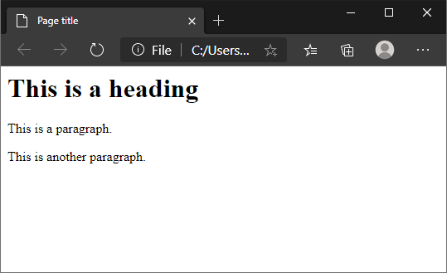
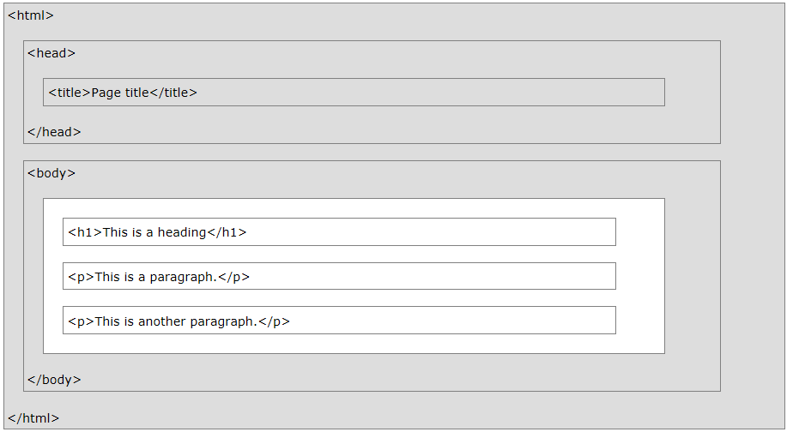

Slide 21
THANKS!
Any questions?
You can find me at nadhiaazman@gmail.com

