Slide 1
Establishing a just, learning culture
Alejandro Quezada
Module 9.2 Assignment: Establishing a just, Learning Curve

Slide 2
Trust
As simple as it sounds, trust needs to always be present in order for a just learning culture to exist. By taking responsibility for our actions and treat it as a learning experience instead of blaming, it would promote growth.

Slide 3

What causes lack of trust
There are numerous things to avoid in order to prevent distrust in the workplace. Our goal is to maintain a healthy workplace.
Having favorites
Unclear job duties
Withholding information from coworkers
Lack of communication
Managers not owning up to their own mistakes

Slide 4
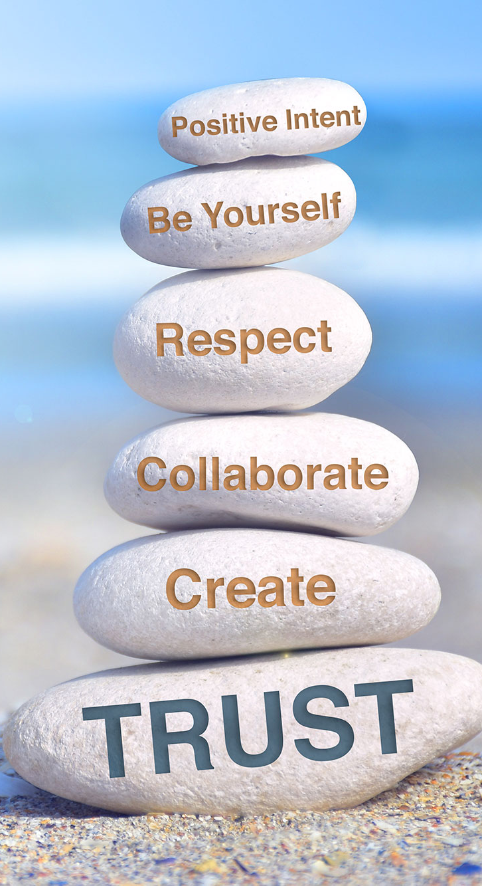
How to promote trust
Fortunately, there are plenty of methods of fostering trust.
Follow through on promises made
Communicate
Honesty
Take the time to know them
Own up to your mistakes
Help each other out
Be inclusive

Slide 5
Encourages questions
In an ideal environment no one would feel uncomfortable for asking a question on something they feel might be a dumb question. Something as simple as this could prevent any issues from occurring down the line.

Slide 6
Increase in production
Decisions are able to be made a lot quicker as it is easier to do so with trust. No one is second guessing each other.

Slide 7
Promote growth
By treating mistakes as a learning experience, they will learn what to avoid and others will learn to trust.

Slide 8
Thank you
Sources:
Thomas Lintner (2 May 2023) Implementing Just Culture – It's Simple But Complex linkedin https://www.linkedin.com/pulse/implementing-just-culture-its-simple-complex-thomas-lintner/
Indeed editorial team (3 Feb 2023) Why Trust Matters in the Workplace (Plus Tips for Building It) indeed https://www.indeed.com/career-advice/career-development/lack-of-trust-in-workplace
Jamie Birt (3 Feb 2023) 14 Tips for Building Trust at Work (And Why It Matters) indeed https://www.indeed.com/career-advice/career-development/building-trust
Dana Brownlee (20 Oct 2019) 5 Reasons Why Trust Matters On Teams forbes https://www.forbes.com/sites/danabrownlee/2019/10/20/5-reasons-why-trust-matters-on-teams/

