Slide 1
Pager Rotation Duties Best Practices
Alejandro Quezada
Module 7.2 Assignment - Pager Rotation Duties

Slide 2
Do NOT use spreadsheets
Using spreadsheets will make work more difficult since you need to make sure it is up to date with changes and to know everyone's availability.

Slide 3
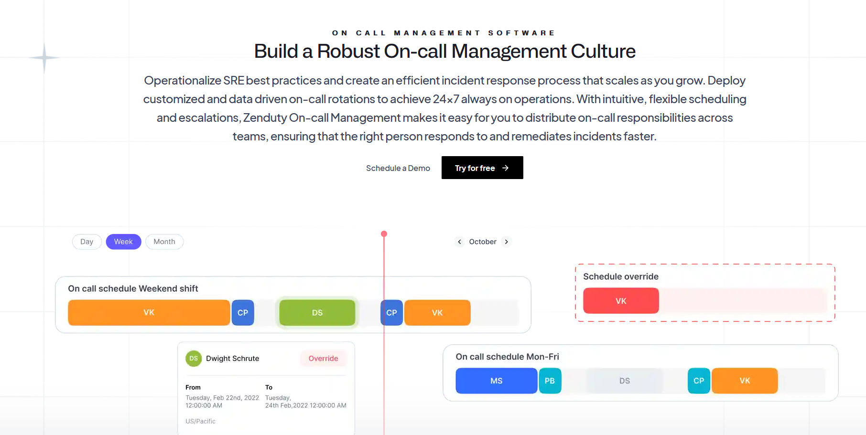
Use dedicated software
Software such as Zenduty offers customizable on call schedule management, easy on call escalation policies, conditional alert routing, and schedule overrides. It makes it easier to create the schedules and they are notified prior to starting their on call shifts.
https://www.zenduty.com/product/oncall-management/

Slide 4


24/7x365
It is ideal to have coverage 100% of the time. A factor that needs to be addressed are any time zone differences any of the employees may have.

Slide 5
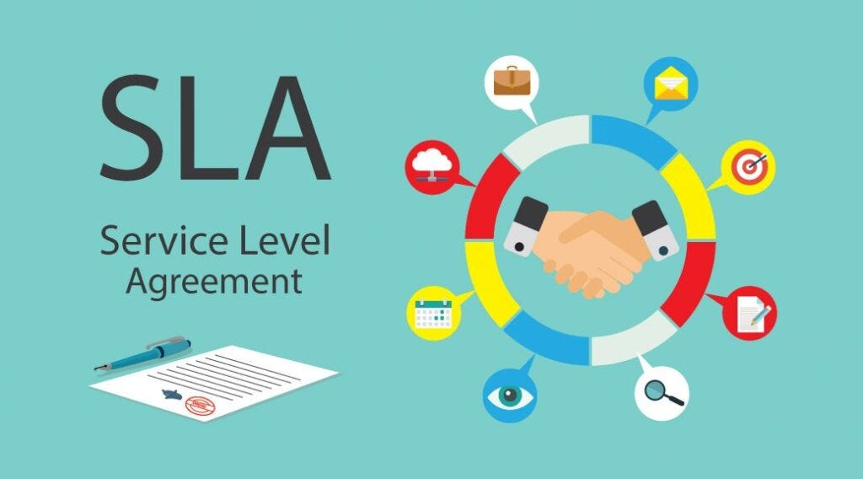
Time limits
If an issue is not being addressed in time and the company has a service level agreement, it should be escalated to be taken care of.

Slide 6
Communication
Even if it is not affecting their schedule everyone needs to be made aware of any changes occurring in the scheduling. It is to prevent anyone from being caught off guard. No one likes to be surprised that they are required to work.

Slide 7
Teams
Organize people in teams who will be responsible for certain services. That way problems are escalated to the appropriate people.

Slide 8
Why do this?
Communication and accountability are improved
Resolve problems quicker
Customers are satisfied due to 24/7 service
Less resources consumed

Slide 9

Thank you
Sources:
(n.d.) On-Call Rotations and Schedule pagerduty https://www.pagerduty.com/resources/learn/call-rotations-schedules/

