Slide 1
IPDv4
Atmospheric-physics wrapper
atmos_model.F
IPD_driver.F90
IPD_typedefs.F90
IPDv4
GFS_abstraction_layer.F90
GFS_driver.F90
GFS_radiation_driver
GFS_physics_driver
gcycle
container
GFS_typedefs.F90
GFS_diagnostics.F90
GFS_restart.F90

Slide 2
GFS_physics_driver
moninedmf
mfpbl

Slide 3
GFS_physics_driver
samfdeepcnv

Slide 4
GFS_physics_driver
samfshalcnv

Slide 5
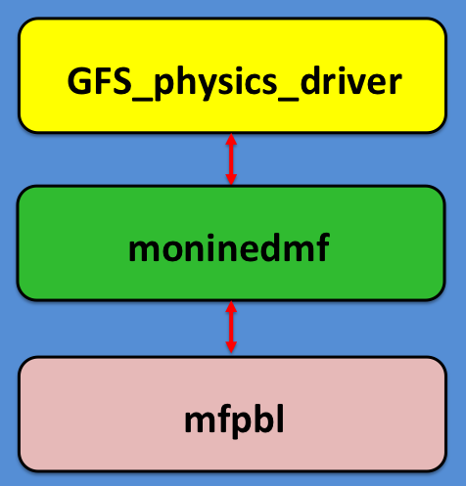

Slide 6
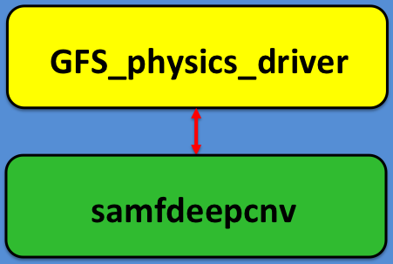

Slide 7
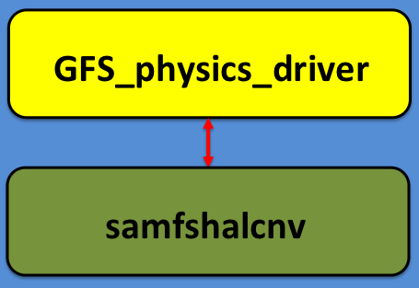

Slide 8
