Slide 1
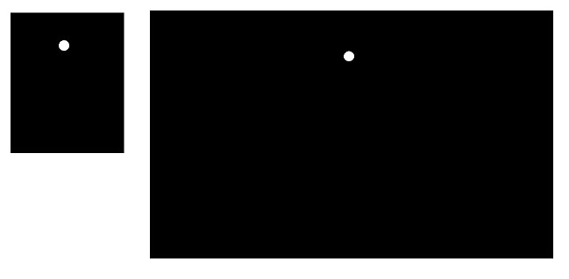
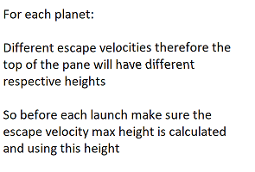
*Exosphere earth = 190000km*
paneHeight – 50 px
**At any time paneHeight – 50 has to be relative
to the max height of the projectile’s motion
** using the height
**Width is irrelavent
Eg: If user picks planet Earth, then the escape velocity should be in the 11.2 km/s,
and when minimized my centerPane is of prefHeight: 327.0 px
50 px
So, paneHeight-50 = 277.0 px
Height to escape vs pane height ratio:
190000km/277px * centerPane.getHeight (when max)
*** Listener to dynamically alter the yPosition of the circle according to maxPane/minPane Heights
and change listener ***
When maximized I can multiply each height value with the ratio
to keep it relative to each other.

