Slide 1
The FAA Allows Americans to be Exposed to Unsafe Levels of Aviation Noise
UC Davis Aviation Noise & Emissions Symposium
Palm Springs, CA March 4-6, 2024
Daniel Fink MD MBA, The Quiet Coalition* Program Chair
*A program of Quiet Communities, Inc.
Concord MA
DJFink@thequietcoalition.org

Slide 2
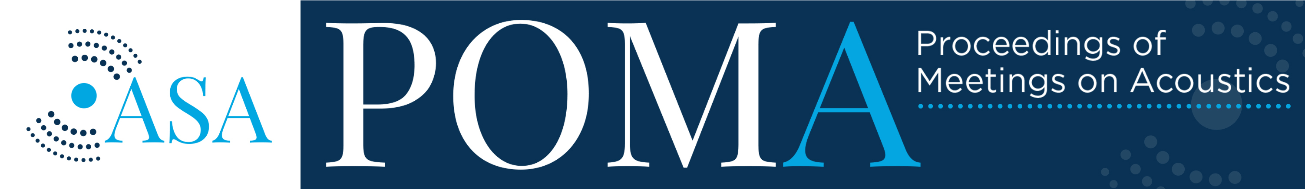
This paper has been accepted for publication.
Volume 50 http://acousticalsociety.org/ IN PRESS
183rd Meeting of the Acoustical Society of America
Nashville, Tennessee 5-9 December 2022
Noise: Paper 4aNS8
The FAA's 65 dBA DNL is not a safe noise exposure level
for the American public
Daniel Fink MD
Board of Directors, The Quiet Coalition, Lincoln, MA, 01773; djfink01@aol.com
The Federal Aviation Administration's (FAA) 65 dBA day-night level (DNL) is not a safe noise exposure level for the American public.
In response to the 1976 Aviation Noise Abatement Policy, using annoyance as the measure of aviation noise effects on the public,
the FAA adopted 65 dBA as the threshold of significant noise exposure, below which residential land uses are compatible. The
Environmental Protection Agency, however, calculated that the safe noise levels for the public are DNL =<55dB to prevent outdoor
activity interference and annoyance and =<45 dB to prevent indoor activity interference and annoyance. Noise has both auditory
and non-auditory health effects. Commercial and general aviation noise exposure have not been shown to cause auditory disorders n the public, but do have non-auditory health effects. Noise exposure is stressful and nighttime noise disrupts sleep. The associations between aviation noise exposure and its adverse health effects are well documented, with likely mechanisms by which the effects occur proposed based on human and animal research. For population health and safety, aviation noise must be reduced.

Slide 3
The FAA Allows Americans to be Exposed to Unsafe Levels of Aviation Noise
The FAA states that aviation noise DNL 65 dBA is compatible with residential land use.
Using the FAA’s same metric, the EPA calculated that L_{dn} (same as DNL) 45 dB for indoor noise and 55 dB for outdoor noise are the safe noise exposure levels for the American public.
A 20 dB increase is perceived as 4 times louder.
The FAA is allowing Americans to be exposed to unsafe levels of aviation noise.

Slide 4
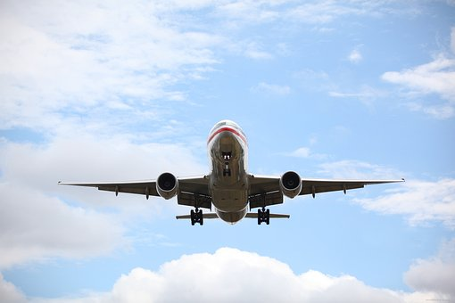
Aviation noise is a problem in the air….

Slide 5
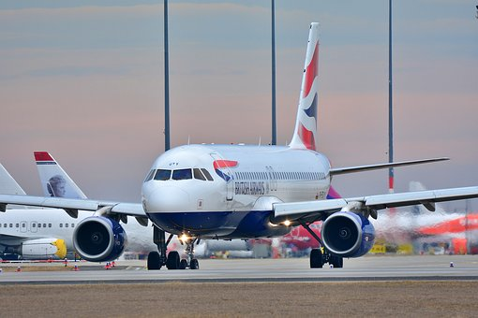

and on the ground….

Slide 6
Aviation (Aircraft) Noise
The FAA states, “While there are many benefits to air travel, aircraft noise can be a concern for communities. The FAA is limited by the simple reality that aircraft make noise.” (FAA webpage, Noise)
Noise has both auditory and non-auditory effects on human health. (Basner et al., Lancet 2014)
Except for certain military aircraft (e.g., EA-18G Growler, F-35 Lightning II, 110+ dBA), aviation noise exposure does not cause hearing loss in the public. (Military aircraft are excluded from FAA regulation.)

Slide 7
Noise is unwanted and/or harmful sound
The standard definition of noise (ASA/ANSI 2.32): Noise. a) undesired sound. By extension, noise is any unwanted disturbance within a useful frequency band, such as undesired electric waves in a transmission channel or device. b) Erratic, intermittent, or statistically random oscillation.
The new definition of noise (Fink D. POMA 2019; APHA policy statement Noise as a Public Health Hazard, January 2022; adopted by ICBEN June 2023): Noise is unwanted and/or harmful sound.
Aviation or aircraft noise is often both unwanted and harmful.

Slide 8
Physiological responses to noise
Immediate: increases in blood pressure and pulse
Few minutes: activation of the hypophyseal-pituitary (ACTH)-adrenocortical axis (stress hormone increase)
Hours: inflammatory response
Days to months: hypertension, diabetes, obesity
Years: heart disease, stroke, increased mortality

Slide 9
What does the FAA say about the adverse health effects of aviation noise?

Slide 10
What does the FAA say about the adverse health effects of aviation noise?
A Google search using the search words “FAA aviation noise health” did not yield any relevant links except one link to FAA research programs and on page 2 of the search results, a link to a 2018 publication by Peters et al. that will be discussed later.
The UK Civil Aviation Authority webpage on aviation noise and health lists annoyance, cognitive impairment, sleep disturbance, and cardiovascular disease as adverse health effects of aircraft noise.

Slide 11
What did the FAA say about the adverse health effects of aviation noise in 1985?
In the 1985 report Aviation Noise Effects, the FAA stated:
“8.4 Summary: Although many airport neighbors have claimed a direct health impact from aviation noise, there is little valid scientific basis for such claims.” [emphasis added]
That may have been true in 1985 [it really wasn’t, aviation noise was recognized as a public health hazard as far back as 1968], but it certainly is not true in 2024.

Slide 12
FAA vs. EPA mission statements
FAA: “Our continuing mission is to provide the safest, most efficient aerospace system in the world.”
EPA: “The mission of EPA is to protect health and the environment.”
QUERY: Does the FAA’s mission to provide a safe aerospace system extend to those on the ground who live near airports and under flight paths?

Slide 13
The FAA considers aviation noise to be an annoyance.
Annoyance due to Noise
To represent the effect of aircraft noise exposure on people, researchers in the 1960's and 1970's developed the concept of noise annoyance. This concept proved useful in understanding how communities felt about the noise from the new aircraft of the jet age. There are several factors that affect the extent of annoyance that a noise causes. How loud is the noise? How long did it last? How often did the noise occur? When did the noise occur: was it during nighttime? Did the noise occur against a backdrop of other noises or did it occur in an otherwise quiet place? (FAA webpage, “Community Response to Noise”, updated March 29, 2022)

Slide 14
Annoyance
The FAA considers aviation noise annoyance a trivial problem, but it is not. Each episode of aviation noise disrupts conversations, interrupts activities, disturbs sleep, decreases productivity. For impacted communities, the effects extend far beyond annoyance to stress, anger, frustration, and a sense of powerlessness.
In 1978, US Surgeon General William Stewart MD said, “Calling noise a nuisance [annoyance] is like calling smog an inconvenience. Noise must be considered a hazard to the health of people everywhere.”

Slide 15
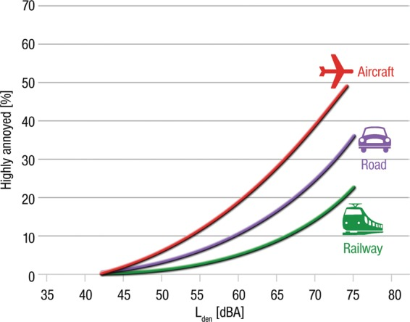
Aviation noise is more annoying than other forms of transportation noise (Munzel, Ann Rev Publ Health 2020)

Slide 16
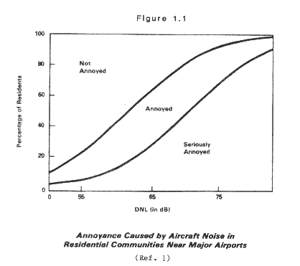
The Schultz Curve
J. Acoust. Soc. Am. 64, 377–405 (1978)

Slide 17
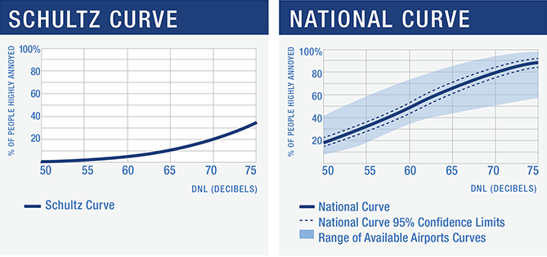
The Neighborhood Environmental Survey* reported much greater annoyance from aircraft noise
*The Neighborhood Environmental Survey was done 2015-2016 but not reported until 2021.

Slide 18
Apparently based on the Schultz Curve…
In response to the 1976 Aviation Noise Abatement Policy (ANAP), “FAA has adopted DNL 65 dBA as the threshold of significant noise exposure, below which residential land uses are compatible…” (FAA Community Response to Noise)
The ANAP also identified DNL 65dBA as the noise exposure level above which aircraft noise "create[s] a significant annoyance for most residents," but it did not provide any additional information supporting this characterization. (FAA History of Noise)
Since the issuance of the ANAP, the FAA has used the DNL 65 dBA threshold as the basis for its "noise goal" of reducing the number of people exposed to significant aircraft noise around U.S. airports.
Other regulations include the National Environmental Policy Act (1970), which required the FAA to ensure that environmental factors are considered in its decision making.

Slide 19
What is the Day-Night Level?
Day-night Sound Level (DNL) or L_{dn} is defined as the average sound energy in a 24-hour period with a 10-dB penalty added to the nighttime levels (10:00 p.m. to 7:00 a.m.).
[Is dBA the correct measure of aircraft noise?]
Is DNL the correct metric for aircraft noise?
Equivalent Operations For DNL = 65
1 Event/Day SEL 114.4 dBA = DNL 65
10 Events/Day SEL 104.4 dBA = DNL 65
100 Events/Day SEL 94.4 dBA = DNL 65
(FAA webpage, Fundamentals of Noise and Sound)

Slide 20
dBA may be an inappropriate measure of aviation noise
“The Occupational Safety and Health Administration states, “The A-weighted sound pressure level measurement is thought to provide a rating of noise that predicts the injurious effects the noise has on human hearing and has been adopted by OSHA in its noise standards.”²⁹ The health concerns about aviation noise are about the non-auditory health effects of exposure. Aviation noise has a large low-frequency component <200 Hertz and infrasound components <20 Hertz.³⁰ Low frequency sound travels greater distances than higher frequency sound and penetrates walls more readily.³¹ Unweighted or C weighted sound measurements may be more appropriate for aviation noise.” (Fink, D. POMA 2024, in press)

Slide 21
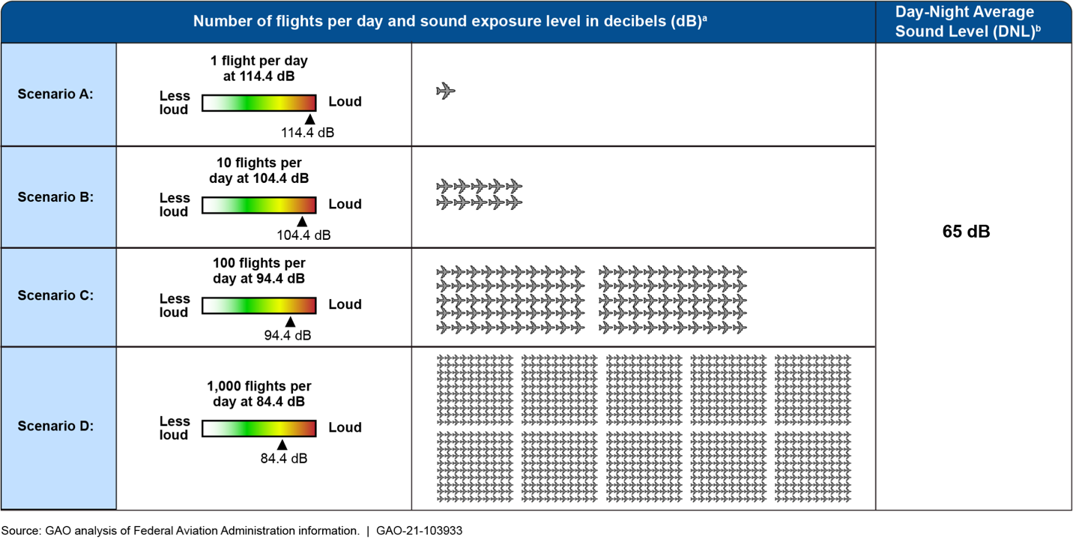
Is DNL the correct metric for aircraft noise?
Figure 2. Different Numbers of Flights and Sound Exposure Levels Result in a Day-Night Average Sound Level (DNL) of 65 Decibels. Reproduced from Government Accountability Office, Aircraft Noise: FAA could improve outreach through enhanced noise metrics, communication, and support to communities

Slide 22
Other metrics for aviation noise
“Rational public discourse is not greatly aided by a debate over the relative merits of expressing noise impact in terms of dB, dBA, dBD, PNL, EPNL, EPNdB, SEL, SENEL, CNR, NEF, CNEL, ASDS, Ldn, and Leq.” [Aviation Noise Abatement Policy 1976]
Number of noise events (NNE)
Number-of-events Above a Specified Level, NA. This metric is usually denoted by NAL(X)'. The NA metric calculates the total number of aircraft events (X) that exceed a selected sound level threshold (L) during a specified time period. The threshold is usually defined using either the SEL or L_{max} metric.

Slide 23
If the FAA chooses a new metric for aviation noise…
If the FAA chooses a new metric for aviation noise-- whatever that metric is-- DNL, flawed though it may be, must continue to be measured and calculated so the public knows whether its aviation noise exposure meets the EPA’s calculated safe noise exposure levels and the WHO’s recommended aviation noise exposure levels.
Otherwise, the FAA might continue to insist that more research needs to be done to determine if the new metric has adverse health effects on the public.

Slide 24
The FAA Allows Americans to be Exposed to Unsafe Levels of Aviation Noise
Regardless of which metric might be better, the FAA states that aviation noise DNL 65 dBA is compatible with residential land use.
Using the FAA’s same metric, the EPA calculated that L_{dn} (same as DNL) 45 dB for indoor noise and 55 dB for outdoor noise are the safe noise exposure levels for the American public.
A 20 dB increase is perceived as 4 times louder.
The FAA is allowing Americans to be exposed to unsafe levels of aviation noise.

Slide 25
What does the EPA consider safe noise exposure levels to be?
From Table 1 in Information on Levels of Environmental Noise Requisite to Protect Public Health and Welfare with an Adequate Margin of Safety (EPA 1974):
Hearing loss L_{eq(24)}=<70 dB All areas.
Outdoor activity interference and annoyance:
Residential areas in which quiet is a basis for use: L_{dn} =<55 dB.
Indoor activity interference and annoyance:
L_{dn}=<45 dB.
The FAA’s 65 dBA DNL clearly exceeds the EPA’s safe noise levels of L_{dn}=<55 dB and L_{dn}=<45 dB.

Slide 26
What does the FAA think needs to be done?
From: Peters JL, Zevitas CD, Redline S, et al. Aviation noise and cardiovascular health in the United States: a review of the evidence and recommendations for research direction. Current Epidemiological Reports 2018; (June) 5(2):140-152
“Summary: Given the state of the literature, future research should leverage emerging tools to estimate aviation, railway, and road traffic noise and apply noise estimates to a range of epidemiological study designs and endpoints to inform causal interpretation and help determine potential intervention strategies.”

Slide 27
What did the WHO recommend in 2018, based on published research available to anyone with a device, a search engine, and an internet connection? [Bolding added]
“For average noise exposure, the GDG [Guidelines Development Group] strongly recommends reducing noise levels produced by aircraft below 45 dB L_{den}, as aircraft noise above this level is associated with adverse health effects.
For night noise exposure, the GDG strongly recommends reducing noise levels produced by aircraft during night time below 40 dB L_{night}, as nighttime aircraft noise above this level is associated with adverse effects on sleep.
To reduce health effects, the GDG strongly recommends that policymakers implement suitable measures to reduce noise exposure from aircraft in the population exposed to levels above the guideline values for average and night noise exposure. For specific interventions the GDG recommends implementing suitable changes in infrastructure.”
WHO Environmental Noise Guidelines for the European Region (2018)

Slide 28
The connection between annoyance and adverse health effects of aircraft noise (1)
Given the FAA’s use of annoyance as the sole basis for its noise policy, and the extensive use of DNL in the literature about the health effects of aviation noise, I will make a direct connection from aviation noise to cardiovascular disease and death.
More research is always good, but no more research is needed to know beyond any reasonable doubt that aviation noise kills people.

Slide 29
The connection between annoyance and adverse health effects of aircraft noise (2)
Noise annoys people. Annoyance is stressful. Noise by itself causes stress. (Westman, Walters: Noise and stress: a comprehensive approach, 1980; Babisch 2014)
Stress causes inflammation of the vascular intima (arterial lining), leading to cardiovascular disease and increased mortality. (Tawakol et al, Lancet 2017)
This effect has specifically been shown to be caused by transportation noise. (Osborne et al, 2020)

Slide 30
The connection between annoyance and adverse health effects of aviation noise (3)
Aviation noise causes cardiovascular and hormonal effects that cannot be habituated to. (Schmidt et al, Eur Ht J 2013; 2021)
The mechanisms by which this occurs are now understood down to the cellular and molecular levels. (Munzel et al, J Am Coll Cardiol 2018)
No more research needs to be done to know with a high degree of certainty that aviation noise causes cardiovascular disease and increased mortality.

Slide 31
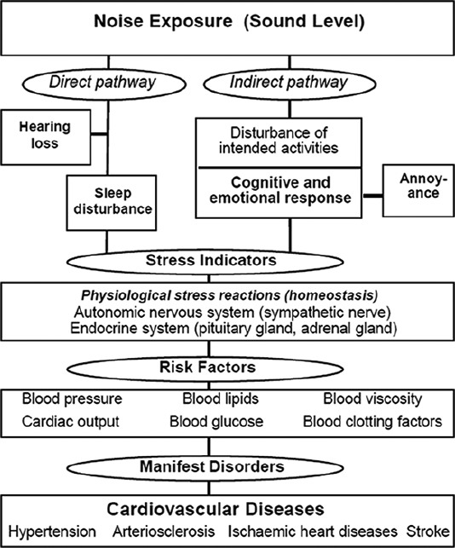
Noise effects reaction scheme (Babisch 2014)

Slide 32
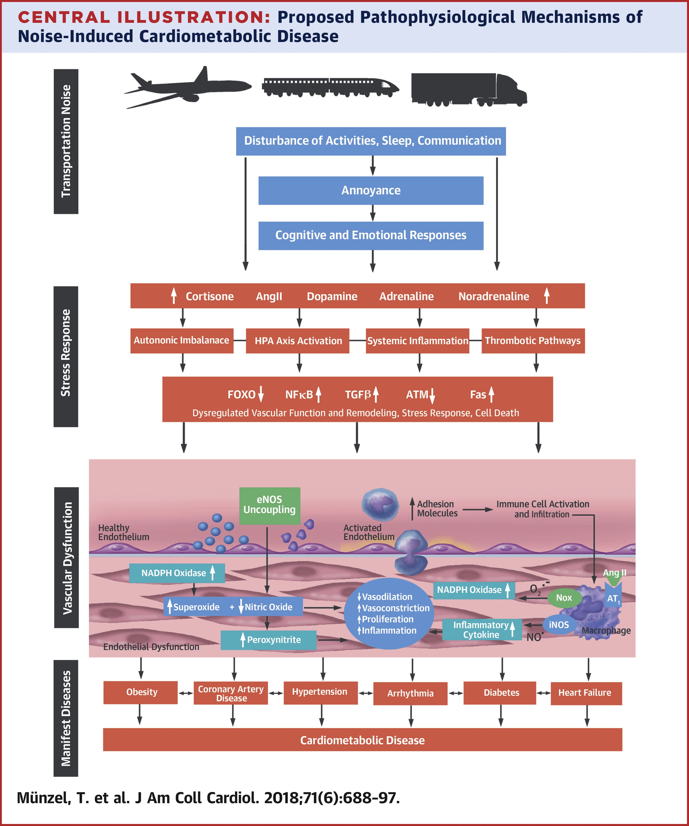
Proposed pathophysiological mechanisms of noise-induced cardiometabolic disease (Munzel et al, JACC, 2018)

Slide 33
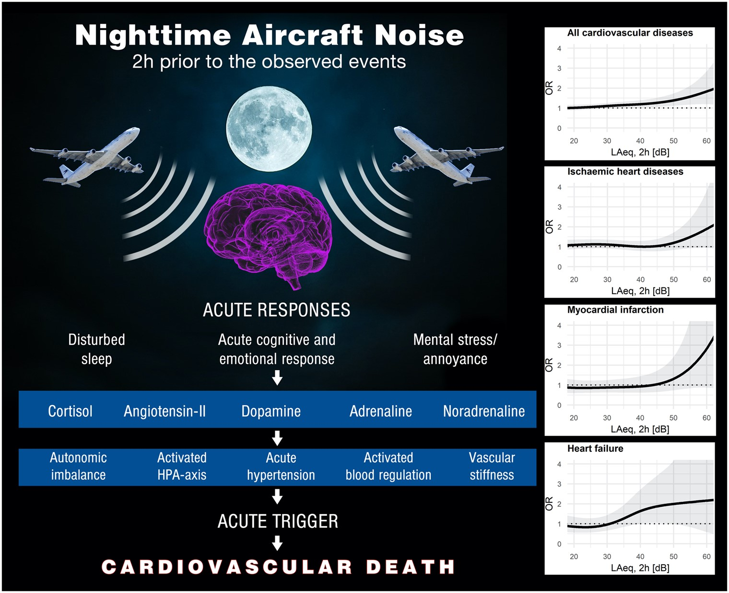
Nighttime aviation noise has particularly deleterious effects on the heart (Munzel et al, Eur Ht J 2021)

Slide 34
Is there any doubt that noise causes cardiovascular disease?(1)
Babisch (2014): “Chronic long-term exposure to transportation noise has been shown to be associated with the prevalence and incidence of cardiovascular diseases, including hypertension, ischemic heart diseases and stroke. The evidence of the association is based on experimental work carried out in the laboratory regarding the biological plausibility (coherence), the consistency amongst study results (different study designs, different populations, different noise sources), the presence of an exposure-response relationship and the magnitude of the effect. The question is no longer whether noise causes cardiovascular diseases; it is rather to what extent. “

Slide 35
Is there any doubt that noise causes cardiovascular disease?(2)
Basner: “The overwhelming majority of noise effect researchers today accept that there is a causal relationship between environmental noise exposure and increased cardiovascular risk.” (Deutsches Artzteblatt International 2016)

Slide 36
Is there any doubt that noise causes cardiovascular disease?(3)
Bradford Hill criteria for establishing causality:
Strength
Consistency
Specificity
Temporality
Biological gradient
Plausibility
Coherence
Experimental evidence
Analogy

Slide 37
CONCLUSION
The FAA states that 65 dBA DNL is compatible with residential land use.
The EPA states that the safe noise exposure limit is 55 dB DNL for outdoor noise and 45 dB DNL for indoor noise.
The scientific and medical literature documents that aviation noise causes cardiovascular disease and death.
The FAA is allowing Americans to be exposed to unsafe levels of aviation noise.
What can be done to prevent unnecessary illness and death in Americans exposed to aviation noise?

Slide 38
The Quiet Communities Noise Challenge
If anyone has published evidence in a peer-reviewed scientific or medical journal that DNL 65 dBA is a safe noise exposure level for humans, in contradistinction to what the EPA and WHO have concluded, please let me have that reference.
EPA: 45 dB DNL for indoor noise, 55 dB DNL for outdoor noise.
WHO 45 dB for L_{den}, 40 dB for L_{night.}

Slide 39
Questions?

Slide 40
Disclosures and Acknowledgements
DISCLOSURES: I am board chair of The Quiet Coalition. A Program of Quiet Communities, Inc. I serve as an Expert Consultant to the World Health Organization on its Make Listening Safe Program, and as a subject matter expert on noise and the public for the National Center for Environmental Health at the Centers for Disease Control and Prevention. All positions are unpaid and I have no conflicts to disclose.
ACKNOWLEDGMENTS: I want to thank my noise colleagues, especially David Sykes, Gina Briggs, Jamie Banks, and Jan Mayes, for their help in teaching me about noise, David Sykes, Jamie Banks, and Tricia Glass for their assistance with this presentation, and my wife, Dr. Ruth Cousineau, for her support. My goal is to find a quiet restaurant in which to enjoy the meal and the conversation with her.
Thanks also to my son Richard for technical support.

