Slide 1
pineR
PROJECT

Slide 2
DESCRIPTIVE PLOTS

Slide 6
(a)
(b)
(c)
(d)
Figures (a) and (b) show the histogram of the variables Altitude of each site and the distance of the
weather stations from the measured position. Figures (c) and (d) show the frequency of Species and
Soil Type in each site.

Slide 7
(a)
(b)
(c)
(d)
Figure (a) shows the frequency of the aspect for each site. Figure (b) is a histogram of the variable
percentage of slope. Figures (c) and (d) show the barplot of the variables Conditions and Roughness.

Slide 8
(a)
(b)
Figure (a) and (b) shows the conditions and roughness associated with site, respectively.

Slide 9
(a)
(b)
Figure (a) and (b) shows the slope type and slope angle associated with site, respectively.

Slide 10
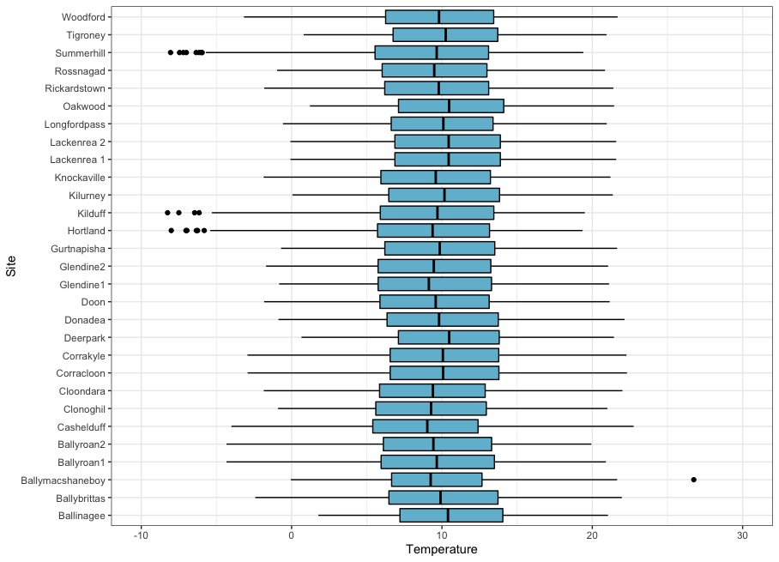
Boxplots of the weighted mean temperature of each site over three years.

Slide 11
OVERVIEW OF THE PACKAGE pineR

Slide 12
How is the package organized?
Principal function: piner.
Principal arguments:
data: a data frame containing the variables “day”, “month”, “year”, “min_temp”, “max_temp” and “temp”, that represents the day, month, year, minimum, maximum and average temperatures, respectively.
npop: population size.
ntimes: number of runs.
ngen: number of generations.
species: species of the tree.
depth: stump depth (1 = 10cm, 2 = 20cm, 3 = 30cm).
The function piner is divided in the following internal functions: getStumpTemp, getFirstGeneration , module1, module2, module3, module4, module5 and module6.
The principal outputs of the function are:
mature
lavalst
gstmonth
geetime
geewinter
geemonth
stageov
rweevil

