Slide 1
Footnote¹
From “is this even true?” to “here’s what I can do about it.”
Live now: footnote.alessandrarye.com
Civic grounding for public claims: sources, transparency, and a real local next step.
Alee · Metana Full Stack Capstone · Final presentation, October 2026
Notes:
We've all had the experience of seeing something alarming online about our local community. It shows up as a meme or a post, with no good next step. You can't tell if it's true, and even if it is, you don't know what to do about it. Footnote fixes that.
When I presented this a few weeks ago, Footnote was a plan and a walking skeleton. Today it's a working product, live at that address, running on real public records from my own county. In the next few minutes, I'll show you what it does, how it's built, what I did with your feedback, and where it honestly still falls short.

Slide 2
The gap between seeing and doing
A resident sees a post: “the new levy money is going to administrator raises.”
Today she has three dead ends. She can’t easily check it. If she checks it, she gets a verdict with no reasoning. And nothing tells her what to actually do next, so she shares it, or shrugs.
Verification tools stop at the verdict
1
Fact-checks and trust ratings end with “true-ish.” Then nothing.
Civic software is sold to governments
2
The municipality is the customer; the resident is the audience.
Early signal: an attorney, a librarian, and a student, interviewed separately, each described this exact gap, and all three responded positively to Footnote.
Community platforms have neither
3
Where claims actually spread, there’s no verification and no path to action.
Nobody connects “I saw this claim” to “here is what I can do about it.”
Notes:
A quick recap of the problem, because everything I built answers it. Picture this for a moment. A resident of your town is scrolling her community Facebook group, and she sees a post: the new levy money is going to administrator raises. There are a hundred angry reactions and sixty comments.
She has hit three dead ends without realizing it. First, she can't easily check whether it's true. The answer exists, but it's in a long financial report on a website she has never been to. So she reads the comments instead, which is never a good idea. There is certainty everywhere, but evidence nowhere.
The second dead end is the fact-check. It may or may not reach her, and if it does, it's a label with no reasoning behind it and no sources. By this point, her feed has repeated the claim until it feels true.
The third dead end is the one nobody talks about. Say she does get the truth. Now what? Nothing tells her what to do with it. There's a school board meeting where the budget is on the agenda, and nothing in her feed will ever tell her that. So she shares the post, or she shrugs.
I tested this before I built anything. An attorney, a librarian, and a student each described this exact gap, without me naming it first.
Nobody connects "I saw this claim" to "here is what I can do about it." That connection is the product.

Slide 3
The solution: one path, four steps
1
2
3
4
Bring a claim
See the sources
Open the record
Get the next step
Paste the claim, pick a place. No login, no feed. Location is declared, never detected.
→
A source card built from primary records, under a visible citation policy. Evidence, not verdict badges.
→
The transparency layer: what was searched, used, rejected, and where AI was involved.
→
The upcoming meetings, the responsible officials, the organizations already on it, and where to find the records.
Then the session ends and evaporates. No profiles, no tracking, no engagement optimization, no ads. The constraints are the product.
Notes:
So here's the path. It's the same four steps I showed you last time. The difference is that every one of them now runs.
Step one. You bring a claim, and you pick a place. By a claim, I mean anything presented to you as true that showed up without its receipts. There's no login and no feed. Footnote tells you what you're holding: a checkable statement of fact, an opinion, or an opinion with a fact buried inside it.
Step two. It shows you what the official records say. Not a true-or-false stamp. The documents themselves.
Step three, if you're curious. You open the transparency record and see how the answer was put together, including where AI was involved.
And step four is the part nothing else does. It hands you the real next step in your actual town. Then the session ends and evaporates. No profiles, no tracking, no ads.

Slide 4
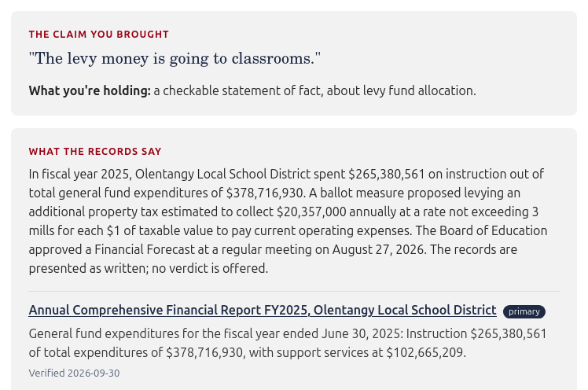
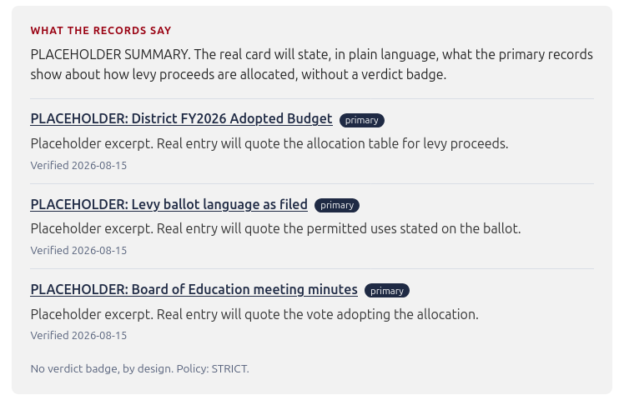
It’s live, on real records
70%
of general fund spending went to instruction in FY2025: $265.4M of $378.7M, audited.
Three primary records
Audited financial report, FY2025
Ballot language, March 2024
Board meeting minutes, August 2026
Each links to the document itself and shows its verified date.
In August
this card was all placeholders. Now every fact is real, sourced, and dated.
Live site, canonical claim, captured 2026-10-07
Notes:
So let me show you. This is the live site, not a mockup. I typed in the claim "the levy money is going to classrooms" and picked Delaware County.
At the top, Footnote tells me what I'm holding: a checkable statement of fact about levy fund allocation. That label came from a real model call.
Below that is what the records say, and it's built from three primary records. The district's audited financial report for fiscal year 2025. The March 2024 ballot language from the Board of Elections. And the August 2026 board meeting minutes. Each one links to the document itself and shows the date I verified it.
Now here's a number most people in my district have never seen. The district spent 265 million dollars on instruction, out of 379 million in general fund spending. That's about seventy percent. Footnote doesn't tell you whether that's good or bad. It puts the number, and where it came from, in front of you.
The last time you saw this card, it was all placeholders. Today, every fact on it is real, sourced, and dated.
But a screenshot is still a screenshot. Let me show you the real thing.
[Switch to the browser. The site is already open to the empty form. Type the claim, pick Delaware County, click Look at the records. While it loads: "That pause is a real model call." Scroll once through the card and the invitation, open the transparency record, point at the policy stage, then say:]
And that's it. It's still live, still real, and still yours to try on your phone later. Back to the slides, because I want to show you how it got there.
[Switch back to the PDF on slide 5.]

Slide 5
How a claim moves through Footnote
“The levy money is going to classrooms”
+ Delaware County, Ohio
1
Classify
AI
2
Source
3
Policy
AI
4
Invite
Claude Haiku labels the claim factual, opinion, or mixed. Strict JSON, validated in code.
Picks the hand-verified record set that matches the claim, or none if nothing matches.
Keeps or rejects each source by tier. Haiku drafts the summary; rules check every sentence.
Meetings, officials, organizations, and resources, closest to the claim first.
Transparency record written by every stage: model and latency, sources kept and rejected, sentences kept and dropped, verified dates
Source card
Civic invitation
Transparency panel
What the records say, cited to primary sources.
Who to contact and where to show up.
How the answer was assembled, stage by stage.
Then the session evaporates. No profiles, no tracking, no ads.
Notes:
You asked me for a diagram of how a claim moves through the system. Here it is. There's a version on the front page of the repo too.
A claim and a place go in at the top. Then four stages run in order. Classify labels the claim. Source picks the set of primary records that matches the claim, or none if nothing matches. Policy decides which sources are good enough to show, and writes the summary. Invite attaches the local next step.
Two of those stages use AI, and I marked them. Both go through a single adapter, and both have a fallback. So if the model is down, or there's no key, the site still works.
The dark band is the part I care about most. Every stage writes down what it did: which model, how long it took, what it kept, what it threw out. That log is the transparency record. I didn't bolt it on at the end. It's how the pipeline is built.
Three things come out after you submit a claim: the source card, the civic invitation, and the transparency panel. Then the session evaporates.

Slide 6
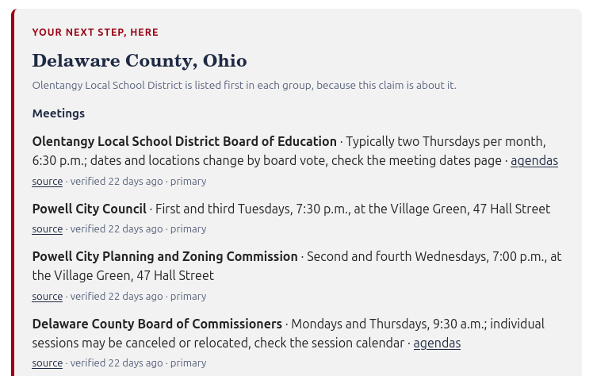
The data: one county, by hand
18
officials
4
public meetings
4
organizations
6
resources
Every entry carries: its source link, the date it was verified, and its tier. Staleness is displayed, never hidden. The git history is the audit log.
Live site, 2026-10-07. The school board leads because the claim is about the levy.
The promise is not “the data is true.” It’s “you can always see where it came from and when it was checked.”
Notes:
Your second piece of feedback was to build out the data for one locality. And from the very start, the concern about this project was the data. So let me show you exactly what's in there.
This is Delaware County, Ohio, and I captured it by hand from official sites. Eighteen officials. Four public meetings. Four organizations. And six resources, things like how to file a public records request and where to watch the meeting videos.
Every entry carries three things: a link to its source, the date I verified it, and its tier, meaning whether it's the record itself, an official communication, or established reporting. And staleness is shown, never hidden. If I checked something twenty days ago, the screen says twenty days ago.
The list is also ordered for the claim. A levy claim leads with the school board, not the city council.
All of it lives in one text file in the repo, which means the whole edit history is public. The git history is the audit log.
I'll be honest about the cost. This is labor. One county took real hours. That labor is also the moat, and I'll come back to who does it.
So the promise is not "the data is true." The promise is "you can always see where it came from and when it was checked."

Slide 7
The model writes, code decides
The draft
Checker test run: six sentences, two kept, four dropped
1
Haiku gets the claim and the kept sources, and returns sentences, each tagged with the source it cites.
KEPT
“The district spent $265,380,561 on instruction.”
cites the financial report · figure found in the source
DROPPED
“The district spent $300,000,000 on instruction.”
cites the financial report · figure not in source
The first run
2
DROPPED
“Voters approved the levy.”
cites the ballot · outcome not stated in source
It wrote that voters “approved” the levy, citing the ballot. The ballot lists the question, not the result.
KEPT
“The board approved the financial forecast.”
cites the board minutes · the minutes use that word
The fix: four rules, plain code
“This proves the levy money is misused.”
contains verdict language
3
DROPPED
Cites a kept source · every figure appears in that source · no verdict language · no outcome word the source does not use.
DROPPED
“The county reported a surplus.”
cites source 7 · does not point to a kept source
The model writes the summary. Code decides what you see.
Notes:
This is the part of the build I'm proudest of. And it started with a mistake.
I wanted the summary on the source card to be written by the model instead of by me. So I gave the model, Claude Haiku, the claim and the three records, and asked for a summary, with every sentence tagged to the source it came from.
On the very first run, it wrote that voters approved the levy. And it cited the ballot. But think about what a ballot is. A ballot lists the question. It doesn't list the result. So the sentence sounded right, and the source didn't say it. For a product whose whole promise is "check our work," that is exactly the failure that matters.
So I built a checker. And the checker is plain code, not AI. Every sentence has to pass four rules. One, it has to point to a source we kept. Two, every figure in it has to appear in that source. Three, no verdict language. And four, it can't use an outcome word, like approved or rejected, unless the source it cites uses that word.
That's why the same word, approved, gets blocked for the ballot and allowed for the board minutes. It depends on what each record says.
On the right is the proof. Six test sentences. Two kept, four dropped, and every drop has a stated reason. On the live site, every dropped sentence is logged in the transparency record.
The model writes the summary. Code decides what you see.

Slide 8
Tech stack: what is running
Frontend
React 19 (Vite) · single-page web app for phone and desktop
FE
Backend
Node.js + Express 5 REST API · four pipeline stages as separate modules (classify → source → policy → invite)
API
Data
Civic locality package as version-controlled YAML · every entry has a source, a tier, and a verified date · sessions are not stored
DATA
Model layer
Claude Haiku 4.5 in two stages, classification and summary draft · one swappable adapter · clean fallback · every call logged to the transparency record
AI
Infra & process
AWS EC2 + nginx + pm2, HTTPS via Let’s Encrypt · pull requests into a protected main · dated decisions log
OPS
Changed since August: no PostgreSQL and no CI pipeline yet. Nothing about a session is kept, so there is nothing to store. Both are on the roadmap.
Notes:
The tech stack, quickly, because the choices are boring on purpose. React on the front end. Node and Express on the back end, with each of the four pipeline stages in a file of its own. Claude Haiku handles the two AI stages, behind one adapter, so the provider can be swapped.
There's one change from the slide I showed you last time. I planned for a PostgreSQL database and an automated test pipeline, and I didn't build either one. Here's why. The product doesn't need a database yet. Sessions aren't stored, and the civic data lives in a version-controlled file. I'd rather show you no database than one that exists to fill a box on a slide. Both are on the roadmap.

Slide 9
Your feedback, and honest limits
1
A diagram of how a claim flows
What it cannot do yet
DONE
In this deck and on the repo front page.
The checker verifies attribution, figures, and wording. It does not yet verify that a paraphrase keeps the source’s meaning.
It has records for one question, the levy. Any other claim, even one its own data could answer, gets a “not yet covered” card until that context is built out.
One county, maintained by hand.
2
Build out the data for one locality
DONE
Delaware County v1, plus three real source records.
3
Keep using GitHub
DONE
Branch, pull request, protected main, decisions log.
4
More interviews
IN PROGRESS
Round 1: attorney, librarian, student. Round 2 is underway.
5
README, server, interface polish
DONE
Instructor feedback in October. All three are live.
A tool about trust has to be honest about its own edges.
Notes:
Last time, you gave me four pieces of feedback. So here's the scorecard. A diagram of the claim flow: done, you just saw it. Build out the data for one locality: done. Keep using GitHub the way I had been: done, and the whole history is public. More interviews: partly. Round one was the attorney, the librarian, and the student. Round two is a teacher, a journalist, and a civic organization, and that outreach is underway now.
Then this month, my instructor asked for three more things: a current README, a current server, and a polished interface. All three are done and live.
Now for what Footnote can't do yet. I'd rather you hear it from me.
The pipeline handles any claim you bring. What it's missing is the context behind most of them. Right now it has records for one question, the school levy. Take a claim like "the school board has five members." Footnote classifies it correctly as a checkable statement of fact. The answer is even sitting in its own civic data; the five board members are listed on the invitation. But the source card says "not yet covered," because nobody has connected that record to that question yet. That's the build-out: records and context for the claims people actually bring, one at a time, each with a source and a verified date. It's a long list, and it's the right kind of long.
The checker has a limit too. It verifies attribution, figures, and wording. It does not yet verify that a paraphrase keeps the source's meaning. And it's one county, maintained by hand.
A tool about trust has to be honest about its own edges.

Slide 10
Beyond the capstone: what comes next
Next in the build
A checker that catches the right number attached to the wrong idea · automated tests for every rule · sources connected to the claims people actually bring.
1
Local stewards
Residents and libraries in each place keep its information current, with the same source-and-date receipt on every entry. Who does this, and how, is the open question.
2
Community source submission
People can hand Footnote evidence; nobody can hand it an opinion. Reviewed pipeline, no posts, no identities, no audience.
3
Topic packages
The same provenance engine aimed at issues residents feel but don’t research: data-center siting, water and power agreements. Cite, never characterize.
4
Sustainability: free for citizens, always · institutional licensing (libraries, schools) · engine as an API · grants bridge · no ads, no engagement monetization, ever.
Notes:
So where does this go? In the code, two things. First, a stronger checker. Today it catches a wrong number. It doesn't yet catch a right number attached to the wrong idea, like the instruction figure described as administrator raises. Second, automated tests, so every rule in that checker runs on every change. And then the records: connecting sources to the claims people actually bring, starting with the ones already sitting in the civic data.
The bigger question is how this reaches a second town. And the answer is people. You saw how much work one county took. I can't do that for every county, and software can't either. Every place needs people who live there keeping its information current, working with their library and their schools.
I don't have that part solved. I don't know yet whether it's a paid role, a volunteer one, or part of a librarian's job. But this isn't a new problem. Wikipedia and OpenStreetMap both started as projects that looked too big to maintain, with no clear way to pay for them, and both are kept current today by people who care about their own corner of it. Footnote doesn't grow without that. The software is the tool. The community is what keeps it true.
It stays free for citizens. The revenue is institutional licensing. And no ads, ever.

Slide 11
Footnote¹
You pick a place. It shows you the records, shows its work, and hands you the next step. Then it forgets you.
Live: footnote.alessandrarye.com Repo: github.com/Alessandrarye/footnote
Questions welcome, especially the hard ones. The transparency record applies to me too.
Notes:
So that's Footnote. You pick a place. It shows you the records, shows its work, and hands you the next step. Then it forgets you.
Last time, that was a promise. Today it's a live site, running on real records from a real county, with an AI component that is checked by rules and logged in the open.
It's live at that address right now, and the repo is public. I'd welcome your questions, especially the hard ones. The transparency record applies to me too.

Slide 12
Backup: competitors
Media trust tools
Gov-side civic platforms
Community platforms
Ground News · NewsGuard · AI verification APIs (Factiverse, ClaimBuster)
CivicPlus · OpenGov · Granicus
Nextdoor · Facebook groups · local forums
Stop at the verdict.
Sold to governments; the citizen isn’t the customer.
Own the attention where claims spread. No verification, no path to action.
Google: substitutes for the verification half. Ran a Civic Information API for local officials data and shut it down in 2025.
OCLC: budget-adjacent in the library market, not functional. Footnote ingests only government primary records.
Footnote occupies the connection: verification → local action.
Notes:
Backup slide, only if asked about competitors. Three camps, all healthy businesses, which proves both halves of the market are real. Media trust tools stop at the verdict. Civic software is sold to governments, so the citizen isn't the customer. Community platforms own the attention and carry no trust layer. Nobody owns the connection between knowing and doing.
On Google: anyone can paste a claim into a chatbot, but a chatbot doesn't maintain a county's meeting calendar and ballot language with a receipt on every entry. Google ran an API for local officials data and shut it down in 2025.

Slide 13
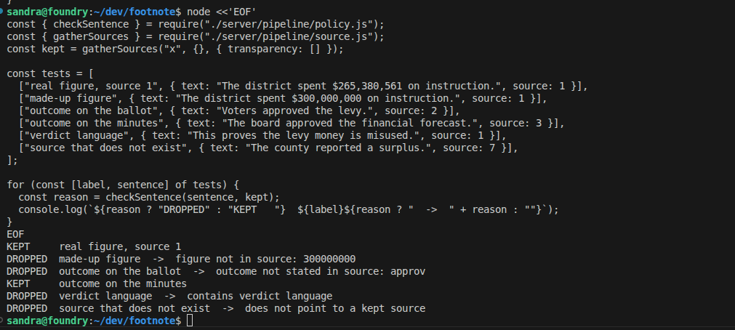
Backup: checker test output
Run from ~/dev/footnote on 2026-10-04. The last six lines are the results.
Notes:
Backup slide, only if someone wants to see the raw test. This is the terminal output from the checker run on October 4. The top half is the six test sentences. The bottom six lines are the results: kept or dropped, and the reason for each drop.

Slide 14
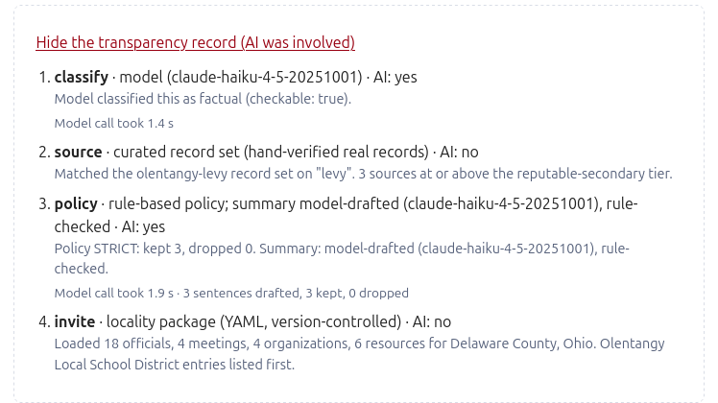
Backup: the transparency record
Live site, 2026-10-07, canonical claim. Every stage says what it did, and whether AI was involved.
Notes:
Backup slide, for anyone who wants to see the record itself. This is the live site on the canonical claim. Four stages. Classify and policy used the model, and each shows which model and how long the call took. Source shows which record set matched and on which word. Policy shows three sentences drafted, three kept, none dropped. Invite shows what was loaded and that the school district entries were listed first.

Slide 15
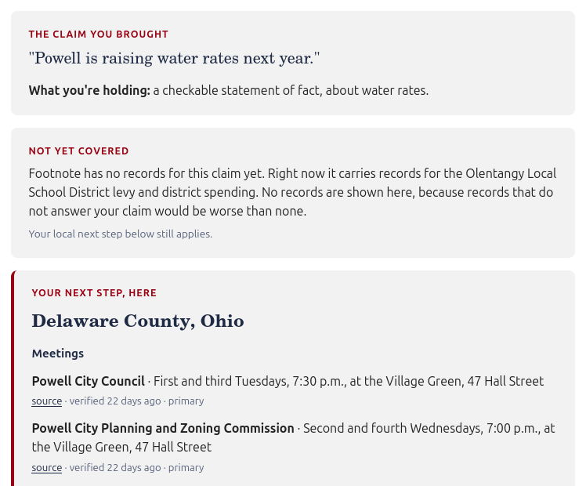
Backup: a claim it has no records for
No records beat the wrong records
Before this, every claim was shown the levy records. Now a claim outside the record set gets a plain statement of what Footnote does carry.
The next step still applies
The civic invitation still appears, in the locality’s normal order, because the meetings and officials are real either way.
And it is on the record
The transparency record says no record set matched and that no summary was written. The model is not asked to fill the gap.
Live site, 2026-10-07
Notes:
Backup slide, if someone asks what happens with a different claim. I typed a claim about water rates. Footnote classified it, said plainly that it has no records for it yet, and named what it does carry. It did not show the levy records, and it did not ask the model to fill the gap. The local next step still appears, because the meetings and officials are real either way.

