Slide 1




ADIOS Tutorial
SciDAC 2008
6/19/2008
http://www.adiosapi.org
C. Jin, S. Klasky, J. Lofstead
GPSC
GSEP

Slide 2
Outline
End to End Vision with ADIOS. (15 minutes)
ADIOS API’s. (15 minutes)
ADIOS XML. (15 minutes).
Heat Equation (1 hour).
XGC code. (45 minutes).

Slide 3
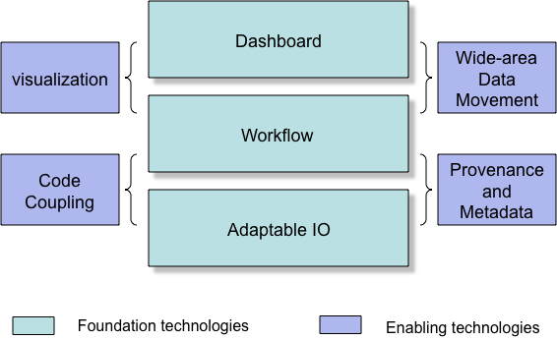
Our End to End vision of computing
Combines
Petascale Applications.
Petascale I/O techniques.
Workflow Automation.
Provenance capturing system.
Dashboards for real-time monitoring/controlling of simulations, and creating social spaces for scientists.
Approach: place highly annotated, fast, easy-to-use I/O methods in the code, which can be monitored and controlled, have a workflow engine record all of the information, visualize this on a dashboard, move desired data to user’s site, and have everything reported to a database.

Slide 4
Motivation
“Those damm fort.* files!”
Multiple HPC architectures
Cray, IB-based clusters, BlueGene
Multiple Parallel Filesystems
Lustre, PVFS2, GPFS, Panasas, PNFS
Many different APIs
MPI-IO, POSIX, HDF5, netCDF
GTC (fusion) has changed IO routines 8 times so far based on performance when moving to different platforms.
Different IO patterns
Restarts, analysis, diagnostics
Different combinations provide different levels of I/O performance

Slide 5

ADIOS Overview
Allows plug-ins for different I/O implementations.
Abstracts the API from the method used for I/O.
Simple API, almost as easy as F90 write statement.
Best practices/optimize IO routines for all supported transports “for free”
Componentization.
Thin API
XML file
data groupings with annotation
IO method selection
buffer sizes
Common tools
Buffering
Scheduling
Pluggable IO routines
Scientific Codes
External
Metadata
(XML file)
ADIOS API
buffering
schedule
feedback
MPI-IO
pHDF-5
POSIX IO
MPI-CIO
pnetCDF
LIVE/DataTap
Viz Engines
Others (plug-in)
Notes:
Please remember that we support both synchronous and asynchronous IO methods!!!

Slide 6
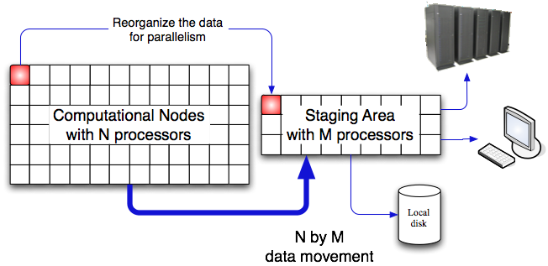
ADIOS Overview
ADIOS is an IO componentization, which allows us to
Abstract the API from the IO implementation.
Switch from synchronous to asynchronous IO at runtime.
Change from real-time visualization to fast IO at runtime.
Combines.
Fast I/O routines.
Easy to use.
Scalable architecture (100s cores) millions of procs.
QoS.
Metadata rich output.
Visualization applied during simulations.
Analysis, compression techniques applied during simulations.
Provenance tracking.
Notes:
Fast and Easy and Portable for most of the codes. We will not guarantee all codes will work, but most codes will work.

Slide 7
Design Goals
ADIOS Fortran and C based API almost as simple as standard POSIX IO
External configuration to describe metadata and control IO settings
Take advantage of existing IO techniques (no new native IO methods)
Fast, simple-to-write, efficient IO for multiple platforms without changing the source code

Slide 8
Design Goals
ADIOS Contributions:
Data Grouping: Multiple, independently controlled IO settings
diagnostics, restarts, analysis, viz
Optional data items: Different data from different processes
Single group write has header from a single proc and data from all
Data sizes change dynamically: Datasets vary in size
Run size changes data sizes; also AMR codes
Constructed output is special: Reused buffers must be handled properly
stack temporaries...
IO memory is second to science: Buffer space for IO is strictly limited
respect the memory needs of the scientific codes
Notes:
i’d rewrite the design goals 2 and 3 to be more principled….right now, they sound like a bunch of implementation….for instance, for the first goal, you could combine 1 and data groupings, so say:
- ADIOS contribution: Data grouping – dealing with multiple indep. controlled IO settings
Now, I am not saying you have to get rid of your current structure (goals, with contributions later), but can you say 2 and 3 in those terms somehow? That is, link them to an important problem….4 and 5 are clearer.

Slide 9
Architecture
Data groupings
logical groups of related items written at the same time.
Not necessarily one group per writing event
IO Methods
Choose what works best for each grouping
Vetted and/or written by experts for each
POSIX (Wei-keng Lao, Northwestern)
MPI-IO (Steve Hodson, Chen Jin, ORNL)
MPI-IO Collective (Wei-keng Lao, Northwestern)
NULL (Jay Lofstead, GT)
Ga Tech DataTap Asynchronous (Hasan Abbasi, GT)
others..

Slide 10
Related Work
Specialty APIs
HDF-5 – complex API
Parallel netCDF – no structure
File system aware middleware
MPI ADIO layer – File system connection, complex API
Parallel File systems
Lustre – Metadata server issues
PVFS2 – client complexity
LWFS – client complexity
GPFS, pNFS, Panasas

Slide 11
Supported Features
Platforms tested
Cray CNL (ORNL Jaguar)
Cray Catamount (ORNL old-Jaguar and SNL Redstorm)
Linux Infiniband (ORNL Ewok)
BlueGene P now being tested/debugged.
IO Methods
MPI-IO independent, MPI-IO collective, POSIX, NULL, Ga Tech DataTap asynchronous, Rutgers DART asynchronous

Slide 12
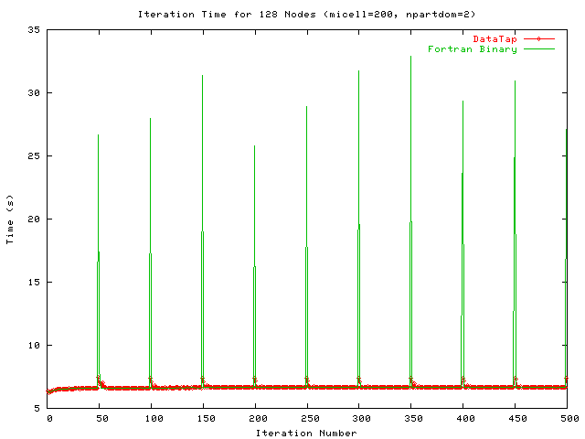
Initial ADIOS performance.
MPI-IO method.
GTC and GTS codes have achieved over 25 GB/sec on Cray XT at ORNL.
30GB diagnostic files every 3 minutes, 1.2 TB restart files every 30 minutes, 300MB other diagnostic files every 3 minutes.
Chimera code speed up by 6.5% (overall time).
DART: <2% overhead for writing 2 TB/hour with XGC code.
DataTap vs. Posix
1 file per process (Posix).
5 secs for GTC computation.
~25 seconds for Posix IO
~4 seconds with DataTap

Slide 13
Codes & Performance
June 7, 2008: 24 hour GTC run on Jaguar at ORNL
93% of machine (28,672 cores)
MPI-OpenMP mixed model on quad-core nodes (7168 MPI procs)
three interruptions total (simple node failure) with 2 10+ hour runs
Wrote 56 TB of data at 20 GB/sec (21 TB for post analysis)
IO overhead 3% of wall clock time
Mixed IO methods of synchronous MPI-IO and POSIX IO configured in the XML file

Slide 14
Chimera IO Performance (Supernova code)
2x scaling
Plot minimum value from 5 runs with 9 restarts/run
Error bars show maximum time for the method.

Slide 15
ADIOS 1.0
Library Release: October 2008
Documents:
ADIOS Manual
Example routines
ADIOS tutorial
ADIOS Utils
Bp2h5, bp2ncd, bp2ascii
ADIOS Tools
Bpdump, bpcopy, bpmody ,adios_lint
ADIOS Methods
MPI-IO, MPI-CIO, Posix, NULL, phdf5, DataTap (experimental).
Supported Platforms
Cray XT, Infiniband (x86), Gigabit
Minimal required Software
C compiler
Optional Software
python.

Slide 16
ADIOS 2.0
Release October, 2009.
BlueGene P will be fully supported.
Index files built for fast reading.
Faster methods for converting codes with F90 writes, C fwrites, netcdf, hdf5 to ADIOS writes.
Metadata Catalogue.
One file will be produced per simulation which hyperlinks to all of the other files produced.
Readers developed.
Integration into Kepler for metadata capture.
Offloading to staging area for other processing, such as data re-arrangement and in situ visualization.
Please suggest changes

Slide 17
ADIOS API Overview
Requirements
Standards
Setup/Cleanup API
Main IO APIs
Secondary IO API
Asynchronous IO hints
Additional Pieces

Slide 18
Requirements
Work equally well for Fortran and C-based codes
Nearly as simple as standard POSIX IO commands
Capable of generating full HDF-5 and netCDF output
Support both synchronous and asynchronous IO
Changes to IO methods do not require source code changes

Slide 19
Standards
64-bit sizing for everything
Fortran 90 and C 99
MPI Messaging
required by some transports for coordination
MPI-IO

Slide 20
Setup/Cleanup API
Initialize/cleanup
adios_init (‘config.xml’)
parse XML file on each process
setup transport methods
adios_finalize (proc_id)
give each transport method opportunity to cleanup
particularly important for asynchronous methods to make sure they have completed before exiting

Slide 21
Main IO API
Open
adios_open (handle, ‘group name’, ‘file name’, mode)
handle used for subsequent calls for write/read/close
‘group name’ matches an entry in the XML
mode is one of ‘w’ (write), ‘r’ (read), ‘a’ (append)
later ‘u’ (update [read/write])
Close
adios_close (handle)
handle from open

Slide 22
Main IO API
Write
adios_write (handle, ‘name’, data)
handle from open
name of var or attribute var in XML for this group
data reference
Read
adios_read (handle, ‘name’, buffer)
handle from open
name of var in XML for this group
buffer to store read value
Must specify one per var written or read

Slide 23
Main IO API
writing and reading based solely on XML
adios_gwrite (handle, ‘group name’)
handle from open
group name in XML used in open
generates all of the detail ‘adios_write’ calls based on XML
adios_gread (handle, ‘group name’)
handle from open
group name in XML used in open
generates all of the detail ‘adios_read’ calls based on XML

Slide 24
Secondary IO API
Get buffer for fewer memory copies
adios_get_write_buffer (handle, ‘var’, buffer)
handle from open
var name from XML
buffer to write into
Set HDF-5 style paths dynamically
adios_set_path (handle, ‘new path’)
adios_set_path_var (handle, ‘new path’, ‘var’)
handle from open
new path to set for either the entire group or just ‘var’
var name from XML

Slide 25
Asynchronous IO hints
Indicate non-IO intensive sections of code
adios_start_calculation ()
adios_stop_calculation ()
IO pacing hint
adios_end_iteration ()

Slide 26
Additional Pieces
Special IO buffering control
adios_allocate_buffer ()
tell ADIOS layer to calculate IO buffer sizes now

Slide 27
Example Program
program p
call adios_init (‘config.xml’)
...
call adios_open (handle, ‘restart’, ‘restart.bp’, ‘w’)
adios_gwrite (handle, ‘restart’)
call adios_close (handle)
...
call adios_finalize (0)
end program p

Slide 28
ADIOS XML Format
File Overview
Group Overview
Method Overview
Other Pieces Overview

Slide 29
File Overview
Single main element
<adios-config [host-language=“x”]>
host-language optional to specify memory layout/comm host language
Fortran
C
Nested elements for groups, methods, buffer specifications

Slide 30
Group Overview
Group root element
<adios-group name=“n” [host-language=“x”] [coordination-communicator=“comm”]
[coordination-var=“var”]>
host-language optional to specify memory layout/comm host language
Fortran
C
name is required and used in the method element and in the adios_open calls
coordination-communicator optional, but specifies parallel write communicator
coordination-var optional, but specifies var to coordinate later
Nested elements for var, global-bounds, attribute
future: mesh description for viz support

Slide 31
Group Details
var element, part 1
<var name=“name” type=“t” [path=“p”] [dimensions=“d”] [copy-on-write=“yes”] [gname=“g”] />
name is used in write/read
flexible names to allow simple expressions
must contain at least one non-number character
main limitations based on use in dimensions (no comma) or not globally unique due to paths (no ‘/’ character)
type is expected names: integer, real, double, complex, string, real*4, integer*8, character, etc.
path for HDF-5 output (optional)
use ‘/’ to separate levels
converted to ‘_’ for netCDF output

Slide 32
Group Details
var element, part 2
<var name=“name” type=“t” [path=“p”] [dimensions=“d”] [copy-on-write=“yes”] [gname=“g”] />
dimensions is a comma separated list of magnitudes for each rank
only used for array elements
either numbers or var names for dynamic sizing
copy-on-write required to handle ephemeral values and reused buffers
stack-based temporaries (e.g., passing in the result of an expression like x+5)
reused buffers (e.g., build a Cartesian coordinate output for each of X, Y, and Z one at a time, writing each in between)
gname is expression to generate for writing for gwrites

Slide 33
Group Details
Global Arrays
<global-bounds dimensions=“d” offsets=“o”>...</global-bounds>
dimensions is the global array size and must be provided consistently by all coordinating processes
offsets is the offset in the global space to start the local data
nested elements are var elements that should conform to the global-bounds
Ghost region support in ADIOS 2.0

Slide 34
Group Details
Attributes
<attribute name=“n” path=“p” value=“val” type=“t” var=“var”/>
name of the attribute
path for HDF-5 style hierarchy
works like the path in a var
for either a group or data item
Group: if the last character is a ‘/’ or not a var name
Data Item: if the last piece names a var (but no trailing ‘/’)
Must provide EITHER value OR var and type
value is a fixed value for the attribute
var is the name of a var so that adios_write can supply the value at runtime
type works like var element type, used for the var

Slide 35
Method Overview
method element
<method group=“g” method=“m” [priority=“p”] [iterations=“i”]>params</method>
group is the name of the group in the XML that should use this method
can have multiple entries per group!
method is the name of the IO method to use
MPI, POSIX, DataTap, NULL, MPI-CIO, etc.
priority is optional hint for asynchronous IO prioritization
iterations is optional hint for pacing of asynchronous IO
params is the optional contents of the element passed to the method on initialization
Used for specifying hints and connectivity information

Slide 36
Method Overview
method element
<method group=“g” method=“m” [priority=“p”] [iterations=“i”]/>
group is the name of the group in the XML that should use this method
can have multiple entries per group!
method is the name of the IO method to use
MPI, POSIX, DataTap, NULL, MPI-CIO, etc.
priority is optional hint for asynchronous IO prioritization
iterations is optional hint for pacing of asynchronous IO

Slide 37
Other Pieces Overview
buffer specification
<buffer
{size-MB=“s” | free-memory-percentage=“p”}
allocate-time=“a”/>
size-MB is a fixed number of MB available for IO buffering
free-memory-percentage is the amount of remaining RAM that can be used for IO buffering
either size-MB or free-memory-percentage required
allocate-time specifies when to check the memory size
now – do it at adios_init time
oncall – do it when adios_buffer_allocate is called

Slide 38
XML Example
<adios-config host-language=“Fortran”>
<adios-group name=“restart”>
<var name=“nx” type=“integer”/>
<var name=“ny” type=“integer”/>
<var name=“gnx” type=“integer”/>
<var name=“gny” type=“integer”/>
<var name=“lnx” type=“integer”/>
<var name=“lny” type=“integer”/>
<global-bounds dimensions=“gnx,gny” offsets=“lnx,lny”>
<var name=“data” type=“real” dimensions=“nx,ny”/>
</global-bounds>
</adios-group>
<method group=“restart” method=“MPI”/>
<buffer size-MB=“100” allocate-time=“now”/>
</adios-config>

Slide 39
ADIOS Demos
An Simple Example
Solution of Heat equation ( C code)
ASCII output
Example taken from http://carbon.cudenver.edu/csprojects/csc5809F99/mpi_examples/2d_heat_equation.html
Real Scientific Applications
XGC-1 (Fortran)
NETCDF, HDF5, ASCII

Slide 40
Numeric Solution of Heat Equation
A simple partial differential equation, describing the heat transfer in 2-D surface
solution function is calculated at discrete spatial mesh points
Proceed in discrete time steps
Parallelize this task on multiple processors (e.g. 16)

Slide 41
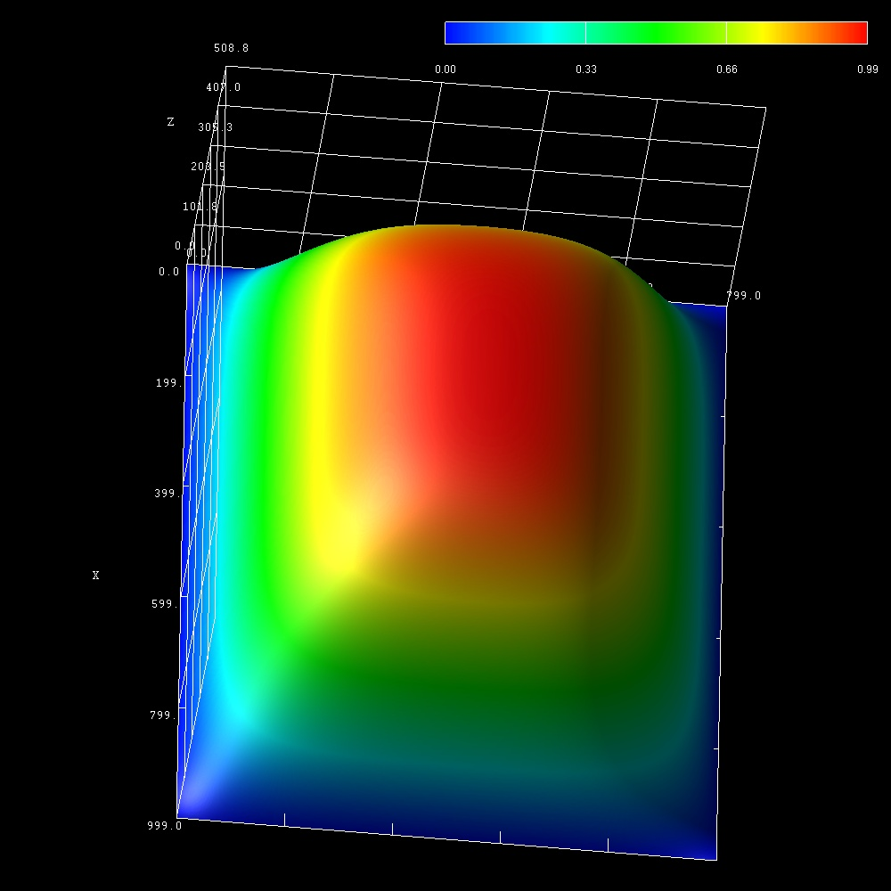
2D Display of the output

Slide 42
Original IO Architecture
Slave Node 1
Boundary Exchange
Slave Node 2
Master Node 0
Write Files
DISK
Slave Node 15

Slide 43
Heat Equation
Show the IO routines in the original code.
Compile/Run Original Code
Show ASCII output

Slide 44
ADIOS Heat Equation
Integrate ADIOS APIs into source Code
Two primary routines in the code to look at
Main()
This routine does the initial domain decomposition, and has all of the routines that call the I/O output.
Adios_init/finalize
Prtdat()
This routine writes the output files.
adios_open/write/close
Notes:
Similar as mpi_init/finalize
Adios_init : initialization
Adios_finalize : cleanup
adios_open: retrieve the buffer buf for the adios-group, which will be read from/written into the given filename
Adios_close: is actually to commit the operation of actual read/write
Adios-open
Adios-write
Adios-close

Slide 45
Prtdat: Original vs. Adios
void prtdat (float *u,
char *fn){
int ix, iy; FILE *fp;
fp=fopen(fn, "w");
for(ix=0;ix<=nx-1;ix++){
for(iy=0;iy<=ny-1;iy++){
fprintf (fp," %8.6f",
ix,iy,*(u1+ix*ny+iy));
if (iy==ny-1)
fprintf(fp, "\n"); }
}
fclose (fp) ;
}
void prtdat (float *u,
char *fn){
long long buf;
adios_open (&buf, “output”, fn,”w”);
adios_write (buf, ”NX", &NX);
adios_write (buf, ”NY", &NY);
adios_write (buf, "data", u);
adios_close (buf);
}

Slide 46
heat.xml (1)
Optional Declaration
<?xml version="1.0"?>
Root Element:
Start-tag
<adios-config host-language="C”>
</adios-config>
<adios-group name="output">
<var name="NX" type="integer"/>
<var name=“NY” type=“integer”/>
<var name="data" gname="u” type=”float" dimensions="NX,NY"/>
</adios-group>
Group Container
Transport method
<method method="POSIX" group="output"/>
<buffer size-MB="100" allocate-time="now"/>
Buffer size/creation
Root Element: End-tag
Notes:
<?xml version=1.0?> optional xml declaration, this element states what version of xml is in use, also may contain information about character encoding
<adios-config> root element (can only be stated once), any text or elements must be enclosed between the root start-tag and end-tag
<adios-group> : a container of a group of variables/attributes that should be treated as a single IO operations
<method>: specify what transport method used for different adios-group
<buffer> : internal buffer size and creation time.

Slide 47
Compile and Run

Slide 48
BP Tools
Adios_lint
Bpdump
Bp2h5
bp2ncd
Bp2ascii

Slide 49
adios_lint
validate configuration XML file conforms to all standards.
adios_lint <filename>
output: no news is good news!

Slide 50
bpdump
./bpdump [-d [var]|--dump [var]] <filename>
Example
./bpdump –d NX final.bp
element size: 39
Scalar NX
Path: /
Type: integer (2)
Value: 400
Notes:
It works as ncdump and h5dump,
Element size here is the size of bp data entry for scalar NX including variable name, path name and other attribute information if provided.

Slide 51
bp2h5
./bp2h5 XXXX.bp [XXXX.h5] [-c]
Example
./bp2h5 final.bp –c heat.xml
h5ls -r final.h5
/NX Dataset {1}
/NY Dataset {1}
/data Dataset {400, 500}

Slide 52
bp2ncd
./bp2ncd XXXX.bp [XXXX.nc] [-c]
Example
./bp2ncd final.bp -c
ncdump -hfinal.nc
netcdf final { // format variant: 64bit
dimensions:
_data_0 = 400 ;
_data_1 = 500 ;
variables:
float _data(_data_0, _data_1) ;
}

Slide 53
bp2ascii
./bp2ascii XXXX.bp [XXXX.txt] -C[-c] data_name1 [data_name2...]
Example
./bp2ascii final.bp -c data
----------------------------
generating file: final.txt
----------------------------
write dataset: data
Dimension:400 x 500

Slide 54
gwrite
Motivation
Easy to Insert/Remove Variables
Only need maintain xml file
How to Use
Source code
Adios_gwrite(buf_id,group_name)
Makefile
Python gwrite.py xml _fname dir_name
Run gwrite.py in every directory containing the adios_gwrite
Notes:
1. when do you use adios_gwrite better than adios_write
2. the adios_write scatterred around different subroutines and not easy for gwrite to replace all the adios_write
3. open/close/gwrite should be in same routines

Slide 55
Show, Compile/Run Heat_adios

Slide 56
Add More output Variables
Output more variables
cos_u,sin_u, tan_u
Modify XML File
Modify ptrdat routine
Replace all of the adios_write statements with just
adios_gwrite(buf_id,”output”);
Recompile/Run

Slide 57
heat.xml (2)
<adios-group name="output”>
<var name="NX" type="integer"/>
<var name="NY" type="integer"/>
<var name=”temperature" gname="u” type="float" dimensions="NX,NY"/>
<var name="cos_temp" gname="cos_u” type=”float" dimensions="NX,NY"/>
<var name="sin_temp" gname="sin_u” type="float" dimensions="NX,NY"/>
<var name="tan_temp" gname="tan_u” type="float" dimensions="NX,NY"/>
</adios-group>
<method method="POSIX" group="output"/>
gname :actual variable name/expression in the source code
Var name: dataset name written into file

Slide 58
Show and run new ADIOS code

Slide 59
Switch To MPI-IO Method
In this example we need to
Define a communicator.
Required whenever not all ranks are participating in the write.
In this example, we have a master process which will NOT participate in this write.
In this case, we put different path name for different slave nodes
Modify the XML file to use the MPI-IO method, and to place the communicator in the group.

Slide 60
ADIOS IO Architecture
Slave Node 1
Edge Exchange
Slave Node 2
Master Node 0
Write Files
DISK
Slave Node 15

Slide 61
Heat.xml (3)
<adios-group name="output” coordination-communicator=“group_comm”>
<var name=”group_comm” type=“integer*8”/>
<var name="NX" type="integer"/>
<var name="NY" type="integer"/>
<var name=”offset" type="integer"/>
<var name=”size" type="integer"/>
<var name=”temperature" gname="u+offset*NY” type=”float" dimensions="size,NY"/>
<var name="cos_temp" gname="cos_u[offset]” type=”float" dimensions="size,NY"/>
<var name="sin_temp" gname="sin_u[offset]” type="float" dimensions=” size,NY"/>
<var name="tan_temp" gname="tan_u[offset]” type="float" dimensions=“size,NY"/>
</adios-group>
<method method=”MPI" group="output"/>
Notes:
Coordination-communication: pass to the transport methods to coordinate the write/read operation

Slide 62
Global Array
Global Array
Global/local dimension, Offset
Used to reconstruct dataset in bp2h5/bp2ncd
Recompile/Run

Slide 63
Heat.xml (4)
<varname="offset" type="integer"/>
<varname="size" type="integer/>
<global-bounds dimensions="NX,NY" offsets="offset,0">
<var name=”temperature" gname="u+offset*NY” type="float" dimensions="size,NY"/>
<var name=”cos_temp" gname=”cos_u[offset]" type="float" dimensions="size,NY"/>
<var name=”sin_temp" gname=”sin_u[offset]” type="float" dimensions="size,NY"/>
<var name=”tan_temp" gname=”tan_u[offset]” type="float" dimensions="size,NY"/>
</global-bounds>

Slide 64
Typos in XML
Adios_lint
Adios run time error
Better to use gwrite/gread to avoid the typos

Slide 65
XGC
Description
IO Pattern
NetCDF files
Hdf5 files
ASCII files

Slide 66
Snapshot of adios-groups in xgc config.xml
<method method=”MPI" group="restart"/>
<method method="POSIX" group="diagnosis.bfield"/>
<method method="POSIX" group="diagnosis.bfield.1"/>
<method method="POSIX" group="diag_pot.fieldp.header"/>
<method method="MPI" group="diag_pot.fieldp"/>
<method method="POSIX" group="diagnosis.flow"/>
<method method="POSIX" group="diagnosis.flux"/>
<method method="POSIX" group="fort.tracer"/>
<method method="POSIX" group="fort.gam"/>
<method method="POSIX" group="fort.ef"/>
<method method="POSIX" group="fort.60"/>
<method method="POSIX" group="fort.50"/>
<method method="POSIX" group="fort.61"/>
<method method="POSIX" group="fort.30"/>
<method method="POSIX" group="fort.p"/>
<method method="POSIX" group="diagnosis.particleweight"/>
<method method="POSIX" group="diagnosis.mesh"/>
<method method="POSIX" group="diagnosis.fieldi"/>
<method method="POSIX" group="diagnosis.fieldi.1"/>
<method method="POSIX" group="diagnosis.fieldi.2"/>
<method method="POSIX" group="diagnosis.fieldi.3"/>
<method method="POSIX" group="diagnosis.fieldi.4"/>
<method method="POSIX" group="diagnosis.fieldi.5"/>
Notes:
WHY is restart POSIX and not MPI?

Slide 67
Restart Files
Original XGC-1
one restart file per processor
ADIOS XGC-1
One restart file for all the processors

Slide 68
XML: restart group
<adios-group name="restart" coordination-communicator="icomm">
<var name="icomm" type="integer*8"/>
<var name="sml_istep" type="integer"/>
<var name="sml_time" type="double"/>
<var name="maxnum" gname="sp%maxnum" type="integer"/>
<var name="inum" gname="sp%num" type="integer"/>
<var name="inphase" gname="sp%nphase" type="integer" />
<var name="imaxgid" gname="sp%maxgid" type="integer"/>
<var name="igid" gname="sp%gid" type="integer*8" dimensions="maxnum"/>
<var name="iphase" gname="sp%phase" type="double" dimensions="inphase,maxnum"/>
••••••

Slide 69
XML: restart group
<gwrite src=" if(sml_electron_on==1) then"/>
<gwrite src=" sp=>ptl%elec"/>
<var name=“enum” gname=“sp%num” type=“integer”/>
<var name="emaxgid" gname="sp%maxgid" type="integer"/>
<var name="enphase" gname="sp%nphase" type="integer"/>
<var name="egid" gname="sp%gid" type="integer*8" dimensions="enum"/>
<var name="ephase" gname="sp%phase" type="double" dimensions="enphase,enum"/>
<gwrite src=" endif"/>
</adios-group>

Slide 70
Restart_write (ADIOS)
! Dynamically form the name for certain time step
write(filename,'("restart.",i4.4,".bp")') sml_istep
call adios_open(buf,’restart’,filename,’w’)
call adios_gwrite(buf,’restart’)
call adios_close(buf)

Slide 71
Restart_read (ADIOS)
! Dynamically form the name for certain time step
write(filename,'("restart.",i4.4,".bp")') sml_istep
call adios_open(buf,’restart’,filename,’w’)
call adios_gread(buf,’restart’)
call adios_close(buf)

Slide 72
HDF5 outputs
ADIOS
Simple APIs
General bp2h5 converter

Slide 73
XML: mesh group
<adios-group name="diagnosis.mesh">
<var name="n_n" type="integer" />
<var name="n_t" type="integer" />
<var name="n_psi" type="integer" />
<var name="values" gname="coord" type="float*8"
path="/coordinates/" dimensions="2,n_n"/>
<var name="node_connect_list" gname="nodeid” type="integer"
path="cell_set[0]" dimensions="3,n_t" />
<var name="nextnode" gname="nextn” type="integer"
dimensions="n_n"/>
<var name="itheta0" gname="n_itheta0" type="integer"
dimensions="n_psi"/>

Slide 74
XML: mesh group
<attribute name="nnodes" path="/" var="n_n" type="integer"/>
<attribute name="nspace" path="/" value="2" />
<attribute name="ncell_sets" path="/" value="1" />
<attribute name="XP_CLASS" path="/" value="Mesh" />
<attribute name="cell_name" path="/cell_set[0]/" value="Tri" />
</adios-group>

Slide 75
Original mesh.h5
GROUP "/”
ATTRIBUTE "nnodes” (int)
ATTRIBUTE "nspace” (int)
ATTRIBUTE "ncell_sets” (int)
ATTRIBUTE "XP_CLASS” = “Mesh”
Group "cell_set[0]"
ATTRIBUTE "ncells” (int)
ATTRIBUTE "cell_name” = “Tri”
DATASET "node_connect_list” (int[][])
GROUP "coordinates”
DATASET “values” (double)
DATASET "itheta0” (int[])
DATASET "nextnode” (int[])

Slide 76
./bp2h5 mesh.bp
H5dump –H mesh.h5
/cell_set[0] Group
/cell_set[0]/node_connect_list Dataset
/coordinates Group
/coordinates/values Dataset
/itheta0 Dataset
/n_n Dataset
/n_psi Dataset
/n_t Dataset
/nextnode Dataset

Slide 77
Bfield.h5
GROUP "/”
ATTRIBUTE "nspace” (int)}
ATTRIBUTE "nnodes” (int)
ATTRIBUTE "nnode_data” (int)
ATTRIBUTE "XP_CLASS = “Node_data”
GROUP "node_data[0]" {
ATTRIBUTE "veclen” (int)
ATTRIBUTE "labels” = “bfield”
ATTRIBUTE "unit” = “telsa’
DATASET "values” (double[][])
GROUP "node_data[1]" {
ATTRIBUTE "veclen” (int)
ATTRIBUTE "labels” = “poloidalflux”
ATTRIBUTE "unit=“Tm^2”
DATASET "values” (double[][])

Slide 78
Fieldi_istep.bp
GROUP "/”
ATTRIBUTE "timestep” (int)
ATTRIBUTE "nspace” (int)
ATTRIBUTE "nnodes” (int)
ATTRIBUTE "nnode_data” (int)
ATTRIBUTE "XP_CLASS” = “Node_data”
GROUP "node_data[0]"
ATTRIBUTE "veclen” (int)
ATTRIBUTE "labels” = “ion__density(2D)”
ATTRIBUTE "units" = "m^-3"
DATASET "values” (double[])

Slide 79
Fieldi_istep.bp
GROUP "node_data[1]"
ATTRIBUTE "veclen” (int)
ATTRIBUTE "labels” = “ion__v_par(2D)”
ATTRIBUTE "units" = "m/s"
DATASET "values” (double[])
GROUP "node_data[2]"
ATTRIBUTE "veclen” (int)
ATTRIBUTE "labels” = “ion__v_ExB-Z(2D)”
ATTRIBUTE "units" = ”m/s"
DATASET "values” (double[])

Slide 80
Fieldi_istep.bp
GROUP "node_data[3]"
ATTRIBUTE "veclen” (int)
ATTRIBUTE "labels” = “ion__T_perp(2D)”
ATTRIBUTE "units" = "keV"
DATASET "values” (double[])
GROUP "node_data[4]"
ATTRIBUTE "veclen” (int)
ATTRIBUTE "labels” = “ion__T_perp(2D)”
ATTRIBUTE "units" = "keV"
DATASET "values” (double[])

Slide 81
Fieldi_istep.bp
GROUP "node_data[5]"
ATTRIBUTE "veclen” (int)
ATTRIBUTE "labels” = “ion__T_perp(2D)"”
ATTRIBUTE "units" = ” keV"
DATASET "values” (double[])

Slide 82
Fieldi_istep.bp
<adios-group name="diagnosis.fieldi.5">
<var name="n_n" type="integer" />
<var name="values" gname="enpe" path="/node_data[5]" type="double" dimensions="n_n"/>
<attribute name="veclen" path="/node_data[5]/" var=“veclen” type=“integer” />
<attribute name="labels" path="/node_data[5]/" value="ion__T_perp(2D)" />
<attribute name="units" path="/node_data[5]/" value="KeV" />
</adios-group>

Slide 83
NETCDF outputs
Complexity of using NETCDF
Three routines to write flowdiag.nc with attributes
diag_flow_ncinit
diag_flow_ncfinal
low_diagnosis
ADIOS
Shift the complexity to XML construction
Provide easy-to-use, high-level APIs for end-uses
Provide flexibility to keep the schema

Slide 84
diag_flow_ncinit
••••••t
var_units(24)='Unitless'
var_units(25)= 'm^3’
! create netCDF file and enter define mode
iret = nf90_create('xgc.flowdiag.cdf',NF90_CLOBBER, diag_flow_ncfileid)
call check_err(iret)
! define netCDF dimensions
iret = nf90_def_dim(diag_flow_ncfileid, 'samples', diag_flow_npsi, diag_psi_ncdim)
call check_err(iret)
iret = nf90_def_dim(diag_flow_ncfileid, 'timesteps', NF90_UNLIMITED, diag_time_ncdim)
call check_err(iret)
! define netCDF variables
diag_psi_ncdims(1) = diag_psi_ncdim
iret = nf90_def_var(diag_flow_ncfileid, 'psi', NF90_DOUBLE, diag_psi_ncdims, diag_psi_ncvarid)
call check_err(iret)
iret = nf90_put_att(diag_flow_ncfileid, diag_time_ncvarid, 'units', 'transit times')
call check_err(iret)
••••••

Slide 85
diag_flow_ncfinal
••••••
! setenetCDF attribute for ElVis to stop monitoring netCDF file
iret = nf90_redef(diag_flow_ncfileid)
call check_err(iret)
iret = nf90_put_att(diag_flow_ncfileid, NF90_GLOBAL, 'running', 'false')
call check_err(iret)
! leave netCDF define mode and close file
iret = nf90_enddef(diag_flow_ncfileid)
call check_err(iret)
iret = nf90_close(diag_flow_ncfileid)
call check_err(iret)
••••••

Slide 86
Flow_diagnosis
••••••
if(sp_type==1) then
diag_time_ncstart(1) = istep/diag_flow_period + 1
simtime(1) = sml_time/sml_tran
iret = nf90_put_var(diag_flow_ncfileid, diag_time_ncvarid, simtime, diag_time_ncstart, diag_time_nccount)
endif
diag_flow_ncstart(2) = istep/diag_flow_period + 1
do j=2, NN2
ret = nf90_put_var(diag_flow_ncfileid, diag_flow_ncvarid(j,sp_type), netcdf_flow(:,j), diag_flow_ncstart, diag_flow_nccount)
Enddo
! sync output file
iret = nf90_sync(diag_flow_ncfileid)
call check_err(iret)
••••••

Slide 87
Flow_diagnosis with ADIOS
filename="flowdiag.bp”
call adios_open(buf_id,"diagnosis.flow”, filename,"a”)
call adios_gwrite(buf_id,"diagnosis.flow")
call adios_close(buf_id)

Slide 88
XML: flow group
<adios-group name="diagnosis.flow">
<var name="samples" gname="diag_flow_npsi" type="integer" />
<var name="istep" gname="istep/diag_flow_period" type="integer" copy-on-write="yes"/>
<gwrite src="if(istep==diag_flow_period) then"/>
<var name="psi" type="double" dimensions="samples"/>
<gwrite src="endif"/>
<var name="time" gname="simtime(1)" type="double"/>
<attribute name="units" path="time" value="transit times"/>
<var name="ion__density(df)" gname="netcdf_flow(:,2)" type="double" dimensions="samples"/>
<attribute name="units" path="ion__density(df)" value="m^-3" />
<var name="ion__toroidal_flow(df)" gname="netcdf_flow(:,3)" type="double" dimensions="samples"/>
<attribute name="units" path="ion__toroidal_flow(df)" value="m/s" />
••••••

Slide 89
flow_diagnosis Original Schema
netcdfxgc.flowdiag {
dimensions:
samples = 50 ;
timesteps = UNLIMITED ; // (372 currently)
variables:
double psi(samples) ;
double time(timesteps) ;
time:units = "transit times" ;
double ion__density(df)(timesteps, samples) ;
ion__density(df):units = "m^-3" ;
double ion__toroidal_flow(df)(timesteps, samples) ;
ion__toroidal_flow(df):units = "m/s" ;
double ion__poloidal_flow(df)(timesteps, samples) ;
ion__poloidal_flow(df):units = "m/s" ;

Slide 90
Bp2ncdxgc flowdiag.bp
netcdfxgc.flowdiag {
dimensions:
timesteps = UNLIMITED ; // (12 currently)
psi_0 = 50 ;
ion__density(df)_0 = 50 ;
••••••
variables:
double psi(psi_0) ;
time:units = "transit times" ;
double ion__density(df)(timesteps, ion__density(df)_0) ;
ion__density(df):units = "m^-3" ;
double ion__toroidal_flow(df)(timesteps, ion__toroidal_flow(df)_0) ;
ion__toroidal_flow(df):units = "m/s" ;
double ion__poloidal_flow(df)(timesteps, ion__poloidal_flow(df)_0) ;
ion__poloidal_flow(df):units = "m/s" ;

Slide 91
Flux_diagnosis with ADIOS
filename="fluxdiag.bp”
call adios_open(buf_id,"diagnosis.flux”,filename,"a”)
call adios_gwrite(buf_id,"diagnosis.flux")
call adios_close(buf_id)

Slide 92
XML: flow group
<adios-group name="diagnosis.flux">
<var name="samples" type="integer" gname="diag_avg_npsi"/>
<var name="istep" type="integer" gname="istep/diag_avg_outperiod"/>
<gwrite src="if(istep==diag_avg_outperiod) then"/>
<var name="psi" type="double" dimensions="samples"/>
<gwrite src="endif"/>
<var name="time" type="double" gname="simtime(1)"/>
<attribute name="units" path="time" value="transit times"/>
<var name="ion__radial_flux(avg)" type="double" dimensions="samples" gname="flux_total(:,2,1)"/>
<attribute name="units" path="ion__radial_flux(avg)" value="psi/s" />
<var name="ion__radial_E_para_flux(avg)" type="double" dimensions="samples" gname="flux_total(:,3,1)"/>
<attribute name="units" path="ion__radial_E_para_flux(avg)" value="J psi/s" />
••••••

Slide 93
Flux_diagnosis: Original Schema
netcdfxgc.flowdiag {
dimensions:
samples = 50 ;
timesteps = UNLIMITED ; // (372 currently)
variables:
double psi(samples) ;
double time(timesteps) ;
time:units = "transit times" ;
double ion__radial_flux(avg) (timesteps, samples) ;
ion__radial_flux(avg) :units = “psi/s" ;
double ion__radial_E_para_flux(avg) (timesteps, samples) ;
ion__radial_E_para_flux(avg) :units = ”J psi/s" ;
double ion__radial_E_perp_flux(avg) (timesteps, samples) ;
ion__radial_E_perp_flux(avg):units = ”J psi/s" ;

Slide 94
Bp2ncdxgc fluxdiag.bp
netcdfxgc.flowdiag {
dimensions:
timesteps = UNLIMITED ; // (12 currently)
psi_0 = 50 ;
ion__radial_flux(avg)_0= 50 ;
••••••
variables:
double psi(psi_0) ;
time:units = "transit times" ;
double ion__radial_flux(avg)(timesteps, ion__density(avg)_0) ;
ion__radial_flux(avg) :units = ” psi/s" ;
double ion__radial_E_para_flux(avg) (timesteps, ion__toroidal_flow(avg)_0) ;
ion__radial_E_para_flux(avg) :units = ” J psi/s" ;
double ion__radial_E_perp_flux(avg) (timesteps, ion__radial_E_perp_flux(avg)_0) ;
ion__radial_E_perp_flux(avg) :units = ” J psi/s" ;

Slide 95
The End

