Slide 1

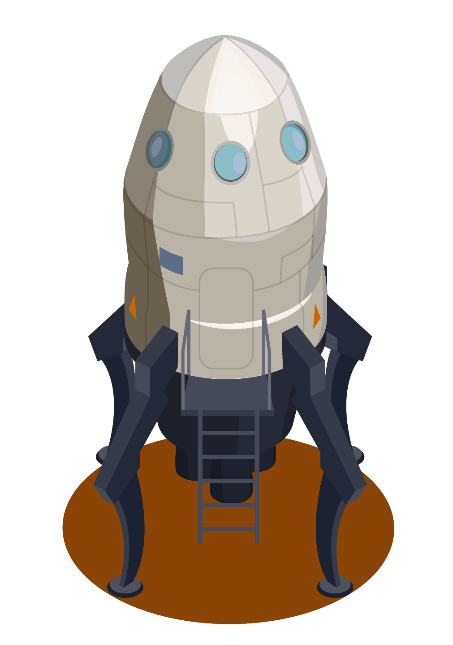


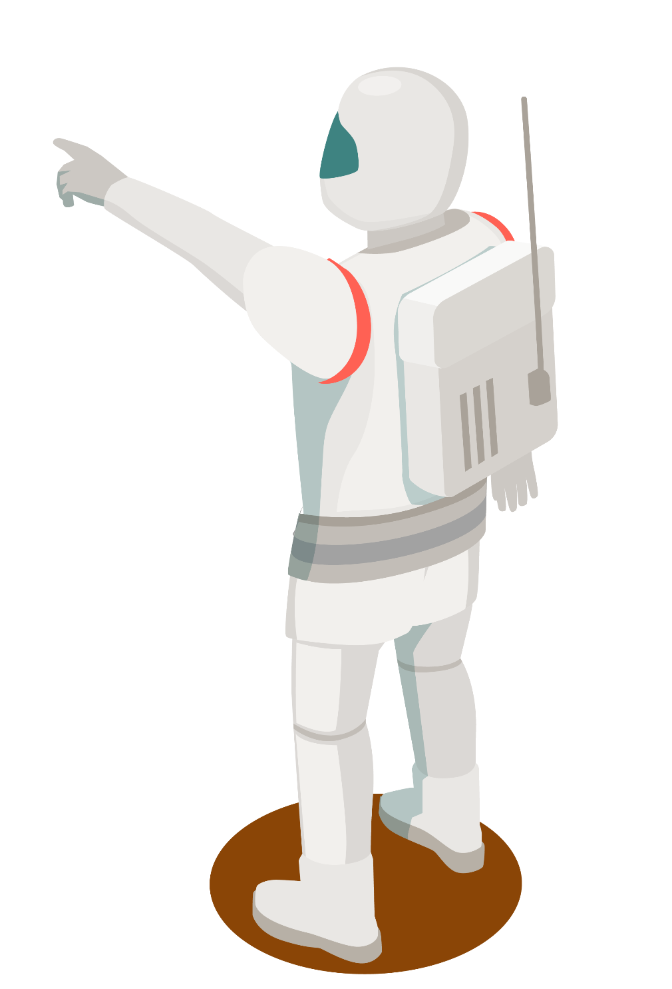

PLAN(ET) MARS
Monitoring System
Please don’t die

Slide 2
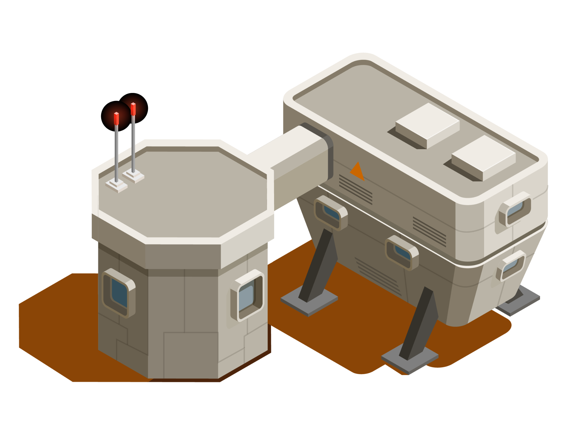
01
Architecture Design

Slide 3
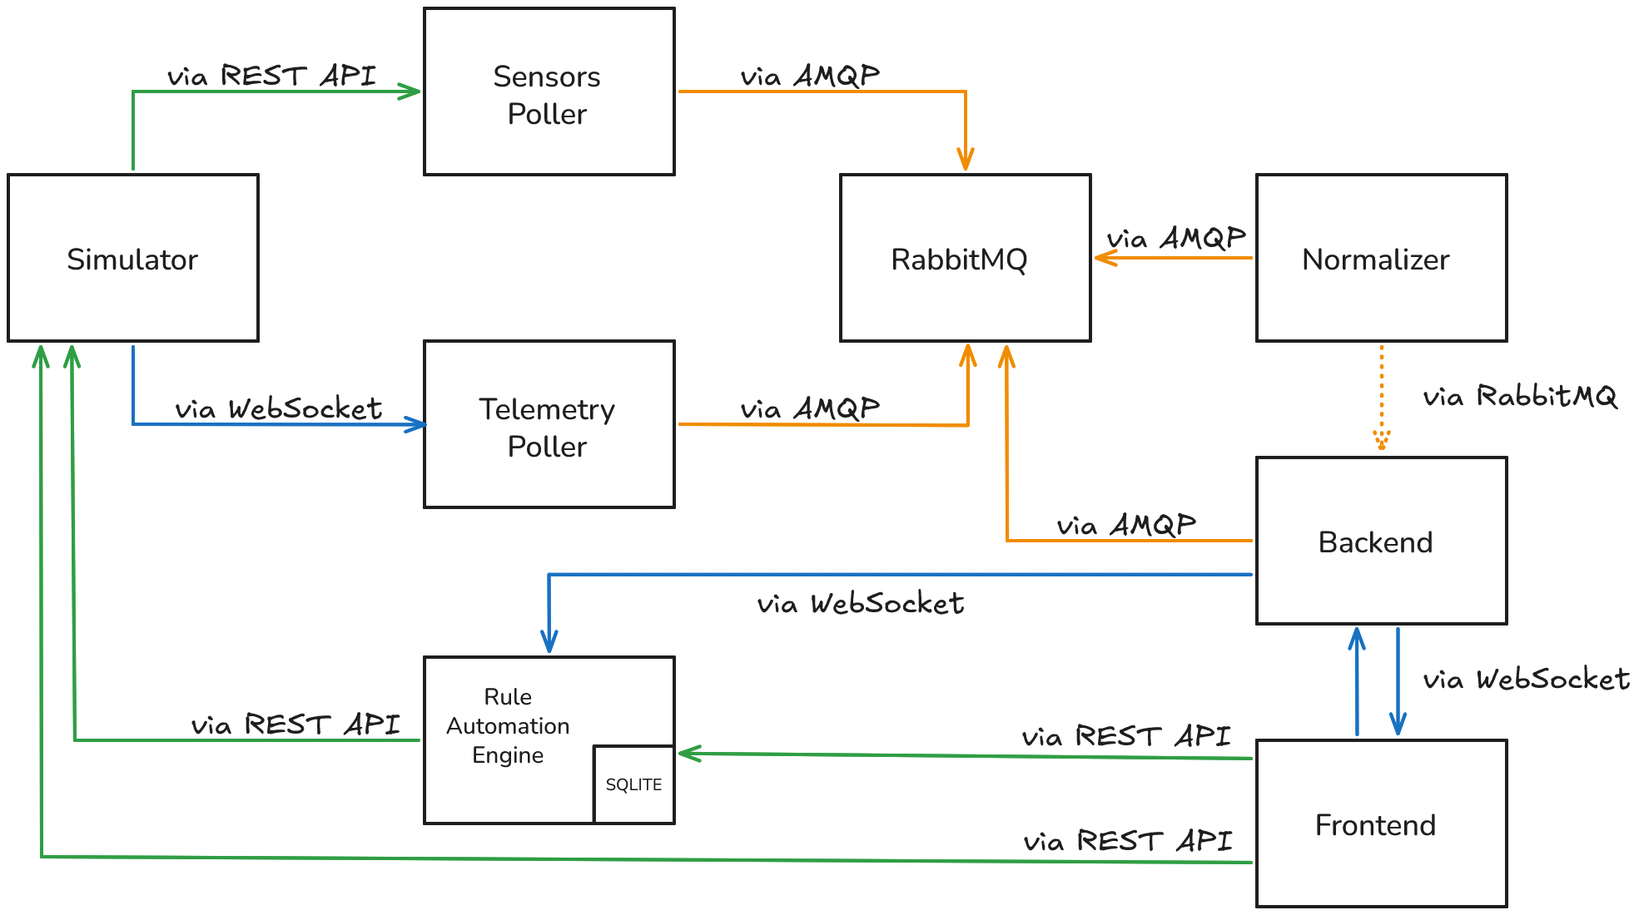

Slide 4
RabbitMQ
To fulfill the requirements of our application we employed a publish/subscribe mechanism. Namely we created two exchanges:
Unnormalized: all the queues within this exchange are filled with data pushed by the injectors to the normalizer
Normalized: this exchange is where the result of normalization is stored, to be used later down in the pipeline

Slide 5

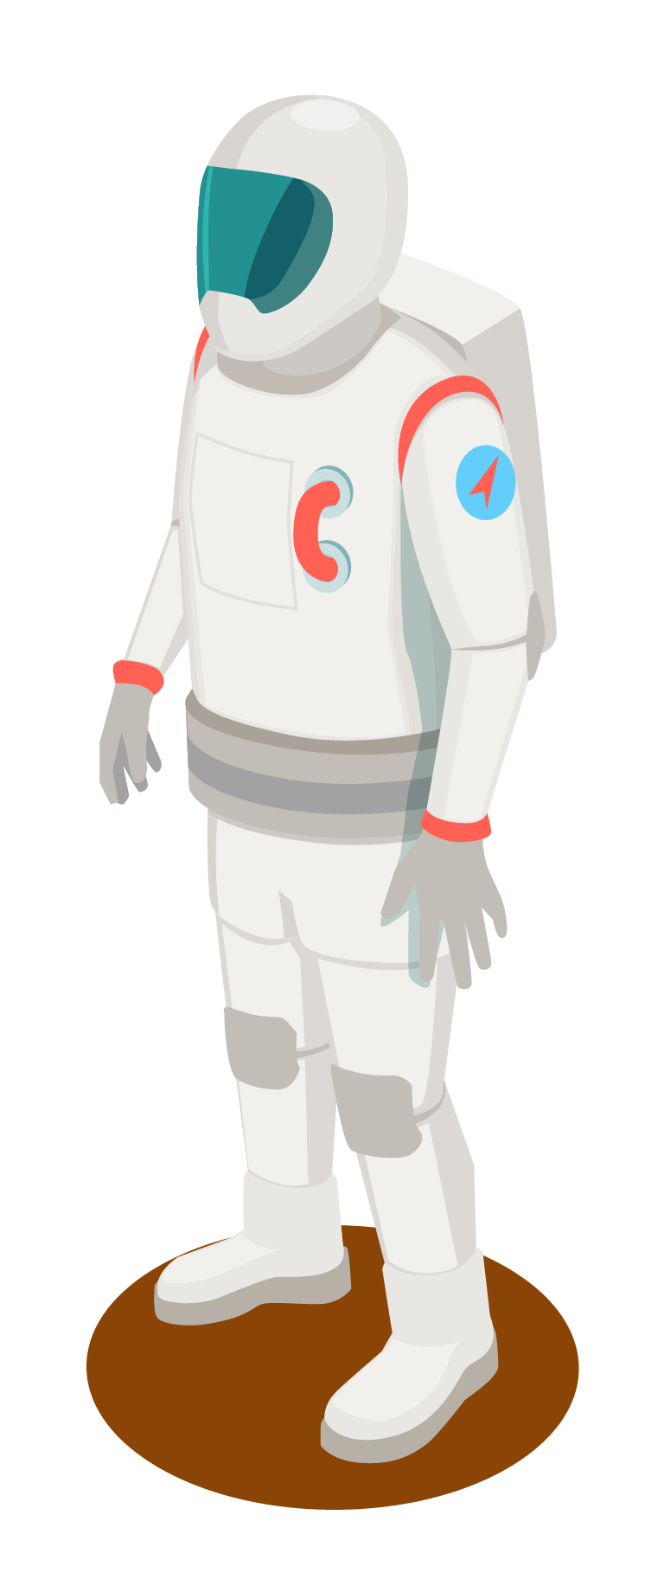
Injectors
There are two types of injectors:
Sensor poller: via REST API acquires data from sensors
Telemetry poller: via WebSocket receives data from telemetry
Both of them push the data to the unnormalized exchange. Furthermore data schema validation is ensured with pydantic BaseModel.

Slide 6
Normalizer
This microservice is responsible for unifying the etherogeneous data into a unified internal schema.
An attempt was made to use two different schema, to distinguish between sensors and telemetry, to reduce the overhead of representing both at once, given that telemetry is far less frequent than sensor data.
Ultimately, we managed to represent both streams in a unified manner.

Slide 7

Backend and Frontend
For these two microservices, communication-wise, we opted for a WebSocket paradigm, because:
The header size is way smaller
The connection is persistent and full-duplex
These properties fit our low latency requirements.

Slide 8
Rule automation engine
Exactly as the frontend, it gathers the normalized data via WebSocket which is then used to compare against the rules stored in the database, taking action upon verifying the conditions, by performing a POST request to the simulator.
As it concerns the database, we chose SQLite since the application requires just one table whose cardinality will not exceed thousands of rows. In addition, we do not perform lots of writes, especially not in a concurrent manner, since we are alone on Mars.
Given these properties SQLite seemed a perfect fit for our system.

Slide 9
USER STORIES
2

Slide 10
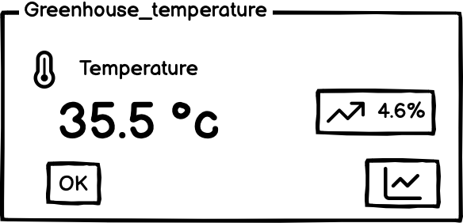
Latest Data
As a user, I want to visualize the latest data reported by each sensor.

Slide 11
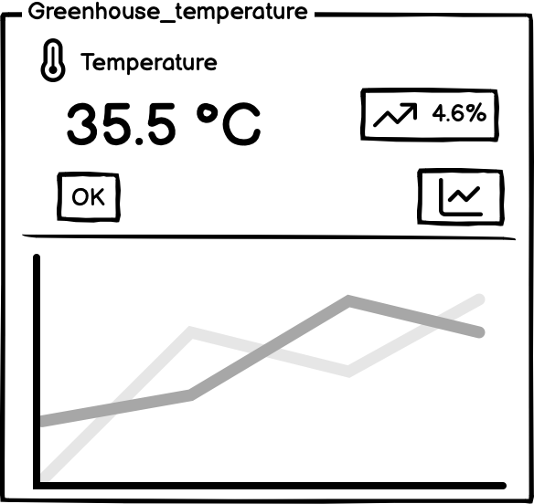
Historical values
As a user, I want to visualize the historical values for each sensor, so that I can see the evolution of the situation over time.

Slide 12
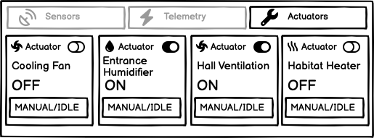
Manual actuators
As a user, I want to be able to manually trigger actuators, so that I can take action in emergency situations.

Slide 13
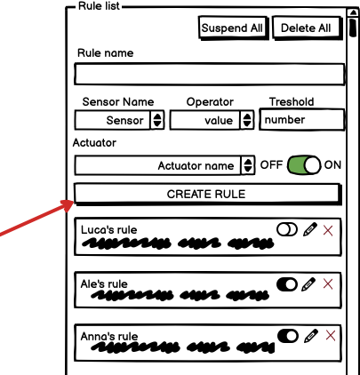
Create rules
As a user, I want to specify rules based on values reported by the sensor and take action through the actuators, so that i can automate my work.

Slide 14
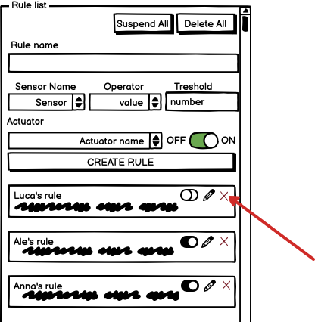
Delete rules
As a user, I want to delete previously specified rules.

Slide 15
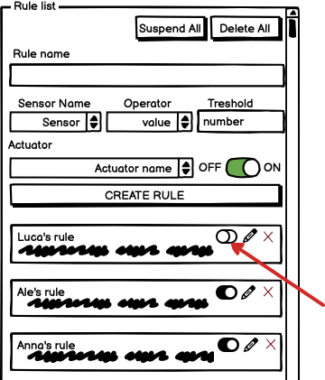
Toggle rules
As a user, I want to be able to temporarily toggle a rule, so that I can perform maintenance.

Slide 16
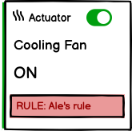
Rule activation
As a user, I want the system to identify which rule activated an actuator, so that everything is transparent.

Slide 17
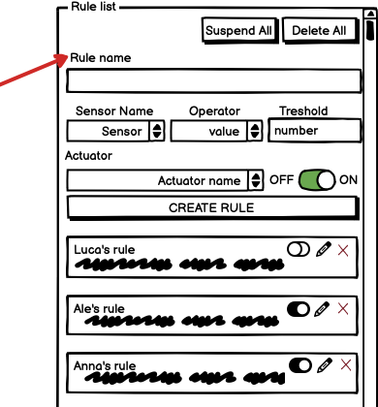
Naming rules
As a user, I want to give names to rules, so that I can easily identify rules.

Slide 18
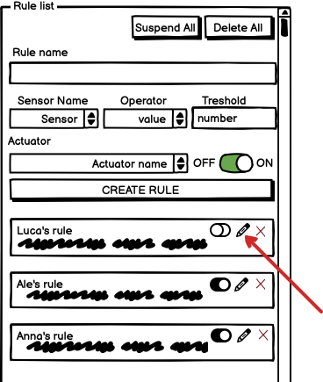
Rule editing
As a user, I want to be able to edit a rule.

Slide 19
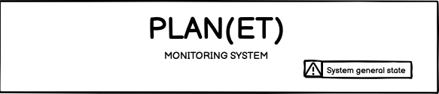
Overall state
As a user, I want to see at a glance the overall health of the system.

Slide 20
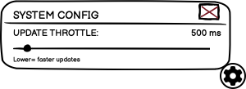
Polling rate
As a user, I want to be able to control the polling rate of the data from the sensors, so that I can reduce the power consumption of the system.

Slide 21
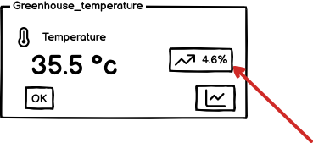
Trend
As a user, I want to be able to quickly see the trend of sensed data, so that I can quickly monitor the situation.

Slide 22
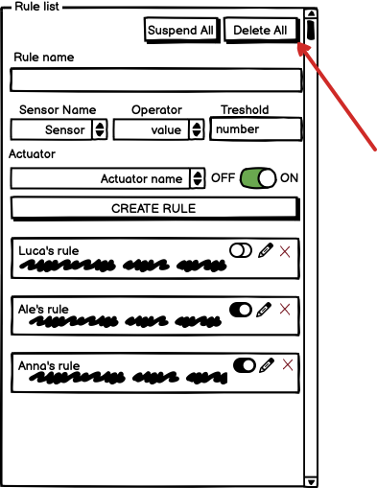
Delete all rules
As a user, I want to be able to remove all rules at once.

Slide 23
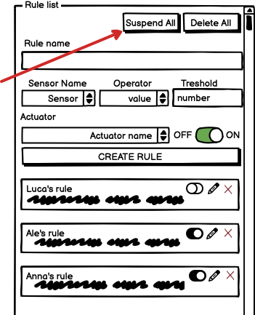
Suspend all rules
As a user, I want to be able to enable/disable all rules at once.

Slide 24
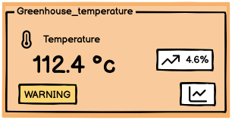
Sensor status
As a user, I want to be able to see the status of each sensor.

