Slide 1
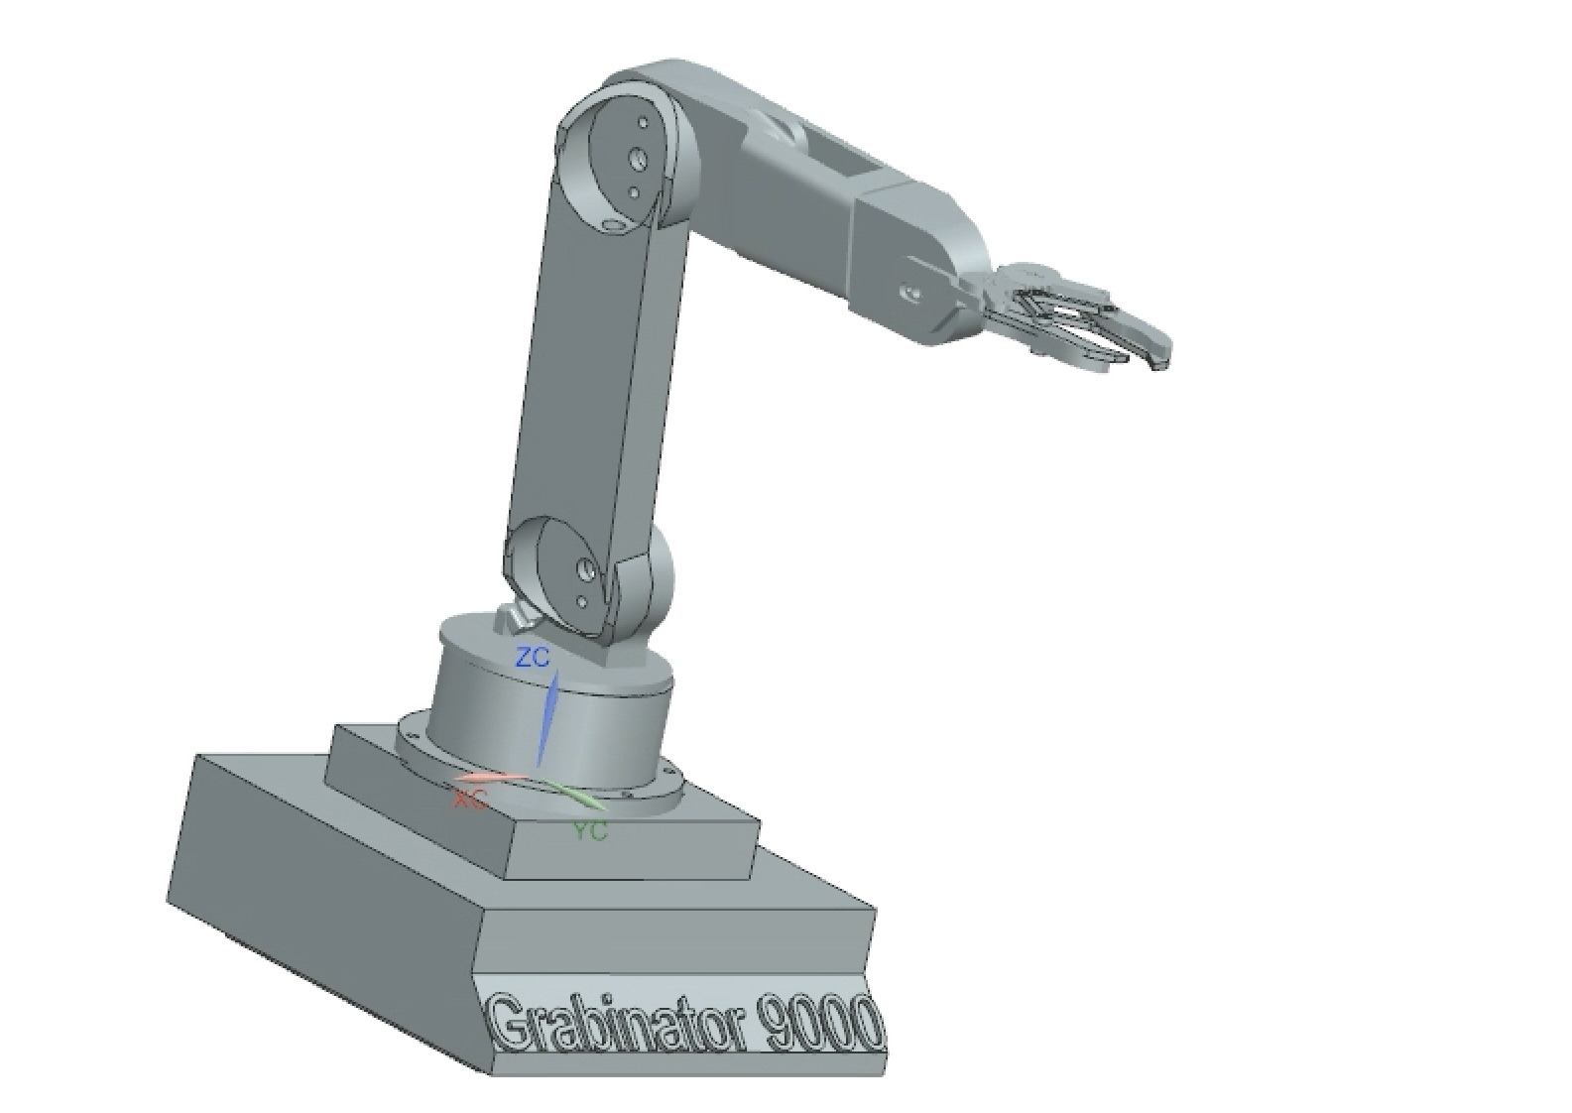
Grabinator
Alessandro Bongiorno
Professor Lenn
Create an easy-to-use and functional robot arm
that can pick up and move items in different planes.
With the help of NX, a Raspberry Pi 4, and simple code. Our group designed
and implemented a robot arm that can reliably and quickly pick items up, using
a simple-to-read interface on a web browser.
Technical Approach: Our design ideas centralized around using an aesthetically pleasing multi-joint robot arm that could easily move in different planes of motion. Also incorporating hardware PWM to send signals from the Pi to the Servo Motors.
Accomplishments: We designed and implemented a robot that can move smoothly using different joints while maintaining an easy and beautiful interface for our users.
Results: A robot arm controlled solely by the user that allows a range of motion in three planes. Using quick movements with almost zero lag time.

