Slide 1
Unsupervised neural network learning through competing hidden neurons
Notes:
In the field of neural network modeling, supervised learning has been successfully applied to a wide variety of tasks.

Slide 2
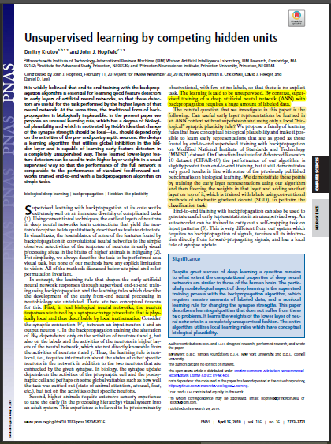
Biological plausibility of neural networks
Notes:
As we know, artificial neural networks are named after their biological counterpart, biological neural network, that exist as a physical interconneted network of physical neurons inside the nervous system of many animal species. However, biological networks remain only a vague inspiration in the development of artificial neural networks. In a 2019 paper, Dimitry Krotov and John J. Hopfield. Ask if it is possible to design a neural network with a higher degree of biological plausibility.

Slide 3
Biological plausibility of neural networks
Two main implausibilities: Backpropagation and supervised learning
Notes:
They identify two main implausibilities in most modern literature on artificila neural networks: backpropagation and supervised learning.

Slide 4
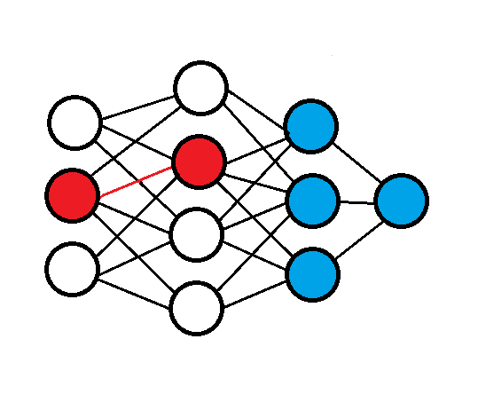
Implausibility 1: backpropagation
Notes:
So, in backpropagation, we define a function to minimize, the loss function, and we calculate the derivatives of this function within respect to the parameters of our model wich in the case of neural networks are the strenghts of between-neurons synapses. The algorithm is thus non-local. For example, in the image on the right if one were to calculate the derivative of the loss function within respect to the strenght of the red colored synapsis, he would need to know not only the activation of the linked neurons but also the activation of all neurons colored in blue.

Slide 5
Implausibility 2: supervised learning
Notes:
In literature, a majority of articles about neural networks regard supervised learning. We know however that the brains of newborn animals and humans do not learn this way. Newborns in the first years of their life are exposed to a great quantity of stimuli (stimiulài), of wich only a fraction are «labeled». so the learning is mostly unsupervised.

Slide 6
No backpropagation
Unsupervised learning
Good performance
Notes:
The main question that the article’s authors try to answer is: is possible, if one’s limit itself to unsupervised and no-backpropagation learning to implement a neural network that can perform as good as more standard networks?

Slide 7
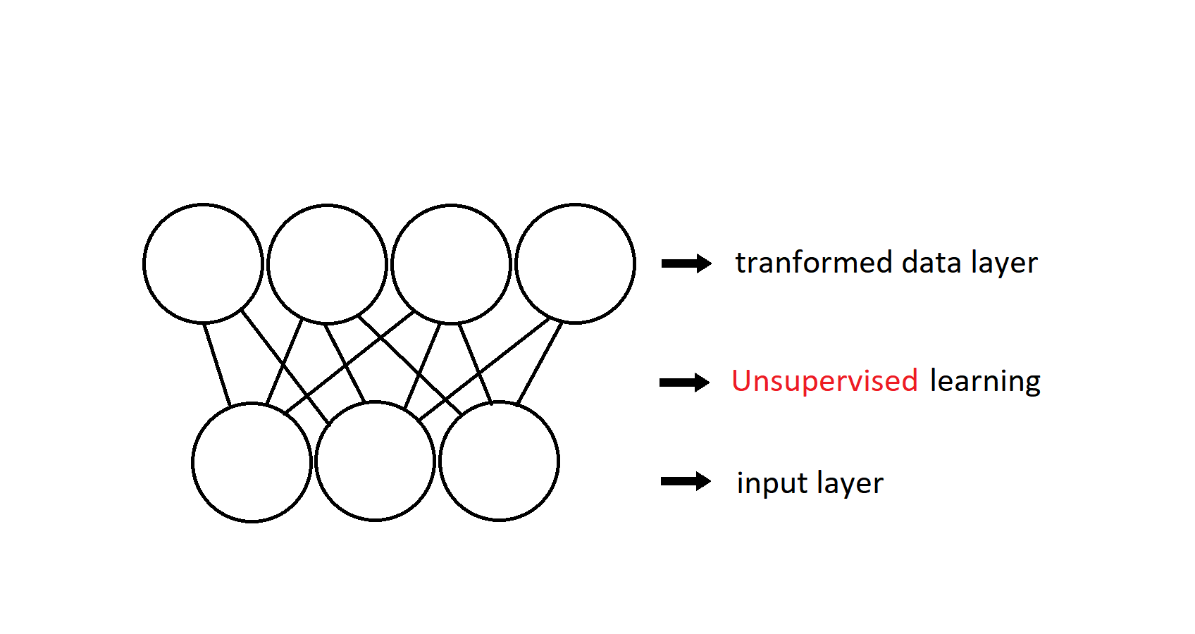
Notes:
Their answer is the following algorithm, that is used to train a matrix of weights of a two layer neural network.

Slide 8
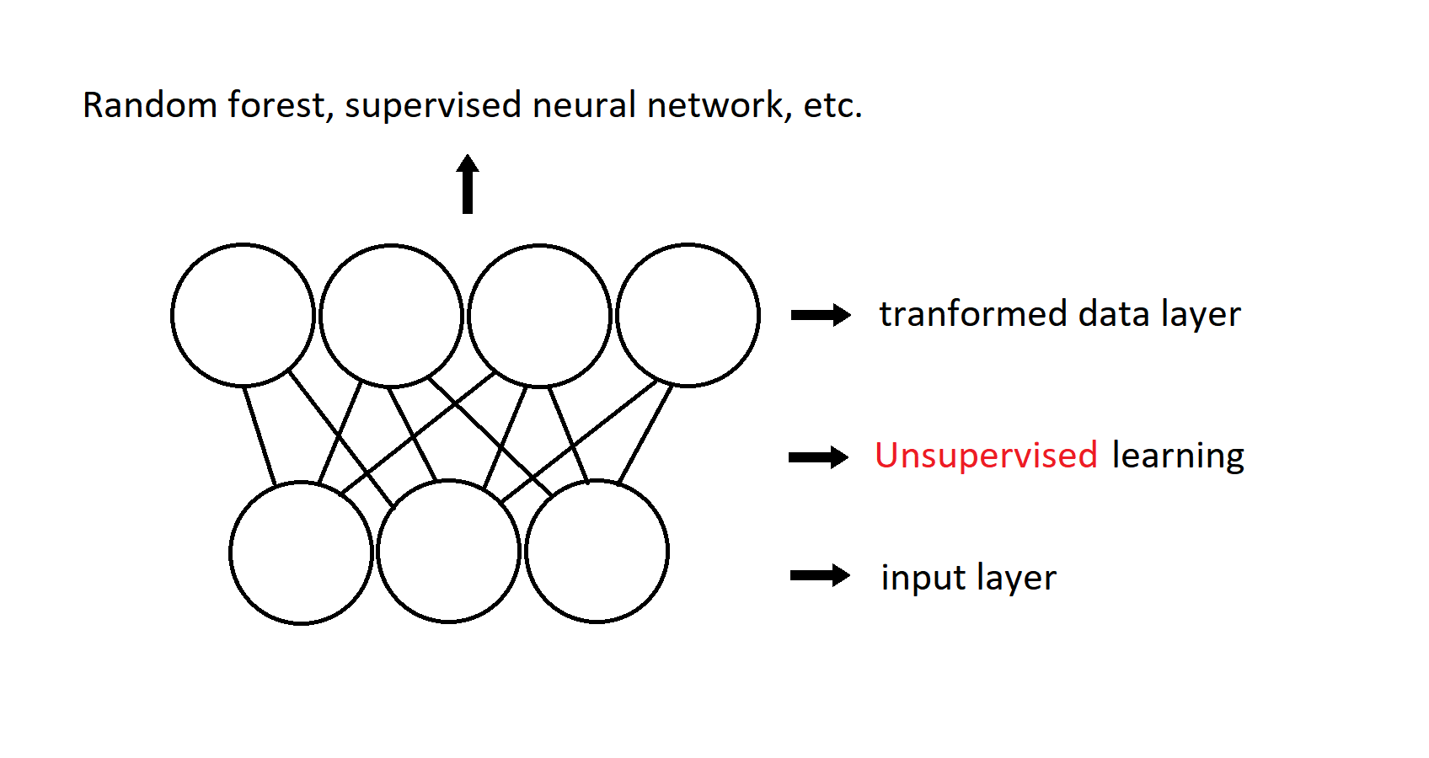
Notes:
Then, once the training is complete, the transformed data is then meant to be used for regular supervised learning, for example, with another layer.

Slide 9
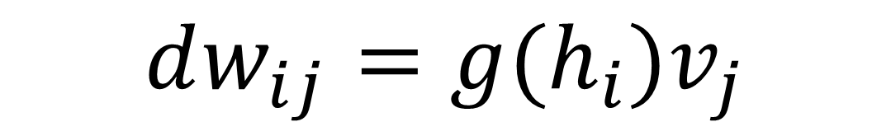
$$dw_{ij}=g(h_{i})v_{j}$$
Notes:
Starting from this paper, i re-implemented the algorithm and tested it on the MNIST-10 handwritten digit database. The equation displayed on screen is a simplification of the main equation of the algorith that still retains the basic concepts.

Slide 10
$$dw_{ij}=g(h_{i})v_{j}$$
Rank of h | Value of g(h) | Sign of d
First | 1 | Positive
Second | -0.4 | Negative
Other | 0 | Null
Notes:
The function g(h) is a nonlinear equation that assumes its value based on the ranking of the hidden neuron activation value h. When h is the most activated neurons for a specific pattern, g has value of 1; when it is the second most activated neuron, g has value minus zero point four; in all other cases, g equals zero.

Slide 11
The most active neuron’s synapses are reinforced
The second most active neuron’s synapses are weakened
$$dw_{ij}=g(h_{i})v_{j}$$
Rank of h | Value of g(h) | Sign of d
First | 1 | Positive
Second | -0.4 | Negative
Other | 0 | Null
Notes:
This means that there is a direct competition between neurons to tune in for each specific recurring pattern, wich leads to unsupervised learning.
The weights are presented to the networks in batches, until the whole training dataset is processed. The procedure (prosìd ia) is then repeated many times until convergence.

Slide 12
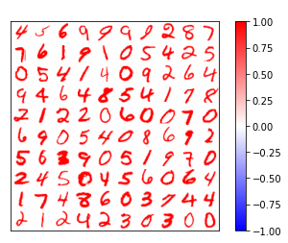
Notes:
One of the most peculiar visual characteristics of this algorithm is that the among the synapses of the neurons visual patterns resembling the original inputs emerge naturally. What we see on screen right are one hundred samples of the mnist handwritten digits dataset. Each sample has seventy hundred eghty seven pixels, arranged in a twenty eight by twenty eight grind.

Slide 13
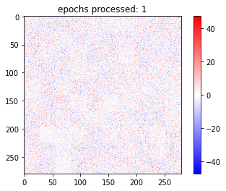
Notes:
This is a visual representation of the weight matrix. There are one hundred hidden neurons, each of wich has seven hundred eighty seven synapses, one for each pixel of the input, similarly arranged in a twenty eight by twenty eight matrix.
This is how the weights evolve during the learning, after being randomly intialized.

Slide 14
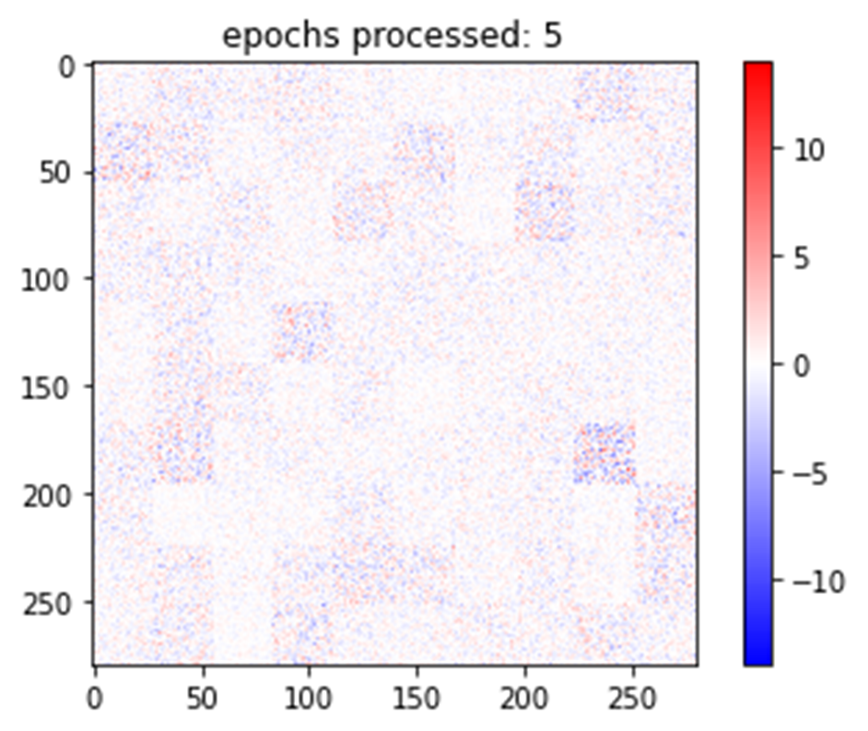

Slide 15
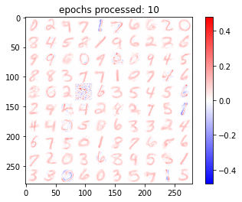

Slide 16
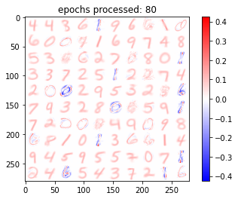
Notes:
As we can see, the emerging patterns resemble quite well the original digits. However, they are not a simple copy. For instance, in some cases negative values are present, while the original samples are all positive. From a mathematical standpoint, this is due to anti-hebbian learning, in which weights are pushed away from a specific pattern.

Slide 17
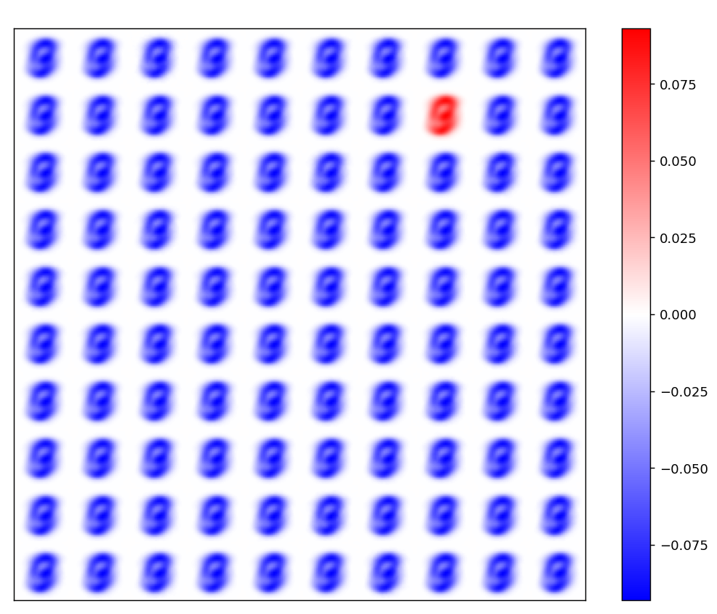
Notes:
One of the first visual observation made about the convergence pattern of the synapses was the subsequent: in some cases, about 20% of the times, this would be the convergence pattern. It is, as one can imagine, not quite useful for classification purposes.
A theoretical explanation can be given in terms of nonsufficient differentiation of initial synapses values, and this is confirmed by the fact that reducing the standard deviation makes this result consistent. A single hidden neuron, the one that has only positive value at convergence, in the upper rright corner of this image, is chosen as the most activated in a majority of cases, resulting in all the other neurons sysnapses values getting lowered.
To avoid this, a slight deviation from the original algorithm has been implemented, switching off hebbian learning.

Slide 18
Rank of h | Value of g(h) | Sign of d
First | 1 | Positive
Second | -0.4 0 | Negative Null
Other | 0 | Null

Slide 19
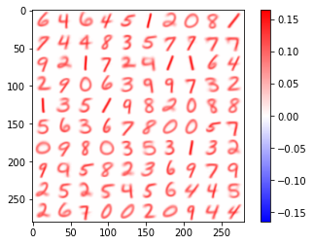
Rank of h | Value of g(h) | Sign of d
First | 1 | Positive
Second | -0.4 0 | Negative Null
Other | 0 | Null

