Slide 1

MACHINE LEARNING
FOR SOFTWARE
ENGINEERING AS
TESTING SUPPORT
Alessandro Finocchi - 0340543
A.A. 2023/2024

Slide 2

AGENDA
1
INTRODUCTION
2
GOAL
3
ASSUMPTIONS
4
METHODOLOGY
5
RESULTS
6
CONCLUSIONS
2/25

Slide 3
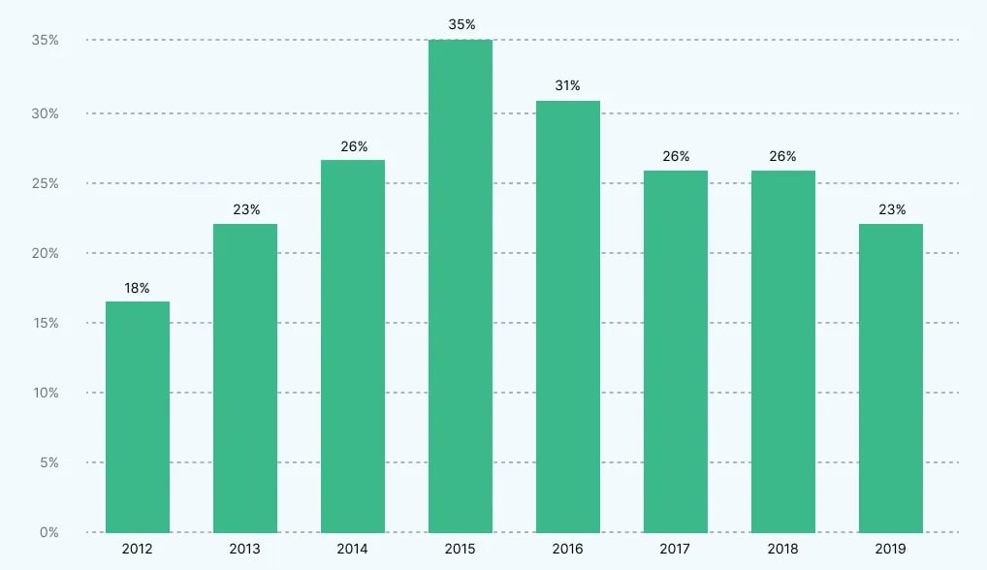

INTRODUCTION
Proportion of budget allocated to quality assurance and testing as a percentage of IT
Software testing expanses typically account for 15-25% of the project budget.
Machine learning prediction models may support this process predicting classes that are more likely to be buggy.
3/25
Notes:
https://www.statista.com/statistics/500641/worldwide-qa-budget-allocation-as-percent-it-spend/ per il grafico

Slide 4

GOAL
We want to make the software testing process more efficient, ensuring the quality and reliability of the results and at the same time optimizing resources and budget.
Given a class, from it’s characteristics we want to know if it will be buggy or not.
Build a machine learning model trained with class characteristics that can answer this demand.
Exploiting such a tool a testing team can focus more precisely on those class predicted to be buggy and test them more intensely.
Use different models and find the optimal configuration.
Empirical study on 2 open source project: AVRO and BOOKKEEPER.
4/25

Slide 5

ASSUMPTIONS
The past is similiar to the future: the software development behavior will follow patterns that the machine learning model will be able to learn, without considering discontinuities.
Linear development model: the developement process doesn’t carry out more version alongside each other.
Jira completeness: the Jira tracking system comprises all the information about the project involved in the study, github will be used only for retrieving the repository.
5/25

Slide 6
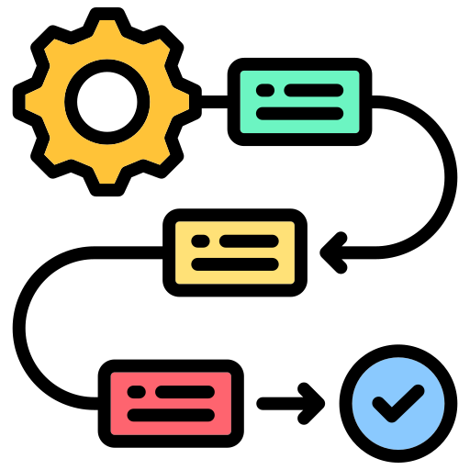


METODOLOGY 1: SCRAPING
Jira
Issue Tracking System to retrieve releases and tickets
GitHub
Version Control System to store the repository and keep track of all commits that touch classes
Releases
n:m
Tickets
1:n
Commits
1:n
Classes
Classes
6/25

Slide 7
METODOLOGY 2: DEFECTS
The idea starts from the lifecycle of a defect
IV
OV
FV
At the beginning the defect doesn’t exist.
At a certain version, not alweys known, the defect is introduced: we will such version the Injected Version (IV).
The defect is not discovered until the Opening Version (OV), respectively the version when the corresponding ticket was created.
When the bug gets fixed, the Fixed Version (FV) is released.
7/25

Slide 8
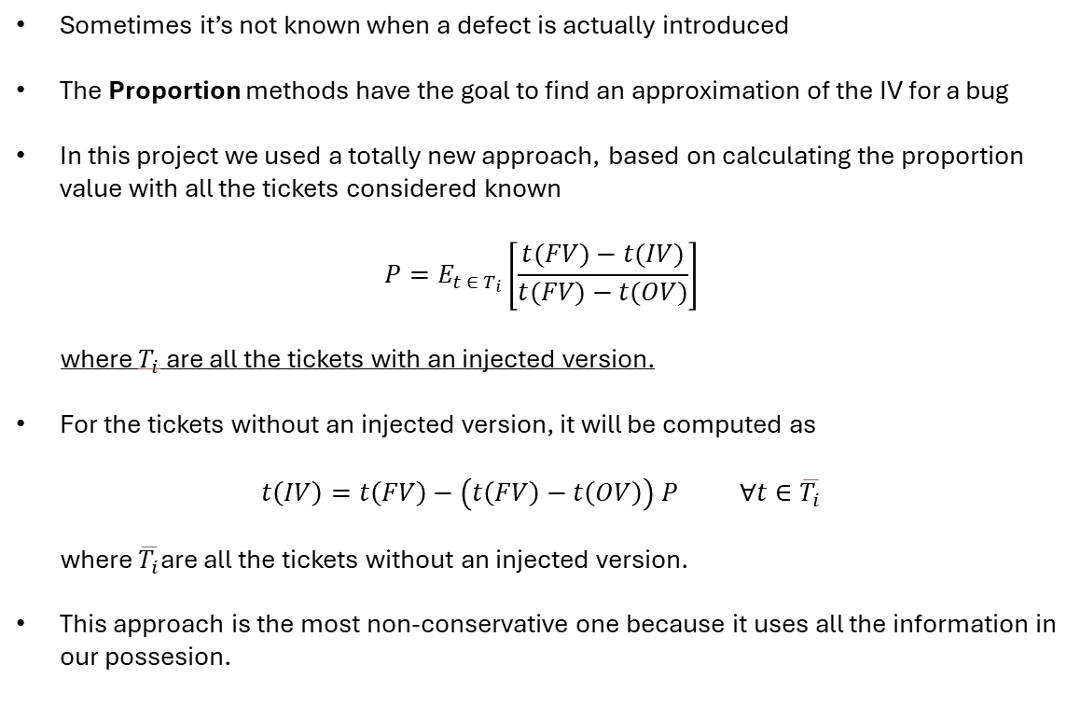
METODOLOGY 3: PROPORTION
Sometimes it’s not known when a defect is actually introduced
The Proportion methods have the goal to find an approximation of the IV for a bug
In this project we used a totally new approach, based on calculating the proportion value with all the tickets considered known
$$P=E_{t ∈ T_{i}}\left[\frac{t(FV)−t(IV)}{t(FV)−t(OV)}\right]$$
where $T_{i}$ are all the tickets with an injected version.
For the tickets without an injected version, it will be computed as
$$t\left(IV\right)=t\left(FV\right)−\left(t\left(FV\right)−t\left(OV\right)\right) P ∀t∈\overline{T_{i}}$$
where $\overline{T_{i}}$are all the tickets without an injected version.
This approach is the most non-conservative one because it uses all the information in our possesion.
8/25
Notes:
Parla di proportion (e dello snoring pure? O forse è meglio altrove?)

Slide 9
METODOLOGY 4: METRICS
Metrics | Description
Size | The lines of code of the class.
LOC_added | The lines of code added during the release.
LOC_removed | The lines of code removed during the release.
Churn | The lines of code added during the release.
N_revisions | Number of revisions.
N_defect_fixes | Number of defect fixes.
N_authors | Number of authors that worked on that class.
CBO | Coupling between objects: counts the number of dependencies a class has.
Fan-in | Counts the number of input dependencies a class has.
Fan-out | Counts the number of output dependencies a class has.
Public_methods_qty | Counts the number of public methods.
Is_buggy | The label to predict.
9/25
Notes:
Parla delle metriche di classe utilizzate

Slide 10
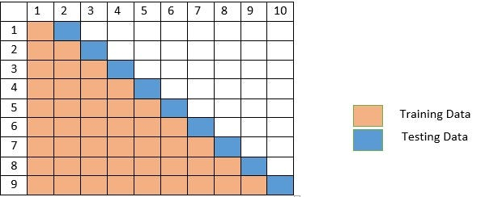
METODOLOGY 5: TRAINING
The ML models we are going to use are Supervised Learning Classificators: they need a dataset with specified the label to predict.
The dataset needs to be splitted in a training set for learning and testing set for evaluating the performances of the model.
Since our data is time-sensitive, we need to take into account its temporal order, thus we use the walk-forward strategy which is a time-series validation technique.
To minimize snoring only the first half releases are used in the dataset construction.
10/25
Notes:
Parla dei dataset per addestrare, quindi del motivo per cui si usa walk forward

Slide 11

METODOLOGY 6: TRAINING
For training models two strategies have been taken into accounts:
  Feature Selection: helps reducing the cost of learning and permits to focus on attributes with the greater information gain.
  Cost Sensitivy: allows to define what type of error is more important, in this case we use it to define that FN are more severe than FP.
Strategies
Feature
Selection
Cost Sensitivity
No Selection
Greedy Stepwise
Best First
FN = FP
FN = 4$⋅$FP
11/25
Notes:
Parla dei dataset per addestrare: tecniche di feature selection e cost sensitiveness

Slide 12
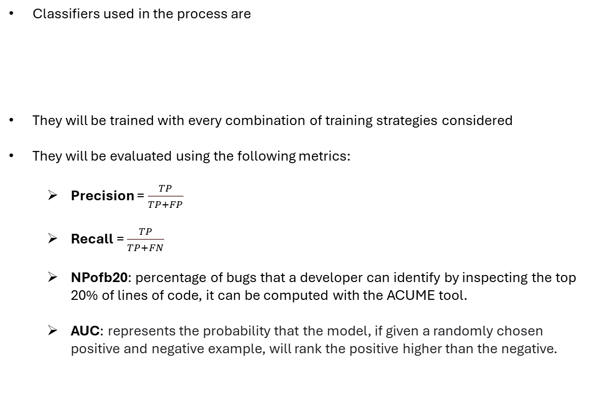
METODOLOGY 7: CLASSIFIERS
Classifiers used in the process are
They will be trained with every combination of training strategies considered
They will be evaluated using the following metrics:
  Precision = $\frac{TP}{TP+FP}$
  Recall = $\frac{TP}{TP+FN}$
  NPofb20: percentage of bugs that a developer can identify by inspecting the top 20% of lines of code, it can be computed with the ACUME tool.
  AUC: represents the probability that the model, if given a randomly chosen positive and negative example, will rank the positive higher than the negative.
Naive Bayes
Random Forest
IBk
12/25
Notes:
Parla dell’addestramento con i classificatori weka

Slide 13

RESULTS
13/25
Notes:
Parla delle metriche che ci interessano: kappa, auc, recall, npofb20… POSSO FARE 4 SLIDE (1 PER OGNI METRICA) PER OGNI PROGETTO, quindi in totale 8 slide, e dedicare le ultime 3 alle conclusioni, ultima slide con i link utili e ringrazio per l’attenzione

Slide 14
RESULTS
14/25
Notes:
Parla delle metriche che ci interessano: kappa, auc, recall, npofb20… POSSO FARE 4 SLIDE (1 PER OGNI METRICA) PER OGNI PROGETTO, quindi in totale 8 slide, e dedicare le ultime 3 alle conclusioni, ultima slide con i link utili e ringrazio per l’attenzione

Slide 15
RESULTS
15/25
Notes:
Parla delle metriche che ci interessano: kappa, auc, recall, npofb20… POSSO FARE 4 SLIDE (1 PER OGNI METRICA) PER OGNI PROGETTO, quindi in totale 8 slide, e dedicare le ultime 3 alle conclusioni, ultima slide con i link utili e ringrazio per l’attenzione

Slide 16
RESULTS
16/25
Notes:
Parla delle metriche che ci interessano: kappa, auc, recall, npofb20… POSSO FARE 4 SLIDE (1 PER OGNI METRICA) PER OGNI PROGETTO, quindi in totale 8 slide, e dedicare le ultime 3 alle conclusioni, ultima slide con i link utili e ringrazio per l’attenzione

Slide 17
RESULTS
17/25
Notes:
Parla delle metriche che ci interessano: kappa, auc, recall, npofb20… POSSO FARE 4 SLIDE (1 PER OGNI METRICA) PER OGNI PROGETTO, quindi in totale 8 slide, e dedicare le ultime 3 alle conclusioni, ultima slide con i link utili e ringrazio per l’attenzione

Slide 18
RESULTS
18/25
Notes:
Parla delle metriche che ci interessano: kappa, auc, recall, npofb20… POSSO FARE 4 SLIDE (1 PER OGNI METRICA) PER OGNI PROGETTO, quindi in totale 8 slide, e dedicare le ultime 3 alle conclusioni, ultima slide con i link utili e ringrazio per l’attenzione

Slide 19
RESULTS
19/25
Notes:
Parla delle metriche che ci interessano: kappa, auc, recall, npofb20… POSSO FARE 4 SLIDE (1 PER OGNI METRICA) PER OGNI PROGETTO, quindi in totale 8 slide, e dedicare le ultime 3 alle conclusioni, ultima slide con i link utili e ringrazio per l’attenzione

Slide 20
RESULTS
20/25
Notes:
Parla delle metriche che ci interessano: kappa, auc, recall, npofb20… POSSO FARE 4 SLIDE (1 PER OGNI METRICA) PER OGNI PROGETTO, quindi in totale 8 slide, e dedicare le ultime 3 alle conclusioni, ultima slide con i link utili e ringrazio per l’attenzione

Slide 21



CONCLUSIONS
THANKS FOR YOUR ATTENTION!
Project links:
https://github.com/AlessandroFinocchi/ISW2_Metrics_Proj
https://sonarcloud.io/project/overview?id=AlessandroFinocchi_ISW2_Metrics_Proj
25/25
Notes:
Parla delle metriche che ci interessano: kappa, auc, recall, npofb20… POSSO FARE 4 SLIDE (1 PER OGNI METRICA) PER OGNI PROGETTO, quindi in totale 8 slide, e dedicare le ultime 3 alle conclusioni, ultima slide con i link utili e ringrazio per l’attenzione

