Slide 1

MACHINE LEARNING
FOR SOFTWARE
ENGINEERING AS
TESTING SUPPORT
Alessandro Finocchi - 0340543
A.A. 2023/2024

Slide 2

AGENDA
1
INTRODUCTION
2
GOAL
3
ASSUMPTIONS
4
METHODOLOGY
5
RESULTS
6
CONCLUSIONS
2/25

Slide 3

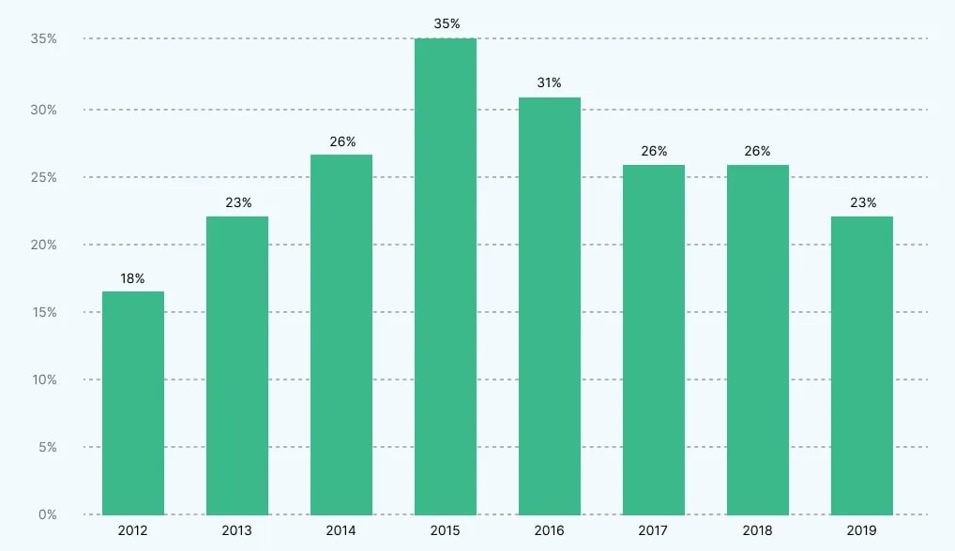
INTRODUCTION
INTRODUCTION
Goal
Assumptions
Proportion of budget allocated to quality assurance and testing as a percentage of IT
Software testing expanses typically account around 18-25% of the project budget.
Machine learning prediction models may support this process predicting classes that are more likely to be buggy.
3/25

Slide 4

GOAL
INTRODUCTION
Goal
Assumptions
We want to make the software testing process more efficient, ensuring quality and reliability in the results, at the same time optimizing resources and budget.
Given a class, from it’s characteristics we want to know if it will be buggy or not.
Build a machine learning model trained with class characteristics that can answer this demand.
Exploiting such a tool, the testing team can focus more precisely on those classes predicted to be buggy and test them more intensely.
Use different models and find the optimal configuration.
Empirical study on 2 open source project: AVRO and BOOKKEEPER.
4/25

Slide 5

ASSUMPTIONS
INTRODUCTION
Goal
Assumptions
The past is similiar to the future: the software development behavior will follow patterns that the machine learning model will be able to learn, without considering discontinuities.
Linear development model: the developement process doesn’t carry out more version alongside each other.
Jira completeness: the Jira tracking system comprises all the information about the project involved in the study, github will be used only for retrieving the repository.
5/25

Slide 6



SCRAPING
METHODOLOGY
Scraping
Defects
Proportion
Jira
Issue Tracking System to retrieve releases and tickets
Metrics
Training
Classifiers
GitHub
Version Control System to store the repository and keep track of all commits that touch classes
Releases
1:m
Tickets
1:n
Commits
n:m
Classes
6/25

Slide 7
DEFECTS
METHODOLOGY
Scraping
Defects
The idea starts from the lifecycle of a defect
Proportion
Metrics
Training
IV
OV
FV
Classifiers
At the beginning the defect doesn’t exist.
At a certain version, not alweys known, the defect is introduced: we will call such version the Injected Version (IV).
The defect is not discovered until the Opening Version (OV), the version when the corresponding ticket was created.
The Fixed Version (FV) is the first release without the defect.
7/25

Slide 8
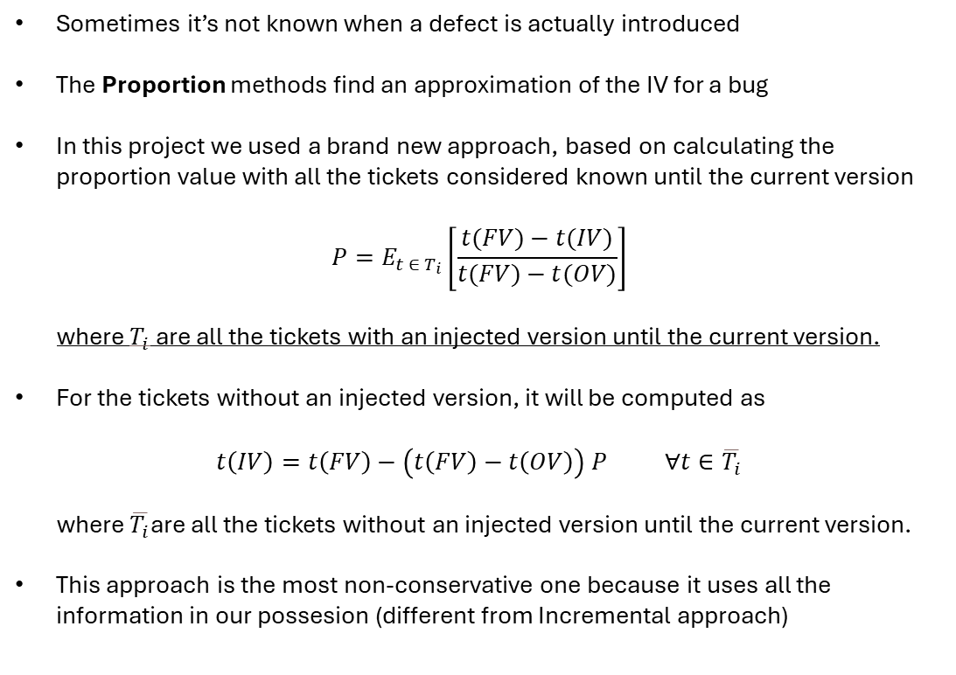
PROPORTION
METHODOLOGY
Scraping
Defects
Sometimes it’s not known when a defect is actually introduced
The Proportion methods find an approximation of the IV for a bug
In this project we used a brand new approach, based on calculating the proportion value with all the tickets considered known until the current version
$$P=E_{t ∈ T_{i}}\left[\frac{t(FV)−t(IV)}{t(FV)−t(OV)}\right]$$
where $T_{i}$ are all the tickets with an injected version until the current version.
For the tickets without an injected version, it will be computed as
$$t\left(IV\right)=t\left(FV\right)−\left(t\left(FV\right)−t\left(OV\right)\right) P ∀t∈\overline{T_{i}}$$
where $\overline{T_{i}}$are all the tickets without an injected version until the current version.
This approach is the most non-conservative one because it uses all the information in our possesion (different from Incremental approach)
Proportion
Metrics
Training
Classifiers
8/25

Slide 9
METRICS
METHODOLOGY
Scraping
Defects
Metrics | Description
Size | The lines of code of the class.
LOC_added | The lines of code added.
LOC_removed | The lines of code removed.
Churn | The difference between added and removed LOC.
N_revisions | Number of revisions.
N_defect_fixes | Number of defect fixes.
N_authors | Number of authors that worked on that class.
CBO | Coupling between objects: counts the number of dependencies that a class owns.
Fan-in | Counts the number of input dependencies a class has.
Fan-out | Counts the number of output dependencies a class has.
Public_methods_qty | Counts the number of public methods.
Is_buggy | The label to predict.
Proportion
Metrics
Training
Classifiers
9/25

Slide 10
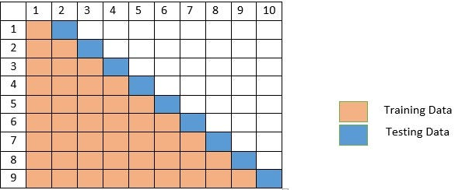
TRAINING
METHODOLOGY
Scraping
Defects
The ML models we are going to use are Supervised Learning classificators: they need a dataset with the label to predict specified.
The dataset needs to be splitted in a training set for learning and testing set for evaluating the performances of the model.
Since our data is time-sensitive, we need to take into account its temporal order, thus we use the walk-forward strategy which is a time-series validation technique.
To minimize snoring, only the first half releases are used in the dataset construction.
Proportion
Metrics
Training
Classifiers
10/25

Slide 11

TRAINING
METHODOLOGY
Scraping
Defects
For training models, different strategies have been taken into accounts:
  Feature Selection: classifiers focus on attributes with the greater IG¹
  Sampling: permits to balance the instance type occurrences in the datasets
  Cost Sensitivity: define what type of error is more important²
  Fake Releases: a brand new strategy for the problem considered³
Proportion
Metrics
Training
Classifiers
Feature
Selection
Sampling⁴
Cost Sensitivity
Fake
Releases⁵
Information Gain
We prefer not having FNs
Consider commits that are no part of any release to use more information
Studied only for Avro
Studied only for Bookkeeper
No Fake Releases
Yes Fake Releases
No Selection
No
Sampling
FN=FP
NFR⁶
Best
First
SMOTE
FN=10$⋅$FP
YFR⁷
11/25

Slide 12

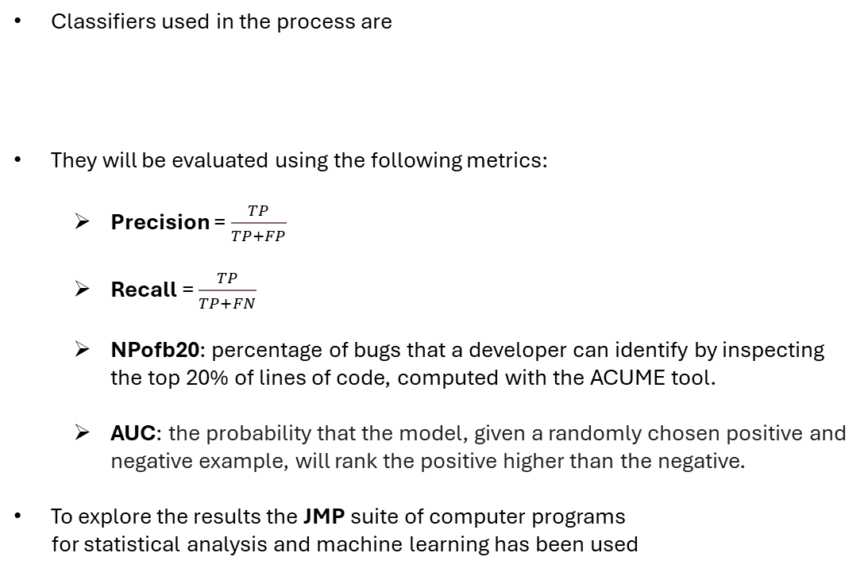
CLASSIFIERS
METHODOLOGY
Scraping
Defects
Classifiers used in the process are
They will be evaluated using the following metrics:
  Precision = $\frac{TP}{TP+FP}$
  Recall = $\frac{TP}{TP+FN}$
  NPofb20: percentage of bugs that a developer can identify by inspecting the top 20% of lines of code, computed with the ACUME tool.
  AUC: the probability that the model, given a randomly chosen positive and negative example, will rank the positive higher than the negative.
To explore the results the JMP suite of computer programs
for statistical analysis and machine learning has been used
Proportion
Naive Bayes
Random Forest
Metrics
IBk
Training
Classifiers
12/25

Slide 13
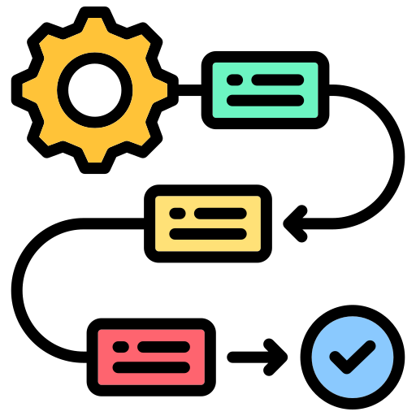
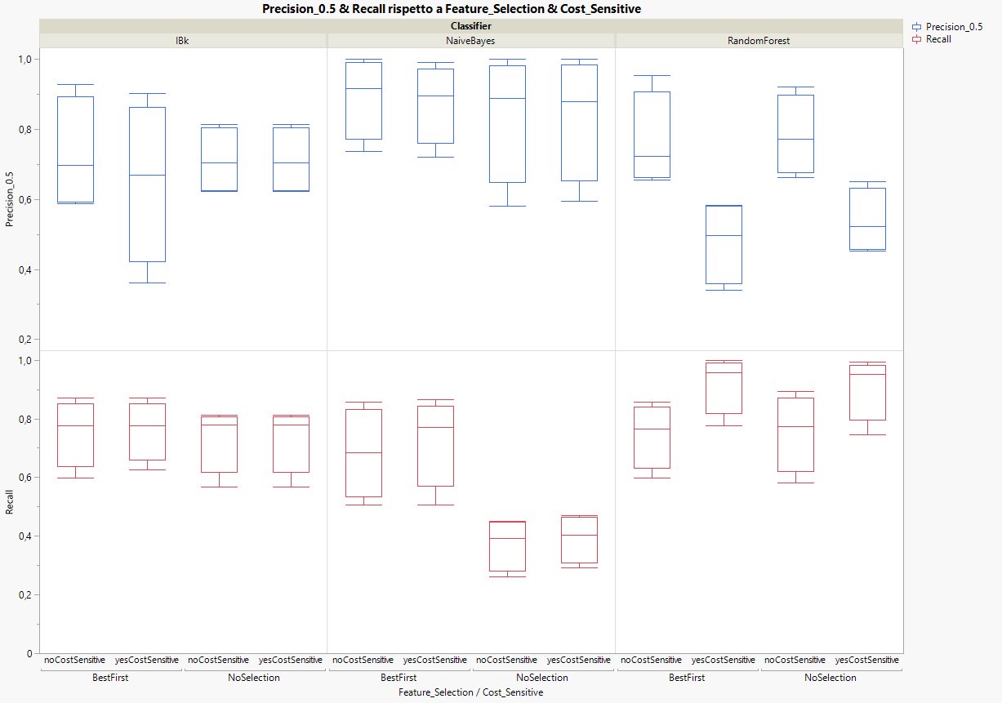
PRECISION & RECALL
BOOKKEEPER RESULTS
No Fake Releases
Yes Fake Releases
The classifier with highest precision is Naïve Bayes for each configuration, particularly the no cost sensitive with best first feature selection configuration.
The classifier with highest recall is Random Forest, with best first feature selection and with cost sensitivity.
AVRO RESULTS
No Sampling
SMOTE
13/25

Slide 14
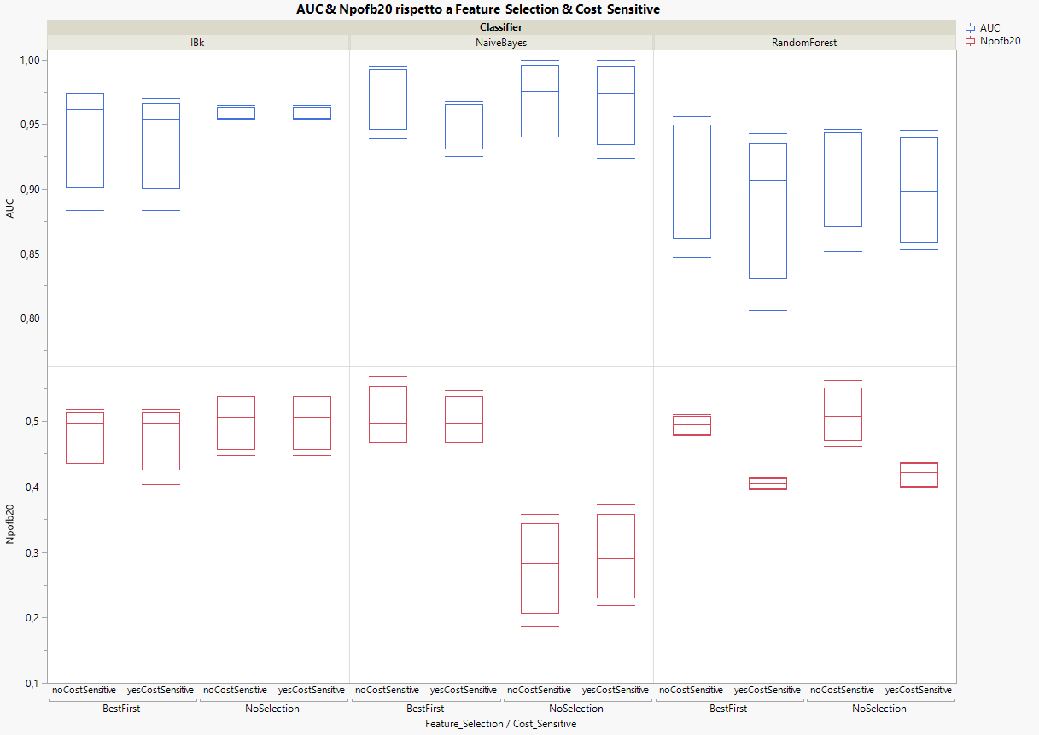
AUC & NPOFB20
BOOKKEEPER RESULTS
No Fake Releases
Yes Fake Releases
The classifier with highest AUC is Naïve Bayes for each configuration, particularly the no cost sensitive with best first feature selection configuration.
The classifier with highest NPofB20 is Random Forest, without feature selection and without cost sensitivity.
AVRO RESULTS
No Sampling
SMOTE
14/25

Slide 15
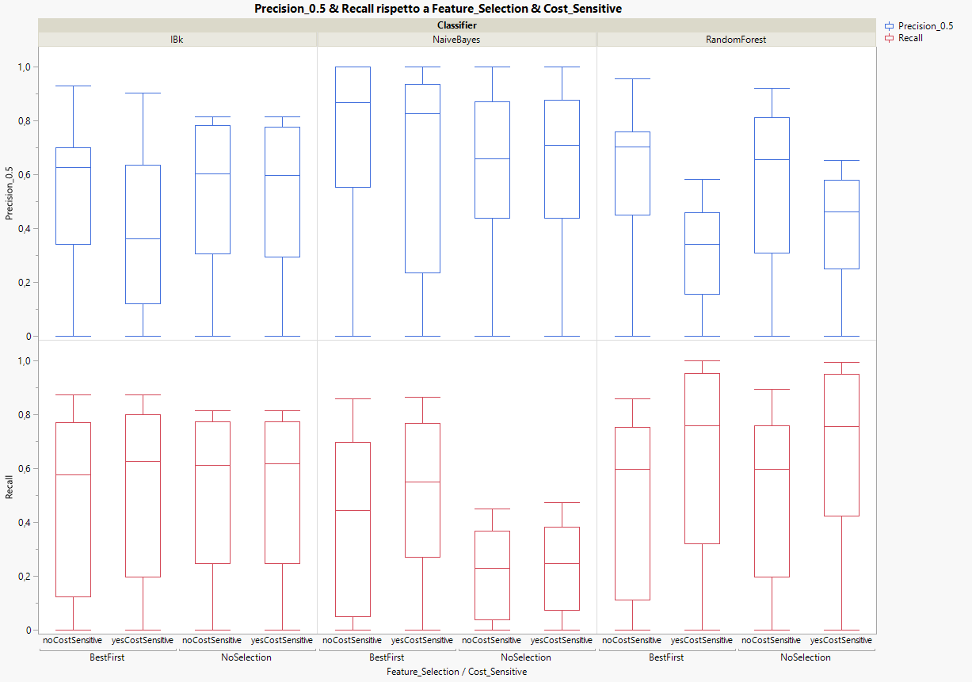
PRECISION & RECALL
BOOKKEEPER RESULTS
No Fake Releases
Yes Fake Releases
The classifier with highest precision is Naïve Bayes for each configuration again, particularly the no cost sensitive and best first feature selection configuration.
The classifier with highest recall is Random Forest, with feature selection and cost sensitivity again.
Observe that dispersion is much higher than in the previous case, without fake releases.
AVRO RESULTS
No Sampling
SMOTE
15/25

Slide 16
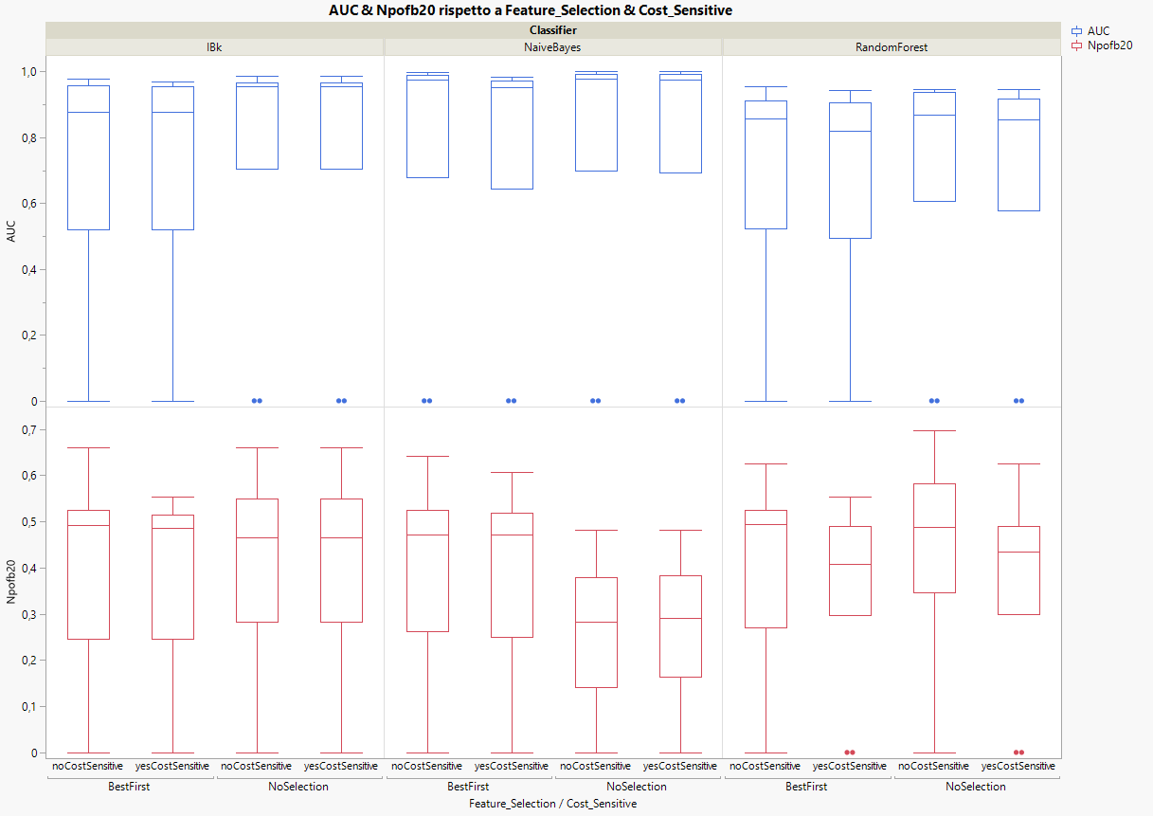
AUC & NPOFB20
BOOKKEEPER RESULTS
No Fake Releases
Yes Fake Releases
The classifier with highest AUC is Naïve Bayes with no cost sensitive and no feature selection configuration.
The classifier with highest NPofB20 is Random Forest, without feature selection and cost sensitivity.
Fake releases introduces also some outliers¹, which didn’t exist in the previous case, without fake releases.
AVRO RESULTS
No Sampling
SMOTE
A data point in a graph or a set of results which is very bigger of smaller than the next nearest data point
16/25

Slide 17
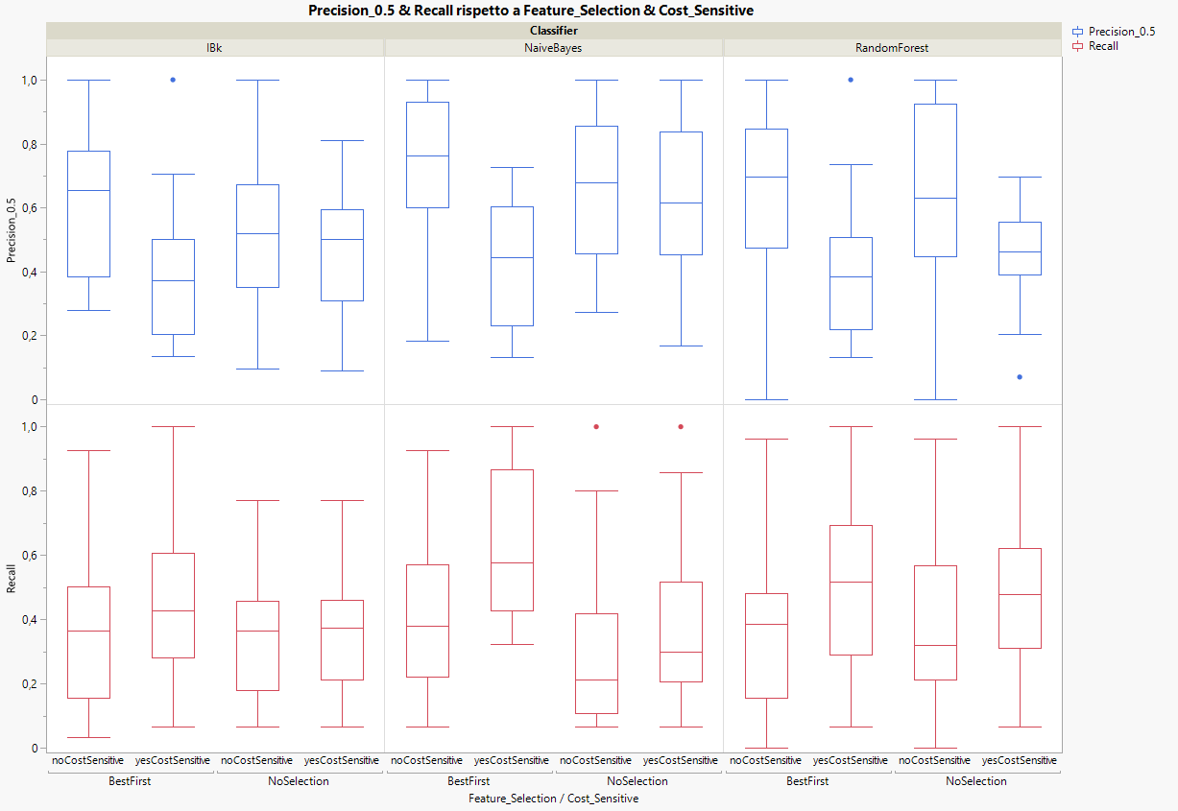
PRECISION & RECALL
BOOKKEEPER RESULTS
No Fake Releases
Yes Fake Releases
The classifier with highest precision is still Naïve Bayes with no cost sensitivity and best first feature selection.
The classifier with highest recall is Naïve Bayes, with both best first feature selection and cost sensitivity.
AVRO RESULTS
No Sampling
SMOTE
17/25

Slide 18
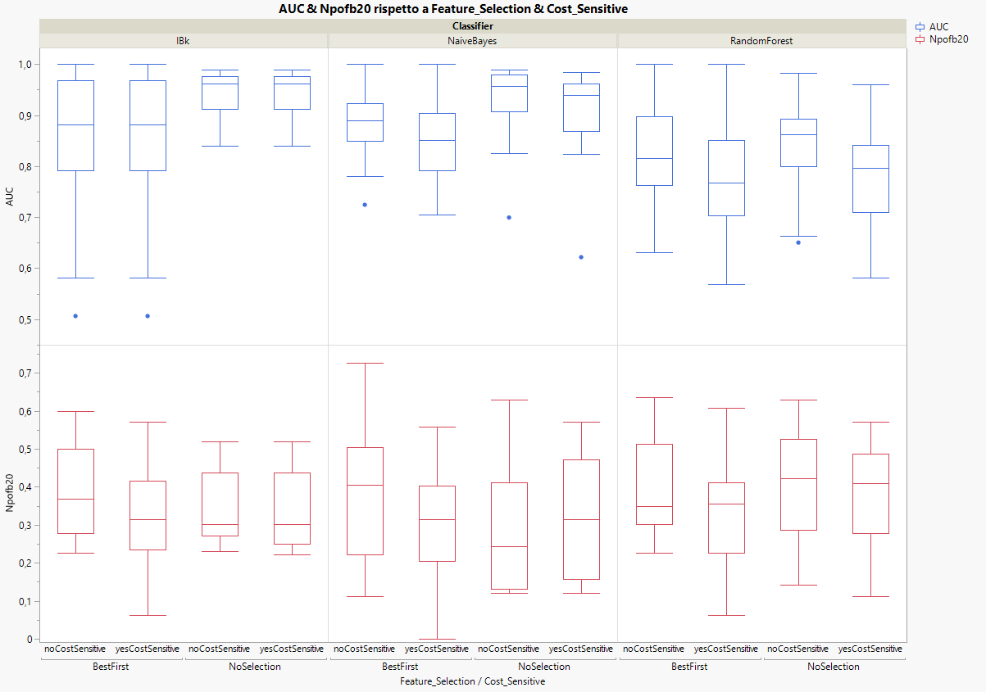
AUC & NPOFB20
BOOKKEEPER RESULTS
No Fake Releases
Yes Fake Releases
The classifier with highest AUC is IBk with no cost sensitivity and no feature selection.
The classifier with highest NPofB20 is Random Forest, without feature selection and cost sensitivity.
AVRO RESULTS
No Sampling
SMOTE
18/25

Slide 19
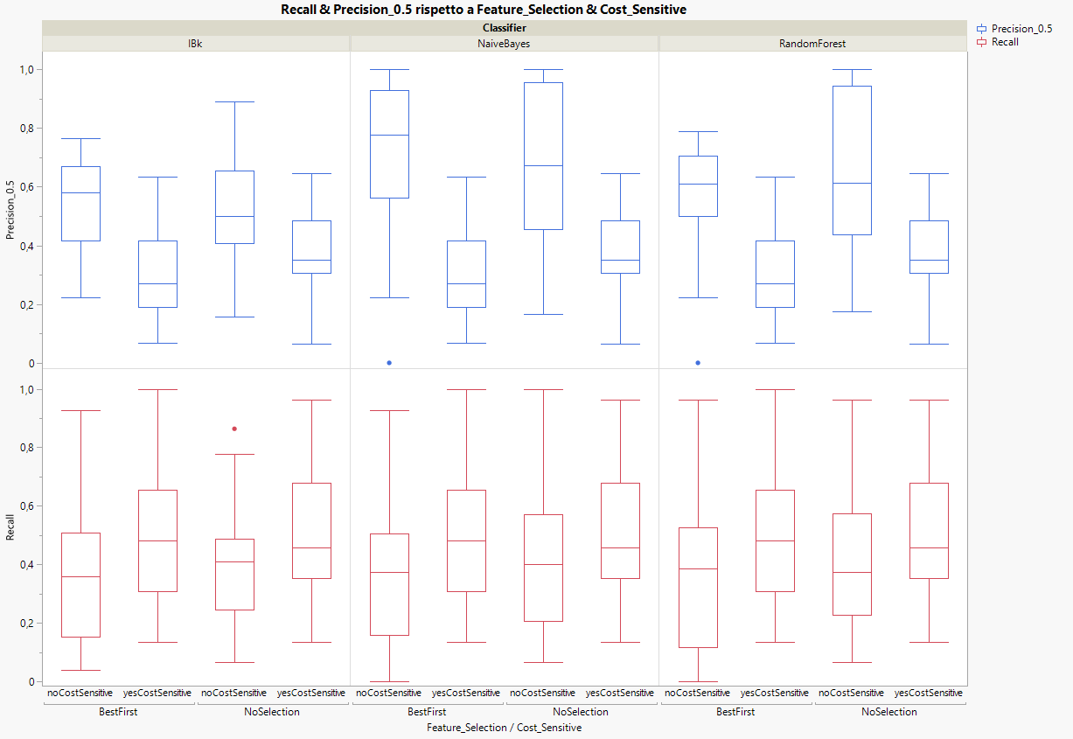
PRECISION & RECALL
BOOKKEEPER RESULTS
No Fake Releases
Yes Fake Releases
The classifier with highest precision is still Naïve Bayes with no cost sensitivity and best first feature selection.
The classifier with highest recall is Random Forest, without both best first feature selection and cost sensitivity.
AVRO RESULTS
No Sampling
SMOTE
19/25

Slide 20
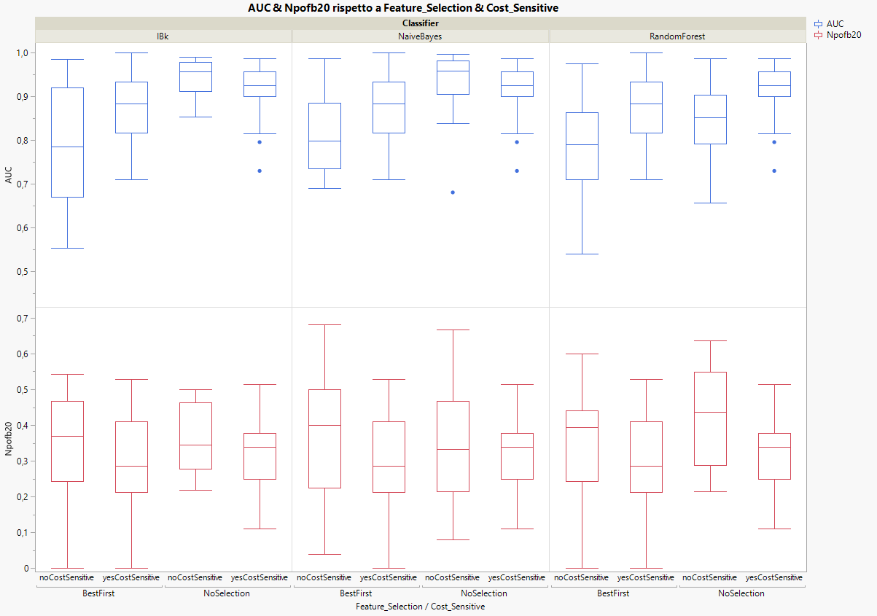
AUC & NPOFB20
BOOKKEEPER RESULTS
No Fake Releases
Yes Fake Releases
The classifier with highest AUC is Naïve Bayes with no cost sensitivity and no feature selection.
The classifier with highest NPofB20 is Random Forest, without both feature selection and cost sensitivity.
AVRO RESULTS
No Sampling
SMOTE
20/25

Slide 21

CONCLUSIONS
CONCLUSIONS
FS & CS
Proj. | Feature Selection | Cost Sensitivity
Bookkeeper | It has always allowed for achieving higher recalls, almost always higher precision, but it shows fluctuating results about AUC and NPofB20. | It has never improved precision but has always increased the recall, while causing slight degradations in both AUC and NPofB20.
Avro | It always yields the highest results for precision and recall, even though each one for different cost sensitivity configurations, it consistently decreases AUC and shows fluctuating results for NPofB20. | It has never improved precision but has always achieved higher recall; moreover, it tends to slightly decrease both NPofB20 and AUC.
FR & S
Lesson Learned
Threats to validity
21/25

Slide 22
CONCLUSIONS
CONCLUSIONS
FS & CS
Fake Releases in Bookkeeper | Sampling in Avro
While precision, recall and NPofB20 alweys decreased using fake releases, AUC had some improvements thanks to this strategy, but it made interquantile range between the 25° percentile and 75° percentile increase a lot, impling an increase in the dispersion of data too, so results are less reliable, and the presence of outlier streghtened this thesis, so in general this is not considered a reliable stratgy. | Tends to decrease precision spread, but it doesn’t give a general imprevement to its performances, while the recall is almost alweys decreased, thus also AUC gets fluctuating changes, but it has a good effect on NPofB20, which tends to increase even though spread gets a bit higher.
FR & S
Lesson Learned
Threats to validity
22/25

Slide 23
CONCLUSIONS
CONCLUSIONS
FS & CS
FR & S
Recall is the most important performance metric in this study.
  We want to make sure that bugs are found.
NPofB20 can help deciding if the effort required to examine code is out of budget, optimizing the decision-making for the prioritization of activities.
  Crucial when resource allocation is as important as prediction accuracy
AUC helps understanding the model ranking quality¹, the higher it is, the higher are the probabilities assigned to positive instances.
  It is effective for comparing different models since it evalutes performances over all thresholds.
Feature selection process is good because allows getting higher precision and recall, but care if the ranking quality characteristic becomes significant.
Cost-sensitive classifiers is good for achieving higher recall, but caution is needed when using them since they negatively impact other metrics.
SMOTE balancing can be taken into account in contexts where the effort management is key.
Fake releases strategy is definitely not reliable.
Lesson Learned
Threats to validity
How well it separates positive and negative classes.
23/25

Slide 24
THREATS TO VALIDITY
CONCLUSIONS
FS & CS
FR & S
Construct Validity: the accuracy in translating theoretical concepts to concrete measurements
  the mapping between tickets and commit can mislead the labeling of classes since it may involve biases
Internal Validity: the degree to which one can be confident that the cause-effect relationship established in a study cannot be explained by other factors
  Chosen metrics may not represent properly the buggyness of a class, other factors like team practices and expertise might play a role
External Validity: the extent to which one can generalize the findinigs of a study to other situations, people, settings and measures
  Analyzed repositories may not generalize the code base for other software projects, or it may overrepresent some types of projects
Conclusion Validity: it refers to the correctness of supported conclusions
  Performance metrics considered could not be the adequate in other contexts, or the datasets could be too small to be statistically significant
Reliability: it refers to the consistency and repeatability of the measures
  Results depend on certain tools, like Jira, GitHub, the complexity metrics extractor, and eventual errors of theirs can affect their reproducibility
Lesson Learned
Threats to validity
24/25

Slide 25


CONCLUSIONS
THANKS FOR YOUR
ATTENTION!
Project links:
Pagina gIthub
Pagina sonarcloud
25/25

