Slide 1

PROJECT 1
ENERGY DATA ANALYSIS
WITH APACHE SPARK
Alessandro Finocchi - 0340543
A.A. 2024/2025

Slide 2

AGENDA
1
INTRODUCTION
2
ARCHITECTURE
3
DATA INGESTION
4
STORAGE AND PERSISTENCE
5
DATA PROCESSING
6
RESULTS
6
CONCLUSION
2

Slide 3

INTRODUCTION
AGENDA
Introduction
Architecture
Deploy analytical platform about energy data
Focus on Italian and Sweden countries
Benchmark queries under different configuration
  Spark APIs (RDD, DataFrame and SQL)
  File formats (CSV and Parquet)
  Spark workers number
Measure and compare query performances with varying configurations
Data ingestion
Storage&Persistence
Data processing
Results
Conclusions
3

Slide 4

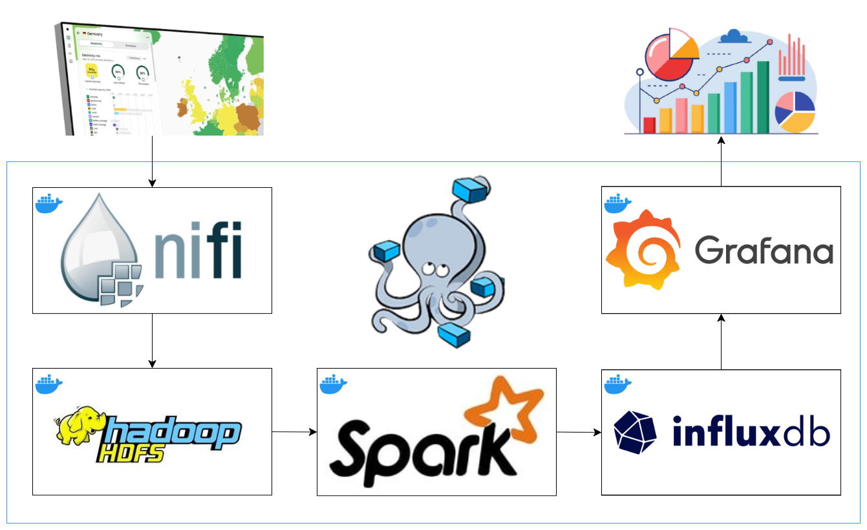
ARCHITECTURE
AGENDA
Introduction
Architecture
Orchestrator: Docker compose
Data ingestion: Apache Nifi
Storage and Persistence: Hadoop HDFS, InfluxDB
Data processing: Apache Spark
Data visualization: Grafana
Data ingestion
Storage&Persistence
Data processing
Results
Conclusions
4

Slide 5

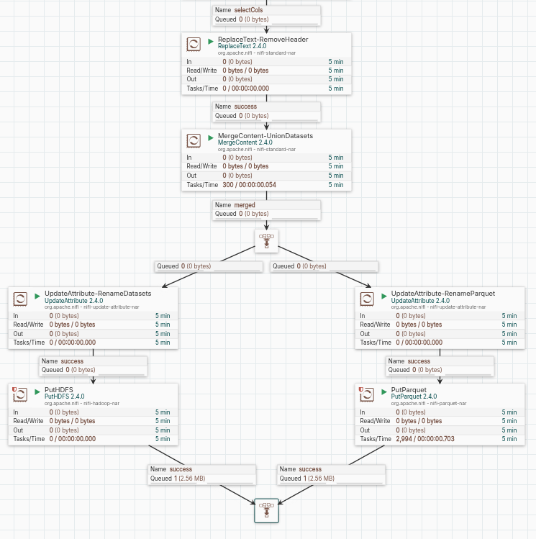
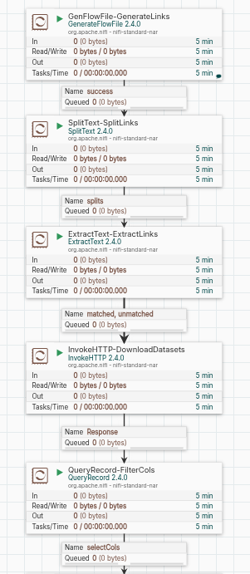
DATA INGESTION
AGENDA
Introduction
Architecture
Nifi flows to manage the ingestion of the dataset from the online repository up to HDFS storage. The datasets have been combined in a single large one.
Accessible through REST APIs
Data ingestion
Storage&Persistence
Data processing
Results
Conclusions
5

Slide 6

STORAGE AND PERSISTENCE
AGENDA
Introduction
Architecture
Hadoop HDFS Cluster:
  Number of datanotes configurable
  Results inside the HDFS directory /data/results
InfluxDB:
  Results are time-series data
  Allows statistical checks before Grafana
Data ingestion
Storage&Persistence
Data processing
Results
Conclusions
6

Slide 7

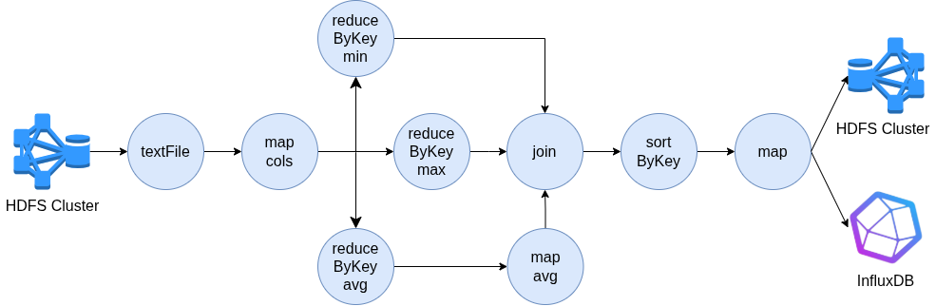
DATA PROCESSING: QUERY 1
AGENDA
Introduction
Architecture
Data ingestion
Storage&Persistence
Data processing
Results
Conclusions
RDD DAG of query 1
No caching is needed
7

Slide 8
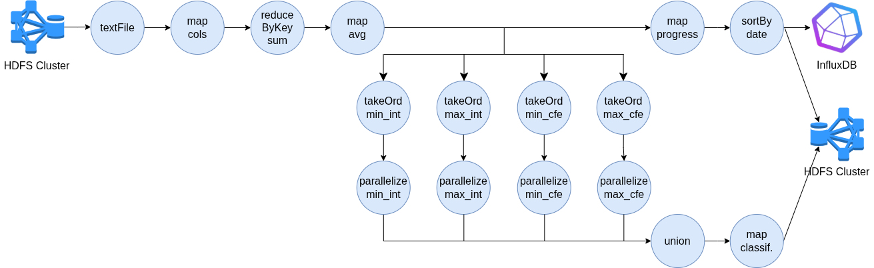
DATA PROCESSING: QUERY 2
AGENDA
Introduction
Architecture
Data ingestion
Storage&Persistence
Data processing
Results
Conclusions
RDD DAG of query 2
No caching is needed
8

Slide 9
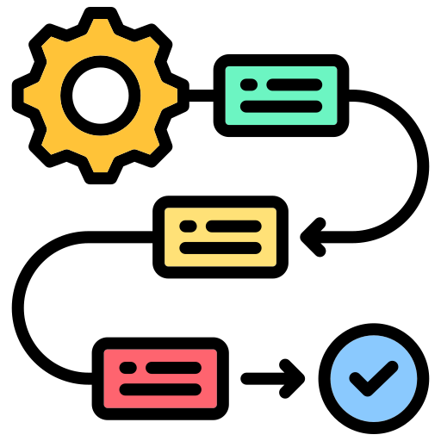
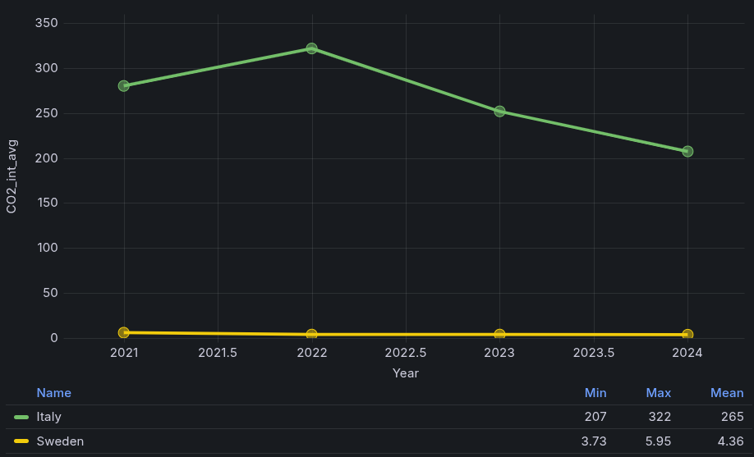
RESULTS: QUERY 1
AGENDA
Introduction
Architecture
Data ingestion
Storage&Persistence
Data processing
Results
Conclusions
9

Slide 10
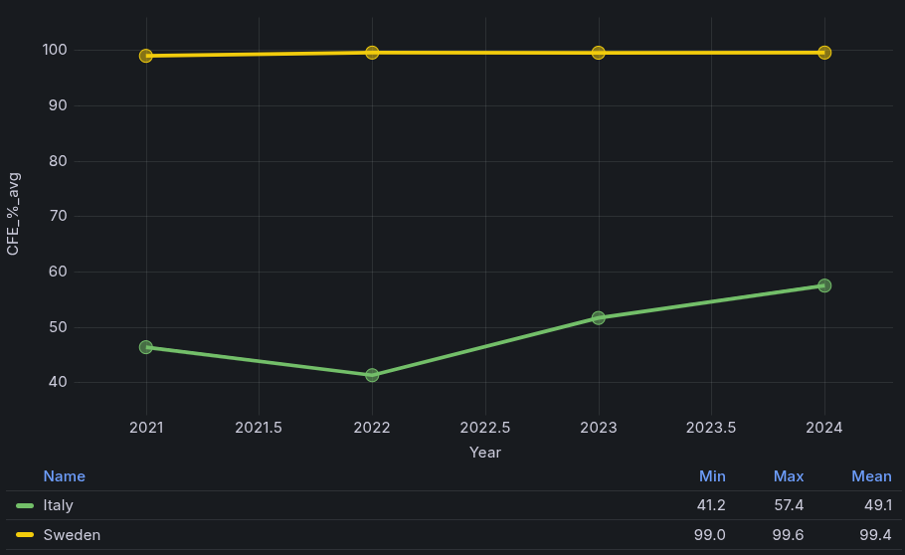
RESULTS: QUERY 1
AGENDA
Introduction
Architecture
Data ingestion
Storage&Persistence
Data processing
Results
Conclusions
10

Slide 11
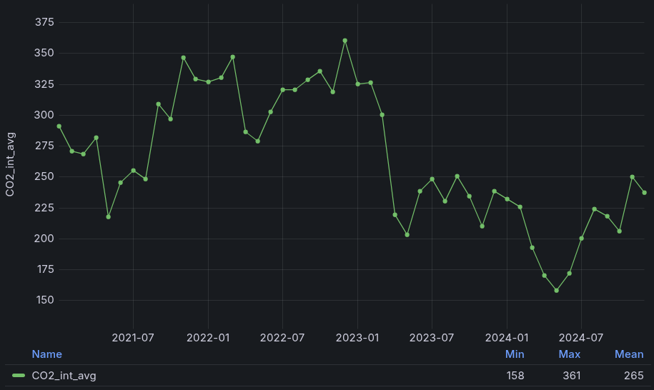
RESULTS: QUERY 2
AGENDA
Introduction
Architecture
Data ingestion
Storage&Persistence
Data processing
Results
Conclusions
11

Slide 12
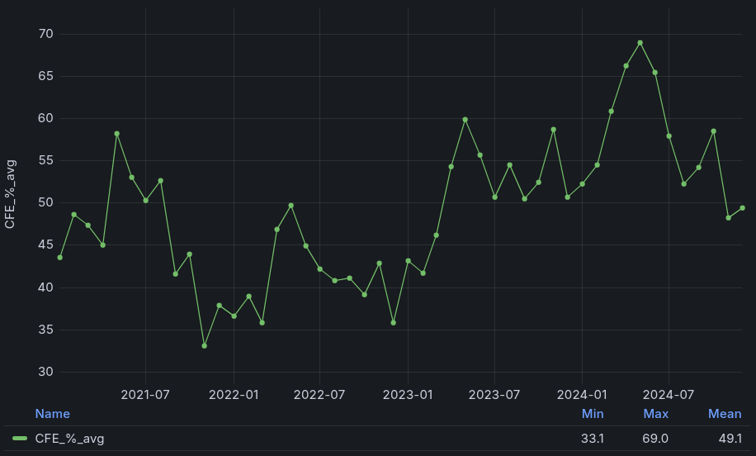
RESULTS: QUERY 2
AGENDA
Introduction
Architecture
Data ingestion
Storage&Persistence
Data processing
Results
Conclusions
12

Slide 13
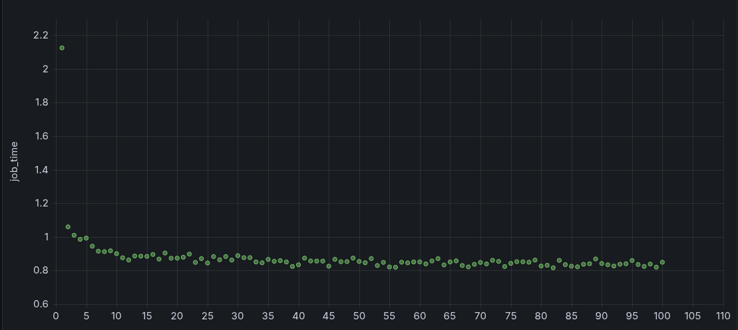
RESULTS: QUERY TIMES
AGENDA
Introduction
Architecture
Data ingestion
Storage&Persistence
Data processing
Results
Conclusions
Typical trend in query execution times (in seconds)
Spark resource optimization at runtime drastically
reduce execution times after the second run
13

Slide 14
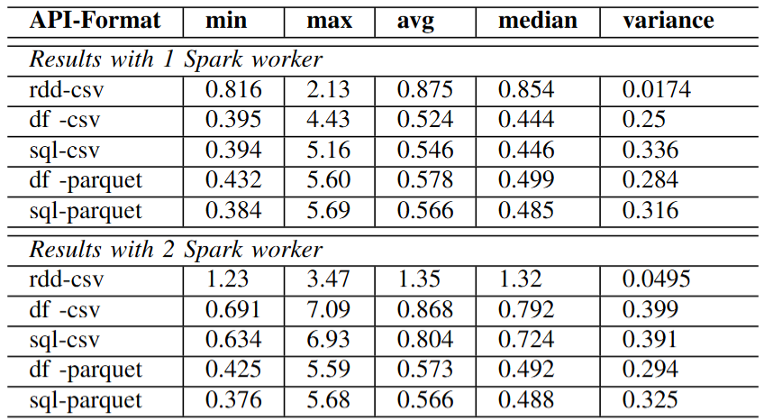
RESULTS: QUERY 2
AGENDA
Introduction
Architecture
Data ingestion
Storage&Persistence
Data processing
Results
Conclusions
14

Slide 15
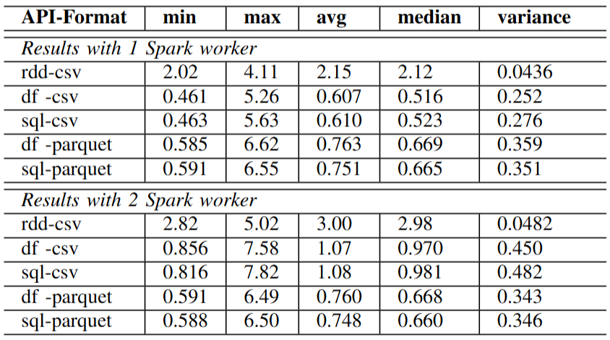
RESULTS: QUERY 2
AGENDA
Introduction
Architecture
Data ingestion
Storage&Persistence
Data processing
Results
Conclusions
15

Slide 16

CONCLUSIONS
AGENDA
Introduction
Proj. | Query 1 | Query 2
Comments | Italy is far behind Sweden in terms of both carbon intensity and carbon-free energy percentage usage. | There appears to be a general downward movement from 2023 onwards in the CO2 intensity trend and a general upward movement from 2023 in the CFE trend, but the overall behaviour seems very unstable, and the global improvement doesn’t look that much significant.
Performances | The maximum execution time is much greater than its mean value: using more Spark workers doesn’t give any consistent advantage, indeed for the csv configuration having 2 Spark workers increases average execution times of about 60%-70%, while in the parquet configuration they are practically the same. Furthermore, DataFrame and SQL APIs show significant increasing of average performance, and even though RDD variance is the lower one, they look like the most preferable
Architecture
Data ingestion
Storage&Persistence
Data processing
Results
Conclusions
16

Slide 17
THREATS TO VALIDITY
AGENDA
Introduction
Architecture
About query performances:
External Validity: the extent to which one can generalize the findings of a study to other situations, people, settings and measures
  Larger datasets would certainly lead to different configurations to be preferable
Conclusion Validity: it refers to the correctness of supported conclusions
  Execution time metric could not be the focus in other contexts
  Dataset could be too small to reproduce a real case scenario
Reliability: it refers to the consistency and repeatability of the measures
  Results strongly depend on the machine they are run on
  Results are not reproducible given the unpredictability of CPUs
Data ingestion
Storage&Persistence
Data processing
Results
Conclusions
17

Slide 18

END
AGENDA
Introduction
Architecture
THANKS FOR YOUR
ATTENTION!
Data ingestion
Storage&Persistence
Data processing
Results
Project links:
Conclusions
GitHub page
18

